Slide 1
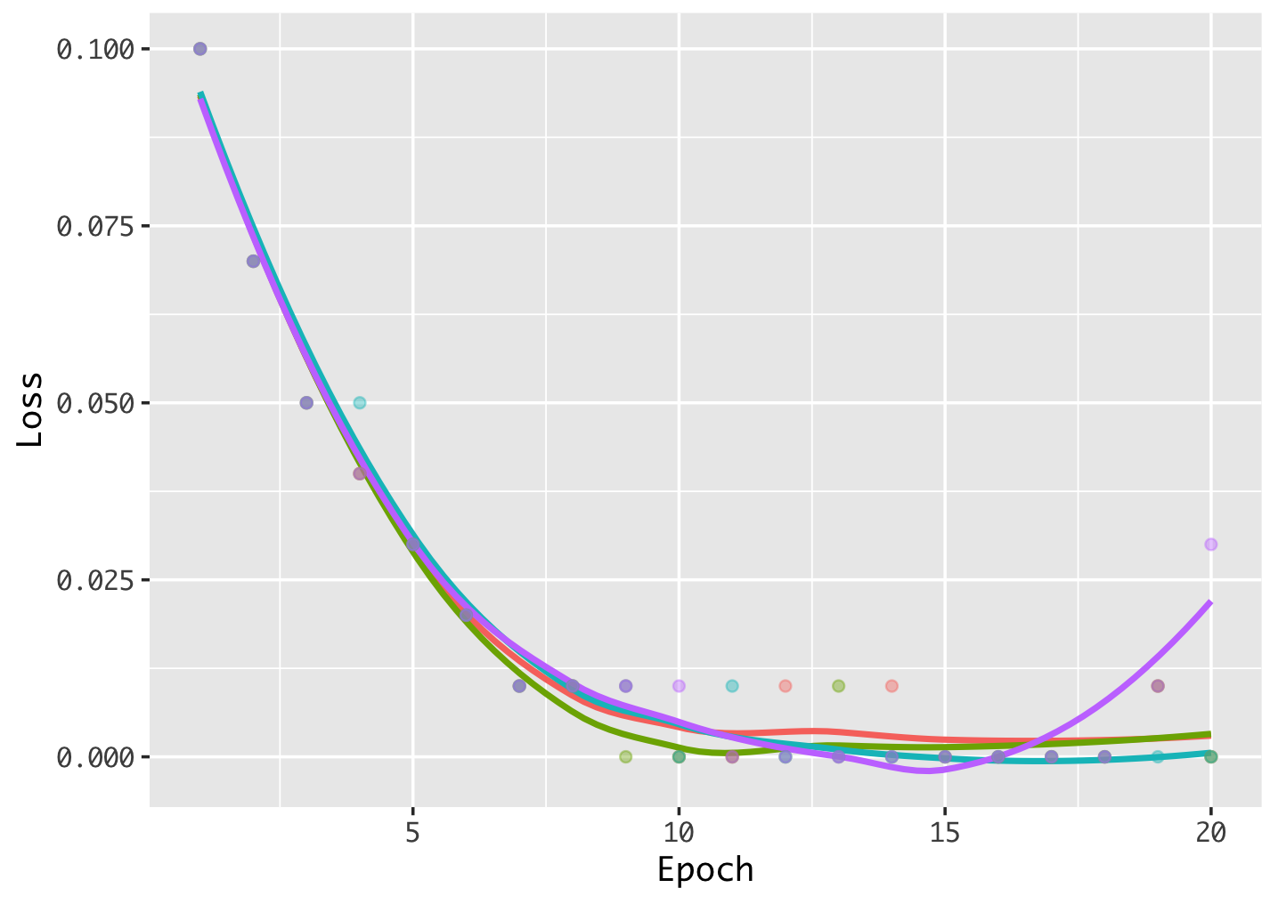
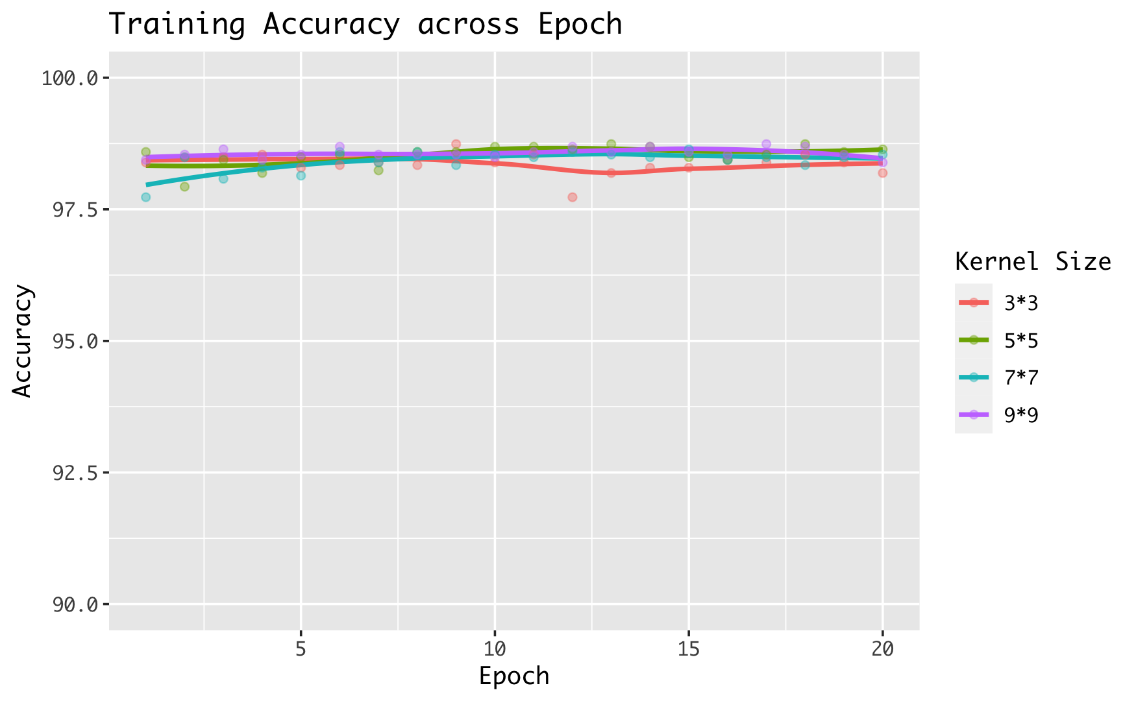
a.
b.
Loss accros epoch for different kernel size
Accuracy accros epoch for different kernel size

