Slide 1
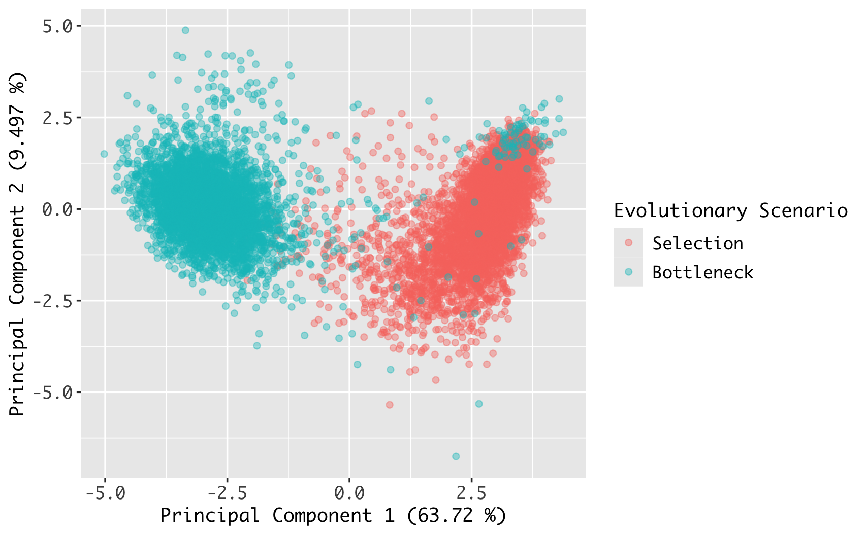
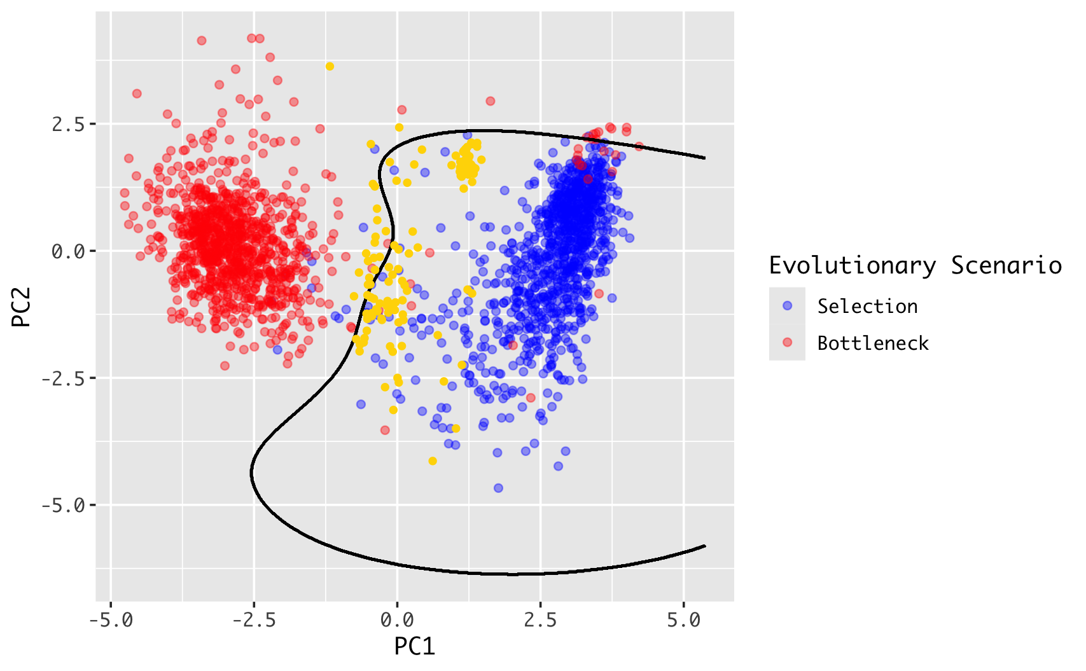
a.
b.
Principal Component Analysis
SVM Trained on PC1 and PC2

