Slide 1
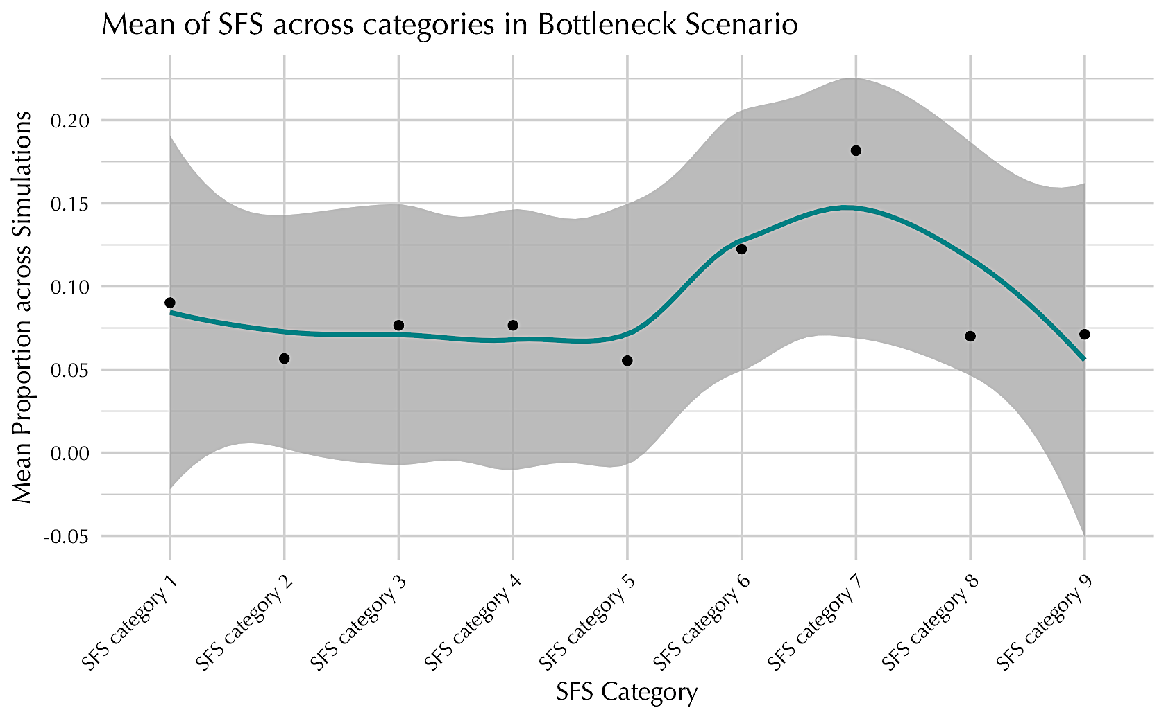
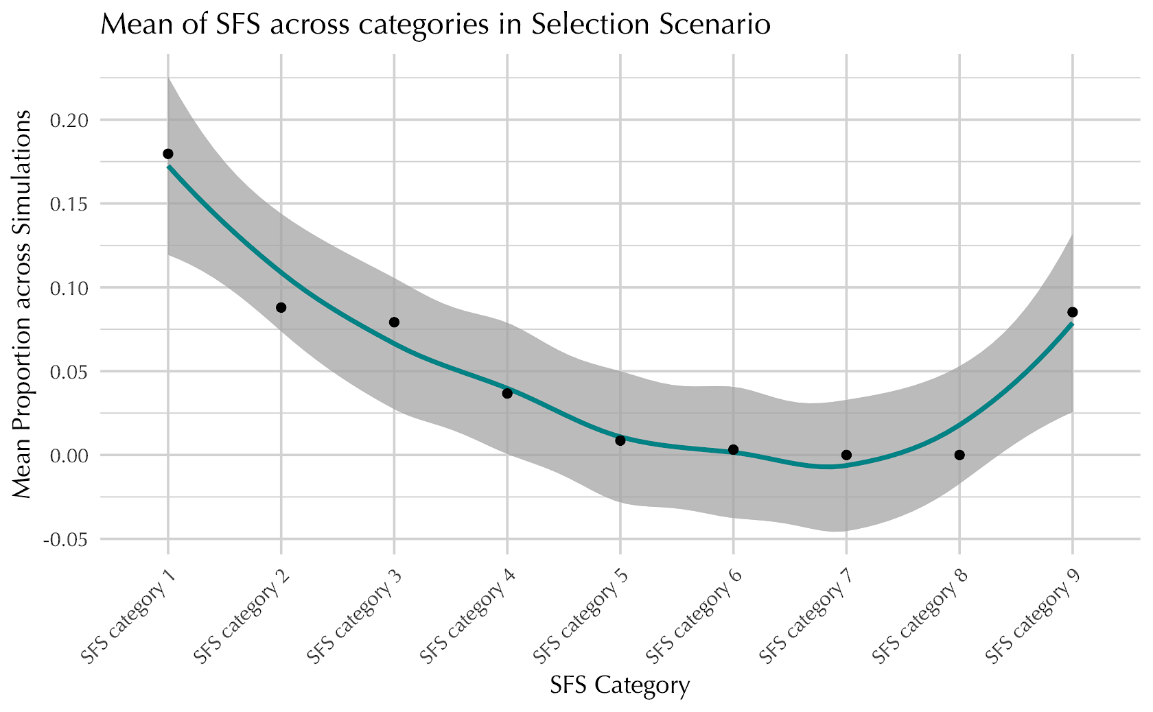
a. Mean of SFS across categories in Bottleneck Scenario | b. Mean of SFS across categories in Selection Scenario

