Slide 1
Prediction of LncRNA Subcellular Localization with Deep Learning from Sequence Features
Student: Vi Ly
Faculty advisor: Dr. Benjamin Soibam
Committee members: DR. dexter Cahoy, dr. Patrick j. king
Department chair: Dr. pepper

Slide 2
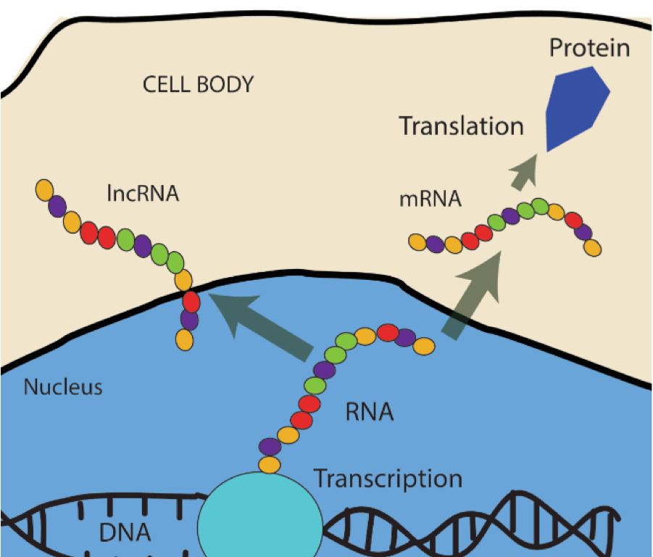
Problem
Long non-coding RNAs (lncRNAs) are large RNA transcripts which do not encode proteins and are estimated to outnumber protein-coding genes within the human genome
The lncRNAs are observed to play an active role in the biological process in the nucleus and cytosol.

Slide 3
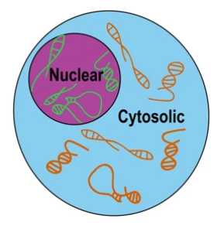
Problems
Knowing the localization patterns of lncRNAs allows the generalization of their biological functional. Therefore, the possibility to learn where a given lncRNA localizes would provide valuable information regarding its biological function as well as the RNA localization mechanism.
LncRNA subcellular localization depends on two main factors: sequence and structural motifs.
Obtaining lncRNA structural data of motifs from manual biological process is a difficult task.
However, lncRNA transcript sequences are readily available publicly in large number. In this research, I use the feature-based machine learning and deep learning algorithms to perform predict lncRNAs localization and, therefore, obtain the motifs.

Slide 4
Thesis
“Can we accurately identify the motifs that associated with lncRNA localization directly from lncRNA transcript sequences?”

Slide 5
Dataset
Firstly, I utilized ENCODE project’s paired-end strand-specific RNA-sequencing of human cell lines. To separate the nucleus from the cytosol, cellular fractionation was performed on these samples. For further analysis, gencode (v28) long non-coding RNA annotations were used to identify LncRNAs.
In total, 7259 lncRNA strands sequences were found in our dataset, classifying into two classes: nuclear localization and cytosolic localization. 5806(80%) of samples strands were used to train our model. We saved 1453 (20%) other strands for evaluation process.
The raw fasta files of the RNA sequence data can be found on this github page: https://github.com/bgudenas/DeepLncRNA/.

Slide 6
Method Overview
Processing Data:
K-mer feature extraction
One-hot Encoding
Feature-based Models with Caret
K-nearest Neighbor (KNN)
Random Forest (RF)
Deep Learning Model with Keras
Long Short-Term Memory Recurrent Network (LSTM)
Convolutional Neural Network (CNN)
CNN + LSTM Combined Model
Hyperparameter Optimization with Talos
Performance Metrics Evaluation

Slide 7
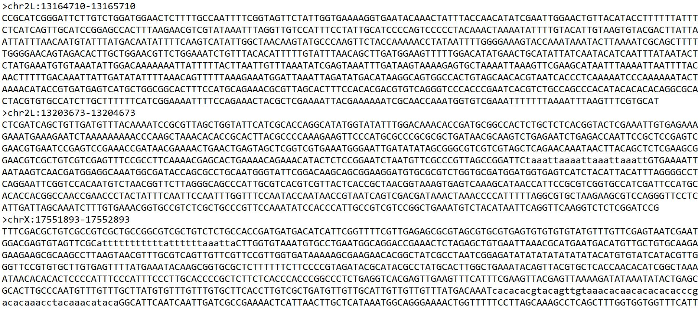
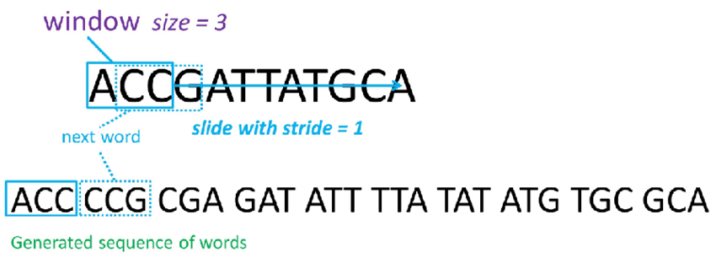
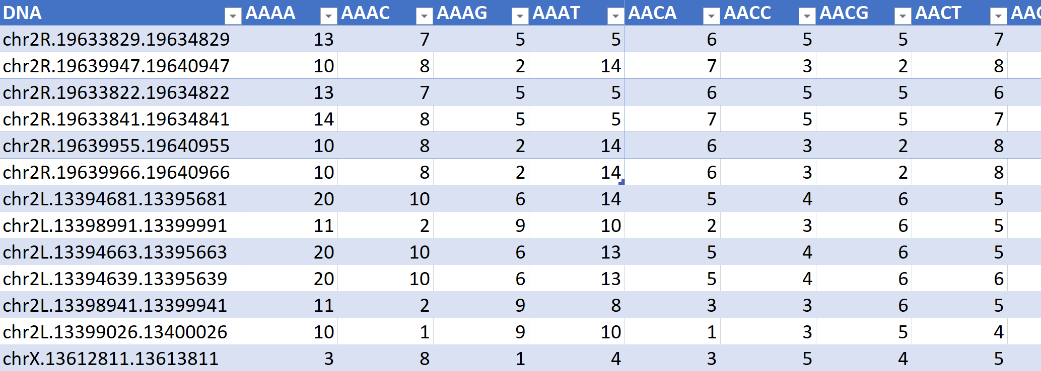
processing Data
I use the function oligonucleotideFrequency in the Biostrings package to slice the raw RNA sequences.
In bioinformatics, k-mers are subsequences of length k contained within the RNA sequence.
I use length k of 4, 6 and 8 with the stride of 3.

Slide 8
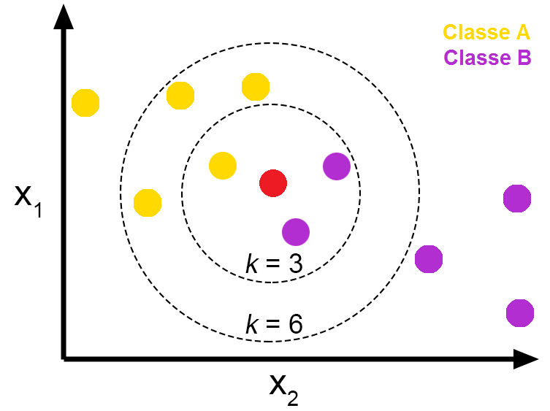
KNN
K-Nearest Neighbor (also known as KNN) is part of the supervised machine learning algorithms family, in which a new class of data point are predicted from a labeled dataset.
The KNN model find the closest neighbors to the target point from training examples in the feature space.

Slide 9
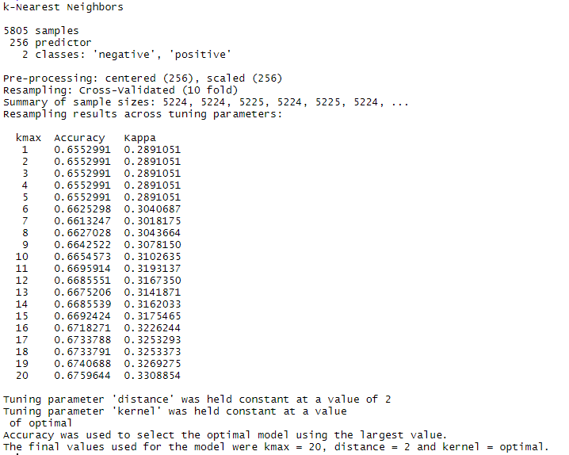
KNN (cont.)
The k parameters tuned are in range 1 to 20. The best model is selected based on the value of the accuracy.

Slide 10

Random Forest (RF)
A decision tree is a flowchart-like structure in which each internal node represents a “test” on an attribute, each branch represents the outcome of the test, and each leaf node represents a class label.
In a RF, each decision tree produces a class prediction, after receiving the results of the forest, the most voted class is selected as the RF model’s prediction.

Slide 11
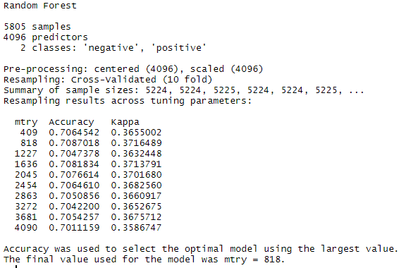
RF
Number of variables available for splitting at each tree node. This is referred to as the mtry parameter
The mtry is in range from 409 to 4090 splits. The accuracy is in consideration for taking the best model.

Slide 12
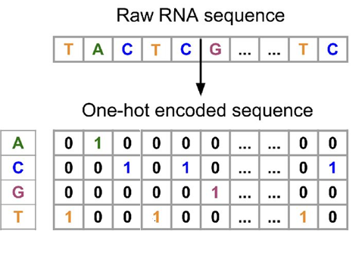
processing Data 2
One-hot vectors can be used to represent sequences, these sequences can conserve the position information of each nucleotide within the sequences. This popular model was created based on an inspiration of a deep learning text classification model. Performance improvements have been achieved in several validation datasets using this model.

Slide 13
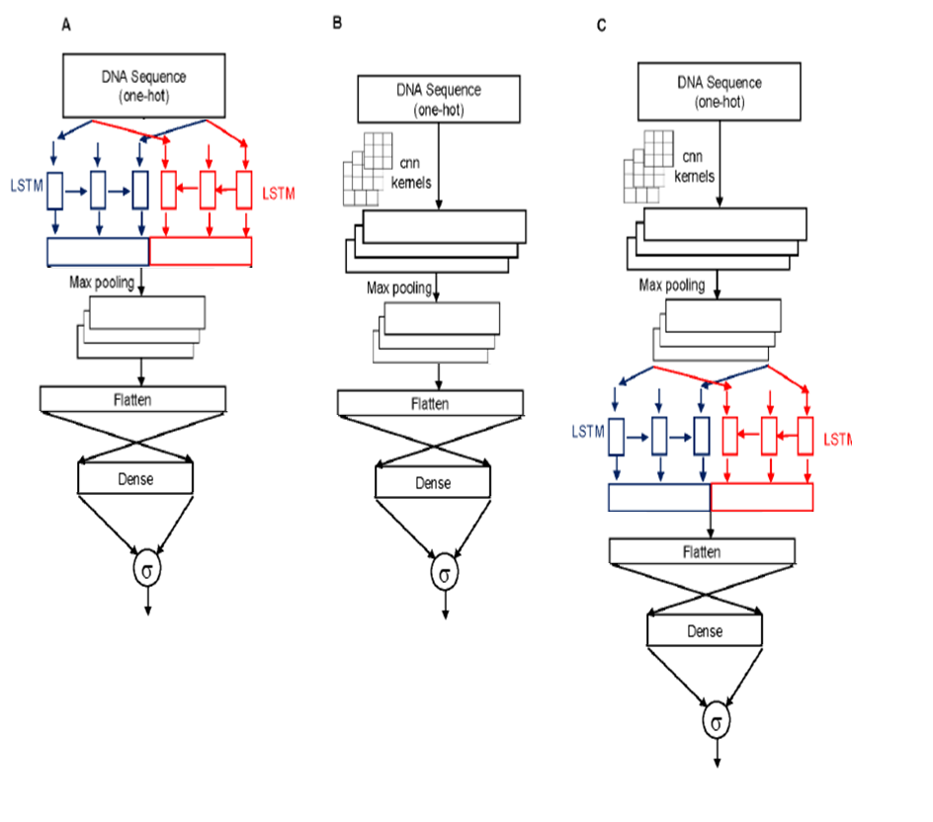
Archtectures of Deep Learning Models

Slide 14
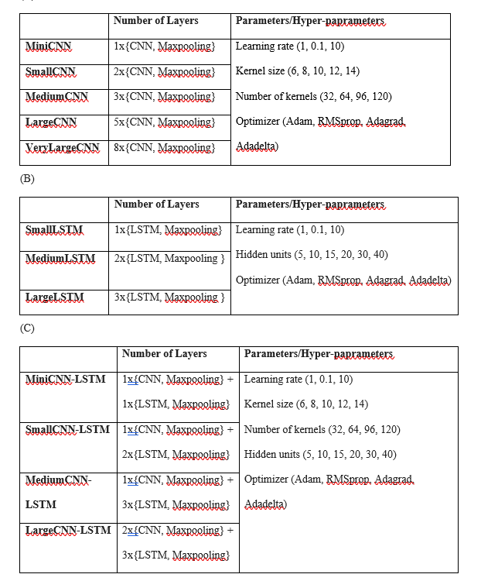
Permutations of Deep Learning Models
(A) Five different permutation sets of layers and hyper-parameters for CNN model.
(B) Three different permutation sets of layers and hyper-parameters for LSTM model.
(C) Four different permutation sets of layers and hyper-parameters for CNN-LSTM model.

Slide 15
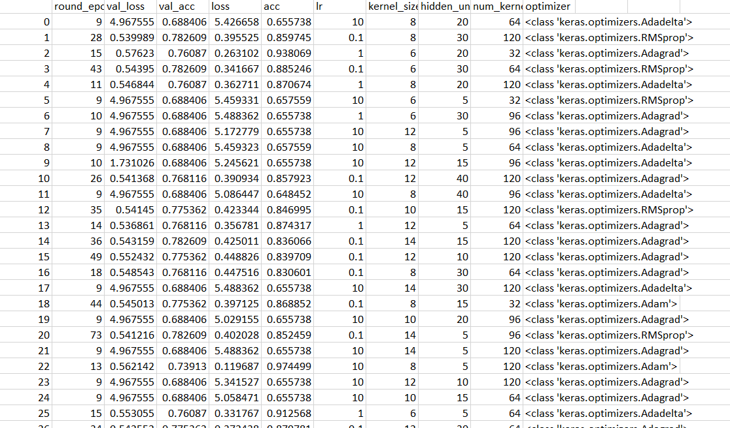

Automating the Training Process
Experiment output from miniCNN-LSTM model
(1x{CNN} + 1x{LSTM})

Slide 16
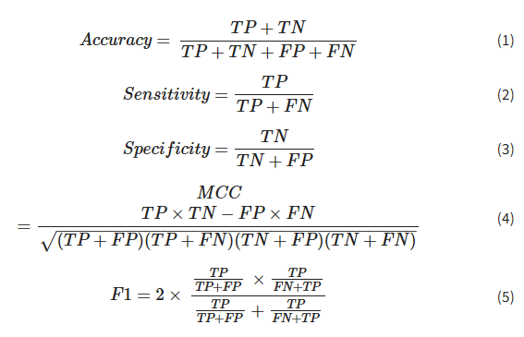
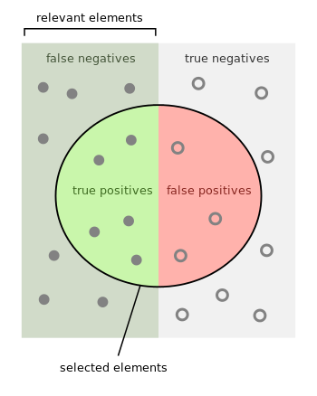
Metrics
The best trained models from each machine learning algorithm is used to perform prediction on the testing dataset. The predicted results are compared with the labels to output the number of TP, TN, FP and FN.
We also use TP, TN, FP and FN to plot a graph called a Receiver Operating Characteristic curve (or ROC curve) and then calculate the area under the curve (or AUC).

Slide 17
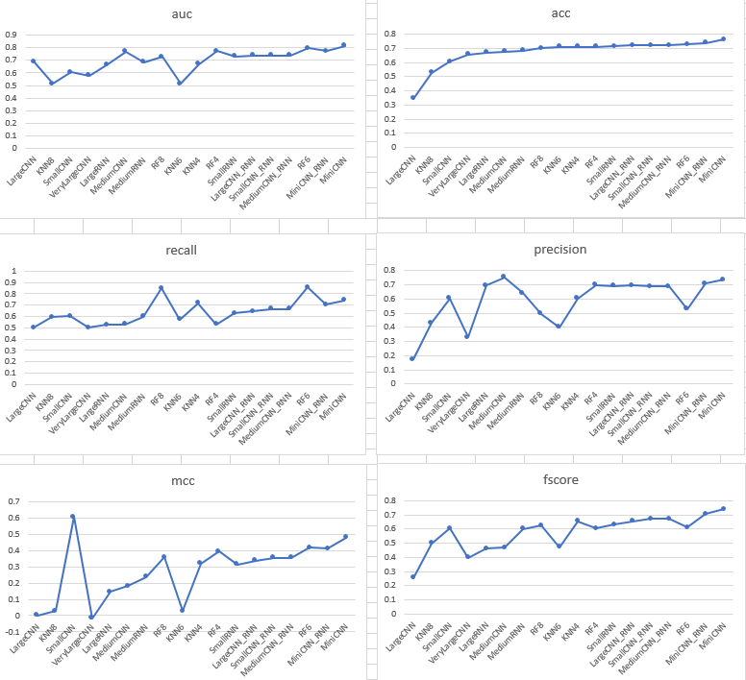
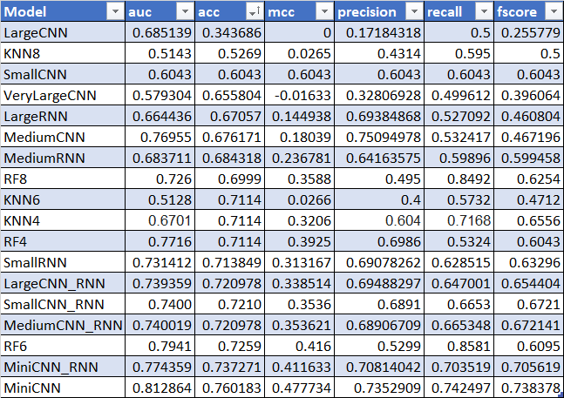
Results

Slide 18
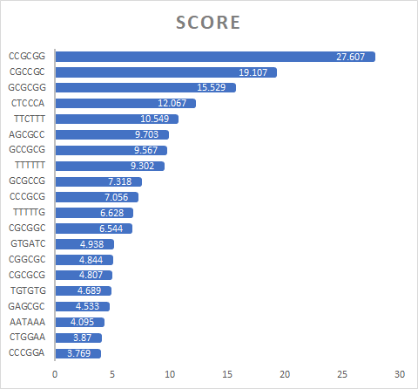
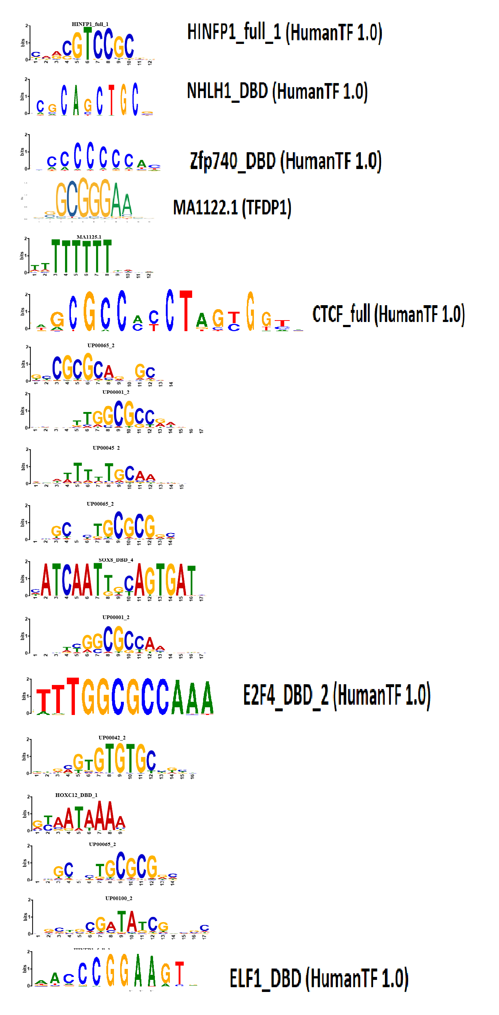
Variable importance and Motifs
After obtaining the best model in each scenario, we ranked the features by their importance in prediction, which is calculated for each parameter in the model. In order to identify the most important k-mer pattern that differentiate between the lncRNA at the Nucleus vs the Cytosol, we will quantify and rank the variable importance of each k-mer. After that, we use match the kmer pattern with the correct DNA and protein motifs using TOMTOM service.
Table 2: (A) shows the top 20 of 6-mers with highest VarImp score. (B) shows the matched motifs with the top 6-mers.

Slide 19
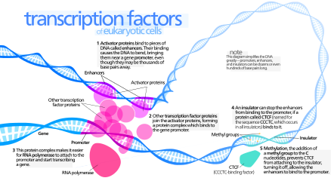
Transcription factors & nuclear localization
In human (and eukaryotes in general), transcription factors are transcribed inside of the nucleus and they are then move to be translated in the cell's cytosol. These factors that are active in the nucleus contain nuclear localization signals that direct them to the nucleus and this is a key point in their regulation. A nuclear localization signals is an amino acid sequence that marks a protein to be imported into the cell nucleus by nuclear transport.

Slide 20
Conclusion
In summary, using feature-based and deep learning methods based on the acquired RNA-features information, we could predict the lncRNA localization in the nucleus or cytosol up to the accuracy o 76%.
By analyzing both feature-based models and deep learning models, we can see that MiniCNN with only one convolutional layer perform he best on all metrics. In contrast, the complex model of large CNN constantly rank the lowest in all the metrics. Therefore, we can conclude that training the deep learning model on simple patterns extracted from the first layer of CNN help is efficient enough to classify precisely the location of RNA.
Top three models with the best metrics are miniCNN, miniCNN-RNN and RF6, which all have very simple architecture. While the architecture of the model become more complex, the learning power of the models decrease and they classify less accurately on the localization task.
After extracting the features with highest score of variable importance to match with actual motifs in human cells, these results suggest that specific gene orientation of transcription factors could be useful for future RNA localization research.

Slide 21
Future Works
From the lncRNA sequence alone, we can have archieve an AUC of 0.81 and accuracy of 0.76 in the RNA localization. This performance can be improved by adding other features such as length of the sequences.
To fully decipher the nature of interaction between these motifs is beyond the scope of this paper and will be addressed in future studies.

Slide 22
Citations
1. Gudenas, B. L., & Wang, L. (2018, November 06). Prediction of LncRNA Subcellular Localization with Deep Learning from Sequence Features. Retrieved from https://www.nature.com/articles/s41598-018-34708-w
2. Pros and Cons of K-Nearest Neighbors. (2018, September 25). Retrieved from https://www.fromthegenesis.com/pros-and-cons-of-k-nearest-neighbors/
3. Decision tree. (2019, July 27). Retrieved from https://en.wikipedia.org/wiki/Decision_tree
4. Tonester. (2019, August 04). Understanding Random Forest. Retrieved from https://towardsdatascience.com/understanding-random-forest-58381e0602d2
5. Abapihi, B., Faisal, M. R., Lumbanraja, F. R., Phan, D., Ngo, D. L., Tran, V. A., . . . Kubo, M. (2016, April 27). DNA Sequence Classification by Convolutional Neural Network. Retrieved from https://m.scirp.org/papers/65923
6. Introduction. (n.d.). Retrieved from https://autonomio.github.io/docs_talos/#introduction
7. Henderson, J., Ly, V., Olichwier, S., Chainani, P., Liu, Y., & Soibam, B. (2019, July 26). Accurate prediction of boundaries of high resolution topologically associated domains (TADs) in fruit flies using deep learning. Retrieved from https://www.ncbi.nlm.nih.gov/pubmed/31049567
8. Transcription factor. (2019, July 25). Retrieved from https://en.wikipedia.org/wiki/Transcription_factor

