Slide 1
Search Machine
Industry 4.0

Slide 2
Product Overview
The problem it addresses
Search machine based on Username, Machine Type (example : Printer , CNC etc.) and machine properties (example : color)
Show similar results in descending order of percentage of matching
In case of no result is found, ask to correct or recheck input.

Slide 3
Why search functionality needed in Industry 4.0
Users can locate content by searching for specific words or phrases, without needing to understand or navigate through the structure of the Web site.

Slide 4
Who is our audience?
Buyer
Seller
Administrator
Operator
Technician

Slide 5
System Requirements
Node js
Mongo DB
Access to “Industry_4_0” database
Web browser (Example : Firefox, Chrome etc.)

Slide 6

Features
Features
  Feature 1 – Enter Search keyword.
  Feature 2 – show list of machines related to search keyword.
  Feature 3 – order result list according to matching with search keyword.
  Feature 4 – Show details of machine on clicking result list.

Slide 7
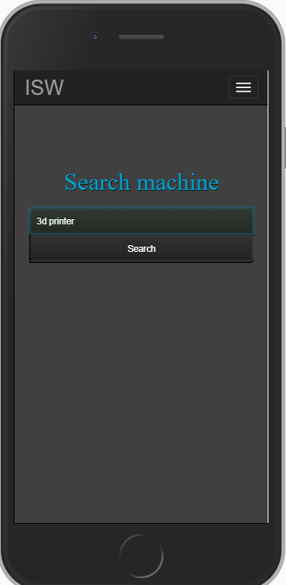
Feature 1
Enter Search keyword
User can enter one or more than one keyword.
Search is not case sensitive
These features are shown using the screen capture.

Slide 8
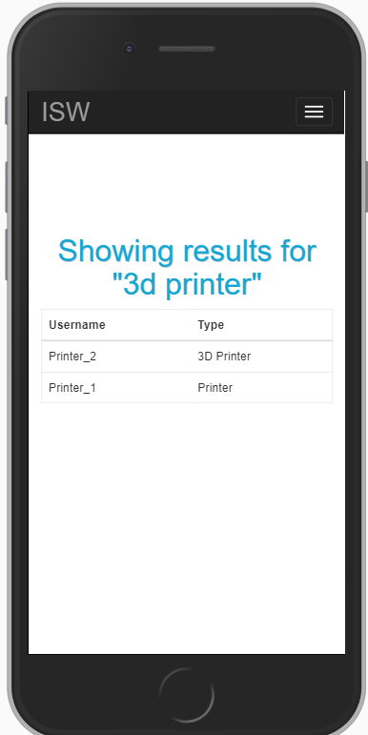
Feature 2 and Feature 3
Result of Search
Show list of machines related to search keyword.
Order result list according to matching with search keyword.
In case no result found user will be asked to check search keyword.

Slide 9
Feature 4
Details of a Machine
On result page user can click on any result to view details on that machine.

Slide 10
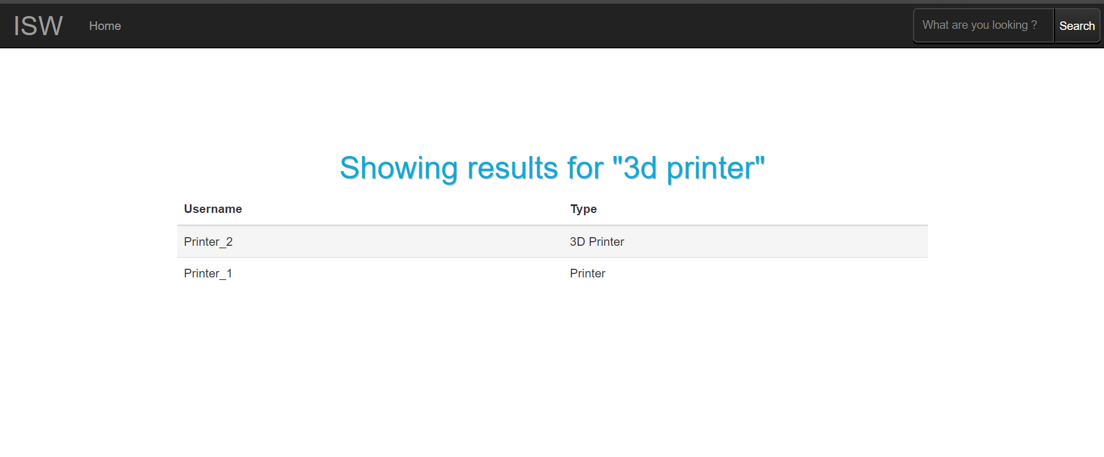
Product Demo
Product Demo is give in screen captures.

Slide 11
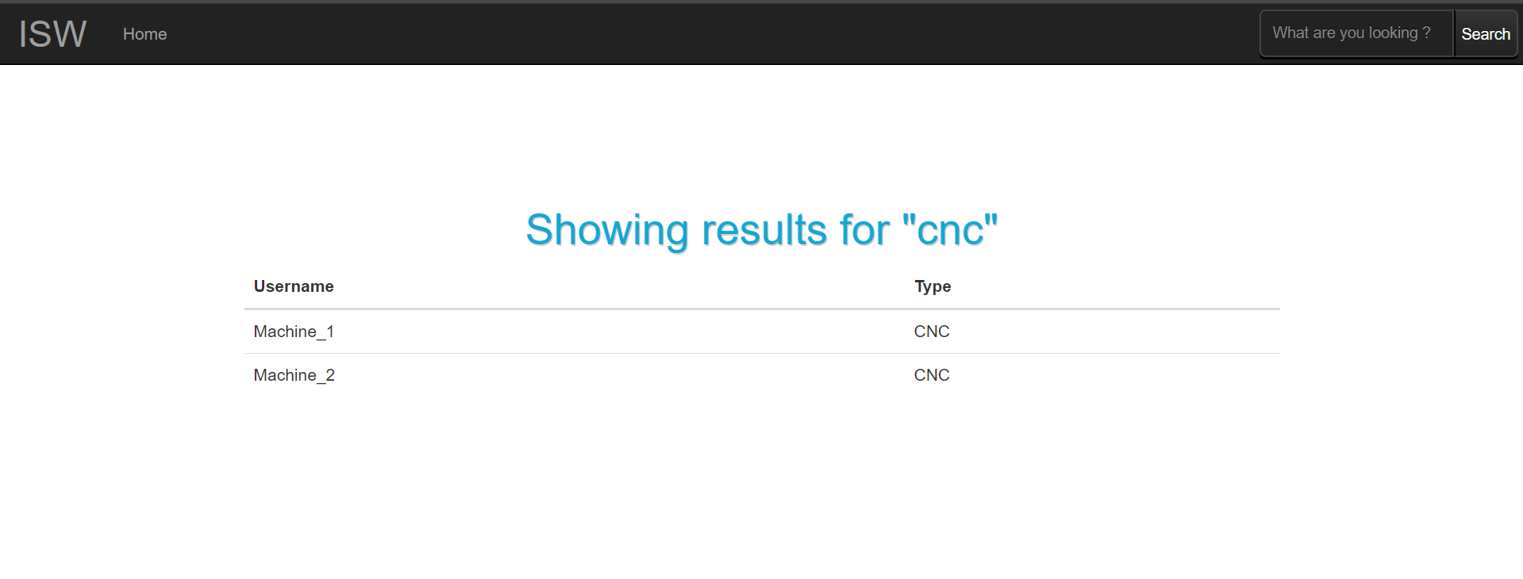
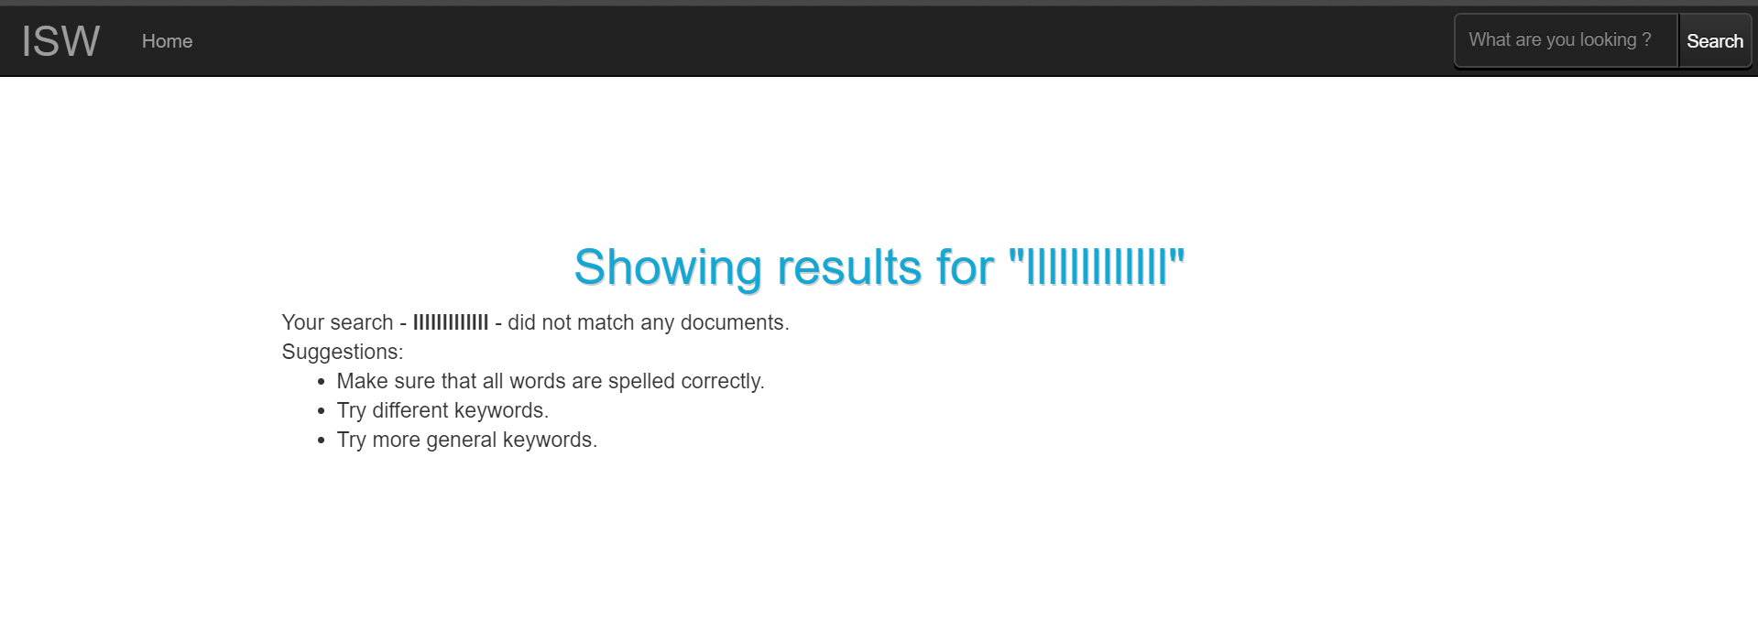
Product Demo

