Slide 1
Development of Dynamic Web Portal for Centre for Research in Smart Manufacturing
- By Group-G
Client: Dr. Bhupesh Kumar Lad
Gvs Akhil
Saptarshi Ghosh
Souvik Mandal
Aravind Ravikumar
Rishika Patel

Slide 2
IIT Indore Industry 4.0 Cyber Twin System (ISW)

Slide 3
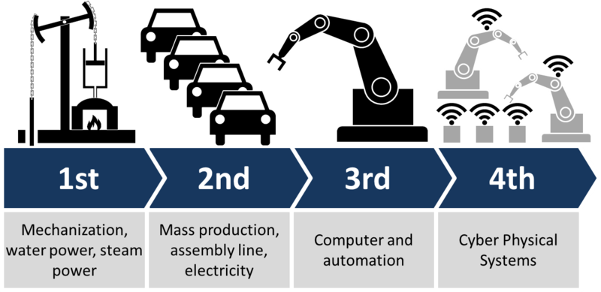
Industry 4.0

Slide 4
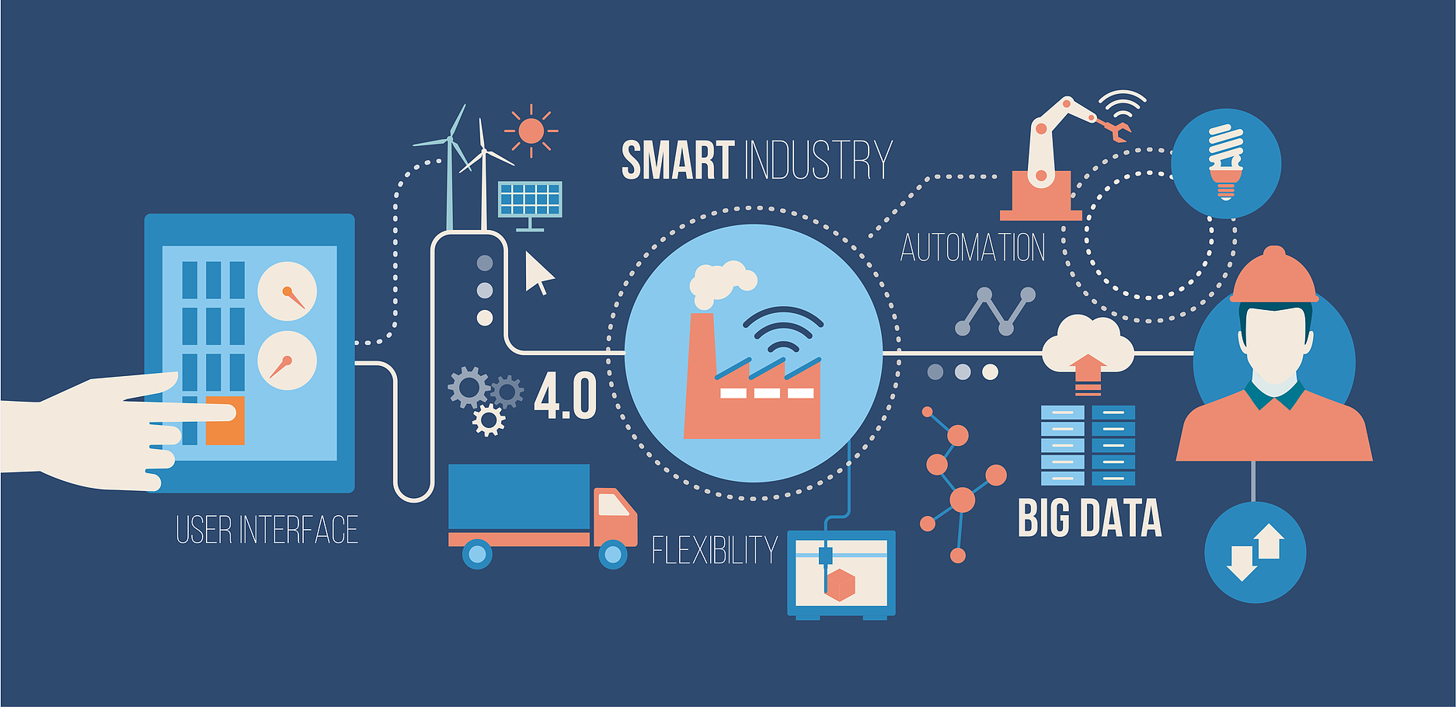
What are Cyber Physical Systems?
Software and physical components are deeply intertwined.
Physical components can communicate with each other.
Tightly integrated with the internted and users.
Automation and monitoring by computer-based algorithms.

Slide 5
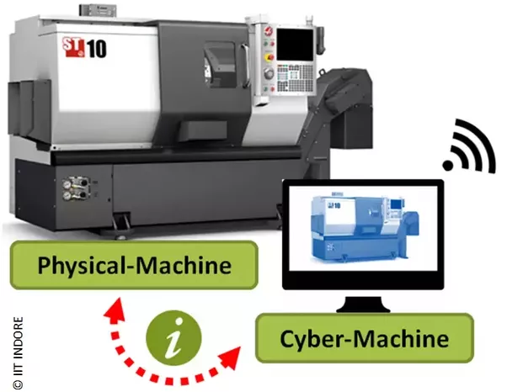
What is a ‘Cyber-Twin’ ?
A ‘cyber twin’ is a software representation of a real machine.
It is able to make decisions on behalf of the machine through embedded data analytics and optimization algorithm.
It captures data through the use of sensors or through a manual data interface by the machine controller.
Ability to predict future performance based on reliability, prognostics and performance models.
Self-Sustainable.

Slide 6

Deliverables
Standardized Manual User Interface (MUI)
Data Logging
Server-Machine Communication
Server-Server Communication
Analytical Engine

