Slide 1

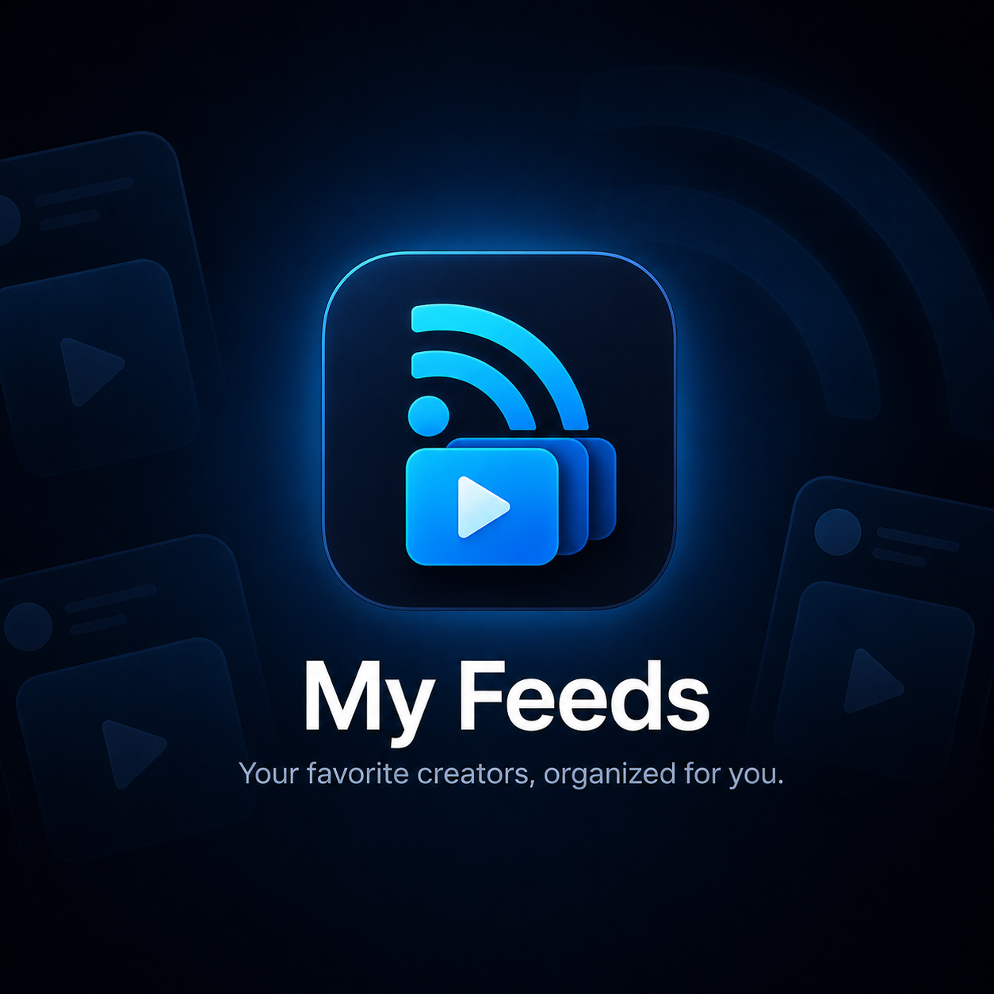
GETTING STARTED
My Feeds
Your favorite creators, organized for you.
A quick tour of what My Feeds does and how to use it.
Notes:
Welcome. This deck is a short tour of My Feeds for people who are just getting started.
By the end you'll know how to build your first collection, add sources, and read and watch everything in one place.

Slide 2
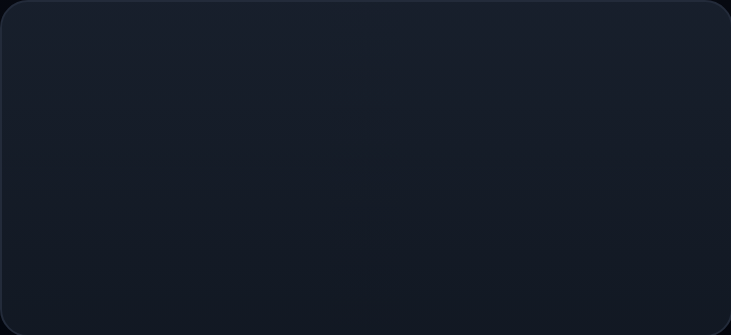
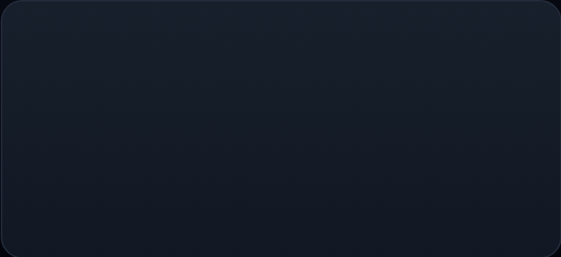
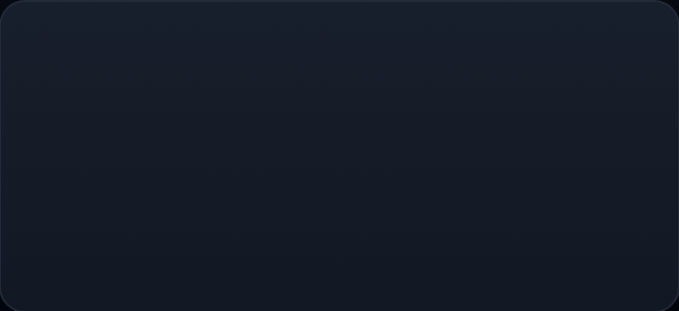
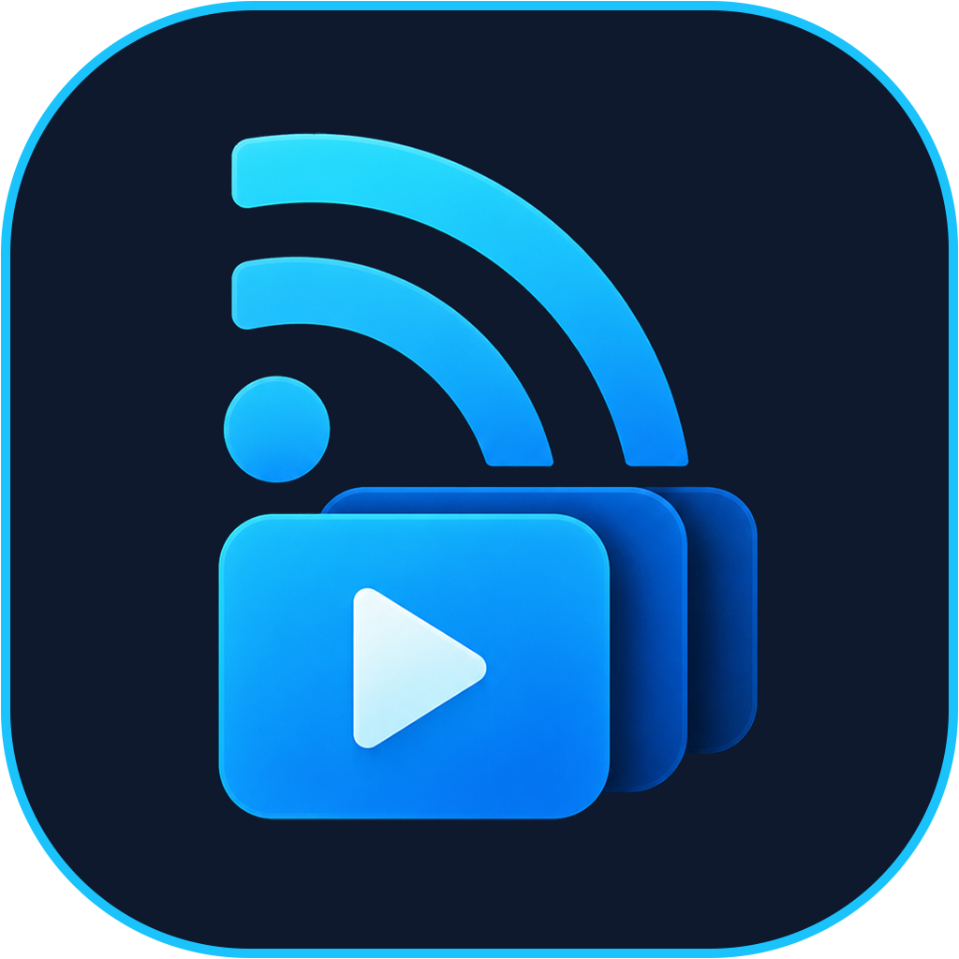
WHY MY FEEDS
Everything you follow, in one feed.
My Feeds watches the topics you care about across YouTube, X, Reddit and more, sums up what's new, and lets you watch and read it all right here.
Watches for you
Sums it up
Keeps you in one place
Collections check your sources on a schedule, so you don't have to open every app.
Posts arrive with a short summary, and videos with their key moments.
Watch, read, like and save without jumping between apps.
My Feeds · 2 / 16
Notes:
The problem is simple: the people you follow are spread across many apps.
My Feeds brings them together. It watches your sources for you, summarises what's new, and lets you read and watch without leaving the app.

Slide 3
WHERE IT LOOKS
Follow people where they already post
YouTube
X
Reddit
Instagram
LinkedIn
Channels
Original posts
Subreddits and users
Posts and reels
People and companies
GitHub
TikTok
Facebook
Apple Music
Apple Podcasts
Repos and releases
Videos and slideshows
Public Pages
New singles and albums
New episodes
Apple Books
Spotify
YouTube Music
New audiobooks
Artists
Artists
Public accounts only. Instagram and TikTok live streams can't be included, because they leave the account's posts when they end.
My Feeds · 3 / 16
Notes:
These are the platforms you can follow today.
For each one you add the thing that makes sense: a channel on YouTube, an account on X, a subreddit on Reddit, an artist on Apple Music, and so on.
Accounts need to be public for their posts to come in.

Slide 4
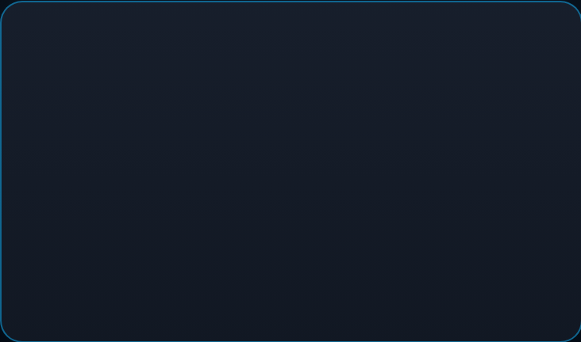
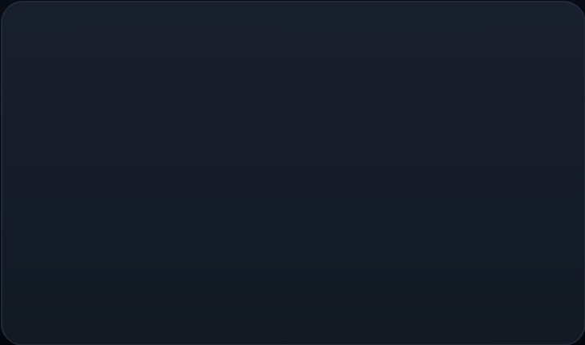
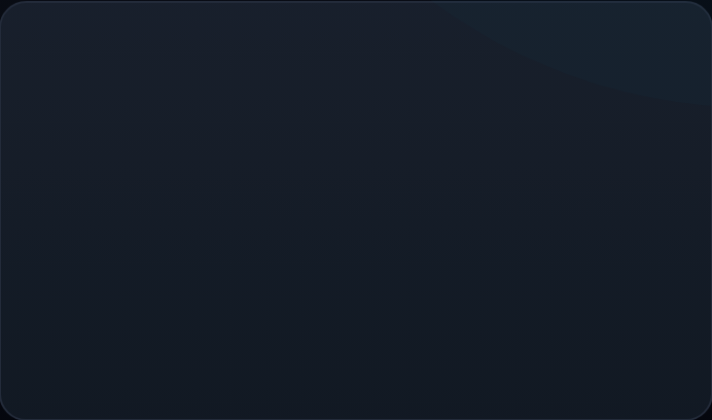



HOW IT WORKS
Three quick steps
1
2
3
Build a collection
Add sources
Read & watch
A collection follows one topic. Name it after what you want to follow.
The channels, accounts and communities this collection should watch.
New posts land in your Feeds, ready to watch and read without leaving.
The first time you open My Feeds, a short wizard walks you through all three. Reopen it any time with the ? button on the Dashboard.
My Feeds · 4 / 16
Notes:
Here's the whole idea in three steps: build a collection, add sources, then read and watch.
The onboarding wizard covers these when you first sign in, and you can bring it back later from the question mark button on the Dashboard.

Slide 5


STEP 1 · COLLECTIONS
One collection, one topic
New Collection
BASIC INFORMATION
Collection name
AI research
A collection follows a topic and pulls the best posts from its sources into one stream. Its name is the topic.
Description
New models, papers and tools
SCHEDULE
Run time
Lookback hours
⏱
Runs on a schedule. Daily at the time you pick, looking back over the hours you choose.
07:00
24
CONTENT FILTERS
✓
Filters what comes in. Include or skip Shorts, live streams, reels or photo posts.
Include Shorts
Create Collection
✉
Emails a digest. Your email is added to every new collection.
Dashboard
Collections
Feeds
History
Settings
My Feeds · 5 / 16
Notes:
Start with a collection. Give it a name that describes the topic, like "AI research".
Set when it runs and how far back it looks. Content filters let you include or skip Shorts and live streams.
Your email is added automatically, so you get the digest after each run.

Slide 6
STEP 2 · SOURCES
Tell each collection who to watch
Paste a link or a handle. You can add more later from the collection page.
PLATFORM
WHAT YOU ADD
EXAMPLE
YouTube
Channel
youtube.com/@ChannelName
X
Account · reposts and replies are skipped
@handle
Reddit
Subreddit or user · top posts from the lookback window
r/subreddit or u/username
GitHub
User or organization · new repositories and releases
@username
Apple Podcasts
Show · new episodes, played right here
Show name or podcasts.apple.com link
My Feeds · 6 / 16
Notes:
Sources are what a collection watches. The wizard asks for at least one, but you can skip and add them later.
Each platform takes what you'd expect: a channel link for YouTube, a handle for X, a subreddit for Reddit.
Adding an artist, show or author also brings in their latest release straight away.

Slide 7



SHORTCUT
Add anyone from the share sheet
Add to My Feeds
Creator Name
From the profile you shared.
COLLECTION
Found someone worth following in another app? Share their profile or one of their posts to Add to My Feeds.
AI research
Suggested
Cooking
Unsorted
Sort it later
1
My Feeds finds the account, even from a post you shared.
ALSO ON
YouTube
Instagram
2
Pick a collection. A suggested one is marked, or save to Unsorted and sort it later.
3
Also on matches the same person on other platforms, so you can add those accounts too.
Add to AI research
My Feeds · 7 / 16
Notes:
You don't have to add everyone by hand. From YouTube, X, Instagram, LinkedIn, TikTok, Facebook or Reddit, use the share button and pick My Feeds.
It finds who posted, suggests a collection, and can add the same person's other accounts too.
Private accounts are added as private: they show on People with a button to open them, but their posts don't appear in your feed.

Slide 8

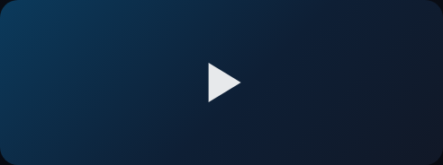

Feeds
STEP 3 · FEEDS
Search feeds, channels, tags...
Everything new, in one stream
All · 128
Recent
Priority
Each run adds new posts to the Feeds tab.
Why small caps lag when rates rise
Markets · 18 min
⌕
Search and filter by collection, channel and status.
Seen
Later
Liked
↕
Sort by Recent, Priority, Views or Account.
Onboarding rewrite is live. A thread on what we cut and why.
✓
Keep track: mark posts Seen, Later or Liked so your feed stays tidy.
X · 2h
☰
Select several at once to update them together.
Dashboard
Collections
Feeds
History
Settings
My Feeds · 8 / 16
Notes:
The Feeds tab is where you'll spend most of your time.
Search, filter by collection or status, and sort the way you like.
Mark things Seen, Later or Liked as you go, or select several to update them in one go.

Slide 9
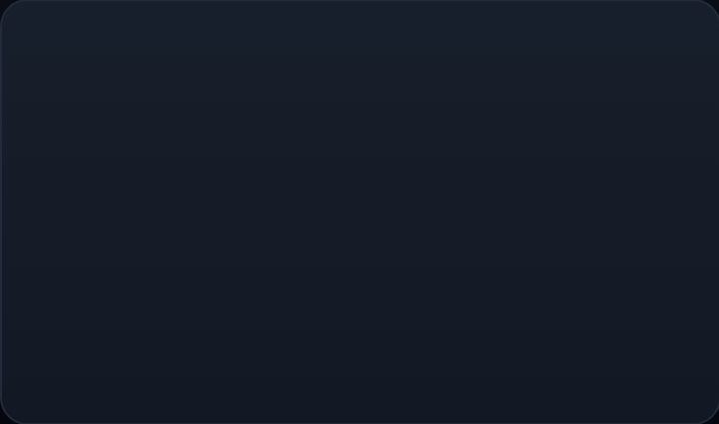
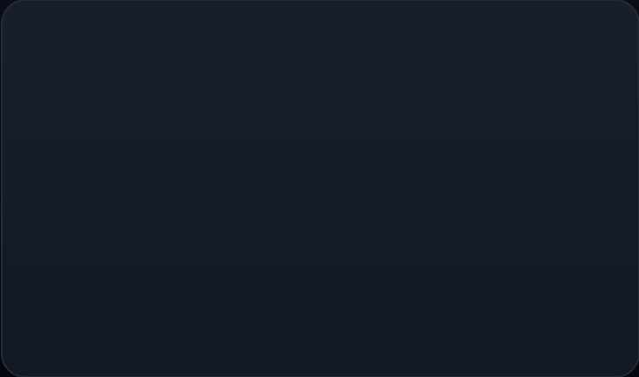
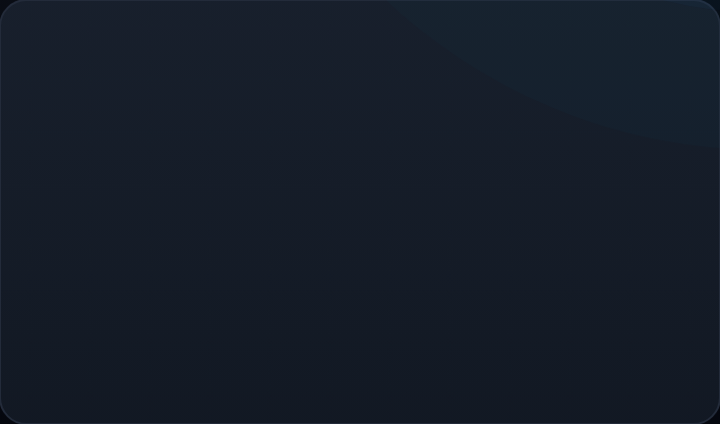



WATCH INSIDE MY FEEDS
Play it here, jump to the good parts
1
2
3
Play it here
Jump to the good parts
Keep track
Tap a video to watch it inside My Feeds. It remembers where you stopped.
Under the player, the summary lists the key moments. Tap a time to jump straight there.
Mark it Seen, Later or Liked from the card so your feed stays tidy.
Choose a default video quality and keep the screen on while playing. Connect YouTube to like videos and save them to a playlist from the player.
PLAYER SETTINGS
My Feeds · 9 / 16
Notes:
Videos play right inside the app and pick up where you left off.
The summary under the player lists key moments, so you can jump to the part you care about.
In Settings you can choose the default quality and keep the screen awake. Connecting YouTube lets you like videos and save them to a playlist.

Slide 10
READ POSTS IN FULL
Most actions stay in My Feeds
Photos, videos and quoted posts open in full. Saving happens here; posting from your account opens the platform.
PLATFORM
IN MY FEEDS
OPENS THE PLATFORM
X
Like saves it · Bookmark adds it to Read later
Reply or repost
Reddit
Upvote saves · downvote marks it read · Save adds to Read later
Comments
Instagram
Swipe carousels, play reels · heart saves, bookmark adds to Read later
Comments
GitHub
Read new repos and releases with a summary · Star saves
Fork
My Feeds · 10 / 16
Notes:
Posts open in full inside the app, with their photos and videos.
The rule of thumb: anything that just saves or tidies stays in My Feeds. Anything that posts from your own account, like replying on X or forking on GitHub, opens that app.

Slide 11
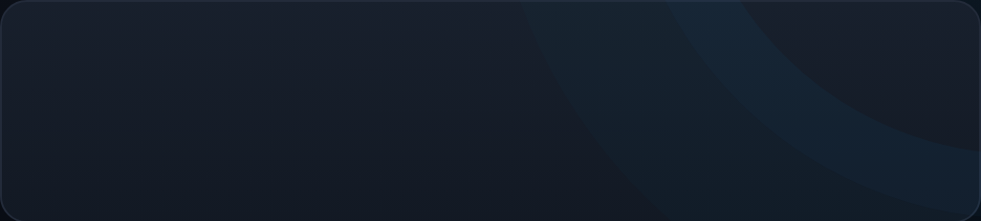
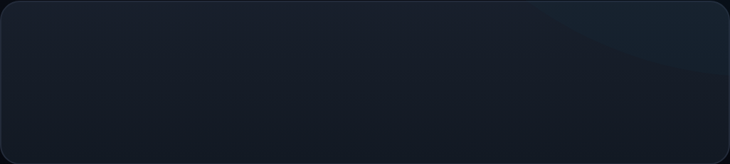
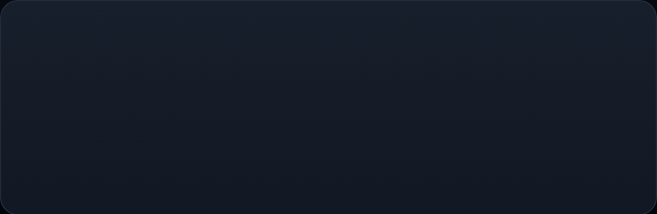
Posts
DOWNLOADS
Saved with their photos and videos.
Take it with you, offline
Podcasts
Open a post, podcast episode or video and tap the download icon at the top. It stays on your phone so you can read or listen with no connection.
Saved with the full episode.
YouTube videos
Downloads work in the iPhone and Android apps. Find them in Settings › Downloads.
YouTube only lets its videos play in its own player. Save summary keeps the summary and key moments for offline reading.
My Feeds · 11 / 16
Notes:
Going somewhere without signal? Download posts and podcast episodes before you leave.
YouTube is the exception: its videos can only play in YouTube's player, so My Feeds saves the summary and key moments instead.
Removing a download only deletes the copy on your phone. The post stays in your feed.

Slide 12
Dashboard
4
37
DASHBOARD
See it all at a glance
Active Collections
Monitored Channels
12
92%
Recent Runs
Success Rate
◎
Four numbers: active collections, monitored channels, and your runs and success rate over the last 7 days.
MY COLLECTIONS
AI research
▤
Every collection shows how many new feeds its last run found, and how far you've got through them.
Found 6 new feeds · 12 channels
Markets
▶
Run All refreshes every collection at once, or add a New Collection.
Found 0 new feeds · 9 channels
Cooking
Numbers shown are an example.
Found 3 new feeds · 6 channels
Dashboard
Collections
Feeds
History
Settings
My Feeds · 12 / 16
Notes:
The Dashboard is your home screen.
The four stats at the top show your collections, the channels you're watching, and how your runs went over the last week.
Each collection card shows how many new feeds it found and your progress. Run All refreshes everything at once.

Slide 13
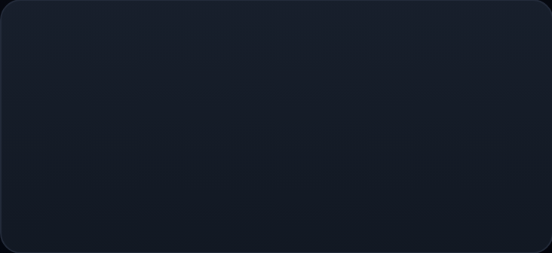
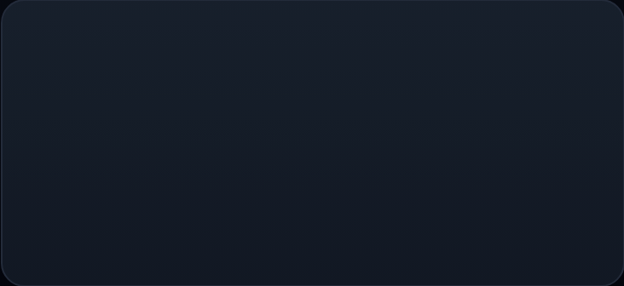
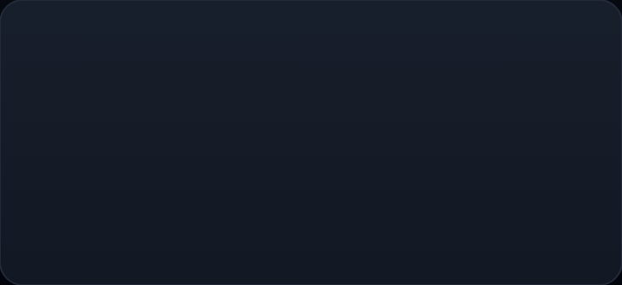
PEOPLE
Everyone you follow, and where else they are
People groups your sources by person, across platforms, so one creator is one card.
Find them elsewhere
Add in one tap
You decide
My Feeds checks where else each person posts and shows what you don't follow yet.
Add their other accounts to your collection, and follow or subscribe on the platform at the same time.
Confirm a match, remove a wrong one, or combine two cards that are the same person.
My Feeds · 13 / 16
Notes:
Most creators post in more than one place. People puts each person on one card and shows where else they are.
You can add their other accounts in one tap, and fix any match that isn't right.
Open it from the Dashboard.

Slide 14
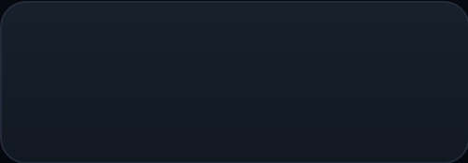
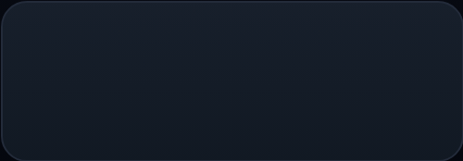
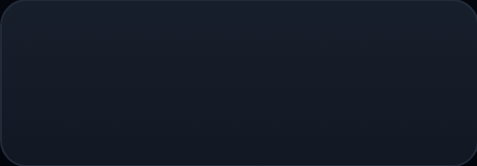
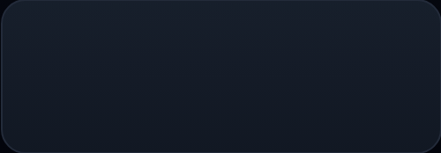
HISTORY
WATCH TIME
Every run, on a timeline
Know where your time goes
See when each collection ran, how long it took and what it found.
Watch Time Statistics on the Dashboard, for 7 days, 30 days or all time.
Success
Partial
Failed
Running
Clearing run history keeps your feeds and statistics.
Daily Trend
By Collection
Bar or area chart
Watched of total
Weekly Comparison
Detailed Breakdown
This week vs last
By channel
My Feeds · 14 / 16
Notes:
History is a timeline of every run, with its status, duration and what it found. If a run is taking too long, you can cancel it there.
Watch Time Statistics live on the Dashboard and show how much you've watched, by day, by collection and week over week.

Slide 15
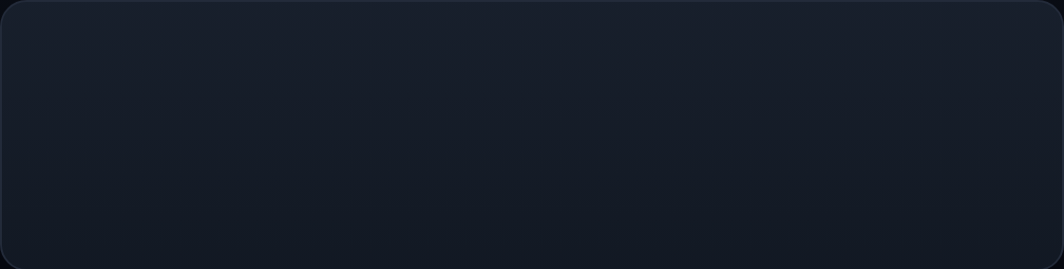
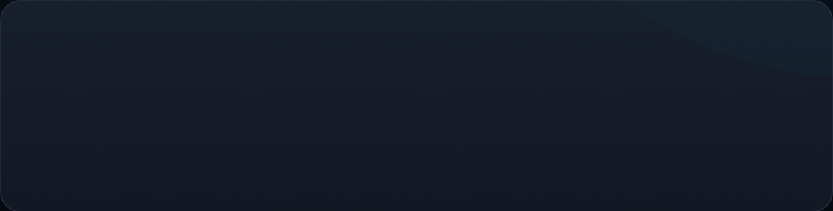
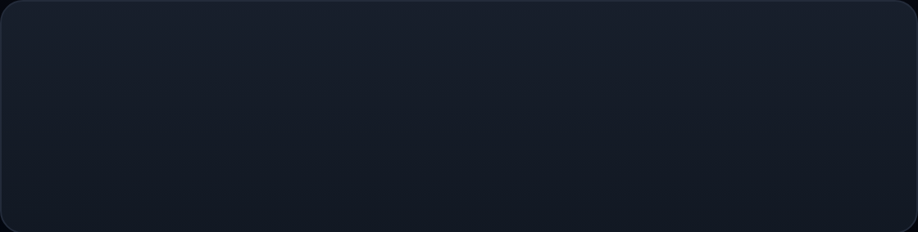
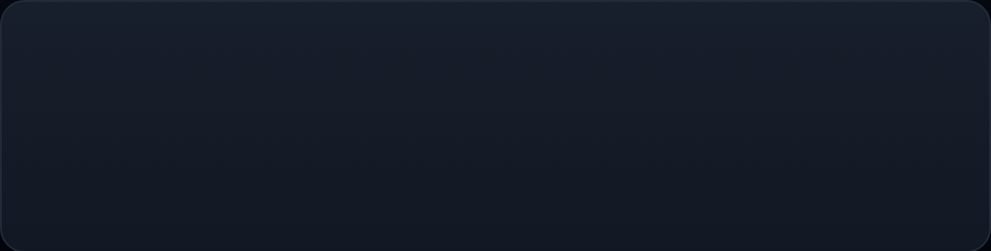
SETTINGS
Make it yours
Language
YouTube account
English or Português (Brasil), or Automatic to follow your phone. The app switches right away.
Optional. Connect it to like videos and save them to a playlist from the player.
Video playback
Your data
Pick a default video quality and keep the screen on while playing.
Delete your account any time from Settings. It removes your collections, feeds, watch history and settings.
My Feeds · 15 / 16
Notes:
A few settings worth knowing about.
Language switches instantly between English and Brazilian Portuguese, or follows your phone on Automatic.
Connecting YouTube is optional. And you're always in control of your data: deleting your account removes everything straight away.

Slide 16
YOUR TURN
Your feed is ready
1
Sign in or create an account.
2
Build your first collection and add a few sources.
3
Tap Run it now, then Go to my feed.
Questions? Contact us at support@travelone.ca
Notes:
That's it. Sign in, build your first collection, add a few sources, and run it now to fill your feed straight away.
After that it runs on its own every morning.
If you need help, write to support@travelone.ca.

