Slide 1
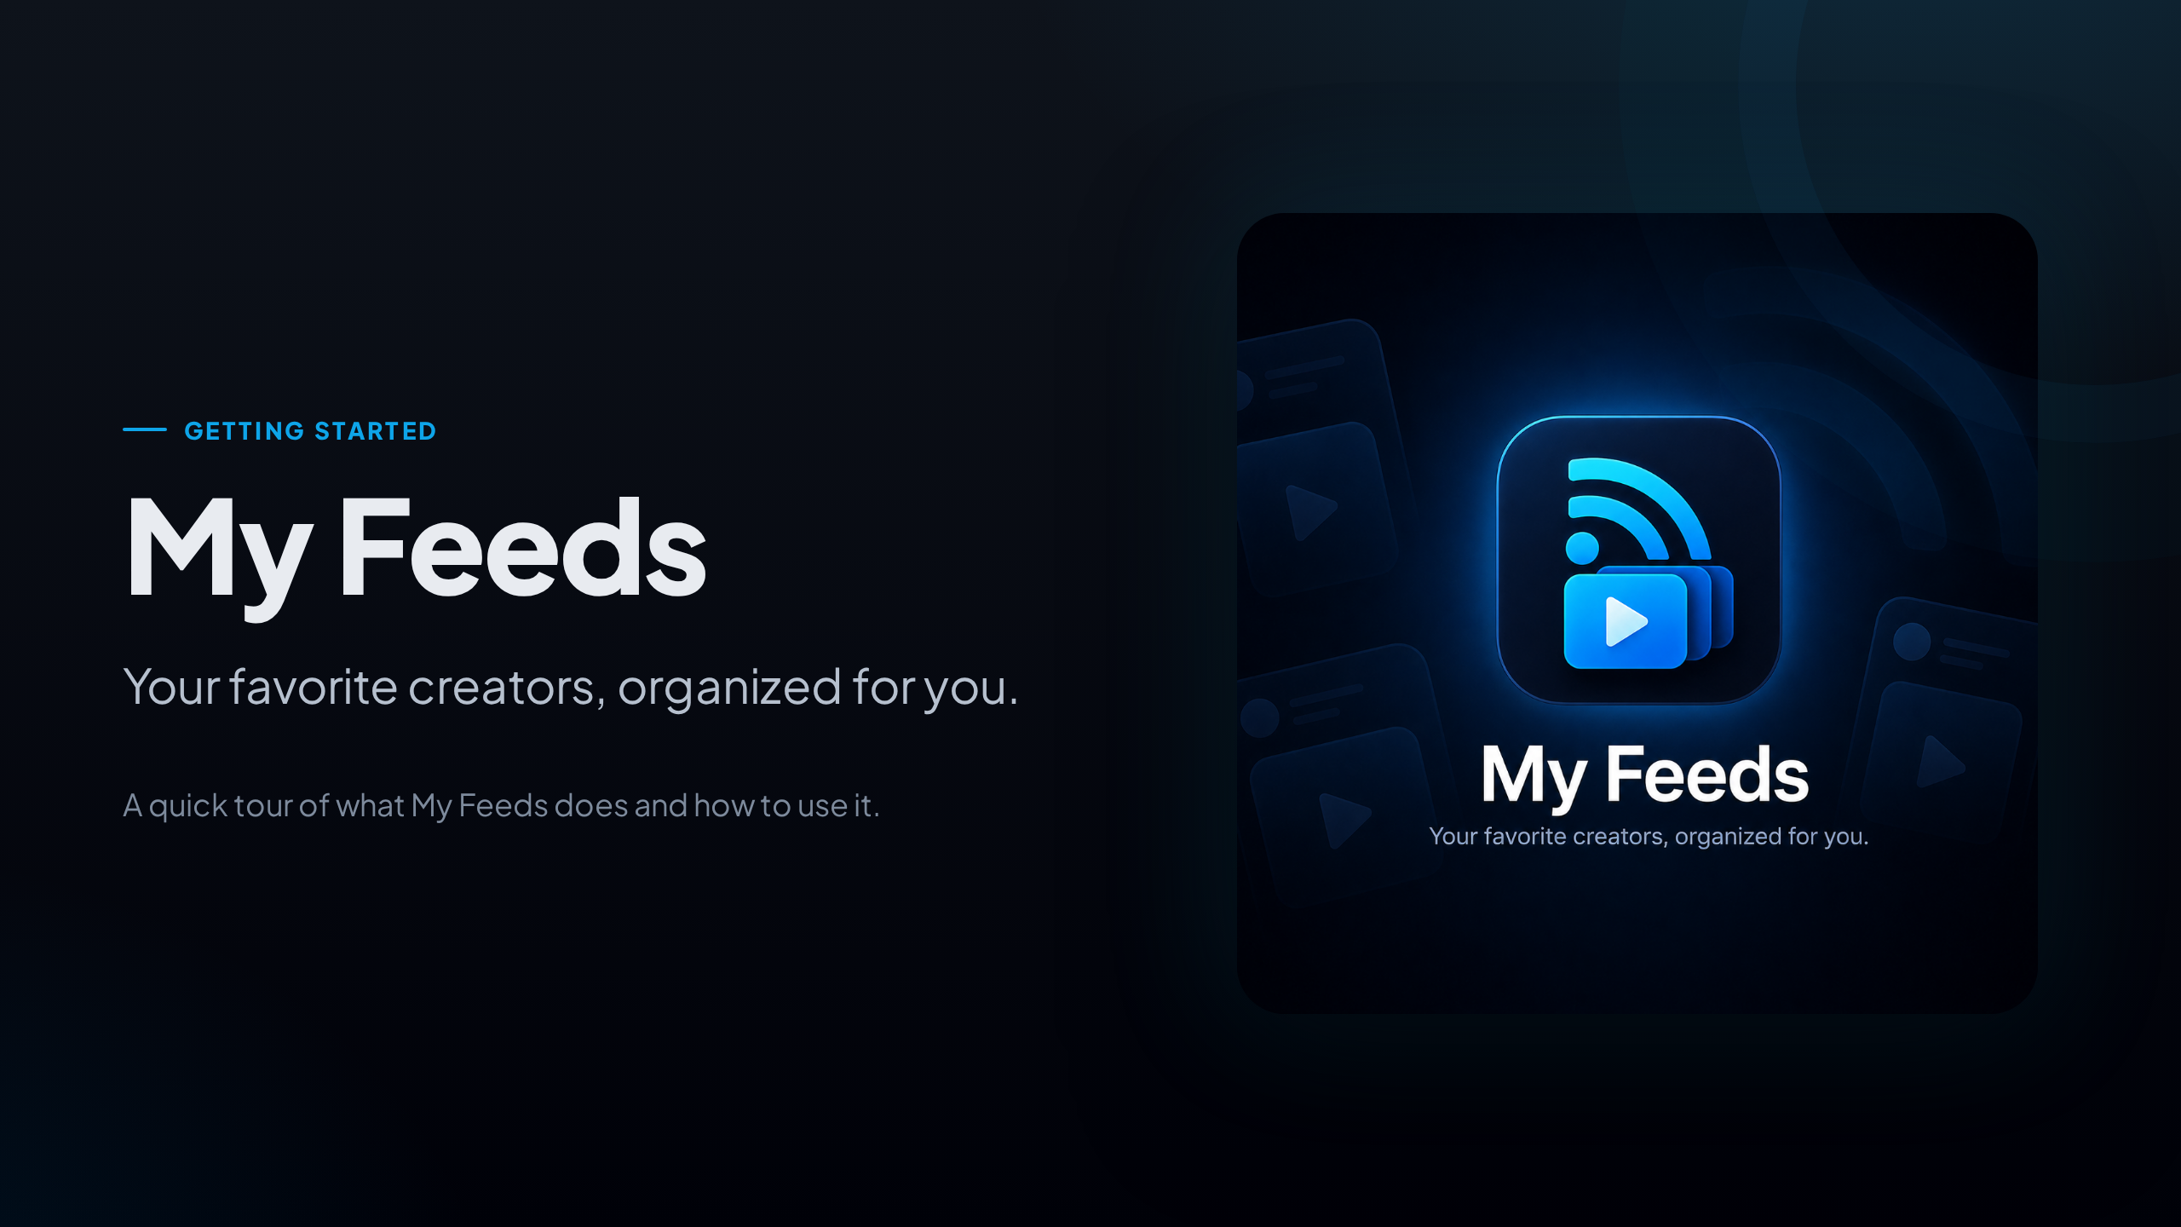
Notes:
Welcome. This deck is a short tour of My Feeds for people who are just getting started.
By the end you'll know how to build your first collection, add sources, and read and watch everything in one place.

Slide 2
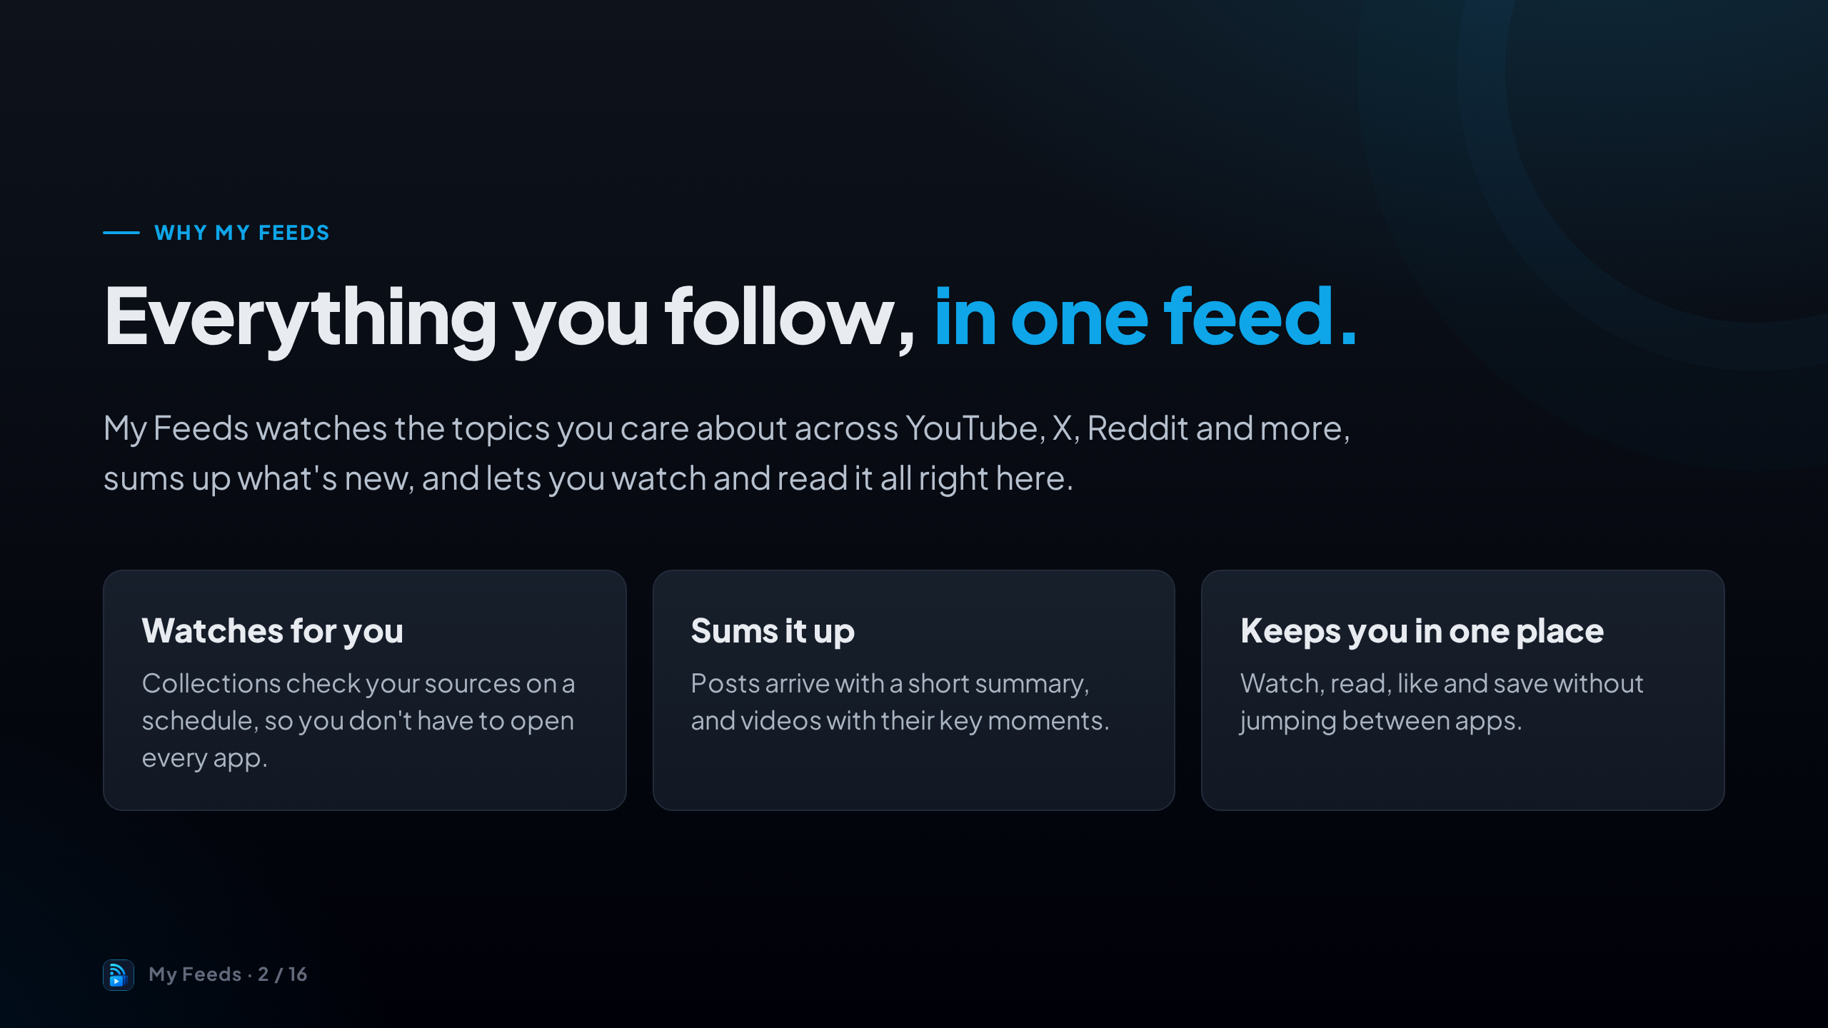
Notes:
The problem is simple: the people you follow are spread across many apps.
My Feeds brings them together. It watches your sources for you, summarises what's new, and lets you read and watch without leaving the app.

Slide 3
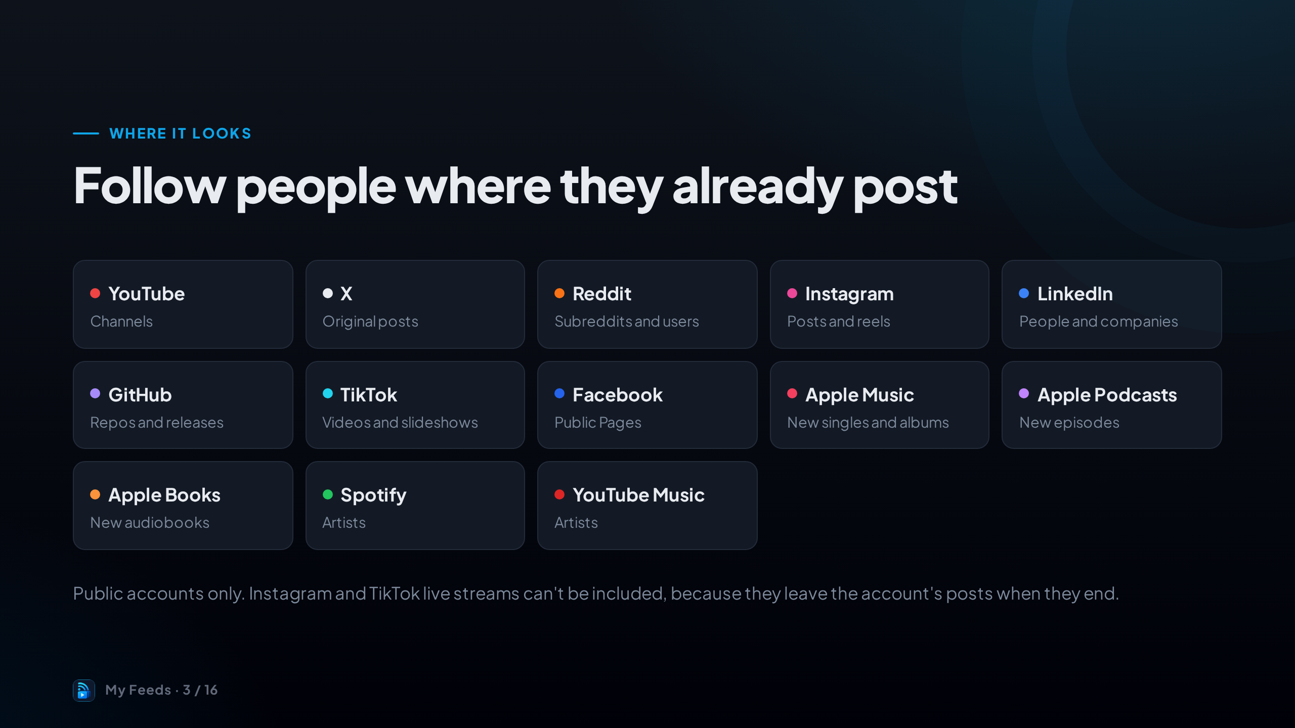
Notes:
These are the platforms you can follow today.
For each one you add the thing that makes sense: a channel on YouTube, an account on X, a subreddit on Reddit, an artist on Apple Music, and so on.
Accounts need to be public for their posts to come in.

Slide 4
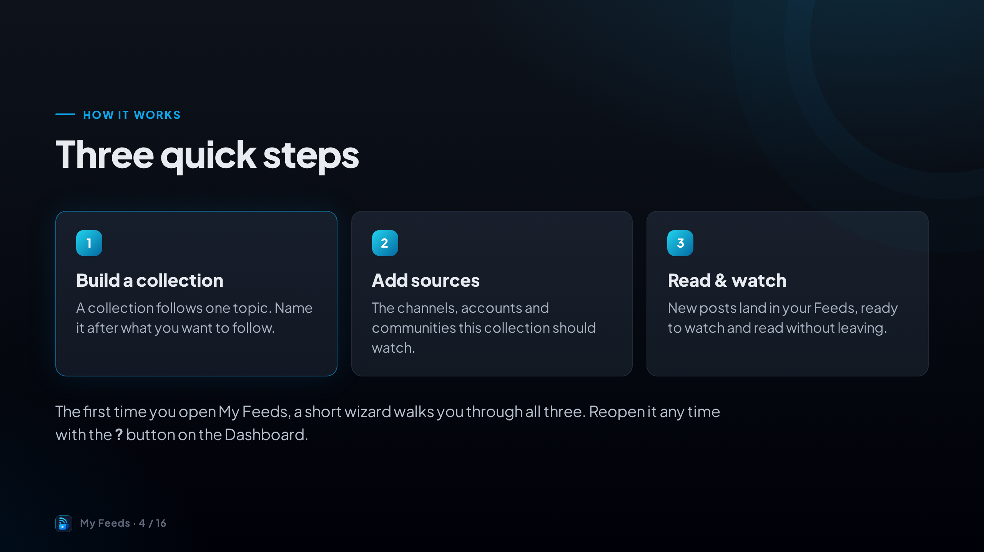
Notes:
Here's the whole idea in three steps: build a collection, add sources, then read and watch.
The onboarding wizard covers these when you first sign in, and you can bring it back later from the question mark button on the Dashboard.

Slide 5
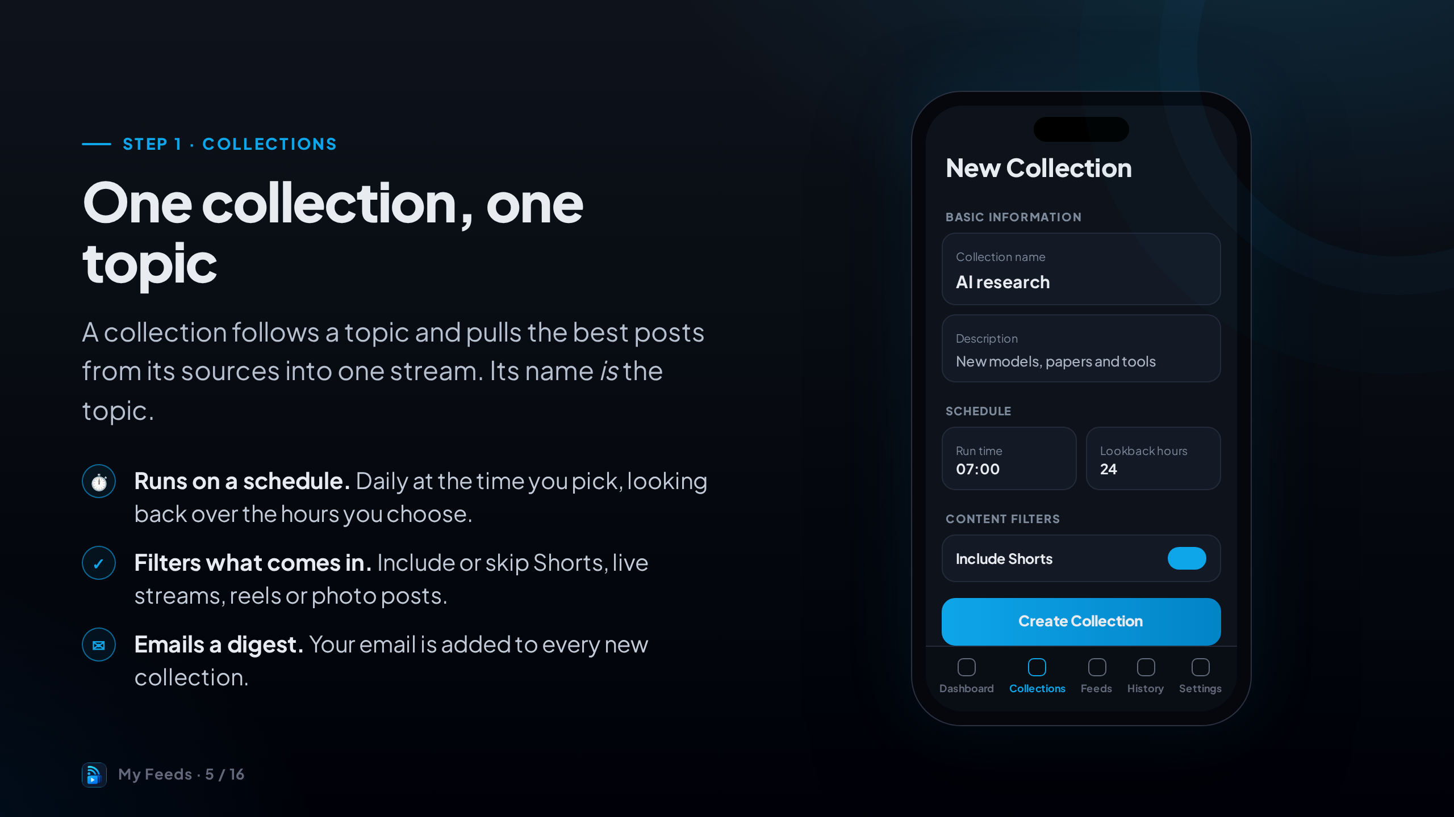
Notes:
Start with a collection. Give it a name that describes the topic, like "AI research".
Set when it runs and how far back it looks. Content filters let you include or skip Shorts and live streams.
Your email is added automatically, so you get the digest after each run.

Slide 6
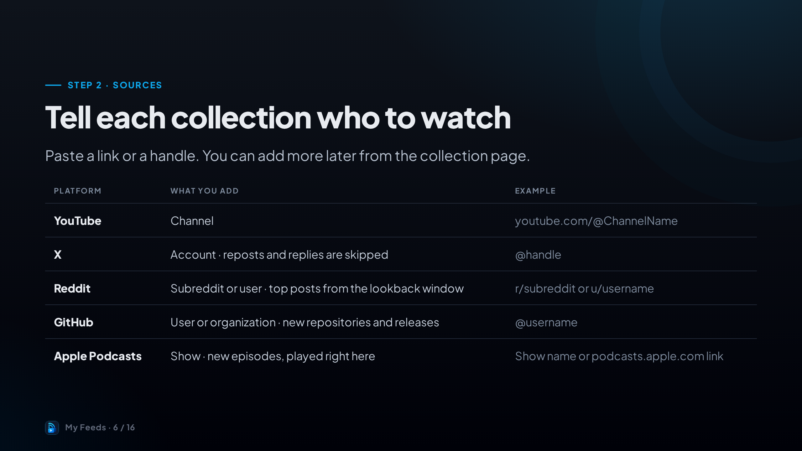
Notes:
Sources are what a collection watches. The wizard asks for at least one, but you can skip and add them later.
Each platform takes what you'd expect: a channel link for YouTube, a handle for X, a subreddit for Reddit.
Adding an artist, show or author also brings in their latest release straight away.

Slide 7
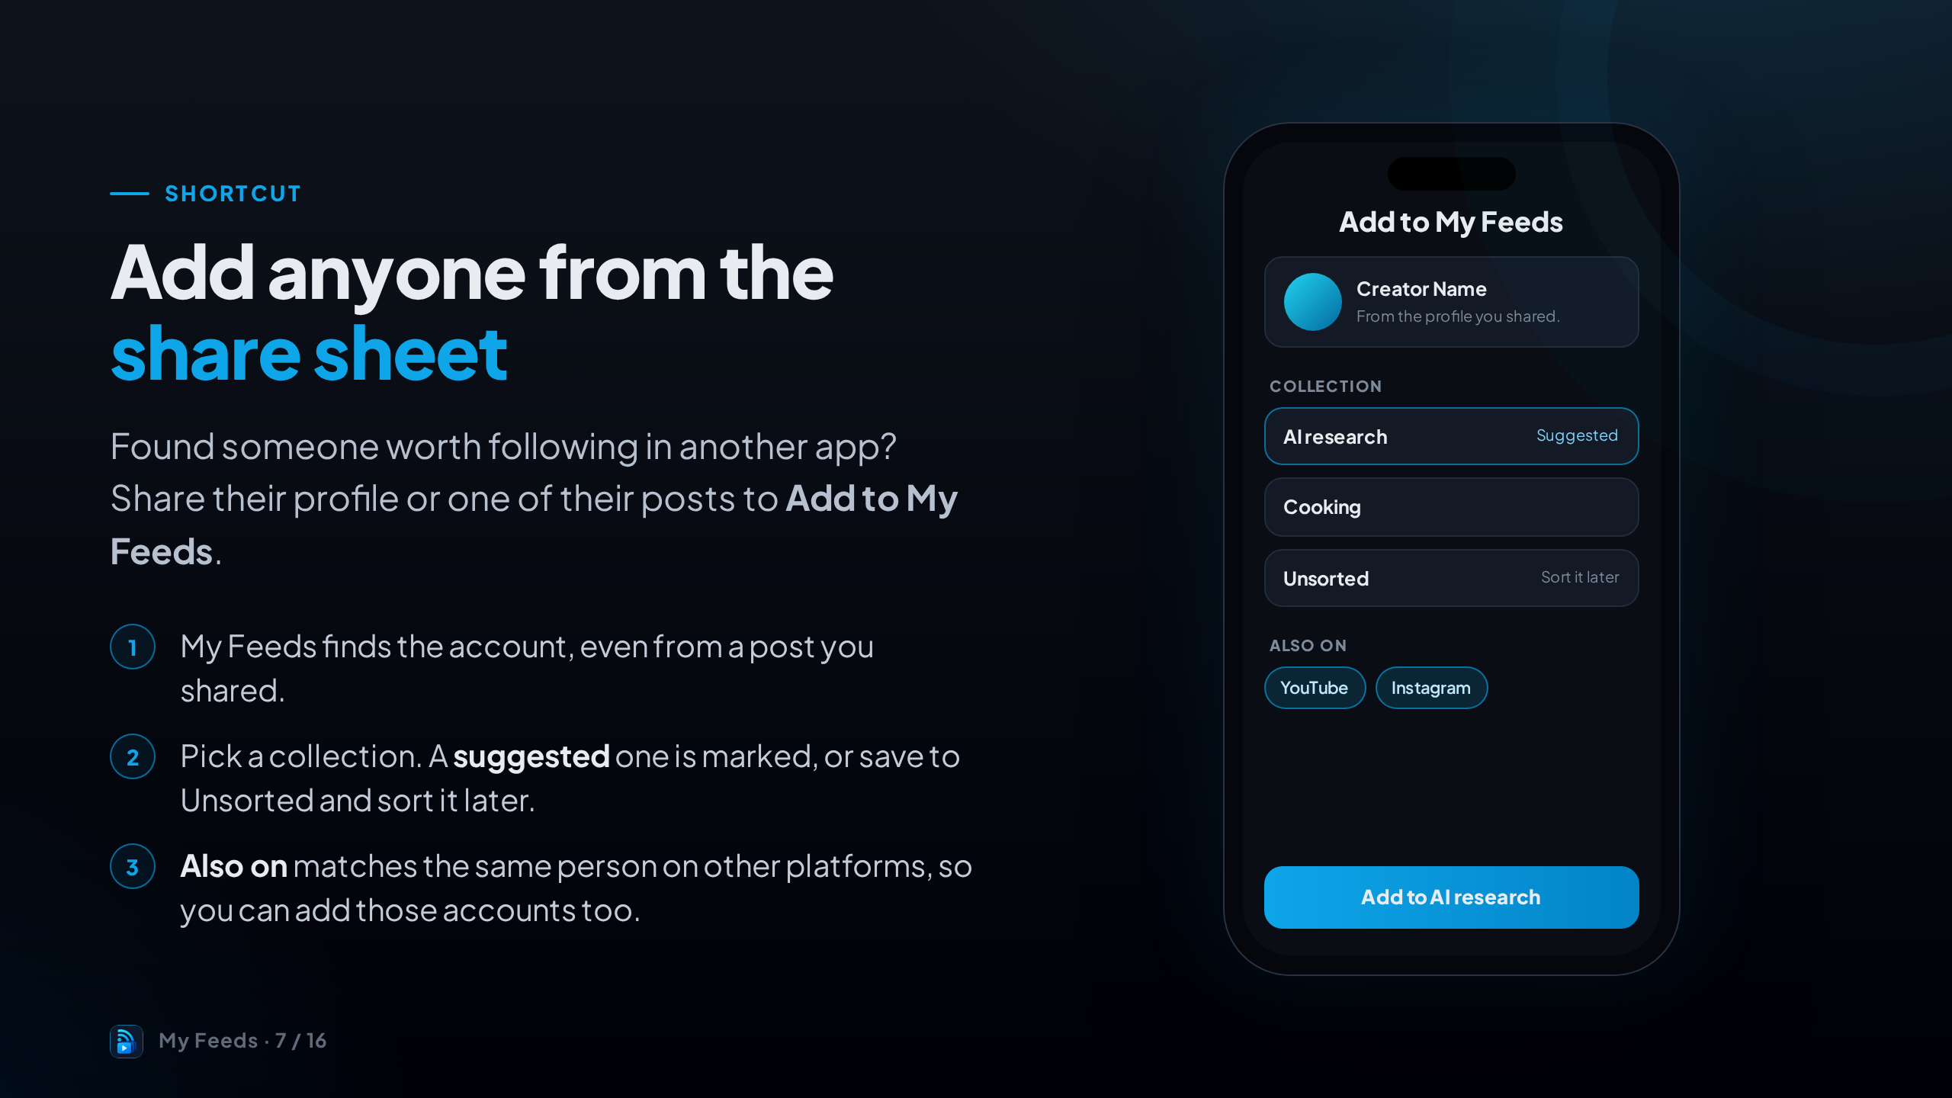
Notes:
You don't have to add everyone by hand. From YouTube, X, Instagram, LinkedIn, TikTok, Facebook or Reddit, use the share button and pick My Feeds.
It finds who posted, suggests a collection, and can add the same person's other accounts too.
Private accounts are added as private: they show on People with a button to open them, but their posts don't appear in your feed.

Slide 8
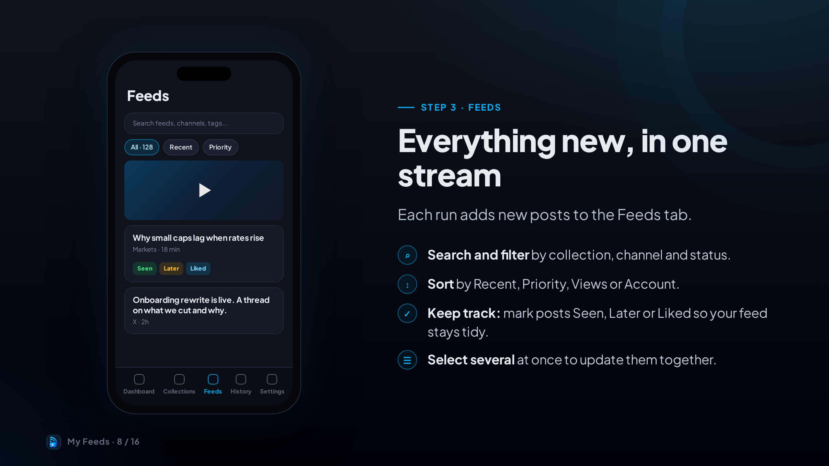
Notes:
The Feeds tab is where you'll spend most of your time.
Search, filter by collection or status, and sort the way you like.
Mark things Seen, Later or Liked as you go, or select several to update them in one go.

Slide 9
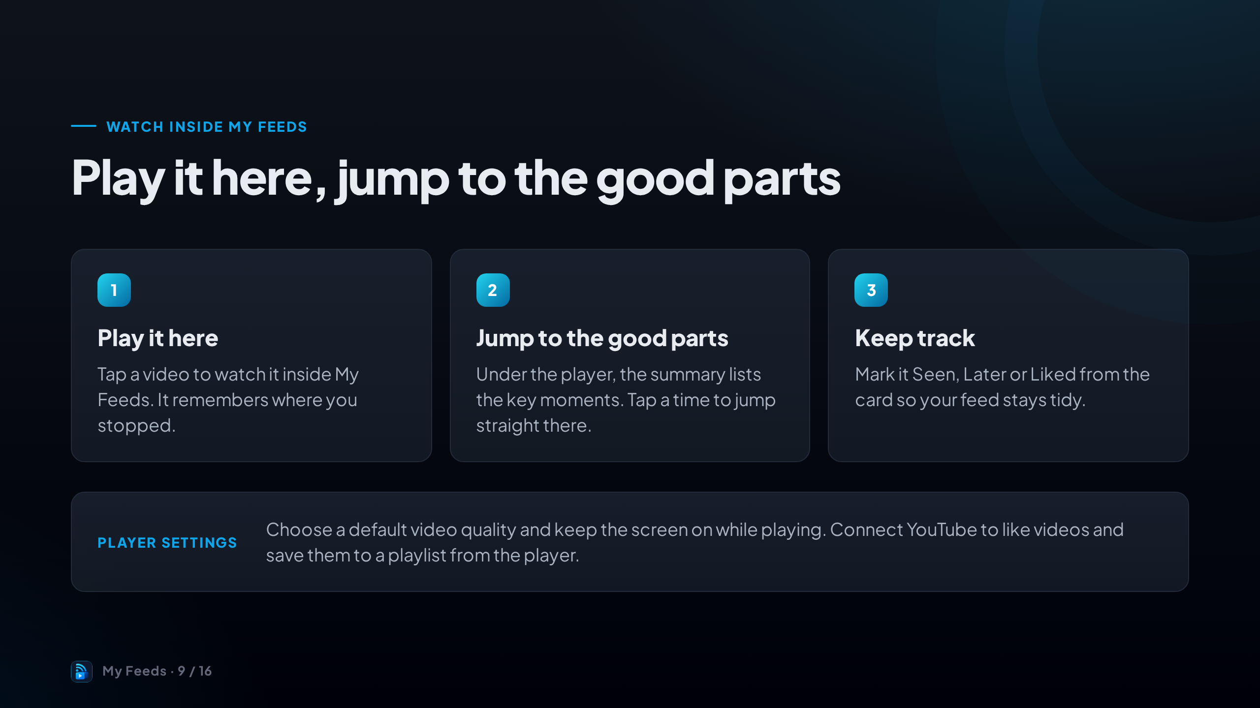
Notes:
Videos play right inside the app and pick up where you left off.
The summary under the player lists key moments, so you can jump to the part you care about.
In Settings you can choose the default quality and keep the screen awake. Connecting YouTube lets you like videos and save them to a playlist.

Slide 10
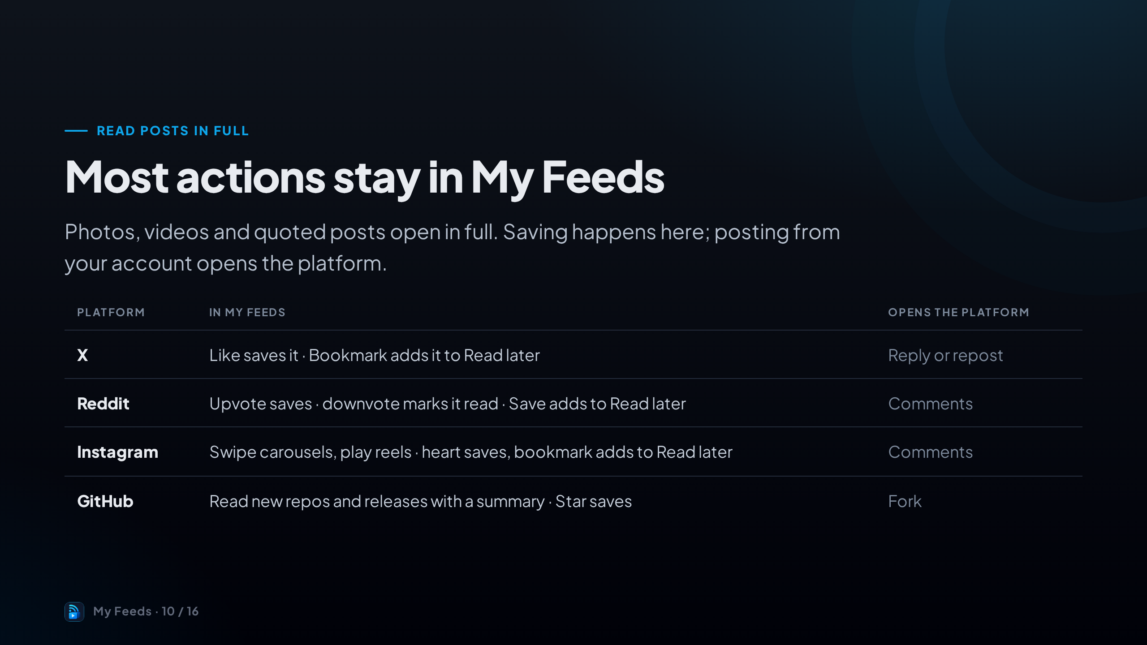
Notes:
Posts open in full inside the app, with their photos and videos.
The rule of thumb: anything that just saves or tidies stays in My Feeds. Anything that posts from your own account, like replying on X or forking on GitHub, opens that app.

Slide 11
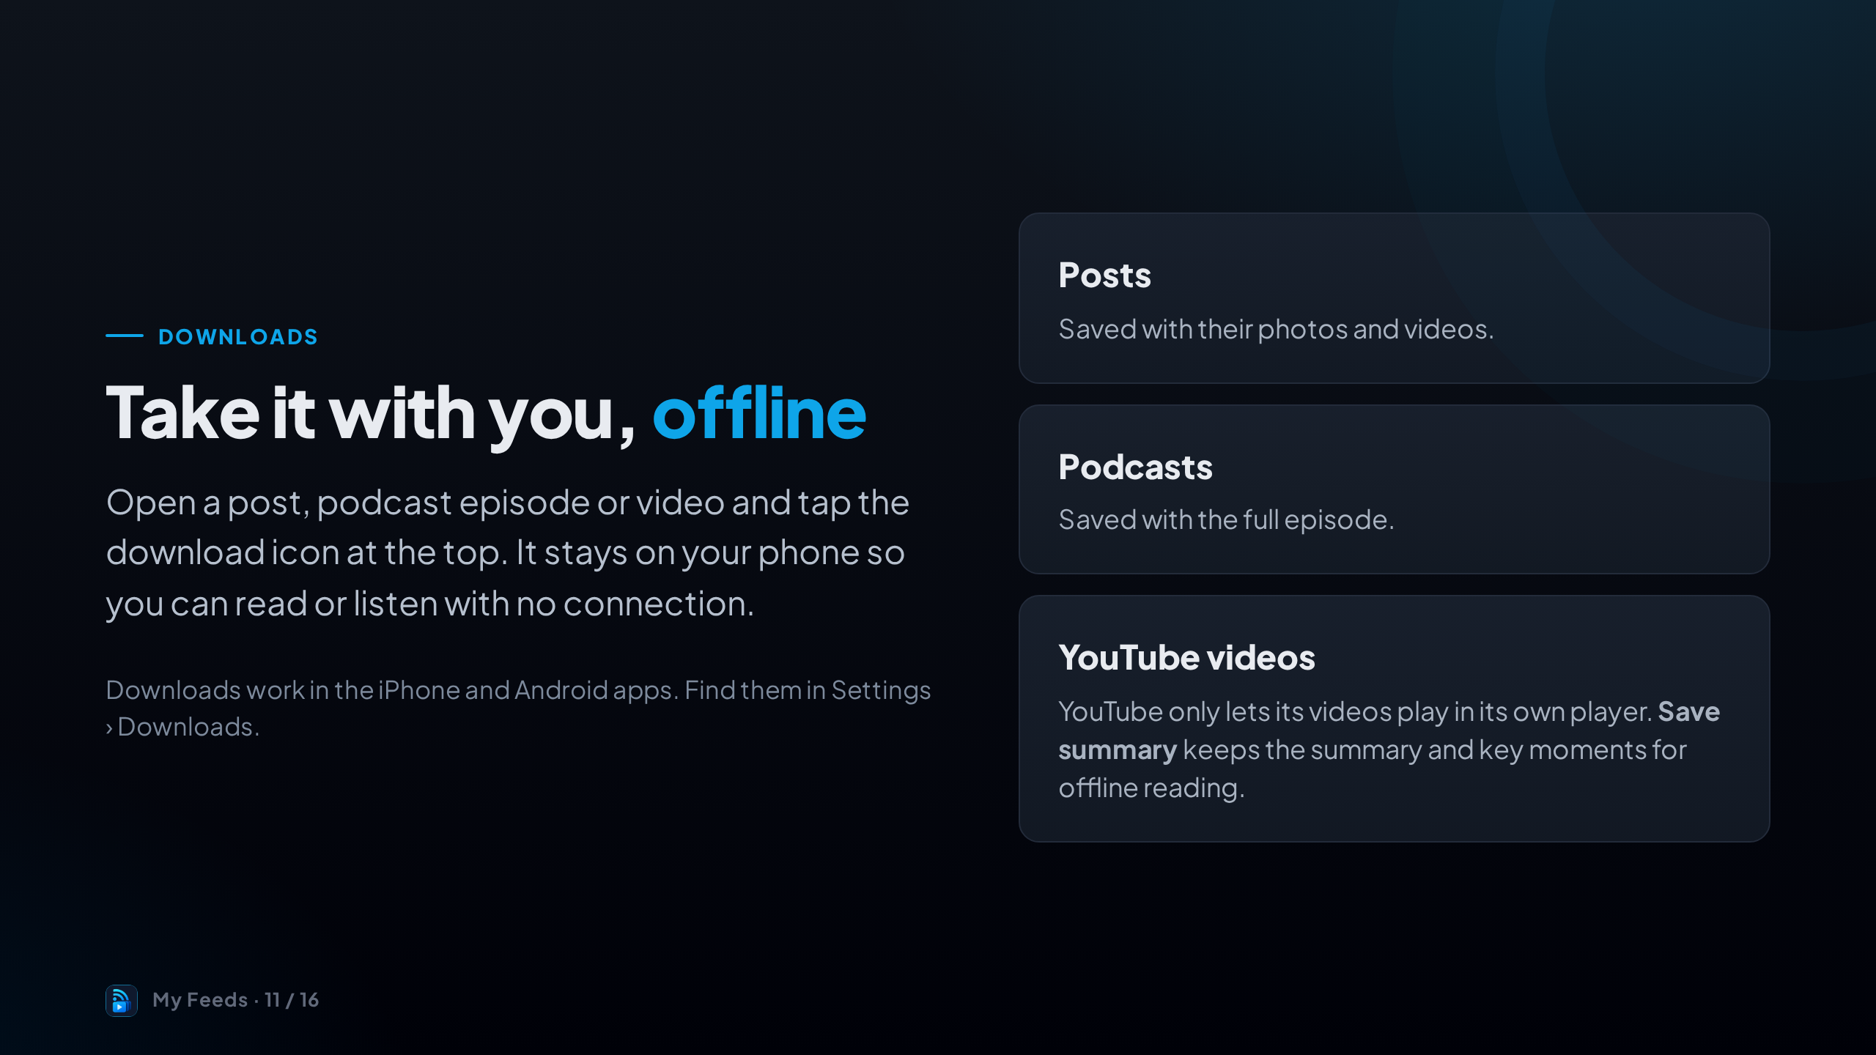
Notes:
Going somewhere without signal? Download posts and podcast episodes before you leave.
YouTube is the exception: its videos can only play in YouTube's player, so My Feeds saves the summary and key moments instead.
Removing a download only deletes the copy on your phone. The post stays in your feed.

Slide 12
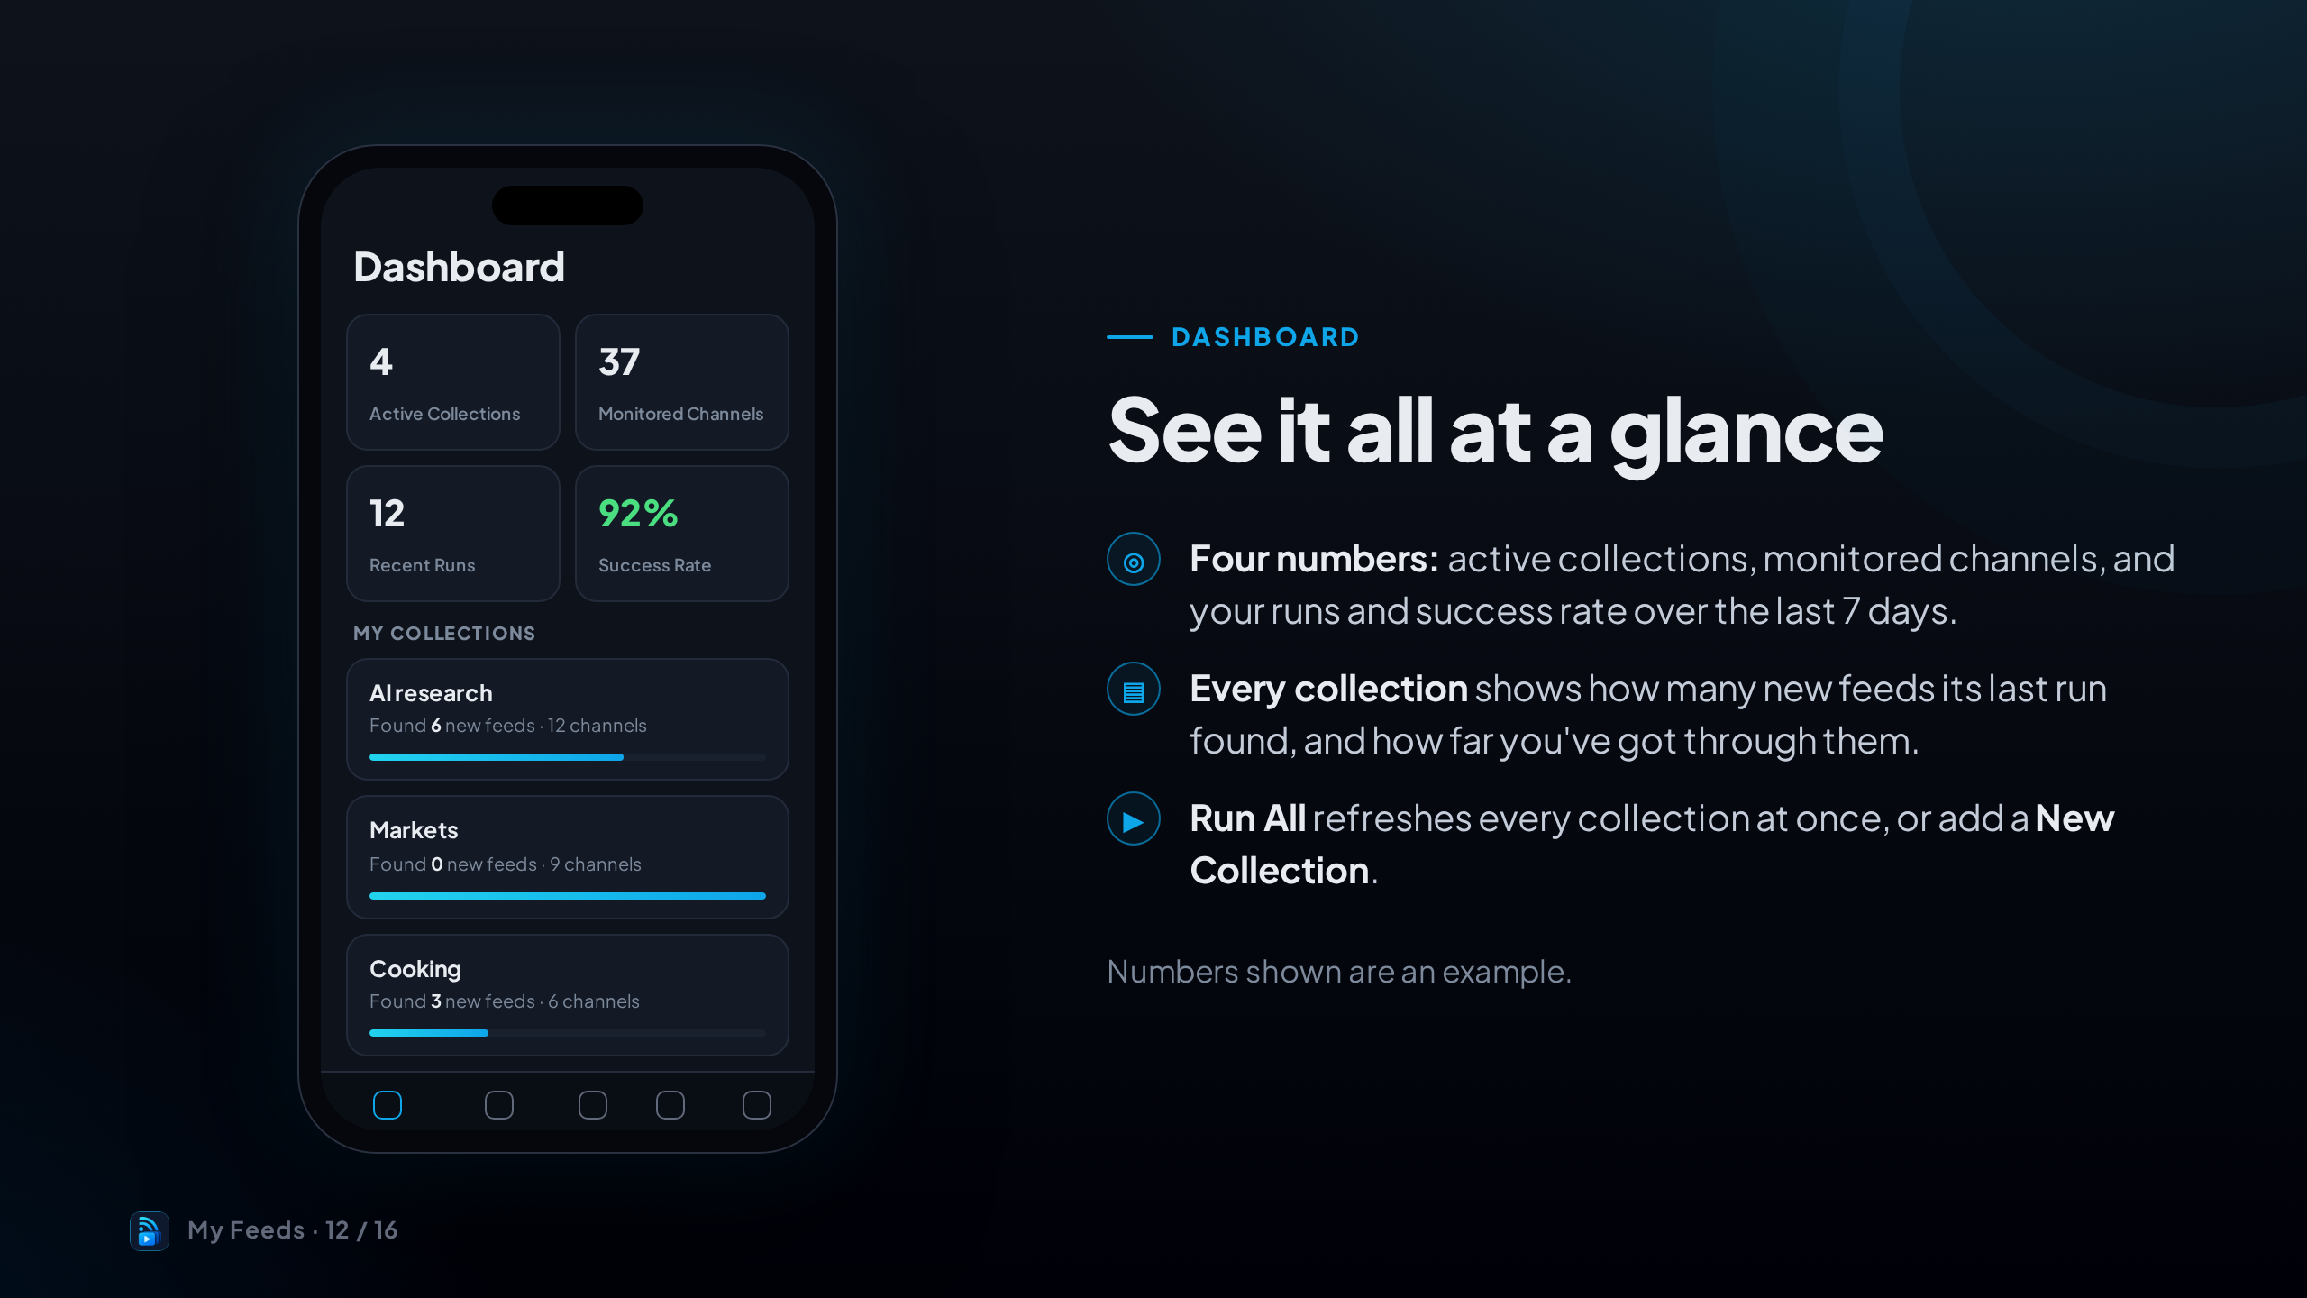
Notes:
The Dashboard is your home screen.
The four stats at the top show your collections, the channels you're watching, and how your runs went over the last week.
Each collection card shows how many new feeds it found and your progress. Run All refreshes everything at once.

Slide 13
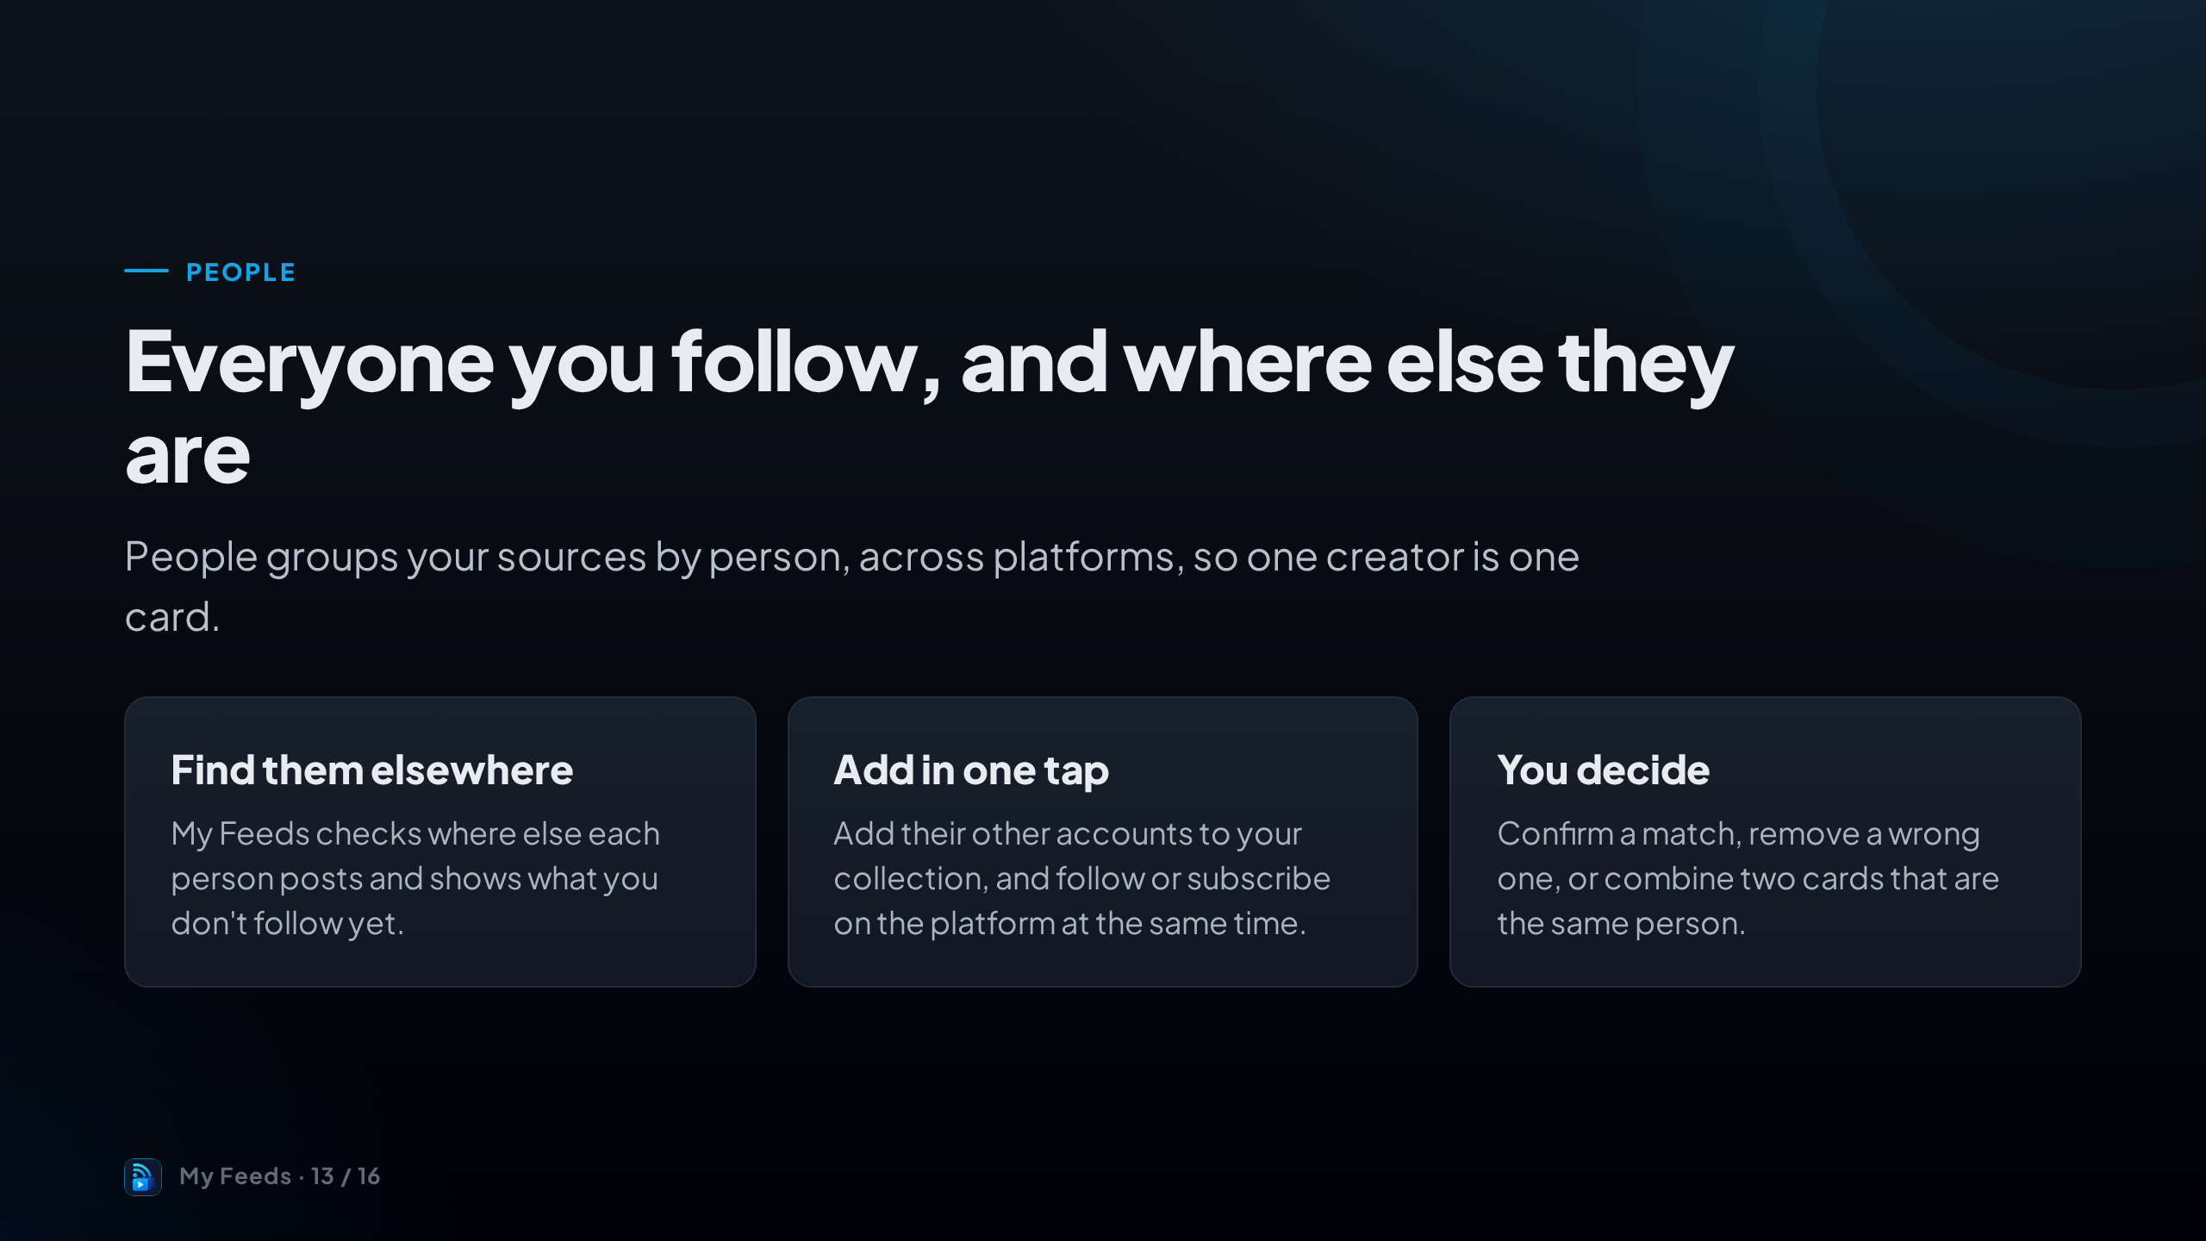
Notes:
Most creators post in more than one place. People puts each person on one card and shows where else they are.
You can add their other accounts in one tap, and fix any match that isn't right.
Open it from the Dashboard.

Slide 14
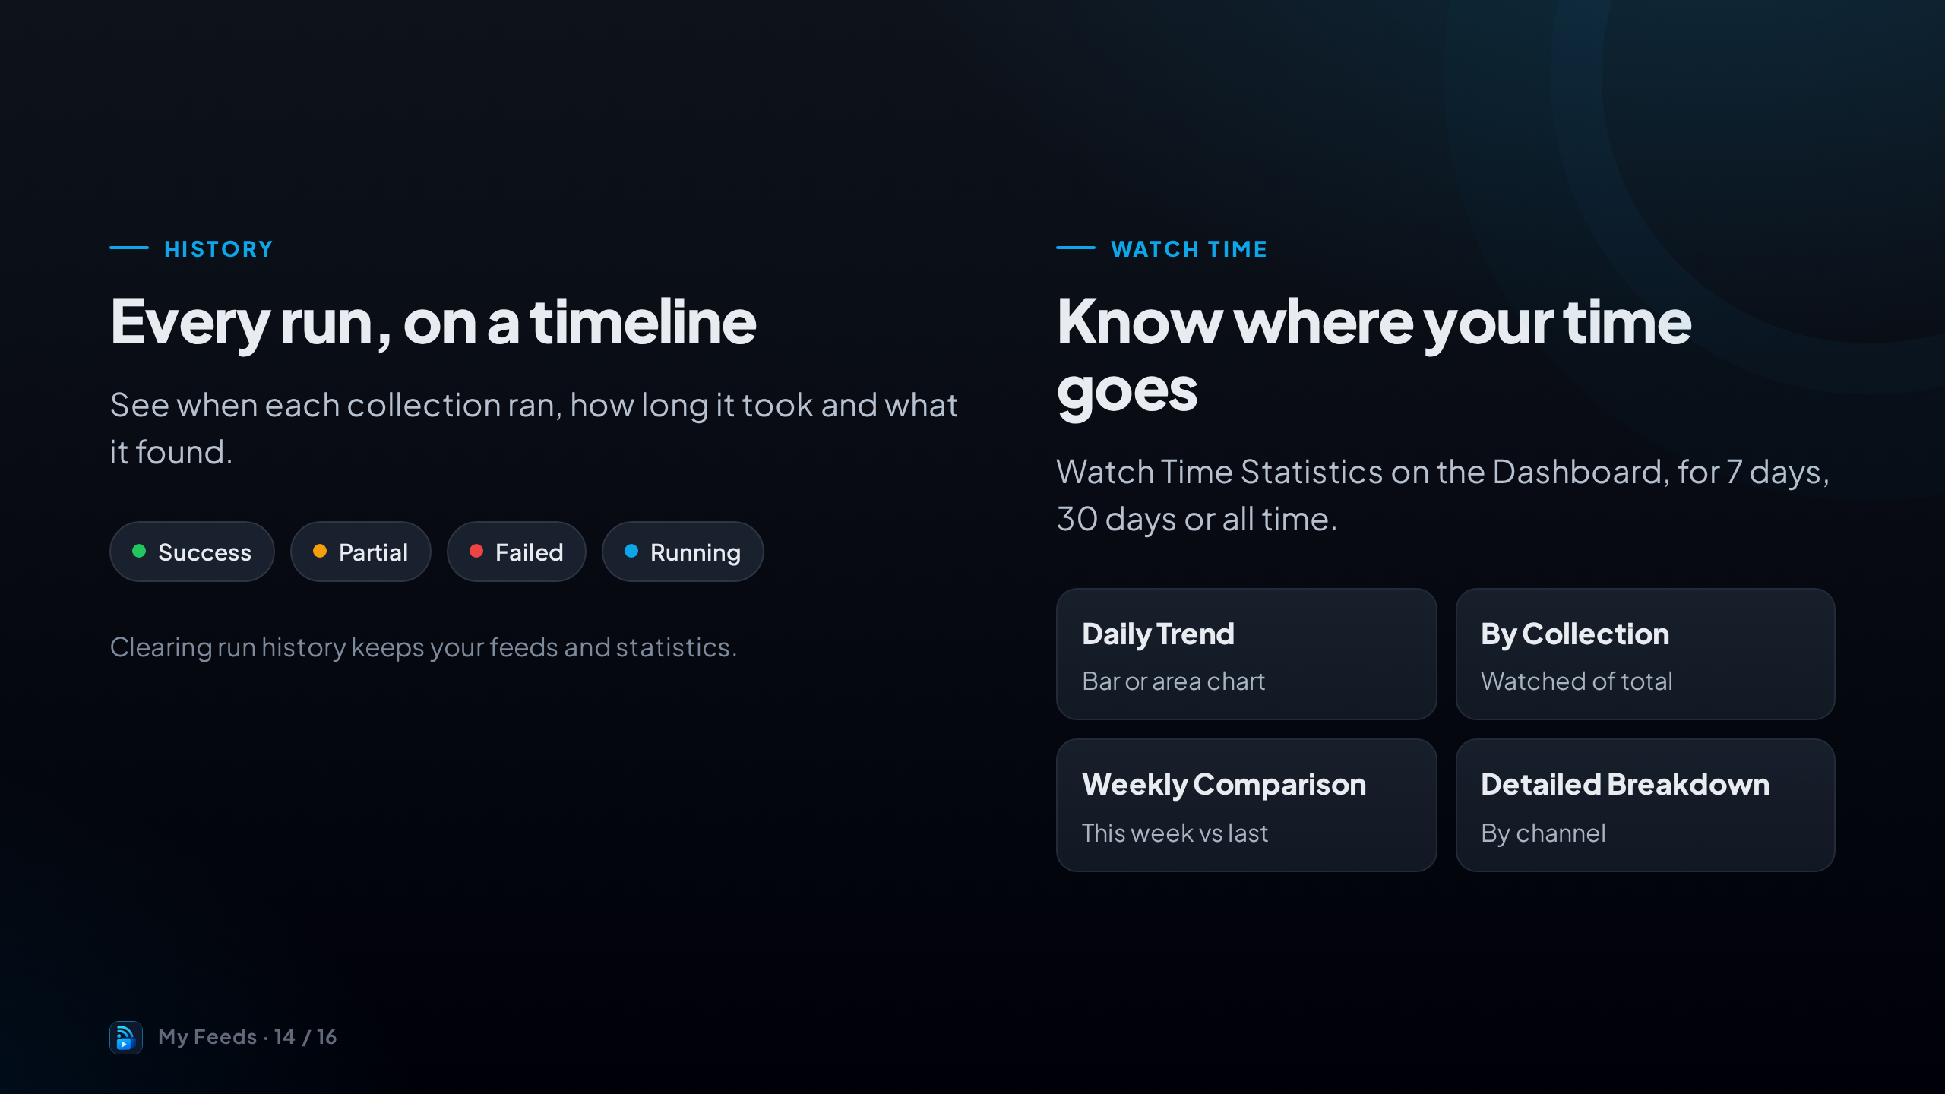
Notes:
History is a timeline of every run, with its status, duration and what it found. If a run is taking too long, you can cancel it there.
Watch Time Statistics live on the Dashboard and show how much you've watched, by day, by collection and week over week.

Slide 15
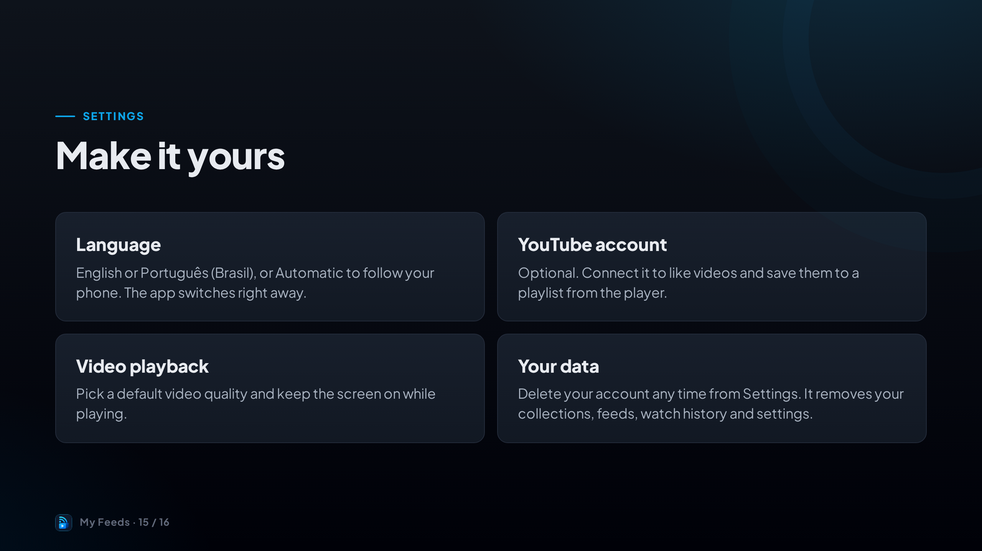
Notes:
A few settings worth knowing about.
Language switches instantly between English and Brazilian Portuguese, or follows your phone on Automatic.
Connecting YouTube is optional. And you're always in control of your data: deleting your account removes everything straight away.

Slide 16
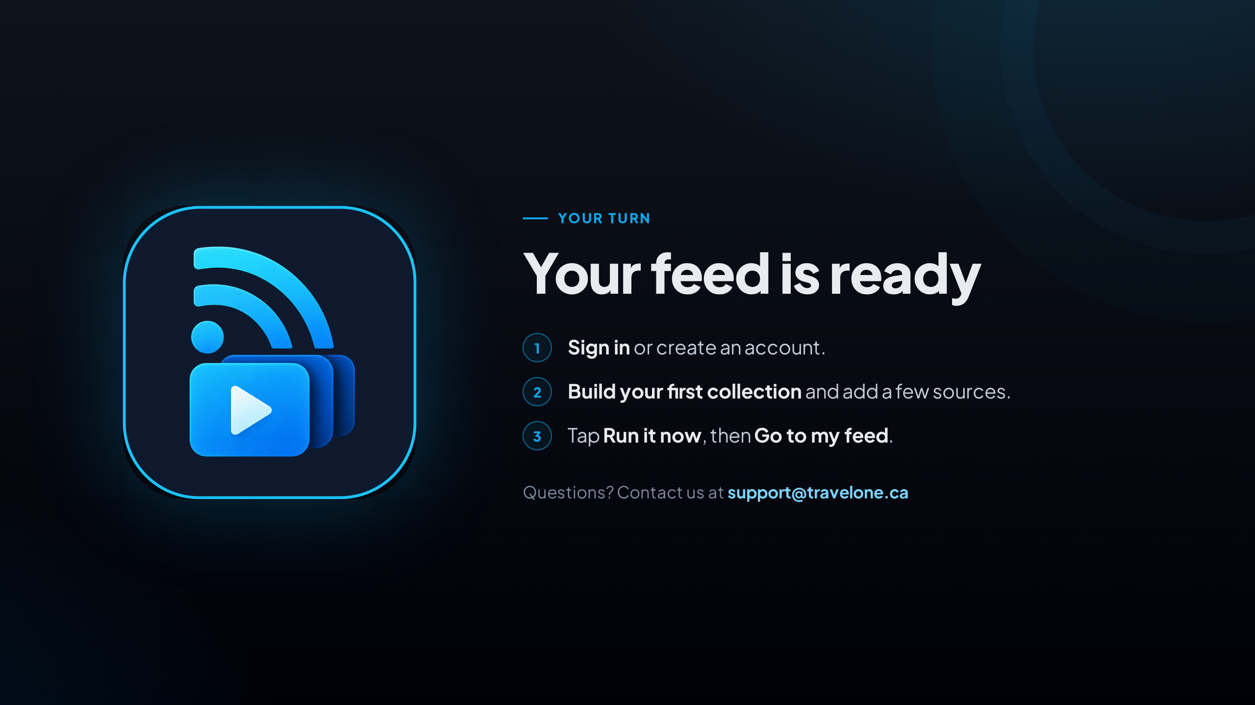
Notes:
That's it. Sign in, build your first collection, add a few sources, and run it now to fill your feed straight away.
After that it runs on its own every morning.
If you need help, write to support@travelone.ca.

