Slide 1



From Large Scale Image Categorization to Entry-Level Categories
Vicente Ordonez, Jia Deng, Yejin Choi, Alexander C. Berg, Tamara L. Berg
Notes:
Hi, my name is Vicente Ordóñez, this is joint work with Jia Deng, Yejin Choi, Alexander Berg and Tamara Berg. I’m presenting here our work on moving From Large Scale Image Categorization to Entry-Level Categories

Slide 2
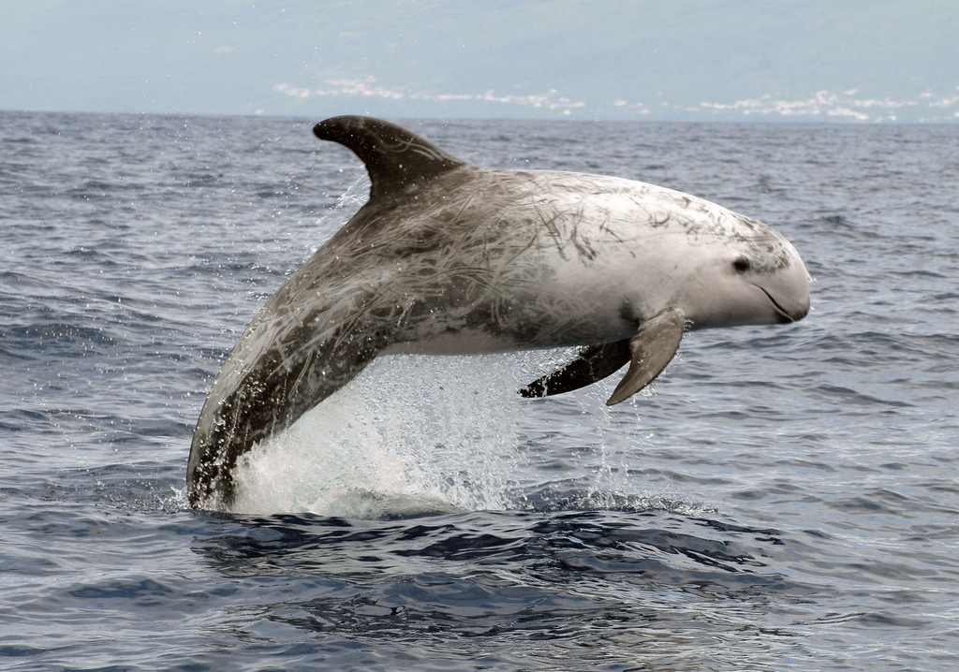
What would you call this?
Grampus griseus
Dolphin
Notes:
Let's try an experiment. [say in an excited way] I'm going to show you an image and then you should say out loud what object you think is depicted. [show pic] what would you call this? [pause] Well this species is actually a "grampus griseus", but I'll bet most of you were not thinking that. Most of you probably said **dolphin**!
Let's look at another example.

Slide 3
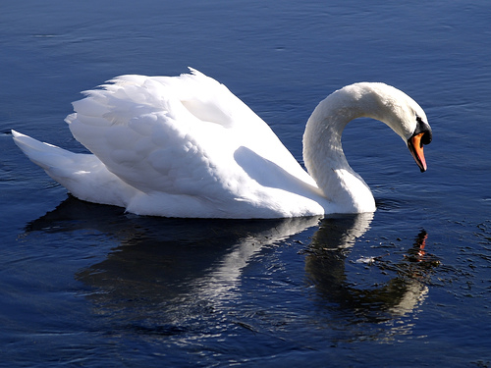
What would you call this?
Object
Organism
Animal
Chordate
Vertebrate
Bird
Aquatic bird
Swan
Whistling swan
Cygnus Colombianus
Notes:
What would you call this? Well actually, there are many correct answers, you could call it an animal, a vertebrate, a .... all are correct in some way, but we are more likely to say swan.
As recognition in computer vision scales, we consider distinguishing between more and more objects with more and more detail, and doing so as accurately as possible.

Slide 4
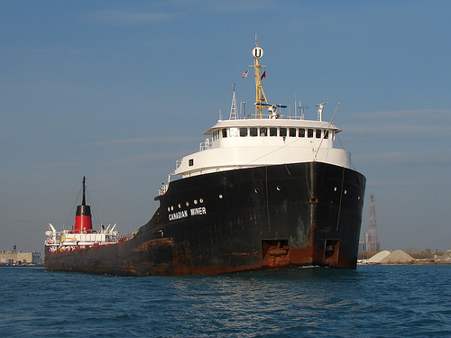
What would you call this?
Object
Artifact
Instrument
Transport
Vehicle
Craft
Vessel
Watercraft
Ship
Cargo vessel
Freighter
Notes:
What would you call this?
Again we are more likely to just say ship.

Slide 5

Naming Image Content
(0.80)
Grampus griseus
(0.83)
American black bear
(0.16)
Grizzly bear
(0.25)
King penguin
(0.11)
Cormorant
(0.56)
Homing pigeon
Vision
(0.26)
Ball-peen hammer
Naming
Grampus griseus
(0.06)
Spigot
(0.07)
Diskette, floppy
(0.06)
Steel arch bridge
(0.16)
Farmhouse
Pick the Best
(0.03)
Soapweed
Dolphin
(0.12)
Brazilian rosewood
(0.13)
Bristlecone pine
(0.04)
Cliffdiving
What Should I Call It?
Input Image
(0.19)
Crabapple
Thousands of Noisy Category Predictions
Notes:
We are thinking of recognition as this black box that outputs these thousands of noisy category predictions, usually we take the list of object category names from dictionaries or linguistic resources like wordnet, after we make the predictions we pick the best category, if we are lucky then we get the correct one like Grampus griseus. But we want to think more about the people and what they see. In this work we are interested in exploring this less studied part of the recognition problem -- how people name content in images. In particular we want to predict what people will call objects.
This is related to the notion of entry level categories from psychology...

Slide 6
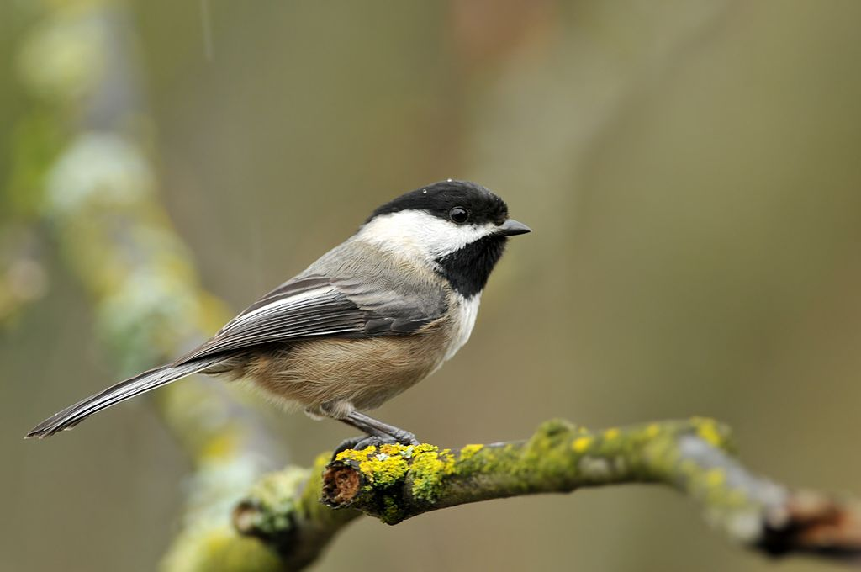
Entry-Level Category
The category that people are likely to name when presented with a depiction of an object.
Rosch et al, 1976
Jolicoeur, Gluck & Kosslyn, 1984
Superordinates: animal, vertebrate Entry Level: bird Subordinates: Black-capped chickadee
Notes:
An entry-level category can be simply defined as the category that people are likely to name when presented with a depiction of an object. Eleanor Rosch and collaborators in 1976 introduced the concept of basic object categories or basic level categories, which are the most abstract categories that we can easily recognize as a group. For instance we can easily identify birds but if we are asked to identify vertebrates, we would have a much harder time. [pause]
Latter, the work of Stephen Kosslyn and collaborators further refined these ideas by introducing the notion of typicality. If you have a bird like the one in this picture you would easily identify it as a bird.

Slide 7
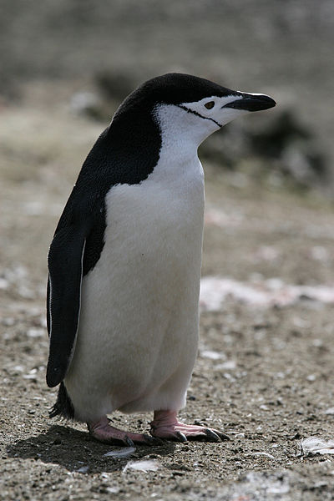
Entry-Level Category
The category that people are likely to name when presented with a depiction of an object.
Rosch et al, 1976
Jolicoeur, Gluck & Kosslyn, 1984
Superordinates: animal, bird Entry Level: penguin Subordinates: Chinstrap penguin
Notes:
But if I show you this other picture you will probably first identify it as a penguin. It would take you a little more effort to classify this one as a bird. This instance is distinctive enough that its entry-level category is lower in the semantic hierarchy-
Now, we had this question, how can we find entry-level categories automatically?

Slide 8
Is this hard?
wordnet hierarchy
Living thing
Bird
Plant, Flora
Seabird
Angiosperm
Bulbous Plant
Penguin
Cormorant
Flower
Narcissus
King penguin
Orchid
Daffodil
Frog Orchid
Daisy
Notes:
One might think that identifying entry level categories should be quite straightforward! After all, we have great linguistic resources like WordNet that puts a large number of nouns into a hierarchical structure.
One obvious algorithm would be to just start at a very specific detailed category and go up in the hiearchy until we find something that looks like an entry level category.
This doesn't always work for a number of reasons -- it's not obviously clear where in the hierarchy to stop because we might not know which categories are entry level for any particular detailed category.
Also the semantic hierarchy is not perfect and sometimes we do not find the entry-level category in the list of hypernyms.
How do we plan to approach this problem?

Slide 9
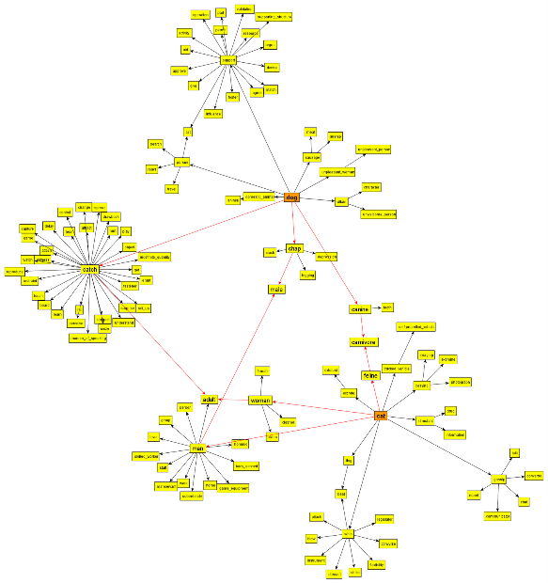
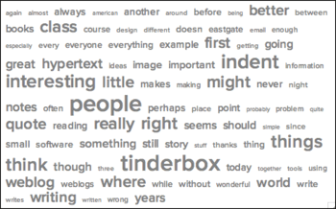
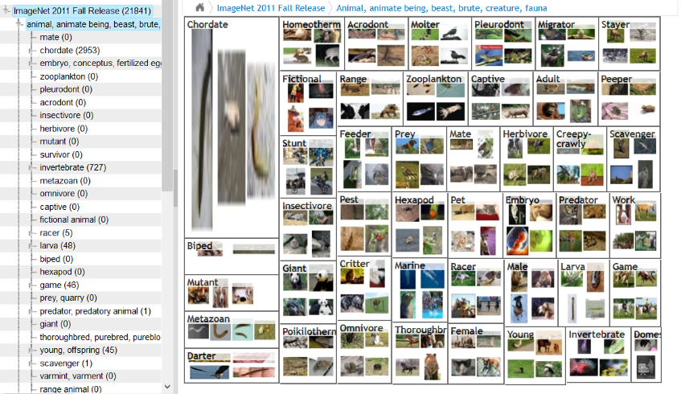
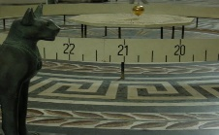
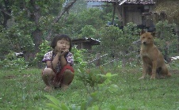

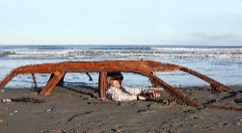
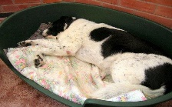
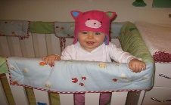
How will we do it?
Wordnet
Google Web 1T
Computer Vision
Linguistic resources
Lots of text
The Egyptian cat statue by the floor clock and perpetual motion
Little girl and her dog in northern Thailand. They both seemed.
Interior design of modern white and brown living room furniture hanging.
Imagenet
SBU Captioned Dataset
Man sits in a rusted car buried in the sand on Waitarere beach
Our dog Zoe in her bed
Emma in her hat looking super cute
Labeled Images
Lots of images with text
Notes:
Instead of explicitly interrogating people about what to call things, we will learn this by using Computer Vision and taking advantage of existing data including … linguistic resources like wordnet…. Large collections of labeled images like imagenet….. Large collections of text and text statistics like the Google Web 1T dataset and large collections of images with descriptions like the SBU Captioned dataset that contains a million image-caption pairs.
This will allow us to analyze the problem at a much larger scale than in the past.

Slide 10
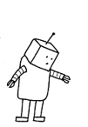

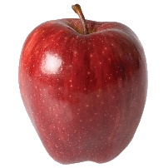
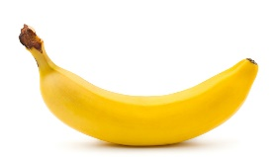
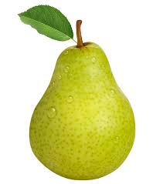
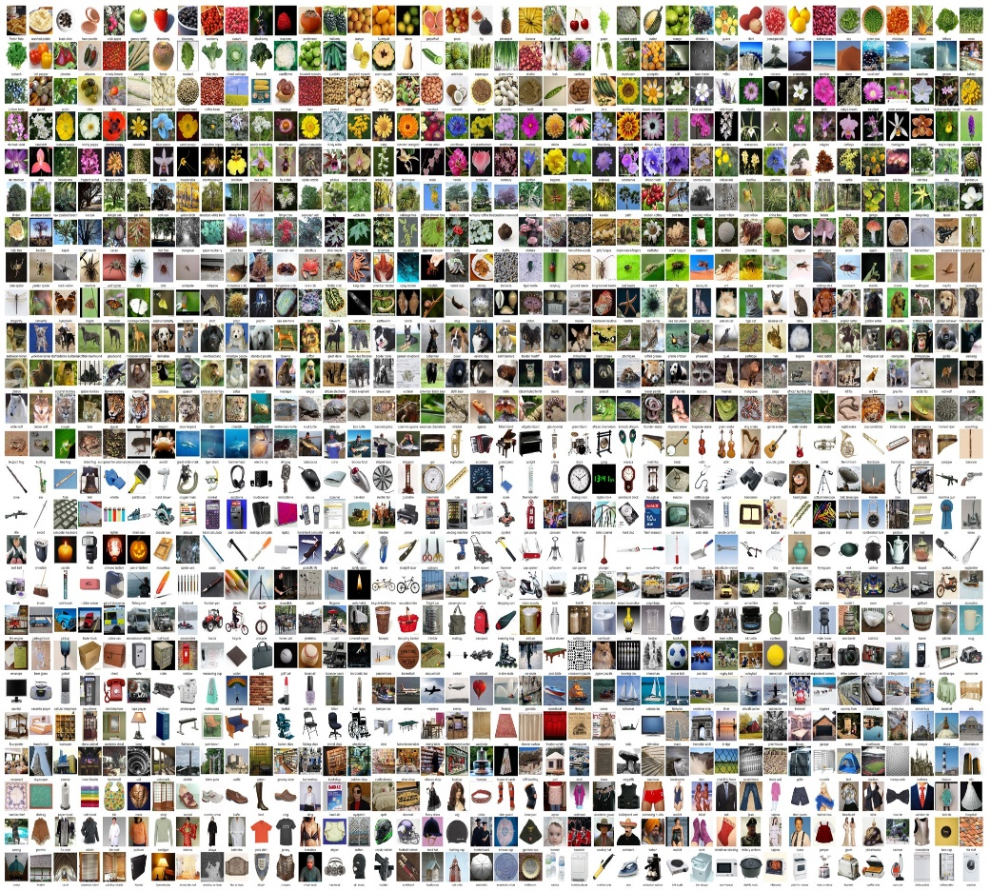
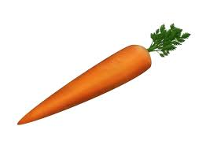
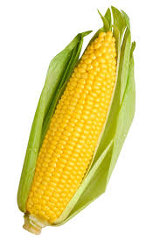
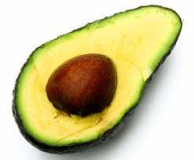
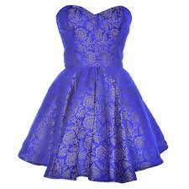
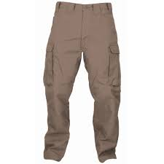
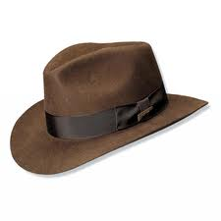
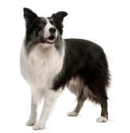
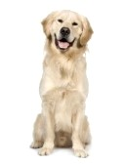
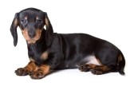
Scaling Naming Tasks!
48 categories
> 7000 categories
Notes:
The experiments performed by psychologist in the late 70’s and 80’s were limited in the number of categories. Using all the resources we have available today we are able to scale to predict entry-level categories for thousands of categories.
Let me present you the two tasks of our paper.

Slide 11




1. Goal: Category Translation
Detailed Category
What should I Call It? (Entry-Level Category)
Grampus griseus
dolphin
$$d$$
$$e$$
2. Goal: Content Naming
Input Image
What should I Call It? (Entry-Level Category)
dolphin
$$e$$
Notes:
Our first tasks involves translating a detailed category into an entry-level category. Our input here is just a concept like Grampus griseus and our output is dolphin.
Our second task involves pictures. Now we have a single picture and we output what would we call it.

Slide 12
1. Goal: Category Translation
Detailed Category
What should I Call It? (Entry-Level Category)
Grampus griseus
dolphin
$$d$$
$$e$$
2. Goal: Content Naming
Input Image
What should I Call It? (Entry-Level Category)
dolphin
$$e$$
Notes:
Let’s look at our first goal.

Slide 13

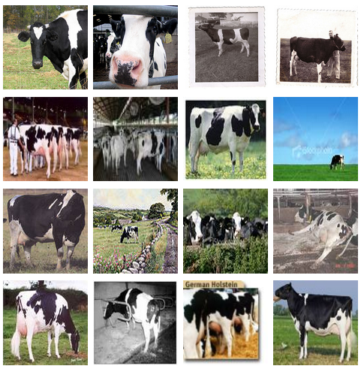
Category Translation by Humans
Friesian, Holstein, Holstein-Friesian
cow cattle pasture fence
Notes:
We first collected some ground-truth translations by using human experiments in the same spirit as those performed by the psychologists. We take a detailed category like “Holstein” from wordnet which is a type of cow and we show images from imagenet to Amazon Mechanical Turk users who had to name things.
Let me present our first automatic approach at this problem which uses text statistics as a proxy for how people name things.

Slide 14



1.1 Category Translation: Text-based
wordnet hierarchy
$$ψ(d, e)$$
$$φ(e)$$
Animal
656M
n-gram Frequency
366M
Bird
Mammal
15M
128M
Seabird
Cetacean
0.9M
Naturalness
Semantic Distance
Penguin
88M
Cormorant
1.2M
Whale
55M
30M
King penguin
22M
Dolphin
6.4M
Sperm whale
Grampus griseus
0.08M
$$τ\left(d,λ\right)=\underset{w}{argmax}{[φ\left(e\right)−λψ(d,e)]}$$
Notes:
In our text-based approach, we have detailed categories and we connect them to a hierarchical semantic structure from wordnet. Each category on the path to the root category is a candidate entry-level category. We might not want to go all the way to the root node because we might not want to be too general so we have a measure of semantic distance from the detailed category.
We also incorporate the frequency a category name is mentioned in text. This is our measure of “naturalness”. If they are mentioned more frequently we assume they are more likely to be an entry-level category. At the end we compute a tradeoff between semantic distance and text priors to obtain a translation.
Still we are limited here by the wordnet hierarchy so we have another approach that doesn’t use a hierarchy.

Slide 15
1.2 Category Translation: Image-based
Friesian, Holstein, Holstein-Friesian
(1.9071) cow (1.1851) orange_tree (0.6136) stall (0.5630) mushroom (0.3825) pasture (0.3156) sheep (0.3321) black_bear (0.3015) puppy (0.2409) pedestrian_bridge (0.2353) nest
Vision System
Notes:
This is similar to the experiments we run with humans but we have replaced the human with a vision system that learned categories from image descriptions. We again take a detailed category like “Holstein” from wordnet which is a type of cow and we show images to this vision system and computes a ranking of words using retrieval metrics of relevance like TFIDF.
Now let me show you some example translations.

Slide 16
Category Translation: Examples
HUMANS
TEXT BASED
IMAGE BASED
cactus wren | bird | bird | bird
buzzard, Buteo buteo | hawk | hawk | bird
whinchat, Saxicola rubetra | bird | chat | bird
Weimaraner | dog | dog | dog
numbat, banded anteater, anteater | anteater | anteater | cat
rhea, Rhea americana | ostrich | bird | grass
Europ. black grouse, heathfowl | bird | bird | duck
yellowbelly marmot, rockchuck | Squirrel | marmot | rock
Notes:
Here is a small comparison of the results of these three approaches. Sometimes both methods agree with the humans on the naming strategy. But each method has its own mistakes. The text-based approach wrongfully believes a whinchat is a type of “chat” because of the frequency of this word. The image-based approach believes the ostrich pictures are depicting the “grass” concept because of co-occurrence in the background

Slide 17
1. Goal: Category Translation
Detailed Category
What should I Call It? (Entry-Level Category)
Grampus griseus
dolphin
$$d$$
$$e$$
2. Goal: Content Naming
Input Image
What should I Call It? (Entry-Level Category)
dolphin
$$e$$
Notes:
Our second task involves pictures. Now we have a single picture for which we can run large scale image categorization and we want to translate this output to a an entry-level category or set of candidate entry-level categories.

Slide 18
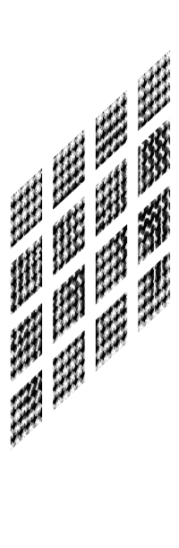



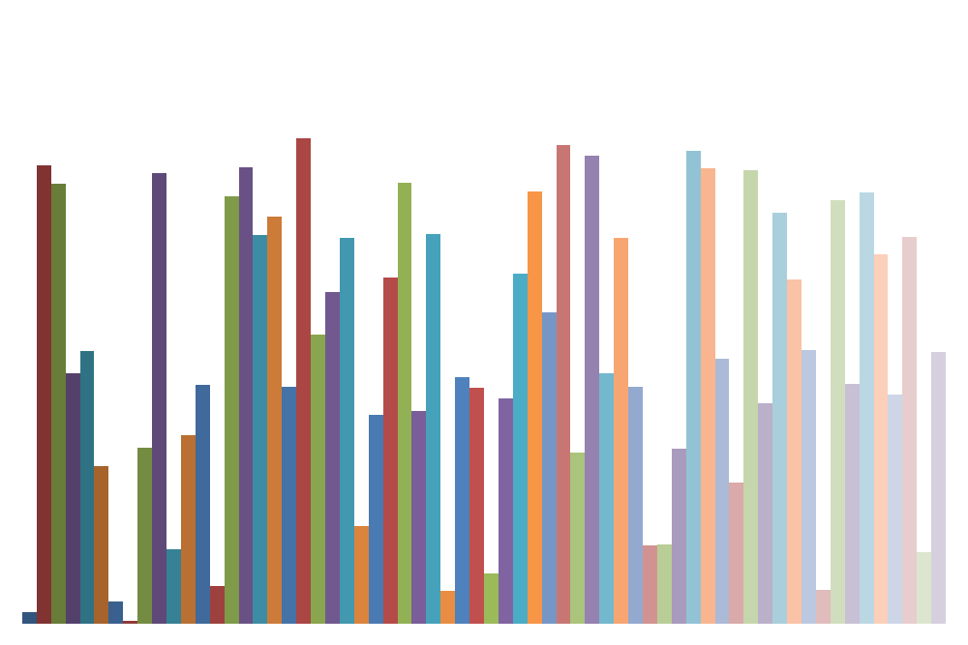
Large Scale Categorization
(0.80)
Grampus griseus
(0.41)
American black bear
(0.16)
Grizzly bear
(0.25)
King penguin
(0.11)
Cormorant
(0.56)
Homing pigeon
Flat Classifiers
(0.26)
Ball-peen hammer
(0.06)
Spigot
(0.07)
Diskette, floppy
(0.06)
Steel arch bridge
(0.16)
Farmhouse
(0.03)
Soapweed
(0.12)
Brazilian rosewood
(0.13)
Bristlecone pine
Selective Search Windows. van De Sande et al. ICCV 2011
Local descriptors
Coding
(LLC), Wang et al. CVPR 2010
Spatial pooling
(0.04)
Cliffdiving
(0.19)
Crabapple
Notes:
This is how a typical large scale image categorization system looks like. We have an input image, we compute some features, encode those features, do some spatial pooling, we run a learning algorithm and we output a likelihood for a large set of detailed categories. We use more than 7000 detailed categories.
In our first method we use those predictions as leaf nodes in a hierarchy.

Slide 19





2.1 Propagated Visual Estimates
$$f(v, I)$$
-$\tilde{ψ}(v)$
$$φ(v)$$
656M
Animal
(1.0)
366M
Bird
(0.2)
15M
Mammal
(0.8)
128M
Seabird
(0.2)
0.9M
Cetacean
(0.8)
(0.05)
Naturalness
(0.15)
55M
Whale
(0.8)
Accuracy
Specificity
88M
Penguin
1.2M
Cormorant
22M
King penguin
(0.15)
30M
Dolphin
(0.6)
6.4M
Sperm whale
(0.2)
0.08M
Grampus griseus
(0.6)
Deng et al. CVPR 2012
Our work
$$f_{nat}\left(v,I, \tilde{λ}\right)=f(v, I){[φ\left(v\right)−\tilde{λ}\tilde{ψ}(v)\text{]} }$$
$$f\left(v,I, \tilde{λ}\right)=f(v, I){[−\tilde{ψ}\left(v\right)\text{+}\tilde{λ}\text{]} }$$
Notes:
We then propagate the likelihoods up in this hierarchy, so when we predict a more general category we are more likely to be right (If you label everything as animal and all your images are of animals then you are always right.). On the other hand we have a notion of specificity. In CVPR 2012 Deng et al presented a technique for trading off specificity and accuracy. Here we are adding this idea of naturalness to connect with what people actually say. Unlike the accuracy the naturalness scores are non-monotonic and they tend to bias our predictions to things that are more likely to be entry-level categories or as I mentioned, categories that people seem to be more likely to name.
Our second approach does not use a hierarchy.

Slide 20

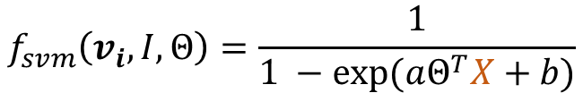
2.2 Supervised Learning
(0.80)
Grampus griseus
training from weak annotations
(0.41)
American black bear
SBU Captioned Photo Dataset
1 million captioned images!
(0.16)
Grizzly bear
(0.25)
King penguin
(0.11)
Cormorant
Bear
(0.56)
Homing pigeon
Dog
(0.26)
Ball-peen hammer
$$X=$$
Building
(0.06)
Spigot
(0.07)
House
Diskette, floppy
(0.06)
Steel arch bridge
Bird
(0.16)
Farmhouse
Penguin
(0.03)
Soapweed
Tree
(0.12)
Brazilian rosewood
Palm tree
(0.13)
Bristlecone pine
(0.04)
Cliffdiving
$$f_{svm}\left(v_{i},I, Θ\right)=\frac{1}{1 −exp⁡(aΘ^{T}X+b)}$$
(0.19)
Crabapple
Notes:
We use our noisy predictions of detailed categories as a feature vector to learn weights between detailed categories and entry level categories. We learn those relationships from a large scale dataset of images and descriptions. We use the SBU Captioned photo dataset which contains a million images and descriptions to learn this models and defining the vocabulary of entry-level categories. We use the most frequent nouns of what people actually mention in image descriptions to define this vocabulary.
We can look at the weights for some of these models.

Slide 21
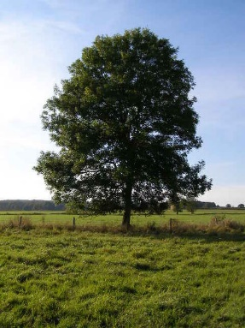
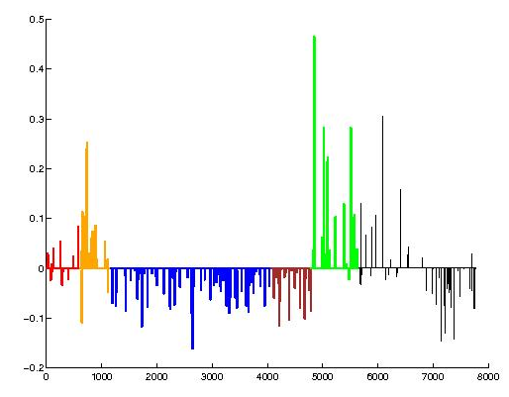
Extracting Meaning from Data
Weights learned to recognize images with “tree” in caption
snag shade tree bracket fungus, shelf fungus bristlecone pine, Rocky Mountain bristlecone pine, Pinus aristata Brazilian rosewood, caviuna wood, jacaranda, Dalbergia nigra redheaded woodpecker, redhead, Melanerpes erythrocephalus redbud, Cercis canadensis mangrove, Rhizophora mangle chiton, coat-of-mail shell, sea cradle, polyplacophore crab apple, crabapple papaya, papaia, pawpaw, papaya tree, melon tree, Carica papaya frogmouth
Mammals
Birds
Instruments
Structures
Plants
Other
Notes:
On the left side I’m showing the weights that we learned grouped in 6 categories. On the right side we are showing the detailed concepts with the largest positive weights. We can see here that there are a lot of detailed categories regarding trees and vegetation and some birds.

Slide 22
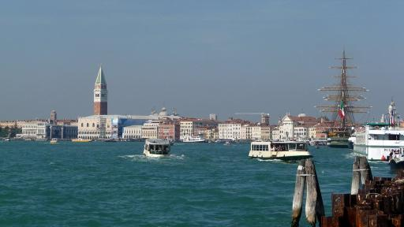
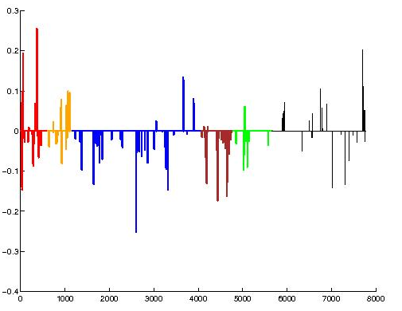
Extracting Meaning from Data
Weights learned to recognize images with “water” in caption
water dog surfing, surfboarding, surfriding manatee, Trichechus manatus punt dip, plunge cliff diving fly-fishing sockeye, sockeye salmon, red salmon, blueback salmon, Oncorhynchus nerka sea otter, Enhydra lutris American coot, marsh hen, mud hen, water hen, Fulica americana booby canal boat, narrow boat, narrowboat
Mammals
Birds
Instruments
Structures
Plants
Other
Notes:
For some words like water we rely on several aquatic mammals, birds, aquatic vehicles and sea activities like surfing.
Let’s look at some results.

Slide 23
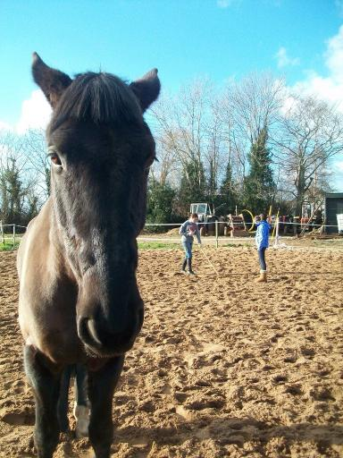
Results: Content Naming
Human Labels | Flat Classifier | Deng et al. CVPR’12 | Propagated Visual Estimates | Supervised Learning | Joint
farm, fence field horse, mule kite, dirt people tree, zoo | gelding yearling shire yearling draft | horse equine perissodactyl ungulate male | horse tree equine male gelding | horse pasture field cow fence | horse pasture field cow fence
Notes:
Here are some qualitative results of our approach compared to a flat classifier, the hierarchical classifer of Deng et al, our two methods and a joint approach. For instance the flat classifier outputs very specialized horse related words like yearling or gelding, the hierarchical classifiers outputs sometimes too abstract terms like equine or ungulate, while our methods favor more commong words like horse, tree, pasture, fence, field or even prefers to make some wrong guesses like cow.

Slide 24
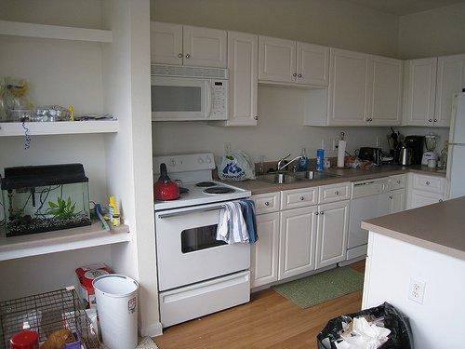
Results: Content Naming
Human Labels | Flat Classifier | Deng et al. CVPR’12 | Propagated Visual Estimates | Supervised Learning | Joint
bucket, cabinet counter, dish, floor, kitchen, microwave, oven, range, rug, shelf, sink stove, tank, teapot, trash, trashcan | microwave console gas freezer electric | microwave kitchen home durable appliance | microwave kitchen appliance good home | counter stove sink cabinet room | microwave room console counter stove
Notes:
Here we have an indoor scene where there are a lot of objects so people mention a lot of things, our methods successfully retrieves more human-like content.

Slide 25
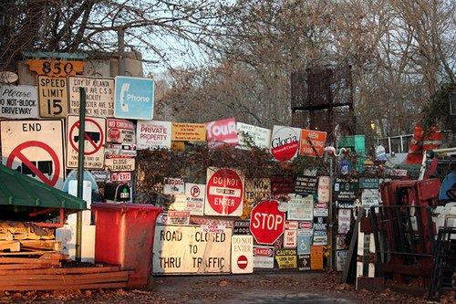
Results: Content Naming
Human Labels | Flat Classifier | Deng et al. CVPR’12 | Propagated Visual Estimates | Supervised Learning | Joint
fence, junk sign stop sign street sign trash can tree | feeder Hyla cleaner box large | woody tree structure plant vascular | tree structure building plant area | logo street neighborhood building office building | logo street neighborhood building office
Notes:
Even when we don’t get any coincidences with human namings for some images we still get more human-like guesses.

Slide 26
Evaluation: Content Naming
Notes:
Here are some quantitative results, we show in blue precision and in orange recall for a task that involves predicting what people said about a group of pictures. We have two test sets, one with random images and another with images with high confidence prediction scores. Our methods outperform both flat classification and hierarchical classification.

Slide 27
Conclusions/Future Work
We explored different models for content naming in images.
Results can be used to improve the larger goal of generating human-like image descriptions.
Go beyond nouns and infer other type of abstractions on action and attribute words.
Notes:
We explored different models for content naming in images.

Slide 28
Questions?

