Slide 1
BooksBuy
By-
Gauri Kirve
Abhishek Vichare
Shantanu Kulkarni

Slide 2
INTRODUCTION
Internet is rapidest growing area in past few decades. Especially online shopping is rapidly growing e-commerce area.
BooksBuy Project is a Web Based Online e-commerce Shopping Project.
Functionalities
User Forms
Different books categories
Keyword Search
Shopping Cart
Two Major Actors of the system :
Admin
User(Customers)

Slide 3
ADMIN
Admin:
Controls, Monitors and keep the whole records.
Main Functionalities:
Add/Delete Categories
Add/update/Delete Books Records
Check queries from users, if have any

Slide 4
USER
Who is User?
The person who want to purchase any book.
Main Functionalities:
User Registration
User Login
Contact Admin
Search a Book
Add to Cart a book

Slide 5
TECHNOLOGIES USED
HTML
CSS
JavaScript
PHP
MYSQL

Slide 6
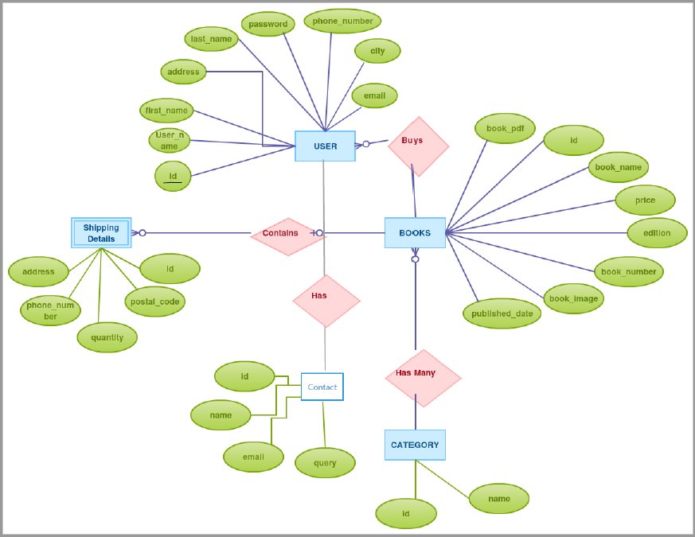
ER DIAGRAM

Slide 7
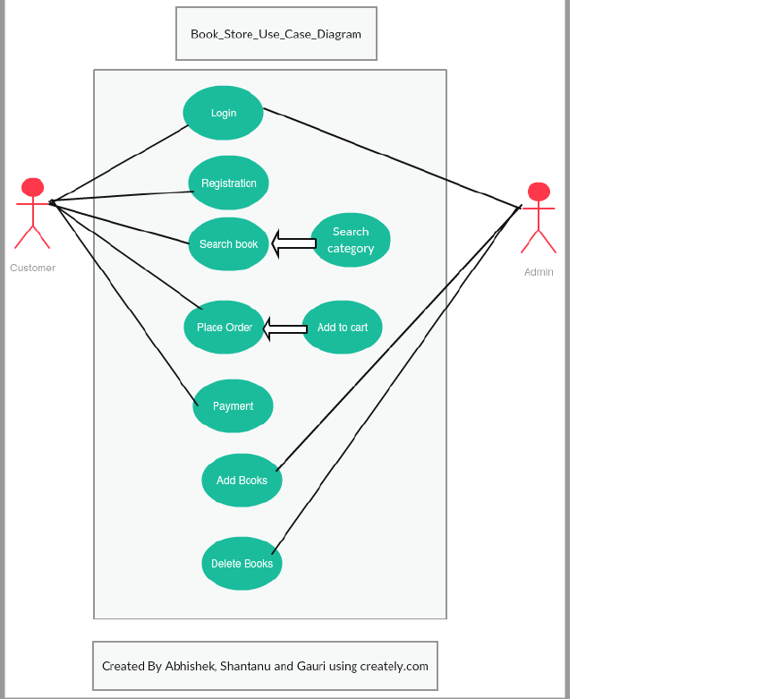
USE CASE

Slide 8
LIVE DEMO

