Slide 1

Dynamic Adaptive of Ransomeware Defensive Profile Using Attack-Defense framework
Royal University of Phnom Penh
Faculty of Engineering
Student Pann Vichhka
Advior Na Sambathchatovong

Slide 2
Outline
Introduction
Objective
Methodology
Expected Result
Current Project Progress

Slide 3
Introduction
Ransomware vectors are nearly impossible to close
Phishing emails 70%
email attachments 54%
users visiting malicious and compromised website 41%
Most of ransomware gangs used MITRE ATT&CK framework as technique for build weaponize or kill chain
Ransomware-as-a-service innovations always change or cover their path based on that framework
Cyber security practitioner are often puzzled how to cope with ransomware attacks when it occurs

Slide 4
Objective
Build up an attack-defense framework by mapping MITRE ATT&CK Framework to NIST Cybersecurity Framework
To experiment defensive approach by identify ransomware gangs techniques based on MITRE ATT&CK Matrix and provide a defensive solution
To customize ransomware defensive profile dynamically
To minimize gap of ransomware attacks using a customize ransomware defensive profile

Slide 5
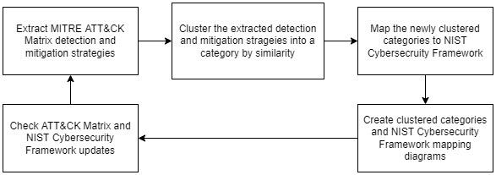
Methodology
From MITRE ATT&CK Matrix to NIST Cybersecurity Framework

Slide 6

Methodology
Usage of attack-defense framework in build up a ransomware defensive profile

Slide 7
Expected Result
To Complete framework diagram
Usable in preactive for assist risk analysis and cyber risk assessment
From techniques attack to cyber risk questionnaires

Slide 8
Current Progress
Mapping MITRE ATT&CK Matrix to NIST Cybersecurity Framework ( Done 50%)
Experiment on Wannary Ransomware by build up its defensive profile

Slide 9
Reference
Why Do Ransomware Attacks Keep Happening? https://www.coresecurity.com/blog/why-do-ransomware-attacks-keep-happening
How to Use the MITRE ATT&CK Framework to Fight Ransomware Attacks https://www.cyberark.com/resources/blog/how-to-use-the-mitre-att-ck-framework-to-fight-ransomware-attacks
R. Kwon, T. Ashley, J. Castleberry, P. Mckenzie and S. N. Gupta Gourisetti, "Cyber Threat Dictionary Using MITRE ATT&CK Matrix and NIST Cybersecurity Framework Mapping," 2020 Resilience Week (RWS), 2020, pp. 106-112, doi: 10.1109/RWS50334.2020.9241271.
S. Boudko and H. Abie, "Adaptive Cybersecurity Framework for Healthcare Internet of Things," 2019 13th International Symposium on Medical Information and Communication Technology (ISMICT), 2019, pp. 1-6, doi: 10.1109/ISMICT.2019.8743905.
N. Teodoro, L. Gonçalves and C. Serrão, "NIST CyberSecurity Framework Compliance: A Generic Model for Dynamic Assessment and Predictive Requirements," 2015 IEEE Trustcom/BigDataSE/ISPA, 2015, pp. 418-425, doi: 10.1109/Trustcom.2015.402.
Barker, W., Scarfone, K., Fisher, W., & Souppaya, M. (2021). Cybersecurity Framework Profile for Ransomware Risk Management (No. NIST Internal or Interagency Report (NISTIR) 8374 (Draft)). National Institute of Standards and Technology.
Mesker, K., Engineer, I. C., & Chevron, E. T. C. (2014, October). Adapting NIST Cybersecurity Framework for Risk Assessment. In NIST Conference.

Slide 10
To be continued…

