Slide 1
AD 358
TORUK MACTO

Slide 2
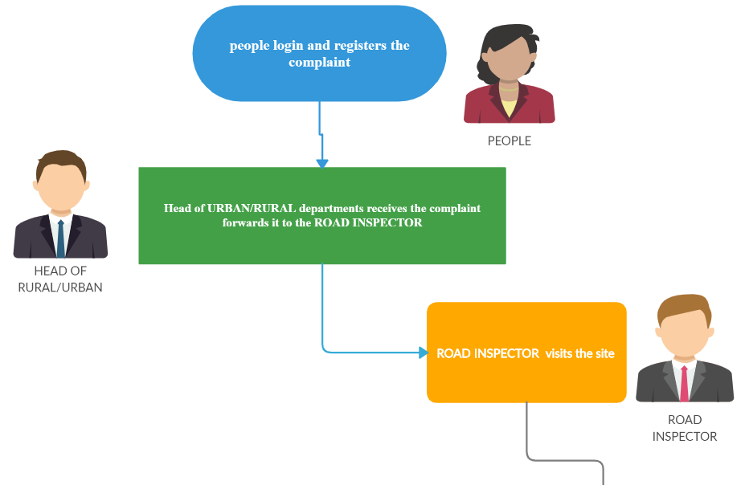
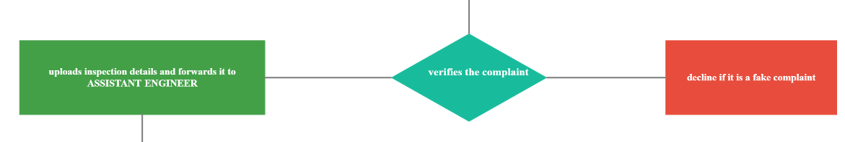

Slide 3
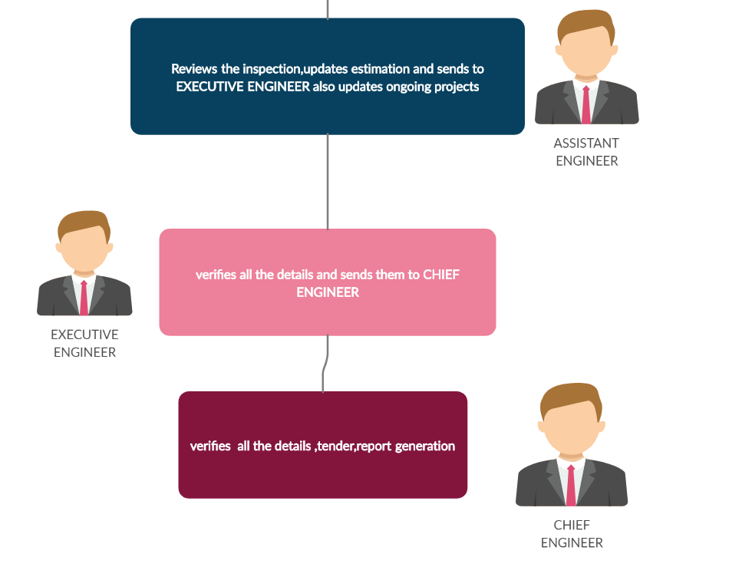

Slide 4
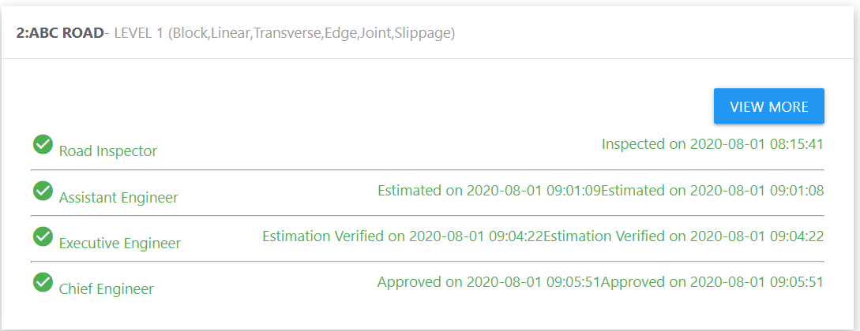
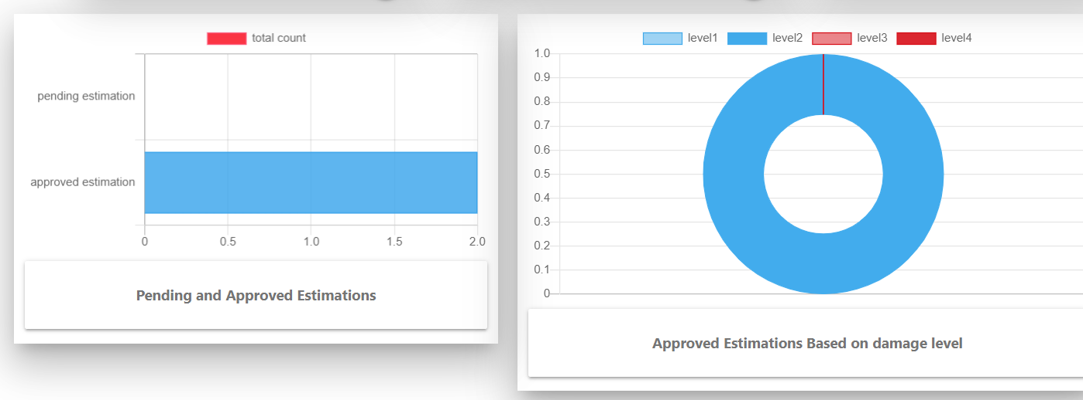
SPEACIAL FEATURES WE HAVE ADDED ;-
COMPLAINT TRACKING SYSTEM
DETAILS ANALYTICS

Slide 5
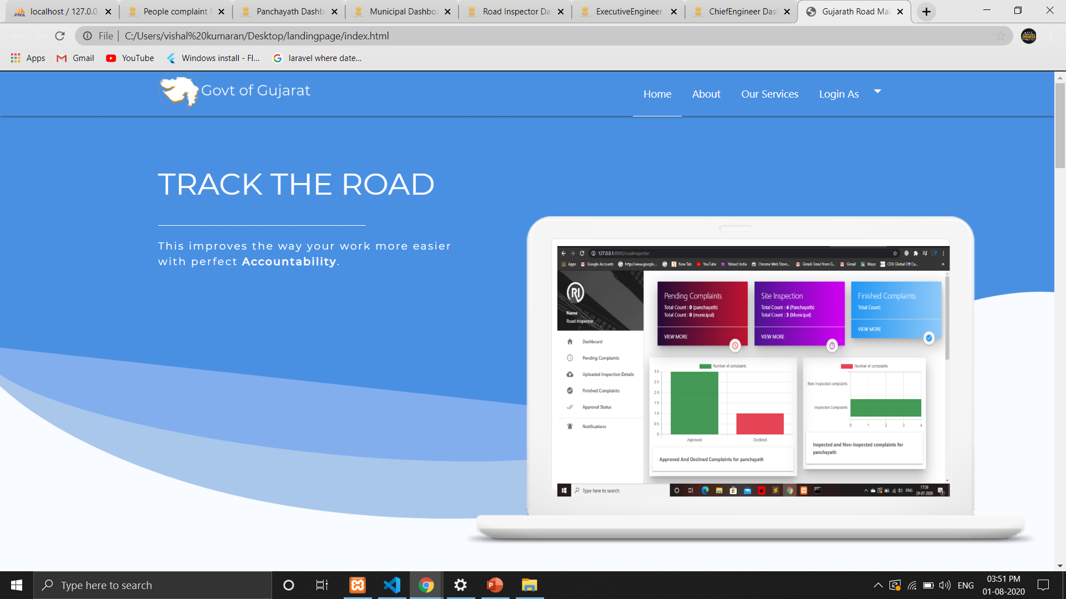
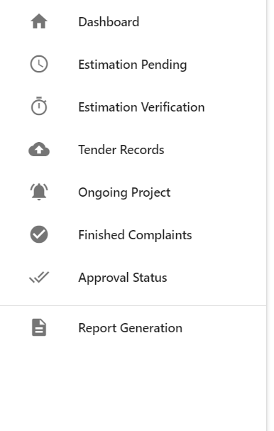
INTERACTIVE UI & DASHBOARD

