Slide 1

FinTok
Trade with Intelligence

Slide 2
What is FinTok? 🤔
FinTok is an open-source, DeFi, Trading Robot.
Using Machine Learning, FinTok aims to empower the average DeFi user with market leading strategies, giving them a higher yield on assets.
FinTok utilizes Open Zeppelin's audited Staking Contracts enabling users to deposit ETH or USDC for trading.
Users can then withdraw staked assets with added rewards.

Slide 3
Core Features
🌍 World’s First Decentralised Trading Robot.
📈 Dedicated Trading Agent, Customisable by user.
📜 Custom Contract Runner.
🧱 App is compatible with all EVM supported chains, deployed on Sepolia.

Slide 4
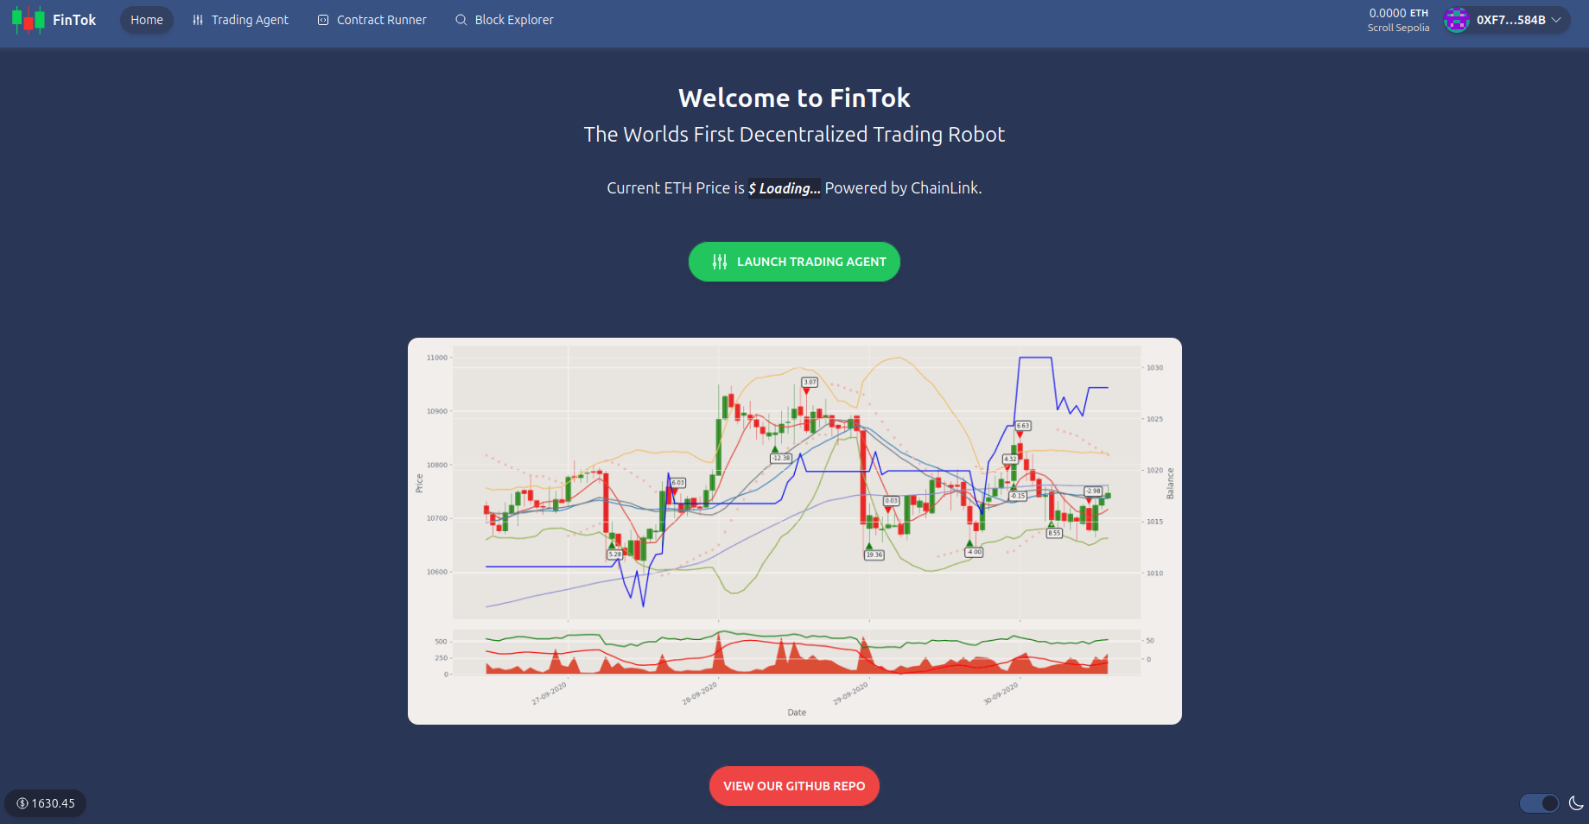
Home Page
Features Include:
ChainLink Price Feed
Launch Trading Agent
Open-Source GitHub Codebase
Multi-chain Wallet Integration

Slide 5
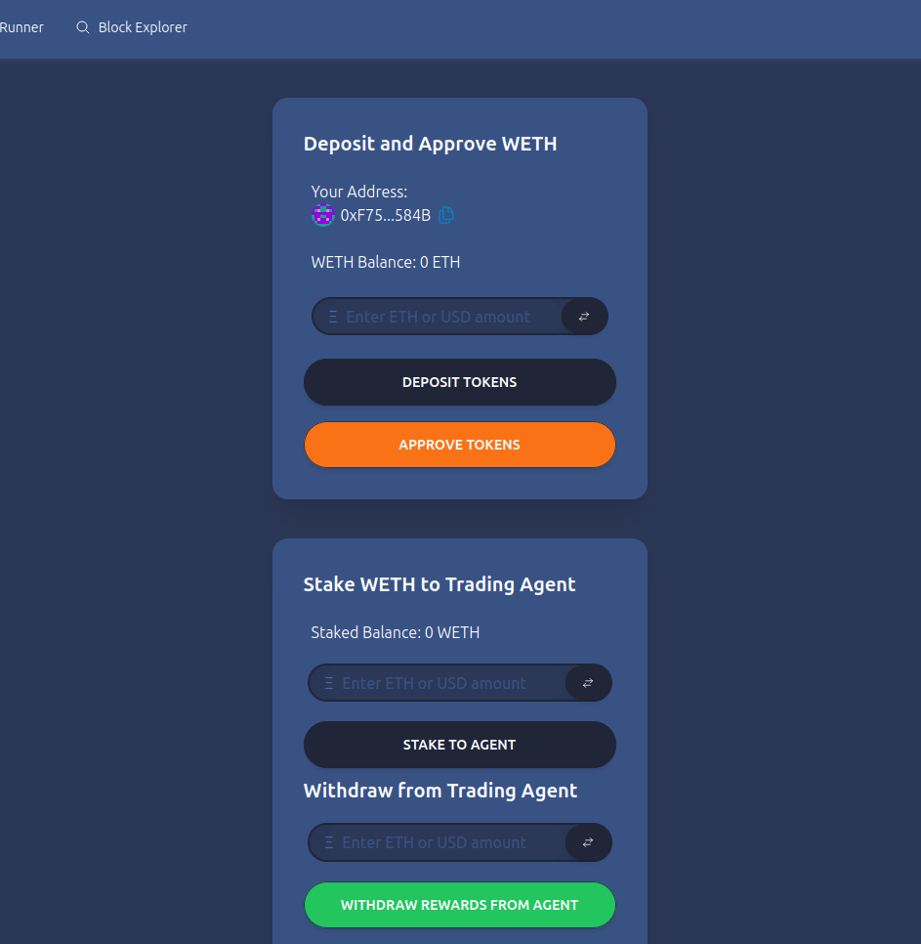
Trading Agent
How to use:
Deposit and Approve WETH
Stake WETH to Trading Agent
Profit
Withdraw from Trading Agent
Note: Historical data fetched from Bitfinex

Slide 6
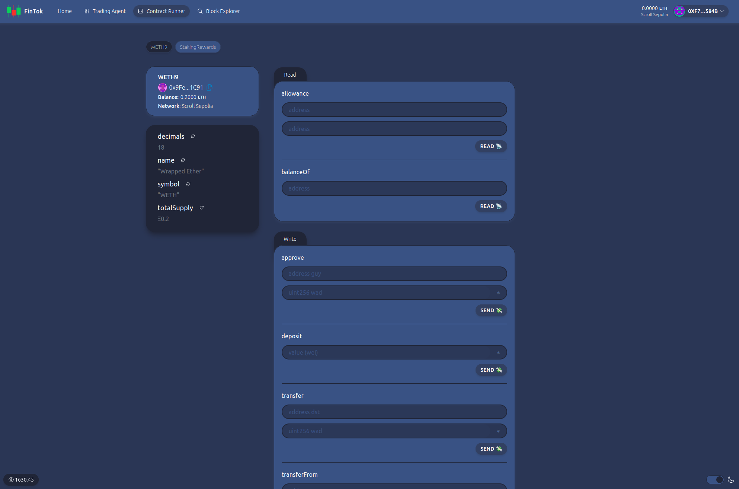
Contract Runner

Slide 7
Features for Developers
✅ Contract Hot Reload: Your frontend auto-adapts to your smart contract as you edit it.
🔥 Burner Wallet & Local Faucet: Quickly test your application with a burner wallet and local faucet or test with any live or testnet EVM chain.

Slide 8
Reinforcement Learning
Actor and Critic model
Reinforcement Learning
How it works:
Model -> Actor/Critic Model
Learn -> Environment and agent to test up to 5 years of data for actor and critic.
Python Processing.
Update
Deploy and use

Slide 9
Next Steps
Improve model so it can fully utilise up to five years of historical data
Train and test model with better hardware
Decrease reinforcement agent learning time
Integrate more ERC20 token pairs
Deploy on Mainnet

Slide 10
Thank you 🤗
Thank you for listening, please let us know if you have any feedback!

