Slide 1
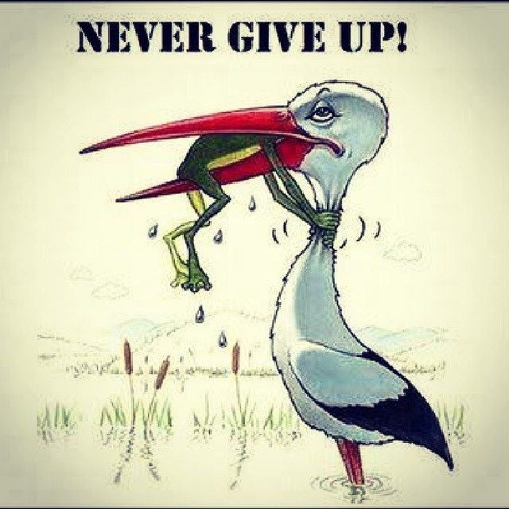

Slide 2
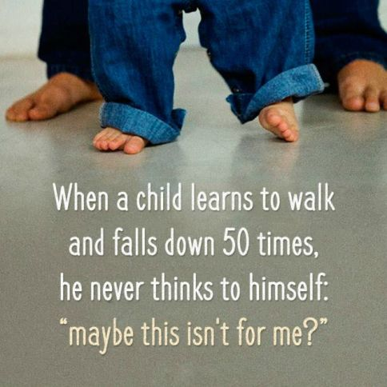
Its not about how many times you get knocked out but about how many times you get up

Slide 3
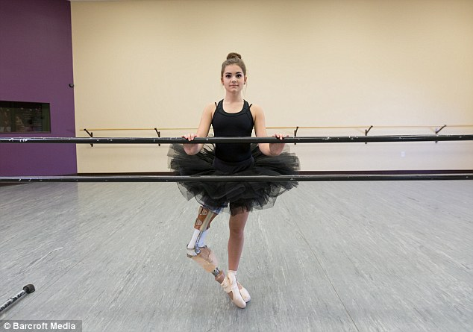
We can achieve anything we want but the matter is how badly we want that

Slide 4

Things are hard only if you don’t want to do it

Slide 5


