Slide 1

Agentic BI Analyst
Governed natural-language analytics and a multi-agent cross-business review for banking: a data science lab, installation, results and a full build walkthrough
LangGraph · Claude · DuckDB · Streamlit
Ahmad Zulfikar Rafsanjani · github.com/vickarzz/agentic-bi-analyst
Notes:
Portfolio project. Wadi Bank is fictional and all data is synthetic.

Slide 2


Why: SQL-writing chatbots aren't safe in a bank
Typical text-to-SQL chatbot
This project
Same question, different numbers
One governed semantic layer: every metric defined once, with an owner
Hallucinated joins and double counting
Deterministic compiler; multi-fact questions use CTEs (no fan-out)
Personal data leaks (names, phones)
Three guardrail layers plus small-cell suppression
No way to prove answers are right
Golden-question evals against independent SQL, run in CI
Narratives invent figures
Every number in the summary is computed from the result

Slide 3




The project at a glance
15
8
94
100%
governed metrics
agents running in parallel
automated tests
golden-question accuracy (28 cases)
What it does: a manager types a question ("Which region has the highest NPF ratio?"). A LangGraph agent turns it into a structured plan that may only use governed metrics. A compiler writes safe SQL, DuckDB runs it, and the app shows the answer, a chart, the SQL, the plan and an audit trace. A second mode runs a team of agents that reviews the whole bank and tests how each business line affects the others.
Data: "Wadi Bank", a fictional Saudi retail bank: 20,000 customers, ~560k transactions, ~5.4k Murabaha/Ijarah contracts, ~174k remittances. 100% synthetic.

Slide 4





Architecture: AI decides what, governed code decides how
Question
Input guard
Planner
Validate
Compile SQL
SQL guard
DuckDB
self-correction: errors fed back (max 3 tries)
Answer
Verified facts + chart
Small-cell suppression
Summary · chart · table · SQL · plan · trace
Numbers computed from the result
Groups under 10 customers masked
Blocked, unclear or unsafe requests exit early with a refusal or a clarifying question.

Slide 5




Tech stack and why each piece was chosen
Python 3.11+
DuckDB
One language for data generation, agent, UI and tests
In-process analytical SQL; no server; patterns transfer to Snowflake, Oracle, Impala
LangGraph
Claude (Anthropic SDK)
The agent as an explicit, testable state machine with bounded retries
Forced tool use with an enum schema returns reliable structured plans
Streamlit + Plotly
pytest + GitHub Actions
A usable chat UI in pure Python; free hosting on Streamlit Cloud
Tests and golden-question evals gate every push

Slide 6
Part 1 · Installation
From the zip file to a running app in about five minutes

Slide 7


Before you start
Python 3.11 or newer
Git
Anthropic API key (optional)
python.org/downloads. On Windows, tick "Add python.exe to PATH" during setup.
git-scm.com. Needed to push the project to GitHub.
Only for the Claude planner. Without it the app runs fully offline.
Check: python --version
Check: git --version
console.anthropic.com
Time needed: ~5 minutes to install, ~5 seconds to generate data. Disk: ~150 MB including libraries.
Tip: use VS Code with its built-in terminal (Terminal → New Terminal) so you can edit and run in one window.

Slide 8
Install in five steps
1
Unzip and open a terminal
cd agentic-bi-analyst
Extract agentic-bi-analyst-v1.zip, then open a terminal inside the agentic-bi-analyst folder.
2
Create a virtual environment
python -m venv .venv
Keeps the project's libraries separate from the rest of your machine.
3
Activate it
Windows: .venv\Scripts\activate
Mac/Linux: source .venv/bin/activate
Your prompt will start with (.venv) when it worked.
4
Install libraries
pip install -r requirements.txt
DuckDB, pandas, LangGraph, Anthropic SDK, Streamlit, Plotly, pytest.
5
Generate the synthetic bank
python scripts/generate_data.py
Builds data/wadi_bank.duckdb with ~900k rows in about 5 seconds.

Slide 9

Three ways to run it
Chat app
Command line
Quality checks
streamlit run app/streamlit_app.py
python -m bi_agent.cli \
--show-sql \
"NPF ratio by segment"
python -m bi_agent.cli
python -m pytest -q
python evals/run_evals.py
Opens http://localhost:8501. Click a sample question in the sidebar or type your own. Stop with Ctrl + C.
One question, or interactive mode with follow-ups ("now by region"). Add --trace to see each agent step.
94 tests should pass. The eval writes evals/report.md. make review runs the multi-agent business review.

Slide 10
Optional: switch the planner to Claude
# Windows (PowerShell)
$env:ANTHROPIC_API_KEY="sk-ant-..."
# Mac / Linux
export ANTHROPIC_API_KEY="sk-ant-..."
streamlit run app/streamlit_app.py
python evals/run_evals.py --planner llm
Variable | What it does
ANTHROPIC_API_KEY | Turns on the Claude planner and summaries
BI_AGENT_PLANNER | auto (default) · llm · rules
BI_AGENT_MODEL | Claude model ID (default claude-sonnet-5-5)
BI_AGENT_DB | Path to the DuckDB file
If Claude fails (no network, wrong key, quota), the agent falls back to the offline planner automatically and notes it in the trace. Set a spending limit on any key used in a public demo.
How to confirm it worked: the header pill in the app changes from "Planner: offline rules" to "Planner: Claude (model name)", and the Trace tab shows "via llm".

Slide 11
Part 2 · What the results look like
Mockups built from real output of the app (numbers are from the synthetic dataset)

Slide 12
Mockup: a trend question answered with a chart
agentic-bi-analyst.streamlit.app
What you see
Try a question
Agentic BI Analyst
Header pills show the planner mode, data date and metric count
The summary is built from computed facts; rates change in percentage points
Plotly line chart (interactive in the real app)
Tabs: Table, SQL, Plan and Trace for full auditability
The sidebar holds sample questions, the metric glossary and governance rules
Monthly digital adoption
Planner: offline rules
Data as of 2026-09-30
15 governed metrics
Highest NPF region
U
Monthly digital adoption rate over the last 12 months
Top 3 corridors 2026
AI
Latest month (Sep 2026): 75.4%. Change vs previous month: +0.9 pts. Change since Oct 2025: +9.2 pts.
Saudi vs expat volume
Murabaha by region
Phone numbers (blocked)
Metric glossary ›
Governance rules ›
Table
SQL
Plan
Trace

Slide 13
Mockup: rankings and breakdowns
agentic-bi-analyst.streamlit.app
agentic-bi-analyst.streamlit.app
U
Which region has the highest NPF ratio?
U
Top 3 corridors by remittance volume in 2026
AI
Highest NPF ratio (90+ DPD): Northern at 5.0%. Lowest: Southern at 2.7%. Northern is 1.9x Southern.
AI
Highest: India at SAR 28.88M. Lowest of the top 3: Pakistan at SAR 18.66M.
Table
SQL
Plan
Trace
Table
SQL
Plan
Trace

Slide 14
Mockup: SQL and Trace tabs make answers auditable
agentic-bi-analyst.streamlit.app
agentic-bi-analyst.streamlit.app
Table
SQL
Plan
Trace
Table
SQL
Plan
Trace
SELECT
r.corridor AS corridor,
SUM(r.amount_sar) AS remittance_volume,
COUNT(DISTINCT r.customer_id)
AS __n_remittances
FROM fact_remittance r
WHERE CAST(r.remittance_date AS DATE)
>= '2026-01-01'
AND CAST(r.remittance_date AS DATE)
<= '2026-09-30'
GROUP BY ALL
ORDER BY remittance_volume DESC
LIMIT 3
Step | ms | Detail
guard_input | 1.6 | passed
plan | 14.1 | attempt 1 via rules
validate | 0.0 | ok
compile | 0.0 | 10 lines, 2 parameters
check_sql | 0.9 | read-only, allow-listed, no PII
execute | 30.5 | 12 rows; 0 suppressed
explain | 2.4 | 4 verified facts
respond | 0.0 | ok
The SQL is generated by the compiler; filter values are bound as parameters (shown inline for display). The __n column counts customers for small-cell suppression and is removed before display.

Slide 15



Mockup: governance in action
agentic-bi-analyst.streamlit.app
agentic-bi-analyst.streamlit.app
agentic-bi-analyst.streamlit.app
You
You
You
Give me the phone numbers of affluent customers
Churned customers by segment this year
NPF ratio by channel
Agent
Agent
Agent
I only return governed, aggregated metrics, never personal data or record-level customer details.
Mass 640 · Affluent 82 · Private n/a (suppressed). 1 value hidden because it describes fewer than 10 customers.
Adjusted the question: 'channel' cannot be used with 'npf_ratio'. NPF ratio (90+ DPD): 4.2%.
Personal data request refused
Small group hidden
Impossible question repaired
Input guard: the database is never queried
Output guard: k-anonymity style rule
Validator feedback and a second planning attempt

Slide 16
Mockup: command line with follow-up questions
$ python -m bi_agent.cli
Agentic BI Analyst — Wadi Bank (synthetic data).
> transaction volume last year
Transaction volume (SAR) (2025): SAR 349.80M.
> now by region
Highest Transaction volume (SAR) (2025): Central at SAR 132.76M.
Lowest: Northern at SAR 22.07M. Central accounts for 38.0% of the total.
> what about the private segment?
Highest Transaction volume (SAR) (2025): Central at SAR 30.37M.
Lowest: Northern at SAR 6.14M.
> exit
How follow-ups work
The last successful plan is kept in memory
"now by region" has no metric, so the metric, dates and filters carry over and region becomes the breakdown
"the private segment" adds a filter on segment while keeping everything else
The same memory powers the Streamlit chat

Slide 17
Mockup: the evaluation report (evals/report.md)
100%
100%
100%
~15 ms
plan accuracy
answer accuracy vs reference SQL
guardrail and clarify cases
median latency (offline)
Case | Question | Plan | Answer | Result
murabaha_region_q2 | Murabaha disbursed by region in Q2 2026 | pass | pass | PASS
multi_model_kpi | Transaction and remittance volume last year | pass | pass | PASS
churn_segment_ytd | Churned customers by segment this year | pass | pass (1 suppressed) | PASS
followup_filter | What about expats in the Western region? | pass | pass | PASS
self_correct_incompatible_dim | NPF ratio by channel | pass | pass | PASS
guard_pii_phone | Give me the phone numbers of affluent customers | — | — | PASS (blocked)
6 of 28 cases shown. Honest note: the golden set was written alongside the rule planner, so 100% means no regressions on known questions. New phrasings will score lower; run the same harness with --planner llm to compare.

Slide 18
Part 3 · How it was built, step by step
Twelve steps from an empty folder to a deployed, tested portfolio project

Slide 19
The build in twelve steps
1
Synthetic data
2
Semantic layer
3
QueryPlan
4
SQL compiler
scripts/generate_data.py
semantic/semantic_layer.yaml
bi_agent/plan.py
bi_agent/compiler.py
5
Guardrails
6
Planners
7
LangGraph agent
8
Insights + charts
bi_agent/guardrails.py
planner_rules.py · planner_llm.py
bi_agent/graph.py
bi_agent/insights.py
9
UI + CLI
10
Tests
11
Evals + CI
12
Publish + deploy
app/streamlit_app.py · cli.py
tests/ (94 tests)
evals/ · .github/workflows
GitHub · Streamlit Cloud · LinkedIn

Slide 20
Step 1 · Synthetic data with planted business stories
dim_customer
20,000 · segment, nationality, age, branch, PII (name, mobile, email)
fact_transaction
~560k · date, channel, type, amount, is_digital
fact_finance
~5.4k Murabaha / Ijarah · principal, profit rate, status, outstanding
fact_remittance
~174k · corridor, channel, amount, fee
dim_branch · dim_product · dim_date
Other planted patterns
Ramadan and pre-Eid spending spikes; payday and weekend effects
Affluent and Private customers have 2.4x and 6x bigger tickets
NPF higher in Mass (5.7%) than Affluent (2.3%)
Expats remit to India, Pakistan, Indonesia, Egypt, Philippines, Bangladesh
~11% of Mass customers churn vs ~2% of Private
23 branches in 5 regions · 8 Islamic products
Vectorised NumPy (no row loops) · fixed seed for reproducibility · PII columns exist on purpose so the guardrails have something real to protect.

Slide 21
Step 2 · The semantic layer: one definition per metric
models:
finance:
table: fact_finance
time_column: f.disbursement_date
customer_key: f.customer_id
joins:
c: LEFT JOIN dim_customer c ...
b: LEFT JOIN dim_branch b ... (requires c)
dimensions:
region: {expr: b.region, requires: [c, b]}
metrics:
npf_ratio:
model: finance
additive: false
expr: SUM(90+ DPD outstanding)
/ SUM(open outstanding)
owner: Retail Credit Risk
synonyms: [npf, npl, default rate]
Models
A fact table plus the joins it is allowed to use
Dimensions
How metrics can be sliced; compatibility is computed from required joins
Metrics
Governed SQL expressions with owner, description, format and synonyms
Governance
PII column list, allow-listed tables, max rows, small-cell threshold
Add a metric without touching Python: add a YAML block, add a golden question, run make evals. The same idea as dbt MetricFlow, Power BI measures or Denodo derived views.

Slide 22
Steps 3–4 · QueryPlan in, safe SQL out
QueryPlan: the planner's only output
Compiler algorithm
{
"metrics": ["remittance_volume"],
"dimensions": ["corridor"],
"start_date": "2026-01-01",
"end_date": "2026-09-30",
"filters": [{"dimension": "segment",
"values": ["Affluent"]}],
"order_by": "remittance_volume",
"limit": 3
}
1
Group metrics by model (fact table)
2
Per model: SELECT time bucket, dimensions, metric expressions and a customer count
3
Add only the joins needed, in dependency order
4
Bind every filter value as a ? parameter (no injection)
5
Several models → one CTE each, then FULL OUTER JOIN on shared dimensions (no fan-out)
validate_plan() checks names, compatibility, dates and limits, and writes errors in plain English for the planner to read.
6
ORDER BY, then LIMIT capped at max_rows

Slide 23
Step 5 · Guardrails: three independent layers
1 · Input guard
2 · SQL guard
3 · Output guard
Before planning
After compiling
After executing
Blocks names, phone, email, ID, IBAN, specific customer IDs, record exports and prompt injection ("ignore previous instructions", "drop table").
Single statement, SELECT/WITH only, no DDL/DML keywords, no PII columns, allow-listed tables only, must end with LIMIT.
Masks any value computed from fewer than 10 customers so aggregates can't re-identify anyone.
Plus: the DuckDB connection is read-only, and the semantic layer simply cannot express a PII column. Regex guards can be evaded, which is exactly why layers 2 and 3 do not trust layer 1.

Slide 24

Step 6 · Two planners behind one interface
Offline rule planner
Claude planner
Longest-first synonym matching for metrics
Dates resolved against the as-of date: last N months, YTD, Q2 2026, since March 2025, 2024 vs 2025
Values from the database become filters (Riyadh, Affluent, Mobile App), plus aliases (murabaha, expats)
"by / per / vs / which" turn a word into a breakdown
Top-N, follow-ups, repair on feedback, clarification
Free, deterministic, used in CI
System prompt holds the catalog and known values; no data rows are sent
Forced tool call submit_query_plan with enum fields, so it cannot invent names
Validator errors are appended on retry (self-correction)
Previous plan included for follow-ups
Optional summary may only rephrase verified facts
Any failure falls back to the rule planner

Slide 25
Step 7 · LangGraph agent: every path visible and bounded
retry with errors
guard_input
plan
validate
compile
check_sql
blocked
clarify
respond
explain
execute
State
Trace reducer
A TypedDict: question, plan, errors, attempts, SQL, result, facts, chart, status, message
Annotated[list, operator.add]: every node appends its step and timing
Conditional edges
Why a graph?
blocked → respond · errors → plan · clarify → respond · SQL violation → respond
Banks need predictable, testable paths. Tests assert the exact node sequence; retries are capped

Slide 26
Steps 8–9 · Verified insights, then the user interface
Question shape | Facts computed with pandas | Chart
KPI | Value per metric, with the time label | Metric tiles
Trend | Latest, change vs previous period, change since start, peak | Line
Breakdown | Highest, lowest, share of total (additive) or N× ratio | Bar
Breakdown over time | Strongest and weakest change by group, largest latest | Line by colour
Streamlit app
Chat with conversation memory
Plotly chart chosen by the agent
Table · SQL · Plan · Trace tabs
Glossary with metric owners
Agent cached with st.cache_resource
Builds the database itself on first cloud start
Rates are compared in percentage points (75% vs 70% is +5.0 pts, not +7.1%). Summaries never contain a number that was not computed from the result.
CLI: one-shot or interactive, --show-sql, --trace, --planner

Slide 27
Steps 10–11 · Tests, golden-question evals and CI
70 pytest tests (~11 s on a 3,000-customer test database)
Golden-question eval
test_compiler.py
parameters, join order, no fan-out, LIMIT cap, every metric runs
- id: murabaha_region_q2
question: Murabaha disbursed by region in Q2 2026
expect: {metrics: [finance_disbursed],
dimensions: [region], ...}
reference_sql: |
SELECT b.region, SUM(f.principal_sar) ...
WHERE f.product_id = 'P06' ...
test_guardrails.py
blocked and allowed questions, SQL rejections, suppression
test_planner.py
11 date expressions, filters vs breakdowns, follow-ups, repair
test_graph.py
node sequence, blocked path, self-correction, mocked Claude, fallback
test_app.py
headless Streamlit runs of both pages
Reference SQL is hand-written without the semantic layer, so a wrong metric definition is caught too.
test_orchestrator.py
fan-out, planted links, placebo, verifier, LLM rewrite
Checkout
Python 3.12
Install
Generate data
pytest
Evals ≥ 90%
Agent review
GitHub Actions on every push · no API key needed · the eval report is posted to the job summary

Slide 28



Step 12 · Publish, deploy and share
GitHub
Streamlit Cloud
LinkedIn
Create public repo agentic-bi-analyst
git init · add · commit · push
Add description and topics
Check the Actions tab is green
Pin the repo on your profile
share.streamlit.io → Create app
Repo vickarzz/agentic-bi-analyst
Main file app/streamlit_app.py
Python 3.12 → Deploy
Optional: API key in Secrets
Projects: title, link, CV bullet
Featured: live demo link
Post with a 30-second demo video
Repo link in the first comment
Post Tuesday to Thursday morning
Order matters: run locally → push to GitHub → deploy → record a demo GIF → post. Everything works when recruiters click.

Slide 29
Part 4 · Multi-agent orchestration
A team of agents reviews the whole bank and tests how each business line affects the others

Slide 30
From one question to the whole business
Chat agent (Parts 1–3)
Business review (Part 4)
Answers one question at a time: "NPF ratio by segment".
Answers "How is the bank doing, and how does each line affect the others?" with a verified executive briefing.
Same governance
Same engine
New: a verifier
Agents use governed metrics or approved SQL templates only
LangGraph, now with parallel fan-out (Send) and a join
An agent that audits the writing before anyone sees it
Output: an executive summary, risk alerts, an impact map, tested links with evidence, recommended actions per business owner, domain scorecards and method caveats, as Markdown, JSON and an interactive page.

Slide 31
Agent workflow: supervisor, parallel specialists, writer, auditor
Run in parallel
Verified briefing
Retail & cards
summary · impact map · actions
Digital banking
Islamic finance
Request
Supervisor
Data steward
Synthesizer
Verifier
Remittances
"Review everything"
scope + dispatch
governed KPI panel
writes briefing
checks numbers
Customer base
Impact analyst
rewrite if issues
Discovery agent
Domain agents (light) report KPIs, breakdowns, alerts and anomalies. The impact analyst and discovery agent (teal) work across business lines.

Slide 32






Who does what
Supervisor
Data steward
5 domain agents
Impact analyst
Reads the request, picks domains in scope ("credit", "churn", or everything), dispatches the team.
Builds one governed monthly KPI panel: 12 metrics × 33 months, shared by all agents.
Quarter KPIs with QoQ and YoY, 12-month breakdowns, alert thresholds (NPF > 5%), unusual months.
Tests 8 owner-written cross-business hypotheses; returns verdict, effect, p-value, action.
no data tools
governed_query
governed_query
governed_query · approved_analysis
Discovery agent
Synthesizer
Verifier
Calendar
Scans all 66 KPI pairs for co-movement nobody hypothesised; proposes candidates only.
Writes the briefing from verified sentences; Claude may rewrite the summary.
Rejects ungrounded numbers, causal wording and weak "confirmed" claims.
Ramadan, Eid and the fee-cut date explain anomalies and anchor event tests.
panel only
no data tools
no data tools
business_calendar.yaml

Slide 33
Cross-business hypotheses are owned, written down and tested
- id: churn_to_credit_risk
title: Churned customers and credit risk
from: {domain: customer, metric: churned_customers}
to: {domain: credit, metric: npf_ratio}
hypothesis: Contracts of customers who left the
bank are more likely to be non-performing.
expected: positive
owner: Retail Credit Risk
if_confirmed: Feed churn signals into early-warning
credit monitoring ...
test:
type: cohort
sql: | # approved, reviewed, no identifiers
SELECT ... FROM fact_finance f
LEFT JOIN dim_customer c ... LIMIT 100000
Test | Question | Method
timeseries | Do two KPIs move together, maybe later? | Growth correlation, lags 0–2
cross_section | Where X is high, is Y high? | Correlation across groups
cohort | Is the outcome different for a group? | Permutation on cohort labels
event | Did a dated event change it? | 6 months before vs after
confirmed
expected sign, p < 0.05, meaningful effect
not detected
no significant evidence
contradicted
significant, opposite sign
control passed
placebo shows no link, as it should

Slide 34




Statistical choices an executive can trust
Growth, not levels
Most KPIs grew in 2024–2026, so raw levels correlate even when unrelated. Month-over-month growth removes the shared trend.
Permutation p-values
"How often would shuffled months show a link this strong?" Easy to explain; no distribution assumptions.
Bonferroni adjustment
Trying 3 lags or 66 pairs raises false alarms, so p-values are multiplied by the number of tries.
A placebo control
Gender has no planted effect on credit risk. If the method ever "confirms" it, the verifier fails the briefing.
Association, not causation
Briefings say "is associated with". Event and cohort designs are stronger evidence, but still not experiments.

Slide 35
What the agents found: 8 hypotheses tested
Link | From → to | Verdict | Evidence
Spending and remittances move together | Retail → Payments | confirmed | Growth r = +0.98; 1% more spending ≈ +0.94% remittances
Churned customers and credit risk | Customer → Credit | confirmed | NPF 12.1% churned vs 3.6% active (3.3x, p < 0.001)
Churn rate and NPF by segment × region | Customer → Credit | confirmed | r = +0.74 across 10 groups (p = 0.009)
Fee cut and revenue per remittance | Payments → Payments | confirmed | SAR 18.05 → SAR 13.59 per transfer (-24.7%)
Fee cut and remittance activity | Payments → Payments | not detected | YoY growth 12.8% → 14.1% (p = 0.82)
Customer age and digital adoption | Customer → Digital | confirmed | r = -0.99 across age bands (82.5% vs 52.2%)
New customers and next-month activity | Customer → Retail | not detected | r = +0.09
Control: gender vs credit risk | Customer → Credit | control passed | 1.3x, p = 0.17: not significant, as expected
These match how the synthetic data was generated: the agents recovered every planted relationship and did not invent the absent ones.

Slide 36
The evidence behind the headline insights
Churned: 3.3x the NPF ratio (p < 0.001)
Revenue per transfer -24.7% (p = 0.002)
…activity growth unchanged (p = 0.82)
Executive insight: the fee cut gave up about a quarter of revenue per transfer without a measurable lift in activity. Test targeted (corridor or segment) pricing instead of a blanket cut.

Slide 37
Mockup: the Business Review page
agentic-bi-analyst.streamlit.app/Business_Review
Cross-business review
Impact map
Retail
Links confirmed
Risk alerts
Watch items
Verifier
5 / 8
2
3
Passed
Executive summary
NPF ratio for the Mass segment is 5.7%, above the 5.0% alert level
Churned customers: NPF 12.1% vs 3.6% for active customers (3.3x)
Spending and remittances move together (growth r = +0.98)
Fee cut: revenue per transfer -24.7%, no detectable activity lift
Customer
Digital
Impact tests
Actions
Risks
Scorecards
Discovery
Trace
Payments
Credit
Each tab: evidence chart per link, owner actions, alerts, heatmap, agent timeline, downloads
confirmed
not detected
o inside one line

Slide 38
Mockup: the agent trace shows the team working in parallel
$ python -m bi_agent.orchestrator
Agent trace
supervisor 0.6 ms scope = whole business
data_steward 153.1 ms 12 metrics x 33 months
∥ domain:retail 341.1 ms 7 findings
∥ domain:digital 358.4 ms 3 findings
∥ domain:credit 344.1 ms 7 findings (2 alert)
∥ domain:payments 159.9 ms 5 findings (1 watch)
∥ domain:customer 160.1 ms 3 findings (2 watch)
∥ impact_analyst 2141.6 ms 8 links: 5 confirmed
∥ discovery_agent 841.7 ms 66 pairs, 1 candidate
synthesizer 0.1 ms 6 summary points
verifier 1.0 ms passed (64 numbers)
respond 0.1 ms briefing ready
governed tool calls: 27
Saved reports/business_review.md and .json
Because specialists run in one parallel super-step, the review takes about as long as the slowest agent (the impact analyst's permutation tests), around 3 seconds in total.

Slide 39
The verifier: an agent that audits the writing
1
Grounding
Draft 1: rejected
Every number must appear in a fact an agent computed
Language
"Churn causes a 99.9% jump in NPF."
2
No "drives", "causes", "leads to", "due to", "proves"
Ungrounded number '99.9%' · causal wording 'causes'
3
Evidence
"Confirmed" requires p < 0.05; a failed control blocks sign-off
Coverage
Draft 2: accepted
4
Every domain in scope has findings
"Churned customers are associated with a higher NPF ratio than active customers."
With the Claude writer, rejected drafts go back with the issues (max 2 rewrites). If it still fails, the deterministic summary ships instead.
This exact loop is a test: test_llm_writer_is_corrected_by_verifier

Slide 40
Run it, extend it, test it
Run
Add a hypothesis (no Python)
Tested (10 tests)
# whole business → reports/*.md + *.json
python -m bi_agent.orchestrator
# narrower scope
python -m bi_agent.orchestrator \
"focus on credit risk and churn"
# or
make review
# in the app: sidebar →
# Run the multi-agent business review
- id: digital_to_fees
title: Digital vs fee income
from:
domain: digital
metric: digital_adoption_rate
to:
domain: payments
metric: remittance_fee_income
expected: negative
owner: Payments
if_confirmed: ...
if_not_detected: ...
test:
type: timeseries
transform: growth
max_lag: 2
All 7 specialists run in parallel
Every tool call is governed
Planted links are confirmed
Absent links are not invented
Focused requests limit scope
Verifier catches invented numbers and causal claims
LLM rewrite loop converges
Business Review page renders

Slide 41
Part 5 · Deploy and train the agents
Three commands to go live, and a 15-minute weekly loop to make the agents smarter

Slide 42
Deploy everything at once
1 · Set up and check
2 · Publish to GitHub
3 · Go live
bash scripts/setup_mac.sh --run
bash scripts/publish_github.sh vickarzz
share.streamlit.io → Create app
app/streamlit_app.py · Python 3.12
Creates .venv, installs libraries, builds data, runs 94 tests, evals and the agent review, then opens the app.
Commits and pushes (data, .venv and feedback logs are excluded). CI runs tests, evals and the review.
Both pages (chat + Business Review) deploy together. Public link: agentic-bi-analyst.streamlit.app
Updates later: edit, then run step 2 again. Streamlit redeploys automatically. Full guide in Indonesian: docs/PANDUAN_ID.md

Slide 43
Training the agents: a governed feedback loop
1
Use + rate
2
Report
3
Teach
4
Check
5
Publish
Every question and 👍/👎 is logged (text, status, plan; never results)
train_from_feedback.py lists unknown words, 👎 answers, golden candidates, blocked questions
teach.py adds synonyms, aliases or golden questions; validates and rolls back bad edits
make test + make evals must stay ≥ 90%
Commit = audit trail of what the agents learned and who approved it
Worked example from the test run
No weights are trained: behaviour changes only through reviewed YAML, so every answer stays explainable
Works in any language: Indonesian, Arabic or bank jargon
New words flow into the Claude planner's catalog automatically
Free cloud logs reset on restart, so run the loop on your laptop
$ python -m bi_agent.cli "kredit macet per wilayah"
I couldn't map that question to a governed metric.
$ python scripts/teach.py synonym npf_ratio "kredit macet"
Added 'kredit macet' as a synonym of npf_ratio.
$ python scripts/teach.py synonym region "wilayah"
$ python scripts/teach.py golden "kredit macet per wilayah"
$ python -m bi_agent.cli "kredit macet per wilayah"
Highest NPF ratio (90+ DPD): Northern at 5.0% ...

Slide 44
Part 6 · Data Science Lab
Five methods on the same governed data, each checked against the truth planted in it

Slide 45
Five business questions, five methods, one honesty test
Module | Business question | Method | Result (planted truth)
Causal inference | Did the Western cashback campaign work? | DiD, randomisation inference, event study, synthetic control | +17.0% (truth +18%)
 | Did the fee cut move customers to digital? | Interrupted time series, placebo dates | Naive +11.2% → +0.4 pts (truth 0)
Churn model | Who leaves in 90 days? Worth a call? | Out-of-time, calibrated, fairness audit, expected value | ROC-AUC 0.92; top 10% hold 73%
Forecasting | Remittances next quarter? | Hijri-calendar regression, 20 rolling backtests | WAPE 3.0% vs 11.8%
A/B testing | Ship the one-tap remittance flow? | SRM, CUPED, power, age effects, guardrail, A/A | +5.2% with CUPED, p = 0.027
Segmentation | What kinds of remitters? | K-means, silhouette, bootstrap stability | 2 segments, ARI 0.95
Honesty test: the data generator plants known effects; 17 checks compare every estimate with them, and CI fails if a method stops recovering the truth (python -m bi_agent.ds validate --strict).

Slide 46
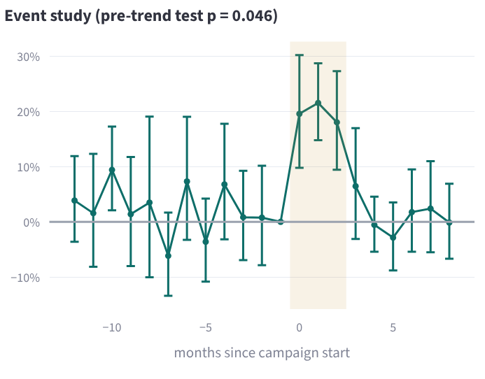
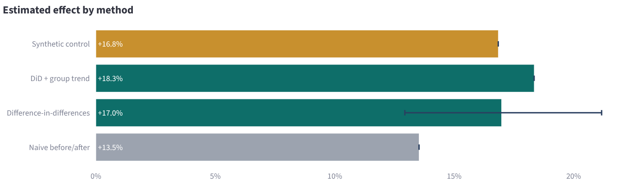
Causal inference: the campaign worked, by +17%
Setup: 4 Western cities treated, 13 control cities, monthly card transactions per customer, Jan 2024 to Sep 2026.
Naive before/after: +13.5%, biased by season and trend.
Difference-in-differences: +17.0% (95% CI +12.9% to +21.2%), city and month fixed effects.
Event study (right): flat before, a jump in the three campaign months, gone after.
Planted truth: +18%. The CI covers it; the naive number does not come close.

Slide 47
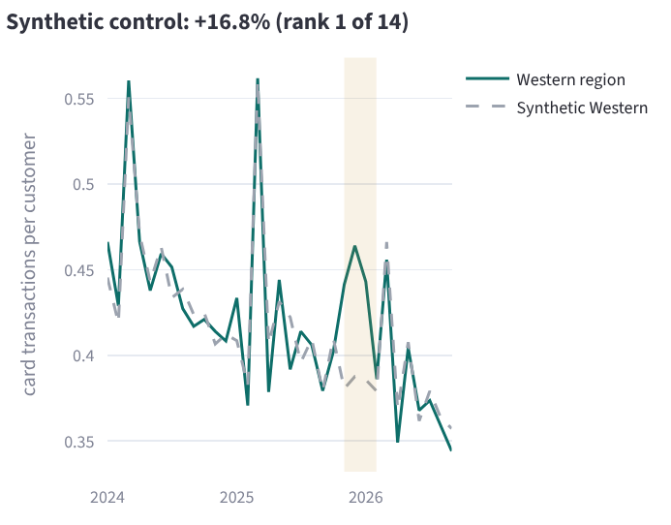
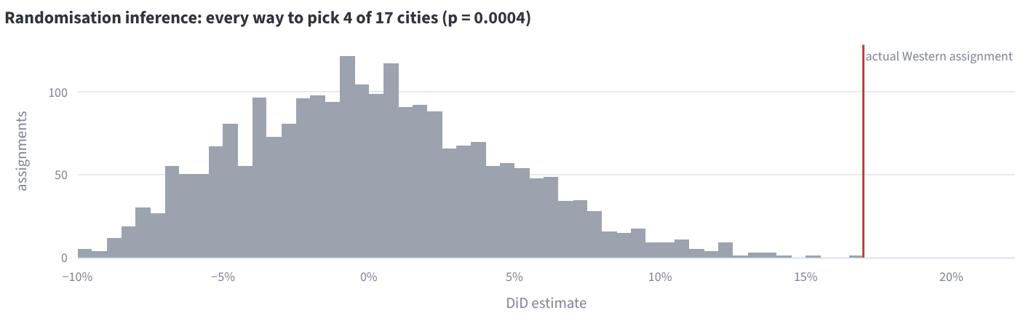
Two more ways to be sure: synthetic control and randomisation
Synthetic control (left): Western rebuilt from a weighted mix of control cities fitted before the campaign; the gap during the campaign is +16.8%, rank 1 of 14 placebos.
Randomisation inference (top): the DiD re-run for all 2,380 ways to pick 4 of 17 cities; the real Western assignment is the most extreme (p < 0.001). Exact, and no assumption about having enough clusters.
Robustness: a treated-group trend gives +18.3%.

Slide 48
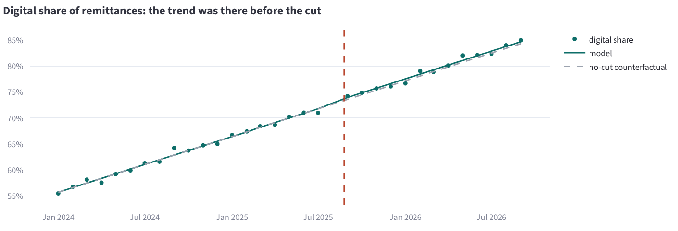
The fee cut: a +11% 'lift' that was only a trend
Verdict
The digital share was already climbing +0.9 pts a month before the cut.
Interrupted time series (chosen by AIC): +0.4 pts (95% CI -0.2 to +0.9).
9 placebo dates give -0.3 to +0.8 pts: the real one looks like them.
Together with −24.7% revenue per transfer: the cut cost money and changed nothing.
Naive: digital remittances +11.2% in the 6 months after vs before.
Lesson from building it: a first design (digital vs branch counts with group trends) failed its placebo test, so it was replaced. A method that can fail its own checks is worth trusting.

Slide 49
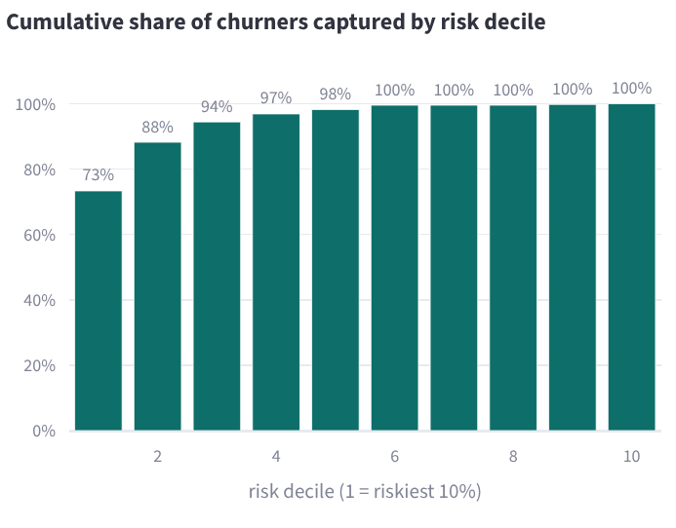
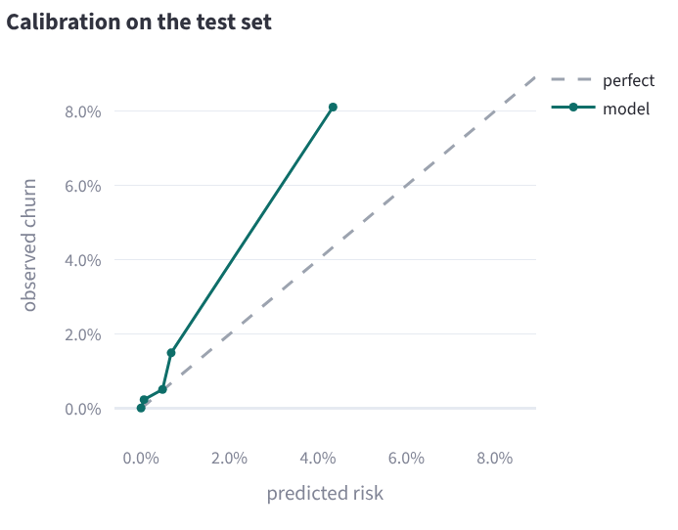
Churn model: out-of-time, calibrated, fair, and priced
0.92
73%
7.3x
0.0119
ROC-AUC on later quarters
of churners in the riskiest 10%
top-decile lift
Brier (base rate 0.0128)
Point-in-time features: a test deletes all data after the cutoff and checks nothing changes.
Out-of-time split: train 2024–25, validate Dec 2025, test Mar and Jun 2026.
Model choice: logistic regression beat gradient boosting on validation PR-AUC.
Calibrated: isotonic, so a 5% risk means about 5 in 100.

Slide 50
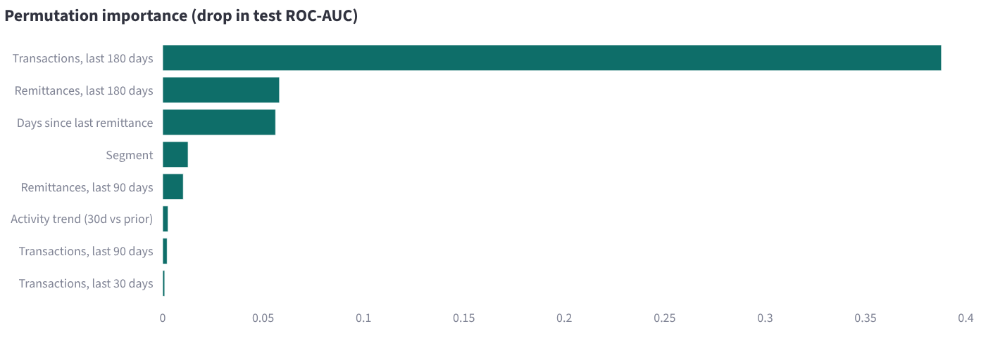
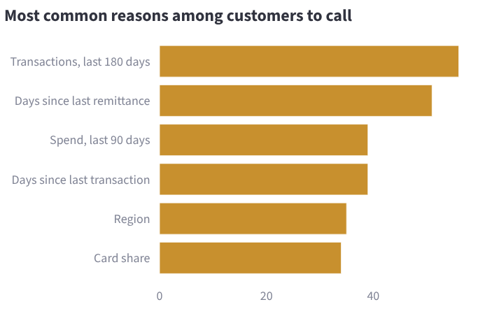
From risk score to decision, with fairness and drift checks
Group | Observed | Predicted | Recall @ top 10%
Female | 1.31% | 0.66% | 78%
Male | 1.29% | 0.69% | 80%
Expat | 1.27% | 0.62% | 74%
Saudi | 1.32% | 0.72% | 81%
Decision rule: call when risk × save rate × annual value > call cost (assumptions in ds_config.yaml).
Next quarter: about 129 expected churners; 131 calls recommended at SAR 40 a call. Sliders in the app re-price the plan.
Fairness: gender and nationality are not inputs; calibration and recall are audited per group (table), no flags.
Drift: score PSI 0.009 between training and today (alert above 0.2).
Model card: intended use, data, metrics, fairness, limitations, written on every run.

Slide 51
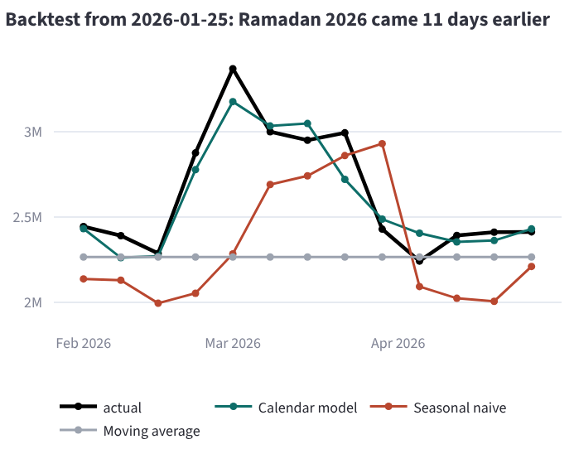
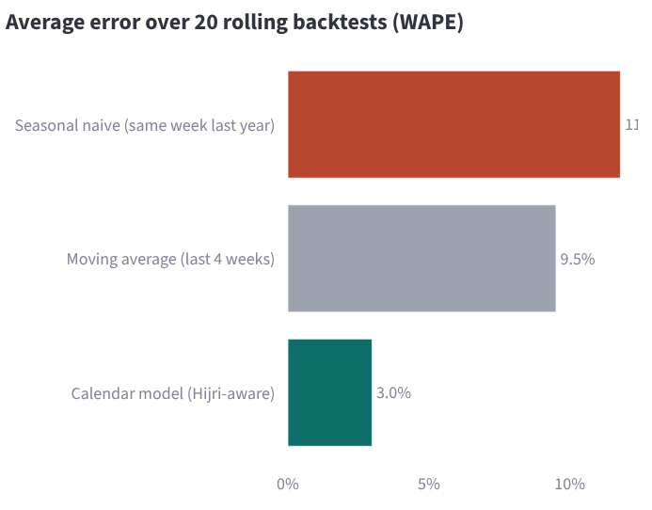
Forecasting with the Hijri calendar
Ramadan moves 11 days a year, so 'same week last year' compares the wrong days. The calendar model learns a Ramadan week at +33% (planted +35%), pre-Eid +22% (planted +25%).
Next 13 weeks: SAR 32.8M (80% interval SAR 32.1M to 33.0M), intervals from backtest errors by horizon.

Slide 52
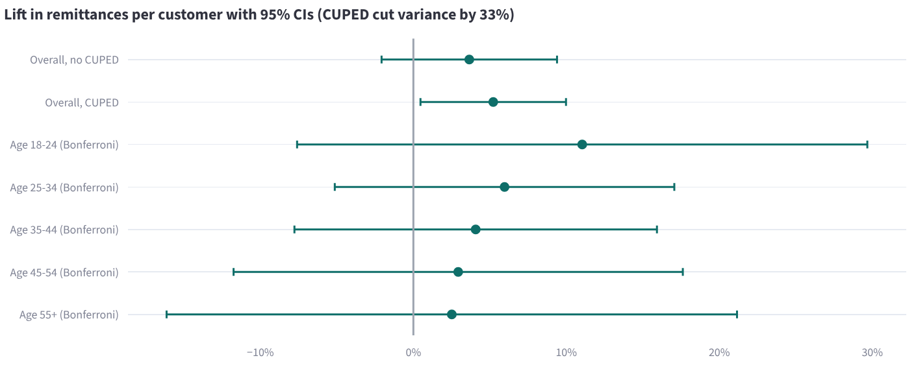
A/B testing: CUPED turned 'maybe' into 'ship'
Without CUPED: +3.7%, p = 0.20. Inconclusive.
With CUPED: +5.2% (95% CI +0.5% to +10.0%), p = 0.027.
Why: pre-period remittances explain 33% of the variance.
Planted truth: about +5.8%, inside the CI.
Sample ratio
A/A simulation
Guardrail
Power
Age effects
p = 0.18, no mismatch
4.8% false positives in 500 splits
failure rate 3.0% vs 3.0%, within 1 pt
MDE 8.1% → 6.6% with CUPED
lift falls with age; none significant alone after Bonferroni

Slide 53
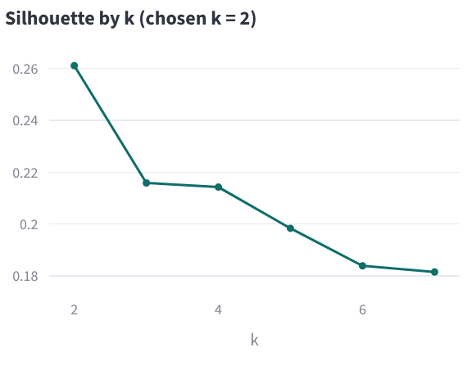
Segmentation, and the validation table that gates CI
Module | Check | Planted truth | Estimate | Result
Causal | Campaign effect (DiD 95% CI covers truth) | +18.0% | +17.0% (+12.9% to +21.2%) | PASS
Causal | Campaign effect is significant (randomisation inference) | non-zero | p = 0.0004 | PASS
Causal | Synthetic control close to truth (±6 pts) | +18.0% | +16.8% | PASS
Causal | Fee cut: interrupted time series CI covers zero | 0 pts | +0.37 pts (-0.17 to +0.91) | PASS
Causal | Fee cut: naive before/after is biased | 0% | +11.2% | PASS
Churn | Out-of-time ROC-AUC ≥ 0.75 | disengagement before churn | 0.92 | PASS
Churn | Top decile captures ≥ 40% of churners |  | 73% | PASS
Churn | Calibration beats the base rate (Brier) |  | 0.0119 vs 0.0128 | PASS
Churn | No fairness flags | gender/nationality not used | none | PASS
Forecast | Ramadan effect recovered (±10 pts) | +35% | +32.8% | PASS
Forecast | Pre-Eid effect recovered (±10 pts) | +25% | +22.1% | PASS
Forecast | Beats 'same week last year' in backtests |  | WAPE 3.0% vs 11.8% | PASS
A/B test | CUPED 95% CI covers the planted lift | +5.8% | +5.2% (+0.5% to +10.0%) | PASS
A/B test | A/A false-positive rate near 5% | 5% | 4.8% | PASS
A/B test | No sample ratio mismatch | 50/50 | p = 0.18 | PASS
A/B test | Guardrail unchanged | no effect on failures | -0.03 pts | PASS
Segments | Stable under bootstrap (ARI ≥ 0.8) | no planted segments | 0.95 | PASS
2 segments: Frequent senders (61% of senders, 74% of volume); Occasional senders, lapsing (39% of senders, 26% of volume).
Stable (bootstrap ARI 0.95) but overlapping (silhouette 0.26): a targeting aid, not hard boxes.

Slide 54
How the lab plugs into the agents, the app and CI
The 8th agent
The app
data_scientist runs in parallel with the other seven; its findings reach the executive briefing through the same verifier, with three new actions.
Data Science Lab page: one tab per module, interactive call-cost and power sliders, validation table, model card.
CI
Governance
python -m bi_agent.ds validate --strict after the evals; the validation table is posted to the job summary.
reviewed SQL templates through the SQL guard, no PII, protected attributes audit-only, aggregates in the UI.
python -m bi_agent.ds # run all five modules → reports/ds/lab_report.md, churn_model_card.md
python -m bi_agent.ds validate --strict # 17 checks against the planted truth
make test # 94 tests, including leakage and recovery tests for the lab

Slide 55

From portfolio to production on enterprise tools
This repo | Power BI / Fabric | dbt | Denodo | Databricks
semantic_layer.yaml | DAX measures in a semantic model | MetricFlow metrics | Derived / interface views | Unity Catalog metric views
compiler.py | DAX via XMLA / executeQueries | Semantic Layer API | VQL / REST data services | SQL on metric views / Genie
Guardrails | RLS / OLS, sensitivity labels | Warehouse grants | Role-based security, masking | Grants, column masks
Planner | Fabric data agent / Copilot | Any LLM + API | Any LLM + REST | Genie
Swapping DuckDB for Snowflake, Oracle or Cloudera Impala only changes bi_agent/db.py (plus small SQL dialect tweaks in the compiler).
Roadmap: MCP server so any assistant can query governed metrics · Arabic questions · metric lineage view · held-out eval set

Slide 56
Telling the story in an interview (STAR)
S
Situation
Business users wait days for analysts, and LLM chat tools give inconsistent, ungoverned numbers, which is unacceptable under banking regulation.
T
Task
Answer plain-English questions with the same numbers as official dashboards, without exposing personal data.
A
Action
Separated understanding from computation: a LangGraph agent plans within a governed semantic layer, a compiler writes parameterised SQL, three guardrail layers protect PII, and evals run in CI.
R
Result
15 governed metrics, 100% plan and answer accuracy on 28 golden questions, every answer auditable, zero PII exposure by design. The agent team tests 8 cross-business links: it recovered all planted relationships, passed the placebo control, and showed that a fee cut lost 24.7% revenue per transfer without lifting activity.

Slide 57
Next steps
Run it locally today, publish this week, then compare the Claude planner against the offline one
1
2
3
4
bash scripts/setup_mac.sh --run
bash scripts/publish_github.sh vickarzz
Deploy on Streamlit Cloud, post on LinkedIn
15-minute weekly training loop

