Slide 1

SCIENTIFIC & UNIT CALCULATOR
Prepared by :
Vignesh Ganesan

Slide 2
Introduction
The project focuses on developing a Calculator Application designed to support multiple types of calculations and conversions within a single interface.
The Calculator App includes the following key functionalities:
Scientific Calculations
Number Conversion
Unit Conversion

Slide 3
Technologies
Progamming Language:
Python
Libraries:
Math - The math library in Python provides access to mathematical functions like square roots, trigonometry, logarithms. It is optimized in C for high-performance numerical computations.
Tkinter - The Tkinter library in Python is a built-in module used to create graphical user interfaces (GUIs) with windows, buttons, labels, and input fields. It acts as a wrapper around the Tk GUI toolkit, making GUI development simple and platform-independent.

Slide 4
Challenges
Challenge 1:
Creating the Multiple Buttons without adding a code for each button.
References:
https://www.geeksforgeeks.org/python/looping-through-buttons-in-tkinter/
Challenge 2:
Adding the functionalities that user pressing the keys in the NumPad.
References:
https://tkinterexamples.com/events/keyboard/

Slide 5
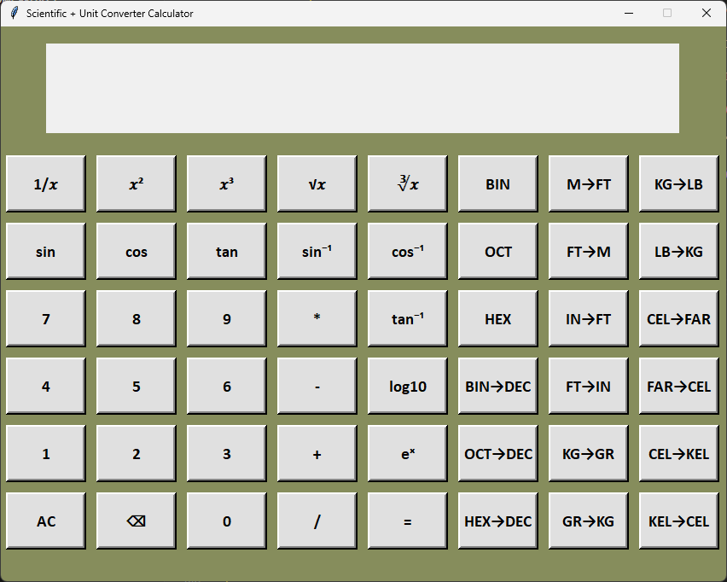
Screenshot:

Slide 6
THANK YOU

