Slide 1
Supervised ML
Victor Nicolausson

Slide 2
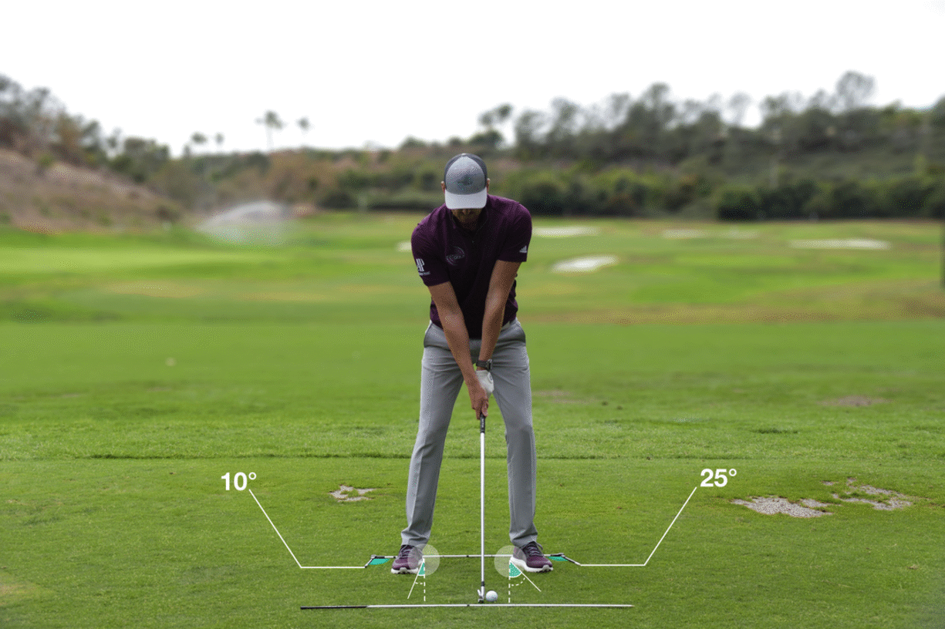
Models for predicting golf strokes
Victor Nicolausson

Slide 3
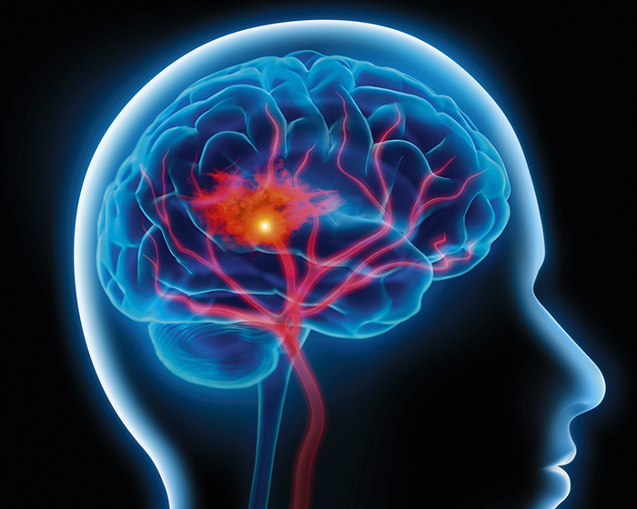
Models for predicting golf strokes

Slide 4
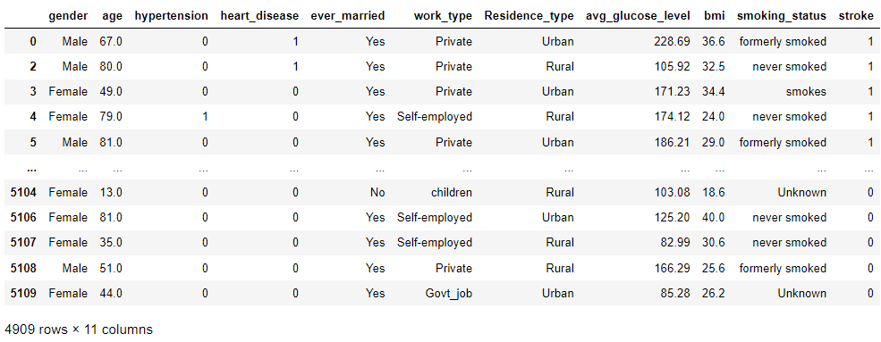
The dataset:

Slide 5
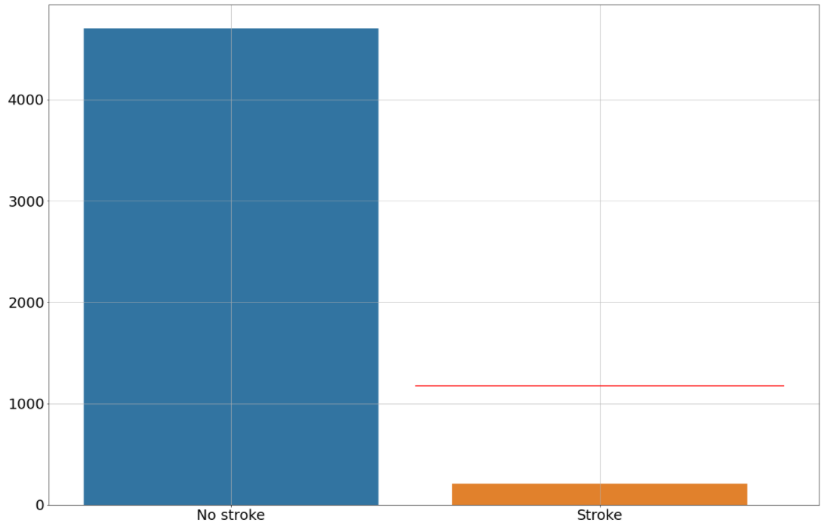
Problems:
Dataset is highly imbalanced
Target ~4% positive (209 / 4909)
Fix: upsample to 20% (1175 / 5875)

Slide 6
Stated problems and procedures:
To the highest degree possible, predict if a patient is going to have a stroke.
Evaluate various classification models (based on ROC/AUC)
Choose the most promising
Perform feature selection/tuning (F1-score)
Perform hyperparameter tuning on most promising model (F1-score)
Hopefully, a reduced amount of features will speed up the diagnostic process (E.g., eliminating a blood sample would save time and resources)
May help to reduce noise and get a more accurate diagnosis

Slide 7
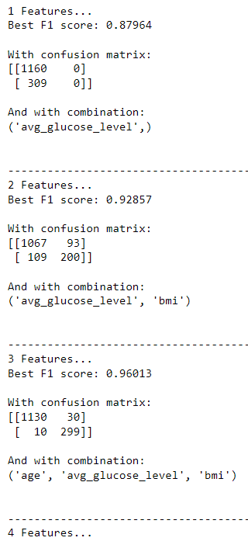
Results:
Cross fold evaluation indicated RFC most suitable
Feature selection was performed - All possible combinations of 10 features - Total of 5020 combinations - F1 - score/confusion matrix
Best RFC-model was selected for HPT

Slide 8
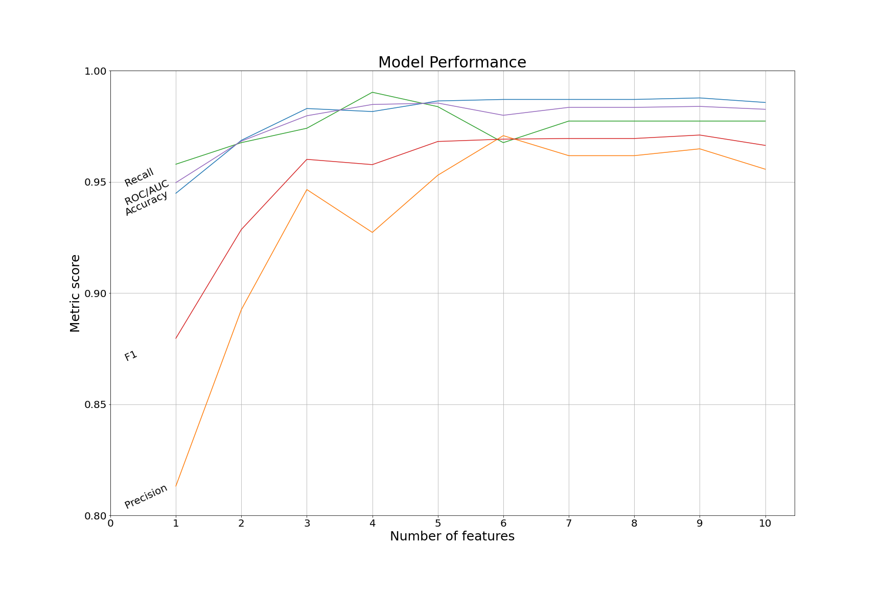
Results: feature selection, various scoring metrics

Slide 9
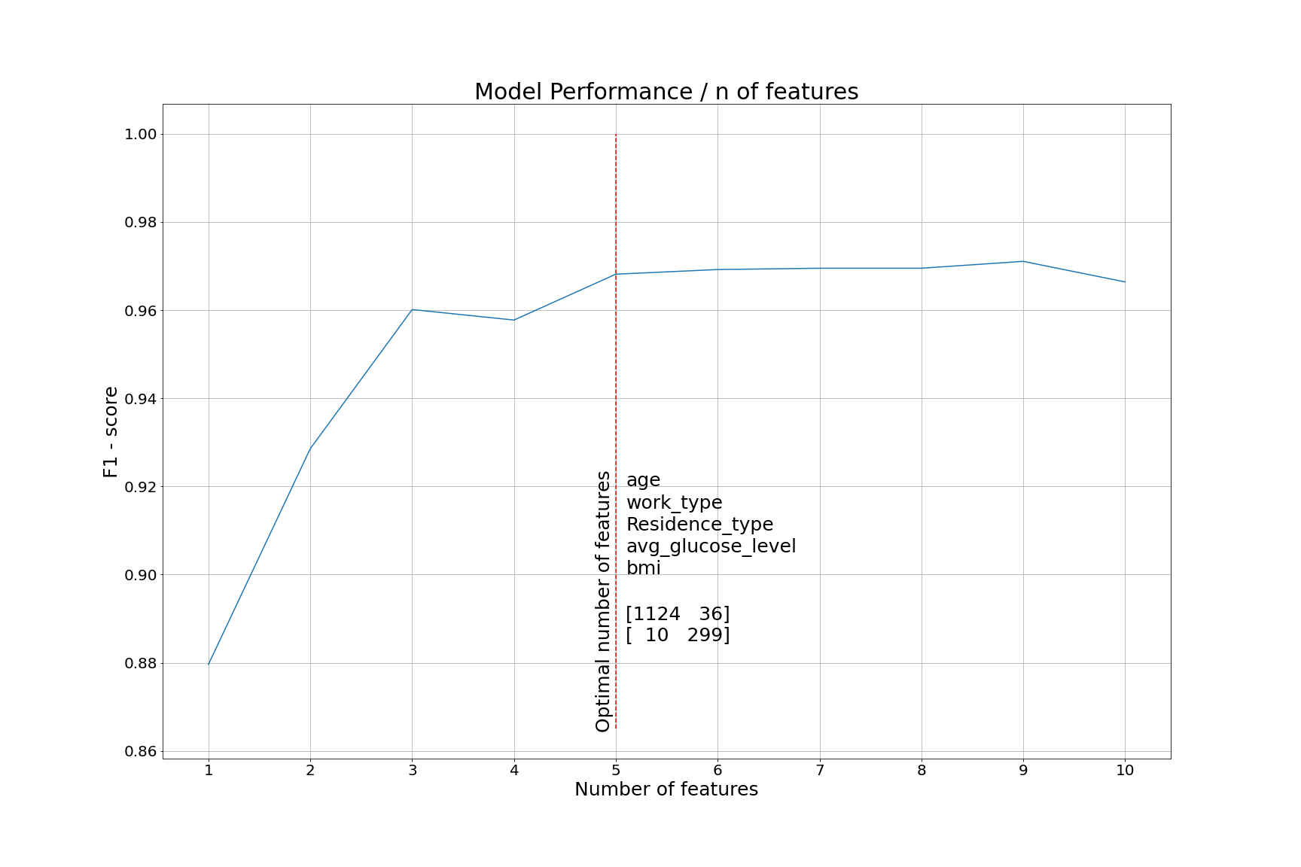
Results: F1-score

Slide 10

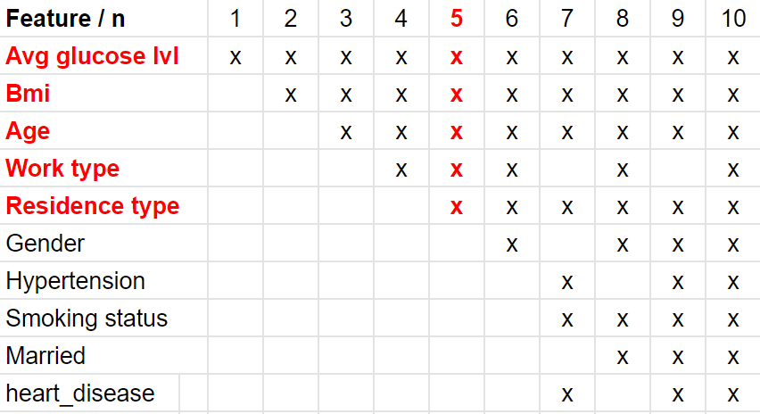
Results: best model (5 feats), test data
Metrics
F1 - score: 0.969…
Accuracy: 0.987…
Confusion matrix: AN AP PN [ 1150 10 ] PP [ 9 300 ]
Findings: We can make fairly good predictions Only a subset of features are needed Risk flagging could (possibly) be performed by less qualifed staff Average stroke patient is 67.7 y/o Come in for a blood sample at 65 (?)
We have probably not revolutionized the medical field though.
TN go up!
FN go down!

Slide 11
FIN

Slide 12
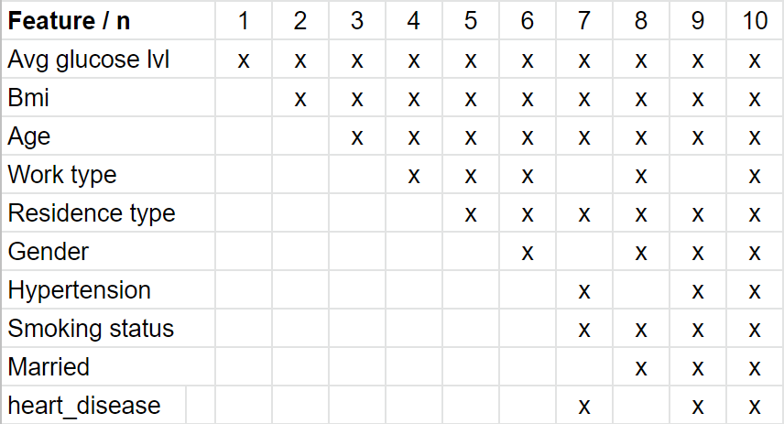
Bonus: best combinations for n features

