Slide 1
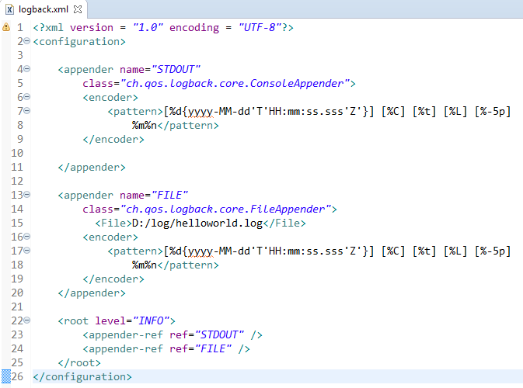
Spring Boot - Configure Logback (Console and File)
We can configure the ConsoleAppender and FileAppender in Logback.xml file. Note that you need to specify the Log file path inside the FileAppender.
We can also define the set of supported log patterns inside the ConsoleAppender or FileAppender

