Slide 1
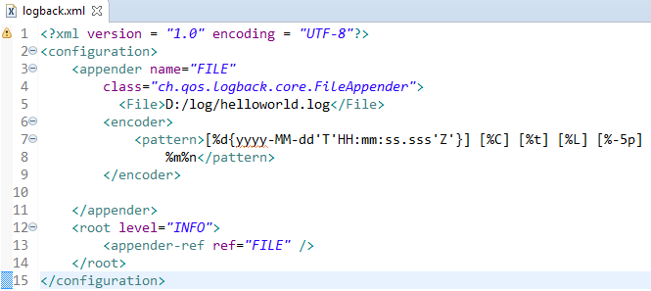
Spring Boot - Configure Logback (File)
We can configure the FileAppender in Logback.xml file. Note that you need to specify the Log file path insider the file appender.
We can also define the set of supported log patterns inside the console or file log appender

