Slide 1
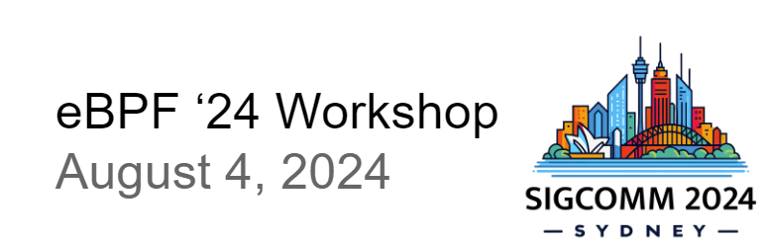


Kernel Extensions Large Language Model Agent
Yusheng Zheng, Yiwei Yang, Maolin Chen, Andrew Quinn

Slide 2
eBPF May be hard to write
For no kernel background junior developer
DevOps debugging the kernel network stack
Security engineer monitoring the system
Developer write network function in xdp or socket
Similar For AI and LLM

Slide 3
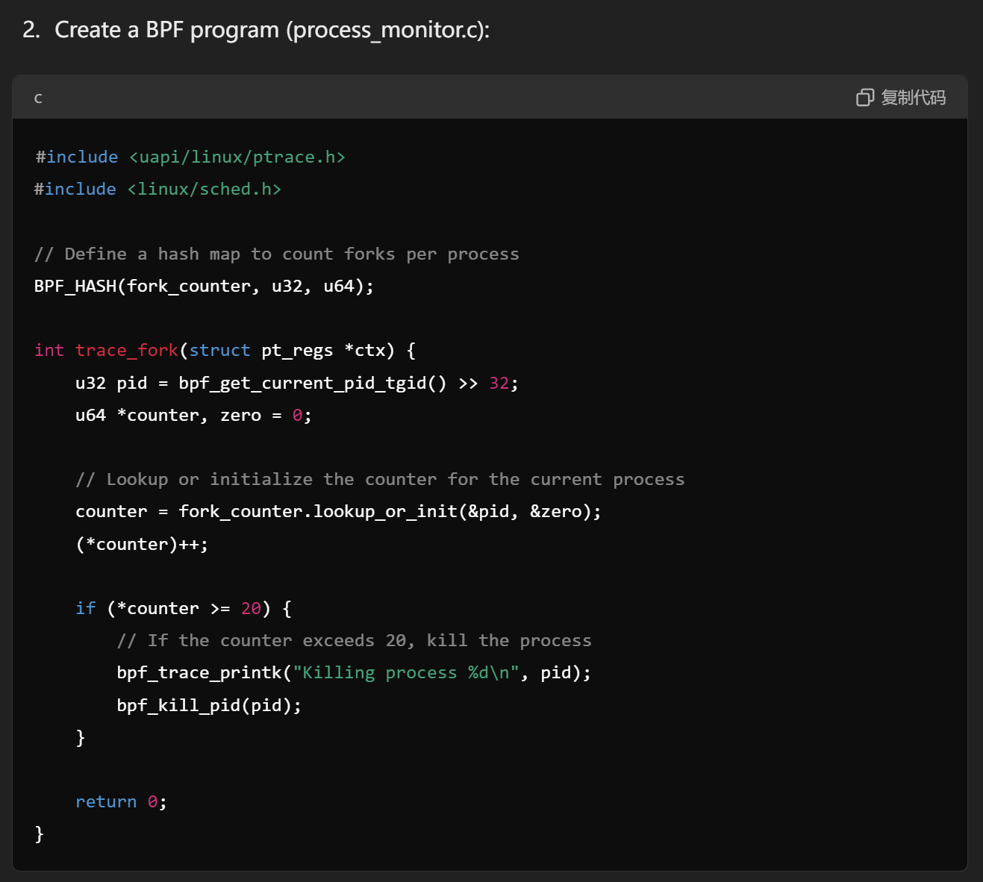

Hallucinations
Wrong API and helpers
https://chatgpt.com/share/6f3b6aca-e1b3-427b-b18d-38d8bcdf85c1

Slide 4
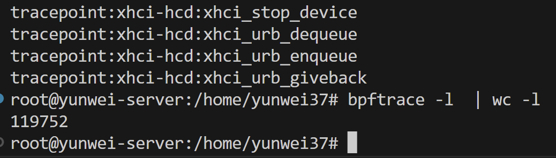
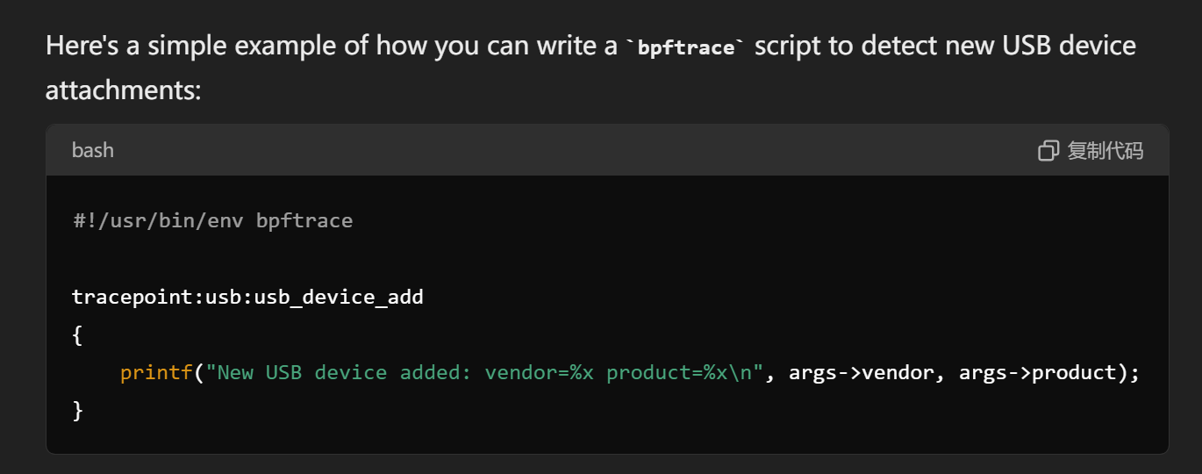

Hallucinations
Wrong attach point
https://chatgpt.com/share/796109a6-c1ce-4309-af70-934dad15ecb5

Slide 5
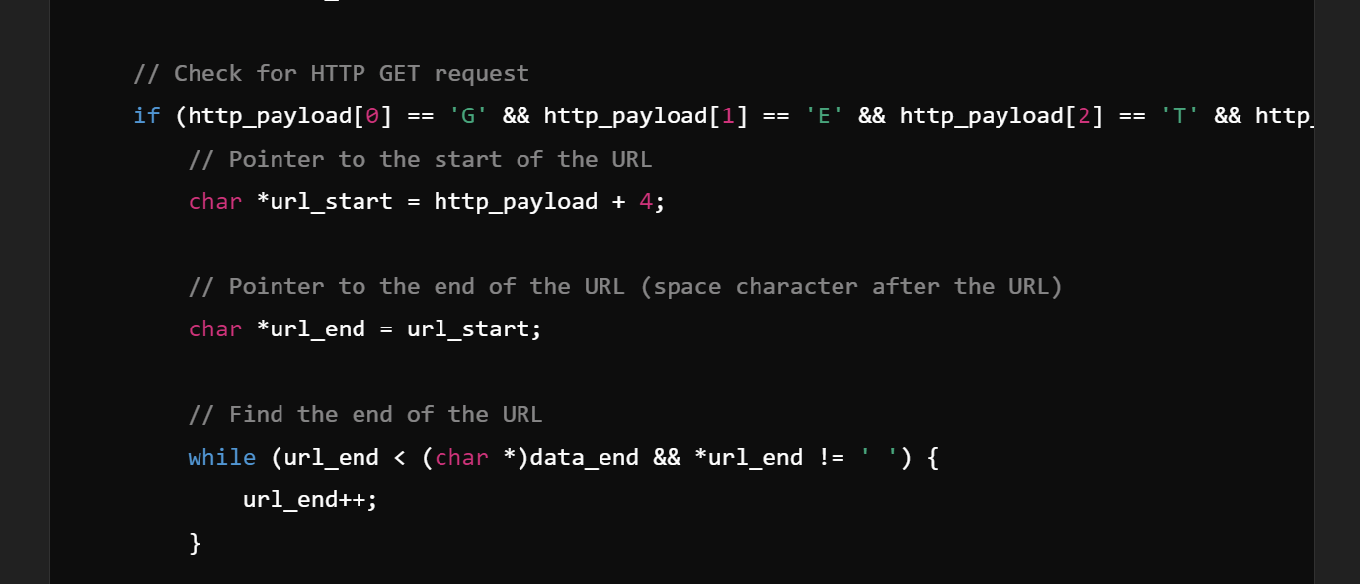

Verifier limitation
https://chatgpt.com/share/f7e8f41c-c191-41f5-ba28-0e7e2856d889

Slide 6
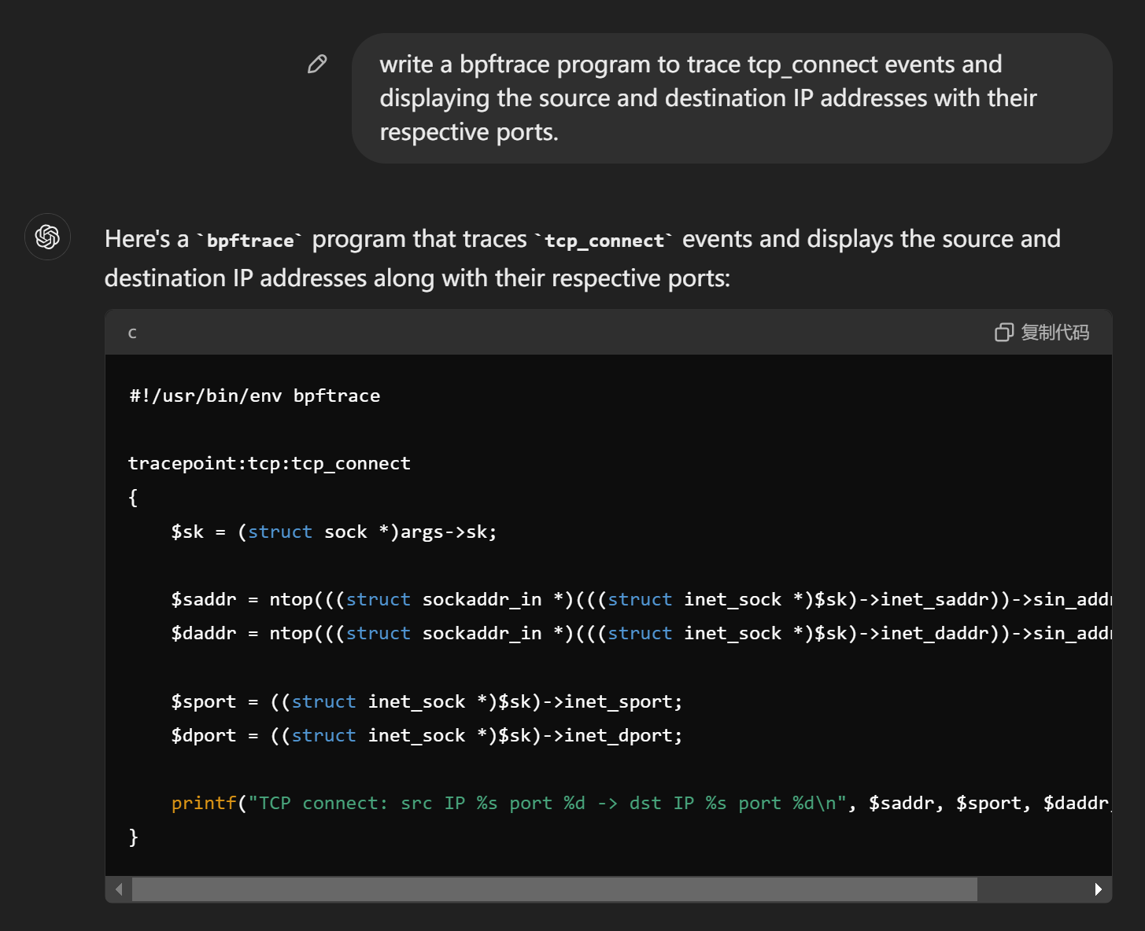

Incorrect behavior
Successful pass the compiler and verifier
Not consider IPv6
Port Byte Order:
https://chatgpt.com/share/5c793353-3ab2-4907-8f82-ec4bccc62a1f

Slide 7
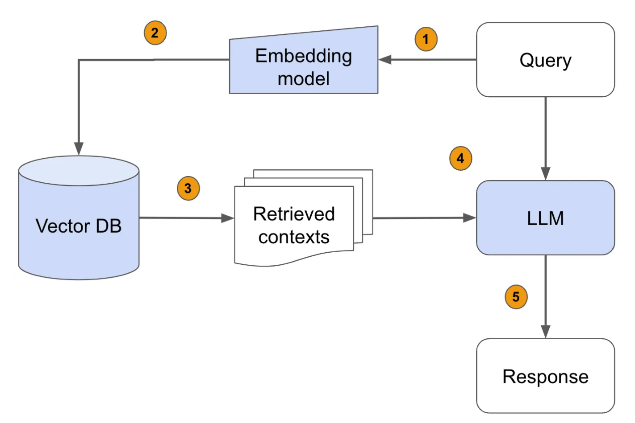
Retrieval-Augmented Generation (RAG)
fine-tuning or RAG?
Data insufficient
eBPF need kernel info when deployed

Slide 8
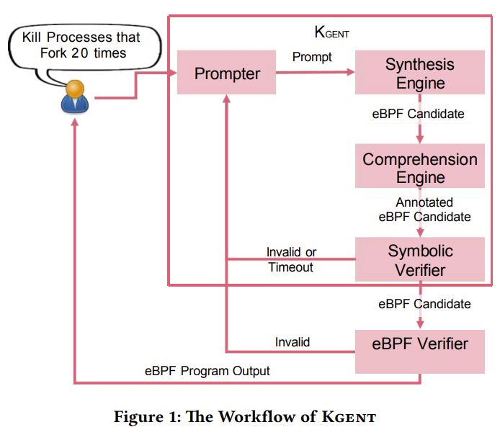
Agent Workflow
Plans:
Workflow
Feedback
ReAct(Thought, Action, Observation)
Tools:
clang
Seahorn
bpftrace
Memory:
Short term in-context memory

Slide 9
Example:
User:
"Trace tcp_connect events for both IPv4 and IPv6 connection attempts, display the source and destination IP addresse."

Slide 10
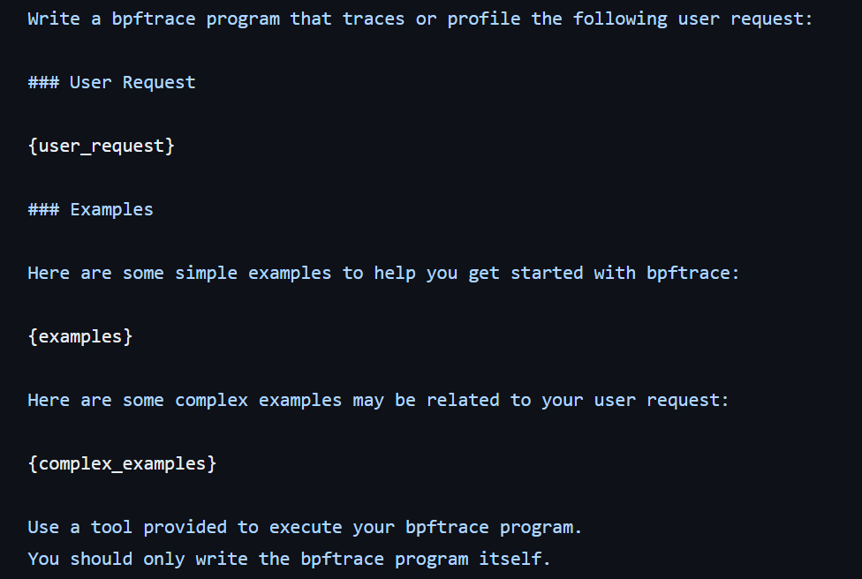
Prompt template
In context learning

Slide 11
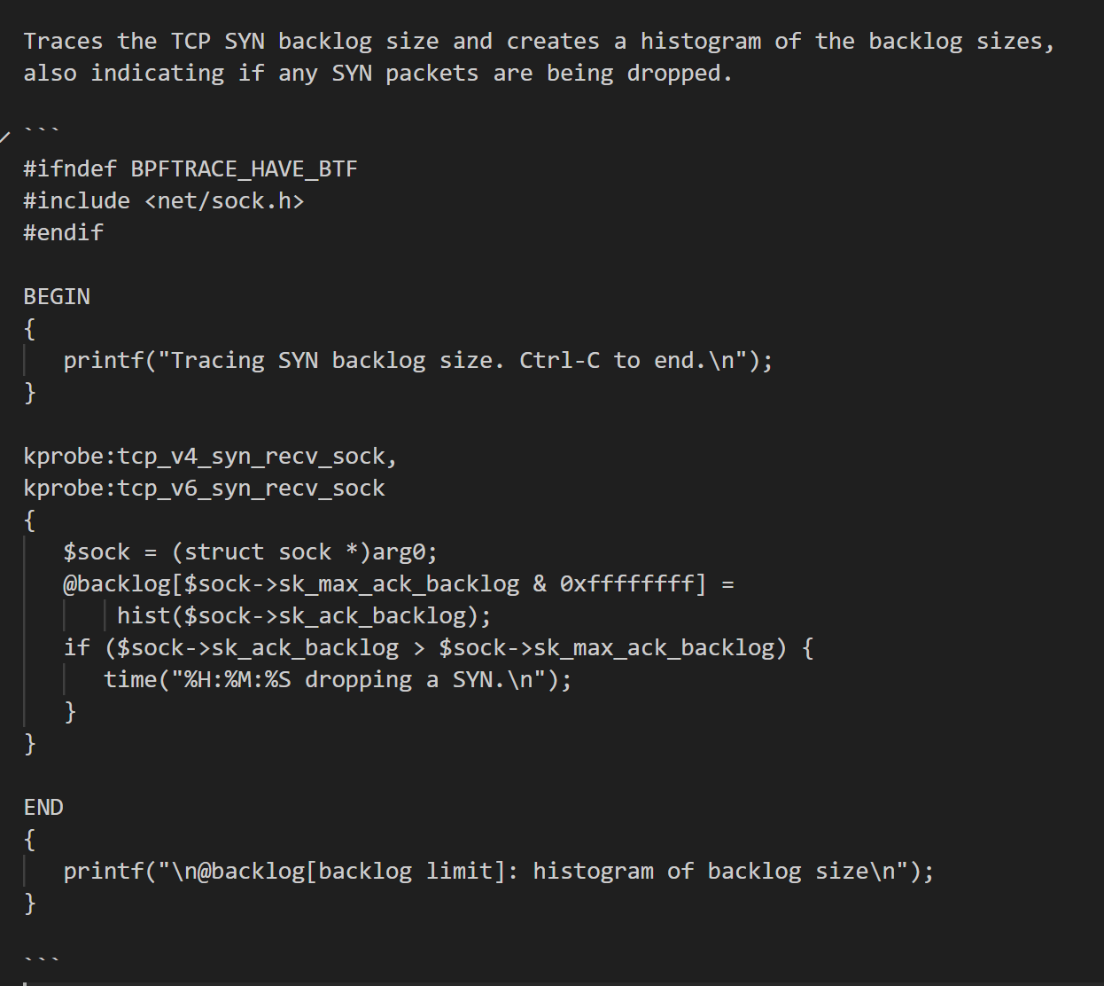
Vector DB
Query: Trace tcp_connect events for both IPv4 and IPv6 connection attempts, display the source and destination IP addresse.
Results:

Slide 12
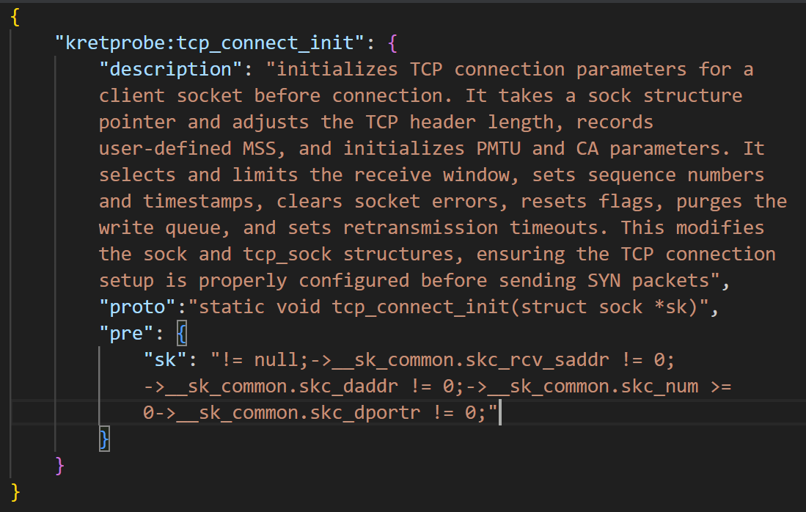
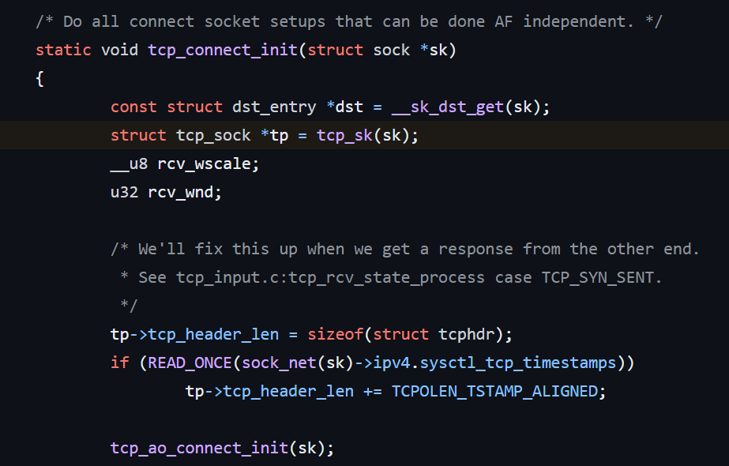
Vector DB: attach and helpers Spec
Generated Spec with LLM from source code once
Get related attach and helper Spec from vector DB
GPT-4
Kernel source code
Spec and description

Slide 13
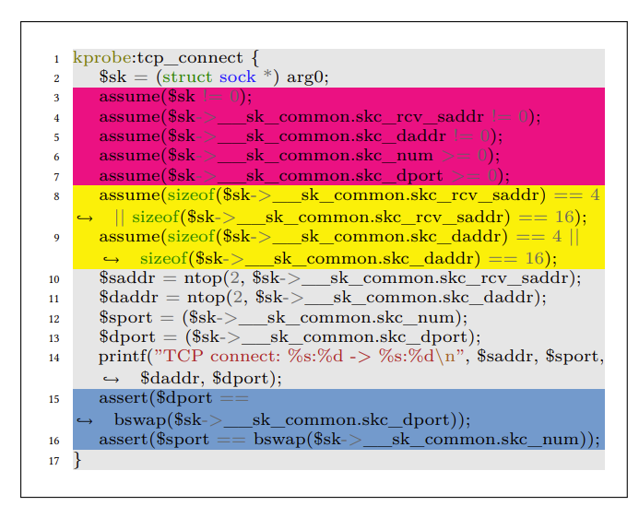
Symbolic Verifier
Read from template
Use LLM to generate Hoare constraints
Verify by SeaHorn for semantic correctness
Output feedback to LLM

Slide 14
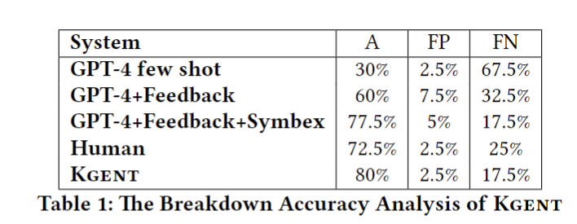
Results
For bpftrace:
Codellama (Based on llama2) bpftrace: 40%
GPT-4 libbpf feedback: 37.5%
Tested with gpt-4 API in 2023-09

Slide 15
Limitations and Future work
How to generate larger and better eBPF?
Limitations:
Small programs and tasks: <100 lines
Context window limit from LLM
Dataset small
Possible solution:
Split the task
Like AutoGPT
Ask user in iteration

Slide 16
Limitations and Future work
Verification may not cover all behavior
More background and description
Generate better Hoare contract.
Use more Software Engineering efforts like counterexample generation.
Test driven development
Security Vulnerabilities
Might contain security flaws
eBPF runs in the kernel

Slide 17
Thanks
Opensource repo:
https://github.com/eunomia-bpf/GPTtrace
https://github.com/eunomia-bpf/KEN

