Slide 1










IPDPS 2026 1st Tutorial on OCEAN: An Open-Source CXL Emulation Platform at Hyperscale (Opening Remarks)
IPDPS 2026 Tutorial
Presenter:
Luanzheng (Lenny) Guo, Andres Marquez, Mujahid Al Rafi, PNNL
Yiwei (Vickie) Yang, UCSC & Zett.ai
Meng (Candice) Tang, Illinois Institute of Technology
Kenza Bouasker, UW & EPFL
PNNL-SA-160879
Slides

Slide 2

Welcome!
We would like to take this opportunity to present our open-source project focused on CXL emulation at hyperscale named OCEAN
This work has been made possible through contributions by our advisors, mentors, and student contributors, including include PNNL, UC Santa Cruz, UC Merced, UC Riverside, University of Washington, Wisconsin-Madison, Texas Tech, Illinois Tech, EPFL, RIKEN R-CCS, LLNL, etc.
The goal of this tutorial is to introduce CXL basics, how OCEAN emulation system works, provide interactive hands-on sessions, invite the community to engage, share expertise, and contribute
We are currently hiring, including student interns and postdoctoral researchers.
If you are interested in joining us, please get in touch by email. I look forward to hearing from you!
lenny.guo@pnnl.gov
2

Slide 3
Schedule
1) Opening remarks (20 mins; 1:30-1:50pm)
2) Introduction to CXL basics and the OCEAN emulation platform including demos (70 mins; 1:50-3pm)
3) Coffee breaks (30 mins; 3-3:30pm)
4) Hands-on sessions and Q&A (80 mins; 3:30-4:50pm)
5) Closing (10 mins; 4:50-5pm)

Slide 4
Introduction
The tutorial presents an innovative open-source CXL emulation platform designed for hyperscale environments, offering a comprehensive implementation of the CXL 3.0 specification
This platform includes significant advancements such as Host-managed Device Memory (HDM) decoders, Fabric Manager for efficient memory management, and CXL switch topology supporting cacheline distribution
Furthermore, the platform ensures full coherence protocol support for reliable and consistent memory operations across multiple hosts

Slide 5
Pre-requisites
Prior Knowledge:
Familiarity with computer architecture concepts and virtual memory management.
Basic experience with Linux systems and command-line utilities.
Required Materials:
A laptop with Linux installed, or access to a Linux-based virtual machine
Internet access to explore code repositories and demo setups.

Slide 6
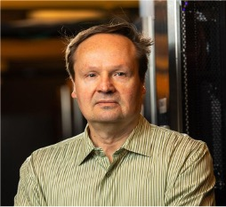
Presenters
Andres Marquez:
Andres Marquez is a Chief Computer Scientist and the HPC Group Lead at Pacific Northwest National Laboratory (PNNL). He is the principal investigator (PI) for the Department of Energy’s Advanced Memory to Support AI for Science (AMAIS) project. He is also the PI on several projects related to memory performance analysis or cybersecurity.

Slide 7
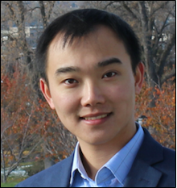
Presenters
Luanzheng (Lenny) Guo:
Luanzheng (Lenny) Guo is a computer scientist in Pacific Northwest National Laboratory (PNNL)’s Future Computing Technologies group, working within the research area between scientific computing, data management, large-scale systems (e.g., HPC, Cloud, Edge, disaggregated memory, etc.), and machine learning. He is serving as the Thrust Lead for the Department of Energy’s Advanced Memory to Support AI for Science (AMAIS) project. His paper was nominated for best paper at CLUSTER 2024, ICS 2025, and SSDBM 2025.

Slide 8

Presenters
Yiwei (Vickie) Yang:
Yiwei Yang is a final-year Ph.D. student in Computer Science and Engineering at the Baskin School of Engineering, University of California, Santa Cruz, advised by Prof. Andi Quinn. His research focuses on hardware–software co-design for modern heterogeneous architectures. In particular, he explores how emerging interconnect technologies such as Compute Express Link (CXL) and UCIe can enable flexible disaggregation, pooled memory systems, and cross-node resource sharing for diverse cloud and HPC workloads. Vickie is the Founder of Zett.ai.

Slide 9
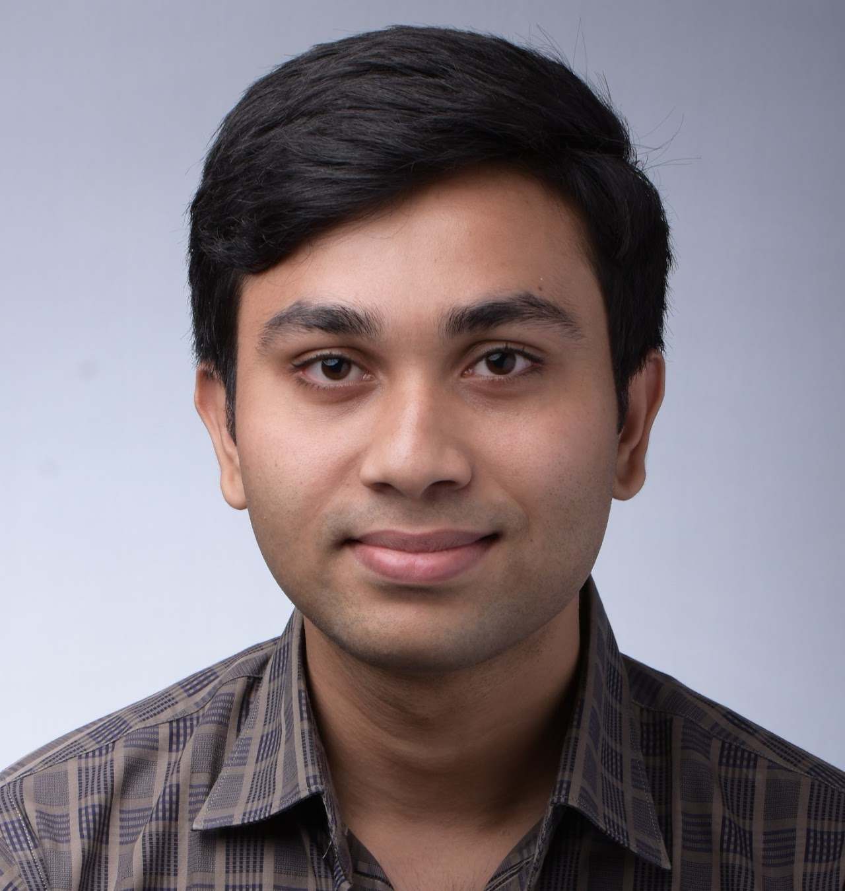
Presenters
Mujahid Al Rafi:
Mujahid Al Rafi just obtained his PhD degree from the Electrical Engineering and Computer Science program at University of California, Merced working under Professor Hyeran Jeon’s supervision. His research as a PhD student is focused on ensuring efficient and secure computer architecture. His works were published in IISWC, TMLR, and GPGPU. Since the summer of 2025, he has been working as a PhD Intern at PNNL. Currently, he a primary contributor to the OCEAN emulation framework.

Slide 10

Presenters
Meng (Candice) Tang:
Meng Tang is a Ph.D. candidate in Computer Science at Illinois Institute of Technology, advised by Xian-He Sun and Anthony Kougkas. Her research focuses on storage and I/O performance for data-intensive scientific workflows on high-performance computing systems, including data-movement modeling and storage-aware workflow scheduling.

Slide 11

Presenters
Kenza Bouasker:
Kenza Bouasker is an undergraduate exchange student from the École Polytechnique Fédérale de Lausanne (EPFL), Switzerland, currently studying Computer Science at the University of Washington, Seattle. She will begin a master's program in machine learning at EPFL next year. She recently joined the advanced memory emulation workgroup, where she is beginning to explore topics related to CXL-based memory systems, large-scale computing environments, and systems-oriented software development.

Slide 12
Acknowledgment
This work was partially supported by the U.S. DOE Office of Science, Office of Advanced Scientific Computing Research, under award 76125: “AMAIS - Advanced Memory to support Artificial Intelligence for Science”. The Pacific Northwest National Laboratory is operated by Battelle for the U.S. Department of Energy under contract DE-AC05-76RL01830
partially supported by National Science Foundation under grants 1955650, 2047521, 2324940, 2324941, 2104116, 2316202, 2348350, and 2341039
partially supported by Zett.ai, a Contributor member of The CXL Consortium

Slide 13
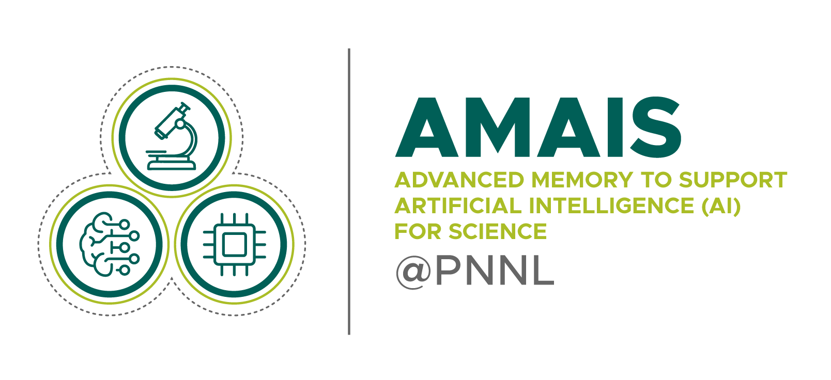
AMAIS - Advanced Memory to support Artificial Intelligence for Science
The AMAIS project focuses on new memory systems applicable to scientific computational research. These new memory systems are needed to enable the convergence of first-principles scientific modeling/simulation with AI data driven science. The resulting requirements increase demand on memory capacity to satisfy the large volume processed by large scale AI boosted simulations.
A key focus for AMAIS is Fabric Attached Memory (FAM), a system architecture that allows large data sets to be stored in memory that is accessible to all nearby and remote compute nodes. The architecture is well suited to handle large data sets that are too big to fit into a single node.
Therefore, the resulting fabric memory architectures introduce additional tiers in the memory hierarchy that require revisiting architectural models and refactoring algorithmic kernels, performance analysis, compilers and runtime systems and cybersecurity.
https://www.pnnl.gov/projects/amais

Slide 14
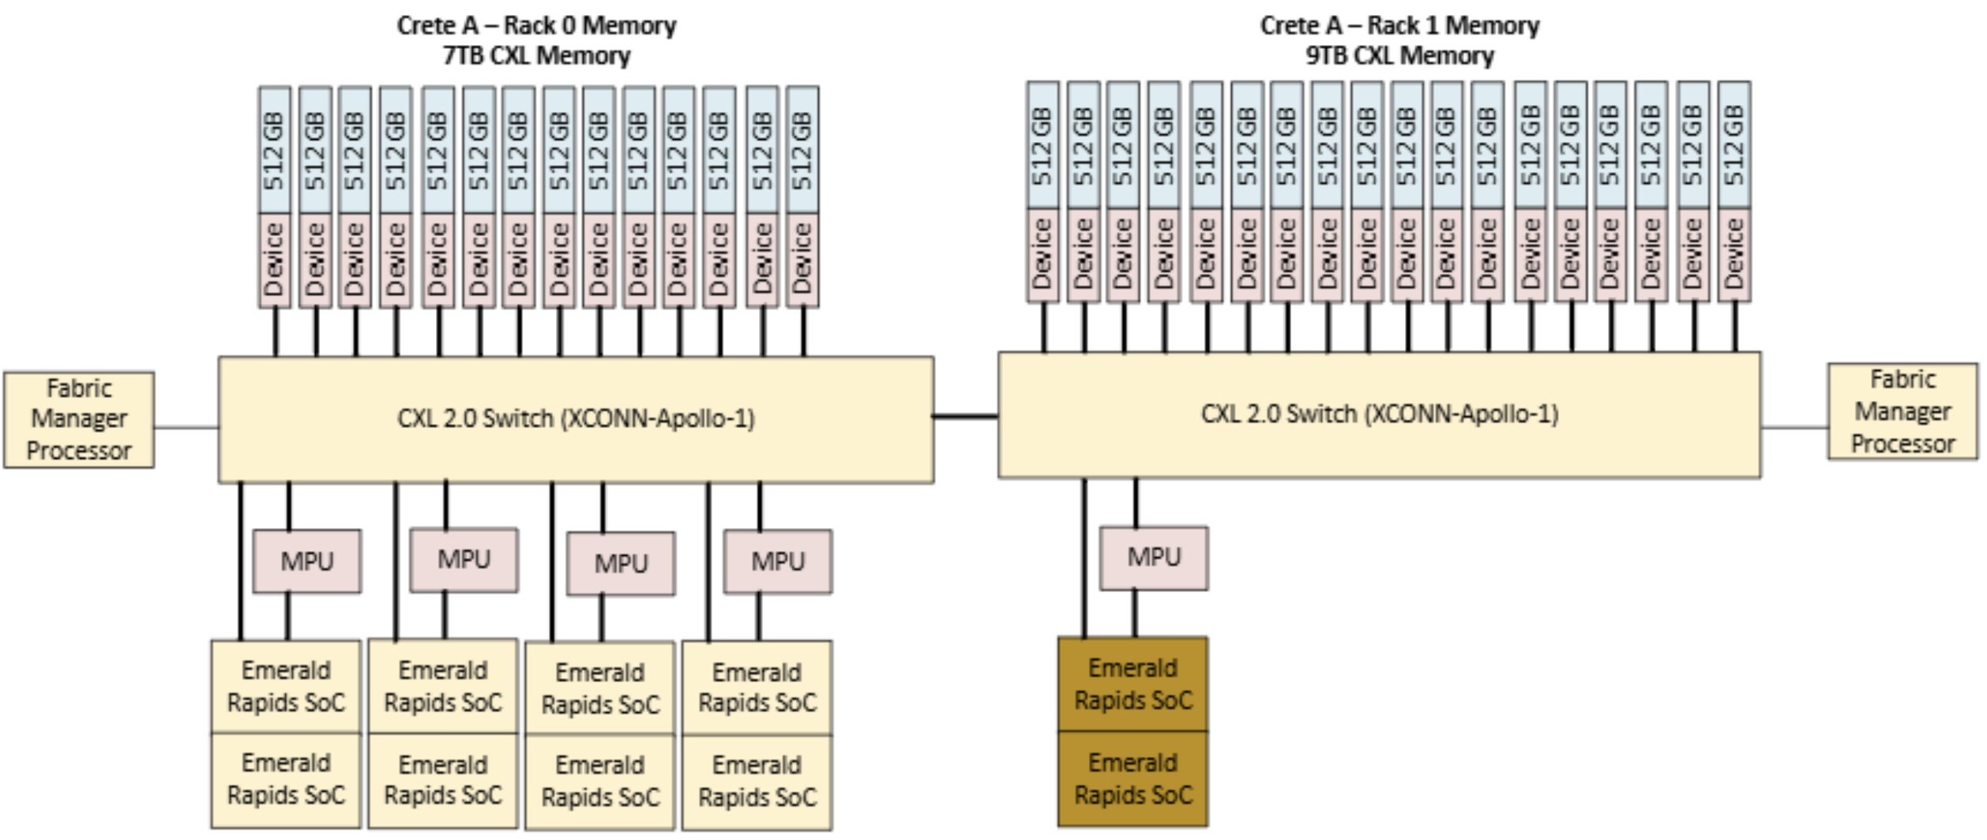
The Crete computing system
The Crete computing system—a prototype memory-to-processor configuration that will offer 15 Terabytes of active CXL memory co-located with the system processors—was developed as part of the AMAIS project
Will open to the public access soon with an application process
https://www.pnnl.gov/projects/amais/crete
Notes:
Big Crete Mode In this configuration, an asymmetric top/bottom switch topology enables four hosts connected
to the top switch to access all Fabric-Attached Memory (FAM) modules connected with both top and bottom. This setup is ideal for
exploring large in-core computations and high-capacity memory pooling scenarios.
The goal of the cxl emulator is to increase the productivity as the hardware is constrained.

Slide 15
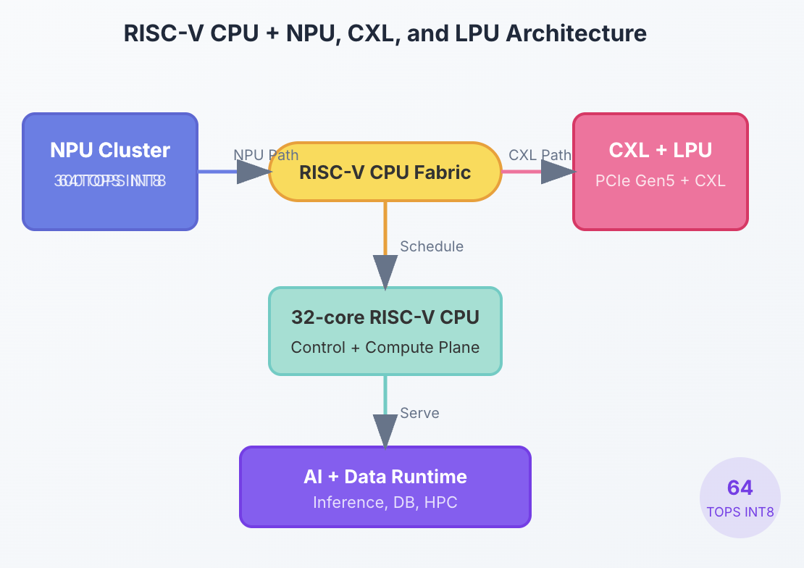

Zett.ai
Zett.ai is aimed at concrete infrastructure deployments where GPU memory, local inference, and expandable memory capacity directly affect cost, density, and service latency
Zett.ai organizes the platform around two building blocks: a server-class RISC-V CPU, a programmable NPU compute base, and a CXL/LPU expansion layer for memory, acceleration, storage, and high-speed I/O
https://zettai.us/

Slide 16
IPDPS 2026 1st Tutorial on OCEAN: An Open-Source CXL Emulation Platform at Hyperscale
IPDPS 2026 Tutorial
Materials used in this tutorial:
Document: https://ocean.readthedocs.io
Git: https://github.com/cxl-emu/OCEAN
OCEAN deployment guide: https://docs.google.com/document/d/18nsbhXxNyZQN49KzRqq4YlFLQ-Yk9bth/edit
WASM link: https://asplos.dev/cxl2/
WASM Instructions: https://docs.google.com/document/d/1u_TabBSlr1Vlxb51-tlG3hLKTDs9XJu7V2wV1wDqYwk/edit?tab=t.0
Q&A for hands-on session: https://washington.zoom.us/j/92251532033?pwd=daTMb2wVFzO4HedlGVOezUMckY3dak.1
Presenters:
Luanzheng (Lenny) Guo, Andres Marquez, Mujahid Al Rafi, PNNL
Yiwei (Vickie) Yang, UCSC & Zett.ai
Meng (Candice) Tang, Illinois Institute of Technology
Kenza Bouasker, UW & EPFL
PNNL-SA-160879

Slide 17
Why this tutorial now?
CONTEXT
1
Hardware gap
2
Software gap
3
Scale gap
Real multi-host CXL 3.0 hardware is not broadly available for researchers.
Single-host tools cannot expose the cross-host behaviors that matter at hyperscale.
Applications still assume private memory + message passing, not pooled coherent memory.
scarcity
compatibility
fidelity
Notes:
This tutorial is timely because the community currently faces three gaps that make CXL 3.0 research difficult.
The first is a hardware gap. Real multi-host CXL 3.0 hardware is not yet broadly available to researchers, so the opportunity to experiment with it remains scarce.
The second is a software gap. Most applications today still assume that memory is private to each machine and that data must be moved through message passing, rather than living in a shared, byte-addressable pool.
The third is a scale gap. The tools we do have are limited to a single host, which means they cannot expose the cross-host behaviors that only become important at hyperscale.
Taken together, these three gaps are precisely what motivates the work we will present today.

Slide 18
What attendees should walk away with
ROADMAP
Fidelity and evaluation
1
CXL essentials
2
OCEAN internals
3
4
Hands-on use
What CXL 3.0 adds over earlier versions: pooling, fabric, coherence, dynamic capacity.
How QEMU, the memory server, the switch, and the fabric manager fit together.
Why active latency injection, bandwidth caps, and calibration matter.
How to reason about experiments and where to contribute next.
Notes:
Here is what you should take away from this tutorial.
First are the CXL essentials. You will learn what CXL 3.0 adds over earlier versions, namely memory pooling, the fabric, coherence, and dynamic capacity.
Second are the internals of OCEAN, so you understand how QEMU, the memory server, the switch, and the fabric manager fit together.
Third is fidelity and evaluation, where we explain why active latency injection, bandwidth caps, and calibration matter for trustworthy results.
Finally comes the hands-on portion, where you will learn how to reason about experiments and where you can contribute.

Slide 19
Introduction to CXL
BASICS
Compute Express Link (CXL) builds on top of the PCIe5.0 interconnect by introducing memory and coherency protocols
CXL.mem
CXL
CXL
GPU
CXL.io: required by devices; uses PCIe features
CXL.mem: allows host to directly access the memory of other devices using load/store primitive
CXL.cache: allows devices to cache host's memory using the MESI coherence protocol
CXL.cache
CXL.io
CXL Mem. Controller
CXL.io
Host CPU
CXL
CXL
CXL.mem
CXL.io
CXL
CXL
Accelerator
CXL.cache
Allows heterogeneous devices to achieve better memory capacity and bandwidth!
Notes:
Let us start with what CXL actually is. Compute Express Link builds on top of the PCIe 5.0 interconnect, so it reuses the same physical
wiring, but it adds new protocols for memory and coherency on top of that foundation.
CXL defines three sub-protocols, and the diagram on the right shows them connecting a host CPU to devices such as a memory controller, a GPU, and an accelerator.
The first is CXL.io. This is essentially PCIe, and every device requires it for discovery, configuration, and management.
The second is CXL.mem, and this is the important one for us, because it lets the host reach into the memory of another device directly, using ordinary load and store instructions, exactly as if it were local memory.
The third is CXL.cache, which works in the other direction. It allows a device to cache the host's memory, and it keeps those caches consistent using the MESI coherence protocol.
Put together, these protocols let heterogeneous devices, whether CPUs, GPUs, or accelerators, share memory and achieve better capacity and bandwidth than any of them could alone.

Slide 20
Brief History of CXL
BASICS
A compact evolution from coherent accelerator links to fabric-level memory sharing.
CXL 1.0 / 1.1
CXL 2.0
CXL 3.0
Why it matters
CPU↔accelerator coherence
Switching + memory expansion
GFAM, MH-SLD, DCD, enhanced fabric mgmt.
Memory pooling, coherent sharing, elastic capacity
GFAM
MH-SLD
DCD
shared global address space
hot-add / hot-remove capacity
one logical device, up to 16 hosts
OCEAN is about making these CXL 3.0 capabilities testable today, at system scale.
Notes:
CXL has evolved quickly, and it helps to see the trajectory.
The first generation, versions 1.0 and 1.1, was narrow in scope, giving a single CPU and an accelerator a coherent link between them.
Version 2.0 widened that picture by adding switching and memory expansion, so a host could reach memory beyond its own board.
Version 3.0, which is our focus, opens it up into a full fabric. It introduces three capabilities that we will unpack on the next slide: GFAM, a shared global address space; MH-SLD, where one device serves up to sixteen hosts; and DCD, which adds or removes capacity at runtime.
Together these enable memory pooling, coherent sharing, and elastic capacity.
OCEAN's job is to make these capabilities testable today, at system scale.

Slide 21
Three CXL 3.0 features that change everything
BASICS
None of these exist in CXL 1.x or 2.0.
GFAM
MH-SLD
DCD
Shared pool on the fabric. All hosts access it directly. Nobody owns it exclusively.
One physical device, up to 16 hosts. Each host gets its own region with access control.
Add or remove memory at runtime. No reboot. Chunks as small as 256 MB.
shared global pool
one device, many hosts
hot add and hot remove
Notes:
These are the three CXL 3.0 features that really change the picture, and the key point is that none of them exist in CXL 1.x or 2.0.
The first is Global Fabric Attached Memory. This is a shared pool of memory that sits out on the fabric. Every host can access it directly, and no single host owns it exclusively.
The second is the Multi-Headed Single Logical Device. Here a single physical device serves up to sixteen hosts at once, and each host is given its own region, protected by access control, so the hosts do not step on one another.
The third is the Dynamic Capacity Device. This one lets you add or remove memory at runtime, with no reboot, in chunks as small as 256 megabytes.
So if you take one thing from this slide, it is that CXL 3.0 turns memory into something that can be pooled across hosts, shared safely, and resized on the fly.

Slide 22
What a shared memory pool looks like
BASICS
Each server normally owns fixed DRAM it cannot share. CXL changes that.
Without CXL
With CXL
Each server owns fixed DRAM at boot. When one runs low and another sits idle, nothing can be shared. Need more? Get a bigger machine.
A pool sits behind a switch. Any host maps a slice and uses it like local memory. The pool grows or shrinks on demand without rebooting.
stranded capacity
elastic capacity
No message passing. No copies. Just a memory address any host on the fabric can use.
Notes:
This slide gives you the core intuition for why pooling matters, and it is built as a before and after.
Start on the left, without CXL. Every server is given a fixed amount of DRAM at boot, and that memory belongs to that machine alone. The problem appears the moment workloads are uneven. One server runs out of memory and begins to struggle, while the machine right next to it sits half idle with
gigabytes to spare, and there is no way to lend that capacity across.
We call this stranded capacity, and the only option is to buy a bigger machine.
Now look at the right, with CXL. The memory instead lives in a pool behind a switch, and any host can map a slice of that pool and use it exactly like local memory, with ordinary loads and stores. Because it is a pool, it can grow or shrink on demand, without rebooting anything.
The key point is at the bottom. There is no message passing and no copying of data.
It is simply a memory address that any host on the fabric can use.

Slide 23
CXL killer App: AI inference
AI
Long-context serving is a memory placement problem: HBM is fast but scarce, CPU DRAM is bounded, and RDMA/SSD tiers add latency and software complexity.
GPU HBM
CPU DRAM
CXL memory pool
NVMe / object store
hot tokens
active attention
scheduler
host staging
KV cache spill
RAG / graph state
shared cold context
archive
checkpoint
cold corpus
Why CXL specifically
Killer app
native load/store semantics, shared pool access, and lower synchronization overhead than remote-memory protocols
large shared KV-cache tier for long-context LLM serving
Sources: Micron CXL memory; Beluga KVCache paper, arXiv:2511.20172; CCCL CXL memory pooling paper, arXiv:2602.22457.
Notes:
Our first killer application is AI inference, specifically serving models with very long contexts.
The core challenge is really a memory placement problem.
The GPU's high-bandwidth memory is extremely fast but scarce, the CPU's DRAM is larger but still bounded, and pushing data out to RDMA or SSD adds both latency and software complexity.
The slide shows these as a hierarchy, from hot tokens in GPU memory at the left, down to cold archives in storage at the right.
CXL slots in as a new tier in the middle. The opportunity is a large, shared key-value cache, which is the state a model accumulates as it reads a long context, held in a pooled CXL tier that many serving instances can reach.
Why CXL specifically? Because it offers native load and store access to that pool, it can be shared across instances, and it carries lower synchronization overhead than remote-memory protocols such as RDMA.

Slide 24
Amenable to existing parallel programming frameworks
MPI
MPI already gives portable message passing. CXL adds a coherent, byte-addressable tier that runtimes can use for shared buffers, collectives, and memory-pressure relief.
MPI ranks
CXL memory pool
MPI runtime
HPC app
rank 0
rank 1
rank 2
Avoid data copies; shared buffers
collective scratch
halo regions
collectives
RMA windows
synchronization
stencil / graph
simulation
checkpoint
Killer app candidate
What CXL can improve
Caveat
large MPI/HPC jobs with collective scratch, halo exchange, shared input data, and checkpoint/restart staging
less duplicated per-rank data, lower copy overhead for shared regions, faster restart, and better capacity elasticity
CXL does not replace MPI or RDMA; correctness still depends on MPI sync and deliberate memory placement.
Sources: MPI RMA windows; OSU Micro-Benchmarks; CXL 3.0 fabric / memory-pooling features.
Notes:
Our second case shows that CXL fits naturally with the tools HPC already uses.
MPI remains the standard for portable message passing across ranks.
What CXL adds underneath is a shared, byte-addressable tier that the runtime can use for shared buffers, collective scratch space, and relief when memory runs tight. The payoff for a large MPI job is concrete. Ranks duplicate less data, copies into shared regions get cheaper, checkpoint and restart can be faster, and capacity becomes more elastic.
But I want to be careful here. CXL does not replace MPI or RDMA. Correctness still depends on the application synchronizing through MPI and on placing data in the pool deliberately.
CXL changes where memory lives, not the rules for coordinating access to it.

Slide 25
CXL killer App: VR/AR
VR / AR
XR workloads combine large scene state, sensor fusion, avatars, physics, and AI perception under strict frame-timing pressure.
tracking
sensors
renderer
and compositor
CXL shared world state
scene graph + avatars + physics + AI memory
AI perception
and NPCs
multi-user
session host
Killer app candidate: multi-user XR rooms and digital twins where rendering, simulation, perception, and avatars need one coherent memory image.
Source: Khronos OpenXR frame timing tutorial; CXL Consortium fabric and memory-sharing features.
Notes:
Our third case is virtual and augmented reality.
These workloads are demanding because they combine a lot of state at once, the scene graph, avatars, physics, and AI perception, and they must do it under strict frame-timing deadlines.
The idea is to hold the shared world state in a CXL pool, so the different components, tracking, perception, rendering, and the session host, all work from a single shared image of the world rather than each keeping its own copy.
The strongest candidate is multi-user rooms and digital twins, where many participants need to see one consistent world.

Slide 26
CXL killer App: vecDB
vecDB
The quiet killer app is operational: many interactive vecDB instances duplicate assets and state while demanding fast warm starts and predictable tail latency.
vecDB instances
host 1
pooled CXL memory
host 2
CXL switch + fabric manager
shared asset cache
warm world state
session migration buffer
host 3
host 4
dedupe
warm start
elasticity
one hot asset copy can serve many sessions
Rotating sessions without re-fetching every asset
DCD-like capacity request on demand
Notes:
Our last case is a quieter one, but it is already operational today: vector databases.
The problem is that many interactive instances each keep their own copy of the same assets and state, while still needing fast warm starts and predictable tail latency.
With a CXL pool behind the switch, those instances can share a single copy of a hot asset instead of duplicating it, which is the deduplication benefit.
They can rotate sessions in and out without re-fetching everything, giving faster warm starts.
And they can request more capacity on demand, using the dynamic capacity feature we saw earlier.

Slide 27
OCEAN makes killer-app questions measurable
BRIDGE
The point of emulation is not just to boot CXL. It is to vary capacity, topology, coherence, and timing until app behavior becomes visible.
scenario
CXL behavior to stress
killer metric
OCEAN knob
AI inference
shared CXL KV cache / pooled context
TTFT, tokens/s, HBM hit rate
capacity, latency, sharing mode
MPI
collective scratch /
RMA windows /
shared halos
Allgather latency,
halo time,
memory copies
coherence mode,
topology,
contention
VR / AR
scene graph shared by tracking, AI, renderer
dropped frames, pose-to-frame delay
coherence delay, topology, contention
vecDB
multi-tenant memory pool + DCD hot-add
memory utilization, warm-start time
host count, FM policy, pool size
Bridge to the next slide: wrong latency, bandwidth, or coherence can make a CXL killer app look either too easy or impossible.
Notes:
The point of emulation is not simply to boot CXL and watch it run.
The point is to vary the things that matter, capacity, topology, the coherence model, and timing, until the behavior of the application actually becomes visible.
This is where fidelity earns its keep, because if the latency, the bandwidth, or the coherence cost is wrong, a killer application can look deceptively easy or falsely impossible.
The table makes this concrete. For each scenario it names the CXL behavior we want to stress, the metric that actually matters, and the specific knob in OCEAN that we turn to study it.
For AI inference, for instance, we stress the shared key-value cache and watch time to first token and throughput while varying capacity, latency, and the sharing mode. OCEAN is what turns these questions from arguments into measurements.

Slide 28
Why existing approaches hit a wall
PROBLEM
Faithfully emulating multi-host CXL 3.0 is simultaneously a latency problem, a granularity problem, a coherence problem, and a scalability problem.
Latency
Granularity
Software interception overhead can be microseconds, dwarfing sub-100 ns hardware paths.
Page-level trapping cannot reproduce 64-byte cacheline sharing semantics.
Coherence
Scalability
Remote writes need invalidation, ordering, and ownership tracking across hosts.
Every new host multiplies snoops, routing state, and capacity-management coordination.
OCEAN answers these with device-level interception, a software coherence engine, active latency injection, bandwidth capping, and a centralized fabric manager.
Notes:
Core Problem: Faithfully emulating multi-host CXL 3.0 is simultaneously a latency problem, a granularity problem, a coherence problem, and a scalability problem.
Latency: Software interception overhead can reach microseconds, which dwarfs actual sub-100 ns hardware paths.
Granularity: Page-level trapping fails to reproduce 64-byte cacheline sharing semantics.
Coherence: Remote writes necessitate invalidation, ordering, and ownership tracking across multiple hosts.
Scalability: Every additional host multiplies the required snoops, routing state, and capacity-management coordination.
OCEAN's Solution: OCEAN answers these challenges with device-level interception, a software coherence engine, active latency injection, bandwidth capping, and a centralized fabric manager.

Slide 29
Where OCEAN sits in the tool landscape
COMPARISON
OCEAN combines CXL 3.0, full-system multi-host support, hardware validation, and high emulation speed.
System
CXL 3.0
Multi-host
HW validated
Speed
GFAM / MH-SLD
DCD
CXLMemSim
—
×
×
Med
×
×
CXL-DMSim
1.1
×
✓
Low
×
×
QEMU CXL
2.0
×
×
High
×
Partial
emucxl
—
×
N/A
High
×
×
SimCXL
1.1
×
✓
Low
×
×
OCEAN
3.0
✓
✓
High
✓
✓
OCEAN deliberately trades the last ounce of cycle-level detail for full-system compatibility, scale, near-native speed, and realistic timing seen by guest software.
Notes:
Landscape Comparison: OCEAN combines CXL 3.0, full-system multi-host support, hardware validation, and high emulation speed.
CXLMemSim: Lacks a specific CXL version, multi-host support, and hardware validation, and features medium speed with no GFAM, MH-SLD, or DCD capabilities.
CXL-DMSim: Supports CXL 1.1 and hardware validation but operates at low speed and lacks multi-host support, GFAM, MH-SLD, and DCD capabilities.
QEMU CXL: Supports CXL 2.0 at high speed and partial DCD capability, but lacks multi-host support, hardware validation, and GFAM/MH-SLD.
emucxl: Offers high speed but lacks a specified CXL version, multi-host support, hardware validation, GFAM, MH-SLD, and DCD features.
SimCXL: Supports CXL 1.1 with hardware validation but operates at low speed without multi-host support, GFAM, MH-SLD, or DCD capabilities.
OCEAN: Supports CXL 3.0 with multi-host support, hardware validation, high speed, GFAM/MH-SLD, and DCD capabilities.
Trade-offs: OCEAN deliberately trades the very last ounce of cycle-level detail to achieve full-system compatibility, scale, near-native speed, and realistic timing as seen by guest software.

Slide 30
OCEAN at a glance
OVERVIEW
A full-system, open-source, CXL 3.0 emulation platform that makes multi-host memory pooling, coherence, dynamic capacity, and topology-aware timing visible to unmodified software.
fabric manager
switch
Built on QEMU + Linux kernel support + custom memory server logic
Supports multi hosts, 32 HDM decoders, and 256 virtual switch ports
Validated against real hardware and used for database + HPC case studies
host
host
host
host
QEMU
MESI
LogP
full-system hosts
software coherence
calibrated timing
Notes:
Overview: OCEAN is a full-system, open-source CXL 3.0 emulation platform that makes multi-host memory pooling, coherence, dynamic capacity, and topology-aware timing visible to unmodified software.
Foundation: It is built on QEMU, Linux kernel support, and custom memory server logic.
Scale Capabilities: The platform supports multiple hosts, 32 HDM decoders, and 256 virtual switch ports.
Validation: It is validated against real hardware and has been utilized for database and HPC case studies.
Architecture Components: Includes a fabric manager, a switch, and multiple hosts.
Mechanisms: Utilizes QEMU for full-system hosts, MESI for software coherence, and LogP for calibrated timing.

Slide 31

Architecture & mechanisms
hosts
How the emulated hosts, switch, memory server, fabric manager, and guest software interact.
switch
memory

Slide 32
OCEAN architecture overview
ARCHITECTURE
Host OS
Fabric manager
QEMU VM
virtual switch
CLI / libs
guest app
Linux CXL driver + NUMA
Type-3 device HPA ↔ DPA
memory server + coherence
transport layer
Notes:
Host Layer: Comprises the Host OS running a QEMU VM which hosts the guest app and the Linux CXL driver with NUMA.
Device Interaction: Features a Type-3 device model handling HPA ↔ DPA address translation.
Network & Management Layer: The transport layer connects the host components to a virtual switch, a memory server with coherence, and a Fabric manager controlled via CLI and libraries.

Slide 33
Where the novelty sits
ARCHITECTURE
OCEAN extends commodity virtualization with three capabilities that single-host CXL emulators do not provide.
Multi-host fabric
guest software + Linux CXL stack
switches, routing, pooling
QEMU Type-3 device model
transport abstraction
Coherence layer
Active timing
MESI + snoop filters + SCC
memory server + timing model
latency injection + bandwidth + LogP
Notes:
Core Advancements: OCEAN extends commodity virtualization with three distinct capabilities that single-host CXL emulators fail to provide.
Software Stack: Consists of guest software utilizing the Linux CXL stack, a QEMU Type-3 device model, and a transport abstraction alongside a memory server and timing model.
Multi-host fabric: Introduces switches, routing, and pooling.
Coherence layer: Incorporates MESI, snoop filters, and Software Cache Coherence (SCC).
Active timing: Implements latency injection, bandwidth controls, and LogP models.

Slide 34
End-to-end memory access
DATAPATH
Critical path of a multi-host access.
1. guest load/store
2. Linux CXL driver
+ FMW mapping
3. Type-3 device
HPA→DPA
4. transport
6. return data +
vCPU stall
5. memory server
+ coherence
Front-end: a guest memory reference becomes a device request through Linux CXL address mapping and Type-3 decode logic.
Notes:
Access Process: Here is the detail the critical path of a multi-host access through a progressive sequence.
Step 1: Begins with a guest load/store operation.
Step 2: The Linux CXL driver performs FMW mapping.
Step 3: The Type-3 device handles the HPA to DPA conversion.
Front-end Summary: A guest memory reference transforms into a device request via Linux CXL address mapping and Type-3 decode logic.

Slide 35
End-to-end memory access (cont’d)
DATAPATH
Critical path of a multi-host access.
1. guest load/store
2. Linux CXL driver
+ FMW mapping
3. Type-3 device
HPA→DPA
4. transport
5. memory server
+ coherence
6. return data +
vCPU stall
Middle: the request traverses SHM, TCP, or RDMA into the distributed memory server.
Notes:
Step 4: The request moves through the transport layer.
Middle Summary: The request traverses via SHM, TCP, or RDMA into the distributed memory server.
Step 5: The memory server processes the request and manages coherence.

Slide 36
End-to-end memory access (cont’d)
DATAPATH
Critical path of a multi-host access.
1. guest load/store
2. Linux CXL driver
+ FMW mapping
3. Type-3 device
HPA→DPA
4. transport
5. memory server
+ coherence
6. return data +
vCPU stall
Back-end: the server consults coherence, computes simulated latency, returns data, and QEMU stalls the vCPU by Tstall = max(0, Tsim − TIPC).
Notes:
Step 6: Data is returned and the vCPU is stalled.
Back-end Summary: The server consults coherence protocols, computes simulated latency, and returns the data, while QEMU stalls the vCPU by the formula $T_{stall} = \max(0, T_{sim} - T_{IPC})$.

Slide 37
Three subsystems that make CXL 3.0 feel “real”
SUBSYSTEMS
Type-3 device model
Virtual CXL switch
Fabric manager
HDM decoders, DCD events, mailbox timing, up to 32 decoders, multi-host access control
port state machine, routing, VC arbitration, credit-based flow control, up to 256 ports
topology discovery, interval-tree address allocation, access control, DCD orchestration
32
DCD
256
WRR
O(log n)
FM
decoders
hot plug
ports
VC QoS
alloc
control plane
Notes:
Type-3 device model: Provides support for HDM decoders, DCD events, mailbox timing, multi-host access control, up to 32 decoders, and DCD hot plug functionality.
Virtual CXL switch: Includes a port state machine, routing, Virtual Channel (VC) arbitration (WRR VC QoS), credit-based flow control, and supports up to 256 ports.
Fabric manager: Manages topology discovery, interval-tree address allocation ($O(\log n)$ alloc), access control, and acts as the FM control plane for DCD orchestration.

Slide 38
Coherence & transport
hosts
The hard part is not sending a remote load. The hard part is doing it correctly, repeatedly, and at scale.
switch
memory

Slide 39
Why multi-host coherence is hard in software
COHERENCE
Hardware does snoops and invalidations in silicon. A software emulator has to explicitly track ownership, sharers, and ordering.
Host A cache
Host B cache
Host C cache
directory: state + owner + sharers
shared cache line in CXL memory
Remote write ⇒ find sharers ⇒ invalidate them ⇒ wait for the ordering point.
Each extra host expands the possible sharer set and the routing / snoop work needed to keep the system correct.
Notes:
Hardware vs. Software: While hardware performs snoops and invalidations natively in silicon, a software emulator must explicitly track ownership, sharers, and ordering.
Architecture: A directory tracks state, owner, and sharers for a shared cache line in CXL memory across Host A, Host B, and Host C caches.
Remote Write Process: A remote write requires finding sharers, invalidating them, and waiting for the ordering point.
Scaling Complexity: Each extra host expands the possible sharer set as well as the routing and snoop work necessary to keep the system correct.

Slide 40
Directory MESI: coherent read path
COHERENCE
Read miss: consult directory, optionally snoop a Modified owner, then grant Shared or Exclusive state.
1. Request
2. Directory lookup
3. Optional snoop
4. Grant
requester misses on the line
if another host has Modified
return Shared or Exclusive
check state + owner + sharer bitmap
If a remote host owns the line in Modified, OCEAN forces a downgrade before the requester can safely consume the data.
Notes:
Read miss process: When a read miss occurs, the system consults the directory, optionally snoops a Modified owner, and then grants a Shared or Exclusive state.
Step 1 (Request): The requester misses on the cache line.
Step 2 (Directory lookup): The system checks the state, owner, and sharer bitmap.
Step 3 (Optional snoop): Occurs if another host holds the line in a Modified state.
Step 4 (Grant): Returns a Shared or Exclusive state.
Downgrade rule: If a remote host owns the line in a Modified state, OCEAN forces a downgrade before the requester can safely consume the data.

Slide 41
Write path and SCC fallback
COHERENCE
Write miss: invalidate only relevant sharers, collect acknowledgments, then transition the writer to Modified.
SCC fallback
writer issues write
OCEAN uses software cache coherence.
directory finds sharers
write → clflush / fence on touched lines
Fabric Manager distributes invalidation tokens
SnpInv to sharer bitmap
remote hosts process tokens lazily on next access
writer becomes Modified
SCC = slower, but always correct
Notes:
Write miss process: A write miss involves invalidating only the relevant sharers, collecting acknowledgments, and then transitioning the writer to a Modified state.
Sequence: The writer issues a write, the directory finds the sharers, sends a Snoop Invalidate (SnpInv) to the sharer bitmap, and the writer becomes Modified.
SCC fallback trigger: When hardware-style coherence is unavailable for a given region, OCEAN falls back to software cache coherence (SCC).
SCC operations: A write triggers a clflush or fence on touched lines, the Fabric Manager distributes invalidation tokens, and remote hosts process these tokens lazily on their next access.
SCC Trade-off: SCC is slower, but it is always correct.

Slide 42
Transport backends: SHM, TCP, RDMA
TRANSPORT
OCEAN cleanly separates the CXL protocol logic from the underlying transport so experiments can target fidelity or deployability.
SHM
TCP
RDMA
single-node, zero-copy ring buffers
portable serialized CXL packets
READ/WRITE for data + SEND/RECV for coherence
≈1 μs round trip
higher latency
near line rate
functional verification
compatibility and large topology tests
performance evaluation
Notes:
Decoupling: OCEAN cleanly separates CXL protocol logic from the underlying transport, allowing experiments to target either fidelity or deployability.
SHM (Shared Memory): Uses single-node, zero-copy ring buffers yielding a roughly 1 μs round trip, which is ideal for functional verification.
TCP: Utilizes portable serialized CXL packets, resulting in higher latency but is suited for compatibility and large topology tests.
RDMA: Employs READ/WRITE for data and SEND/RECV for coherence, running at near line rate, making it optimal for performance evaluation.

Slide 43
Timing fidelity & implementation
hosts
The emulation is only useful if timing is visible to the guest, not just computed offline.
switch
memory

Slide 44
Active latency injection
TIMING
The key idea: stall the vCPU thread for exactly the extra time needed after accounting for IPC overhead already spent in real time.
Wall-clock time
TIPC already elapsed
inject extra stall
instruction retires
Implementation details from the paper
Guest-visible timing is the point: the application cannot retire the load/store until the simulated access completes.
spin-wait for short delays
nanosleep for long delays, spin for the tail
latency injection can be disabled below a minimum threshold
Notes:
Key Concept: The core idea is to stall the vCPU thread for exactly the extra time needed after accounting for the Inter-Process Communication (IPC) overhead that has already elapsed in real time.
Mechanism: Based on wall-clock time, it evaluates the $T_{IPC}$ already elapsed, injects the extra stall, and then the instruction retires.

Slide 45
Bandwidth ceilings + extended LogP
TIMING
Latency fidelity alone is not enough. OCEAN also caps throughput and models hop count, coherence work, and contention.
Token bucket for per-device bandwidth
Extended LogP view of one access
request size s
o_s
n_hops·L_switch
L_coherency
L_congestion
o_r
bucket
sender overhead
fabric traversal
snoops / invalidations
utilization-dependent queuing
Receiver overhead
wait if empty
T_{sim} is calibrated to hardware; T_{stall} is what the guest finally experiences.
Notes:
Fidelity Requirements: Latency fidelity alone is insufficient; OCEAN also caps throughput and models hop count, coherence work, and contention.
Bandwidth Control: It uses a token bucket model for per-device bandwidth where requests of size $s$ must wait if the bucket is empty.
LogP Components: The extended LogP view of a single access includes sender overhead ($o_s$), fabric traversal ($n\_hops \cdot L\_switch$), snoops and invalidations ($L\_coherency$), utilization-dependent queuing ($L\_congestion$), and receiver overhead ($o_r$).
Calibration: $T_{sim}$ is calibrated to hardware, while $T_{stall}$ is what the guest finally experiences.

Slide 46
Implementation stack
IMPLEMENTATION
guest app / MPI / DB / HPC code
QEMU latency injection hook
Linux guest: CXL probe + DCD lifecycle + flush notifier
clock_gettime(..., &ts);
cxl_memsim_request(READ, dpa, size, &resp);
memcpy(data, resp.data, size);
cxl_memsim_inject_latency(start_ns, resp.latency_ns);
QEMU 10.0: Type-3 mailbox, HDM decode, switch model
memory server: coherence, timing, capacity manager
RDMA / SHM / TCP transport
The vCPU thread itself is delayed
Notes:
Top Layer: Consists of the guest app, including MPI, DB, and HPC code.
OS Layer: The Linux guest manages the CXL probe, DCD lifecycle, and flush notifiers.
Emulation Layer: QEMU 10.0 provides the Type-3 mailbox, HDM decode, and switch model.
Server Layer: The memory server handles coherence, timing, and acts as the capacity manager.
Base Layer: Relies on RDMA, SHM, or TCP transports.
Latency Hook Code: QEMU uses a latency injection hook where it gets the clock time, makes a cxl_memsim_request, copies the response data, and runs cxl_memsim_inject_latency.
Result: The vCPU thread itself is effectively delayed.

Slide 47
Evaluation setup
EVALUATION
Fidelity is grounded against real CXL hardware and then stress-tested with microbenchmarks, OLTP workloads, key–value workloads, and HPC applications.
Benchmarks and applications
Hardware grounding
LMbench
random memory latency
2-node CXL memory system
STREAM
Copy / Scale / Add / Triad bandwidth
Intel Xeon Gold 5420+ compute nodes
OSU MPI
Allgather latency vs. message size
32 GB FPGA-based CXL-attached memory device
TPC-C
contention-heavy OLTP
YCSB
read/write crossover
GROMACS
policy sensitivity on PEPSIN
Notes:
Methodology: Fidelity is grounded against real CXL hardware and subsequently stress-tested using microbenchmarks, OLTP workloads, key–value workloads, and HPC applications.
Hardware Grounding: The setup uses a 2-node CXL memory system comprising Intel Xeon Gold 5420+ compute nodes and a 32 GB FPGA-based CXL-attached memory device.
Benchmarks/Apps Used:
LMbench: Used for testing random memory latency.
STREAM: Evaluates Copy, Scale, Add, and Triad bandwidths.
OSU MPI: Measures Allgather latency versus message size.
TPC-C: Serves as a contention-heavy OLTP workload.
YCSB: Evaluates the read/write crossover.
GROMACS: Analyzes policy sensitivity on PEPSIN.

Slide 48
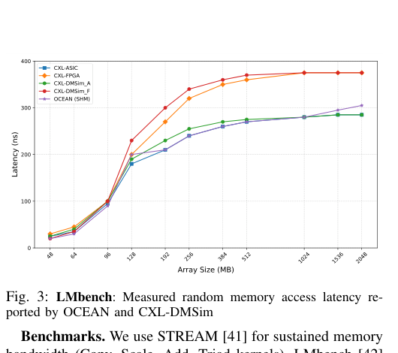
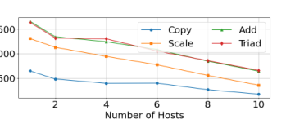
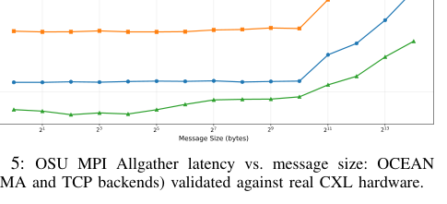
Fidelity snapshot: latency, bandwidth, collectives
EVALUATION
Three sanity checks, three different dimensions of realism.
LMbench
OCEAN tracks the large-array latency trend of the ASIC baseline.
STREAM
Per-host bandwidth falls as more hosts contend for the shared pool.
OSU MPI Allgather
RDMA stays much closer to real hardware than TCP.
These three views establish the baseline credibility before any application case study.
Notes:
Evaluation Scope: Presents three sanity checks across three different dimensions of realism.
LMbench: Demonstrates that OCEAN successfully tracks the large-array latency trend of the ASIC baseline.
STREAM: Shows that per-host bandwidth appropriately falls as more hosts contend for the shared pool.
OSU MPI Allgather: Illustrates that the RDMA backend stays much closer to real hardware performance than TCP.
Conclusion: These three views establish the baseline credibility of the emulator before conducting any application case studies.

Slide 49
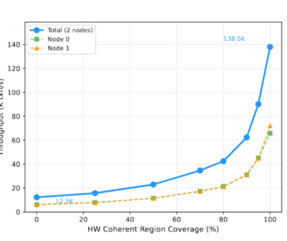
Case study: what hardware coherence buys you
CASE STUDY
TPC-C NewOrder exposes the software-flush tax directly: as more memory regions use hardware coherence, throughput rises sharply.
Interpretation
At 0% HCC, cross-host writes force clflush/mfence round-trips.
At 100% HCC, snoops and invalidations replace software flushes.
The bottleneck is coherence overhead, not raw bandwidth.
12.3K
138K
11×
txn/s at 0% HCC
txn/s at 100% HCC
throughput gain
Notes:
TPC-C Findings: The TPC-C NewOrder benchmark exposes the software-flush tax directly, showing that as more memory regions use hardware coherence (HCC), throughput rises sharply.
Metrics: Throughput increased from 12.3K txn/s at 0% HCC to 138K txn/s at 100% HCC, resulting in an 11× throughput gain.
Interpretation:
At 0% HCC, cross-host writes force costly clflush/mfence round-trips.
At 100% HCC, native snoops and invalidations replace the software flushes.
This confirms the bottleneck is coherence overhead, not raw bandwidth.

Slide 50
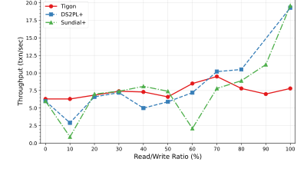
Case study: when software coherence stops scaling
CASE STUDY
YCSB read/write sweeps show the decision boundary: software coherence is fine for read-heavy workloads, but hardware coherence becomes essential as writes climb.
Tigon (HCC)
DS2PL+ / Sundial+
Tigon stays comparatively stable across the write spectrum.
Software-managed alternatives drop once the write ratio passes roughly 40%.
This gives designers a concrete crossover point for choosing coherence mode.
Notes:
YCSB Decision Boundary: YCSB read/write sweeps reveal that software coherence is adequate for read-heavy workloads, but hardware coherence becomes essential as the volume of writes climbs.
Protocol Comparison: Tigon (using HCC) stays comparatively stable across the write spectrum, while software-managed alternatives like DS2PL+ and Sundial+ suffer performance drops once the write ratio exceeds roughly 40%.
Takeaway: This provides designers with a concrete crossover point to inform their choice of coherence mode.

Slide 51
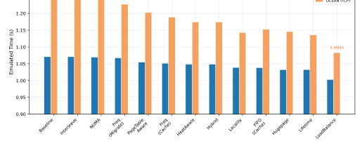
Case study: policy choice still matters
CASE STUDY
Even with the same emulator and the same application, memory placement policy changes execution time measurably.
12
≈7%
policies swept
performance spread
Static policies: interleave, NUMA-aware placement, huge-page promotion.
Dynamic policies: migration, heat-aware tiering, lifetime-based allocation, load balancing.
OCEAN makes this design-space exploration possible before hardware is common.
Notes:
Policy Impact: Even when utilizing the same emulator and the same application, the chosen memory placement policy changes execution time measurably.
Results: Sweeping across 12 different policies yielded approximately a 7% performance variation spread.
Static Policies: Tested policies included interleave, NUMA-aware placement, and huge-page promotion.
Dynamic Policies: Tested policies included migration, heat-aware tiering, lifetime-based allocation, and load balancing.
Conclusion: OCEAN enables this type of critical design-space exploration before the actual hardware becomes commonplace.

Slide 52
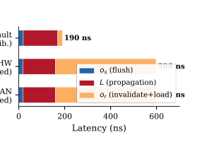
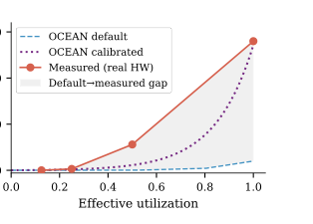
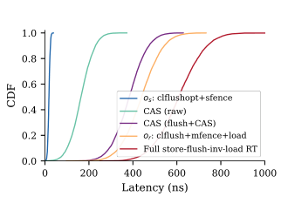
Calibration: why receiver overhead dominates
EVALUATION
We decompose cross-host access latency into per-operation pieces and shows where the default model was too optimistic.
Flush cost is tight; invalidate + reload has the long tail.
Receiver overhead o_r dominates the point-to-point path after calibration.
Default contention model underestimates high-utilization latency.
Takeaway: the timing model is not guessed; it is fitted so the guest feels realistic latency and congestion patterns.
Notes:
Latency Decomposition: The evaluation decomposes cross-host access latency into per-operation pieces, revealing where the default model was previously too optimistic.
Operation Costs: The flush cost is tightly bounded, but the invalidate + reload operations produce a long tail latency.
Receiver Impact: Receiver overhead ($o_r$) dominates the point-to-point path following calibration.
Contention: The default contention model significantly underestimates high-utilization latency.
Takeaway: The timing model is not merely guessed; it is explicitly fitted so that the guest operating system experiences realistic latency and congestion patterns.

Slide 53
Coffee breaks (30 mins; 3-3:30pm)
Back for Hands-on session
Links
Document: https://ocean.readthedocs.io
Git: https://github.com/cxl-emu/OCEAN
OCEAN deployment guide: https://docs.google.com/document/d/18nsbhXxNyZQN49KzRqq4YlFLQ-Yk9bth/edit
WASM link: https://asplos.dev/cxl2/ WASM Instructions: https://docs.google.com/document/d/1u_TabBSlr1Vlxb51-tlG3hLKTDs9XJu7V2wV1wDqYwk/edit?tab=t.0
Q&A for hands-on session: https://washington.zoom.us/j/92251532033?pwd=daTMb2wVFzO4HedlGVOezUMckY3dak.1

Slide 54
Hands-on & community
hosts
switch
memory

Slide 55
How to run the tutorial as a hands-on session
TUTORIAL
A practical sequence that keeps the audience engaged even if they are new to CXL.
Lab 1
Lab 2
Lab 3
Inspect topology + device model
Trace one coherent access
Change timing / policy
show HDM decoders
watch request path
toggle backend
show switch ports
track ownership
sweep HCC coverage
show DCD region
explain stall timing
change placement policy
Notes:
Format: The tutorial utilizes a practical sequence designed to keep the audience engaged, even if they are entirely new to CXL.
Lab 1 (Inspect topology + device model): Participants will learn to show HDM decoders, show switch ports, and show DCD regions.
Lab 2 (Trace one coherent access): Participants will watch the request path, track ownership, and have stall timing explained.
Lab 3 (Change timing / policy): Participants will toggle the backend, sweep the HCC coverage, and alter the memory placement policy.

Slide 56

What the open-source community can do next
COMMUNITY
OCEAN is a collaborative platform for addressing coherency, scalability, and hardware-availability challenges.
Current directions
OCEAN repository
test more workloads (e.g., LLM, graph analytics)
assess switch / fabric manager / coherence components individually
scale experiments toward cloud and hyperscale service settings
OCEAN repo
Notes:
Collaborative Nature: OCEAN serves as a collaborative platform dedicated to addressing coherency, scalability, and hardware-availability challenges.
Current Directions: Future work includes testing more workloads (such as LLM and graph analytics), assessing the switch, fabric manager, and coherence components individually, and scaling experiments toward cloud and hyperscale service settings.
Resources: A QR code and link are provided to access the OCEAN repository.

Slide 57
Takeaways
CLOSE
That is exactly where commodity hardware is currently least accessible.
1
CXL 3.0 is most interesting when multiple hosts share memory coherently.
2
OCEAN fills that gap with full-system emulation.
The guest OS and applications observe timing and correctness effects, not just traces.
The data matters.
The result shows an 11× coherence gain, a ~7% policy spread, and hardware-calibrated timing behavior.
3
4
The tutorial’s goal
Attendees should leave knowing what to run next and where to contribute.
Notes:
CXL 3.0: The technology is most interesting when multiple hosts share memory coherently, which is precisely where commodity hardware is currently least accessible.
OCEAN: The emulator fills this critical gap with full-system emulation, allowing the guest OS and applications to observe real timing and correctness effects rather than just reading traces.
Data Impact: The empirical data matters; results demonstrated an 11× coherence gain, an approximate 7% policy spread, and heavily relied on hardware-calibrated timing behavior.
Tutorial Goal: Attendees should leave the session knowing exactly what to run next and where they can contribute to the ecosystem.

Slide 58
Questions?

Slide 59
IPDPS 2026 1st Tutorial on OCEAN: An Open-Source CXL Emulation Platform at Hyperscale (Closing)
IPDPS 2026 Tutorial
Presenters:
Luanzheng (Lenny) Guo, Andres Marquez, Mujahid Al Rafi, PNNL
Yiwei (Vickie) Yang, UCSC & Zett.ai
Meng (Candice) Tang, Illinois Institute of Technology
Kenza Bouasker, UW & EPFL
PNNL-SA-160879

Slide 60
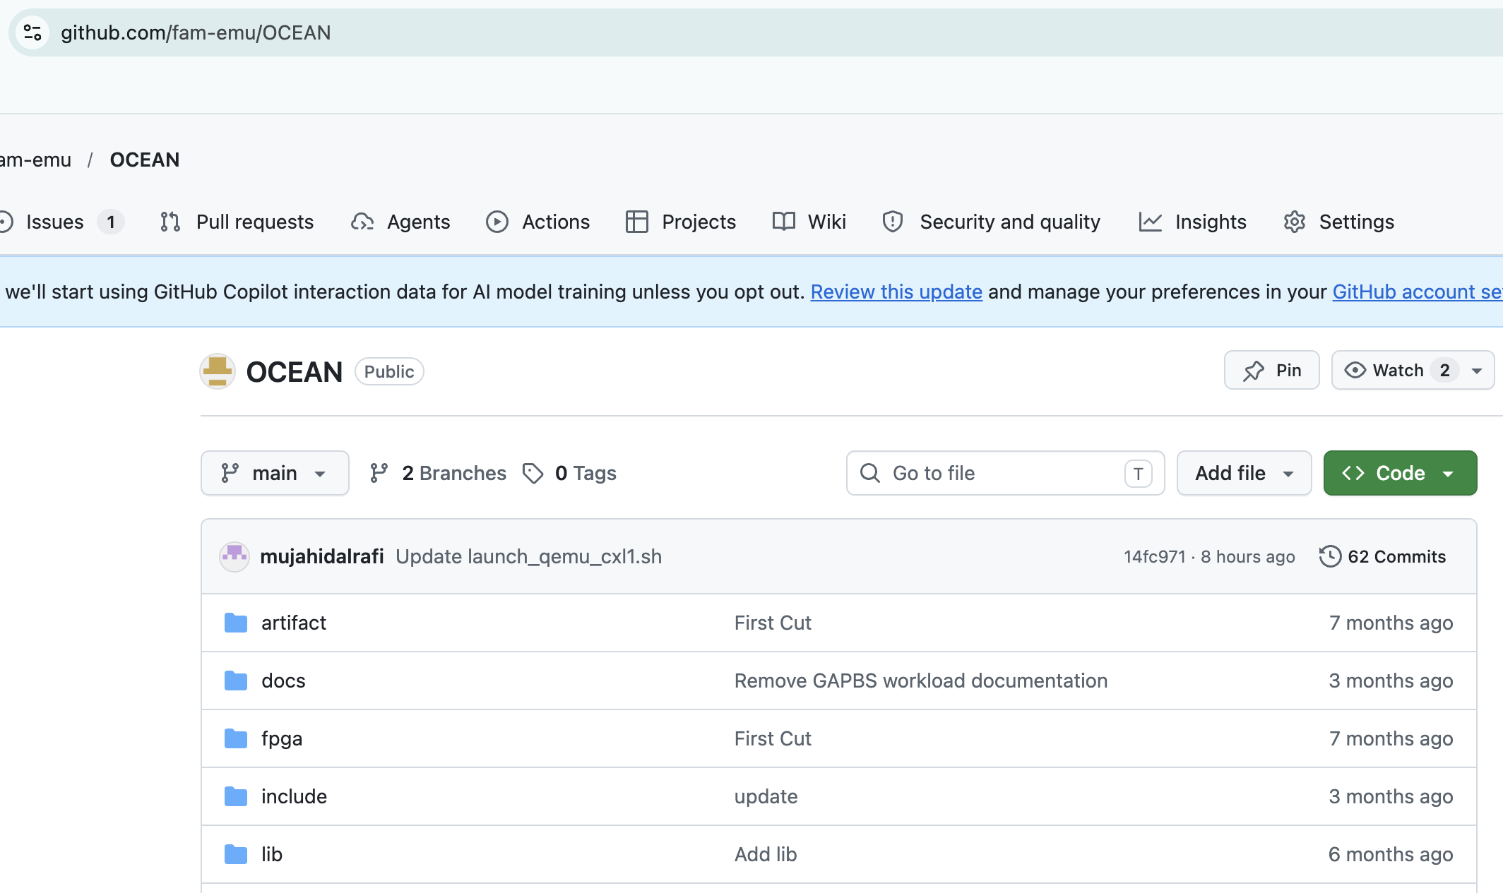
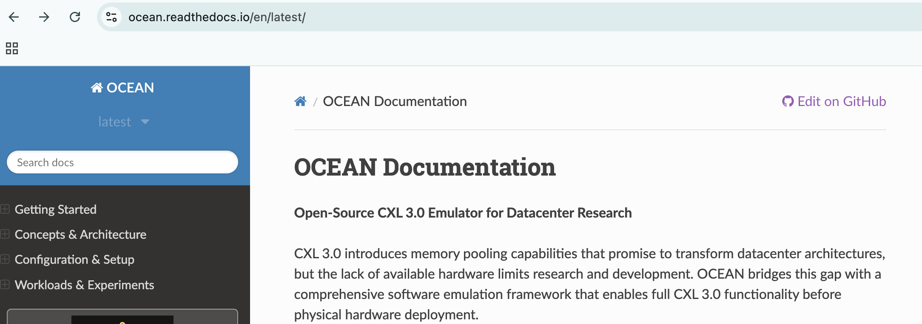
Slides, demos, and documents will be shared to the public on the OCEAN webpage (https://github.com/fam-emu/OCEAN)

Slide 61
Roadmaps
Will open the PNNL BlueOCEAN Emulation Platform (~36 nodes) with OCEAN emulation VMs deployed
Will collaborate with Cloud vendors to provide OCEAN emulation as a service
Will work closely with domain scientists to scale AI-driven science to tackle large-scale scientific challenges and elevate research to new heights
Will open to collaboration with the whole HPC system community, encouraging broad participation and shared advancements

Slide 62

Hiring!!
We are currently hiring, including student interns, postdoctoral researchers, and entry-level computer scientists.
If you are interested in joining us, please get in touch by email.
Look forward to hearing from you!
lenny.guo@pnnl.gov

Slide 63
Other activities at IPDPS
PowerMorph: Shaping LLM Training for Data Center Demand Response
Boqiang Li (Clemson University); Luanzheng Guo, et al.
Friday 3:30pm-4:14pm Salon D
Characterizing Dataflow for I/O-Aware Scheduling in HPC Workflows
Meng Tang (Illinois Institute of Technology), Luanzheng Guo, et al.
Thursday 10:30am-11:58am Salon E
QoSFlow: Ensuring Service Quality of Distributed Workflows Using Interpretable Sensitivity Models
Md Hasanur Rashid (University of Delaware); Jesun Firoz, Nathan R. Tallent, and Luanzheng Guo, et al.
Wednesday 1:30pm-2:58pm Salon D
Accelerating AI Compression through Lightweight Lossless Encoding and Pipelined Workflows
Boyuan Zhang (Indiana University), Luanzheng Guo, et al.
Wednesday 10:30am-11:58am Salon F-G-H

Slide 64
Thank you!

