Slide 1

Project for the study of suicide rate
By GROUP 10:
JIANING XU, HUMPHREY ZHANG, JUNZHEN LAO

Slide 2
Introduction & dataset description
In 2014, nearly 781,000 people in the world die from suicide, while in 2017, this number was nearly 793,000.
Suicide Rates Overview 1985 to 2016: It is collected for the purpose of recording the relationship between suicide rates and GDP, age group, and sexuality among different countries over the years from 1985 to 2016.
There is a total of 27921 rows with 11 columns representing the country, year, sex (male/female), age, suicide number, population, suicide rate, HDI, GDP, GDP per capita, and generation.
Notes:
Now there is more and more news about suicide, which has aroused people's attention. We can analyze some social problems by analyzing the suicide rate and its related data. The suicide rate is an important indicator to analyze social issues in the world, as well as potential reasons for suicide that can lead to its growth or decline. In the world, the global suicide rate has been increasing in recent years. In particular, in 2014, nearly 781,000 people in the world die from suicide, while in 2017, this number was nearly 793,000 (Our World in Data, n.d.). Therefore, this huge number of suicide data has caught our attention and we are interested in this topic.
The data set being analyzed is titled “Suicide Rates Overview 1985 to 2016” on Kaggle. It is collected for the purpose of recording the relationship between suicide rates and GDP, age group, and sexuality among different countries over the years from 1985 to 2016. There is a total of 27921 rows with 11 columns representing the country, year, sex (male/female), age, suicide number, population, suicide rate, HDI, GDP, GDP per capita, and generation.

Slide 3
Research Question
We want to analyze the relationship between suicide rates and GDP per capita to see if the country's economy and social stability impact suicide rates.
We try to explore the relationship between suicide rates and age groups to look at the stresses and challenges faced by different age groups and find solutions to reduce the corresponding suicide rates.
We wish to focus on the relationship between Canada's suicide rates and different years, gender and age. We combine some relevant information to analyze some of Canada's social problems.
Notes:
Based on our study's original purpose and the dataset collected, we raised three research questions:
3.1. We want to analyze the relationship between suicide rates and GDP per capita to see if the country's economy and social stability impact suicide rates.
3.2. We try to explore the relationship between suicide rates and age groups to look at the stresses and challenges faced by different age groups and find solutions to reduce the corresponding suicide rates.
3.3. We wish to focus on the relationship between Canada's suicide rates and different years, gender and age. We combine some relevant information to analyze some of Canada's social problems.

Slide 4
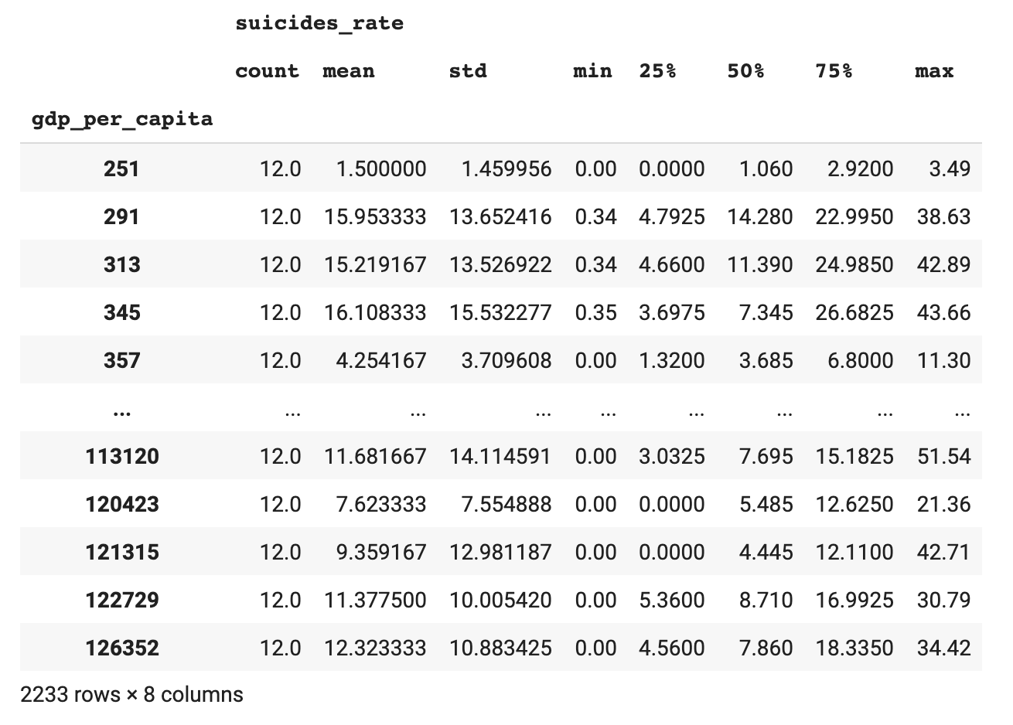
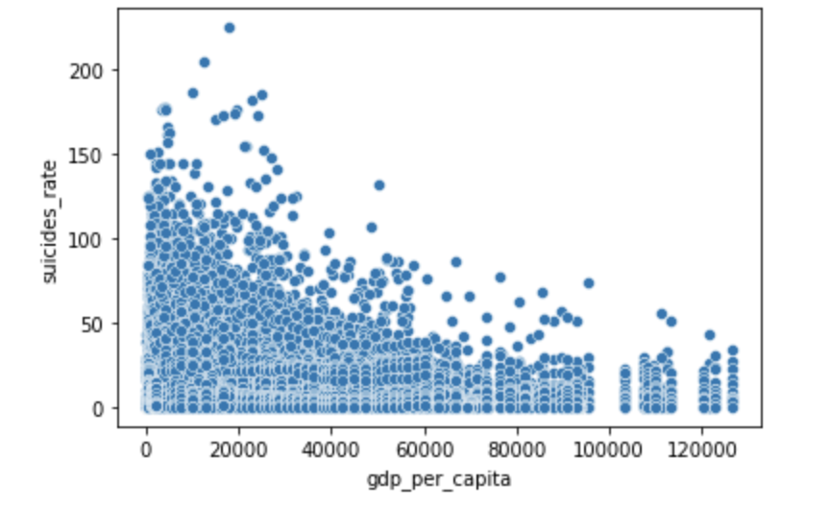
Research question 1 – Descriptive STATISTICS

Slide 5
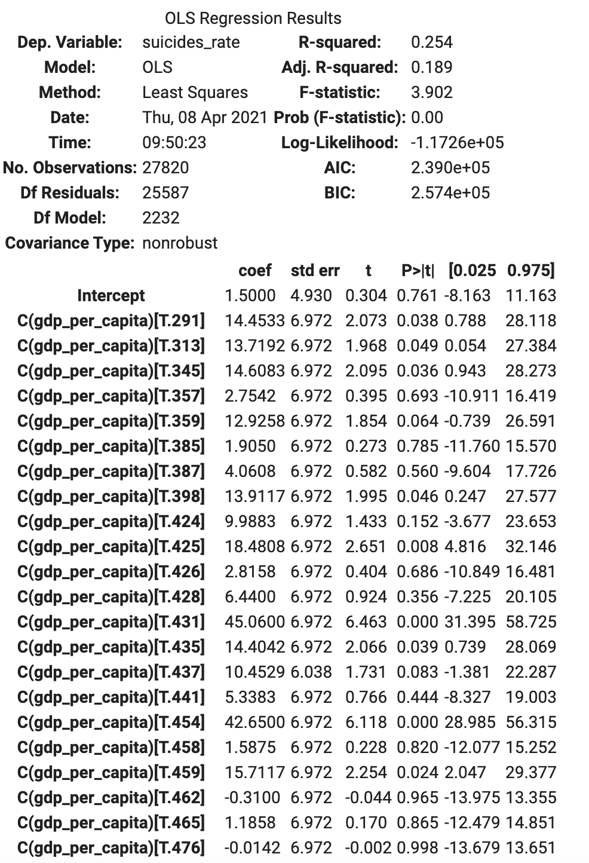
Research question 1 – Power analysis

Slide 6
Research question 1 – METHODS & RESULTS

Slide 7
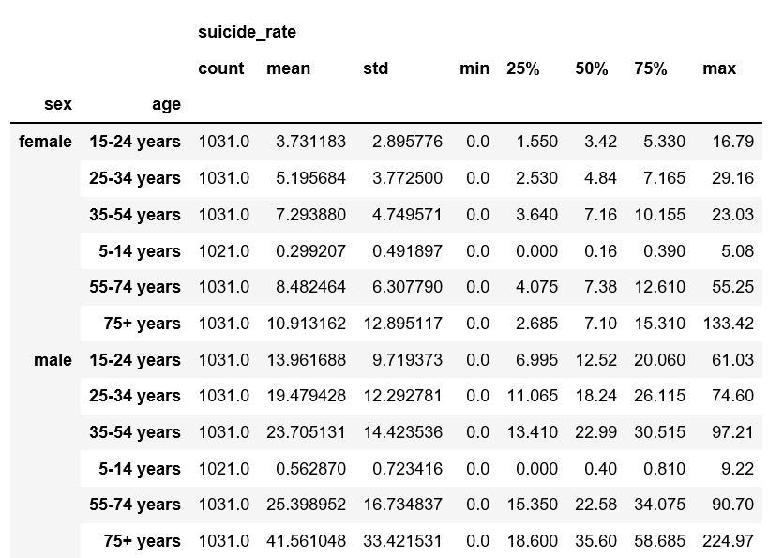
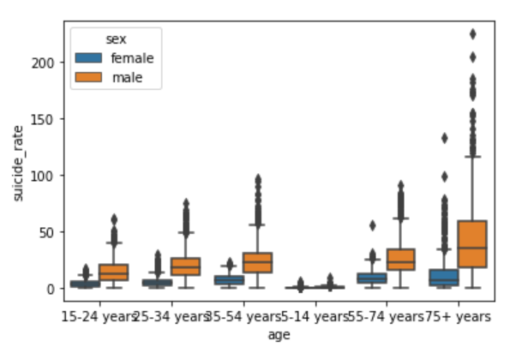
Research question 2 – Descriptive STATISTICS
In the developed countries, the mean suicide rate of women over the age of 75 is 10.913, which is higher than the women of other age groups. And the mean suicide rate of men over the age of 75 is 41.561, which is higher than the men of other age groups. Besides, men have higher suicide rates than women in all different age groups.
In addition, from the boxplot, we find that the age group of 5-14 years has the lowest suicide rate and the age group of 75+ years has the highest suicide rate.

Slide 8
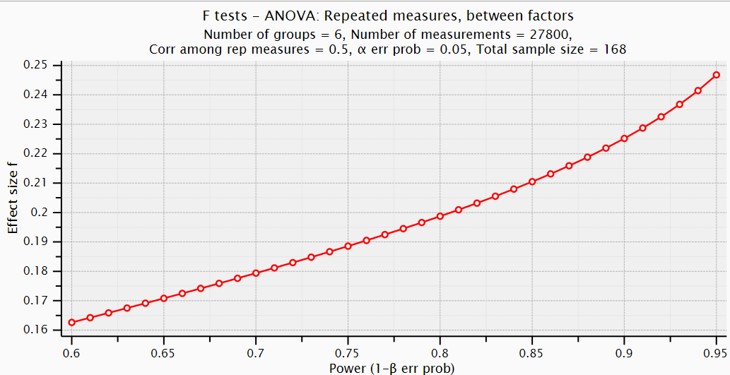
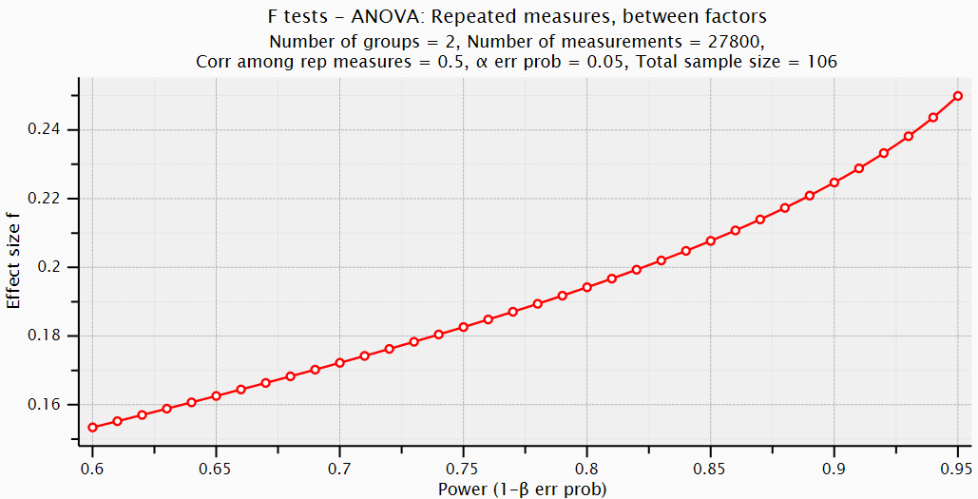
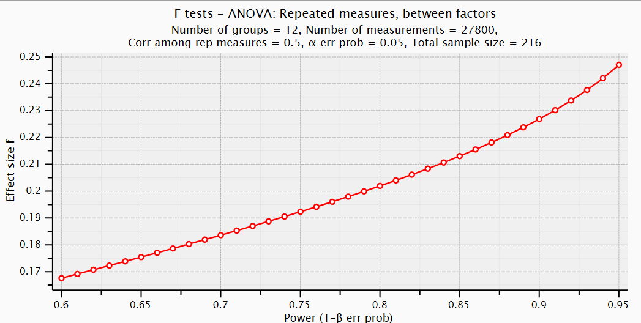
Research question 2 – power analysis
Power for age
Power for sex
Power for age and sex
Notes:
Graph 1, 2 and 3 corresponds to the relationship between power and effect size for our main effects ‘age’, ‘sex’ and their interaction with the large sample size of 27800. Our power behaves pretty well with the main effects since the sample size for each group is large enough and we can see that our sample size is relatively powerful in finding out small effect sizes.

Slide 9
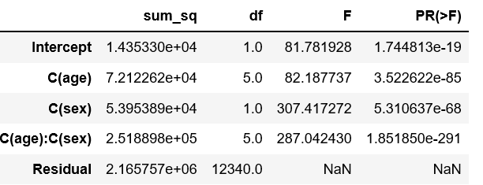
Research question 2 – ANOVA & RESULTS
Two-way ANOVA means there are two independent variables: 'age' and 'sex'. Our dependent variable is ‘suicide rate’.
We conducted ANOVA on our two main effects and their interaction. The p-values for all the effects and interactions are less than the common alpha value 0.05
The vairable ‘age’ significantly affects suicide rate
The variable ‘sex’ significantly affects suicide rate
The interaction of age and sex significantly affects 'suicide rate'

Slide 10
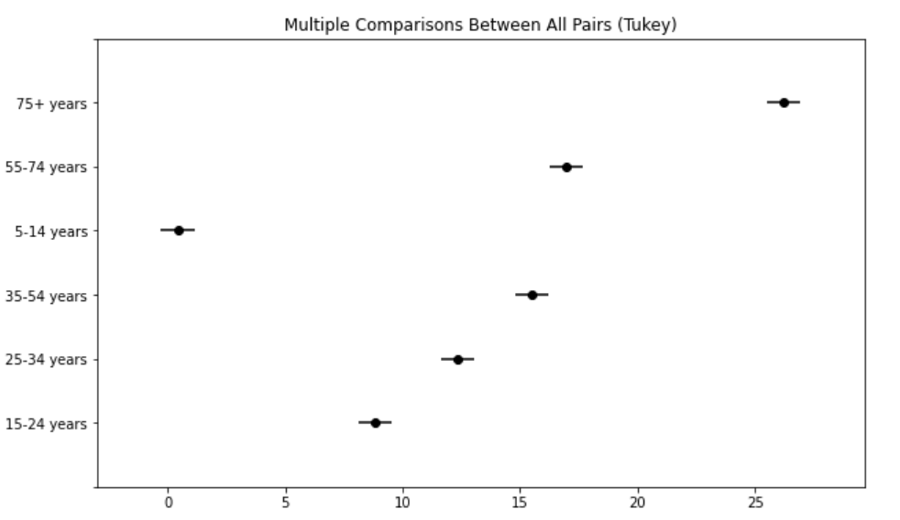

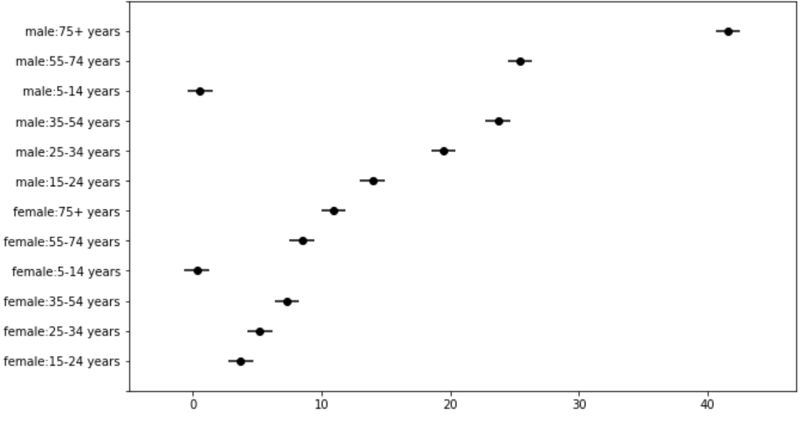
Research question 2 – POST HOC TEST
perform multiple pairwise comparison (Tukey HSD) for main effects 'age'
perform multiple pairwise comparison (Tukey HSD) for main effects 'sex'
Graph b
The mean suicide rate difference is significant between different age groups. (Graph a)
There is a significant difference in the means of suicide rate between male and female. (Graph b)
All the suicide rates for female is much lower than male no matter the age, except when the age is between 5-14 years. (Graph c)
The suicide rate for male 75+ years is much higher than other groups. (Graph c)
Graph a
perform multiple pairwise comparison (Tukey HSD) for interaction effect
between age and sex
Graph c

Slide 11
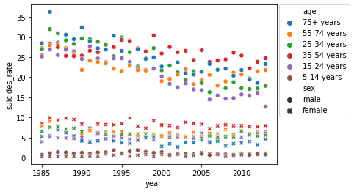
Research question 3 – Is there any relationship between the suicides rates, years, gender and age?
Any trend for year?
A large gap between male and female
How about the age?

Slide 12
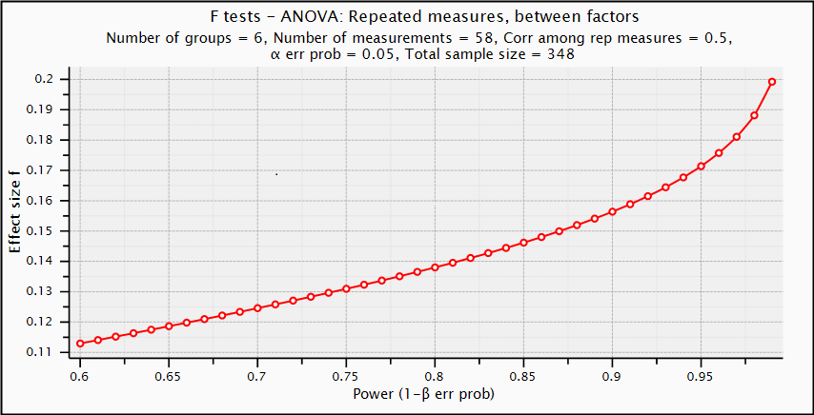
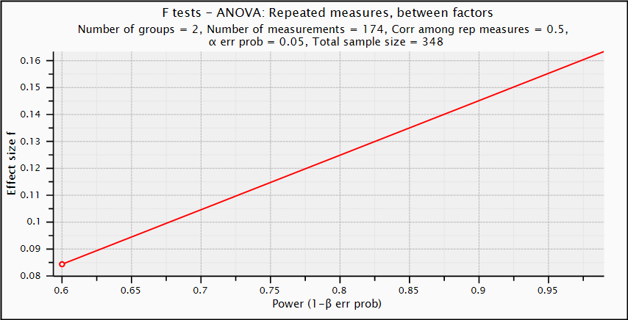
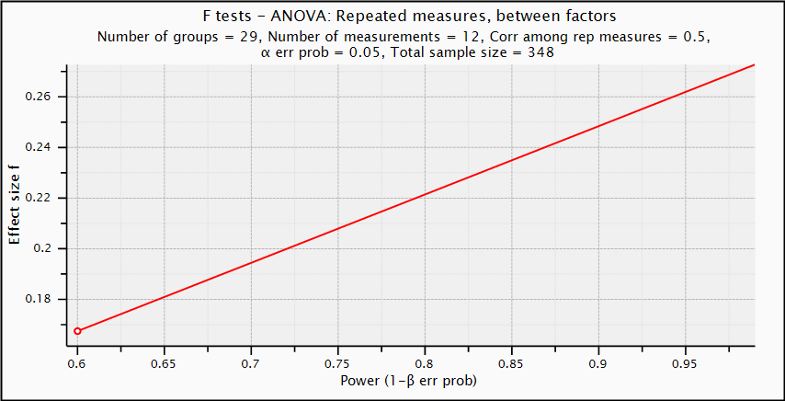
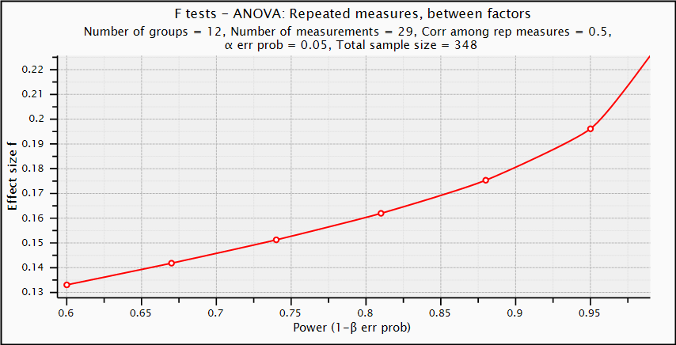
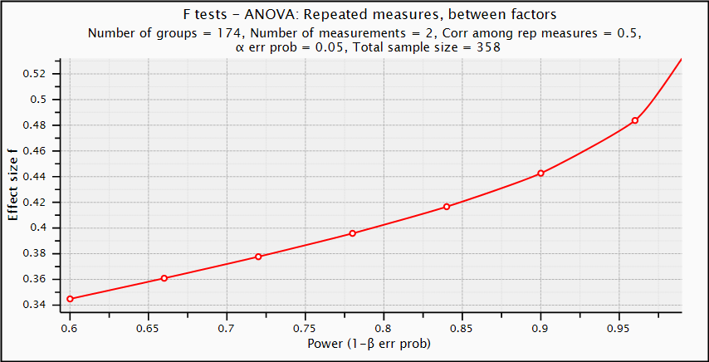

Research question 3 – power analysis
Power for age
Power for gender
Power for years
Power for age and gender
Power for age and years
Power for gender and years

Slide 13
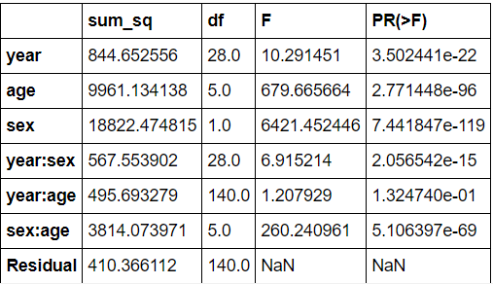
Research question 3 – ANOVA RESULT
We conducted a three-way ANOVA for our analysis.
Our dependent variable is the suicide rates, and the independent variables are the years, gender, age group, and their two-way interactions
Parameters that are statistically significant: Year
Age
Sex
Year & Sex
Sex & Age
Parameters that are statistically insignificant: Year & Age

Slide 14
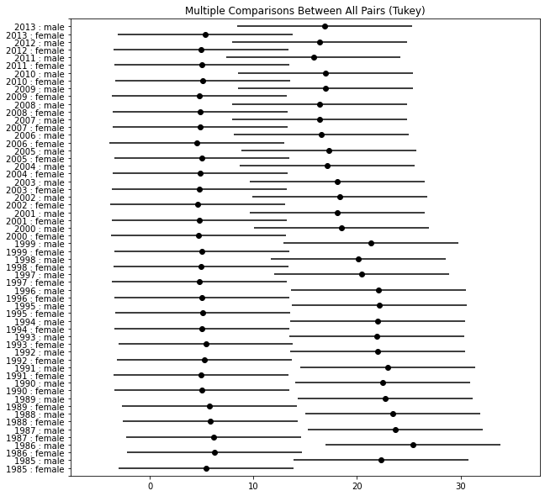
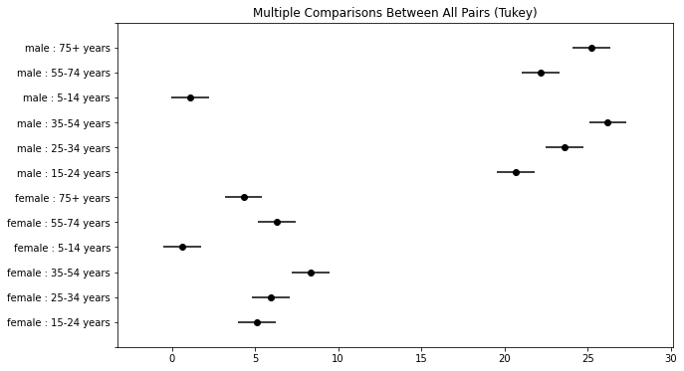
Research question 3 – POST HOC TEST
Year & Gender: Nothing particular in general.
Gender & Age: All of the differences in suicide rates are statistically significant between female and male no matter if the ages are the same or not. The only exception happens between 5-14 years, that the difference for female and male is statistically insignificant.

Slide 15
Results and discussions
Countries with higher GDP per capita tends to have higher suicide rates.
Among those countries with the GDP per capita higher than $12000, their suicide rates have relationships with both age and gender.
Canada's suicide rates has relation with different years, gender and age. And more specifically, male tends to have higher suicide rates than female after the age of 15.
Any lessons or possible improvements?
Power analysis is important.
Could try to do analysis on multiple datasets and conclude them together.
Could consider more possibly effecting variables such as employment rates or education levels.

Slide 16

Thank you!

