Slide 1
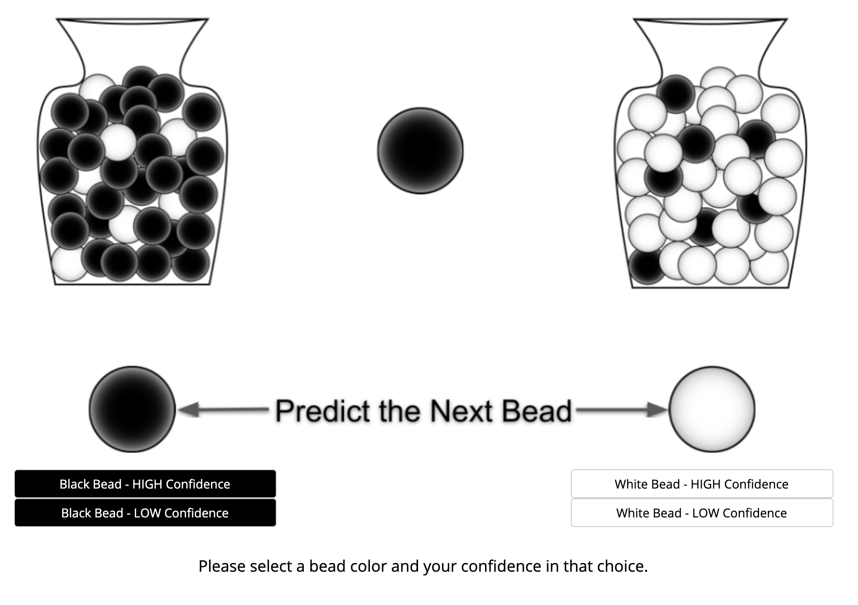
Task starts
Subject selects option
Correct bead appears
Next trial

