Slide 1

Shopping list
IPD Java III Final Project
– Weiwei Guo

Slide 2
Objective
Create a Java spring web application – shopping list

Slide 3
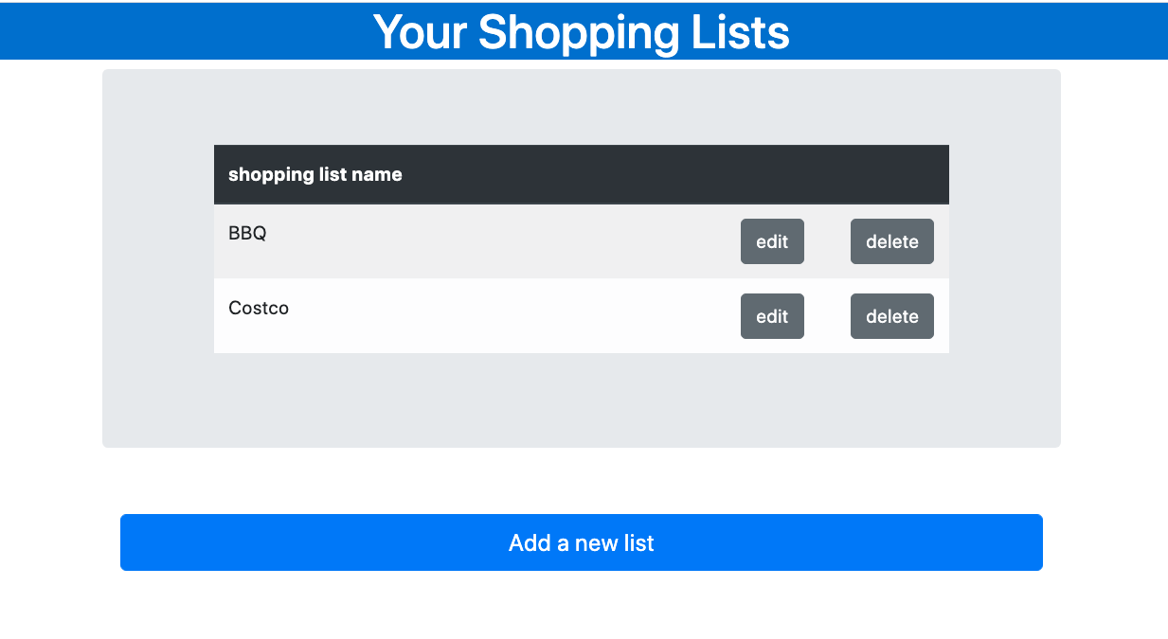
UI Design
Home page
Display saved lists
Click, page goes to another page to add a new list

Slide 4
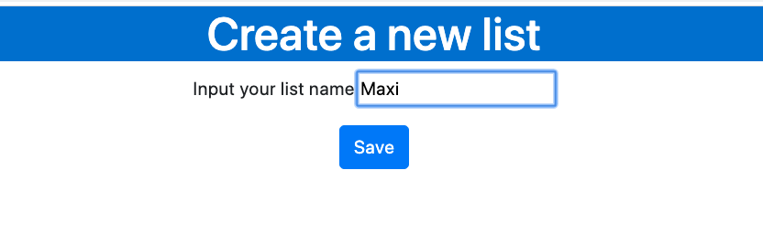
UI Design
Create a new shopping list
Input a list name & Click to save

Slide 5
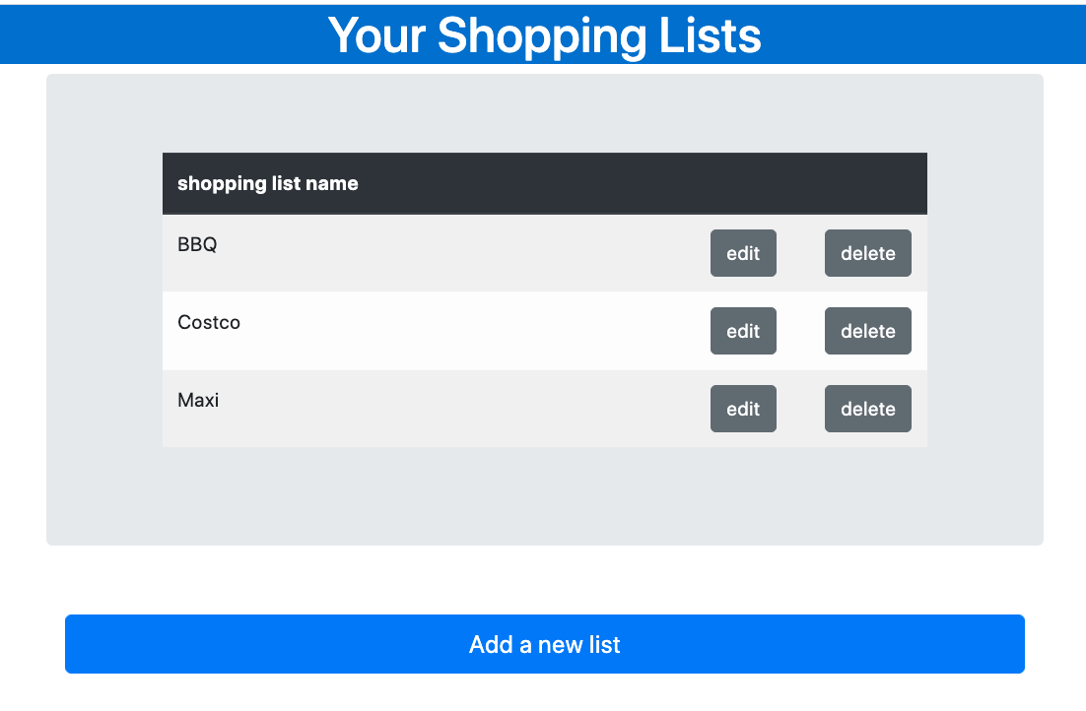
UI Design
Show lists
New list 'Maxi' is saved
Click 'delete' to delete,
Click 'edit' to edit in another page

Slide 6
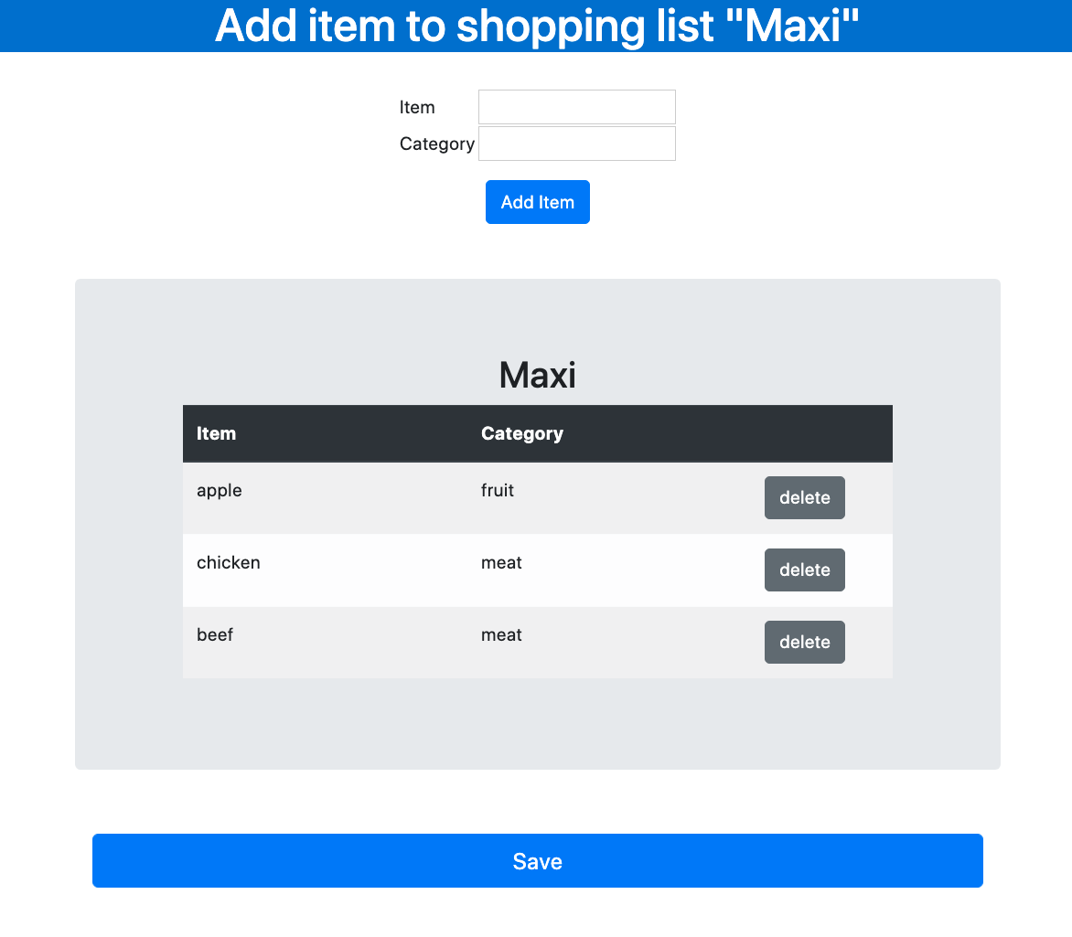
UI Design
Display the list name you chose to edit
Edit a list
Input item name & category name, the record is showing in the list
Click 'Save' to save the record to list

Slide 7
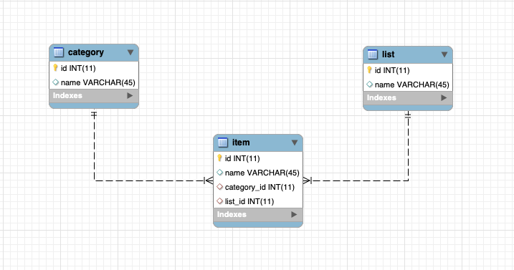
DB Design

Slide 8
Develop Environment
macOS Catalina

Slide 9
Develop Softwares
Eclipse IDE
Apache Tomcat
MySQL Comminity Server
MySQL Workbench

Slide 10
Develop Technologies
Spring Framework: Spring MVC + Spring JDBC + Annotations
Java Servlet
Java Server Pages (JSP)
JSP Standart Tag Library (JSTL)
Hibrenate: database connection
Maven

Slide 11
Steps
1. Create MySQL Database
2. Create Dynamic Web Project
3. Specify Depencies
4. Create resouces folder and add property files
5. Add Configurations
6. Code Model Entities
7. Code Dao
8. Code Service
9. Code Controller
10. Code View

