Slide 1

Blockchain: The Decentralized Revolution
Blockchain is a revolutionary decentralized technology that enables secure, transparent, and tamper-proof digital transactions without the need for a central authority. This groundbreaking system has the potential to transform industries, redefine trust, and empower individuals in the digital age.

Slide 2
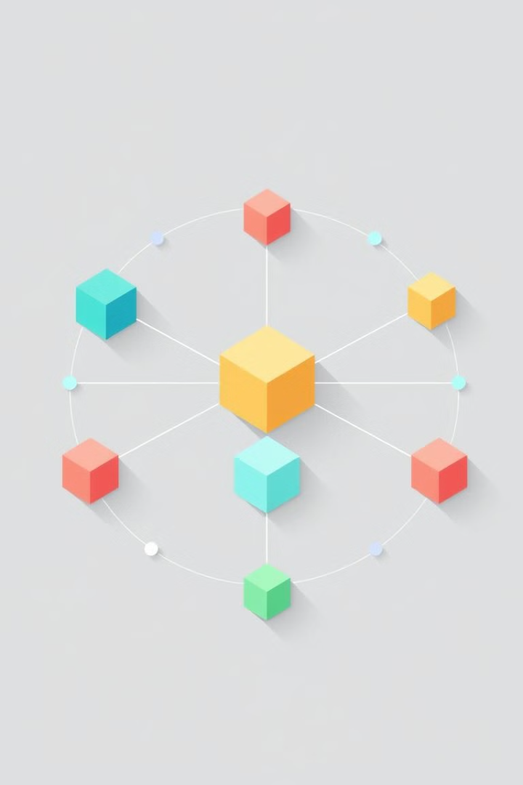
Introduction to Blockchain Technology
1
Distributed Ledger
2
Transparency and Trust
Blockchain is a decentralized digital ledger that records transactions across many computers in a network.
The distributed nature of the blockchain ensures transparency and builds trust, as all transactions are publicly verifiable.
3
Security and Immutability
Blockchain utilizes cryptography to secure the network and make the ledger virtually impossible to alter.

Slide 3
Key Components of Blockchain
Blocks
Transactions
Nodes
The basic units that store transaction data, with each block linked to the previous one, forming a chain.
Digital records of exchange, verified and added to the blockchain through a consensus mechanism.
Computers or devices that maintain a copy of the blockchain and validate new transactions and blocks.

Slide 4
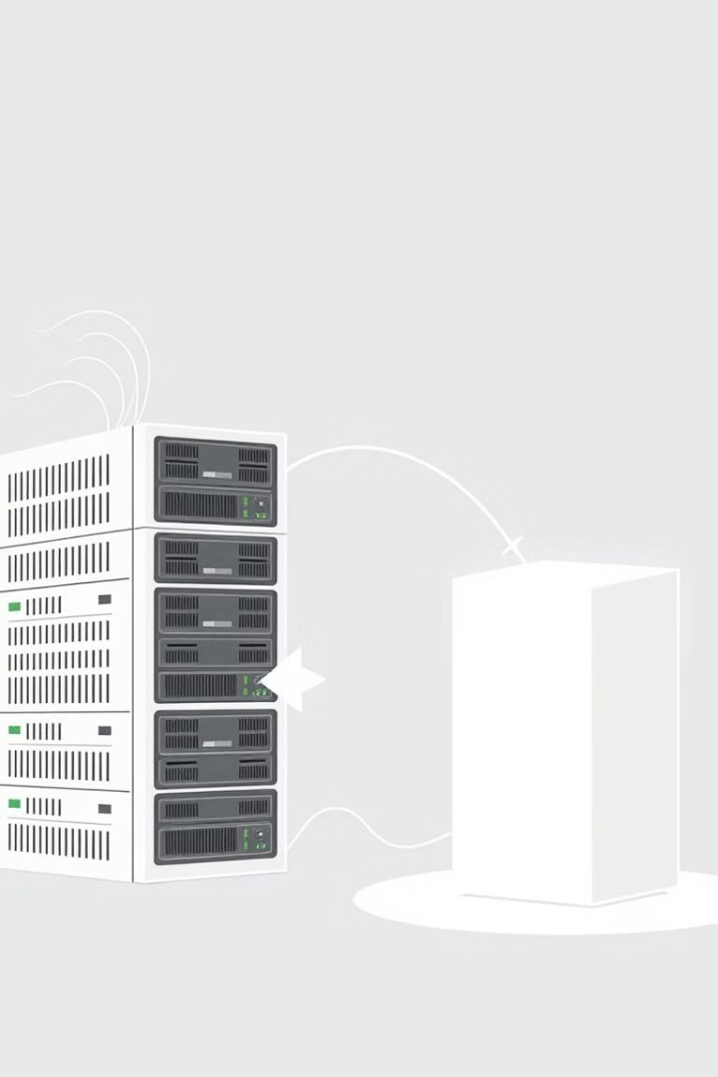
How Blockchain Works: Blocks, Chains, Miners, Cryptography
1
Blocks
New transactions are grouped into blocks, with each block containing a unique identifier, called a hash.
2
Chains
Blocks are chained together chronologically, with each new block referencing the hash of the previous block.
3
Miners
Miners use computational power to verify transactions, solve complex mathematical problems, and add new blocks to the chain.

Slide 5
Types of Blockchain: Public, Private, Consortium
Public Blockchain
Private Blockchain
Consortium Blockchain
Open to anyone, with transactions and blocks visible to the public. Examples include Bitcoin and Ethereum.
Controlled by a single organization, with restricted access and permissions managed by a central authority.
Managed by a group of organizations, with a shared governance model and controlled access to the network.

Slide 6

Cryptocurrency: The Birth of Bitcoin
Digital Currency
Decentralized Network
Bitcoin, the first and most well-known cryptocurrency, is a digital asset designed to work as a medium of exchange.
The Bitcoin network is decentralized, with transactions verified and recorded on a public distributed ledger.
Blockchain-based
Pseudonymous
Bitcoin's underlying technology is the blockchain, which enables secure, transparent, and tamper-proof transactions.
Bitcoin transactions are pseudonymous, as they are associated with a wallet address rather than a real-world identity.

Slide 7
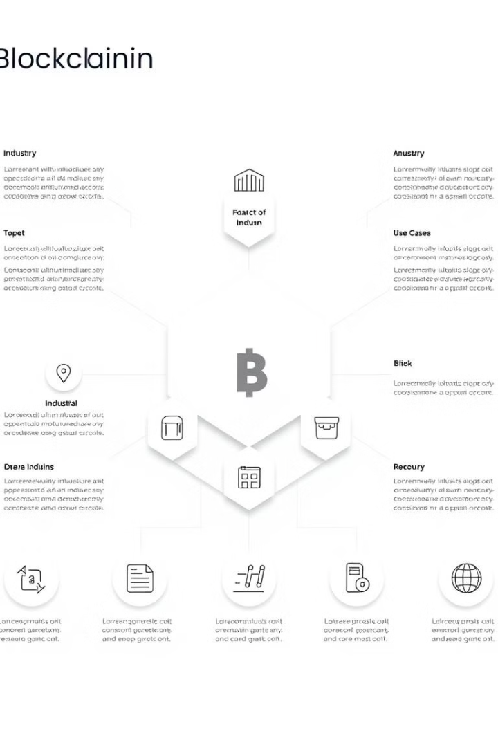




Blockchain Applications: Supply Chain, Digital Identity, and Beyond
Supply Chain
Digital Identity
Blockchain can enhance transparency, traceability, and efficiency in supply chain management.
Blockchain-based digital identity solutions can help secure personal data and reduce fraud.
Healthcare
Finance
Blockchain can improve data security, patient privacy, and seamless data sharing in the healthcare industry.
Blockchain can revolutionize financial services, enabling faster, cheaper, and more secure transactions.

Slide 8
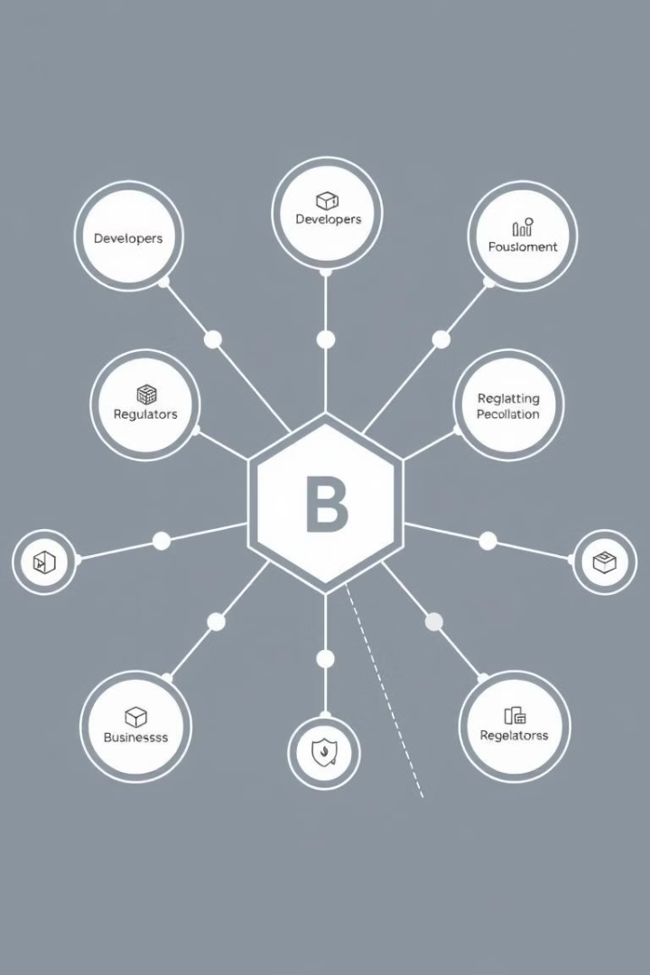




The Blockchain Ecosystem
Developers
Engineers and researchers who build and improve blockchain technologies and applications.
Businesses
Organizations that adopt and integrate blockchain solutions into their operations and services.
Users
Individuals and communities who utilize blockchain-based products and services.
Regulators
Governmental and financial authorities that establish policies and guidelines for blockchain adoption.

Slide 9

Key Challenges: Scalability, Energy Consumption, Regulation
1
Scalability
2
Energy Consumption
3
Regulation
The ability to handle growing transaction volumes and maintain low latency is a significant challenge for blockchain networks.
The energy-intensive nature of the mining process used to validate transactions is a concern for the sustainability of blockchain networks.
Lack of clear and consistent regulation around blockchain and cryptocurrency can hinder mainstream adoption and integration.

Slide 10
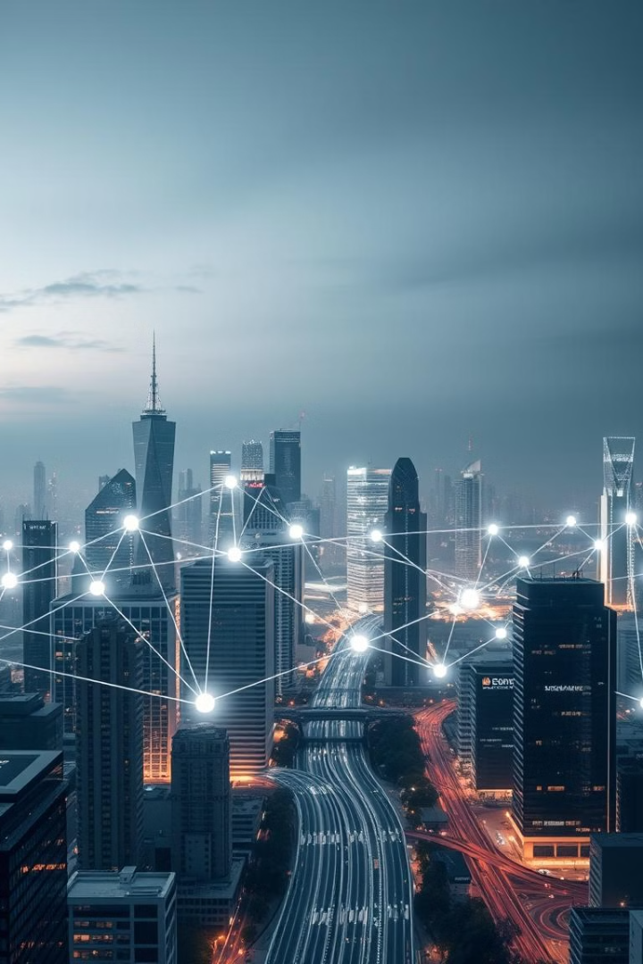
The Future of Blockchain: Transforming Industries
1
Decentralized Finance
Blockchain-based financial services that are more transparent, accessible, and secure than traditional systems.
2
Smart Contracts
Self-executing contracts that automatically enforce the terms of an agreement, reducing the need for intermediaries.
3
Internet of Things (IoT)
Blockchain can enable secure, decentralized communication and data sharing between IoT devices.

