Slide 1
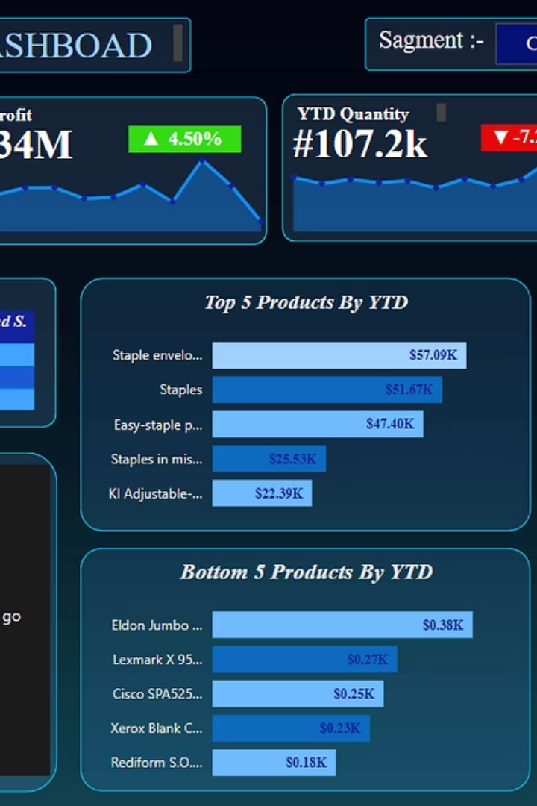
E-commerce Sales Analysis Dashboard with Power BI
Interactive dashboard for data-driven business decisions

Slide 2




Dashboard Overview
Visualize Sales Data
Track Performance
Interactive visuals for key metrics
YTD sales and profit calculations
Enhanced Exploration
Slicers and filters for detailed analysis

Slide 3
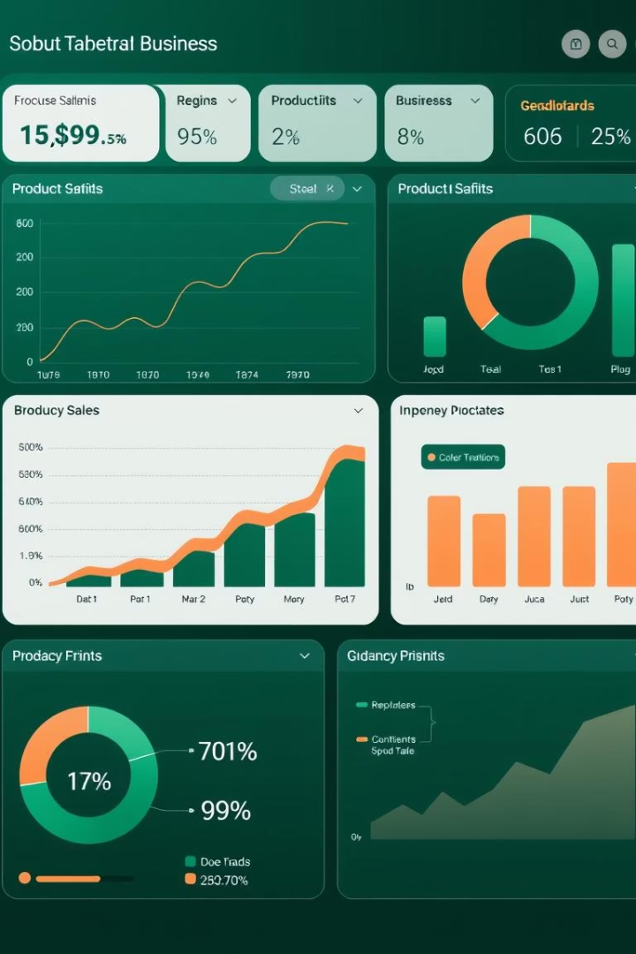
Key Features
Interactive Visualizations
Appealing charts and graphs
Key Metrics
Sales, profit, performance tracking
Product Analysis
Top-selling items identified
Regional Patterns
Geographic sales distribution

Slide 4





Data Transformation Process
Raw Data Collection
Gather e-commerce sales data
Cleaning
Python scripts for preprocessing
Transformation
Structure for analysis
Visualization
Create Power BI dashboard

Slide 5








Business Insights
Strategic Decisions
Data-driven business planning
Performance Analysis
Sales and profit trends
Product Intelligence
Top performers identified
Market Understanding
Regional sales patterns

Slide 6
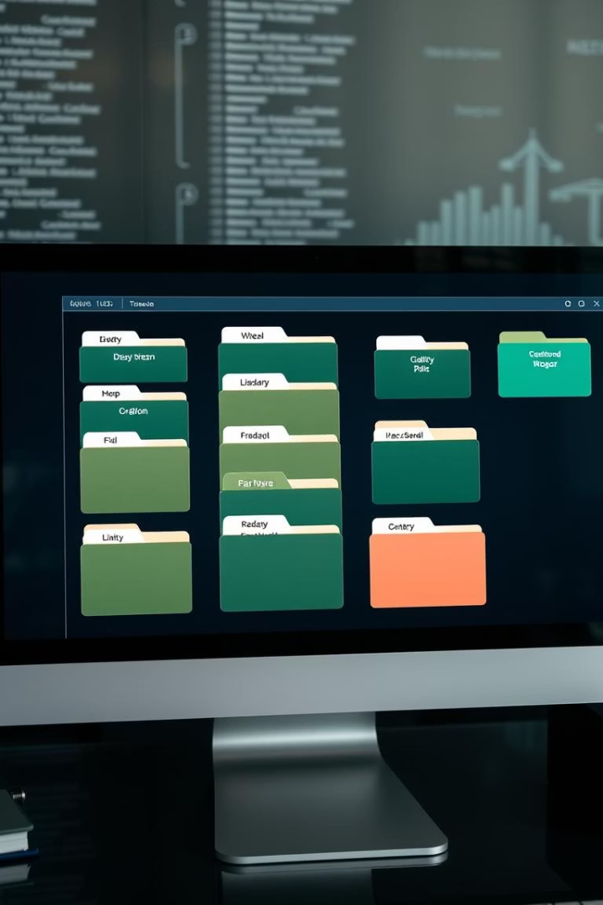




Project Structure
Project Storytelling
Detailed presentation file
Description
In-depth analysis documentation
README.md
Project overview and guide
Data Cleaning
Python scripts for preprocessing

Slide 7
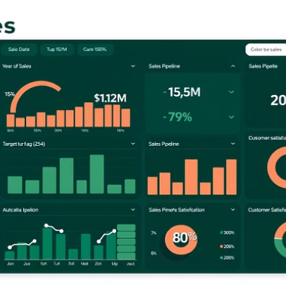
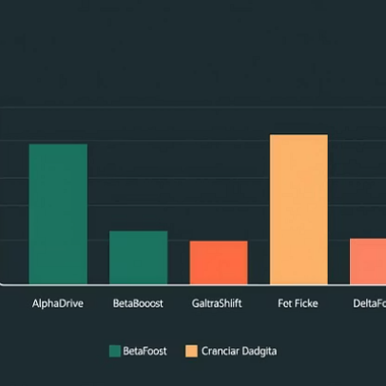
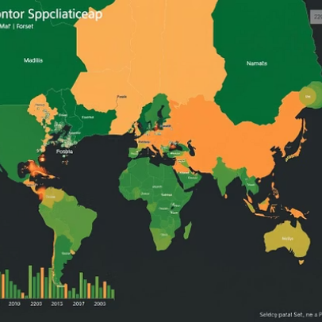
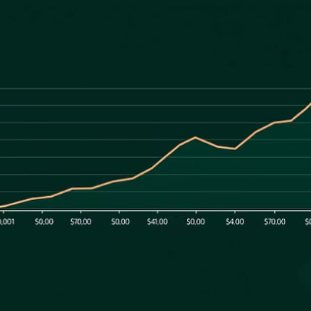
Dashboard Components
Interactive elements for comprehensive business analysis

Slide 8
Contribution & Next Steps
Review Dashboard
Explore interactive features
Analyze Documentation
Check description folder
Contribute Improvements
Submit pull requests

