Slide 1
Virtualization
Unit-2

Slide 2
Distributed and Cloud Computing K. Hwang, G. Fox and J. Dongarra Chapter 3: Virtual Machines and Virtualization of Clusters and datacenters Adapted from Kai Hwang University of Southern California March 30, 2012

Slide 3
Virtualization for Datacenter Automation to serve millions of clients, simultaneously
Server Consolidation in Virtualized Datacenter
Virtual Storage Provisioning and Deprovisioning
Cloud Operating Systems for Virtual Datacenters
Trust Management in virtualized Datacenters

Slide 4
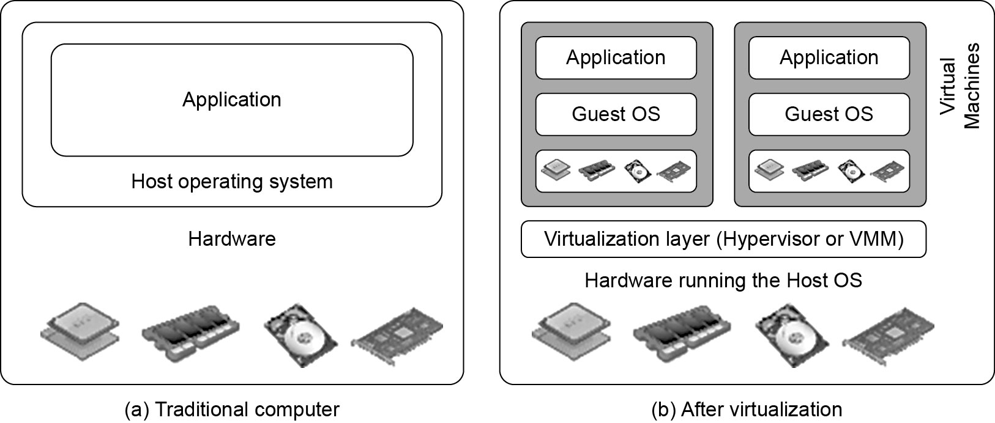
Difference between Traditional Computer and Virtual machines
(Courtesy of VMWare, 2008)

Slide 5
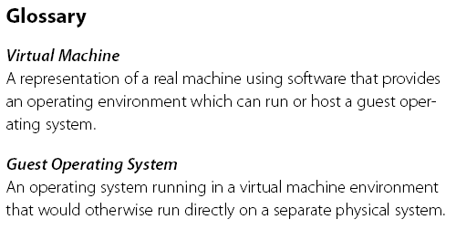
) :Virtual Machine, Guest Operating System, and VMM (Virtual Machine Monitor
The Virtualization layer is the middleware between the underlying hardware and virtual machines represented in the system, also known as virtual machine monitor (VMM) or hypervisor.

Slide 6
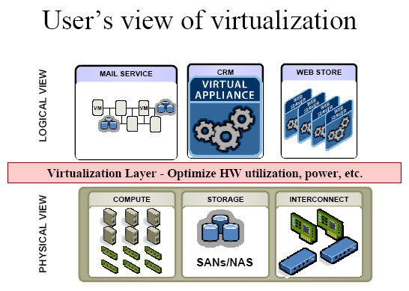
(Courtesy of VMWare, 2008)

Slide 7
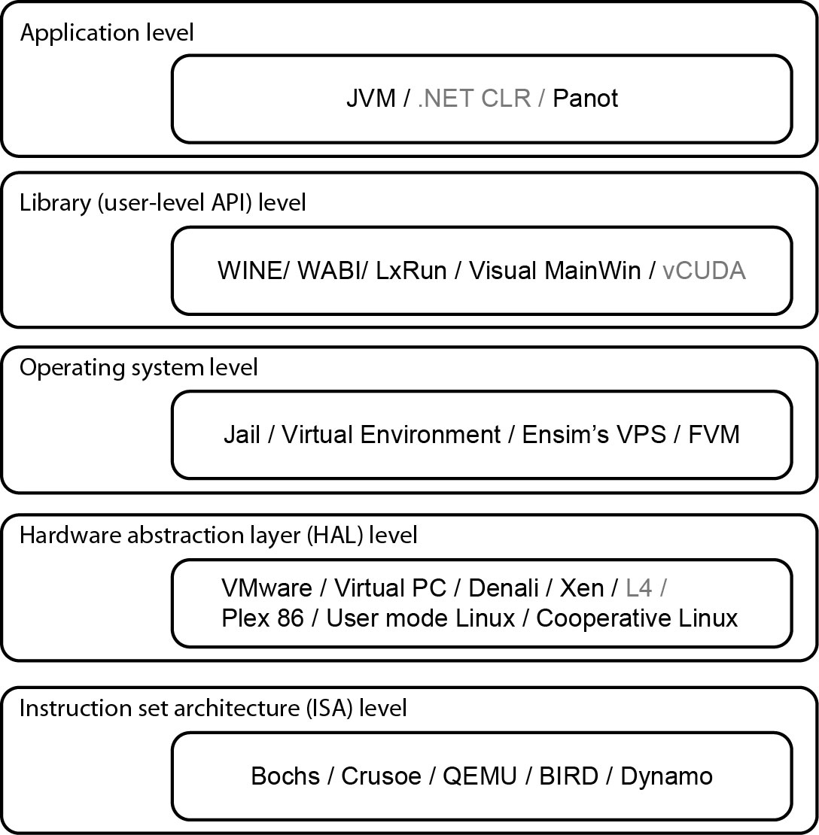
Virtualization Ranging from Hardware to Applications in Five Abstraction Levels

Slide 8
Virtualization at ISA (Instruction Set Architecture) level:
Emulating a given ISA by the ISA of the host machine.
e.g, MIPS binary code can run on an x-86-based host machine with the help of ISA emulation.
Typical systems: Bochs, Crusoe, Quemu, BIRD, Dynamo
Advantage:
It can run a large amount of legacy binary codes written for various processors on any given new hardware host machines
best application flexibility
Shortcoming & limitation:
One source instruction may require tens or hundreds of native target instructions to perform its function, which is relatively slow.
V-ISA requires adding a processor-specific software translation layer in the complier.

Slide 9
Virtualization at Hardware Abstraction level: Virtualization is performed right on top of the hardware.
It generates virtual hardware environments for VMs, and manages the underlying hardware through virtualization.
Typical systems: VMware, Virtual PC, Denali, Xen
Advantage:
Has higher performance and good application isolation
Shortcoming & limitation:
Very expensive to implement (complexity)

Slide 10
Virtualization at Operating System (OS) level:
It is an abstraction layer between traditional OS and user placations.
This virtualization creates isolated containers on a single physical server and the OS-instance to utilize the hardware and software in datacenters.
Typical systems: Jail / Virtual Environment / Ensim's VPS / FVM
Advantage:
Has minimal starup/shutdown cost, low resource requirement, and high scalability; synchronize VM and host state changes.
Shortcoming & limitation:
All VMs at the operating system level must have the same kind of guest OS
Poor application flexibility and isolation.

Slide 11
Virtualization at OS Level

Slide 12
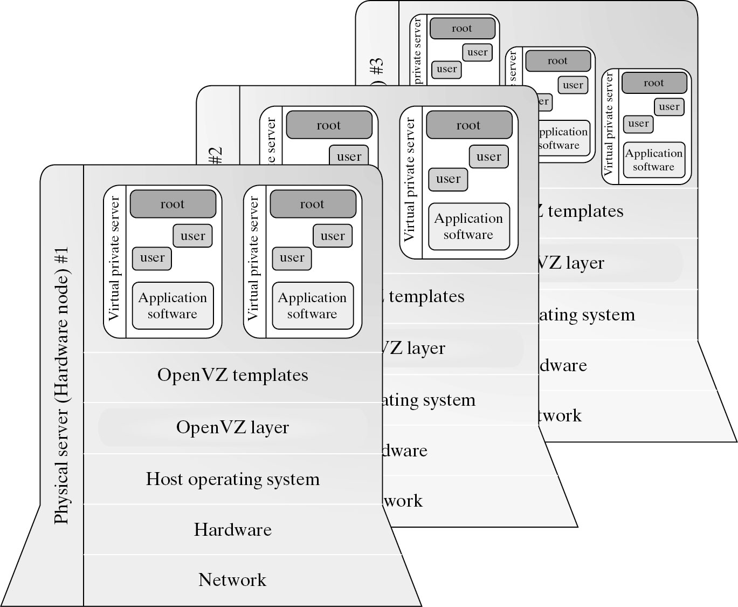
Virtualization for Linux and Windows NT Platforms

Slide 13


Slide 14
Advantages of OS Extension for Virtualization
VMs at OS level has minimum startup/shutdown costs
OS-level VM can easily synchronize with its environment
Disadvantage of OS Extension for Virtualization All VMs in the same OS container must have the same or similar guest OS, which restrict application flexibility of different VMs on the same physical machine.

Slide 15
Library Support level:
It creates execution environments for running alierather than creating VM to run the entire operating system.
It is done by API call interception and remapping.
Typical systems: Wine, WAB, LxRun , VisualMainWin
Advantage:
It has very low implementation effort
Shortcoming & limitation:
poor application flexibility and isolation

Slide 16
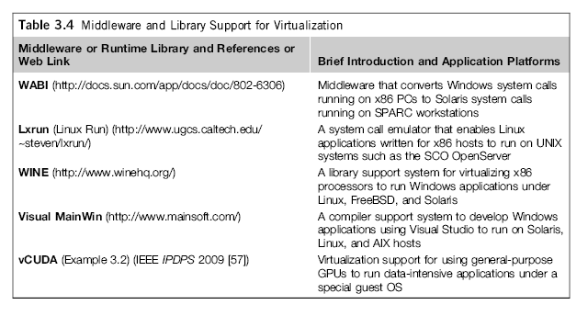
Virtualization with Middleware/Library Support

Slide 17
The vCUBE for Virtualization of GPGPU

Slide 18
User-Application level:
It virtualizes an application as a virtual machine.
This layer sits as an application program on top of an operating system and exports an abstraction of a VM that can run programs written and compiled to a particular abstract machine definition.
Typical systems: JVM , NET CLI , Panot
Advantage:
has the best application isolation
Shortcoming & limitation:
low performance, low application flexibility and high implementation complexity.

Slide 19
More Xs mean higher merit

Slide 20
Hypervisor
A hypervisor is a hardware virtualization technique allowing multiple operating systems, called guests to run on a host machine. This is also called the Virtual Machine Monitor
Type 1: bare metal hypervisor
sits on the bare metal computer hardware like the CPU, memory, etc.
All guest operating systems are a layer above the hypervisor.
The original CP/CMS hypervisor developed by IBM was of this kind.
Type 2: hosted hypervisor
Run over a host operating system.
Hypervisor is the second layer over the hardware.
Guest operating systems run a layer over the hypervisor.
The OS is usually unaware of the virtualization

Slide 21
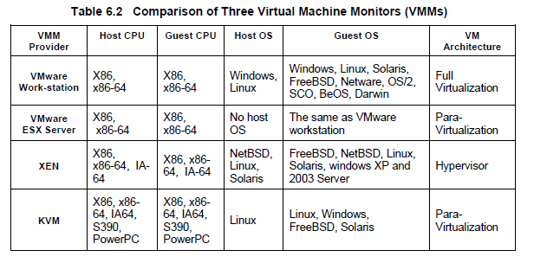
Major VMM and Hypervisor Providers

Slide 22
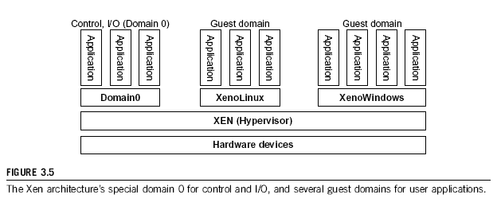
The XEN Architecture (1)

Slide 23
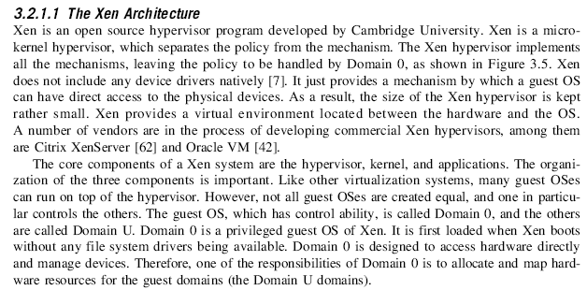
The XEN Architecture (2)

Slide 24
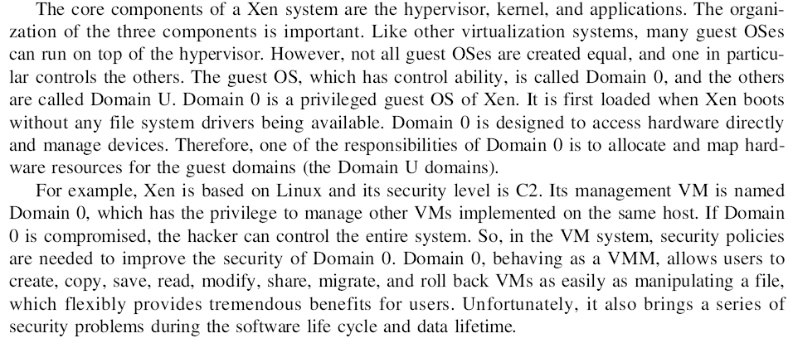
The XEN Architecture (3)

Slide 25
Full Virtualization vs. Para-Virtualization
Full virtualization
Does not need to modify guest OS, and critical instructions are emulated by software through the use of binary translation.
VMware Workstation applies full virtualization, which uses binary translation to automatically modify x86 software on-the-fly to replace critical instructions.
Advantage: no need to modify OS.
Disadvantage: binary translation slows down the performance.
Para virtualization
Reduces the overhead, but cost of maintaining a paravirtualized OS is high.
The improvement depends on the workload.
Para virtualization must modify guest OS, non-virtualizable instructions are replaced by hypercalls that communicate directly with the hypervisor or VMM.
Para virtualization is supported by Xen, Denali and VMware ESX.

Slide 26
Full Virtualization

Slide 27
Binary Translation of Guest OS Requests using a VMM:

Slide 28
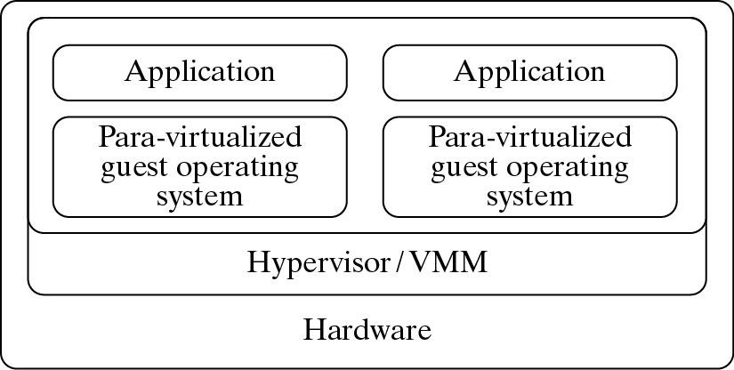
Para- Virtualization with Compiler Support.
The KVM builds offers kernel-based VM on the Linux platform, based on para-virtualization

Slide 30
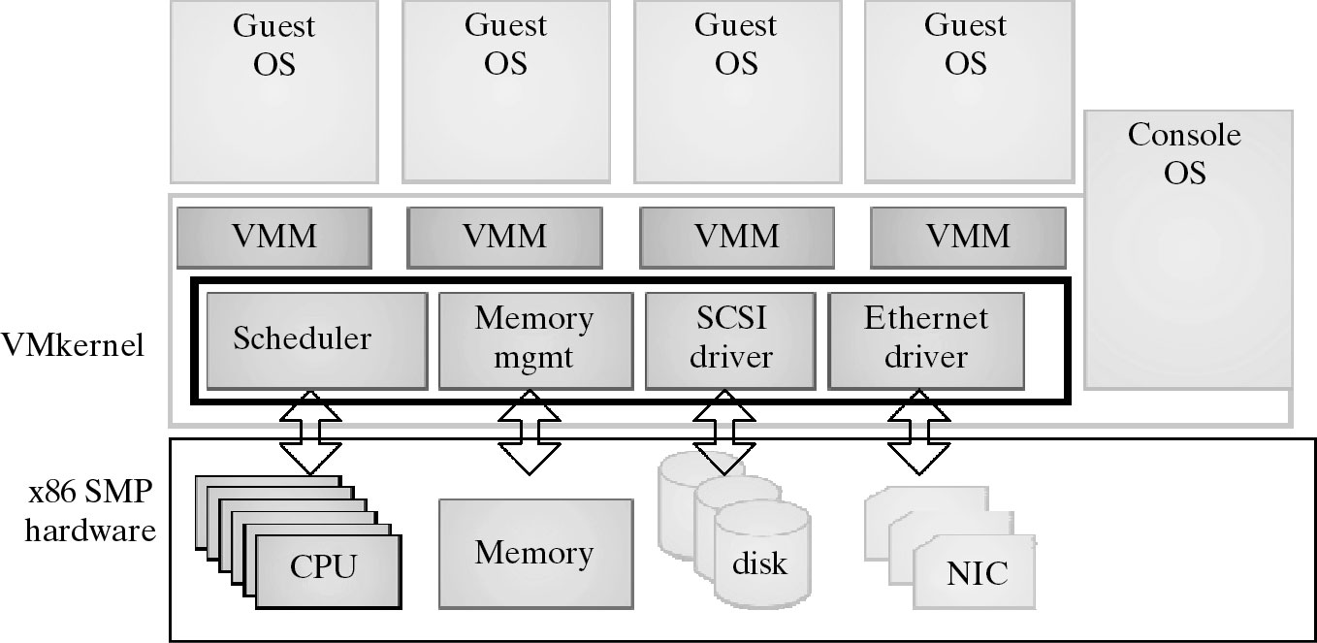
VMWare ESX Server for Para-Virtualization

Slide 31
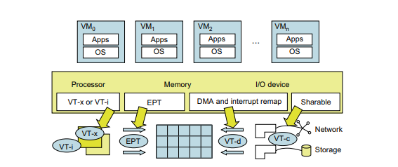
Hardware Support for Virtualization in the Intel x86 Processor
For processor virtualization, Intel offers the VT-x or VT-i technique. VT-x adds a privileged mode (VMX Root Mode) and some instructions to processors. This enhancement traps all sensitive instructions in the VMM automatically.
For memory virtualization, Intel offers the EPT, which translates the virtual address to the machine’s physical addresses to improve performance.
For I/O virtualization, Intel implements VT-d and VT-c to support.

Slide 32
CPU Virtualization
The critical instructions are divided into three categories:
Privileged instructions,
Privileged instructions execute in a privileged mode and will be trapped if executed outside this mode.
Control sensitive instructions, and
Control-sensitive instructions attempt to change the configuration of resources used.
Behavior-sensitive instructions.
Behavior-sensitive instructions have different behaviors depending on the configuration of resources, including the load and store operations over the virtual memory

Slide 33
CPU Virtualization
A CPU architecture is virtualizable if it supports the ability to run the VM’s privileged and unprivileged instructions in the CPU’s user mode while the VMM runs in supervisor mode.
When the privileged instructions including control- and behavior-sensitive instructions of a VM are executed, they are trapped in the VMM. In this case, the VMM acts as a unified mediator for hardware access from different VMs to guarantee the correctness and stability of the whole system.
However, not all CPU architectures are virtualizable.
RISC CPU architectures can be naturally virtualized because all control- and behavior-sensitive instructions are privileged instructions.
On the contrary, x86 CPU architectures are not primarily designed to support virtualization.

Slide 34
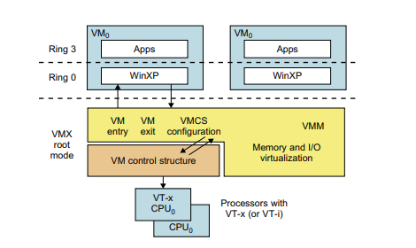
Hardware-Assisted CPU Virtualization
This technique attempts to simplify virtualization because full or para-virtualization is complicated.
Intel and AMD add an additional mode called privilege mode level (some people call it Ring-1) to x86 processors.
Therefore, operating systems can still run at Ring 0 and the hypervisor can run at Ring -1.
Intel Hardware-Assisted CPU Virtualization
*All the privileged and sensitive instructions are trapped in the hypervisor automatically. This technique removes the difficulty of implementing binary translation of full virtualization. It also lets the operating system run in VMs without modification.

Slide 35
Memory Virtualization
Operating system maintains mappings of virtual memory to machine memory using page tables, which is a one-stage mapping from virtual memory to machine memory.
Virtual memory virtualization involves sharing the physical system memory in RAM and dynamically allocating it to the physical memory of the VMs
Two-stage mapping process should be maintained by the guest OS and the VMM, virtual memory to physical memory and physical memory to machine memory.
MMU virtualization should be supported, which is transparent to the guest OS. The guest OS continues to control the mapping of virtual addresses to the physical memory addresses of VMs

Slide 36
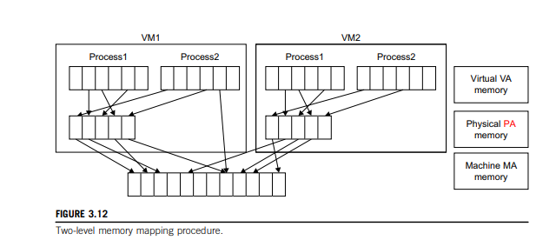
Two-level memory mapping procedure.

Slide 37
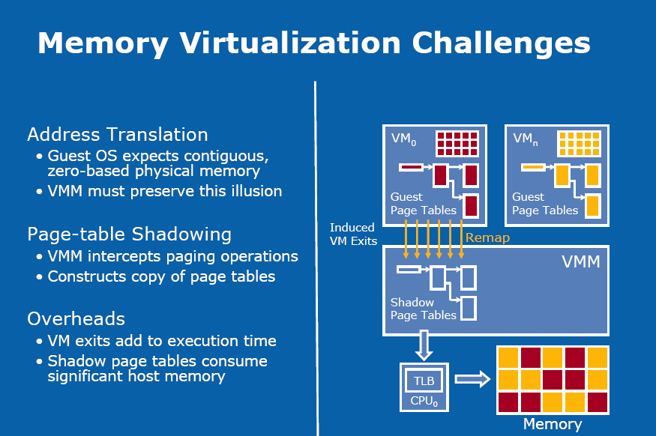

Slide 38
I/O Virtualization
I/O virtualization involves managing the routing of I/O requests between virtual devices and the shared physical hardware.
There are three ways to implement I/O virtualization:
full device emulation,
para-virtualization, and
direct I/O.
Full device emulation is the first approach for I/O virtualization. Generally, this approach emulates well-known, real-world devices.

Slide 39
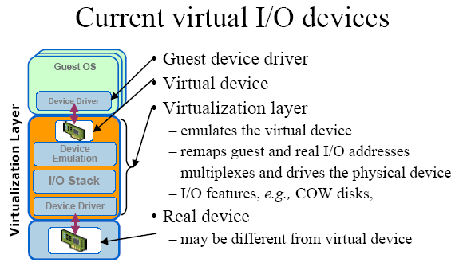

Slide 40
Conclusions on CPU, Memory and I/O Virtualization :
CPU virtualization demands hardware-assisted traps of sensitive instructions by the VMM
Memory virtualization demands special hardware support (shadow page tables by VMWare or extended page table by Intel) to help translate virtual address into physical address and machine memory in two stages.
I/O virtualization is the most difficult one to realize due to the complexity if I/O service routines and the emulation needed between the guest OS and host OS.

Slide 41
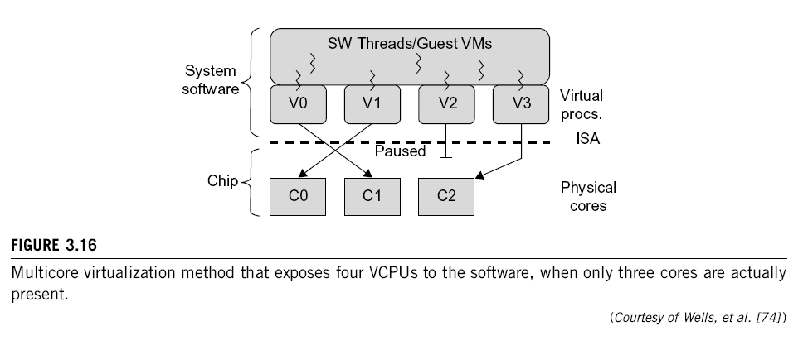
Multi-Core Virtualization: VCPU vs. traditional CPU
Figure 3.16 Four VCPUs are exposed to the software, only three cores are actually present. VCPUs V0, V1, and V3 have been transparently migrated, while VCPU V2 has been transparently suspended. (Courtesy of Wells, et al., “Dynamic Heterogeneity and the Need for Multicore Virtualization”, ACM SIGOPS Operating Systems Review, ACM Press, 2009 [68] )

Slide 42
Virtual Cores vs. Physical Processor Cores
Physical cores | Virtual cores
The actual physical cores present in the processor. | There can be more virtual cores visible to a single OS than there are physical cores.
More burden on the software to write applications which can run directly on the cores. | Design of software becomes easier as the hardware assists the software in dynamic resource utilization.
Hardware provides no assistance to the software and is hence simpler. | Hardware provides assistance to the software and is hence more complex.
Poor resource management. | Better resource management.
The lowest level of system software has to be modified. | The lowest level of system software need not be modified.

Slide 43
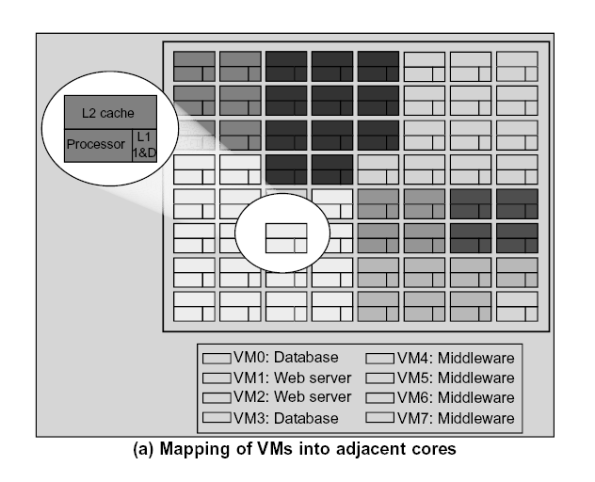
(Courtesy of Marty and Hill, 2007)

Slide 44
Virtual Clusters in Many Cores Space Sharing of VMs -- Virtual Hierarchy
(Courtesy of Marty and Hill, 2007)

Slide 45
Virtual Cluster Characteristics
The virtual cluster nodes can be either physical or virtual machines. Multiple VMs running with different OSs can be deployed on the same physical node.
A VM runs with a guest OS, which is often different from the host OS, that manages the resources in the physical machine, where the VM is implemented.
The purpose of using VMs is to consolidate multiple functionalities on the same server. This will greatly enhance the server utilization and application flexibility.
VMs can be colonized (replicated) in multiple servers for the purpose of promoting distributed parallelism, fault tolerance, and disaster recovery.
The size (number of nodes) of a virtual cluster can grow or shrink dynamically, similarly to the way an overlay network varies in size in a P2P network.
The failure of any physical nodes may disable some VMs installed on the failing nodes. But the failure of VMs will not pull down the host system.

Slide 46
Virtual Clusters vs. Physical Clusters

Slide 48
Live Migration of Virtual Machines

Slide 50
Virtual Cluster Projects

Slide 51
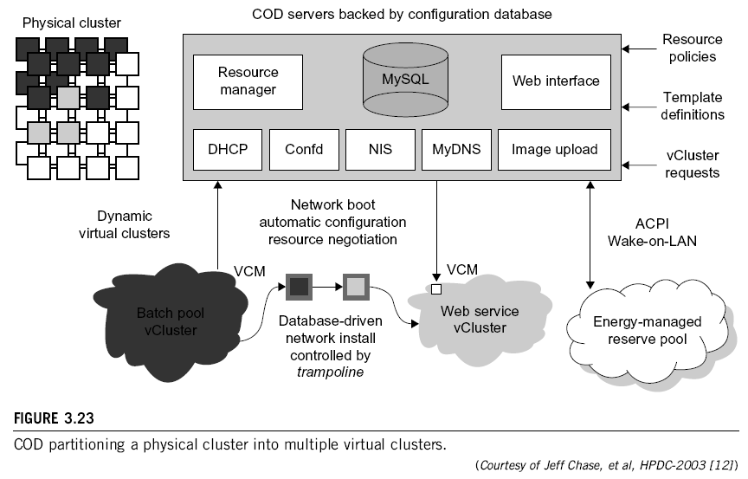

Slide 52
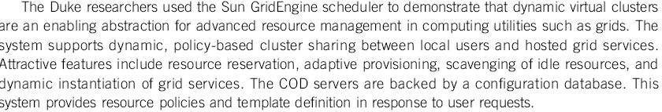
Cluster-on-Demand (COD Project) at Duke University

Slide 53
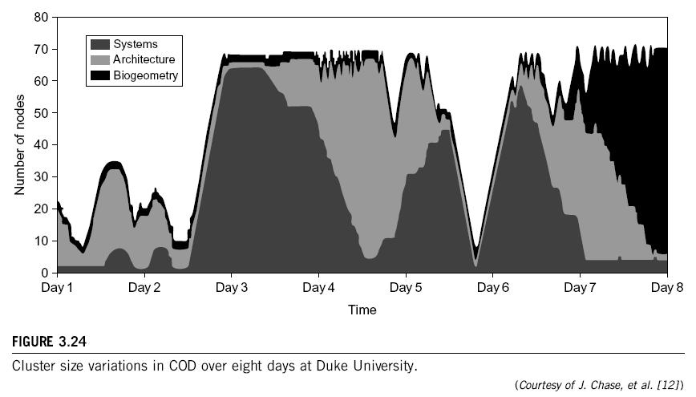

Slide 54
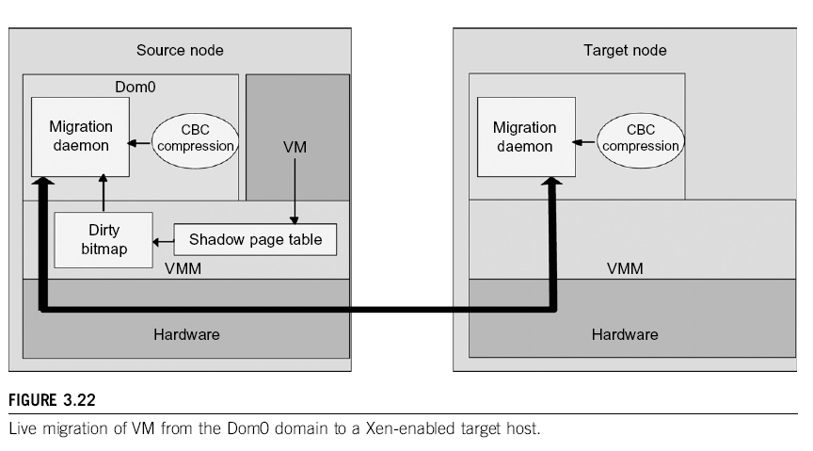

Slide 55
VIOLIN Project at Purdue University

Slide 57
Parallax for VM Storage Management

Slide 58
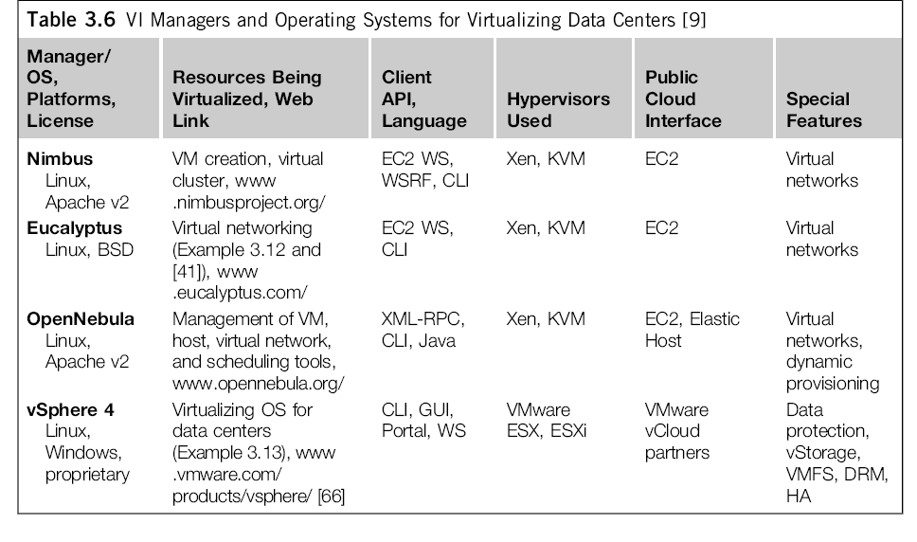
Cloud OS for Building Private Clouds

Slide 59
Eucalyptus : An Open-Source OS for Setting Up and Managing Private Clouds

Slide 60
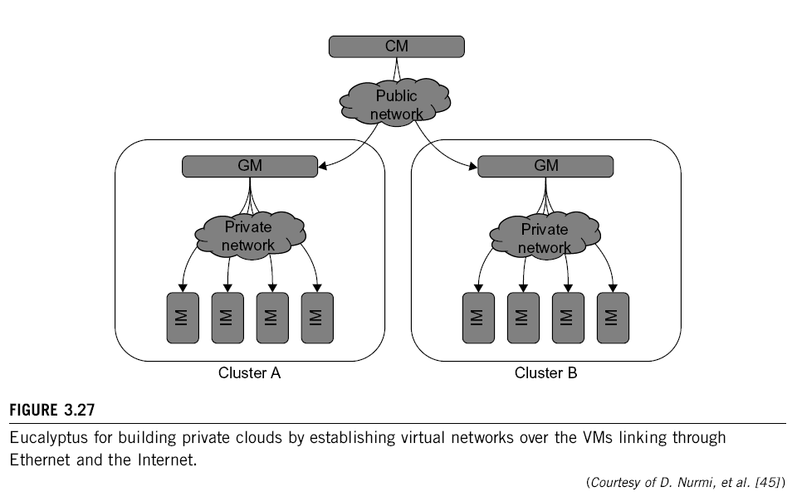

Slide 62


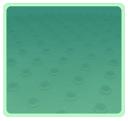



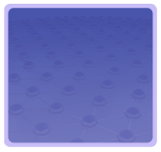

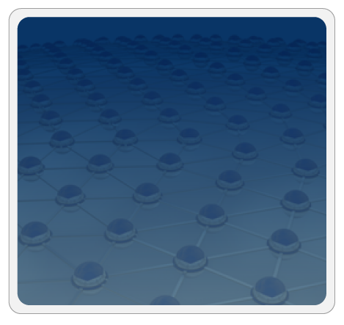



Trusted Zones for VM Insulation
Insulate infrastructure from Malware, Trojans and cybercriminals
Anti-malware
Federate identities with public clouds
Identity federation
Cybercrime intelligence
Strong authentication
APP
APP
Tenant #2
OS
OS
Control and isolate VM in the virtual infrastructure
Virtual Infrastructure
Insulate information
from other tenants
Virtual network security
Data loss prevention
APP
APP
Tenant #1
OS
OS
Virtual Infrastructure
Insulate information from cloud providers’ employees
Encryption & key mgmt
Access Mgmt
Segregate and control user access
Cloud Provider
Tokenization
Security Info. & Event Mgmt
Physical Infrastructure
GRC
Enable end to end view of security events and compliance across infrastructures
(Courtesy of L. Nick, EMC 2008)
Notes:
62

