Slide 1
MapReduce

Slide 2
Single-node architecture
CPU
Machine Learning, Statistics
Memory
“Classical” Data Mining
Disk

Slide 3
Commodity Clusters
Web data sets can be very large
  Tens to hundreds of terabytes
Cannot mine on a single server (why?)
Standard architecture emerging:
  Cluster of commodity Linux nodes
  Gigabit ethernet interconnect
How to organize computations on this architecture?
  Mask issues such as hardware failure

Slide 4
Cluster Architecture
2-10 Gbps backbone between racks
1 Gbps between
any pair of nodes
in a rack
Switch
Switch
Switch
CPU
CPU
CPU
CPU
Mem
…
Mem
Mem
…
Mem
Disk
Disk
Disk
Disk
Each rack contains 16-64 nodes

Slide 5
Stable storage
First order problem: if nodes can fail, how can we store data persistently?
Answer: Distributed File System
  Provides global file namespace
  Google GFS; Hadoop HDFS; Kosmix KFS
Typical usage pattern
  Huge files (100s of GB to TB)
  Data is rarely updated in place
  Reads and appends are common

Slide 6
Distributed File System
Chunk Servers
  File is split into contiguous chunks
  Typically each chunk is 16-64MB
  Each chunk replicated (usually 2x or 3x)
  Try to keep replicas in different racks
Master node
  a.k.a. Name Nodes in HDFS
  Stores metadata
  Might be replicated
Client library for file access
  Talks to master to find chunk servers
  Connects directly to chunkservers to access data

Slide 7
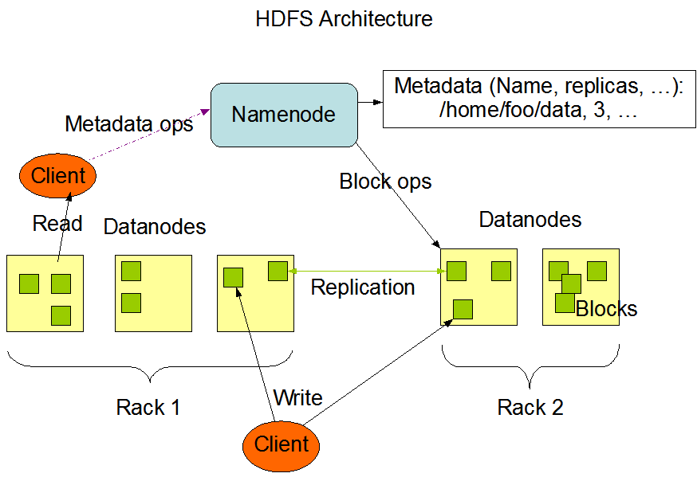
HDFS

Slide 8
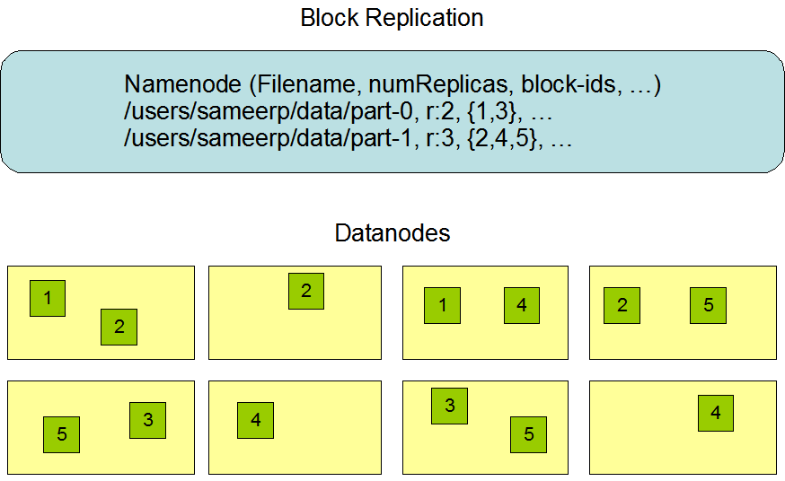
Data Node

Slide 9
Warm up: Word Count
We have a large file of words, one word to a line
Count the number of times each distinct word appears in the file
Sample application: analyze web server logs to find popular URLs

Slide 10
Word Count (2)
Case 1: Entire file fits in memory
Case 2: File too large for mem, but all <word, count> pairs fit in mem
Case 3: File on disk, too many distinct words to fit in memory
  sort datafile | uniq –c

Slide 11
Word Count (3)
To make it slightly harder, suppose we have a large corpus of documents
Count the number of times each distinct word occurs in the corpus
  words(docs/*) | sort | uniq -c
  where words takes a file and outputs the words in it, one to a line
The above captures the essence of MapReduce
  Great thing is it is naturally parallelizable

Slide 12
MapReduce: The Map Step
Input
key-value pairs
Intermediate
key-value pairs
k
v
map
k
v
k
v
map
k
v
k
v
…
…
k
v
k
v

Slide 13
MapReduce: The Reduce Step
Output
key-value pairs
Intermediate
key-value pairs
Key-value groups
reduce
k
v
k
v
v
v
k
v
reduce
k
v
k
v
v
k
v
group
k
v
…
…
…
k
v
k
v
k
v

Slide 14
MapReduce
Input: a set of key/value pairs
User supplies two functions:
  map(k,v) → list(k1,v1)
  reduce(k1, list(v1)) → v2
(k1,v1) is an intermediate key/value pair
Output is the set of (k1,v2) pairs

Slide 15
Word Count using MapReduce
map(key, value):
// key: document name; value: text of document
for each word w in value:
emit(w, 1)
reduce(key, values):
// key: a word; value: an iterator over counts
result = 0
for each count v in values:
result += v
emit(result)

Slide 16
Distributed Execution Overview
User
Program
fork
fork
fork
Master
assign
map
assign
reduce
Input Data
Worker
write
Output
File 0
local
write
Worker
Split 0
read
Split 1
Worker
Split 2
Output
File 1
Worker
Worker
remote
read,
sort

Slide 17
Data flow
Input, final output are stored on a distributed file system
  Scheduler tries to schedule map tasks “close” to physical storage location of input data
Intermediate results are stored on local FS of map and reduce workers
Output is often input to another map reduce task

Slide 18
Coordination
Master data structures
  Task status: (idle, in-progress, completed)
  Idle tasks get scheduled as workers become available
  When a map task completes, it sends the master the location and sizes of its R intermediate files, one for each reducer
  Master pushes this info to reducers
Master pings workers periodically to detect failures

Slide 19
Failures
Map worker failure
  Map tasks completed or in-progress at worker are reset to idle
  Reduce workers are notified when task is rescheduled on another worker
Reduce worker failure
  Only in-progress tasks are reset to idle
Master failure
  MapReduce task is aborted and client is notified

Slide 20
How many Map and Reduce jobs?
M map tasks, R reduce tasks
Rule of thumb:
  Make M and R much larger than the number of nodes in cluster
  One DFS chunk per map is common
  Improves dynamic load balancing and speeds recovery from worker failure
Usually R is smaller than M, because output is spread across R files

Slide 21
Combiners
Often a map task will produce many pairs of the form (k,v1), (k,v2), … for the same key k
  E.g., popular words in Word Count
Can save network time by pre-aggregating at mapper
  combine(k1, list(v1)) → v2
  Usually same as reduce function
Works only if reduce function is commutative and associative

Slide 22
Partition Function
Inputs to map tasks are created by contiguous splits of input file
For reduce, we need to ensure that records with the same intermediate key end up at the same worker
System uses a default partition function e.g., hash(key) mod R
Sometimes useful to override
  E.g., hash(hostname(URL)) mod R ensures URLs from a host end up in the same output file

Slide 23
Exercise 1: Host size
Suppose we have a large web corpus
Let’s look at the metadata file
  Lines of the form (URL, size, date, …)
For each host, find the total number of bytes
  i.e., the sum of the page sizes for all URLs from that host

Slide 24
Exercise 2: Distributed Grep
Find all occurrences of the given pattern in a very large set of files

Slide 25
Exercise 3: Graph reversal
Given a directed graph as an adjacency list:
src1: dest11, dest12, …
src2: dest21, dest22, …
Construct the graph in which all the links are reversed

Slide 26
Exercise 4: Frequent Pairs
Given a large set of market baskets, find all frequent pairs
  Remember definitions from Association Rules lectures

Slide 27
Implementations
Google
  Not available outside Google
Hadoop
  An open-source implementation in Java
  Uses HDFS for stable storage
  Download: http://lucene.apache.org/hadoop/
Aster Data
  Cluster-optimized SQL Database that also implements MapReduce
  Made available free of charge for this class

Slide 28
Cloud Computing
Ability to rent computing by the hour
  Additional services e.g., persistent storage
We will be using Amazon’s “Elastic Compute Cloud” (EC2)
Aster Data and Hadoop can both be run on EC2
In discussions with Amazon to provide access free of charge for class

Slide 29
Special Section on MapReduce
Tutorial on how to access Aster Data, EC2, etc
Intro to the available datasets
Friday, January 16, at 5:15pm
  Right after InfoSeminar
  Tentatively, in the same classroom (Gates B12)

Slide 30
Reading
Jeffrey Dean and Sanjay Ghemawat,
MapReduce: Simplified Data Processing on Large Clusters
http://labs.google.com/papers/mapreduce.html
Sanjay Ghemawat, Howard Gobioff, and Shun-Tak Leung, The Google File System
http://labs.google.com/papers/gfs.html

