Slide 1
Green Cloud Computing
Notes:
1

Slide 2

Energy-Efficient Cloud Computing
Energy efficiency is increasingly important for future ICT
Rapid growth of the demand for computational power has led to the creation of large-scale data centers
Energy savings are achieved by continuous consolidation of VMs

Slide 3
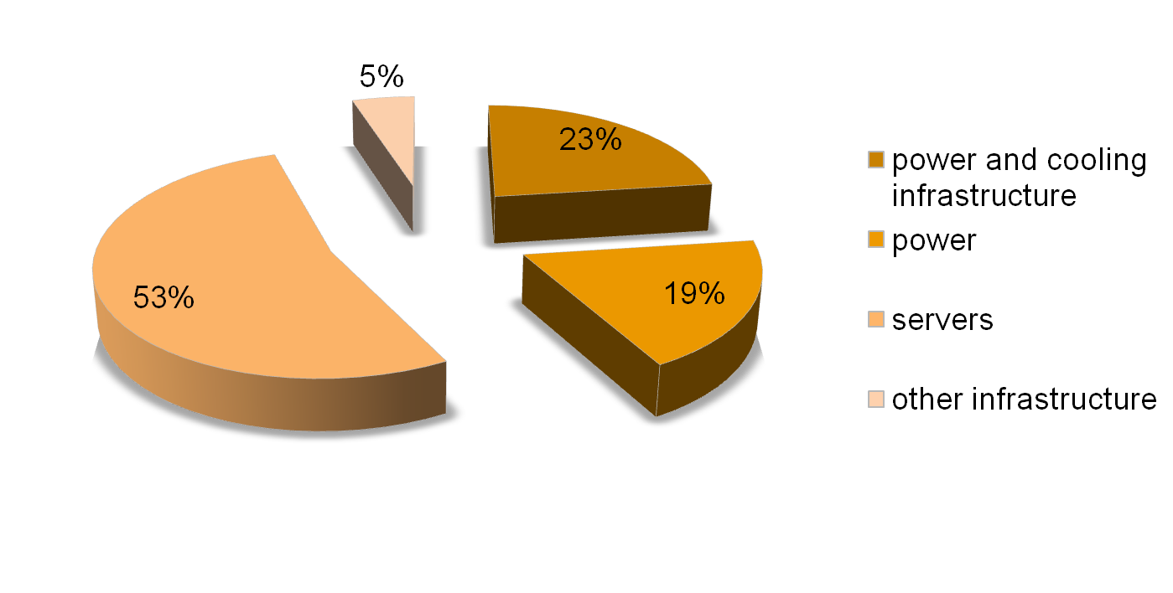
Energy distribution in the data centre [1]

Slide 4

Vision and Potential of Cloud Computing
Computer networks grow up and
become sophisticated!
Computing utilities based on a
service provisioning model
Users can access applications as services
from anywhere in the world on demand
Our Contributions to minimize the energy consumption

Slide 5

Open Challenges
Ability to transfer VMs between physical nodes using live migration
Energy-aware Dynamic Resource Allocation
QoS-based Resource Selection and Provisioning
Optimization of Virtual Network Topologies
Autonomic Optimization
Efficient Consolidation of VMs

Slide 6

Green HPC
DVS-based Cluster Scheduling
EDF-based scheduling
The scheduler always executes the earliest-deadline task in the queue.
Proportional share-based scheduling
Multiple tasks share the processor performance in proportion to each task’s weight.

Slide 7

Current State OF Energy Efficiency In ICT Infrastructure
Energy-efficient hardware
Energy-aware scheduling in multiprocessor and grid systems
Power minimization in clusters of servers
Power minimization in wireless and wired networks

Slide 8


Toward Energy Efficient Cloud Computing
Energy-aware data centre
Energy savings in networks and protocols
The effect of Internet applications

Slide 9
Green Open Cloud
Goal of this framework is to curb the energy consumption of Clouds without sacrificing the quality of service
GOC uses prediction algorithms to avoid frequent on/off cycles
The GOC framework relies on energy sensors (wattmeter)
Network Presence

Slide 10
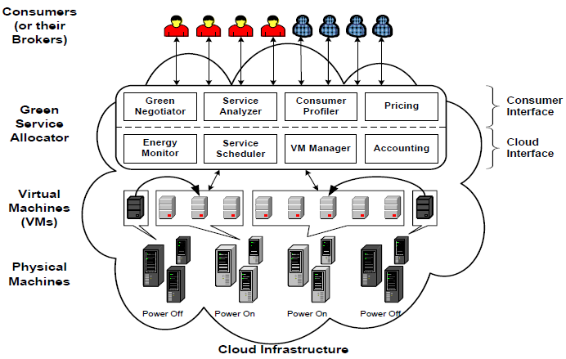
Cloud Infrastructure

Slide 11

Allocation Policies
The VM reallocation problem can be divided in two:
selection of VMs to migrate
determining new placement of these VMs on physical hosts

Slide 12
Concluding
As Clouds are more and more broadly used
New technologies have emerged for increasing their capacity to provide on-demand XaaS resources in a pay-as-you-use fashion
Propose an original software framework, the Green Open Cloud (GOC) which aims at controlling and optimizing the energy consumed by the overall Cloud infrastructure
This work advances Cloud computing field in two ways

Slide 13
References
Berl, A., Gelenbe, E., Di Girolamo, M., Giuliani, G., De Meer, H., Dang, M. and Pentikousis, K. Energy-efficient cloud computing. The Computer Journal, 53, 7 2010), 1045.
Cafaro, M. and Aloisio, G. Grids, Clouds, and Virtualization. Grids, Clouds and Virtualization, 145-170.
Buyya, R., Beloglazov, A. and Abawajy, J. Energy-Efficient management of data center resources for cloud computing: A vision, architectural elements, and open challenges. City, 2010.
Beloglazov, A. and Buyya, R. Energy efficient allocation of virtual machines in cloud data centers. IEEE, City, 2010.
Kim, K. H., Buyya, R. and Kim, J. GreenCloud: Energy-Efficient Cloud Computing Project. City, 2007.

