Slide 1
Distributed and Cloud Computing Chapter 4: Cloud Platform Architecture over Virtualized Datacenters

Slide 2
Typical Datacenter Layout

Slide 3
Power and Cooling Requirements
Cooling system also uses water (evaporation and spills)
E.g. 70,000 to 200,000 gallons per day for an 8 MW facility
Power cost breakdown:
Chillers: 30-50% of the power used by the IT equipment
Air conditioning: 10-20% of the IT power, mostly due to fans
How many servers can a WSC support?
Each server:
“Nameplate power rating” gives maximum power consumption
To get actual, measure power under actual workloads
Oversubscribe cumulative server power by 40%, but monitor power closely
(Courtesy of Hennessy and Patterson, 2012)
Notes:
The University of Adelaide, School of Computer Science
9 May 2022
Chapter 2 — Instructions: Language of the Computer
3

Slide 4
(Courtesy of Luiz Andre Barroso and Urs Holzle, Google Inc., 2009)

Slide 5
Measuring Efficiency of a WSC
Power Utilization Effectiveness (PEU)
= Total facility power / IT equipment power
Median PUE on 2006 study was 1.69
Performance
Latency is important metric because it is seen by users
Bing study: users will use search less as response time increases
Service Level Objectives (SLOs)/Service Level Agreements (SLAs)
E.g. 99% of requests be below 100 ms
(Courtesy of Hennessy and Patterson, 2012)
Notes:
The University of Adelaide, School of Computer Science
9 May 2022
Chapter 2 — Instructions: Language of the Computer
5

Slide 6
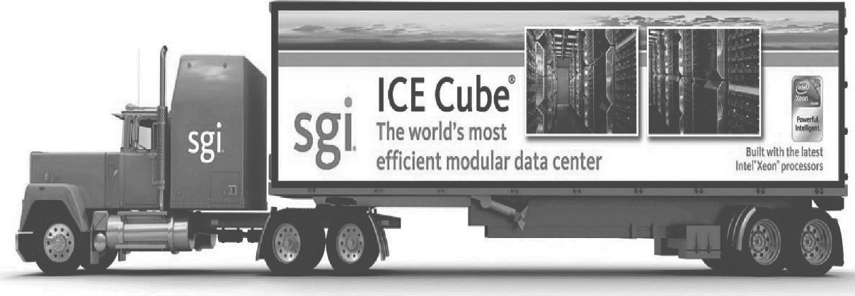
Modular Data Center

Slide 7
Cloud Computing
WSCs offer economies of scale that cannot be achieved with a datacenter:
5.7 times reduction in storage costs
7.1 times reduction in administrative costs
7.3 times reduction in networking costs
This has given rise to cloud services such as Amazon Web Services
“Utility Computing”
Based on using open source virtual machine and operating system software
(Courtesy of Hennessy and Patterson, 2012)
Notes:
The University of Adelaide, School of Computer Science
9 May 2022
Chapter 2 — Instructions: Language of the Computer
7

Slide 8
Enabling Technologies for The Clouds

Slide 9
Cloud Computing as A Service
[9]

Slide 11
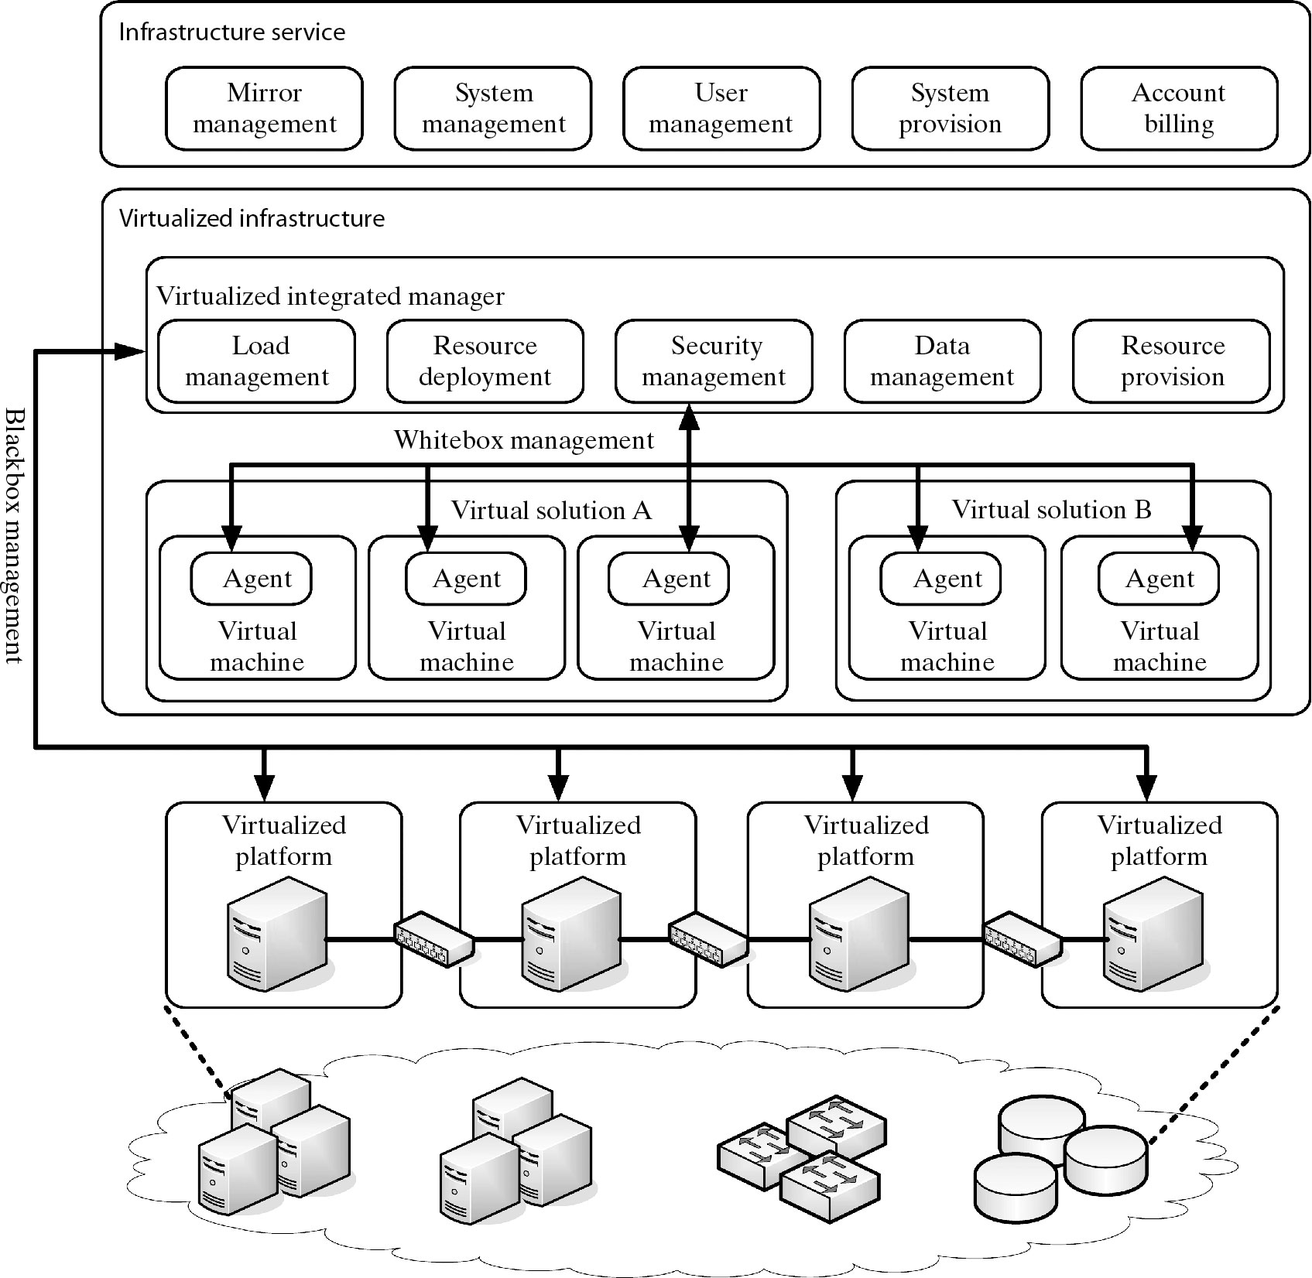
Virtualized servers, storage , and network for cloud platform construction

Slide 12
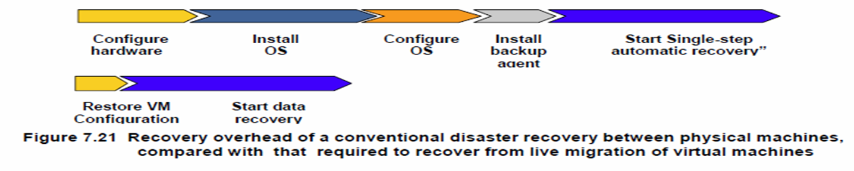

Slide 13
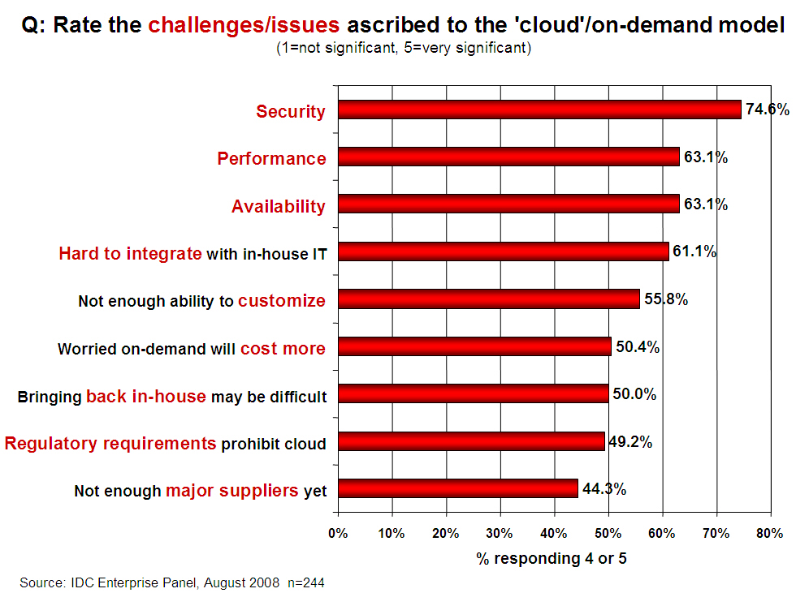
Challenges/Issues in Cloud Computing
13

Slide 14
Challenges in Cloud Computing (1)
Concerns from The Industry (Providers)
Replacement Cost
Exponential increase in cost to maintain the infrastructure
Vendor Lock-in
No standard API or protocol can be very serious
Standardization
No standard metric for QoS is limiting the popularity
Security and Confidentiality
Trust model for cloud computing
Control Mechanism
Users do not have any control over infrastructures

Slide 15
Challenges in Cloud Computing (2)
Concerns from Research Community :
Conflict to legacy programs
With difficulty in developing a new application due to lack of control
Provenance
How to reproduce results in different infrastructures
Reduction in Latency
No specially designed interconnect used
Very low controllability in layout of interconnect due to abstraction
Programming Model
Hard to debug where programming naturally error-prone
Details about infrastructure are hidden
QoS Measurement
Especially for ubiquitous computing where context changes

Slide 16
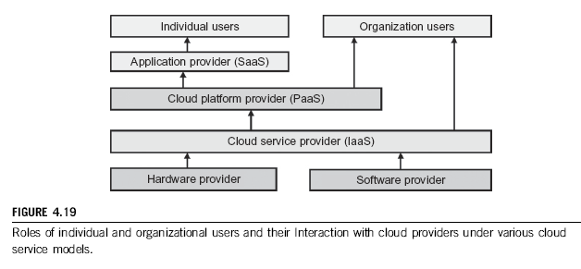
Public Clouds and Service Offerings

Slide 18
Platform as a Service (PaaS): Google App Engine
This platform allows users to develop and host web application in Google datacenters with automatic scaling according to the demand.
It is a free service for a certain limit and it only requires a Gmail account to access the services. After the free limit is exceeded the customers are charged for additional storage, bandwidth and instance hours.
The current version supports Java, Python and Go as the programming languages and Google plans to add more languages in the future.
All billed App Engine applications have a 99.95% uptime SLA. App Engine is designed to sustain multiple datacenter outages without any downtime.
The app engine has a few restrictions - can only execute code called from an HTTP request, Java applications may only use a subset from the JRE standard edition and Java application cannot create new threads.

Slide 19
Google AppEgine (GAE)

Slide 20
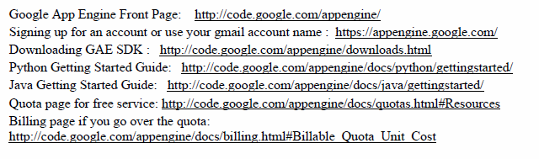

Slide 21
AWS – a leader in providing public IaaS services.
EC2 (Elastic compute cloud allows users to rent virtual computers to run their own computer applications. It allows scalable deployment. A user can create, launch, and terminate server instances as needed, paying by the hour for active servers.
S3 (simple storage service) provides the object-oriented storage service for users.
EBS (Elastic block service) provides the block storage interface which can be used to support traditional applications.
Amazon DevPay is a simple to use online billing and account management service that makes it easy for businesses
MPI clusters uses hardware-assisted virtualization instead of para-virtualization and users are free to create a new AMIs
AWS import/export allows one to ship large volumes of data to and from EC2 by shipping physical discs.
Brokering systems offer a striking model for controlling sensors and providing office support of smartphones and tablets.
Small-business companies can put their business on the Amazon cloud platform. Using AWS they can service a large number of internet users and make profits through those paid services.

Slide 23
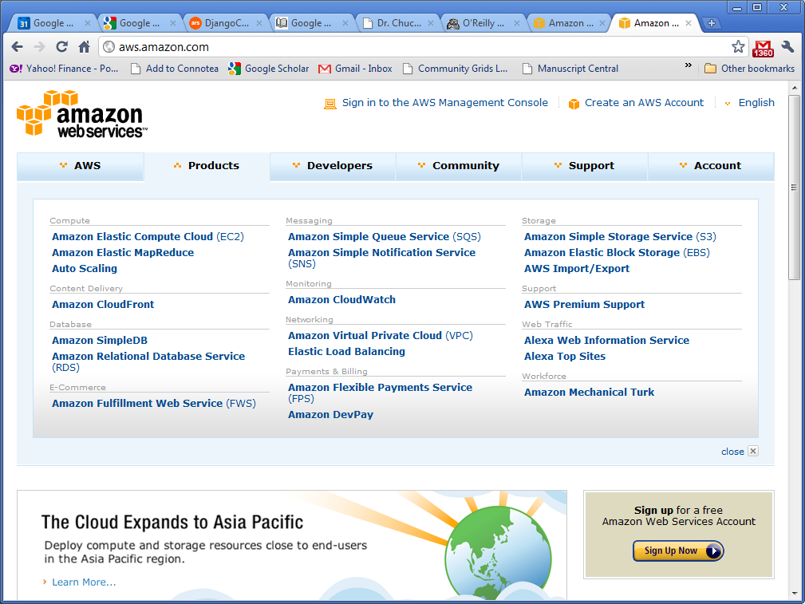
Amazon Web Services (AWS)

Slide 24
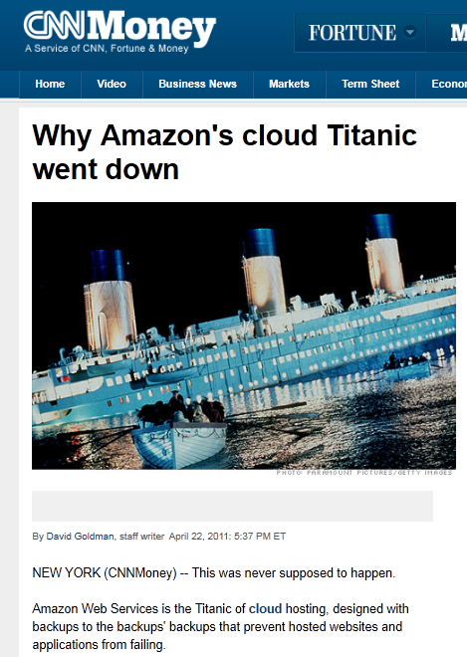
Amazon’s Lesson
Down for 3 days since 4/22/2011
1000x of businesses went offline. E.g. Pfizer, Netflix, Quora, Foursquare,Reddit
SLA contract
99.95% availability (<4.5hour down）
10% penalty, otherwise
Notes:
SLA = Service Level Agreement
24

Slide 25
Microsoft Azure Cloud :
This is essentially a PaaS Cloud.
Windows Azure run its cluster hosted at Microsoft's datacenters that manages computing and storage resources.
One can download Azure development kit to run a local version of Azure. It allows Azure applications to be developed and debugged one the windows 7 hosts.
All cloud services can interact with traditional MS software applications such as Windows Live, Office Live, Exchange Online, etc.
If offers a Windows-based cloud platform using Microsoft virtualization technology.
Applications are built on VM’s deployed on the data-center services.
Azure manages all servers, storage and network resources of the data center.

Slide 26
Microsoft Windows Azure

Slide 27
Cloud Services and Major Providers
Notes:
Cloud applications are the key global opportunity for developers during next four years
2009: $8.5 billion
2013: $16.8 billion

Slide 28
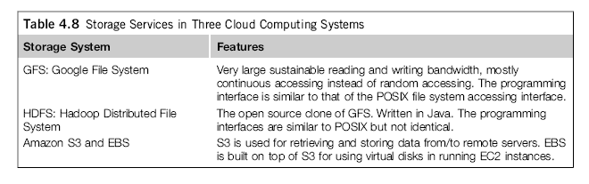

Slide 29
Security and Trust Barriers in Cloud Computing
Protecting datacenters must first secure cloud resources and uphold user privacy and data integrity.
Trust overlay networks could be applied to build reputation systems for establishing the trust among interactive datacenters.
A watermarking technique is suggested to protect shared data objects and massively distributed software modules.
These techniques safeguard user authentication and tighten the data access-control in public clouds.
The new approach could be more cost-effective than using the traditional encryption and firewalls to secure the clouds.
29

