Slide 1
SimpleSideDrawer v2
adamrocker
Mar 19th, 2013
adamrocker@gmail.com

Slide 2
What’s this?
Side Drawer library for Android
Easy to use
High affinity
Light weight
OSS
(Add only 2 lines)
(Not need to extend)
(Less than 11KByte)
(Apache License, v2.0)

Slide 3

Demo

Slide 4
Demo
Tap!

Slide 5
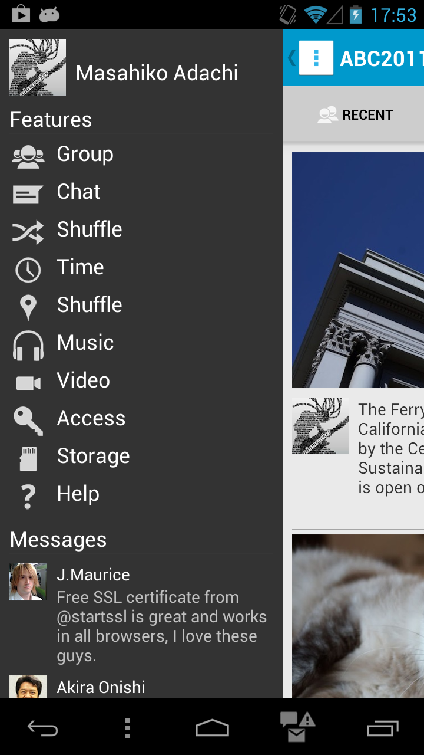
Demo

Slide 6
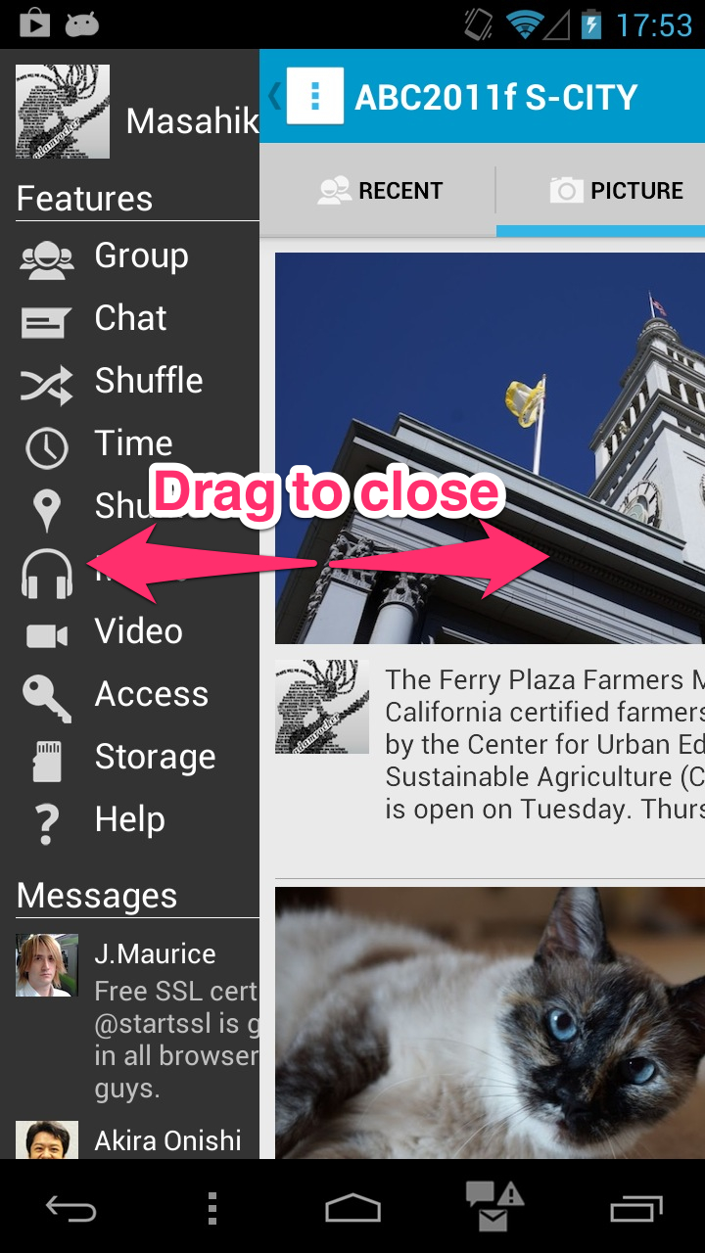
Demo

Slide 7
How to use?
◆ Add only 2 lines
public void onCreate( Bundle saved ) {
super.onCreate( saved );
setContentView( R.layout.main );
}
public void onCreate( Bundle saved ) {
super.onCreate( saved );
setContentView( R.layout.main );
nav = new SimpleSideDrawer( this );
nav.setLeftBehindContentView( R.layout.left_menu );
}
Easy and high affinity to use

Slide 8
Right side menu is also available
◆ Add 1 more line
public void onCreate( Bundle saved ) {
super.onCreate( saved );
setContentView( R.layout.main );
}
public void onCreate( Bundle saved ) {
super.onCreate( saved );
setContentView( R.layout.main );
nav = new SimpleSideDrawer( this );
nav.setLeftBehindContentView( R.layout.left_menu );
nav.setRightBehindContentView( R.layout.right_menu );
}
NEW!!

Slide 9
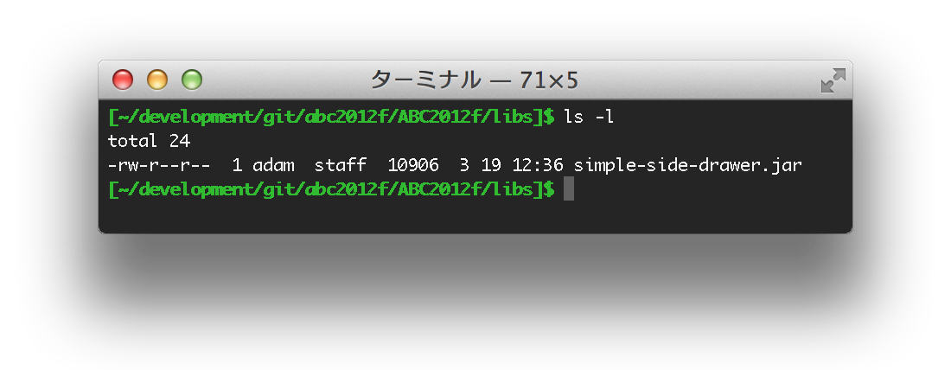
Light weight library ever!!
◆ less than 11KByte
This PNG file size is around 82KByte!!

Slide 10
How does it work
◆ Android’s layout system
Application’s layout view
set with setContentView() method
Above
Decor: the base of layout

Slide 11
How does it work
◆ Remove the above layout view from the decor
Above
decor = window.getDecorView();
above = decor.getChildAt( 0 );
decor.removeView( above );

Slide 12
How does it work
SimpleSideDrawer (extends FrameLayout)
◆ Insert the behind layout view
LinearLayout (horizontal)
wrap
RightBehindBase
weight=1
wrap
Above
LeftBehindBase
Spacer

Slide 13
How does it work
◆ Open the left-side menu
RightBehindBase is GONE
weight=1
wrap
Above
LeftBehindBase
Spacer

Slide 14
How does it work
◆ Open the right-side menu
wrap
RightBehindBase
weight=1
LeftBehindBase is GONE
Above

Slide 15
How does it work
◆ Control drag action
Handling the touch event
Overlay

Slide 16
Structure of SimpleSideDrawer
Original
Using SimpleSideDrawer library

Slide 17
Thank you
What’s SimpleSideDrawer?
>> Side Drawer library for Android
Features:
Easy to use
High affinity
Light weight
OSS
(Add only 2 lines)
(Not need to extend)
(Less than 11KByte)
(Apache License, v2.0)
https://github.com/adamrocker/simple-side-drawer

