Slide 1


Android – User Interfaces Using XML Layouts
Part 4
Notes are based on:
The Busy Coder's Guide to Android Development
by Mark L. Murphy
Copyright © 2008-2009 CommonsWare, LLC.
ISBN: 978-0-9816780-0-9
&
Android Developers
http://developer.android.com/index.html

Slide 2

4. Android – UI - User Interfaces
The View Class
Lớp View đại diện cho khối cơ bản cho các thành phần giao diện người dùng.
Mỗi View chiếm một vùng hình chữ nhật trên màn hình và chịu trách nhiệm cho drawing (vẽ) và event handling (xử lý sự kiện).
View là lớp cơ sở cho các widget, dùng để tạo các component tương tác của UI (buttons, text fields, etc.).
Lớp con ViewGroup là lớp cơ sở cho các layout (bố cục), là các container vô hình chứa các View (hoặc các ViewGroup) khác và quy định các đặc điểm bố cục của chúng.
2

Slide 3
4. Android – UI - User Interfaces
Sử dụng View
Tất cả các view trong một cửa sổ được tổ chức trong một cấu trúc cây.
Ta có thể bổ sung các view từ mã nguồn hoặc định nghĩa cấu trúc cây của các view trong một hoặc vài file layout XML.
Sau khi đã tạo một cây view, có một số thao tác có thể cần thực hiện:
Set properties: ví dụ gán sẵn dòng text trong một TextView. Các property biết từ trước có thể được đặt sẵn trong các file layout XML.
Set focus: cơ chế di chuyển focus để đáp ứng input của người dùng. Để yêu cầu focus cho một view cụ thể, gọi hàm requestFocus().
Set up listeners: View cho phép đặt các listener, các listener này được gọi khi có sự kiện xảy ra đối với view. Ví dụ, một Button dùng một listener để nghe sự kiện button được click.
Set visibility: Ta có thể che hoặc hiện view bằng setVisibility(int).
3

Slide 4
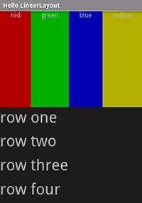
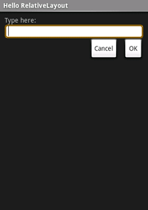
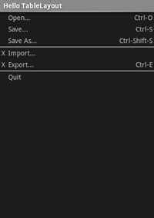
4. Android – UI - User Interfaces
A brief sample of UI components
Layouts
Linear Layout
A LinearLayout is a GroupView that will lay child View elements vertically or horizontally.
Relative Layout
A RelativeLayout is a ViewGroup that allows you to layout child elements in positions relative to the parent or siblings elements.
Table Layout
A TableLayout is a ViewGroup that will lay child View elements into rows and columns.
4

Slide 5
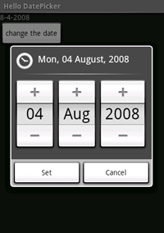
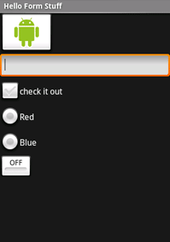
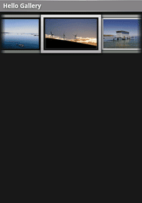
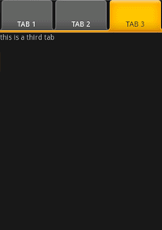
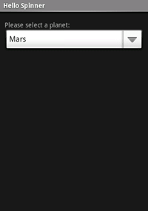
4. Android – UI - User Interfaces
A brief sample of UI components
Widgets
GalleryView
TabWidget
Spinner
DatePicker
A DatePicke is a widget that allows the user to select a month, day and year.
Form Controls
Includes a variety of typical form widgets, like:
image buttons,
text fields,
checkboxes and
radio buttons.
5

Slide 6
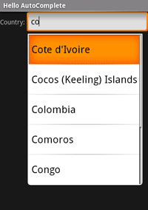
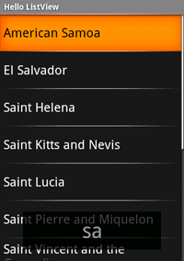
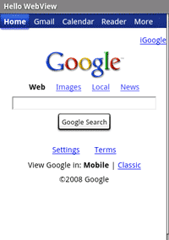
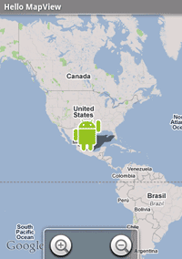
4. Android – UI - User Interfaces
A brief sample of UI components
WebView
MapView
AutoCompleteTextView
It is a version of the EditText widget that will provide auto-complete suggestions as the user types. The suggestions are extracted from a collection of strings.
ListView
A ListView is a View that shows items in a vertically scrolling list. The items are acquired from a ListAdapter.
6

Slide 7
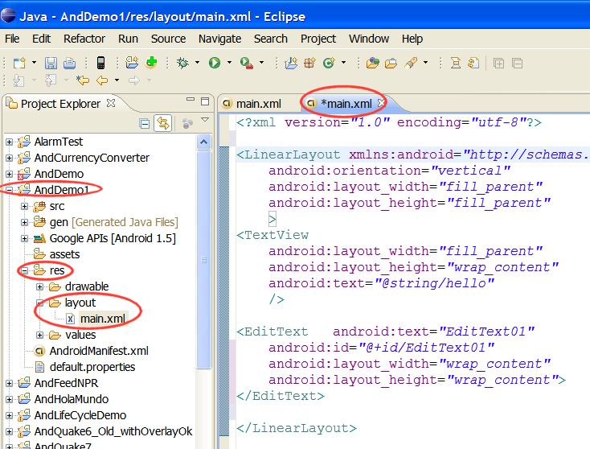
4. Android – UI - User Interfaces
What is an XML Layout?
XML-based layout là một đặc tả về các UI component (widget), quan hệ giữa chúng với nhau và với container chứa chúng – tất cả được viết theo định dạng XML.
Android coi các XML-based layout là các resource (tài nguyên), và các file layout được lưu trong thư mục res/layout trong project của ta.
7

Slide 8
4. Android – UI - User Interfaces
What is an XML Layout?
Mỗi file XML chứa một cấu trúc phân cấp dạng cây, đặc tả layout của các widget và các container thành phần của một View.
Các thuộc tính của mỗi phần tử XML là các tính chất, mô tả bề ngoài của widget hoặc hoạt động của một container.
Example:
Nếu một phần tử Button có một thuộc tính có giá trị
android:textStyle = "bold"
Nghĩa là phần text hiện trên mặt nút cần được vẽ bằng font chữ đậm (bold).
8

Slide 9
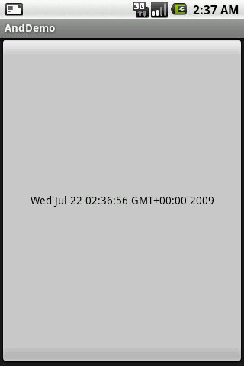
4. Android – UI - User Interfaces
An example
Ứng dụng có một nút bấm chiếm toàn bộ màn hình. Khi nhấn nút, phần text của nút cho biết thời gian hiện hành.
import java.util.Date;
import android.app.Activity;
import android.os.Bundle;
import android.view.View;
import android.view.View.OnClickListener;
import android.widget.Button;
public class AndDemo extends Activity {
Button btn;
@Override
public void onCreate(Bundle icicle) {
super.onCreate(icicle);
setContentView(R.layout.main);
btn = (Button) findViewById(R.id.myButton);
btn.setOnClickListener(new OnClickListener() {
@Override
public void onClick(View v) {
updateTime();
}
});
}// onCreate
//
private void updateTime() {
btn.setText(new Date().toString());
}
}
9

Slide 10
4. Android – UI - User Interfaces
An example
This is the XML-Layout definition
<?xml version="1.0" encoding="utf-8"?>
<Button xmlns:android="http://schemas.android.com/apk/res/android"
android:id="@+id/myButton"
android:text=""
android:layout_width="fill_parent"
android:layout_height="fill_parent"
/>
Phần tử gốc(root) cần khai báo Android XML namespace:
xmlns:android="http://schemas.android.com/apk/res/android"
Tất cả các phần tử khác sẽ là con của root và sẽ thừa kế khai báo namespace đó.
Vì ta muốn gọi đến nút đó từ bên trong mã Java, ta cần cho nó một id qua thuộc tính android:id .
10

Slide 11
4. Android – UI - User Interfaces
An example cont.
<?xml version="1.0" encoding="utf-8"?>
<Button
xmlns:android="http://schemas.android.com/apk/res/android"
android:id="@+id/myButton"
android:text=""
android:layout_width="fill_parent"
android:layout_height="fill_parent"
/>
Các thuộc tính còn lại của thực thể Button này là:
android:text giá trị khởi tạo của chuỗi text cần hiện trên mặt nút (ở đây là xâu rỗng)
android:layout_width và android:layout_height báo cho Android rằng chiều rộng và chiều cao của nút chiếm toàn bộ container (parent), ở đây là toàn bộ màn hình.
11

Slide 12
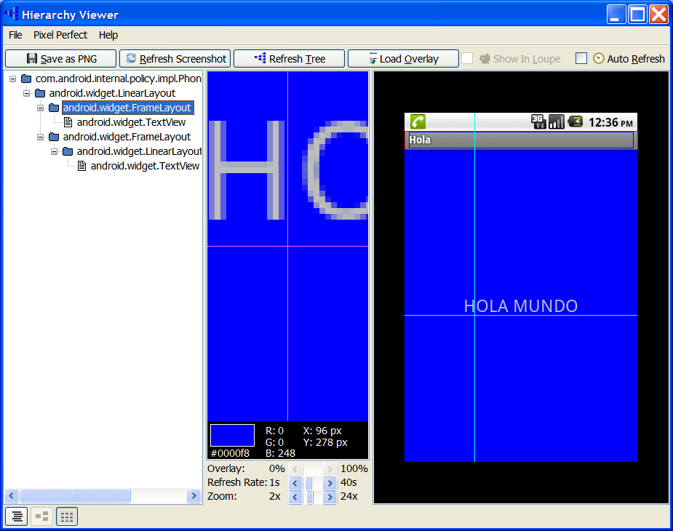
4. Android – UI - User Interfaces
UI Hierarchy
Look for your SDK folder, usually:
C:/your_sdk_path/android_sdk_windows/tools
UI
Tree
The utility HierarchyViewer displays the UI structure of the current screen shown on the emulator or device.
( Execute app on emulator, execute HierarchyViewer, click on Emulator > Refresh Screenshot )
12

Slide 13
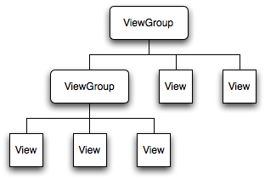
4. Android – UI - User Interfaces
Android Layouts
Each element in the XML Layout is either a View or ViewGroup object
13

Slide 14
4. Android – UI - User Interfaces
Android Layouts
Displaying the Application’s View
The Android UI Framework paints the screen by walking the View tree by asking each component to draw itself in a pre-order traversal way.
Each component draws itself and then asks each of its children to do the same.
See: Android – Application Development, by R. Rogers et al. O’Reilly Pub. 2009, ISBN 978-0-596-52147-0
14

Slide 15
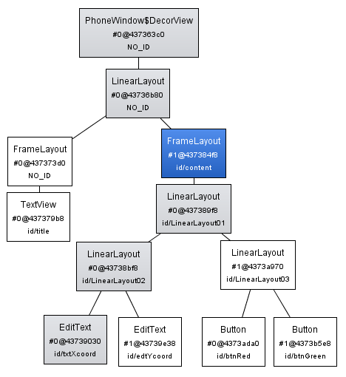
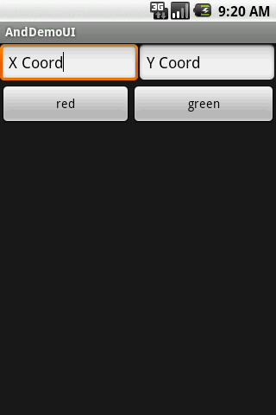
4. Android – UI - User Interfaces
Android Layouts
Example: Display UI Hierarchy
Using SDK older than r8.
vertical
Horizontal 1
Horizontal 2
See: Android – Application Development, by R. Rogers et al. O’Reilly Pub. 2009, ISBN 978-0-596-52147-0
15

Slide 16
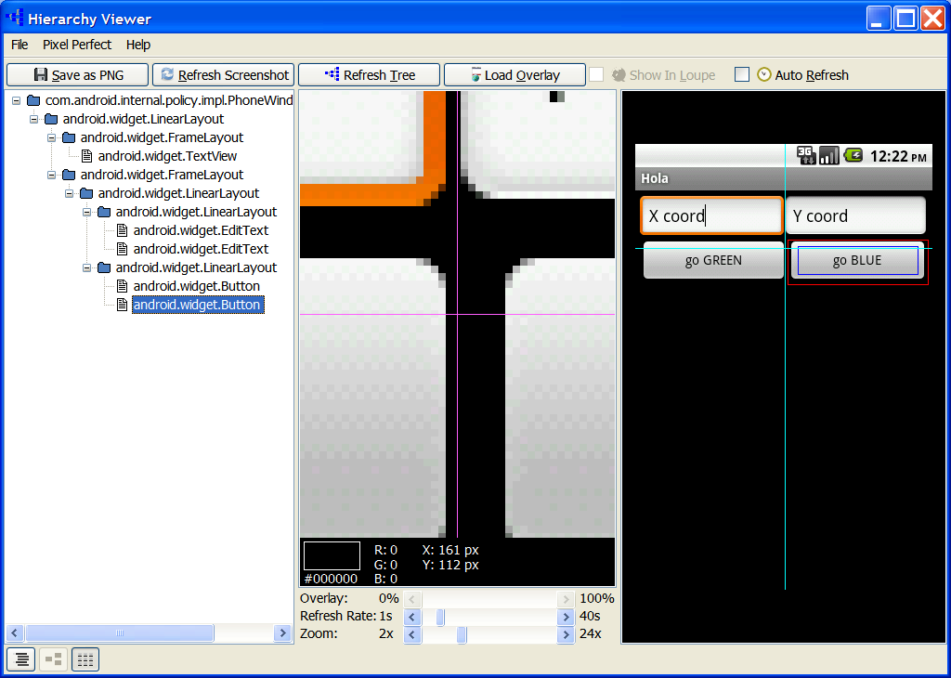
4. Android – UI - User Interfaces
Android Layouts
Example: Display UI Hierarchy (Using SDK Revision 8)
UI
Tree
vertical
Horizontal 1
Horizontal 2
16

Slide 17
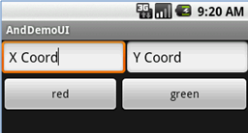
4. Android – UI - User Interfaces
Example: Display UI Hierarchy
<?xml version="1.0" encoding="utf-8"?>
<LinearLayout android:id="@+id/LinearLayout01"
android:layout_width="fill_parent" android:layout_height="fill_parent"
android:orientation="vertical" xmlns:android="http://schemas.android.com/apk/res/android">
<LinearLayout android:id="@+id/LinearLayout02"
android:layout_width="fill_parent" android:layout_height="wrap_content">
<EditText android:id="@+id/txtXcoord" android:layout_width="wrap_content"
android:layout_height="wrap_content" android:text="X Coord"
android:layout_weight="1">
</EditText>
<EditText android:id="@+id/edtYcoord" android:layout_width="wrap_content"
android:layout_height="wrap_content" android:text="Y Coord"
android:layout_weight="1">
</EditText>
</LinearLayout>
<LinearLayout android:id="@+id/LinearLayout03"
android:layout_width="fill_parent" android:layout_height="wrap_content">
<Button android:id="@+id/btnRed" android:layout_width="wrap_content"
android:layout_height="wrap_content" android:text="red"
android:layout_weight="1">
</Button>
<Button android:id="@+id/btnGreen" android:layout_width="wrap_content"
android:layout_height="wrap_content" android:text="green"
android:layout_weight="1">
</Button>
</LinearLayout>
</LinearLayout>
See: Android – Application Development, by R. Rogers et al. O’Reilly Pub. 2009, ISBN 978-0-596-52147-0
17

Slide 18
4. Android – UI - User Interfaces
Common Layouts
There are five basic types of Layouts:
Frame, Linear, Relative, Table, and Absolute.
1. FrameLayout
FrameLayout is the simplest type of layout object. It's basically a blank space on your screen that you can later fill with a single object — for example, a picture that you'll swap in and out.
All child elements of the FrameLayout are pinned to the top left corner of the screen; you cannot specify a different location for a child view.
Subsequent child views will simply be drawn over previous ones, partially or totally obscuring them (unless the newer object is transparent).
18

Slide 19
4. Android – UI - User Interfaces
Common Layouts
2. LinearLayout
LinearLayout aligns all children in a single direction — vertically or horizontally depending on the android:orientation attribute.
All children are stacked one after the other, so a
vertical list will only have one child per row, no matter how wide they are, and a
horizontal list will only be one row high (the height of the tallest child, plus padding).
A LinearLayout respects margins between children and the gravity (right, center, or left alignment) of each child.
19

Slide 20
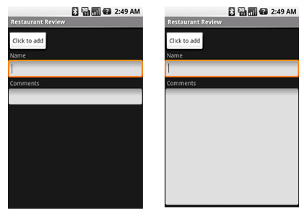
4. Android – UI - User Interfaces
Common Layouts
2. LinearLayout
You may attribute a weight to children of a LinearLayout.
Weight gives an "importance" value to a view, and allows it to expand to fill any remaining space in the parent view.
Example:
The following two forms represent a LinearLayout with a set of elements: a button, some labels and text boxes. The text boxes have their width set to fill_parent; other elements are set to wrap_content. The gravity, by default, is left.
The difference between the two versions of the form is that the form on the left has weight values unset (0 by default), while the form on the right has the comments text box weight set to 1. If the Name textbox had also been set to 1, the Name and Comments text boxes would be the same height.
20

Slide 21
4. Android – UI - User Interfaces
Common Layouts
3. TableLayout
TableLayout positions its children into rows and columns.
TableLayout containers do not display border lines.
The table will have as many columns as the row with the most cells.
A cell could be empty, but cannot span columns, as they can in HTML.
A TableRow object defines a single row in the table.
A row has zero or more cells, each cell is defined by any kind of other View.
A cell may also be a ViewGroup object.
21

Slide 22
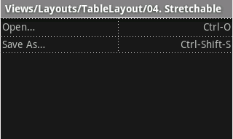
4. Android – UI - User Interfaces
Common Layouts
<?xml version="1.0" encoding="utf-8"?>
<TableLayout
xmlns:android="http://schemas.android.com/apk/res/android"
android:layout_width="fill_parent"
android:layout_height="fill_parent"
android:stretchColumns="*">
<TableRow>
<TextView android:text="Open…"
android:padding="3dip" />
<TextView android:text="Ctrl-O"
android:gravity="right"
android:padding="3dip" />
</TableRow>
<TableRow>
<TextView android:text="Save As…"
android:padding="3dip" />
<TextView android:text="Ctrl-Shift-S"
android:gravity="right"
android:padding="3dip" />
</TableRow>
</TableLayout>
TableLayout Example
The following sample layout has two rows and two cells in each. The accompanying screenshot shows the result, with cell borders displayed as dotted lines (added for visual effect).
22

Slide 23
4. Android – UI - User Interfaces
Common Layouts
4. RelativeLayout
RelativeLayout lets child views specify their position relative to the parent view or to each other (specified by ID).
You can align two elements by right border, or make one below another, centered in the screen, centered left, and so on.
Elements are rendered in the order given, so if the first element is centered in the screen, other elements aligning themselves to that element will be aligned relative to screen center.
Also, because of this ordering, if using XML to specify this layout, the element that you will reference (in order to position other view objects) must be listed in the XML file before you refer to it from the other views via its reference ID.
23

Slide 24
4. Android – UI - User Interfaces
Common Layouts
4. RelativeLayout
The defined RelativeLayout parameters are (android:layout_...) :
width, height,
below, above
alignTop, alignParentTop,
alignBottom, alignParentBottom
toLeftOf, toRightOf
padding [Bottom|Left|Right|Top], and
margin [Bottom|Left|Right|Top].
For example, assigning the parameter
android:layout_toLeftOf=“@+id/my_button"
to a TextView would place the TextView to the left of the View with the ID my_button
24

Slide 25
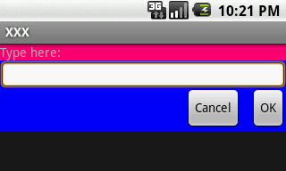
4. Android – UI - User Interfaces
Common Layouts
<?xml version="1.0" encoding="utf-8"?>
<RelativeLayout
xmlns:android="http://schemas.android.com/apk/res/android"
android:layout_width="fill_parent"
android:layout_height="wrap_content"
android:background="#ff0000ff"
android:padding="10px" >
<TextView android:id="@+id/label"
android:layout_width="fill_parent"
android:layout_height="wrap_content"
android:background="#ffff0077"
android:text="Type here:" />
<EditText android:id="@+id/entry"
android:layout_width="fill_parent"
android:layout_height="wrap_content"
android:layout_below="@+id/label" />
RelativeLayout Example
The example below shows an XML file and the resulting screen in the UI. Note that the attributes that refer to relative elements (e.g., layout_toLeft) refer to the ID using the syntax of a relative resource (@+id/id).
Continue next page
25

Slide 26
4. Android – UI - User Interfaces
Common Layouts
<Button
android:id="@+id/ok"
android:layout_width="wrap_content"
android:layout_height="wrap_content"
android:layout_below="@+id/entry"
android:layout_alignParentRight="true"
android:layout_marginLeft="10px"
android:text="OK" />
<Button
android:text="Cancel"
android:layout_width="wrap_content"
android:layout_height="wrap_content"
android:layout_toLeftOf="@+id/ok"
android:layout_alignTop="@+id/ok“ />
</RelativeLayout>
RelativeLayout Example
Cont.
26

Slide 27
4. Android – UI - User Interfaces
A Detailed List of Widgets
For a detailed list consult:
http://developer.android.com/reference/android/widget/package-summary.html
AbsListView
AbsListView.LayoutParams
AbsoluteLayout
AbsoluteLayout.LayoutParams
AbsSeekBar
AbsSpinner
AdapterView<T extends Adapter>
AdapterContextMenuInfo
AlphabetIndexer
AnalogClock
ArrayAdapter<T>
AutoCompleteTextView
BaseAdapter
BaseExpandableListAdapter
Button
CheckBox
CheckedTextView
Chronometer
CompoundButton
CursorAdapter
CursorTreeAdapter
DatePicker
DialerFilter
DigitalClock
EditText
ExpandableListView
ExpandableListContextMenuInfo
Filter
Filter.FilterResults
FrameLayout
FrameLayout.LayoutParams
Gallery
Gallery.LayoutParams
GridView
HeaderViewListAdapter
HorizontalScrollView
ImageButton
ImageSwitcher
ImageView
LinearLayout
LinearLayout.LayoutParams
ListView
ListView.FixedViewInfo
MediaController
MultiAutoCompleteTextView
CommaTokenizer
PopupWindow
ProgressBar
RadioButton
RadioGroup
RadioGroup.LayoutParams
RatingBar
RelativeLayout
RelativeLayout.LayoutParams
RemoteViews
ResourceCursorAdapter
ResourceCursorTreeAdapter
Scroller
ScrollView
SeekBar
SimpleAdapter
SimpleCursorAdapter
SimpleCursorTreeAdapter
SimpleExpandableListAdapter
SlidingDrawer
Spinner
TabHost
TabHost.TabSpec
TableLayout
TableLayout.LayoutParams
TableRow
TableRow.LayoutParams
TabWidget
TextSwitcher
TextView
TextView.SavedState
TimePicker
Toast
ToggleButton
TwoLineListItem
VideoView
ViewAnimator
ViewFlipper
ViewSwitcher
ZoomButton
ZoomControls
27

Slide 28
4. Android – UI - User Interfaces
Attaching Layouts to Java Code
PLUMBING. Ta phải ‘nối’ các phần từ XML với các đối tượng tương đương trong activity. Nhờ đó, ta có thể thao tác với UI từ mã chương trình.
XLM Layout
<xml….
. . .
. . .
</xml>
JAVA code
public class ….
{
. . .
. . .
}
28

Slide 29
4. Android – UI - User Interfaces
Attaching Layouts to Java Code
Giả sử UI đã được tạo tại res/layout/main.xml. Ứng dụng có thể gọi layout này bằng lệnh
setContentView(R.layout.main);
Có thể truy nhập các widget, chẳng hạn myButton, bằng lệnh findViewByID(…) như sau
Button btn = (Button) findViewByID(R.id.myButton);
Trong đó, R là một lớp được sinh tự động để theo dõi các tài nguyên của ứng dụng. Cụ thể, R.id... là các widget được định nghĩa trong layout XML.
29

Slide 30
4. Android – UI - User Interfaces
Attaching Layouts to Java Code
Gắn Listener cho Widget (event handling)
Button trong ví dụ của ta có thể dùng được sau khi gắn một listener cho sự kiện click:
btn.setOnClickListener(new OnClickListener() {
@Override
public void onClick(View v) {
updateTime();
}
});
private void updateTime() {
btn.setText(new Date().toString());
}
30

Slide 31
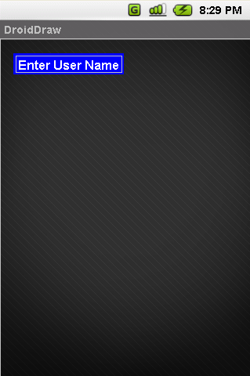
4. Android – UI - User Interfaces
Basic Widgets: Labels
A label is called in android a TextView.
TextViews are typically used to display a caption.
TextViews are not editable, therefore they take no input.
31

Slide 32
4. Android – UI - User Interfaces
Basic Widgets: Labels
<?xml version="1.0" encoding="utf-8"?>
<LinearLayout
android:id="@+id/myLinearLayout"
android:layout_width="fill_parent" android:layout_height="fill_parent"
xmlns:android="http://schemas.android.com/apk/res/android"
>
<TextView
android:id="@+id/myTextView1"
android:layout_width="wrap_content"
android:layout_height="wrap_content"
android:background="#ff0000ff"
android:padding="3dp"
android:text="Enter User Name"
android:textSize="16sp"
android:textStyle="bold"
android:gravity="center">
</TextView>
</LinearLayout>
32

Slide 33
4. Android – UI - User Interfaces
Basic Widgets: Labels/TextViews
http://developer.android.com/reference/android/widget/TextView.html
Attribute Name | Related Method | Description
android:autoLink | setAutoLinkMask(int) | Controls whether links such as urls and email addresses are automatically found and converted to clickable links.
android:autoText | setKeyListener(KeyListener) | If set, specifies that this TextView has a textual input method and automatically corrects some common spelling errors.
android:bufferType | setText(CharSequence,TextView.BufferType) | Determines the minimum type that getText() will return.
android:capitalize | setKeyListener(KeyListener) | If set, specifies that this TextView has a textual input method and should automatically capitalize what the user types.
android:cursorVisible | setCursorVisible(boolean) | Makes the cursor visible (the default) or invisible Must be a boolean value, either "true" or "false".
android:digits | setKeyListener(KeyListener) | If set, specifies that this TextView has a numeric input method and that these specific characters are the ones that it will accept.
android:drawableBottom | setCompoundDrawablesWithIntrinsicBounds(Drawable,Drawable,Drawable,Drawable) | The drawable to be drawn below the text.
android:drawableLeft | setCompoundDrawablesWithIntrinsicBounds(Drawable,Drawable,Drawable,Drawable) | The drawable to be drawn to the left of the text.
android:drawablePadding | setCompoundDrawablePadding(int) | The padding between the drawables and the text.
android:drawableRight | setCompoundDrawablesWithIntrinsicBounds(Drawable,Drawable,Drawable,Drawable) | The drawable to be drawn to the right of the text.
android:drawableTop | setCompoundDrawablesWithIntrinsicBounds(Drawable,Drawable,Drawable,Drawable) | The drawable to be drawn above the text.
android:editable |  | If set, specifies that this TextView has an input method.
android:editorExtras | setInputExtras(int) | Reference to an <input-extras> XML resource containing additional data to supply to an input method, which is private to the implementation of the input method.
android:ellipsize | setEllipsize(TextUtils.TruncateAt) | If set, causes words that are longer than the view is wide to be ellipsized instead of broken in the middle.
android:ems | setEms(int) | Makes the TextView be exactly this many ems wide Must be an integer value, such as "100".
android:freezesText | setFreezesText(boolean) | If set, the text view will include its current complete text inside of its frozen icicle in addition to meta-data such as the current cursor position.
33

Slide 34
4. Android – UI - User Interfaces
Basic Widgets: Labels/TextViews cont.
http://developer.android.com/reference/android/widget/TextView.html
Attribute Name | Related Method | Description
android:gravity | setGravity(int) | Specifies how to align the text by the view's x and/or y axis when the text is smaller than the view.
android:height | setHeight(int) | Makes the TextView be exactly this many pixels tall.
android:hint | setHint(int) | Hint text to display when the text is empty.
android:imeActionId | setImeActionLabel(CharSequence,int) | Supply a value for EditorInfo.actionId used when an input method is connected to the text view.
android:imeActionLabel | setImeActionLabel(CharSequence,int) | Supply a value for EditorInfo.actionLabel used when an input method is connected to the text view.
android:imeOptions | setImeOptions(int) | Additional features you can enable in an IME associated with an editor, to improve the integration with your application.
android:includeFontPadding | setIncludeFontPadding(boolean) | Leave enough room for ascenders and descenders instead of using the font ascent and descent strictly.
android:inputMethod | setKeyListener(KeyListener) | If set, specifies that this TextView should use the specified input method (specified by fully-qualified class name).
android:inputType | setRawInputType(int) | The type of data being placed in a text field, used to help an input method decide how to let the user enter text.
android:lineSpacingExtra | setLineSpacing(float,float) | Extra spacing between lines of text.
android:lineSpacingMultiplier | setLineSpacing(float,float) | Extra spacing between lines of text, as a multiplier.
android:lines | setLines(int) | Makes the TextView be exactly this many lines tall Must be an integer value, such as "100".
android:linksClickable | setLinksClickable(boolean) | If set to false, keeps the movement method from being set to the link movement method even if autoLink causes links to be found.
android:marqueeRepeatLimit | setMarqueeRepeatLimit(int) | The number of times to repeat the marquee animation.
android:maxEms | setMaxEms(int) | Makes the TextView be at most this many ems wide Must be an integer value, such as "100".
android:maxHeight | setMaxHeight(int) | Makes the TextView be at most this many pixels tall Must be a dimension value, which is a floating point number appended with a unit such as "14.5sp".
android:maxLength | setFilters(InputFilter) | Set an input filter to constrain the text length to the specified number.
android:maxLines | setMaxLines(int) | Makes the TextView be at most this many lines tall Must be an integer value, such as "100".
34

Slide 35
4. Android – UI - User Interfaces
Basic Widgets: Labels/TextViews cont.
http://developer.android.com/reference/android/widget/TextView.html
Attribute Name | Related Method | Description
android:maxWidth | setMaxWidth(int) | Makes the TextView be at most this many pixels wide Must be a dimension value, which is a floating point number appended with a unit such as "14.5sp".
android:minEms | setMinEms(int) | Makes the TextView be at least this many ems wide Must be an integer value, such as "100".
android:minHeight | setMinHeight(int) | Makes the TextView be at least this many pixels tall Must be a dimension value, which is a floating point number appended with a unit such as "14.5sp".
android:minLines | setMinLines(int) | Makes the TextView be at least this many lines tall Must be an integer value, such as "100".
android:minWidth | setMinWidth(int) | Makes the TextView be at least this many pixels wide Must be a dimension value, which is a floating point number appended with a unit such as "14.5sp".
android:numeric | setKeyListener(KeyListener) | If set, specifies that this TextView has a numeric input method.
android:password | setTransformationMethod(TransformationMethod) | Whether the characters of the field are displayed as password dots instead of themselves.
android:phoneNumber | setKeyListener(KeyListener) | If set, specifies that this TextView has a phone number input method.
android:privateImeOptions | setPrivateImeOptions(String) | An addition content type description to supply to the input method attached to the text view, which is private to the implementation of the input method.
android:scrollHorizontally | setHorizontallyScrolling(boolean) | Whether the text is allowed to be wider than the view (and therefore can be scrolled horizontally).
android:selectAllOnFocus | setSelectAllOnFocus(boolean) | If the text is selectable, select it all when the view takes focus instead of moving the cursor to the start or end.
android:shadowColor | setShadowLayer(float,float,float,int) | Place a shadow of the specified color behind the text.
android:shadowDx | setShadowLayer(float,float,float,int) | Horizontal offset of the shadow.
android:shadowDy | setShadowLayer(float,float,float,int) | Vertical offset of the shadow.
android:shadowRadius | setShadowLayer(float,float,float,int) | Radius of the shadow.
35

Slide 36
4. Android – UI - User Interfaces
Basic Widgets: Labels/TextViews cont.
http://developer.android.com/reference/android/widget/TextView.html
Attribute Name | Related Method | Description
android:singleLine | setTransformationMethod(TransformationMethod) | Constrains the text to a single horizontally scrolling line instead of letting it wrap onto multiple lines, and advances focus instead of inserting a newline when you press the enter key.
android:text | setText(CharSequence) | Text to display.
android:textColor | setTextColor(ColorStateList) | Text color.
android:textColorHighlight | setHighlightColor(int) | Color of the text selection highlight.
android:textColorHint | setHintTextColor(int) | Color of the hint text.
android:textColorLink | setLinkTextColor(int) | Text color for links.
android:textScaleX | setTextScaleX(float) | Sets the horizontal scaling factor for the text Must be a floating point value, such as "1.2".
android:textSize | setTextSize(float) | Size of the text.
android:textStyle | setTypeface(Typeface) | Style (bold, italic, bolditalic) for the text.
android:typeface | setTypeface(Typeface) | Typeface (normal, sans, serif, monospace) for the text.
android:width | setWidth(int) | Makes the TextView be exactly this many pixels wide.
36

Slide 37
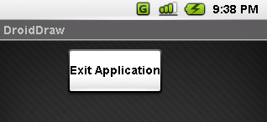
4. Android – UI - User Interfaces
Basic Widgets: Buttons
A Button widget allows the simulation of a clicking action on a GUI.
Button is a subclass of TextView. Therefore formatting a Button’s face is similar to the setting of a TextView.
...
<Button
android:id="@+id/btnExitApp"
android:layout_width="wrap_content"
android:layout_height="wrap_content"
android:padding="10px"
android:layout_marginLeft="5px"
android:text="Exit Application"
android:textSize="16sp"
android:textStyle="bold"
android:gravity="center"
android:layout_gravity="center_horizontal"
>
</Button>
37

Slide 38
Bài tập!
Cài đặt một trong các project sau
bằng các text box đơn giản
(EditText, TextView)
và các Button:
Tính lãi suất gửi tiền tiết kiệm (tiền gốc, lãi suất, thời hạn -> lãi)
Tính điểm tổng kết môn học Lập trình nhúng từ 3 điểm thành phần
Simple Flashlight (các nút bấm để đổi màu màn hình)
Chú ý: Activity label và tên project bắt đầu bằng username bitbucket. Tự thiết kế bố cục các view trên màn hình giao diện.
Nộp: toàn bộ mã nguồn + một vài trang màn hình tiêu biểu.
Hạn nộp: trước giờ thực hành tuần sau.

Slide 39
4. Android – UI - User Interfaces
Basic Widgets: Images
ImageView and ImageButton are two Android widgets that allow embedding of images in your applications.
Both are image-based widgets analogue to TextView and Button, respectively.
Each widget takes an android:src or android:background attribute (in an XML layout) to specify what picture to use.
Pictures are usually reference a drawable resource.
ImageButton, is a subclass of ImageView. It adds the standard Button behavior for responding to click events.
39

Slide 40
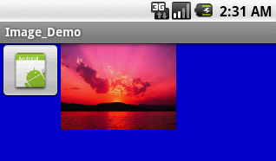
4. Android – UI - User Interfaces
Basic Widgets: Images
...
<ImageButton
android:id="@+id/myImageBtn1"
android:src="@drawable/icon"
android:layout_width="wrap_content"
android:layout_height="wrap_content"
>
</ImageButton>
<ImageView
android:id="@+id/myImageView1"
android:src="@drawable/microsoft_sunset"
android:layout_width="150px"
android:layout_height="120px"
android:scaleType="fitXY"
>
</ImageView>
40

Slide 41
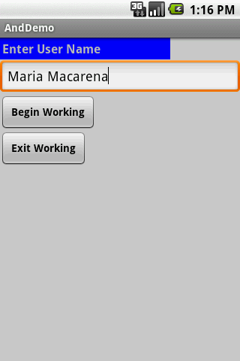
4. Android – UI - User Interfaces
Basic Widgets: EditText
The EditText (or textBox) widget is an extension of TextView that allows updates.
The control configures itself to be editable.
Important Java methods are:
txtBox.setText(“someValue”) and
txtBox.getText().toString()
41

Slide 42
4. Android – UI - User Interfaces
Basic Widgets: EditText
In addition to the standard TextView properties EditText has many others features such as:
• android:autoText, (true/false) provides automatic spelling assistance
• android:capitalize, (words/sentences) automatic capitalization
• android:digits, to configure the field to accept only certain digits
• android:singleLine, is the field for single-line / multiple-line input
• android:password, (true/false) controls field’s visibility
• android:numeric, (integer, decimal, signed) controls numeric format
• android:phonenumber, (true/false) Formatting phone numbers
42

Slide 43
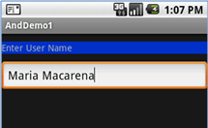
4. Android – UI - User Interfaces
Basic Widgets: EditViews
Example
...
<EditText
android:id="@+id/txtUserName"
android:layout_width="fill_parent"
android:layout_height="wrap_content"
android:textSize="18sp"
android:autoText="true"
android:capitalize="words"
android:hint="First Last Name"
>
</EditText>
...
Upper case words
Enter “teh”
It will be changed to: “The”
Suggestion (grey)
43

Slide 44
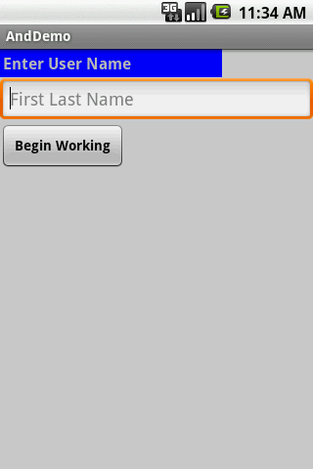

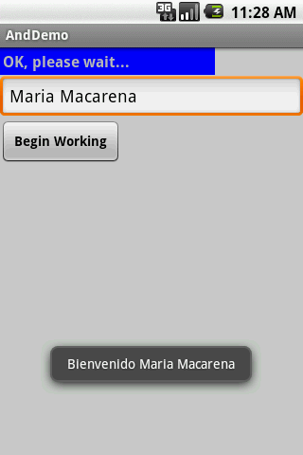
4. Android – UI - User Interfaces
Basic Widgets: Example 1
In this little example we will use an AbsoluteLayout holding a label( TexView), a textBox (EditText), and a Button.
We will use the view as a sort of simplified login screen.
Hint
Setting text
Capitals & spelling
A brief message box
44

Slide 45
4. Android – UI - User Interfaces
Basic Widgets: Example 1
Application’s Layout: main.xml
45

Slide 46
4. Android – UI - User Interfaces
Basic Widgets: Example 1
Android’s Application (1 of 2)
package cis493.gui;
import android.app.Activity;
import android.os.Bundle;
import android.view.View;
import android.view.View.OnClickListener;
import android.widget.Button;
import android.widget.EditText;
import android.widget.TextView;
import android.widget.Toast;
////////////////////////////////////////////////////////////////////////
// "LOGIN" - a gentle introduction to UI controls
public class AndDemo extends Activity {
TextView labelUserName;
EditText txtUserName;
Button btnBegin;
@Override
public void onCreate(Bundle savedInstanceState) {
super.onCreate(savedInstanceState);
setContentView(R.layout.main);
//binding the UI's controls defined in "main.xml" to Java code
labelUserName = (TextView) findViewById(R.id.labelUserName);
txtUserName = (EditText) findViewById(R.id.txtUserName);
btnBegin = (Button) findViewById(R.id.btnBegin);
46

Slide 47
4. Android – UI - User Interfaces
Basic Widgets: Example 1
Android’s Application (2 of 2)
//LISTENER: wiring the button widget to events-&-code
btnBegin.setOnClickListener(new OnClickListener() {
@Override
public void onClick(View v) {
String userName = txtUserName.getText().toString();
if (userName.compareTo("Maria Macarena")==0){
labelUserName.setText("OK, please wait...");
Toast.makeText(getApplicationContext(),
"Bienvenido " + userName,
Toast.LENGTH_SHORT).show();
}
Toast.makeText(getApplicationContext(),
"Bienvenido " + userName,
Toast.LENGTH_SHORT).show();
}
});// onClick
}//onCreate
}//class
47

Slide 48
4. Android – UI - User Interfaces
Basic Widgets: Example 1
Note: Another way of defining a Listener for multiple button widgets
48

Slide 49
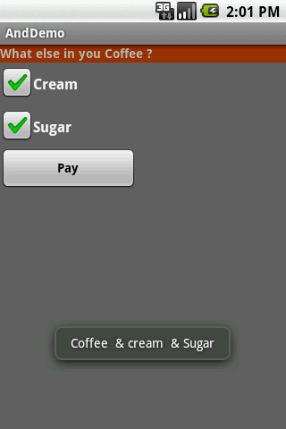
4. Android – UI - User Interfaces
Basic Widgets: CheckBox
A checkbox is a specific type of two-states button that can be either checked or unchecked.
A example usage of a checkbox inside your activity would be the following:
49

Slide 50
4. Android – UI - User Interfaces
Example 2: CheckBox
Complete code for the checkBox demo (1 of 3)
50

Slide 51
4. Android – UI - User Interfaces
Example 2: CheckBox
Complete code for the checkBox demo (2 of 3)
51

Slide 52
4. Android – UI - User Interfaces
Example 2: CheckBox
Complete code for the checkBox demo (1 of 2)
52

Slide 53
4. Android – UI - User Interfaces
Basic Widgets: RadioButtons
A radio button is a two-states button that can be either checked or unchecked.
When the radio button is unchecked, the user can press or click it to check it.
Radio buttons are normally used together in a RadioGroup.
When several radio buttons live inside a radio group, checking one radio button unchecks all the others.
RadioButton inherits from … TextView. Hence, all the standard TextView properties for font face, style, color, etc. are available for controlling the look of radio buttons.
Similarly, you can call isChecked() on a RadioButton to see if it is selected, toggle() to select it, and so on, like you can with a CheckBox.
53

Slide 54
4. Android – UI - User Interfaces
Basic Widgets: RadioButtons
Example
We extend the previous example by adding a RadioGroup and three RadioButtons. Only new XML and Java code is shown:
<?xml version="1.0" encoding="utf-8"?>
<LinearLayout
android:id="@+id/myLinearLayout"
android:layout_width="fill_parent"
android:layout_height="fill_parent"
android:orientation="vertical"
xmlns:android="http://schemas.android.com/apk/res/android"
>
<RadioGroup
android:id="@+id/radGroupCoffeeType"
android:layout_width="fill_parent"
android:layout_height="wrap_content"
android:orientation="vertical"
>
<TextView
android:id="@+id/labelCoffeeType"
android:layout_width="fill_parent"
android:layout_height="wrap_content"
android:background="#ff993300"
android:text="What type of coffee?"
android:textStyle="bold"
>
</TextView>
<RadioButton
android:id="@+id/radDecaf"
android:layout_width="fill_parent"
android:layout_height="wrap_content"
android:text="Decaf"
>
</RadioButton>
<RadioButton
android:id="@+id/radExpresso"
android:layout_width="wrap_content"
android:layout_height="wrap_content"
android:text="Expresso"
>
</RadioButton>
<RadioButton
android:id="@+id/radColombian"
android:layout_width="wrap_content"
android:layout_height="wrap_content"
android:text="Colombian"
>
</RadioButton>
</RadioGroup>
...
</LinearLayout>
54

Slide 55
4. Android – UI - User Interfaces
Basic Widgets: RadioButtons
Android Activity (1 of 3)
package cis493.demoui;
// example using RadioButtons
import android.app.Activity;
import android.os.Bundle;
import android.view.View;
import android.view.View.OnClickListener;
import android.widget.Button;
import android.widget.CheckBox;
import android.widget.RadioButton;
import android.widget.RadioGroup;
import android.widget.Toast;
public class AndDemoUI extends Activity {
CheckBox chkCream;
CheckBox chkSugar;
Button btnPay;
RadioGroup radCoffeeType;
RadioButton radDecaf;
RadioButton radExpresso;
RadioButton radColombian;
55

Slide 56
4. Android – UI - User Interfaces
Basic Widgets: RadioButtons
Android Activity (2 of 3)
@Override
public void onCreate(Bundle savedInstanceState) {
super.onCreate(savedInstanceState);
setContentView(R.layout.main);
//binding XMl controls to Java code
chkCream = (CheckBox)findViewById(R.id.chkCream);
chkSugar = (CheckBox)findViewById(R.id.chkSugar);
btnPay = (Button) findViewById(R.id.btnPay);
radCoffeeType = (RadioGroup)findViewById(R.id.radGroupCoffeeType);
radDecaf = (RadioButton)findViewById(R.id.radDecaf);
radExpresso = (RadioButton)findViewById(R.id.radExpresso);
radColombian = (RadioButton)findViewById(R.id.radColombian);
56

Slide 57
4. Android – UI - User Interfaces
Basic Widgets: RadioButtons
//LISTENER: wiring button-events-&-code
btnPay.setOnClickListener(new OnClickListener() {
@Override
public void onClick(View v) {
String msg = "Coffee ";
if (chkCream.isChecked())
msg += " & cream ";
if (chkSugar.isChecked())
msg += " & Sugar";
// get radio buttons ID number
int radioId = radCoffeeType.getCheckedRadioButtonId();
// compare selected's Id with individual RadioButtons ID
if (radColombian.getId()== radioId)
msg = “Colombian " + msg;
// similarly you may use .isChecked() on each RadioButton
if (radExpresso.isChecked())
msg = "Expresso " + msg;
Toast.makeText(getApplicationContext(), msg, Toast.LENGTH_SHORT).show();
// go now and compute cost...
}// onClick
});
}// onCreate
}// class
57

Slide 58
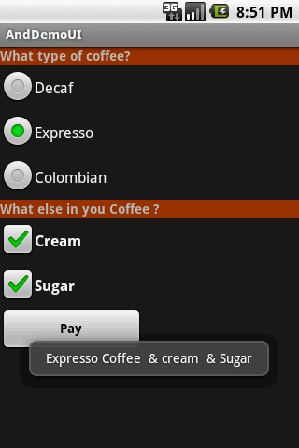
4. Android – UI - User Interfaces
Basic Widgets: RadioButtons
Example
This UI uses RadioButtons and
CheckBoxes
to define choices
RadioGroup
Summary of choices
58

Slide 59
UI – Other Features
All widgets extend View therefore they acquire a number of useful View properties and methods including:
XML Controls the focus sequence:
android:visibility
Android:background
Java methods
myButton.requestFocus()
myTextBox.isFocused()
myWidget.setEnabled()
myWidget.isEnabled()

Slide 60
UI - User Interfaces
Questions ?

Slide 61
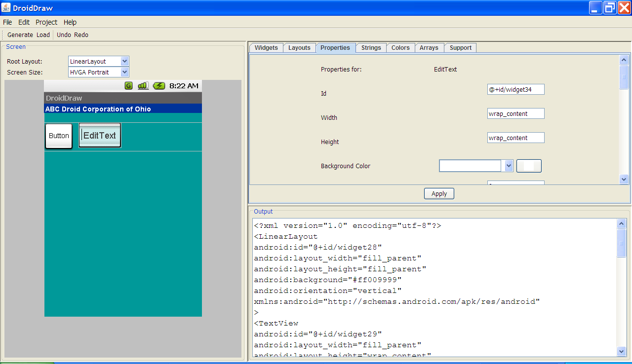
UI - User Interfaces
Resource: DroidDraw www.droidDraw.org

Slide 62

Android Asset Studio – Beta (Accessed: 18-Jan-2011)
AAS Link: http://code.google.com/p/android-ui-utils/
Icon Gen http://android-ui-utils.googlecode.com/hg/asset-studio/dist/index.html
Pencil 1.2 http://pencil.evolus.vn/en-US/Home.aspx
Video: http://www.youtube.com/watch?v=EaT7sYr_f0k&feature=player_embedded
WARNING: These utilities are currently in beta.
Utilities that help in the design and development of Android application user interfaces. This library currently consists of three individual tools for designers and developers:
1. UI Prototyping Stencils
A set of stencils for the Pencil GUI prototyping tool, which is available as an add-on for Firefox or as a standalone download.
2. Android Asset Studio
Try out the beta version: Android Asset Studio (shortlink: http://j.mp/androidassetstudio)
A web-based set of tools for generating graphics and other assets that would eventually be in an Android application's res/ directory.
Currently available asset generators area available for:
Launcher icons
Menu icons
Tab icons
Notification icons
Support for creation of XML resources and nine-patches is planned for a future release.
3. Android Icon Templates
A set of Photoshop icon templates that follow the icon design guidelines, complementing the official Android Icon Templates Pack.

Slide 63
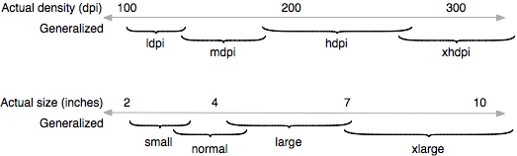
Questions - Measuring Graphic Elements
Q. What is dpi ?
Stands for dots per inch. You can compute it using the following formula:
dpi = sqrt (width_pixels^2 + height_pixels^2) / diagonal_inches
G1 (base device 320x480) 155.92 dpi (3.7 in diagonally)
Nexus (480x800) 252.15 dpi
Q. What is my Emulator’s Screen Resolution?
When creating an AVD you could set the entry “Abstracted LCD density” parameter to anything. Its default value is 160 dpi (use 260 for Nexus).
Q. How Android deals with screen resolutions?
Illustration of how the Android platform maps actual screen densities and sizes to generalized density and size configurations.

Slide 64
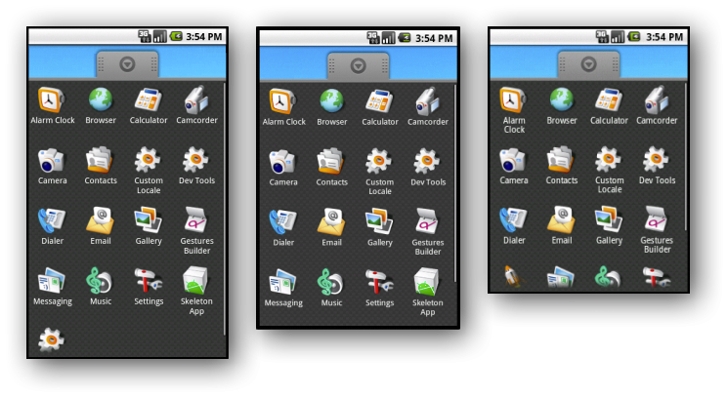
Questions - Measuring Graphic Elements
Q. What do I gain by using screen densities?
More homogeneous results as shown below
Q. How to set different density/size screens in my application?
The following manifest fragments declares support for small, normal, large, and xlarge screens in any density.
<manifest xmlns:android="http://schemas.android.com/apk/res/android"> <supports-screens android:smallScreens="true" android:normalScreens="true" android:largeScreens="true" android:xlargeScreens="true" android:anyDensity="true" /> ... </manifest>
Examples of density independence on WVGA high density (left), HVGA medium density (center), and QVGA low density (right).

Slide 65
Questions - Measuring Graphic Elements
Q. Give me an example on how to use dip units.
Assume you design your interface for a G1 phone having 320x480 pixels (Abstracted
LCD density is 160 – See your AVD entry)
You want a button to be hand-placed in the middle of the screen.
You could allocate the 320 horizontal pixels as [ 100 + 120 + 100 ]. The XML would be
<Button>
android:layout_height="wrap_content"
android:layout_width="120dip"
android:layout_x="100dip"
android:layout_y=“240dip"
android:text="Go"
android:id="@+id/btnGo"
</Button>
Instead of using pixels (px) you should use dip. If the application is deployed on a higher resolution screen (more pixels in 1 dip) the button is still mapped to the middle of the screen.

