Slide 1


Android Selection Widgets Các Widget cho phép chọn
6
Notes are based on:
The Busy Coder's Guide to Android Development
by Mark L. Murphy
Copyright © 2008-2009 CommonsWare, LLC.
ISBN: 978-0-9816780-0-9
&
Android Developers
http://developer.android.com/index.html

Slide 2
6. Android – UI – Selection Widgets
Selection Widgets
RadioButton và CheckButton thích hợp cho việc chọn từ một số ít các tùy chọn.
Khi số lựa chọn lớn hơn, có thể dùng các widget khác như: listbox, combobox, drop-down list, picture gallery, v.v...
Android data adapter cung cấp một giao diện chung cho các selection list (các danh sách cho phép chọn) từ các mảng nhỏ cho đến các nội dung từ CSDL.
Selection view – các widget hiển thị một danh sách các lựa chọn mà một adapter cung cấp để người dùng thực hiện chọn lựa tại đây.
ListView, Spinner, GridView, AutoCompleteTextView, Galery
2

Slide 3
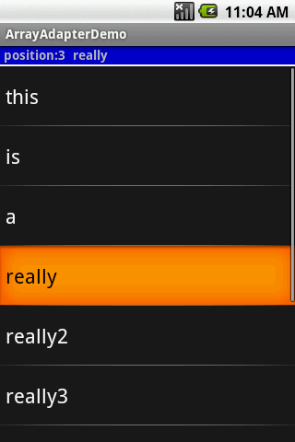
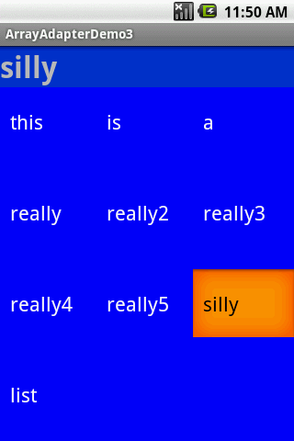
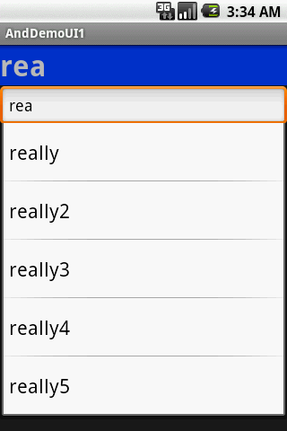
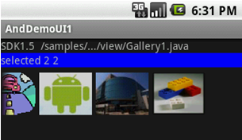

6. Android – UI – Selection Widgets
Selection Widgets
ListView, Spinner, GridView, AutoCompleteTextView, Galery
3
3

Slide 4
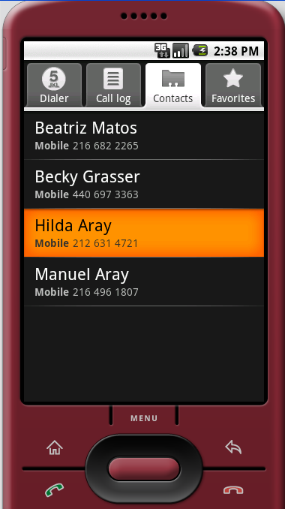
6. Android – UI – Selection Widgets
Selection Widgets
Displaying/Selecting Options
Selection
DATA
Raw data
Formatted & bound
data
DATA
ADAPTER
Destination layout
Holding a ListView
4

Slide 5
6. Android – UI – Selection Widgets
Selection Widgets
Displaying/Selecting Options:
Thông thường, một data adapter được gắn với một ListView – đây là một UI widget dành riêng cho việc hiển thị danh sách
Destination layout
Holding a ListView
5

Slide 6
6. Android – UI – Selection Widgets
Using ArrayAdapter
Loại adapter đơn giản nhất là ArrayAdapter. Ta chỉ bọc một đối tượng loại này ra ngoài một mảng Java hoặc java.util.List instance từ bên trọng một ListActivity (Chú ý: không phải một Activity…).
String[] items={"this", "is", "a","really", "silly", "list"};
new ArrayAdapter<String>(this,
android.R.layout.simple_list_item_1,
items);
Constructor của ArrayAdapter lấy 3 tham số:
Context sử dụng (thường thì this là con trỏ đến activity hiện hành)
resource ID của view sẽ hiển thị danh sách ( thường là một ListView , chẳng hạn cái đã được định nghĩa trong resource : android.R.layout.simple_list_item_1 ở trên)
Mảng hoặc list chứa các items cần hiển thị trong danh sách
6

Slide 7
6. Android – UI – Selection Widgets
Selection Widgets
Example 1: A simple list (1 of 4)
Instead of Activity we will use a ListActivity which is an Android class specializing in
the use of ListViews.
<?xml version="1.0" encoding="utf-8"?>
<LinearLayout
xmlns:android="http://schemas.android.com/apk/res/android"
android:orientation="vertical"
android:layout_width="fill_parent"
android:layout_height="fill_parent" >
<TextView
android:id="@+id/selection"
android:layout_width="fill_parent"
android:layout_height="wrap_content"
android:background="#ff0000cc"
android:textStyle="bold“ />
<!-- Here is the list. Since we are using a ListActivity, we have to call it "@android:id/list" so ListActivity will find it --> <ListView
android:id="@android:id/list"
android:layout_width="fill_parent"
android:layout_height="fill_parent"
android:drawSelectorOnTop="false" />
<TextView android:id="@android:id/empty"
android:layout_width="wrap_content"
android:layout_height="wrap_content"
android:text="Empty set" />
</LinearLayout>
Android’s built-in list layout
Used on empty lists
7

Slide 8
6. Android – UI – Selection Widgets
Selection Widgets
Example 1 : A simple list (2 of 4)
package cis493.selectionwidgets;
import android.app.ListActivity;
import android.os.Bundle;
import android.view.View;
import android.widget.ArrayAdapter;
import android.widget.ListView;
import android.widget.TextView;
public class ArrayAdapterDemo extends ListActivity {
TextView selection;
String[] items = { "this", "is", "a", "really",
"really2", "really3","really4",
"really5", "silly", "list" };
// next time try an empty list such as:
// String[] items = {};
Data source
NOTE: The ListActivity class is implicitly bound to an object identified by @android:id/list
8

Slide 9
6. Android – UI – Selection Widgets
Selection Widgets
Example 1: A simple list (3 of 4)
@Override
public void onCreate(Bundle savedInstanceState) {
super.onCreate(savedInstanceState);
setContentView(R.layout.main);
setListAdapter(new ArrayAdapter<String>(
this,
android.R.layout.simple_list_item_1,
items));
selection=(TextView)findViewById(R.id.selection);
}
@Override
protected void onListItemClick(ListView l, View v,
int position, long id) {
super.onListItemClick(l, v, position, id);
String text = " position:" + position + " " + items[position];
selection.setText(text);
}
}
List adapter
Selection listener
9

Slide 10

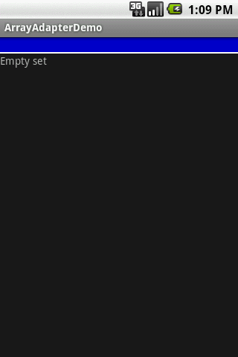
6. Android – UI – Selection Widgets
Selection Widgets
Example 1: A simple list (4 of 4)
Selection seen
by the listener
When you click here
background flashes orange
10

Slide 11


6. Android – UI – Selection Widgets
Selection Widgets
Observations on Example1.
Ví dụ này dùng một số component dựng sẵn của Android
Trong XML layout ta gọi một widget ListView dựng sẵn với id android:id/list
(includes: multiple lines, black /orange background, light-gray separator line, horiz/vert. scroll-bar)
Trong khi đặt cấu hình của ArrayAdapter ta dùng android.R.layout.simple_list_item_1
(indicates how to display a single line of data)
Android SDK có sẵn một loạt các layout định nghĩa trước, chúng nằm tại thư mục: C:\Android\platforms\android-xx\data\res\layout
See Appendix A for more on this issue.
11

Slide 12

6. Android – UI – Selection Widgets
Selection Widgets
A Variation on Example1.
Ta có thể dùng Activity thông thường thay cho ListActivity. Tự định nghĩa một ListView (thay cho @android:id/list). Gắn adapter với ListView mới.
public class Main extends Activity {
ListView myListView;
@Override
public void onCreate(Bundle savedInstanceState) {
super.onCreate(savedInstanceState);
setContentView(R.layout.main);
myListView = (ListView) findViewById(R.id.ListView01);
final String[] items={"this", "is", "a","really", "really2",
"really3", "really4", "really5", "silly", "list"};
ArrayAdapter<String> ad = new ArrayAdapter<String>(this,
android.R.layout.simple_list_item_1,
items);
myListView.setAdapter(ad);
}
}
12

Slide 13
6. Android – UI – Selection Widgets
Selection Widgets
A Variation on Example1 (cont.)
Để cung cấp một listener cho ListView, thêm đoạn mã sau vào phương thức onCreate.
myListView.setOnItemClickListener(new OnItemClickListener() {
@Override
public void onItemClick(AdapterView<?> av, View v, int position, long id) {
String text = "\n av: " + av.toString()
+ "\n v: " + v.toString()
+ "\n pos:" + position
+ "\n id: " + id
+ "\n data:" + items[position];;
Toast.makeText(getApplicationContext(), text, 1).show();
}
});
13

Slide 14

6. Android – UI – Selection Widgets
Selection Widgets
Spin Control
Trong Android, Spinner là widget chọn dạng drop-down.
Spinner có cùng chức năng với ListView nhưng chiếm ít không gian hơn.
Cũng như với ListView, ta dùng adapter để liên kết dữ liệu với Spinner, dùng hàm setAdapter()
Thêm một đối tượng listener để nhận chọn lựa từ danh sách (hàm setOnItemSelectedListener()).
Dùng setDropDownViewResource() để cung cấp resource ID của multi-line selection list view cần dùng.
14

Slide 15
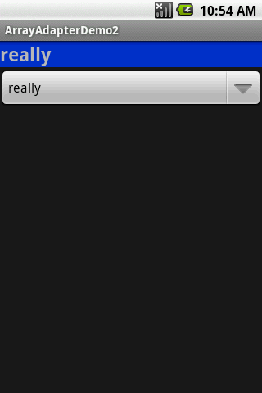
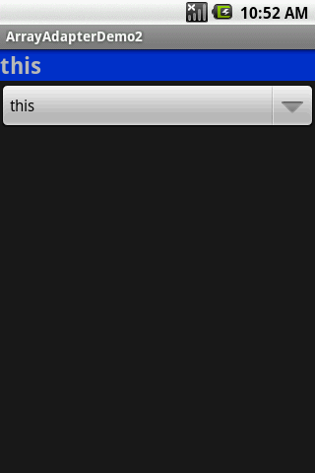
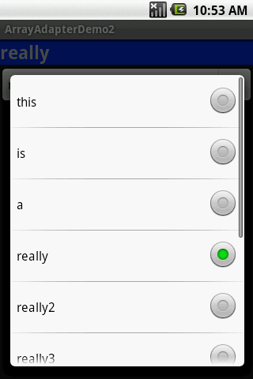
6. Android – UI – Selection Widgets
Selection Widgets
Example 2. Using the Spinner
3. Selected value
1. Click here
2. Select this option
15

Slide 16
6. Android – UI – Selection Widgets
Selection Widgets
Example 2. Using the Spinner
<?xml version="1.0" encoding="utf-8"?>
<LinearLayout
android:id="@+id/myLinearLayout"
android:layout_width="fill_parent"
android:layout_height="fill_parent"
android:orientation="vertical"
xmlns:android="http://schemas.android.com/apk/res/android"
>
<TextView
android:id="@+id/selection"
android:layout_width="fill_parent"
android:layout_height="wrap_content"
android:background="#ff0033cc"
android:textSize="14pt"
android:textStyle="bold"
>
</TextView>
<Spinner
android:id="@+id/spinner"
android:layout_width="fill_parent"
android:layout_height="wrap_content"
>
</Spinner>
</LinearLayout>
You choose the name
16

Slide 17
6. Android – UI – Selection Widgets
Selection Widgets
Example 2. Using the Spinner
package cis493.selectionwidgets;
import android.app.Activity;
import android.os.Bundle;
import android.view.View;
import android.widget.AdapterView;
import android.widget.ArrayAdapter;
import android.widget.Spinner;
import android.widget.TextView;
public class ArrayAdapterDemo2 extends Activity
implements AdapterView.OnItemSelectedListener {
TextView selection;
String[] items = { "this", "is", "a",
"really", "really2", "really3",
"really4", "really5", "silly", "list" };
17

Slide 18
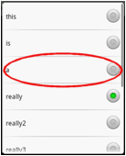
6. Android – UI – Selection Widgets
Selection Widgets
Example 2. Using the Spinner
@Override
public void onCreate(Bundle icicle) {
super.onCreate(icicle);
setContentView(R.layout.main);
selection = (TextView) findViewById(R.id.selection);
Spinner spin = (Spinner) findViewById(R.id.spinner);
spin.setOnItemSelectedListener(this);
// bind array to UI control to show one-line
ArrayAdapter<String> aa = new ArrayAdapter<String>(
this, android.R.layout.simple_spinner_item, items);
// showing the drop-down multi-line window
aa.setDropDownViewResource(
android.R.layout.simple_spinner_dropdown_item);
// associate GUI spinner and adapter
spin.setAdapter(aa);
}
// ////////////////////////////////////////////////////////////////////
public void onItemSelected(
AdapterView<?> parent, View v, int position, long id) {
selection.setText(items[position]);
}
public void onNothingSelected(AdapterView<?> parent) {
selection.setText("");
}
}
18

Slide 19
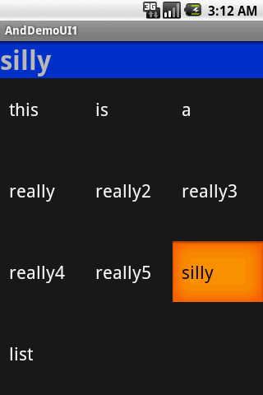
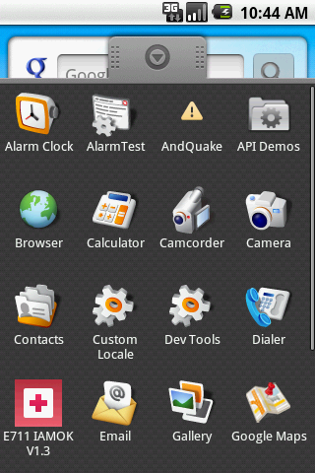
6. Android – UI – Selection Widgets
Selection Widgets
GridView
GridView là một ViewGroup hiển thị các phần tử trong một lưới 2 chiều, có thanh cuốn.
Các item được chèn tự động vào lưới bằng một ListAdapter.
19

Slide 20
6. Android – UI – Selection Widgets
Selection Widgets
GridView
Some properties used to determine the number of columns and their sizes:
android:numColumns spells out how many columns there are, or, if you supply a value of auto_fit, Android will compute the number of columns based on available space and the properties listed below.
android:verticalSpacing and its counterpart android:horizontalSpacing indicate how much whitespace there should be between items in the grid.
android:columnWidth indicates how many pixels wide each column should be.
android:stretchMode indicates, for grids with auto_fit for android:numColumns, what should happen for any available space not taken up by columns or spacing .
20

Slide 21
6. Android – UI – Selection Widgets
Selection Widgets
GridView
Example: Fitting the View
Suppose the screen is 320 (dip) pixels wide, and we have
android:columnWidth set to 100dip and
android:horizontalSpacing set to 5dip.
Three columns would use 310 pixels (three columns of 100 pixels and two whitespaces of 5 pixels).
With android:stretchMode set to columnWidth, the three columns will each expand by
3-4 pixels to use up the remaining 10 pixels.
With android:stretchMode set to spacingWidth, the two internal whitespaces will each grow by 5 pixels to consume the remaining 10 pixels.
21

Slide 22
6. Android – UI – Selection Widgets
Selection Widgets
Example 3. GridView
<?xml version="1.0" encoding="utf-8"?>
<LinearLayout
xmlns:android="http://schemas.android.com/apk/res/android"
android:orientation="vertical"
android:layout_width="fill_parent"
android:layout_height="fill_parent"
>
<TextView
android:id="@+id/selection"
android:layout_width="fill_parent"
android:layout_height="wrap_content"
android:background="#ff0033cc"
android:textSize="14pt"
android:textStyle="bold"
/>
<GridView
android:id="@+id/grid“
android:background="#ff0000ff"
android:layout_width="fill_parent"
android:layout_height="fill_parent"
android:verticalSpacing="35px"
android:horizontalSpacing="5px"
android:numColumns="auto_fit"
android:columnWidth="100px"
android:stretchMode="columnWidth"
android:gravity="center"
/>
</LinearLayout>
22

Slide 23
6. Android – UI – Selection Widgets
Selection Widgets
Example 3. GridView
package cis493.selectionwidgets;
// using a gridview
import android.app.Activity;
import android.os.Bundle;
import android.view.View;
import android.widget.AdapterView;
import android.widget.ArrayAdapter;
import android.widget.GridView;
import android.widget.TextView;
public class ArrayAdapterDemo3 extends Activity
implements AdapterView. OnItemClickListener {
TextView selection;
String[] items = { "this", "is", "a",
"really", "really2", "really3",
"really4", "really5", "silly", "list" };
23

Slide 24
6. Android – UI – Selection Widgets
Selection Widgets
Example 3. GridView
@Override
public void onCreate(Bundle icicle) {
super.onCreate(icicle);
setContentView(R.layout.main);
selection = (TextView) findViewById(R.id.selection);
GridView gv = (GridView) findViewById(R.id.grid);
ArrayAdapter<String> aa = new ArrayAdapter<String>(
this,
android.R.layout.simple_list_item_1,
items );
gv.setAdapter(aa);
gv.setOnItemClickListener(this);
}
public void onItemClick(AdapterView<?> parent, View v,
int position, long id) {
selection.setText(items[position]);
}
}// class
24

Slide 25
6. Android – UI – Selection Widgets
Selection Widgets
AutoCompleteTextView
Với auto-completion, trong khi người dùng gõ, phần text đã nhập được dùng làm tiết đầu tố để lọc dữ liệu, so sánh phần text đã nhập với một danh sách các lựa chọn có thể.
Matches are shown in a selection list that, like with Spinner, folds down from the field.
The user can either type out a new entry (e.g., something not in the list) or choose an entry from the list to be the value of the field.
AutoCompleteTextView subclasses EditText, so you can configure all the standard look-and-feel aspects, such as font face and color.
AutoCompleteTextView has a android:completionThreshold property, to indicate the minimum number of characters a user must enter before the list filtering begins.
25

Slide 26
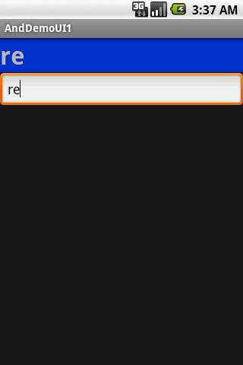

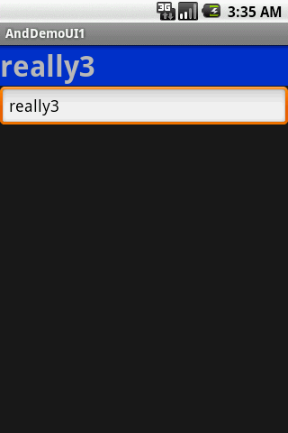
6. Android – UI – Selection Widgets
Selection Widgets
AutoCompleteTextView
Select this
26

Slide 27
6. Android – UI – Selection Widgets
Selection Widgets
Example 4. AutoCompleteTextView
<?xml version="1.0" encoding="utf-8"?>
<LinearLayout
xmlns:android="http://schemas.android.com/apk/res/android"
android:orientation="vertical"
android:layout_width="fill_parent"
android:layout_height="fill_parent"
>
<TextView
android:id="@+id/selection"
android:layout_width="fill_parent"
android:layout_height="wrap_content"
android:background="#ff0033cc"
android:textSize="14pt"
android:textStyle="bold"
/>
<AutoCompleteTextView
android:id="@+id/edit"
android:layout_width="fill_parent"
android:layout_height="wrap_content"
android:completionThreshold="3"/>
</LinearLayout>
Min. 3 chars to work
27

Slide 28
6. Android – UI – Selection Widgets
Selection Widgets
Example 4. AutoCompleteTextView
package cis493.selectionwidgets;
import android.app.Activity;
import android.os.Bundle;
import android.text.Editable;
import android.text.TextWatcher;
import android.widget.ArrayAdapter;
import android.widget.AutoCompleteTextView;
import android.widget.TextView;
public class AndDemoUI1 extends Activity implements TextWatcher {
TextView selection;
AutoCompleteTextView edit;
String[] items = { "this", "is", "a",
"really", "really2", "really3",
"really4", "really5", "silly", "list" };
28

Slide 29
6. Android – UI – Selection Widgets
Selection Widgets
Example 4. AutoCompleteTextView
@Override
public void onCreate(Bundle icicle) {
super.onCreate(icicle);
setContentView(R.layout.main);
selection = (TextView) findViewById(R.id.selection);
edit = (AutoCompleteTextView) findViewById(R.id.edit);
edit.addTextChangedListener(this);
edit.setAdapter(new ArrayAdapter<String>(this,
android.R.layout.simple_dropdown_item_1line, items));
}
public void onTextChanged(CharSequence s, int start, int before, int count) {
selection.setText(edit.getText());
}
public void beforeTextChanged(CharSequence s, int start,
int count, int after) {
// needed for interface, but not used
}
public void afterTextChanged(Editable s) {
// needed for interface, but not used
}
}
29

Slide 30
6. Android – UI – Selection Widgets
Selection Widgets
Gallery Widget
Widget Gallery hiển thị các lựa chọn dưới dạng các hình ảnh.
Image choices are offered on a contiguous horizontal mode, you may scroll across the image-set.
30

Slide 31
6. Android – UI – Selection Widgets
Selection Widgets
Gallery Widget - Example
<?xml version="1.0" encoding="utf-8"?>
<LinearLayout xmlns:android="http://schemas.android.com/apk/res/android"
android:orientation="vertical"
android:layout_width="fill_parent"
android:layout_height="fill_parent"
>
<TextView
android:layout_width="fill_parent"
android:layout_height="wrap_content"
android:text="SDK1.5 /samples/.../view/Gallery1.java"
/>
<TextView
android:id="@+id/mySelection"
android:layout_width="fill_parent"
android:layout_height="wrap_content"
android:background="#ff0000ff"
/>
<Gallery
android:id="@+id/myGallery"
android:layout_width="fill_parent"
android:layout_height="wrap_content"
android:gravity="bottom"
/>
</LinearLayout>
31

Slide 32
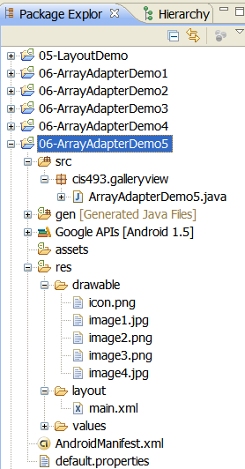
6. Android – UI – Selection Widgets
Selection Widgets
Gallery Widget - Example
package cis493.selectionwidgets;
import android.app.Activity;
import android.content.Context;
import android.os.Bundle;
import android.view.View;
import android.view.ViewGroup;
import android.widget.AdapterView;
import android.widget.BaseAdapter;
import android.widget.Gallery;
import android.widget.ImageView;
import android.widget.TextView;
import android.widget.AdapterView.OnItemSelectedListener;
public class AndDemoUI1 extends Activity {
// Using Gallery widget. G1 phone resolution: HVGA 320x480 px
// code adapted from:
// C:\Android\platforms\android-1.5\samples\ApiDemos\
// src\com\example\android\apis\view\Galler1.java
TextView mySelection;
Gallery myGallery;
32

Slide 33
6. Android – UI – Selection Widgets
Selection Widgets
Gallery Widget - Example
33

Slide 34
6. Android – UI – Selection Widgets
Selection Widgets
Gallery Widget - Example
public class ImageAdapter extends BaseAdapter {
/** The parent context */
private Context myContext;
// Put some images to project-folder: /res/drawable/
// format: jpg, gif, png, bmp, ...
private int[] myImageIds = { R.drawable.image1, R.drawable.image2,
R.drawable.image3, R.drawable.image4 };
/** Simple Constructor saving the 'parent' context. */
public ImageAdapter(Context c) {
this.myContext = c;
}
// inherited abstract methods - must be implemented
// Returns count of images, and individual IDs
public int getCount() {
return this.myImageIds.length;
}
public Object getItem(int position) {
return position;
}
public long getItemId(int position) {
return position;
}
34

Slide 35
6. Android – UI – Selection Widgets
Selection Widgets
Gallery Widget - Example
// Returns a new ImageView to be displayed,
public View getView(int position, View convertView,
ViewGroup parent) {
// Get a View to display image data
ImageView iv = new ImageView(this.myContext);
iv.setImageResource(this.myImageIds[position]);
// Image should be scaled somehow
//iv.setScaleType(ImageView.ScaleType.CENTER);
//iv.setScaleType(ImageView.ScaleType.CENTER_CROP);
//iv.setScaleType(ImageView.ScaleType.CENTER_INSIDE);
//iv.setScaleType(ImageView.ScaleType.FIT_CENTER);
//iv.setScaleType(ImageView.ScaleType.FIT_XY);
iv.setScaleType(ImageView.ScaleType.FIT_END);
// Set the Width & Height of the individual images
iv.setLayoutParams(new Gallery.LayoutParams(95, 70));
return iv;
}
}// ImageAdapter
}// class
35

Slide 36
6. Android – UI – Selection Widgets
Selection Widgets
GridView (again…)
Có thể dùng GridView với lựa chọn là các hình ảnh thay vì text.
Cần dùng một ImageAdapter để quy định nhiệm vụ cần thực hiện mỗi khi một hình ảnh được chọn (selected/clicked).
The following example illustrates how to use this control.
36

Slide 37
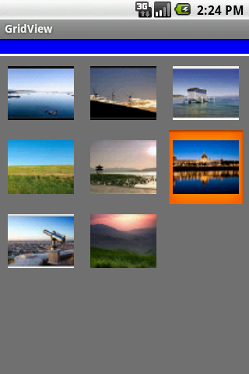
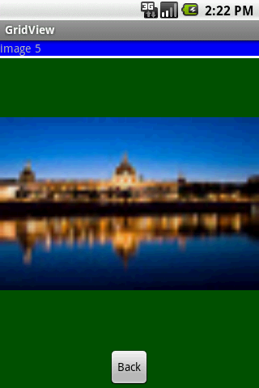
6. Android – UI – Selection Widgets
Selection Widgets
GridView (again…)
A –perhaps-- more interesting version of the GridView control uses images instead of text.
The programmer must supply a modified BaseAdapter to indicate what to do when an individual image is selected/clicked.
The following example illustrates how to use this control.
37

Slide 38
6. Android – UI – Selection Widgets
Selection Widgets
GridView (again…)
main.xml
<?xml version="1.0" encoding="utf-8"?>
<LinearLayout xmlns:android="http://schemas.android.com/apk/res/android"
android:orientation="vertical"
android:layout_width="fill_parent"
android:layout_height="fill_parent"
>
<TextView
android:id="@+id/tvMsg"
android:layout_width="fill_parent"
android:layout_height="wrap_content"
android:background="#ff0000ff"
/>
<TextView
android:layout_width="fill_parent"
android:layout_height="3px"
android:background="#ffffffff"
/>
<GridView
android:id="@+id/gridview"
android:layout_width="fill_parent"
android:layout_height="fill_parent"
android:numColumns="auto_fit"
android:verticalSpacing="10dp"
android:horizontalSpacing="10dp"
android:columnWidth="90dp"
android:stretchMode="columnWidth"
android:gravity="center"
android:background="#ff777777" />
</LinearLayout>
38

Slide 39
6. Android – UI – Selection Widgets
Selection Widgets
GridView (again…)
solo_picture.xml
<?xml version="1.0" encoding="utf-8"?>
<LinearLayout xmlns:android="http://schemas.android.com/apk/res/android"
android:orientation="vertical"
android:layout_width="fill_parent"
android:layout_height="fill_parent"
android:background="#ff005500" >
<TextView
android:id="@+id/tvSoloMsg"
android:layout_width="fill_parent"
android:layout_height="wrap_content"
android:background="#ff0000ff" />
<TextView
android:layout_width="fill_parent"
android:layout_height="3px"
android:background="#ffffffff" />
<ImageView
android:id="@+id/imgSoloPhoto"
android:layout_width="fill_parent"
android:layout_height="fill_parent"
android:layout_gravity="center|fill"
android:layout_weight="2“ />
<Button
android:text="Back"
android:id="@+id/btnBack"
android:layout_width="wrap_content"
android:layout_height="wrap_content"
android:layout_gravity="center_horizontal" />
</LinearLayout>
39

Slide 40
6. Android – UI – Selection Widgets
Selection Widgets
GridView (again…)
package cis493.matos;
/* --------------------------------------------------------------------------
References:
Website on which you could make free thumbnails:
http: www.makeathumbnail.com/thumbnail.php
--------------------------------------------------------------------------
GOAL: displaying a number of pictures in a GridView. Example taken from:
http: developer.android.com/guide/tutorials/views/hello-gridview.html
--------------------------------------------------------------------------
Reference: http://developer.android.com/guide/practices/screens_support.html
px Pixels - corresponds to actual pixels on the screen.
dp Density-independent Pixels (dip) - an abstract unit that is based on the
physical density of the screen. These units are relative to a
160 dpi screen, so one dp is one pixel on a 160 dpi screen.
--------------------------------------------------------------------------------
*/
import android.app.Activity;
import android.content.Context;
import android.os.Bundle;
import android.view.View;
import android.view.ViewGroup;
import android.view.View.OnClickListener;
import android.widget.AdapterView;
import android.widget.BaseAdapter;
import android.widget.Button;
import android.widget.GridView;
import android.widget.ImageView;
import android.widget.TextView;
import android.widget.Toast;
import android.widget.AdapterView.OnItemClickListener;
40

Slide 41
6. Android – UI – Selection Widgets
Selection Widgets
GridView (again…)
public class GridViewAct1 extends Activity implements OnItemClickListener {
TextView tvMsg;
GridView gridview;
TextView tvSoloMsg;
Integer[] mThumbIds;
ImageView ivSoloPicture;
Button btnBack;
Bundle myMemoryBundle;
@Override
public void onCreate(Bundle savedInstanceState) {
super.onCreate(savedInstanceState);
myMemoryBundle = savedInstanceState;
setContentView(R.layout.main);
tvMsg = (TextView )findViewById(R.id.tvMsg);
//initialize array of images with a few pictures
mThumbIds = new Integer[] {
R.drawable.gallery_photo_1, R.drawable.gallery_photo_2,
R.drawable.gallery_photo_3, R.drawable.gallery_photo_4,
R.drawable.gallery_photo_5, R.drawable.gallery_photo_6,
R.drawable.gallery_photo_7, R.drawable.gallery_photo_8
};
gridview = (GridView) findViewById(R.id.gridview);
gridview.setAdapter(new ImageAdapter(this));
gridview.setOnItemClickListener(this);
}//onCreate
41

Slide 42
6. Android – UI – Selection Widgets
Selection Widgets
GridView (again…)
// this nested class could also be placed as a separated class
public class ImageAdapter extends BaseAdapter {
private Context mContext;
public ImageAdapter(Context c) {
mContext = c;
}
public int getCount() {
return mThumbIds.length;
}
public Object getItem(int position) {
Toast.makeText(getApplicationContext(), "Pos: " + position, 1).show();
return null;
}
public long getItemId(int position) {
return 0;
}
// create a new ImageView for each item referenced by the Adapter
public View getView(int position, View convertView, ViewGroup parent) {
ImageView imageView;
if (convertView == null) {
// if it's not recycled, initialize some attributes
imageView = new ImageView(mContext);
imageView.setLayoutParams(new GridView.LayoutParams(85, 85));
imageView.setScaleType(ImageView.ScaleType.CENTER_CROP);
imageView.setPadding(8, 8, 8, 8); }
else {
imageView = (ImageView) convertView;
}
imageView.setImageResource(mThumbIds[position]);
return imageView;
}
}// ImageAdapter
42

Slide 43
6. Android – UI – Selection Widgets
Selection Widgets
GridView (again…)
// a picture in the gallery view has been clicked
@Override
public void onItemClick(AdapterView<?> parent, View v, int position, long id) {
tvMsg.setText("Position: " + position +
" R.drawable.gallery_photo_" + (position+1) );
// show selected picture in an individual view
showScreen2(position);
}
//////////////////////////////////////////////////////////////////////////
private void showScreen2(int position){
// show the selected picture as a single frame
setContentView(R.layout.solo_picture);
tvSoloMsg = (TextView) findViewById(R.id.tvSoloMsg);
ivSoloPicture = (ImageView) findViewById(R.id.imgSoloPhoto);
tvSoloMsg.setText("image " + position);
ivSoloPicture.setImageResource(mThumbIds[position]);
btnBack = (Button) findViewById(R.id.btnBack);
btnBack.setOnClickListener(new OnClickListener() {
@Override
public void onClick(View v) {
// redraw the main screen beginning the whole app.
onCreate(myMemoryBundle);
}
});
}//showScreen2
//////////////////////////////////////////////////////////////////////////
}// GridViewAct1
43

Slide 44
6. Android – UI – Selection Widgets
Selection Widgets
Customized Lists
Android provides predefined row layouts for displaying simple lists. However, you may want more control in situations such as:
Not every row uses the same layout (e.g., some have one line of text, others have two)
You need to configure the widgets in the rows (e.g., different icons for different cases)
In those cases, the better option is to create your own subclass of your desired Adapter.
44

Slide 45
6. Android – UI – Selection Widgets
Selection Widgets
Customized Lists – tự tạo danh sách
Để tạo subclass của Adapter mong muốn, ta cần
override getView(), và
Tự tạo các dòng trong list.
Phương thức getView() có nhiệm vụ trả về một View đại diện cho dòng ở vị trí cho trước của adapter.
Example: Sửa getView() để ta có thể có các icon khác nhau cho các dòng trong một list, ở đây ta muốn một icon cho các từ ngắn và 1 icon cho các từ dài.
45

Slide 46
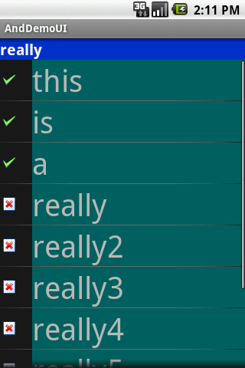
6. Android – UI – Selection Widgets
Selection Widgets
Customized Lists – Example: main.xml
<?xml version="1.0" encoding="utf-8"?>
<LinearLayout
android:id="@+id/widget28"
android:layout_width="fill_parent"
android:layout_height="fill_parent"
android:orientation="vertical"
xmlns:android="http://schemas.android.com/apk/res/android"
>
<TextView
android:id="@+id/selection"
android:layout_width="fill_parent"
android:layout_height="wrap_content"
android:background="#ff0033cc"
android:textSize="20px"
android:textStyle="bold"
android:textColor="#ffffffff"
>
</TextView>
<ListView
android:id="@android:id/list"
android:layout_width="fill_parent"
android:layout_height="fill_parent"
>
</ListView>
</LinearLayout>
46

Slide 47

6. Android – UI – Selection Widgets
Selection Widgets
Customized Lists – Example: myrow.xml
<?xml version="1.0" encoding="UTF-8"?>
<LinearLayout xmlns:android="http://schemas.android.com/apk/res/android"
android:layout_width="fill_parent"
android:layout_height="wrap_content"
android:orientation="horizontal"
>
<ImageView
android:id="@+id/icon"
android:layout_width="22px"
android:paddingLeft="2px"
android:paddingRight="2px"
android:paddingTop="2px"
android:layout_height="wrap_content"
android:src="@drawable/ok"
/>
<TextView
android:id="@+id/label"
android:layout_width="wrap_content"
android:layout_height="wrap_content"
android:textSize="40sp"
/>
</LinearLayout>
47

Slide 48
6. Android – UI – Selection Widgets
Selection Widgets
import android.app.Activity;
import android.os.Bundle;
import android.app.ListActivity;
import android.view.View;
import android.view.ViewGroup;
import android.view.LayoutInflater;
import android.widget.ArrayAdapter;
import android.widget.ImageView;
import android.widget.ListView;
import android.widget.TextView;
Customized Lists
package cis493.demoui;
import ...
public class AndDemoUI extends ListActivity {
TextView selection;
String[] items = { "this", "is", "a", "really", "really2",
"really3", "really4", "really5", "silly", "list" };
@Override
public void onCreate(Bundle icicle) {
super.onCreate(icicle);
setContentView(R.layout.main);
setListAdapter(new IconicAdapter(this));
selection = (TextView) findViewById(R.id.selection);
}
public void onListItemClick(ListView parent, View v, int position, long id) {
selection.setText(items[position]);
}
48

Slide 49
6. Android – UI – Selection Widgets
Selection Widgets
Customized Lists
class IconicAdapter extends ArrayAdapter {
Activity context;
IconicAdapter(Activity context) {
super(context, R.layout.myrow, items);
this.context = context;
}
public View getView(int position, View convertView, ViewGroup parent) {
LayoutInflater inflater = context.getLayoutInflater();
View row = inflater.inflate(R.layout.myrow, null);
TextView label = (TextView) row.findViewById(R.id.label);
ImageView icon = (ImageView) row.findViewById(R.id.icon);
label.setText(items[position]);
if (items[position].length() > 4)
icon.setImageResource(R.drawable.delete);
else
icon.setImageResource(R.drawable.ok);
return (row);
}//getView
}//IconicAdapter
}//AndDemoUI
49

Slide 50
6. Android – UI – Selection Widgets
Selection Widgets
Customized Lists – LayoutInflater()
In this case, “inflation” means the act of converting an XML layout specification into the actual tree of View objects the XML represents.
An ArrayAdapter requires three arguments: current context, layout to show the output row, source data items (data to place in the rows).
The overridden getView() method inflates the layout by custom allocating icons and text taken from data source in the user designed row. Once assembled the View (row) is returned.
50

Slide 51
6. Android – UI – Selection Widgets
Selection Widgets
Questions ?
51

Slide 52
6. Android – UI – Selection Widgets
Selection Widgets
Appendix A. Android’s Predefined Layouts
This is the definition of: simple_list_item_1 . It is just a TextView field named “text1” centered, large font, and some padding.
<?xml version="1.0" encoding="utf-8" ?>
<!-- Copyright (C) 2006 The Android Open Source Project Licensed under the Apache License, Version 2.0 (the "License"); you may not use this file except in compliance with the License. You may obtain a copy of the License at http://www.apache.org/licenses/LICENSE-2.0 Unless required by applicable law or agreed to in writing, software distributed under the License is distributed on an "AS IS" BASIS, WITHOUT WARRANTIES OR CONDITIONS OF ANY KIND, either express or implied. See the License for the specific language governing permissions and limitations under the License. -->
<TextView xmlns:android="http://schemas.android.com/apk/res/android"
android:id="@android:id/text1"
android:layout_width="fill_parent"
android:layout_height="wrap_content" android:textAppearance="?android:attr/textAppearanceLarge" android:gravity="center_vertical"
android:paddingLeft="6dip"
android:minHeight="?android:attr/listPreferredItemHeight"
/>
52

Slide 53
6. Android – UI – Selection Widgets
Selection Widgets
Appendix A. Android’s Predefined Layouts
This is the definition of: simple_spinner_dropdown_item. Other possible built-in spinner layout is: simple_spinner_item.
<?xml version="1.0" encoding="utf-8"?>
<!-- legal comments removed !!! -->
<CheckedTextView
xmlns:android="http://schemas.android.com/apk/res/android"
android:id="@android:id/text1"
style="?android:attr/spinnerDropDownItemStyle"
android:singleLine="true"
android:layout_width="fill_parent"
android:layout_height="?android:attr/listPreferredItemHeight“
android:ellipsize="marquee"
/>
53

