Slide 1


Android Date – Time - Tabs
7A
Notes are based on:
The Busy Coder's Guide to Android Development
by Mark L. Murphy
Copyright © 2008-2009 CommonsWare, LLC.
ISBN: 978-0-9816780-0-9
&
Android Developers
http://developer.android.com/index.html

Slide 2
7. Android – UI – Date Time Tabs
Date/Time Selection Widgets
Date
Android also supports widgets (DatePicker, TimePicker) and dialogs (DatePickerDialog, TimePickerDialog) for helping users enter dates and times.
The DatePicker and DatePickerDialog allow you to set the starting date for the selection, in the form of a year, month, and day.
Value of month runs from 0 for January through 11 for December.
Each widget provides a callback object (OnDateChangedListener or
OnDateSetListener) where you are informed of a new date selected by the user.
2

Slide 3
7. Android – UI – Date Time Tabs
Date/Time Selection Widgets
Time Selection
The widgets TimePicker and TimePickerDialog let you:
set the initial time the user can adjust, in the form of an hour (0 through 23) and a minute (0 through 59)
indicate if the selection should be in 12-hour mode (with an AM/PM toggle), or in 24-hour mode.
provide a callback object (OnTimeChangedListener or OnTimeSetListener) to be notified of when the user has chosen a new time (which is supplied to you in the form of an hour and minute)
3

Slide 4
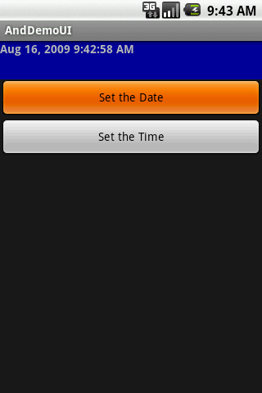
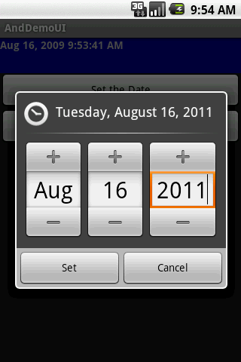
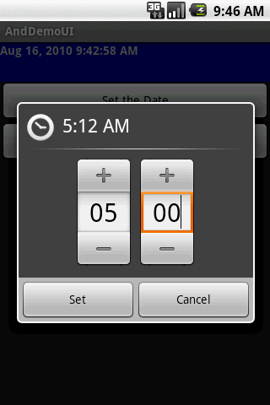
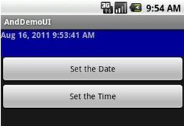
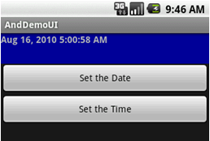
7. Android – UI – Date Time Tabs
Date/Time Selection Widgets
Example: Using Calendar Widgets
4

Slide 5
7. Android – UI – Date Time Tabs
Date/Time Selection Widgets
Example: Using Calendar Widgets
<?xml version="1.0" encoding="utf-8"?>
<LinearLayout
android:id="@+id/widget28"
android:layout_width="fill_parent"
android:layout_height="fill_parent"
android:orientation="vertical"
xmlns:android="http://schemas.android.com/apk/res/android"
>
<TextView
android:id="@+id/lblDateAndTime"
android:layout_width="fill_parent"
android:layout_height="47px"
android:background="#ff000099"
android:textStyle="bold"
>
</TextView>
<Button
android:id="@+id/btnDate"
android:layout_width="fill_parent"
android:layout_height="wrap_content"
android:text="Set the Date"
>
</Button>
<Button
android:id="@+id/btnTime"
android:layout_width="fill_parent"
android:layout_height="wrap_content"
android:text="Set the Time"
>
</Button>
</LinearLayout>
5

Slide 6
7. Android – UI – Date Time Tabs
Date/Time Selection Widgets
package cis493.demoui;
import android.app.Activity;
import android.os.Bundle;
import android.app.DatePickerDialog;
import android.app.TimePickerDialog;
import android.view.View;
import android.widget.Button;
import android.widget.DatePicker;
import android.widget.TimePicker;
import android.widget.TextView;
import java.text.DateFormat;
import java.util.Calendar;
public class AndDemoUI extends Activity {
DateFormat fmtDateAndTime = DateFormat.getDateTimeInstance();
TextView lblDateAndTime;
Calendar myCalendar = Calendar.getInstance();
DatePickerDialog.OnDateSetListener d = new DatePickerDialog.OnDateSetListener() {
public void onDateSet(DatePicker view,
int year, int monthOfYear, int dayOfMonth) {
myCalendar.set(Calendar.YEAR, year);
myCalendar.set(Calendar.MONTH, monthOfYear);
myCalendar.set(Calendar.DAY_OF_MONTH, dayOfMonth);
updateLabel();
}
};
6

Slide 7
7. Android – UI – Date Time Tabs
Date/Time Selection Widgets
TimePickerDialog.OnTimeSetListener t = new TimePickerDialog.OnTimeSetListener() {
public void onTimeSet(TimePicker view, int hourOfDay, int minute) {
myCalendar.set(Calendar.HOUR_OF_DAY, hourOfDay);
myCalendar.set(Calendar.MINUTE, minute);
updateLabel();
}
};
private void updateLabel() {
lblDateAndTime.setText(fmtDateAndTime.format(myCalendar.getTime()));
}
7

Slide 8
7. Android – UI – Date Time Tabs
Date/Time Selection Widgets
@Override
public void onCreate(Bundle icicle) {
super.onCreate(icicle);
setContentView(R.layout.main);
lblDateAndTime = (TextView) findViewById(R.id.lblDateAndTime);
Button btnDate = (Button) findViewById(R.id.btnDate);
btnDate.setOnClickListener(new View.OnClickListener() {
public void onClick(View v) {
new DatePickerDialog(AndDemoUI.this, d,
myCalendar.get(Calendar.YEAR), myCalendar.get(Calendar.MONTH),
myCalendar.get(Calendar.DAY_OF_MONTH)).show();
}
});
Button btnTime = (Button) findViewById(R.id.btnTime);
btnTime.setOnClickListener(new View.OnClickListener() {
public void onClick(View v) {
new TimePickerDialog(AndDemoUI.this, t,
myCalendar.get(Calendar.HOUR_OF_DAY),
myCalendar.get(Calendar.MINUTE), true).show();
}
});
updateLabel();
}// onCreate
} //class
8

Slide 9
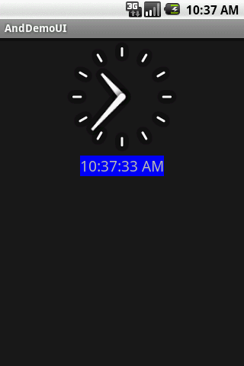
7. Android – UI – Date Time Tabs
Date/Time Selection Widgets
Other Time Widgets
Android provides a DigitalClock and AnalogClock widgets.
Automatically update with the passage of time (no user intervention is required).
<?xml version="1.0" encoding="utf-8"?>
<RelativeLayout
android:id="@+id/widget34"
android:layout_width="fill_parent"
android:layout_height="fill_parent"
xmlns:android="http://schemas.android.com/apk/res/android"
>
<DigitalClock
android:id="@+id/digital"
android:layout_width="wrap_content"
android:layout_height="wrap_content"
android:background="#ff0000ff"
android:textSize="20px"
android:layout_below="@+id/analog"
android:layout_centerHorizontal="true"
>
</DigitalClock>
<AnalogClock
android:id="@+id/analog"
android:layout_width="fill_parent"
android:layout_height="wrap_content"
android:layout_alignParentTop="true"
android:layout_alignParentLeft="true"
>
</AnalogClock>
</RelativeLayout>
9

Slide 10
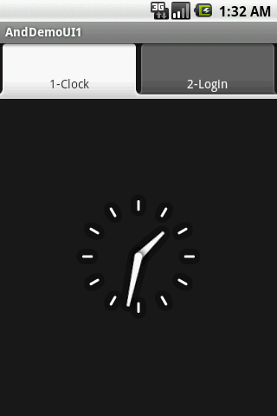
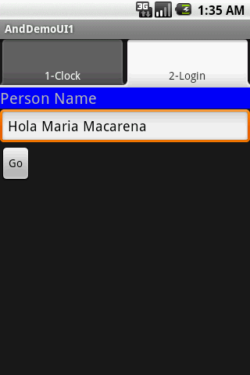
7. Android – UI – Date Time Tabs
Tab Selection Widget
Tab Selector
Android UIs should be kept simple at all costs.
When many pieces of information must be displayed in a single app, the Tab Widget could be used to make the user aware of the pieces but show only a portion at the time.
10

Slide 11
7. Android – UI – Date Time Tabs
Tab Selection Widget
Tabs – Components
There are a few widgets and containers you need to use in order to set up a tabbed portion of a view:
TabHost is the main container for the tab buttons and tab contents
TabWidget implements the row of tab buttons, which contain text labels and optionally contain icons
FrameLayout is the container for the tab contents
11

Slide 12
7. Android – UI – Date Time Tabs
Tab Selection Widget
Components
Tab1
Tab2
Tab3
Tab Widgets
FrameLayout1
TabHost
FrameLayouts
12

Slide 13
7. Android – UI – Date Time Tabs
Tab Selection Widget
CAUTION (Jan 22, 2011) SDK 2.2 has an apparent bug on this issue. See link http://code.google.com/p/android/issues/detail?id=13092.
Temporal solution is to create app for SDK 1.6.
Example: Using Tabs
<?xml version="1.0" encoding="utf-8"?>
<LinearLayout xmlns:android="http://schemas.android.com/apk/res/android"
android:orientation="vertical"
android:layout_width="fill_parent"
android:layout_height="fill_parent">
<TabHost android:id="@+id/tabhost"
android:layout_width="fill_parent"
android:layout_height="fill_parent">
<TabWidget android:id="@android:id/tabs"
android:layout_width="fill_parent"
android:layout_height="wrap_content"
/>
<FrameLayout
android:id="@android:id/tabcontent"
android:layout_width="fill_parent"
android:layout_height="fill_parent"
android:paddingTop="62px">
<!-- PUT HERE FrameLayout1 -->
<!-- PUT HERE FrameLayout2 -->
</FrameLayout>
</TabHost>
</LinearLayout>
You may enter here the actual layout specification, or (better) use the <include> tag to refer to an external layout assembled in a separated xml file.
Details in next pages…
13

Slide 14
7. Android – UI – Date Time Tabs
Tab Selection Widget
Example: Using Tabs
This goes in place of FrameLayout1. It defines an analog clock
(optionally surround with a <FrameLayout > tag using the clause android:id="@+id/tab1" In that case apply a different id to the clock)
<AnalogClock
android:id="@+id/tab1"
android:layout_width="fill_parent"
android:layout_height="fill_parent" android:layout_centerHorizontal="true"
/>
14

Slide 15
7. Android – UI – Date Time Tabs
Tab Selection Widget
Example: Using Tabs
This is FrameLayout2. It defines a LinearLayout holding a label, a textBox, and a button.
<LinearLayout
android:id="@+id/tab2"
android:layout_width="fill_parent"
android:layout_height="fill_parent"
android:orientation="vertical"
xmlns:android="http://schemas.android.com/apk/res/android"
>
<TextView
android:id="@+id/caption1"
android:layout_width="fill_parent"
android:layout_height="wrap_content"
android:background="#ff0000ff"
android:text="Person Name"
android:textSize="20px"
>
</TextView>
<EditText
android:id="@+id/txtPerson"
android:layout_width="fill_parent"
android:layout_height="wrap_content"
android:text="txtPerson"
android:textSize="18sp"
>
</EditText>
<Button
android:id="@+id/btnGo"
android:layout_width="wrap_content"
android:layout_height="wrap_content"
android:text="Go"
>
</Button>
</LinearLayout>
15

Slide 16
7. Android – UI – Date Time Tabs
Tab Selection Widget
Example: Using Tabs
In order to keep the main.xml design as simple as possible
ou may introduce <include> clauses as illustrated below
/res/layout/screen2.xml
<LinearLayout
android:id="@+id/tab2"
android:layout_width="fill_parent"
android:layout_height="fill_parent"
android:orientation="vertical"
xmlns:android="http://schemas.android.com/apk/res/android"
>
<TextView
android:id="@+id/caption1"
android:layout_width="fill_parent"
android:layout_height="wrap_content"
android:background="#ff0000ff"
android:text="Person Name"
android:textSize="20px"
>
</TextView>
<EditText
android:id="@+id/txtPerson"
android:layout_width="fill_parent"
android:layout_height="wrap_content"
android:text="txtPerson"
android:textSize="18sp"
>
</EditText>
<Button
android:id="@+id/btnGo"
android:layout_width="wrap_content"
android:layout_height="wrap_content"
android:text="Go"
>
</Button>
</LinearLayout>
<!-- PUT HERE FrameLayout2 -->
<FrameLayout
android:id="@+id/tab2"
android:layout_width="fill_parent"
android:layout_height="fill_parent" >
<include
layout="@layout/screen2" />
</FrameLayout>
16

Slide 17
7. Android – UI – Date Time Tabs
Tab Selection Widget
Example: Using Tabs
package cis493.selectionwidgets;
import android.app.Activity;
import android.os.Bundle;
import android.view.View;
import android.view.View.OnClickListener;
import android.widget.Button;
import android.widget.EditText;
import android.widget.TabHost;
public class AndDemoUI1 extends Activity {
17

Slide 18
7. Android – UI – Date Time Tabs
Tab Selection Widget
Example: Using Tabs
@Override
public void onCreate(Bundle icicle) {
super.onCreate(icicle);
setContentView(R.layout.main);
TabHost tabs=(TabHost)findViewById(R.id.tabhost);
tabs.setup();
TabHost.TabSpec spec;
spec =tabs.newTabSpec("tag1");
spec.setContent(R.id.tab1);
spec.setIndicator("1-Clock");
tabs.addTab(spec);
spec=tabs.newTabSpec("tag2");
spec.setContent(R.id.tab2);
spec.setIndicator("2-Login");
tabs.addTab(spec);
tabs.setCurrentTab(0);
Set Tab1
Set Tab2
18

Slide 19
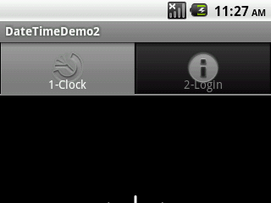
7. Android – UI – Date Time Tabs
Tab Selection Widget
HINT
Example: Using Tabs
You may decorate the tab indicator
Including text and image as shown
below:
spec = tabs.newTabSpec("tag2");
spec.setContent(R.id.tab2);
spec.setIndicator("2-Login",
getResources().getDrawable(R.drawable.ic_menu_info_details));
tabs.addTab(spec);
Note: Many icons available at SDKfolder\docs\images\icon-design
19

Slide 20
7. Android – UI – Date Time Tabs
Tab Selection Widget
Example: Using Tabs
Button btnGo = (Button)findViewById(R.id.btnGo);
btnGo.setOnClickListener(new OnClickListener() {
@Override
public void onClick(View arg0) {
EditText txtPerson = (EditText)findViewById(R.id.txtPerson);
String theUser = txtPerson.getText().toString();
txtPerson.setText("Hola " + theUser);
}
});
}
}
20

Slide 21
7. Android – UI – Date Time Tabs
Tab Selection Widget
Example: Using Tabs
You may want to add a listener to monitor the selecting of a particular tab. Add this fragment to the onCreate method.
// tabs.setCurrentTab(0);
// you may also use
tabs.setCurrentTabByTag("tag1");
tabs.setOnTabChangedListener(new OnTabChangeListener() {
@Override
public void onTabChanged(String tagId) {
// do something useful with the selected screen
String text = "Im currently in: " + tagId
+ "\nindex: " + tabs.getCurrentTab();
Toast.makeText(getApplicationContext(), text, 1).show();
}
});
This fragment returns:
Im currently in: tag1
index: 0
21

Slide 22
7. Android – UI – Date Time Tabs
SlidingDrawer Widget
SlidingDrawer
hides content out of the screen and allows the user to drag a handle to bring the content on screen.
SlidingDrawer can be used vertically or horizontally.
SlidingDrawer should be used as an overlay inside layouts. This means SlidingDrawer should only be used inside of a FrameLayout or a RelativeLayout for instance.
The size of the SlidingDrawer defines how much space the content will occupy once slid out so SlidingDrawer should usually use fill_parent for both its dimensions.
Taken from: http://developer.android.com/reference/android/widget/SlidingDrawer.html
22

Slide 23
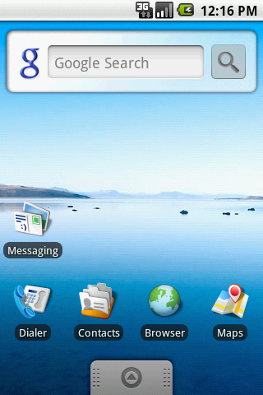
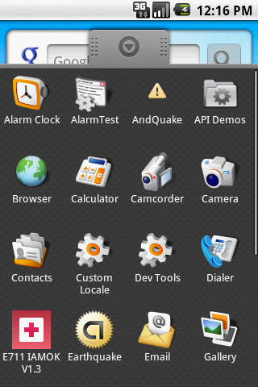
7. Android – UI – Date Time Tabs
SlidingDrawer Widget
Example:
This SlidingDrawer is used by the Android’s interface to access applications installed in the device.
content
handle
23

Slide 24
7. Android – UI – Date Time Tabs
SlidingDrawer Widget
Taken from: http://developer.android.com/reference/android/widget/SlidingDrawer.html
Example1:
Inside an XML layout, SlidingDrawer must define the id of the handle and the content:
<SlidingDrawer
android:id="@+id/drawer"
android:layout_width="fill_parent"
android:layout_height="fill_parent"
android:handle="@+id/handle"
android:content="@+id/content">
<ImageView
android:id="@id/handle"
android:layout_width="88dip"
android:layout_height="44dip" />
<GridView
android:id="@id/content"
android:layout_width="fill_parent"
android:layout_height="fill_parent" />
</SlidingDrawer>
handle is just a small graphic to visually indicate the opening/closing control
content is usually some type of container holding the desired UI held by the drawer
24

Slide 25
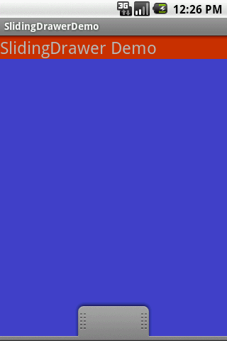
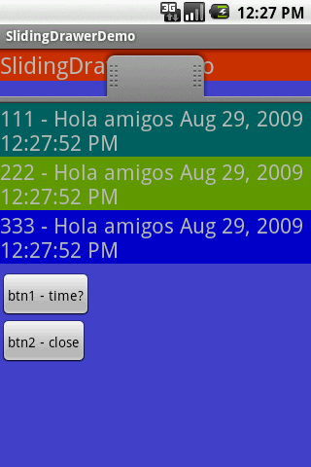
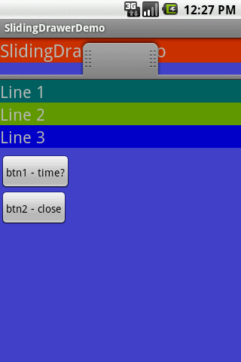
7. Android – UI – Date Time Tabs
SlidingDrawer Widget
Example2. A more elaborated SlidingDrawer.
The background UI is overlapped by the contents of the drawer. Tapping the handle closes the drawer (but does not erase its data)
The red TextView simulates the main UI, the SlidingDrawer is an overlay, tapping the handle opens the new view
25

Slide 26
7. Android – UI – Date Time Tabs
SlidingDrawer Widget
Example 2: SlidingDrawer XML layout (main UI)
<?xml version="1.0" encoding="utf-8"?>
<RelativeLayout
xmlns:android="http://schemas.android.com/apk/res/android"
android:layout_width="fill_parent"
android:layout_height="fill_parent"
android:background="#FF4444CC"
>
<TextView
android:id="@+id/label0"
android:layout_alignParentTop="true"
android:layout_width="fill_parent"
android:layout_height="wrap_content"
android:background="#ffcc3300"
android:text="SlidingDrawer Demo"
android:textSize="24sp" />
26

Slide 27
7. Android – UI – Date Time Tabs
SlidingDrawer Widget
Example 2: SlidingDrawer XML layout (Drawer )
<SlidingDrawer
android:id="@+id/drawer"
android:layout_alignParentBottom="true"
android:layout_width="fill_parent"
android:layout_height="fill_parent"
android:handle="@+id/handle"
android:content="@+id/content" >
<ImageView
android:id="@id/handle"
android:layout_width="wrap_content"
android:layout_height="wrap_content"
android:src="@drawable/tray_handle_normal" />
27

Slide 28
7. Android – UI – Date Time Tabs
SlidingDrawer Widget
Example 2: SlidingDrawer XML layout (Drawer)
<LinearLayout
android:id="@id/content"
android:layout_width="fill_parent"
android:layout_height="fill_parent"
android:orientation="vertical“ >
<TextView
android:id="@+id/label1"
android:layout_width="fill_parent"
android:layout_height="wrap_content"
android:background="#ff006666"
android:text="Line 1"
android:textSize="22sp" />
<TextView
android:id="@+id/label2"
android:layout_width="fill_parent"
android:layout_height="wrap_content"
android:background="#ff669900"
android:text="Line 2"
android:textSize="22sp" />
28

Slide 29
7. Android – UI – Date Time Tabs
SlidingDrawer Widget
Example 2: SlidingDrawer XML layout (Drawer)
<TextView
android:id="@+id/label3"
android:layout_width="fill_parent"
android:layout_height="wrap_content"
android:background="#ff0000cc"
android:text="Line 3"
android:textSize="22sp" />
<TextView
android:id="@+id/filler1"
android:layout_width="fill_parent"
android:layout_height="wrap_content"
android:textSize="6sp" />
<Button
android:id="@+id/btn1"
android:layout_width="wrap_content"
android:layout_height="wrap_content"
android:padding="4px"
android:text=" btn1 - time? " />
29

Slide 30
7. Android – UI – Date Time Tabs
SlidingDrawer Widget
Example 2: SlidingDrawer XML layout (Drawer)
<Button
android:id="@+id/btn2"
android:layout_width="wrap_content"
android:layout_height="wrap_content"
android:padding="4px"
android:text=" btn2 - close " />
</LinearLayout>
</SlidingDrawer>
</RelativeLayout>
30

Slide 31
7. Android – UI – Date Time Tabs
SlidingDrawer Widget
Example 2: SlidingDrawer. Android Activity
package cis493.slidingdreawerdemo;
import java.util.Date;
import android.app.Activity;
import android.os.Bundle;
import android.view.View;
import android.view.View.OnClickListener;
import android.widget.*;
public class SlidingDrawerDemo extends Activity
{
Button btn1;
Button btn2;
TextView label1;
TextView label2;
TextView label3;
SlidingDrawer myDrawer;
31

Slide 32
7. Android – UI – Date Time Tabs
SlidingDrawer Widget
Example 2: SlidingDrawer. Android Activity
@Override
public void onCreate(Bundle savedInstanceState)
{
super.onCreate(savedInstanceState);
setContentView(R.layout.main);
myDrawer = (SlidingDrawer)findViewById(R.id.drawer);
btn1 = (Button)findViewById(R.id.btn1);
btn2 = (Button)findViewById(R.id.btn2);
label1 = (TextView)findViewById(R.id.label1);
label2 = (TextView)findViewById(R.id.label2);
label3 = (TextView)findViewById(R.id.label3);
32

Slide 33
7. Android – UI – Date Time Tabs
SlidingDrawer Widget
Example 2: SlidingDrawer. Android Activity
btn1.setOnClickListener(new OnClickListener() {
@Override
public void onClick(View v) {
Date dt = new Date();
String now = dt.toLocaleString();
label1.setText("111 - Hola amigos " + now);
label2.setText("222 - Hola amigos " + now) ;
label3.setText("333 - Hola amigos " + now);
}
});
btn2.setOnClickListener(new OnClickListener() {
@Override
public void onClick(View v) {
myDrawer.animateClose();
}
});
} //onCreate
} // class
33

Slide 34
7. Android – UI – Date Time Tabs
UI Selection Widgets
Questions ?
34

