Slide 1


Android Hard & Soft Keyboards
7B
Notes are based on:
The Busy Coder's Guide to Android Development
by Mark L. Murphy
Copyright © 2008-2009 CommonsWare, LLC.
ISBN: 978-0-9816780-0-9
&
Android Developers
http://developer.android.com/index.html

Slide 2
7B. Android – UI – Hard & Soft Keyboard
Hard & Soft Keyboard
Android r1.5 introduced the notion of Input Method Framework (IMF).
The idea is to let the IFM arbitrate the interaction between applications and the current input method chosen by the user.
The motivation behind this framework is the realization that as Android matures, more hardware /software devices, and input techniques will appear in user’s applications, for instance:
real & virtual keyboards,
voice recognition,
hand writing,
etc…
2

Slide 3
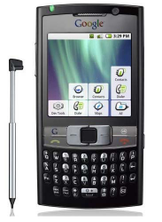
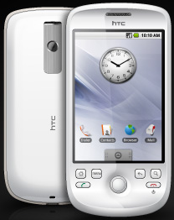
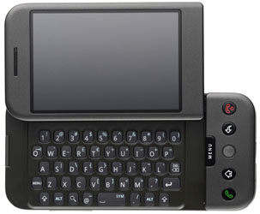
7B. Android – UI – Hard & Soft Keyboard
Hard & Soft Keyboard
Keyboarding data into Android’s applications is functionally dependent of the hardware present in the actual device.
HTC – G1
Sliding Window exposes (occasionally) a hard keyboard
Samsung
Model shows a permanent hard keyboard
HTC - Magic
Model shown has no
hard keyboard
3

Slide 4
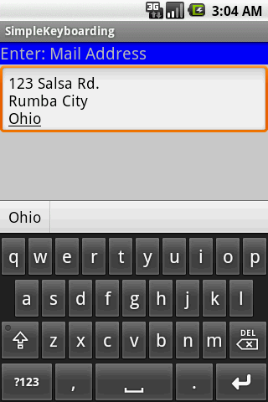
7B. Android – UI – Hard & Soft Keyboard
Hard & Soft Keyboard
The IMF is aware of the available hardware and its current state.
If there is no a readily available hardware keyboard, an input method editor (IME) will be made available to the user when they tap on an enabled EditText.
Enabled
EditText
Soft Keyboard
4

Slide 5
7B. Android – UI – Hard & Soft Keyboard
Hard & Soft Keyboard
Telling Android what data to expect
TextViews can indicate by XML attribute or Java method the expected type of a text field:
android:inputType=“...”
editTextBox.setRawInputType(int)
This way Android knows the type of data to be placed in a text field.
Knowing the type is useful in deciding what appropriated input method could be applied to help the user enter text.
XML
Java
5

Slide 6
7B. Android – UI – Hard & Soft Keyboard
Hard & Soft Keyboard
Android:inputType Values
Constant | Value | Description
none | 0x00000000 | There is no content type. The text is not editable.
text | 0x00000001 | Just plain old text.
textCapCharacters | 0x00001001 | Can be combined with text and its variations to request capitalization of all characters.
textCapWords | 0x00002001 | Can be combined with text and its variations to request capitalization of the first character of every word.
textCapSentences | 0x00004001 | Can be combined with text and its variations to request capitalization of the first character of every sentence.
textAutoCorrect | 0x00008001 | Can be combined with text and its variations to request auto-correction of text being input.
6

Slide 7
7B. Android – UI – Hard & Soft Keyboard
Hard & Soft Keyboard
Android:inputType Values
Constant | Value | Description
textAutoComplete | 0x00010001 | Can be combined with text and its variations to specify that this field will be doing its own auto-completion and talking with the input method appropriately.
textMultiLine | 0x00020001 | Can be combined with text and its variations to allow multiple lines of text in the field. If this flag is not set, the text field will be constrained to a single line.
textImeMultiLine | 0x00040001 | Can be combined with text and its variations to indicate that though the regular text view should not be multiple lines, the IME should provide multiple lines if it can.
7

Slide 8
7B. Android – UI – Hard & Soft Keyboard
Hard & Soft Keyboard
Android:inputType Values
Constant | Value | Description
textUri | 0x00000011 | Text that will be used as a URI.
textEmailAddress | 0x00000021 | Text that will be used as an e-mail address.
textEmailSubject | 0x00000031 | Text that is being supplied as the subject of an e-mail.
textShortMessage | 0x00000041 | Text that is the content of a short message.
textLongMessage | 0x00000051 | Text that is the content of a long message.
textPersonName | 0x00000061 | Text that is the name of a person.
textPostalAddress | 0x00000071 | Text that is being supplied as a postal mailing address.
textPassword | 0x00000081 | Text that is a password.
textVisiblePassword | 0x00000091 | Text that is a password that should be visible.
textWebEditText | 0x000000a1 | Text that is being supplied as text in a web form.
8

Slide 9
7B. Android – UI – Hard & Soft Keyboard
Hard & Soft Keyboard
Android:inputType Values
Constant | Value | Description
textFilter | 0x000000b1 | Text that is filtering some other data.
textPhonetic | 0x000000c1 | Text that is for phonetic pronunciation, such as a phonetic name field in a contact entry.
number | 0x00000002 | A numeric only field.
numberSigned | 0x00001002 | Can be combined with number and its other options to allow a signed number.
numberDecimal | 0x00002002 | Can be combined with number and its other options to allow a decimal (fractional) number.
phone | 0x00000003 | For entering a phone number.
datetime | 0x00000004 | For entering a date and time.
date | 0x00000014 | For entering a date.
time | 0x00000024 | For entering a time.
9

Slide 10
7B. Android – UI – Hard & Soft Keyboard
Hard & Soft Keyboard
Example1: Using android:text="inputType: text|textCapWords"
<?xml version="1.0" encoding="utf-8"?>
<LinearLayout
android:id="@+id/widget31"
android:layout_width="fill_parent"
android:layout_height="fill_parent"
android:background="#ffcccccc"
android:orientation="vertical"
xmlns:android="http://schemas.android.com/apk/res/android" >
<TextView
android:id="@+id/caption"
android:layout_width="fill_parent"
android:layout_height="wrap_content"
android:background="#ff0000ff"
android:text="inputType: text|textCapWords"
android:textStyle="bold"
android:textSize="22sp" />
<EditText
android:id="@+id/editTextBox"
android:layout_width="fill_parent"
android:layout_height="wrap_content"
android:padding="10px"
android:textSize="18sp"
android:inputType="text|textCapWords" />
</LinearLayout>
Multiple types of input methods could be combined. Use “pipe” symbol | to separate the options.
In the example a soft text keyboard is used,
in addition it should proper capitalize each word
10

Slide 11
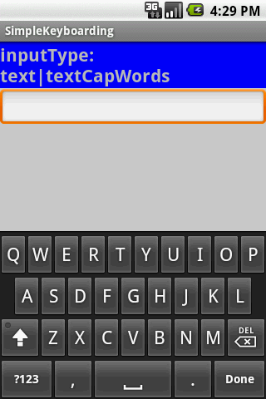
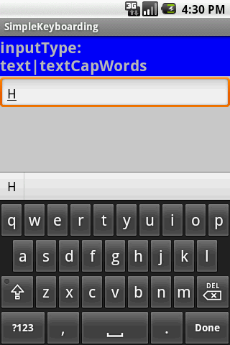
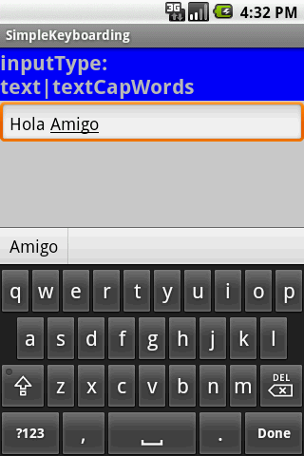
7B. Android – UI – Hard & Soft Keyboard
Hard & Soft Keyboard
Example1: Using android:text="inputType: text|textCapWords"
After tapping the EditBox a soft keyboard appears showing CAPITAL letters
After first letter is typed the Keyboard switches automatically to LOWER case to complete the word.
After entering space the keyboard repeats cycle beginning with UPPER case, then LOWER case letters.
11

Slide 12
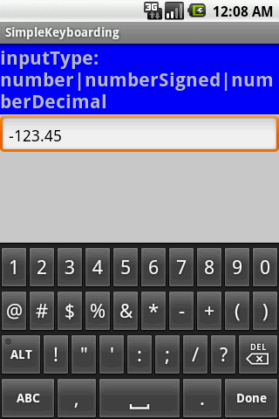
7B. Android – UI – Hard & Soft Keyboard
Hard & Soft Keyboard
Example2: Using android:inputType="number|numberSigned|numberDecimal"
The keyboard displays numbers.
In general other non-numeric keys are visible but disable.
Only valid numeric expressions can be entered.
Type number|numberSigned accepts integers.
Type numberDecimal accepts real numbers.
Assume the EditText field is named: editTextBox, In Java code we could at run-time set the input method by issuing the command:
editTextBox.setRawInputType(
android.text.InputType.TYPE_CLASS_PHONE ) ;
12

Slide 13
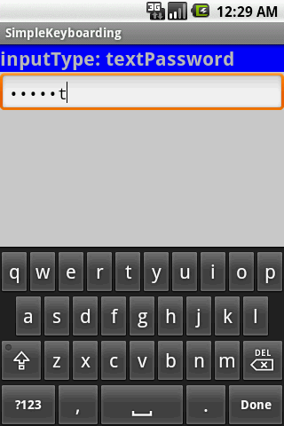
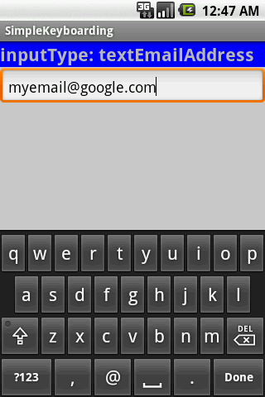
7B. Android – UI – Hard & Soft Keyboard
Hard & Soft Keyboard
Example2: Using
android:inputType="textPassword"
Example3: Using
android:inputType="textEmailAddress"
Soft keyboard favors characters commonly used in email addresses such as letters, @
The keyboard displays all possible keys.
Current character is briefly displayed for verification purposes.
The current character is hidden and a heavy-dot is displayed.
13

Slide 14
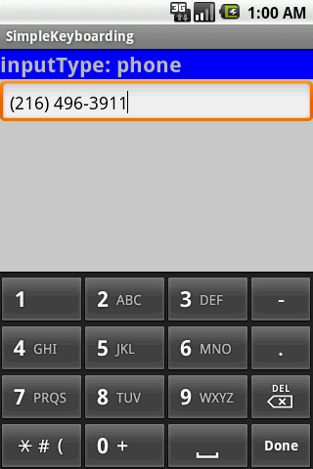
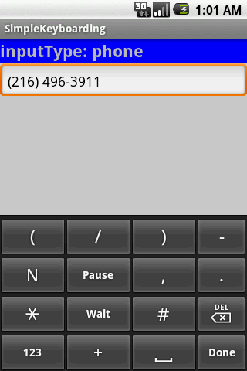
7B. Android – UI – Hard & Soft Keyboard
Hard & Soft Keyboard
Example4: Using android:inputType= "phone"
Soft keyboard displays the layout of a typical phone keypad plus additional non digit symbols such as:
( ) . / Pause Wait # - +
14

Slide 15
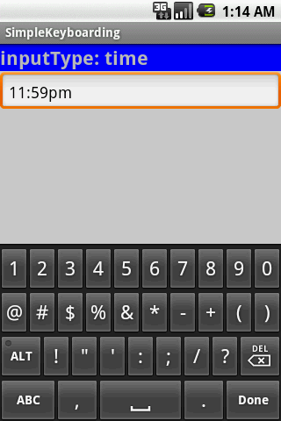
7B. Android – UI – Hard & Soft Keyboard
Hard & Soft Keyboard
Example5: Using android:inputType="time"
Soft keyboard displays a numerical layout.
Only digits and colon-char : can be used.
When clicking on alphabetic choice ABC only character to make am and pm are allowed.
15

Slide 16

7B. Android – UI – Hard & Soft Keyboard
Hard & Soft Keyboard
Example6: Using android:inputType="date"
Soft keyboard displays a numerical layout.
Only digits and date valid characters are allowed.
Examples of valid dates are:
12/31/2011
12-31-2011
12.31.2011
16

Slide 17
7B. Android – UI – Hard & Soft Keyboard
Hard & Soft Keyboard
Disable Soft Keyboarding on an EditText View
Assume txtBox1 is an EditText box. To disable the action of the soft keyboard on an EditText you should set its input type to null, as indicated below:
txtBox.setInputType( InputType.TYPE_NULL );
You may also try (deaf touch listener)
txtBox.setOnTouchListener(new OnTouchListener() {
@Override
public boolean onTouch(View arg0, MotionEvent arg1) {
// return true to consume the touch event without
// allowing virtual keyboard to be called
return true;
}
});
17

Slide 18
7B. Android – UI – Hard & Soft Keyboard
Hard & Soft Keyboard
Close SoftKeyboard Window / Hide SoftKeyboard
Once it has opened, you may close the virtual keyboard by tapping the hardware BackArrow key or issuing the following commands:
InputMethodManager imm =
(InputMethodManager) getSystemService(Context.INPUT_METHOD_SERVICE);
imm.hideSoftInputFromWindow (theEditTextField.getWindowToken(), 0);
18

Slide 19
7B. Android – UI – Hard & Soft Keyboard
Hard & Soft Keyboard
TextWatcher Control
Assume txtBox1 is an Editable box. A listener of the type onKeyListener could be used to follow the actions made by the hardware keyboard; however it will not properly work with the Virtual Keyboard.
A solution to this problem is to attach to the Editable control a TextWatcher and let its methods be called when the Editable text is changed.
The main methods of a TextWatcher are:
public void afterTextChanged (Editable theWatchedText)
public void beforeTextChanged ( … )
public void onTextChanged ( … )
19

Slide 20
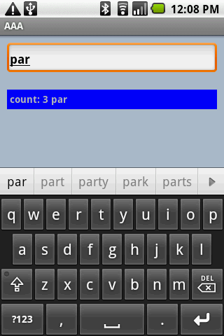
7B. Android – UI – Hard & Soft Keyboard
Hard & Soft Keyboard
Example 7: TextWatcher Demo
EditText uses .addTextChangedListener
IMF suggestions
20

Slide 21
7B. Android – UI – Hard & Soft Keyboard
Hard & Soft Keyboard
Example 7: TextWatcher Demo
<?xml version="1.0" encoding="utf-8"?>
<LinearLayout xmlns:android="http://schemas.android.com/apk/res/android"
android:orientation="vertical"
android:layout_width="fill_parent"
android:layout_height="fill_parent"
android:background="#ffaabbcc"
>
<EditText
android:id="@+id/txtInput"
android:layout_width="fill_parent"
android:layout_height="wrap_content"
android:layout_margin="10px"
android:padding="4px"
android:textStyle="bold"
/>
<TextView
android:id="@+id/txtMsg"
android:layout_width="fill_parent"
android:layout_height="wrap_content"
android:layout_margin="10px"
android:padding="4px"
android:background="#ff0000ff"
android:textStyle="bold"
/>
</LinearLayout>
21

Slide 22
7B. Android – UI – Hard & Soft Keyboard
Hard & Soft Keyboard
Example 7: TextWatcher Demo
// demonstrate the use of a simple TEXTWATCHER control
package cis493.keyboarding;
…
public class TextWatcherDemo extends Activity {
EditText txtInput;
TextView txtMsg;
int keyCount = 0;
@Override
public void onCreate (Bundle savedInstanceState) {
super.onCreate(savedInstanceState);
setContentView(R.layout.main);
txtMsg = (TextView)findViewById(R.id.txtMsg);
txtInput = (EditText)findViewById(R.id.txtInput);
txtInput.addTextChangedListener(new TextWatcher() {
public void afterTextChanged (Editable theWatchedText) {
String msg = "count: " + txtInput.getText().toString().length() + " " + theWatchedText.toString();
txtMsg.setText( msg );
}
public void beforeTextChanged (CharSequence arg0, int arg1, int arg2, int arg3) {
//Toast.makeText(getApplicationContext(), "BTC " + arg0, 1).show();
}
public void onTextChanged (CharSequence arg0, int arg1, int arg2, int arg3) {
//Toast.makeText(getApplicationContext(), "OTC " + arg0, 1).show();
}
}); //addTextChangedListener
} //onCreate
}
22

Slide 23
7B. Android – UI – Hard & Soft Keyboard
Hard & Soft Keyboard
Questions?
23

