Slide 1


Android Fonts
9
Notes are based on:
The Busy Coder's Guide to Android Development
by Mark L. Murphy
Copyright © 2008-2009 CommonsWare, LLC.
ISBN: 978-0-9816780-0-9
&
Android Developers
http://developer.android.com/index.html

Slide 2
9. Android – UI – Fonts
Fonts
Android naturally provides three fonts:
sans: An m is wider than i, mmm iiii
serif: An m is wider than i, mmm iiii
monospaced: An mmm is not wider than iii
2

Slide 3
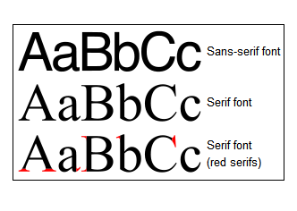
9. Android – UI – Fonts
Fonts
Also know as:
Grotesque or Gothic
Roman Type
Source: http://en.wikipedia.org/wiki/Serif
3

Slide 4
9. Android – UI – Fonts
Fonts
Developers may add any font to their application by following the next steps:
Create the /fonts folder in the /assets directory.
Copy any fonts you plan to use into the new folder.
Use Java code to bind the font with the UI widget wanting to display the custom typeface (see example).
4

Slide 5
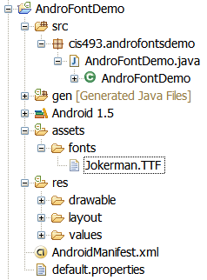
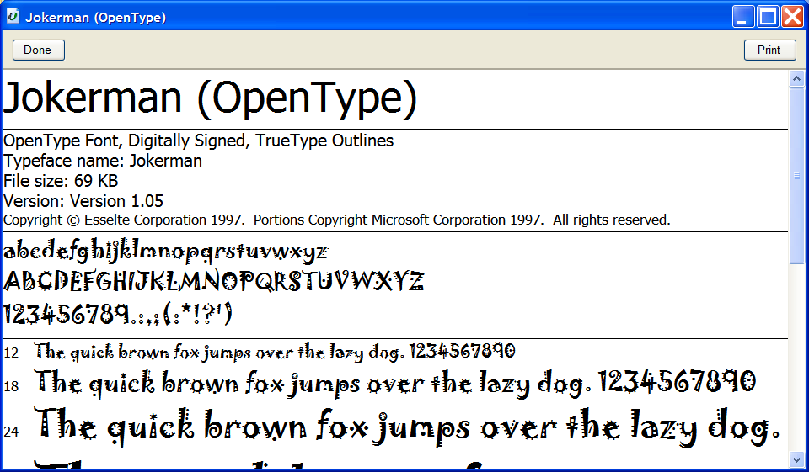
9. Android – UI – Fonts
Fonts
Example: Getting ready to use the Jokerman.TTF font.
Original font taken from c:\Windows\Fonts
5

Slide 6
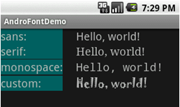
9. Android – UI – Fonts
Fonts
Example:
Display the Hello World ! message using different fonts.
Using the font:
Jokerman.TTF
Note:
If you are using Windows XP look into the folder: c:\Windows\Fonts for fonts installed in your machine.
Consult the page: http://www.ascendercorp.com/support/windows/ for additional information in manipulating fonts.
6

Slide 7
9. Android – UI – Fonts
Fonts
Example Application:
Showing different FONT types.
<?xml version="1.0" encoding="utf-8"?>
<TableLayout
android:id="@+id/myTableLayout"
android:layout_width="fill_parent"
android:layout_height="fill_parent"
android:orientation="vertical"
android:stretchColumns="1"
xmlns:android="http://schemas.android.com/apk/res/android"
>
7

Slide 8
9. Android – UI – Fonts
Fonts
<TableRow
android:id="@+id/myRow1"
android:layout_width="fill_parent"
android:layout_height="wrap_content"
android:orientation="horizontal"
>
<TextView
android:id="@+id/labelSans"
android:layout_width="wrap_content"
android:layout_height="wrap_content"
android:background="#ff006666"
android:layout_marginRight="24px"
android:text="sans:"
android:textSize="20sp"
>
</TextView>
<TextView
android:id="@+id/sans"
android:layout_width="wrap_content"
android:layout_height="wrap_content"
android:text="Hello, world!"
android:textSize="20sp"
android:typeface="sans"
>
</TextView>
</TableRow>
8

Slide 9
9. Android – UI – Fonts
Fonts
</TableRow>
<TableRow
android:id="@+id/myRow2"
android:layout_width="fill_parent"
android:layout_height="wrap_content"
android:orientation="horizontal"
>
<TextView
android:id="@+id/labelSerif"
android:layout_width="wrap_content"
android:layout_height="wrap_content"
android:layout_marginRight="24px"
android:text="serif:"
android:textSize="20sp"
android:background="#ff006666"
>
</TextView>
<TextView
android:id="@+id/serif"
android:layout_width="wrap_content"
android:layout_height="wrap_content"
android:text="Hello, world!"
android:textSize="20sp"
android:typeface="serif"
>
</TextView>
</TableRow>
9

Slide 10
9. Android – UI – Fonts
Fonts
<TableRow
android:id="@+id/myRow3"
android:layout_width="fill_parent"
android:layout_height="wrap_content"
android:orientation="horizontal"
>
<TextView
android:id="@+id/labelMonospace"
android:layout_width="wrap_content"
android:layout_height="wrap_content"
android:layout_marginRight="24px"
android:text="monospace:"
android:textSize="20sp"
android:background="#ff006666"
>
</TextView>
<TextView
android:id="@+id/monospace"
android:layout_width="wrap_content"
android:layout_height="wrap_content"
android:text="Hello, world!"
android:textSize="20sp"
android:typeface="monospace"
>
</TextView>
</TableRow>
10

Slide 11
9. Android – UI – Fonts
Fonts
<TableRow
android:id="@+id/myRow4"
android:layout_width="fill_parent"
android:layout_height="wrap_content"
android:orientation="horizontal"
>
<TextView
android:id="@+id/labelCustom"
android:layout_width="wrap_content"
android:layout_height="wrap_content"
android:layout_marginRight="24px"
android:text="custom:"
android:textSize="20sp"
android:background="#ff006666"
>
</TextView>
<TextView
android:id="@+id/custom"
android:layout_width="wrap_content"
android:layout_height="wrap_content"
android:text="Hello, world!"
android:textSize="20sp"
>
</TextView>
</TableRow>
</TableLayout>
To be displayed using a custom font
11

Slide 12
9. Android – UI – Fonts
Fonts
package cis493.androfontsdemo;
import android.app.Activity;
import android.graphics.Typeface;
import android.os.Bundle;
import android.widget.TextView;
public class AndroFontDemo extends Activity {
@Override
public void onCreate(Bundle icicle) {
super.onCreate(icicle);
setContentView(R.layout.main);
// bind the "custom" textview with chosen font
TextView tvCustom=(TextView)findViewById(R.id.custom);
Typeface myNewFace=Typeface.createFromAsset(
getAssets(), "fonts/Jokerman.TTF“ );
tvCustom.setTypeface(myNewFace);
}
}
12

Slide 13
09 - Android – UI – Fonts
Fonts
Questions ?
13
13

