Slide 1


Android Using Menus
8
Notes are based on:
The Busy Coder's Guide to Android Development
by Mark L. Murphy
Copyright © 2008-2009 CommonsWare, LLC.
ISBN: 978-0-9816780-0-9
&
Android Developers
http://developer.android.com/index.html

Slide 2
8. Android – UI – Using Menus
Using Menus
Menus usually increase the functionality of an app by providing additional operations on a small overlapping panel.
Android provides two types of menu known as:
options menu and context menu.
The options menu is triggered by pressing the hardware Menu button on the device, while
the context menu is raised by a tap-and-hold on the widget associated to the menu.
2

Slide 3
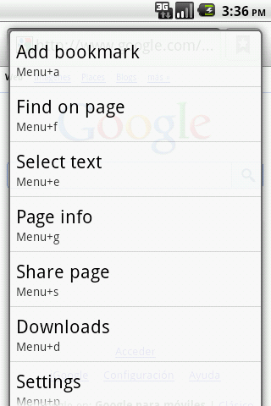
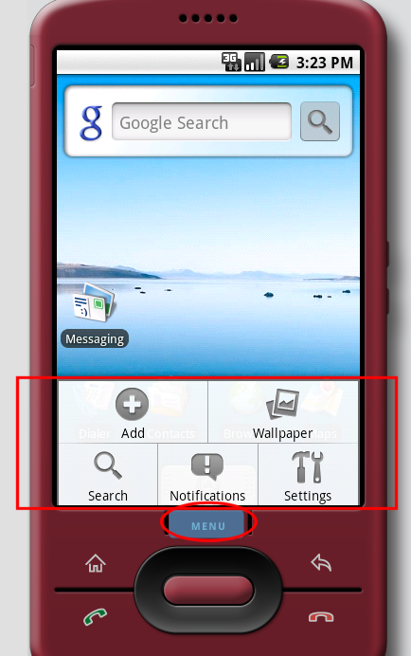
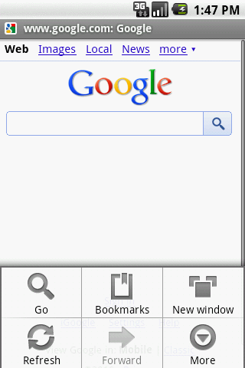
8. Android – UI – Using Menus
Using Menus
Example: Using an option menu
Options
available in
this context
Press Menu
button
A max of six entries per menu. Excess will be displayed as part of the More option
3

Slide 4
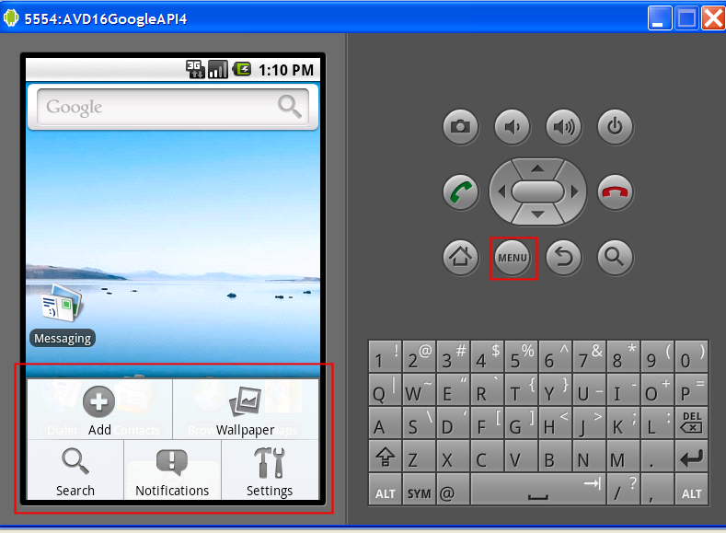
8. Android – UI – Using Menus
Using Menus
Example:
Using an option menu
Five available
Options in
this context
Press Menu
button
4

Slide 5
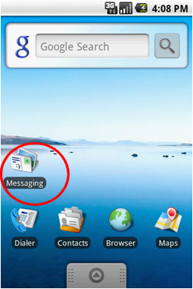
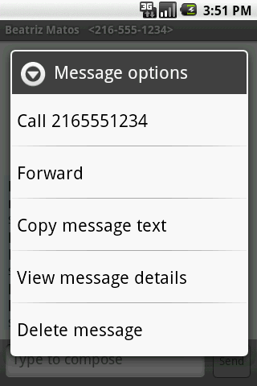
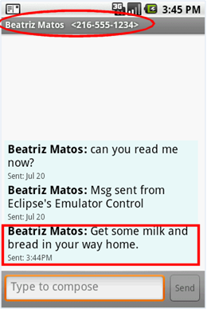
8. Android – UI – Using Menus
Using Menus
Example :
Dealing with SMS (text-messages) by using the built-in Messaging app’s
context menu
Available options
Tap-&-Hold
5

Slide 6
8. Android – UI – Using Menus
Using Menus
Observation:
Option and Context Menus may include:
Text
Icons
Radio Buttons
Check Boxes
Sub-menus
Short-cut keys
6

Slide 7
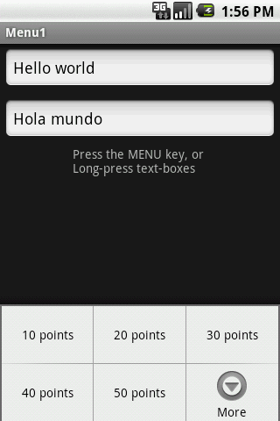
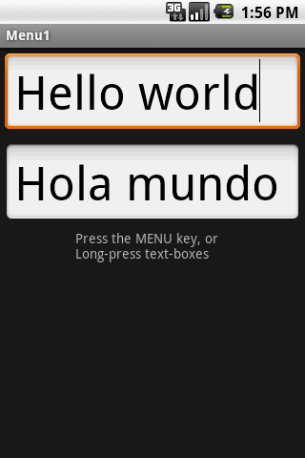
8. Android – UI – Using Menus
Using Menus
Example 1: Using an Option Menu
In this application the
Option menu offers
a way of changing the
text size (on both
EditText boxes)
Click on Menu button to see size options
After choosing option:
50 points
7

Slide 8
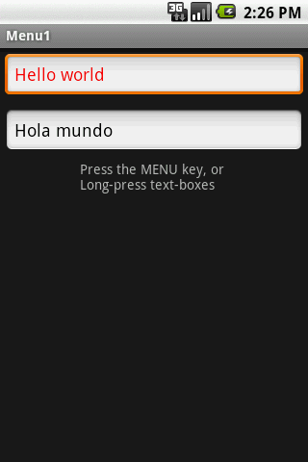
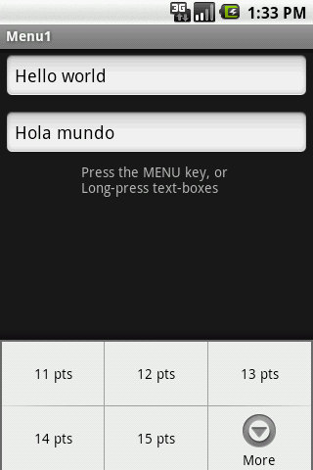
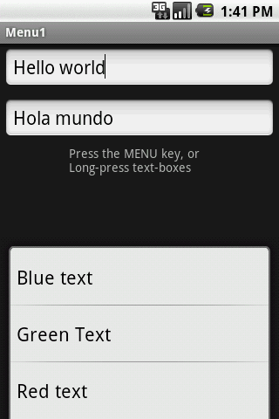
8. Android – UI – Using Menus
Using Menus
Example 1: Using an Option Menu
Up to six options will
Be displayed on the
Option menu.
If there are more than six options pushing the More button will show the rest
Click the More button to see additional options
Additional choices of the Option menu
8

Slide 9
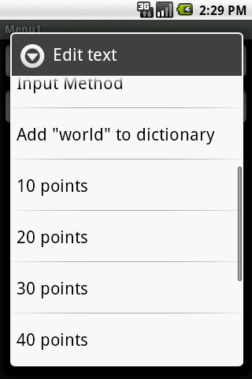
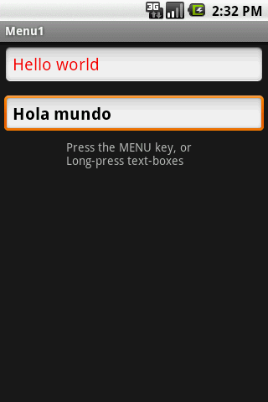
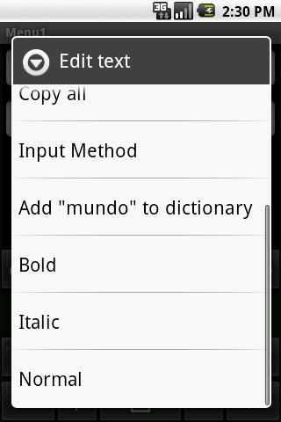
8. Android – UI – Using Menus
Using Menus
Example 1: Using a Context Menu
Each view could have an associated
Context Menu
Long-press a textbox to invoke its Context Menu
9

Slide 10
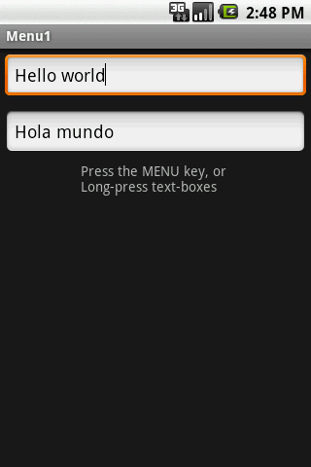
8. Android – UI – Using Menus
Using Menus
Example 1: Using Option and Context Menu
The app shows two text boxes. Menus are used to change text’s size, color, and style.
<?xml version="1.0" encoding="utf-8"?>
<LinearLayout xmlns:android="http://schemas.android.com/apk/res/android"
android:orientation="vertical"
android:layout_width="fill_parent"
android:layout_height="fill_parent“ >
<EditText
android:id="@+id/etMessage1"
android:text="Hello world"
android:layout_width="fill_parent"
android:layout_height="wrap_content"
android:layout_margin = "5dp" />
<EditText
android:id="@+id/etMessage2"
android:text="Hola mundo"
android:layout_width="fill_parent"
android:layout_height="wrap_content"
android:layout_margin = "5dp" />
<TextView
android:text="Press the MENU key, or \nLong-press text-boxes"
android:layout_width="wrap_content"
android:layout_height="wrap_content"
android:layout_gravity="center" />
</LinearLayout>
10

Slide 11
8. Android – UI – Using Menus
Using Menus
Example 1: Using Option and Context Menu
The app shows two text boxes. Menus are used to change text’s size, color, and style.
package cis493.matos.menu;
// using Menus (Option & Context)
import android.app.Activity; …
public class Menu1Act1 extends Activity {
EditText etMessage1;
EditText etMessage2;
Integer[] arrayPointSize = {10, 20, 30, 40, 50};
@Override
public void onCreate(Bundle savedInstanceState) {
super.onCreate(savedInstanceState);
setContentView(R.layout.main);
etMessage1 = (EditText)findViewById(R.id.etMessage1);
etMessage2 = (EditText)findViewById(R.id.etMessage2);
// you may register an individual context menu for each view
registerForContextMenu(etMessage1);
registerForContextMenu(etMessage2);
} //onCreate
11

Slide 12
8. Android – UI – Using Menus
Using Menus
Example 1: Using Option and Context Menu
The app shows two text boxes. Menus are used to change text’s size, color, and style.
// set the option menu for the current activity
@Override
public boolean onCreateOptionsMenu(Menu menu) {
// only one Option menu per activity
populateMyFirstMenu(menu);
return super.onCreateOptionsMenu(menu);
}
// detect what view is calling and create its context menu
@Override
public void onCreateContextMenu(ContextMenu menu, View v,
ContextMenuInfo menuInfo) {
super.onCreateContextMenu(menu, v, menuInfo);
// decide what context menu needs to be made
if (v.getId() == etMessage1.getId())
// create a menu for etMessage1 box
populateMyFirstMenu(menu);
if (v.getId() == etMessage2.getId()){
// create a menu for etMessage2 box
populateMySecondMenu(menu);
}
} //onCreateContextMenu
12

Slide 13
8. Android – UI – Using Menus
Using Menus
Example 1: Using Option and Context Menu
The app shows two text boxes. Menus are used to change text’s size, color, and style.
private void populateMyFirstMenu(Menu menu){
int groupId = 0; int order= 0;
//arguments: groupId, optionId, order, title
menu.add(groupId, 1, 1, "10 points");
menu.add(groupId, 2, 2, "20 points");
menu.add(groupId, 3, 3, "30 points");
menu.add(groupId, 4, 4, "40 points");
menu.add(groupId, 5, 5, "50 points");
menu.add(groupId, 6, 8, "Red text");
menu.add(groupId, 7, 7, "Green Text");
menu.add(groupId, 8, 6, "Blue text");
} //populateMyMenu
private void populateMySecondMenu(Menu menu){
int groupId = 0; int order= 0;
//arguments: groupId, optionId, order, title
menu.add(groupId, 9, 1, "Bold");
menu.add(groupId, 10, 2, "Italic");
menu.add(groupId, 11, 3, "Normal");
}//populateMySecondMenu
13

Slide 14
8. Android – UI – Using Menus
Using Menus
Example 1: Using Option and Context Menu
The app shows two text boxes. Menus are used to change text’s size, color, and style.
// called whenever an item in your context menu is selected
@Override
public boolean onContextItemSelected(MenuItem item) {
return(applyMenuOption(item) ||
super.onContextItemSelected(item) );
}
// called whenever an item in your options menu is selected
@Override
public boolean onOptionsItemSelected(MenuItem item) {
return(applyMenuOption(item) ||
super.onOptionsItemSelected(item) );
}
Note: boolean event observers of the type onEvent(. . . ) by convention return true to indicate the triggered event has been consumed by the method, when false is returned the event is still alive and could be consumed by others.
14

Slide 15
8. Android – UI – Using Menus
Using Menus
Example 1: Using Option and Context Menu
// apply the action associated to selected item
private boolean applyMenuOption(MenuItem item){
int menuItemId = item.getItemId(); // 1, 2, 3, ...11
String strMsg2 = etMessage2.getText().toString();
if (menuItemId <= 5) {
// first five option are for setting text size
int newPointSize = arrayPointSize[menuItemId - 1];
etMessage1.setTextSize(newPointSize);
etMessage2.setTextSize(newPointSize);
}
else {
// either change color on box text1 or style on text2
if (menuItemId == 6)
etMessage1.setTextColor(color.background_dark | Color.RED);
etMessage1.setTextColor(0xffff0000); // red
else if (menuItemId == 7)
etMessage1.setTextColor(0xff00ff00); // green
else if (menuItemId == 8)
etMessage1.setTextColor(0xff0000ff); // blue
else if (menuItemId == 9)
etMessage2.setText(beautify(strMsg2, "BOLD")); //bold
else if (menuItemId == 10)
etMessage2.setText(beautify(strMsg2, "ITALIC")); //italic
else if (menuItemId == 11)
etMessage2.setText(beautify(strMsg2, "NORMAL")); //normal
}
return false;
} //applyMenuOption
15

Slide 16
8. Android – UI – Using Menus
Using Menus
Example 1: Using Option and Context Menu
The app shows two text boxes. Menus are used to change text’s size, color, and style.
// changing text style using HTML formatting
// Spanned is text to which you could add formatting features
private Spanned beautify (String originalText, String selectedStyle){
Spanned answer = null;
if (selectedStyle.equals("BOLD"))
answer = Html.fromHtml("<b>" + originalText +"</b");
else if (selectedStyle.equals("ITALIC"))
answer = Html.fromHtml("<i>" + originalText +"</i>");
else if (selectedStyle.equals("NORMAL"))
answer = Html.fromHtml("<normal>" + originalText +"</normal");
return answer;
} //beautify
} //Menu1Act1
16

Slide 17
8. Android – UI – Using Menus
Using Menus
Comments on Creating an Option & Context Menu
Step1.
Indicate which widget(s) on your activity have context menus. To do this, call registerForContextMenu(theWidget)
supplying the View that is the widget needing a context menu.
Step2.
Implement onCreateContextMenu(…), populate your menu adding text, icons, etc. to the different options. Use input menu parameter to determine which menu to build (assuming your activity has more than one).
The onCreateContextMenu() method gets the ContextMenu itself, the View the
context menu is associated with, and a ContextMenu.ContextMenuInfo, which
tells you which item in the list the user did the tap-and-hold over, in case
you want to customize the context menu based on that information
17
17

Slide 18
8. Android – UI – Using Menus
Using Menus
Comments on Creating an Option & Context Menu
onCreateContextMenu() is called each time the context menu is requested.
Unlike the options menu (which is only built once per activity), context menus are discarded once they are used or dismissed.
To find out when a context menu choice was chosen, implement onContextItemSelected() on the activity.
18
18

Slide 19
8. Android – UI – Using Menus
Using Menus
Comments on Creating an Option & Context Menu
In Example1 the event observers:
onOptionsItemSelected() (for options menu selections) and
onContextItemSelected() (for context menu selections)
delegate on the applyMenuChoice(…) method the performing of the actions associated to the choices made by the user.
@Override
public boolean onOptionsItemSelected(MenuItem item) {
return (applyMenuChoice(item) );
}
@Override
public boolean onContextItemSelected(MenuItem item) {
return (applyMenuChoice(item));
}
19
19

Slide 20
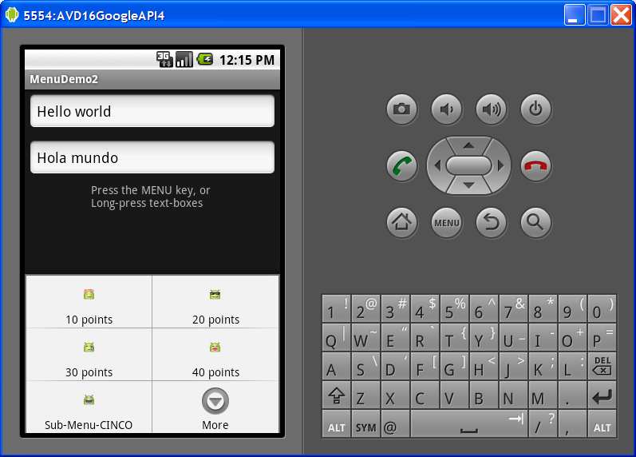
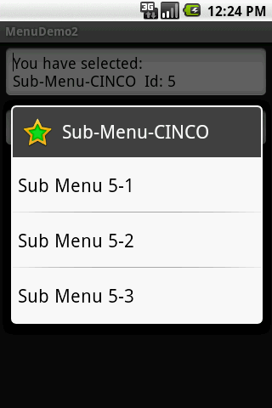
8. Android – UI – Using Menus
Using Menus
Extending Example1.
Example 2: Enhancing Option/Context Menu
This extension of the previous example adds icons and links to the Option Menu entries, as well as a sub-menu list tied to one the option menu buttons.
Keyboard shortcuts / links
Click on SubMenu to see additional options
20

Slide 21
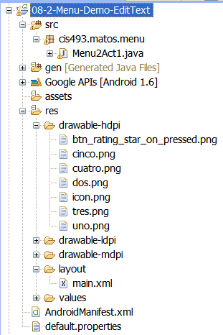
8. Android – UI – Using Menus
Using Menus
Extending Example1.
Example 2: Enhancing Option/Context Menu
This extension of the previous example adds icons and links to the Option Menu entries, as well as a sub-menu list tied to one the option menu buttons.
21

Slide 22
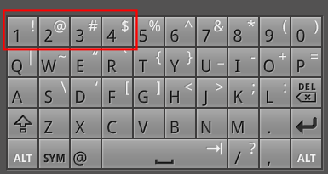
8. Android – UI – Using Menus
Using Menus
Extending Example1.
Example 2: Enhancing Option/Context Menu
Replace the method
populateMyFirstMenu
with the following code
private void populateMyFirstMenu(Menu menu){
int groupId = 0;
//arguments: groupId, optionId, order, title
MenuItem item1 = menu.add(groupId, 1, 1, "10 points");
MenuItem item2 = menu.add(groupId, 2, 2, "20 points");
MenuItem item3 = menu.add(groupId, 3, 3, "30 points");
MenuItem item4 = menu.add(groupId, 4, 4, "40 points");
//MenuItem item5 = menu.add(groupId, 5, 5, "50 points");
MenuItem item6 = menu.add(groupId, 6, 8, "Red text");
MenuItem item7 = menu.add(groupId, 7, 7, "Green Text");
MenuItem item8 = menu.add(groupId, 8, 6, "Blue text");
//set icons
item1.setIcon(R.drawable.uno);
item2.setIcon(R.drawable.dos);
item3.setIcon(R.drawable.tres);
item4.setIcon(R.drawable.cuatro);
// shortcuts using device’s keyboard-keypad
// on a G1 open slide open the keyboard and
// type letter u (same as pressing menu UNO)
item1.setShortcut('1', '1');
item2.setShortcut('2', '2');
item3.setShortcut('3', '3');
item4.setShortcut('4', '4');
Remove this line from previous version
Figures used in this example were taken from:
C:\android-sdk-windows\platforms\android-4\data\res\drawable
22

Slide 23
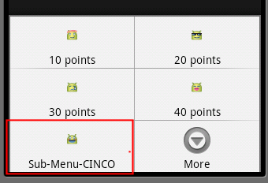
8. Android – UI – Using Menus
Using Menus
Extending Example1.
Continuation…
Replace the method
populateMyFirstMenu
with the following code
Example 2: Enhancing Option/Context Menu
// adding a sub-menu as fifth entry of this menu
// .addSubMenu(int groupId, int itemId, int order, CharSequence title)
int smGroupId = 0; // don't care, same as Menu.NONE
int smItemId = 5; // fifth element
int smOrder = 5; // don't care, same as Menu.NONE
SubMenu mySubMenu5 = menu.addSubMenu(smGroupId, smItemId, smOrder, "Sub-Menu-CINCO");
mySubMenu5.setHeaderIcon(R.drawable.btn_rating_star_on_pressed);
mySubMenu5.setIcon(R.drawable.cinco);
// .add(int groupId, int itemId, int order, CharSequence title)
MenuItem sub51 = mySubMenu5.add(smGroupId,5,1,"Sub Menu 5-1");
MenuItem sub52 = mySubMenu5.add(smGroupId,5,2,"Sub Menu 5-2");
MenuItem sub53 = mySubMenu5.add(smGroupId,5,3,"Sub Menu 5-3");
} //populateMyFirstMenu
23

Slide 24
8. Android – UI – Using Menus
Using Menus
Extending Example1.
Continuation…
Replace the method
applyMenuOption
with the following code
Example 2: Enhancing Option/Context Menu
private boolean applyMenuOption(MenuItem item){
int menuItemId = item.getItemId(); //1, 2, 3, ...11
String strMsg2 = etMessage2.getText().toString();
if (menuItemId < 5) {
// first four options are for setting text size
int newPointSize = arrayPointSize[menuItemId - 1];
etMessage1.setTextSize(newPointSize);
etMessage2.setTextSize(newPointSize);
}
else if (menuItemId == 5) {
// the sub-menu (attached to 5th item) is processed here
etMessage1.setText (
"You have selected: \n" +item.getTitle()
+ "\nId: " + menuItemId
+ " order: " + item.getOrder() );
}
// either change color on text1 or style on text2
else if (menuItemId == 6)
etMessage1.setTextColor(0xffff0000); // red
Same as before
Take care of sub-menu here
24

Slide 25
8. Android – UI – Using Menus
Using Menus
Extending Example1.
Continuation…
Replace the method
applyMenuOption
with the following code
Example 2: Enhancing Option/Context Menu
else if (menuItemId == 7)
etMessage1.setTextColor(0xff00ff00); // green
else if (menuItemId == 8)
etMessage1.setTextColor(0xff0000ff); // blue
else if (menuItemId == 9)
etMessage2.setText(beautify(strMsg2, "BOLD")); //bold
else if (menuItemId == 10)
etMessage2.setText(beautify(strMsg2, "ITALIC")); //italic
else if (menuItemId == 11)
etMessage2.setText(beautify(strMsg2, "NORMAL")); //normal
return false;
} //applyMenuOption
Same as before
25

Slide 26
8. Android – UI – Using Menus
Using Menus
Questions ?
26
26

