Slide 1
Setting Up the ZCU102/104 Evaluation Board
The Vitis™ AI software is made available via docker hub https://hub.docker.com/r/xilinx/vitis-ai/tags
Vitis AI consists of the following two docker images:
• xilinx/vitis-ai:tools-1.0.0-cpu • xilinx/vitis-ai:runtime-1.0.0-cpu

Slide 2
Setting Up the Host
Clone the Vitis AI repository:
On linux terminal : “git clone https://github.com/xilinx/vitis-ai”
Set up Vitis AI to target Alveo cards (Only for systems with Alveo cards)
Run the following commands:
cd Vitis-AI/alveo/packages
sudo su ./install.sh

Slide 3
Start the Docker Container.
a. Change directories to Vitis AI:
cd Vitis-AI/
b. Run one of the following command sets.
• For a CPU tools container:
./docker_run.sh xilinx/vitis-ai:1.0.0-cpu
• For a GPU-enabled tools container:
cd Vitis-AI/docker
./docker_build.sh
cd Vitis-AI
./docker_run.sh xilinx/vitis-ai:runtime-1.0.0-gpu
• For MPSoC Runtime tools container:
./docker_run.sh xilinx/vitis-ai:runtime:1.0.0-cpu
c. Upon starting the container your current working directory will be mounted to: /
workspace

Slide 4
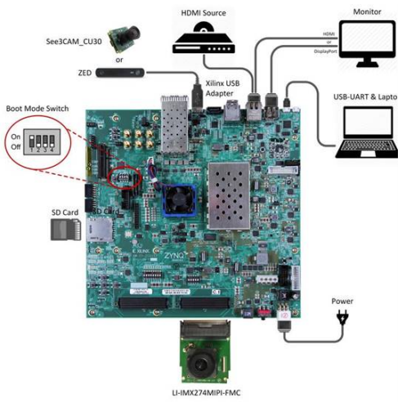
Xilinx ZCU102 Evaluation Board and Peripheral Connections

Slide 5
Flashing the OS Image to the SD Card
For ZCU102, the system images can be downloaded from here:
https://www.xilinx.com/bin/public/openDownload?filename=xilinx-zcu102-dpu-v2019.2.img.gz
The image file has to be flashed into the sd card
Download and install Etcher from: https://etcher.io/
Eject any external storage devices such as USB flash drives and backup hard disks. Then, insert the SD card into the slot on your computer, or into the reader.
Run Etcher. Choose the image file -> Choose the SD card ->Click Flash

Slide 6
Booting the Evaluation Board
Connect the power supply (12V ~ 5A).
Connect the UART debug interface to the host and other peripherals as required.
Turn on the power and wait for the system to boot.

Slide 7
Accessing the Evaluation Board
There are three ways to access the ZCU102 board: • UART port • Ethernet connection • Standalone
You generally need to connect the board via both UART port and Ethernet connection with the host PC
Download and install Putty or Teraterm in linux using linux Apps search bar

Slide 8
UART Port
Open Putty by typing “sudo putty” -> select serial port -> Choose the USB port
(The ttyUSB number varies. I suggest you to try each ones. If you cant find ttyUSB in dropdown list box in putty, try google the issue. The linux connection port drivers might need an update. Try typing “lsusb” on linux terminal)
Select • baud rate: 115200 bps • data bit: 8 • stop bit: 1 • no parity
(Make sure you type the right baudrate. Once, the terminal is launched, press enter to get the cursor)

Slide 9
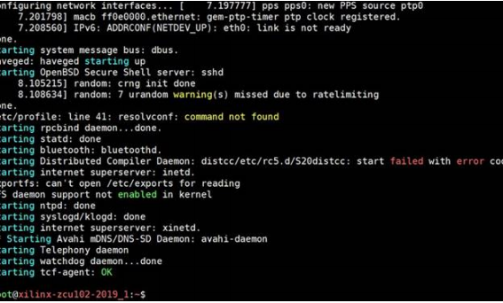
Example of UART Boot on Putty Terminal

Slide 10
Ethernet Port
You need to assign appropriate ip address in both host pc and the target to establish Ethernet Connection
On putty terminal type “ipconfig eth0 192.168.0.101”
On linux terminal type “ipconfig –a” to know the name of the Ethernet port on host pc we are trying to connect. Typically it is eth0 or something like enx00…,
On linux terminal type “sudo ipconfig eth0(or enx00… or other name) 192.168.0.100”
Verify the Ethernet connection by typing “ping 192.168.0.101” on linux terminal. This will exchange packets between host and target. Press Ctrl+C to stop verifying

Slide 11
Installing Vitis AI Package on the Evaluation Board
With an Ethernet connection established, you can copy the Vitis AI installation package from docker image vitis-ai-docker-runtime to the evaluation board and set up Vitis AI running environment for the ZCU102 board.
On linux terminal “sudo scp -r /opt/vitis_ai/xilinx_vai_board_package root@192.168.0.101:~/”
(syntax: scp-r filetobecopied root@IPofboard:~/”
On the ZCU102 board, change to the ~/xilinx_vai_board_package/ directory and run install.sh. The Vitis AI runtime and utility tools will be installed into system automatically. You can now copy Vitis AI samples from docker image vitis-ai-docker-runtime to the evaluation board for evaluation.

Slide 12
Running Examples
samples can be found at https://github.com/xilinx/vitis-ai
The /alveo folder contains the sample for DPU-v1 on Alveo platform, and the folder mpsoc contains the samples for edge DPU on ZCU102 and ZCU104 boards
If you are using Xilinx ZCU102 and ZCU104 boards to run samples, make sure to enable X11 forwarding with the command export DISPLAY=192.168.0.10:0.0 (assuming the IP address of host machine is 192.168.0.10) when logging in to the board using an SSH terminal since all the examples require Linux windows system to work properly.

Slide 13
Vitis AI samples can be found in the following locations:
• ZCU102 board samples: https://github.com/Xilinx/Vitis-AI/tree/master/mpsoc/vitis_ai_samples_zcu102
After downloading the samples, copy them into your /workspace/sample/ folder
Test images can be found in /workspace/sample/vitis_ai_samples_zcu102/images/
copying the whole directory /workspace/sample/vitis_ai_samples_zcu102/ to ZCU102 board directory /home/root/ is recommend.

Slide 14
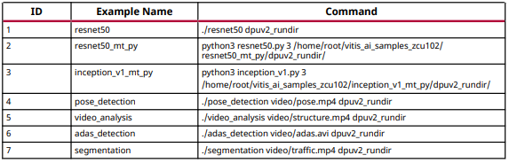
The launching command for each sample is listed in the following table. For Python samples, note that the absolute path for dpuv2_rundir should be specified.

Slide 15
Legacy DNNDK Examples
The legacy DNNDK C++/Python examples can be found at the following locations:
• ZCU102 examples: https://github.com/Xilinx/Vitis-AI/tree/master/mpsoc/dnndk_samples_zcu102
After downloading the samples, copy them into the /workspace/sample/ folder within the runtime container. These examples can be built with Arm GCC cross-compilation toolchains.

Slide 16
The samples stay under the directory /workspaces/sample/ dnndk_samples_zcu102/. After all the samples are built by Arm GCC cross-compilation toolchains within runtime container, it is recommended to copy the whole directory / workspaces/sample/dnndk_samples_zcu102/ to ZCU102 board directory /home/root/.

Slide 17
Running Examples
ResNet-50
$dnndk_sample_base/resnet50 contains an example of image classification using Caffe
ResNet-50 model. It reads the images under the $dnndk_sample_base/dataset/
image500_640_480 directory and outputs the classification result for each input image. You
can then launch it with the./resnet50 command.
Video Analytics
An object detection example is located under the $dnndk_sample_base/video_analysis
directory. It reads image frames from a video file and annotates detected vehicles and
pedestrians in real-time. Launch it with the command ./video_analysis video/
structure.mp4 (where video/structure.mp4 is the input video file).

Slide 18
ADAS Detection
An example of object detection for ADAS (Advanced Driver Assistance Systems) application
using YOLO-v3 network model is located under the directory $dnndk_sample_base/
adas_detection. It reads image frames from a video file and annotates in real-time. Launch it
with the ./adas_detection video/adas.avi command (where video/adas.mp4 is the
input video file).
Semantic Segmentation
An example of semantic segmentation in the $dnndk_sample_base/segmentation
directory. It reads image frames from a video file and annotates in real-time. Launch it with
the ./segmentation video/traffic.mp4 command (where video/traffic.mp4 is the input
video file).

Slide 19
Running Examples On Cloud
Working with Vitis AI via cloud is fairly straightforward
Refer to this youtube tutorial https://www.youtube.com/watch?v=FCP0sN_HInw

