Slide 1
RABBIT MQ
https://tinyurl.com/rabbitMQ-vatsan

Slide 2
Data Flow
Data is every where
Data flows from
  Method – Method
  Class – Class
  Module – Module
  System – System
Producer
Data
Consumer

Slide 3
Need for Messaging systems
Loose coupling between modules
Queuing data for later delivery
Asynchronous processing
Reliable load balancing

Slide 4
Rabbit MQ
Rabbit Technologies started as a joint venture
  between LShift and CohesiveFT in 2007
Acquired in April 2010 by SpringSource, a division of VMWare.
  Became part of GoPivotal in May 2013
Client Libraries available for all major languages

Slide 5
Rabbit MQ
RabbitMQ is open source MessagingBroker software
  Message Oriented Middleware
  Server written in Erlang
  Implements Advanced Message Queuing Protocol

Slide 6
AMQP
AMQP stands for Advanced Message Queuing Protocol
  An open standard protocol for implementing Message Oriented Middleware).
  Enables conforming client applications to communicate with conforming messaging middleware brokers.
Brokers and Their Role
  Receive messages from applications that publish
  Route to an applications that process them
  Publishers, consumers and the broker can all reside on different machines.

Slide 7
Need for AMQP
JMS API
  Interoperability means Messaging systems that will work only in Java-based applications.
  It does not support other languages.
AMQP solves the JMS API problem.
  AMQP supports interoperability between heterogeneous platforms and messaging brokers.
  Can develop in any language (Java, C++, C#)
  Can communicate with each other by using AMQP based message brokers.

Slide 8
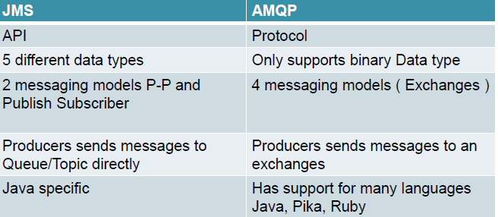
Differences between JMS and
AMQP

Slide 9
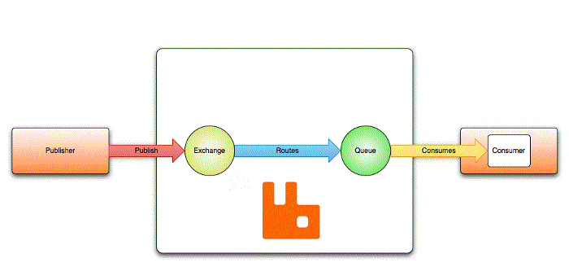
AMQP Entities.
Message
Exchange
Queue
Binding

Slide 10
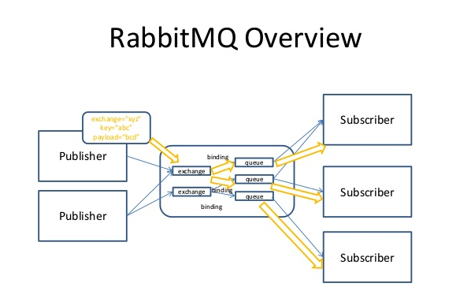
RabbitMQ Overview

Slide 11
AMQP Entities.
Messages
  Published to exchanges
Exchanges
  Distribute message copies to queues
Binding
  Messages are distributed using rules called bindings.
Queue
  Store messages that are consumed by applications
Broker
  Either deliver messages to consumers subscribed to queues,
  Consumers may fetch/pull messages from queues on demand.

Slide 12
Binding and Routing Key
Bindings:
  Each Queue should bind with an Exchange with a routing key
Routing key :
  String of characters
  Exchange Type decides strategy for routing messages to bounded queues
Direct exchange
  matches routing key of message exactly with the routing key of queues specified at the time of binding
Fanout exchange
  ignores the routing key and sends a copy of message to every bounded queue

Slide 13
Exchange
Default
  Direct exchange with no name
  Routing key equals QueueName
Direct
  Messages would only be routed when there is queue bonded with Routing Key
Fanout
  Messages would be routed to all queues bounded irrespective of routing key
Topic
  We can use regular expressions for routing key

Slide 14
Default Exchange
A direct exchange with no name
Its pre-declared by the broker.
Every queue that is created is automatically bound to it with a routing key which is the same as the queue name.
A message published to the default exchange with the routing key "search-indexing-online" will be routed to the queue "search-indexing-online".

Slide 15
Direct Exchange
Delivers messages to queues based on the message routing key.
Ideal for the unicast routing of messages
A queue binds to the exchange with a routing key K
When a new message with routing key R arrives at the direct exchange, the exchange routes it to the queue if K = R
Used to distribute tasks between multiple workers
  Instances of the same application in a round robin manner.

Slide 16
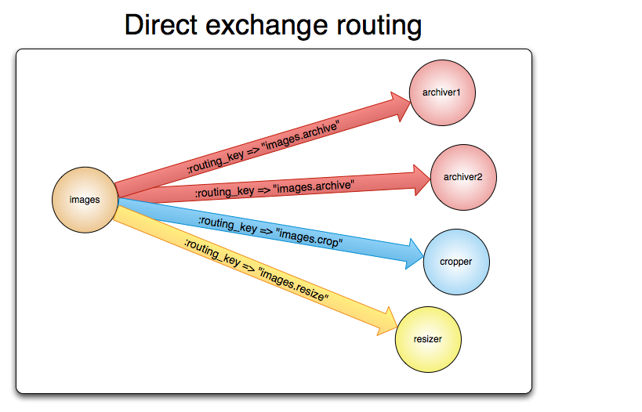
Direct Exchange Routing

Slide 17
Fan Out Exchange
Routes messages to all of the queues that are bound to it
  The routing key is ignored.
If N queues are bound to a fanout exchange,
  when a new message is published to that exchange
  a copy of the message is delivered to all N queues.
Ideal for the broadcast routing of messages.
Delivers a copy of message to every queue bound to it

Slide 18
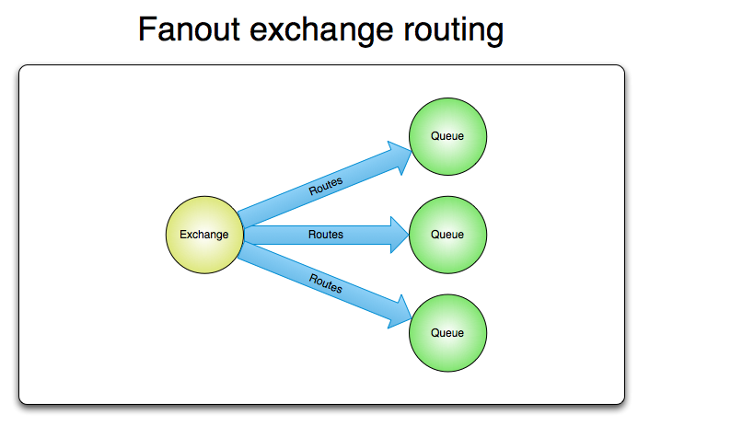
Fanout Exchange Routing

Slide 19
Topic Exchange
Route messages to one or many queues
  based on matching between a message routing key and the pattern that was used to bind a queue to an exchange.
Used to implement various publish/subscribe pattern variations.
Used for the multicast routing of messages.
Involves multiple consumers/applications that selectively choose which type of messages they want to receive

Slide 20
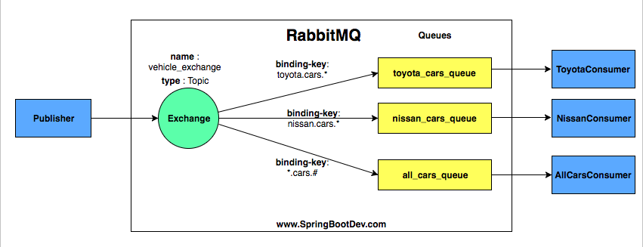
Topic Exchange
Regular Expression as Routing Key
* Denotes one Word
# Denotes one or more word

Slide 21
Bindings
Bindings are rules that exchanges use
  To route messages to queues.
  To instruct an exchange E to route messages to a queue Q,
  Q has to be bound to E.
  Bindings may have an optional routing key attribute used by some exchange types.
  The purpose of the routing key is to select certain messages published to an exchange to be routed to the bound queue.
  Routing key acts like a filter.

Slide 22
Queues
Store messages that are consumed by applications.
Queues share some properties with exchanges, but also have some additional properties:
  Name
  Durable (the queue will survive a broker restart)
  Exclusive (used by only one connection and the queue will be deleted when that connection closes)
Before a queue can be used it has to be declared.
Declaring a queue will cause it to be created if it does not already exist.

Slide 23
Consumers
Application can Consume messages in queues
There are two ways for applications to do this:
  Have messages delivered to them ("push API")
  Fetch messages as needed ("pull API")
"push API",
  Applications to register as a consumer
  They need to subscribe to a queue.
  Can have more than one consumer per queue or to register an exclusive consumer

Slide 24
Consumers
Pull API
  To retrieve individual messages, from the returned header information (properties) the message body can be extracted:
  This API is relatively inefficient.

Slide 25
Acknowledgement
Consume application chooses when it is time to send an acknowledgement.
It can be right after receiving a message, or after persisting it to a data store before processing, or after fully processing the message
If a consumer dies without sending an acknowledgement, the broker will redeliver it to another consumer or, if none are available at the time, the broker will wait until at least one consumer is registered for the same queue before attempting redelivery.

Slide 26
Analogy
Queue is like a in Chennai
Exchange is like Chennai airport
Bindings are routes from Airport to destination.
There can be zero or many ways to reach it

Slide 27
Queue Durability
Durable queues are persisted to disk and thus survive broker restarts.
Queues that are not durable are called transient.
Not all scenarios and use cases mandate queues to be durable.
Durability of a queue does not make messages that are routed to that queue durable.
If broker is taken down and then brought back up, durable queue will be re-declared during broker startup,
  only persistent messages will be recovered.

Slide 28
SPRING AMQP

Slide 29
Spring RabbitMQ
Spring Provides AMQP API to integrate AMQP Message brokers with Spring applications
Popular AMQP protocol implemented Message brokers
  Apache Active MQ server
  Spring Rabbit MQ server
By default, Spring AMQP uses localhost to connect to RabbitMQ.
Spring can load the configuration details from properties file

Slide 30
Dependency
  <dependency>
  <groupId>org.springframework.amqp</groupId>
  <artifactId>spring-rabbit</artifactId>
  </dependency>

Slide 31
Spring AMQP
Exchange
  The Exchange interface represents an AMQP Exchange,
Queue
  The Queue class represents the component from which a message consumer receives messages.
Binding
  A Binding class to represent Binding and its connections.
  new Binding(someQueue, someDirectExchange, "foo.bar");
  new Binding(someQueue, someTopicExchange, "foo.*");
  new Binding(someQueue, someFanoutExchange);

Slide 32
AMQP Template
Rabbit Template
  Spring AMQP provides a “template” that plays a central role.
  The interface that defines the main operations to send and receive.
Sending Messages
  amqpTemplate.send("marketData.topic", "quotes.nasdaq.THING1", new Message("12.34".getBytes(), someProperties));
Receiving Message
  Message receive(String queueName) throws AmqpException;

Slide 33
Message Converters
Has convenience methods for receiving POJOs instead of Message instances
Object receiveAndConvert(String queueName) throws AmqpException;
Message receiveAndConvert(String queueName, long timeoutMillis) throws AmqpException;
  waiting up to the specified wait time if necessary for a message to become available

Slide 34
@RabbitListerner
Receiver class is annotated with @RabbitListener
The Name of the queue is passed
Annotate receive method with @RabbitHandler
  passing in the payload that has been pushed to the queue.

Slide 35
Application.properties
  spring.rabbitmq.host=localhost
  spring.rabbitmq.port=5672
  spring.rabbitmq.username=test
  spring.rabbitmq.password=test

Slide 36
Producer
  public class Producer {
  @Autowired
  private RabbitTemplate template;
  @Autowired
  private Queue queue;
  public void send() {
  String message = "Hello World!";
  this.template.convertAndSend(queue.getName(), message);
  System.out.println(" [x] Sent '" + message + "'");
  }
  }

Slide 37
@Scheduled
  @Scheduled(fixedDelay = 1000, initialDelay = 500)
fixedDelay
To ensure that there is a delay of n millisecond between the finish time of an execution of a task and the start time of the next execution of the task.
The task always waits until the previous one is finished.
  @Scheduled(fixedDelay = 1000, initialDelay = 500)
  public void send() {
  }

Slide 38
Receiver
  @RabbitListener(queues = "hello")
  public class Receiver {
  @RabbitHandler
  public void receive(String in) {
  System.out.println(" [x] Received '" + in + "'");
  }
  }

Slide 39
Register the Beans
  @Bean
  public Queue hello() {
  return new Queue("hello");
  }
  @Bean
  public Receiver receiver() {
  return new Receiver();
  }
  @Bean
  public Producer sender() {
  return new Producer();
  }

Slide 40
Application
  @SpringBootApplication
  public class RabbitMqBasicsApplication {
  public static void main(String[] args) {
  ConfigurableApplicationContext ctx= SpringApplication.run(RabbitMqBasicsApplication.class, args);
  Producer sender = ctx.getBean(Producer.class);
  sender.send();
  }
  }

Slide 41
FAN OUT EXCHANGE

Slide 42
Fan out Exchange Routing

Slide 43
Fan Out Sender
  @Component
  public class Sender {
  @Autowired
  private RabbitTemplate template;
  @Autowired
  private FanoutExchange fanout;

Slide 44
Fan Out Sender
  public void send() {
  StringBuilder builder = new StringBuilder("Hello Sent to All");
  String routingKey = "";
  String message = builder.toString();
  template.convertAndSend(fanout.getName(), routingKey, message);
  System.out.println(" [x] Sent '" + message + "'");
  } }

Slide 45
Receiver
  @Component
  public class Receiver {
  @RabbitListener(queues = "#{autoDeleteQueue1.name}")
  public void receive1(String in) throws InterruptedException {
  receive(in, 1);
  }
  @RabbitListener(queues = "#{autoDeleteQueue2.name}")
  public void receive2(String in) throws InterruptedException {
  receive(in, 2);
  }
  }

Slide 46
Receiver
  public void receive(String in, int receiver) throws InterruptedException {
  System.out.println("instance " + receiver + " [x] Received '" + in + "'");
  }

Slide 47
Application
  @SpringBootApplication
  public class RabbitMqFanoutApplication {
  public static void main(String[] args) {
  ConfigurableApplicationContext ctx
  ` =SpringApplication.run(RabbitMqFanoutApplication.class, args);
  Sender sender = ctx.getBean(Sender.class); sender.send();
  }

Slide 48
Registering Beans
  @Bean
  public FanoutExchange fanout() {
  return new FanoutExchange("example.fanout");
  }
  @Bean
  public Queue autoDeleteQueue1() {
  return new AnonymousQueue(); }
  @Bean
  public Queue autoDeleteQueue2() {
  return new AnonymousQueue(); }

Slide 49
Registering Beans
  @Bean
  public Binding binding1(FanoutExchange fanout, Queue autoDeleteQueue1) {
  return BindingBuilder.bind(autoDeleteQueue1).to(fanout);
  }
  @Bean
  public Binding binding2(FanoutExchange fanout, Queue autoDeleteQueue2) {
  return BindingBuilder.bind(autoDeleteQueue2).to(fanout); }

Slide 50
SPRING CLOUD STREAM

Slide 51
Spring Cloud Stream
A framework for building message-driven microservice applications.
Without the need to specify the implementation details of the underlying messaging system we want to use.
Just need to specify the required binding dependencies
Cloud Stream will integrate the messaging systems to Spring Boot Application.
Spring Integration to provide connectivity to message brokers.
Kafka & Rabbit are currently supported

Slide 52
Cloud Stream
Transparent content-type negotiation and argument resolution
Ability to connect microservices to external systems
  Kafka
  Rabbit MQ
  JMS
  Etc. . .
Provides flexible programming model
  Built on familiar Spring idioms - Spring Messaging
  Supports pub/sub semantics, consumer groups, stateful partitions and other messaging paradigms
  Message centric
  Supports Imperative and Declarative programming models

Slide 53
Programming model
Spring Cloud Stream - Spring Boot app
Flexible configuration (i.e., Annotation, XML, hybrid)
Binders
  Streaming
    Kstream
  Channel-based
    Kafka
    Rabbit
Seamless integration with the rest of the Spring Cloud stack
  Metrics
  Sleuth
  Config
  Circuit Braker
  Etc.

Slide 54
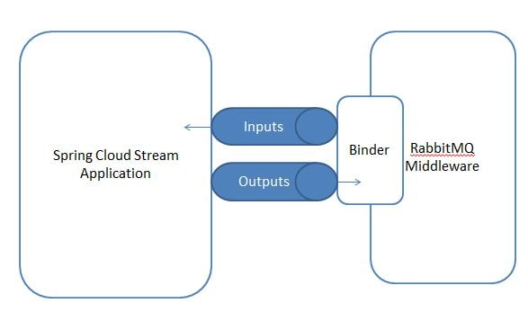
Cloud Stream

Slide 55
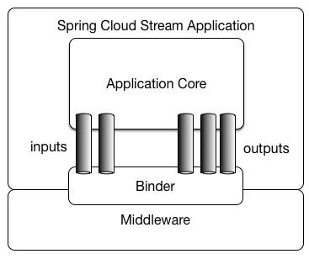
Cloud Stream

Slide 56
Concepts
Binder
  Represents the underlying message broker middleware such as RabbitMQor Kafka.
Channel
  Represents a logical connection between the external application and the message broker middleware.
  Can be either input channel or output channel based on the participating application.
Publisher application publishes message to the message broker through Output channel
Consumer application receives messages from message broker through Input channel.

Slide 57
Introducing Spring Cloud Stream
@EnableBinding
  To get immediate connectivity to a message broker
  Takes one or more interfaces as parameters
@StreamListener
  To receive events for stream processing.

Slide 58
Sink
  public interface Sink {
  String INPUT = "input";
  @Input(Sink.INPUT)
  SubscribableChannel input();
  }

Slide 59
Sink
@Input
  Identifies an input channel, through which received messages enter the application.
@Output
  Identifies an output channel, through which published messages leave the application.
Both take a channel name as a parameter.
If a name is not provided, the name of the annotated method is used.

Slide 60
Source, Sink, and Processor
Spring Cloud Stream provides three predefined interfaces
Source
  To be used for an application which has a single outbound channel.
Sink
  Sink is used to consume message from queue.
Processor
  can be used for an application which has both an inbound channel and an outbound channel.

Slide 61
Producing and Consuming Messages
Cloud Stream application can use either Spring Integration annotations or Spring Cloud Stream’s @StreamListener
@StreamListener
  annotation is modeled after other Spring Messaging annotations
  @MessageMapping, @JmsListener, @RabbitListener, etc.) but adds content type management and type coercion features.

Slide 62
Setting Up Application
spring.cloud.stream.bindings.<channel-name>.destination
  Represent the exchange in which to the created queue is bound and subscribed.
  The exchange will direct the received messages relevant bound(subscribed) queue based on the routing key

Slide 63
Setting Up Application
spring.cloud.stream.bindings.<channel-name>.group :-
  This will represent the queue that is responsible for storing the messages.
  The queue will be created when the consumer application is up and it will be subscribed to theexchange for getting messages.
  The consumer application will listen to the queue for receiving incoming messages.

Slide 64
Rabbit MQ Config Property
  server.port=7070
  spring.rabbitmq.host=localhost
  spring.rabbitmq.port=5672
  spring.rabbitmq.username=guest
  spring.rabbitmq.password=guest
  spring.cloud.stream.bindings.employeeRegistrationChannel.destination=employeeRegistrations

Slide 65
Application
  @SpringBootApplication
  @EnableBinding(Sink.class)
  public class CloudStreamWithRabbitApplication {
  public static void main(String[] args) {
  SpringApplication.run(CloudStreamWithRabbitApplication.class, args);
  }
  @StreamListener(target = Sink.INPUT)
  public void processRegisterEmployees(String employee) {
  System.out.println("Employees Registered by Client " + employee);
  } }

Slide 66
Message Channel
  public interface EmployeeRegistrationSource {
  @Output("employeeRegistrationChannel")
  MessageChannel employeeRegistration();
  }

Slide 67
Controller
  @RestController
  @EnableBinding(EmployeeRegistrationSource.class)
  public class EmployeeRegistrationController {
  @Autowired
  EmployeeRegistrationSource employeeRegistrationSource;
  @PostMapping("/register")
  public String orderFood(@RequestBody Employee employee) {
  employeeRegistrationSource.employeeRegistration().
  send(MessageBuilder.withPayload(employee).build());
  System.out.println(employee.toString());
  return "Employee Registered";
  }
  }

Slide 68
Stream Consumer
server.port=8090
spring.rabbitmq.host=localhost
spring.rabbitmq.port=5672
spring.rabbitmq.username=guest
spring.rabbitmq.password=guest
spring.cloud.stream.bindings.input.destination=employeeRegistrations
spring.cloud.stream.bindings.input.group=employeeRegistrationQueue

Slide 69
Consume Message
    @EnableBinding(Sink.class)
    @SpringBootApplication
    public class EmployeeRegistrationProcessingApplication {
    public static void main(String[] args) {
    SpringApplication.run(EmployeeRegistrationProcessingApplication.class, args);
    }
    @StreamListener(target = Sink.INPUT)
    public void processRegisterEmployees(String employee) {
    System.out.println("Employees Registered by Client " + employee); }
    }

