Slide 1


SPRING 5.0 WITH BOOT 2.1

Slide 2

K.Srivatsan - vatsan@gmail.com
IT Trainer Since 1991
Conducting Java Training Since 2004
More than 60+ Corporate Clients

Slide 3
Introduction
Spring
  An application development framework and inversion of control container for Java
Spring Boot
  Makes it easy to create stand-alone, production-grade Spring Applications and expose then as services
Micro services
  Break large system into number of independent collaborating components.
Spring Cloud
  Built on top of Spring Boot
  Provides a set of features to quickly build and Deploy Micro services with minimal configurations.

Slide 4
Spring-Objectives
Understanding Dependency Injection and Inversion of Controller
Understand the relationships between Spring and JEE, AOP, IOC, JDBC, Hibernate
Write applications that take advantage of the Spring container.
Understand the Spring Database access options
Understand the Spring MVC Development.

Slide 5
Software Requirement
Java 8.x or above
Eclipse IDE with Spring Tool Suite or Spring Tool Suite
Spring Distribution 5.X and Boot 2.1
MySQL or Oracle RDBMS
Tomcat Server

Slide 6
IoC Container
Introduction
Basic Containers and Beans
Dependencies
Bean Scope
The Application Context
Quick Start Spring Application Using Eclipse IDE

Slide 7
Spring Framework
Light-weight comprehensive framework for building Java SE and Java EE applications
Created by Rod Johnson
Java Bean-based configuration management,
Uses Inversion-of-Control principles, specifically using the Dependency Injection technique

Slide 8
Key Features
Suite for Both Java SE and EE
IoC Container
Integration with persistence frameworks.
MVC web application framework
Java Transaction API and a single JDBC Data Source
  This removes the dependency on a Java EE environment for transaction support.
Aspect-oriented programming (AOP) framework

Slide 9
History of Spring Framework
The Spring Framework was first released in 2004
Spring 2.0
  provided XML namespaces and AspectJ support;
Spring 2.5
  embraced annotation-driven configuration;
Spring 3.0
  Support for Java 5+ across the framework codebase,
  Java-based @Configuration model.
Spring 4.0
  Fully support Java 8 features.
  The minimum requirement is Java SE 6
  Spring 5.0
  Full compatibility with JDK 9 for development and deployment.

Slide 10
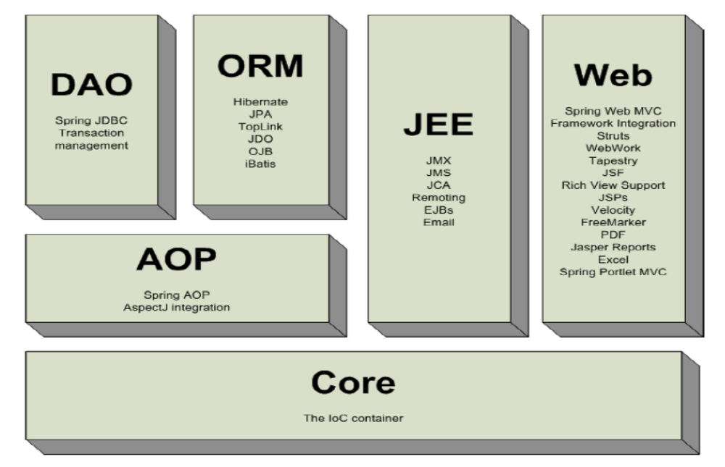
Spring Framework

Slide 11
IoC Container
Introduction
Basic Containers and Beans
Dependencies
Bean Scope
The Application Context
Quick Start Spring Application Using Eclipse IDE

Slide 12
Dependency Injection
A pattern of injecting a class’s dependencies into it at runtime.
Achieved by defining the dependencies and then injecting in a concrete class
Can swap in different implementations without having to modify the main class.
Promotes high cohesion by promoting the Single Responsibility Principle (SRP)

Slide 13
Dependency Inversion Principle
  High level modules should not depend upon low level modules.
  Low and High Modules should depend upon abstractions.
  Low modules should NOT define a interface that Higher Level module depend on
  Higher Level Module should define an interface that lower level module must implement
This gives the flexibility at the cost of increased effort.

Slide 14
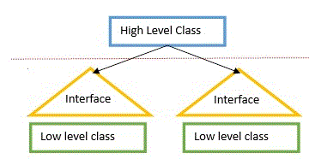

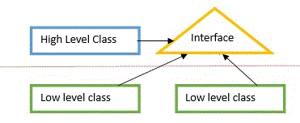

Dependency Inversion Principle

Slide 15
Dependency Inversion Principle
public class Messaging {
MessageService service;
public void sendMssage(){
service.sendMessage();
} }
public interface MessageService {
public String sendMessage();
}
public class Email implements MessageService {
public String sendMessage() { }
}
High-level modules should not depend on low-level modules.
Both should depend on abstractions.
High Level Module
Abstraction
Low Level Module

Slide 16
Inversion of Control Container(IoC)
A container that supports Dependency Injection.
No Need to create objects but describe how they should be created.
Describe which services are needed by which components in a configuration file.
Objects are given their dependencies at creation time by the IoC
IoC - inversion of responsibility with regard to how an object obtains references to collaborating objects.

Slide 17

The Container

Slide 18
Container and Beans
org.springframework.beans.factory.BeanFactory is the representation of the Spring IoC container
  containing and managing beans,
  instantiating or sourcing application objects
  configuring such objects
  assembling the dependencies between objects.
A bean is an object that is instantiated, assembled, and otherwise managed by a Spring IoC container.
Beans, and the dependencies among them, are reflected in the configuration metadata used by a container

Slide 19
Application Context
ApplicationContext is a complete superset of the BeanFactory
Containers gets its instructions on what objects to instantiate, configure, and assemble by reading configuration metadata.
There are many Implementations of the ApplicationContext

Slide 20
Implementation of Application Context
ClassPathXmlApplicationContext:
  Loads a context definition from an XML file located in the classpath,
  context definition files as classpath resources.
FileSystemXmlApplicationContext
  Loads a context definition from an XML file in the file system.
XmlWebApplicationContext
  Loads context definitions from an XML file contained within a web application.

Slide 21
Bean Factory and Application Context
Application Context
Bean Factory
Can have more than one config files
Publish events to beans that are registered as listeners
Support internationalization (I18N) messages
Support application lifecycle events, and validation.
Support for JNDI , EJB, remoting
In this only one config file or .xml file
Doesn’t support.
Doesn’t support
Doesn’t support.
Doesn’t support.

Slide 22
Beans
The term “bean” is used to refer any component managed by the BeanFactory
The “beans” are in the form of JavaBeans (in most cases)
  Present in a Named Package
  No Argument constructor
  getter and setter methods for the properties
  Can be controlled for scope, life cycle and callbacks.
Beans are singletons by default
Properties the beans may be simple values or references to other beans

Slide 23
Configuration Meta Data
Instructs IoC Container to instantiate, configure, and assemble the objects
Can be done in XML format
  Supported from Spring 2.0
Can be done with Annotation
  Supported from Spring 2.5
Can be done with Just Java
  Supported from Spring 3.0

Slide 24
SPRING BOOT 2.1

Slide 25
Spring Boot
Extension of the Spring framework
  A faster and more efficient development
Eliminates the boilerplate configurations required for setting up a Spring application.
  Opinionated ‘starter’ dependencies to simplify build and application configuration
  Embedded server to avoid complexity in application deployment
  Metrics, Health check, and externalized configuration
  Automatic configuration whenever possible

Slide 26
Spring Boot
Spring Boot 2.1.3.RELEASE
requires Java 8 and is compatible up to Java 11
Spring Framework 5.1.5.RELEASE or above
Supports the Tomcat 9.0 ,Jetty 9.4

Slide 27
Spring Boot Starters
Set of convenient dependency descriptors
Eliminates the need to hunt through sample code
No need to copy-paste loads of dependency descriptors.
Contains lot of the dependencies that are required to get a project up and running
Also has support of managed transitive dependencies.

Slide 28
Creating a Spring Boot Project
In the Eclipse IDE Right-click in the package explorer and select New -> Spring Starter Project
A screen opens with some details which can be changed or can accept the default values for a simple project
The entry point of a Spring Boot application is the class which is annotated with @SpringBootApplication:
Uses this class with public static void main entry-point to launch an embedded web server.

Slide 29
Spring Boot Bootstrap
  @SpringBootApplication
  public class Application {
  public static void main(String[] args) {
  SpringApplication.run(Application.class, args);
  }
  }
Spring Boot can scan all the classes in the same package or sub packages of Main-class for components.
Equivalent to using @Configuration, @EnableAutoConfiguration, and @ComponentScan with their default attributes,

Slide 30
DEPENDENCY INJECTION

Slide 31
Dependency Injection
Spring could inject dependencies between the beans by following way of injection types:
  Setter Injection
  Constructor Injection
  Field Injection (@Autowired at field)
  Method Injection
Dependency can be wired in three ways
  XML Based Configuration
  Annotation Based Configuration
  Java Based Configuration

Slide 32
Setter Injection
All dependencies injected via setter methods
  No need for constructors
Allows flexible initialization
  Any set of properties can be initialized
Named properties allow for readable configuration data
  Clear what is being injected
Requires Java Bean conventions to be followed
  Non standard method names are problematic
Can result in invalid object configurations
  Need post initialization checking methods

Slide 33
Constructor Dependency Injection
Container invokes a class constructor with a number of arguments, each representing a dependency on the other class
Dependency can be one of the following
  primitive and String-based values
  Dependent object (contained object)
  Collection values
Constructor is annotated with @Autowired
  Can omit from Spring 4.3 there is single constructor

Slide 34
Constructor-based or setter-based DI?
Constructor arguments for mandatory dependencies and setters for optional dependencies.
Constructor dependency , disadvantage is that the object becomes less amenable to reconfiguration and re-injection.
A legacy class may not expose any setter methods, and so constructor injection is the only available DI.

Slide 35
ANNOTATION BASED CONFIGURATIONS

Slide 36
@ Component
Bean are defined in the bean configuration file.
Spring can scan all the beans through auto scan
The @Component in class indicates that it is an auto scan component.
By default the First character of the component is lower Cased
  ‘CustomerService’ to ‘customerService’.
CustomerService cust = (CustomerService)context.getBean("customerService");

Slide 37
Setter Injection
  @Component(“inv”)
  public class Annot_Invoice {
  @Value("101")
  private int invoiceNumber;
  @Value("Raja")
  private String customerName;
  @Value("3450.00")
  private double amount;
  // Zero Arg Construtor
  // Set /Get Methods
  }

Slide 38
Application
  @SpringBootApplication
  public class FirstExampleApplication {
  public static void main(String[] args) {
  ConfigurableApplicationContext ctx =
  SpringApplication.run(FirstExampleApplication.class, args);
  Author author1 = ctx.getBean(Author.class);
  System.out.println( author1);
  }

Slide 39
LOMBOK

Slide 40
Introduction
A java library that automatically plugs into editor and build tools
Helps reduce the boiler plate code.
Has various annotations which can be used within our code that is be processed during the compile time and appropriate code expansion would take place based on the annotation used.
Does the code reduction in view time, after the compiling the byte code is injected with all the boiler plate.
This helps keeping our codebase small, clean and easy to read and maintain.

Slide 41
Adding Lombok to Eclipse
Downloaded from https://projectlombok.org/download
Execute command in terminal: java -jar lombok.jar
Will Open a window requesting Eclipse Desination
Copy lombok.jar into Eclipse Parent Directory directory.
Add the following command to end of EClipse..ini
  -javaagent:lombok.jar .
Restart Eclipse and enable “Annotation Processing”

Slide 42
Lombok Annotation
To generate Setters and Getters
  @Getter
  @Setter
To generate constructors,
  @NoArgsConstructor
  @RequiredArgsConstructor
Other Annotations
  @ToString
  @EqualsAndHashCode
  @Data
  @Slf4j

Slide 43
Constructor Injection
@Component("custBean")
public class Customer {
  private int customerId;
  private String customerName;
  private long phoneNumber;
@Autowired
public Customer(@Value("101") int customerId, @Value("Siva") String customerName,@Value("9484848") long phoneNumber) {
  this.customerId = customerId;
  this.customerName = customerName;
  this.phoneNumber = phoneNumber;
}

Slide 44
@ComponentScan
@Configuration
@ComponentScan("com.training")
public class Config {
}
All the Spring's meta-annotated components with @Component are candidates for component scanning.
During component scanning components will be autowired together.

Slide 45
Auto Wiring of Bean
@Autowired :
  Used to auto wire bean on the setter method, constructor or a field.
  It uses auto wire bean by matching data type.
@Qualifier
  Is used to control which bean should be autowired on a field.
  If the bean configuration file has two similar beans, can specify the bean to be wired by giving the bean name
  @Required
  . When matching bean to wire is not found , it will throw an exception.
  To disable this checking setting the “required” to false.
  it will leave the property unset.

Slide 46
Auto Wiring Collaborators
  @Component(“myBean2”)
  public class AutoWireBean {
    @Value("120")
    private int productCode;
    @Value("Laptop")
    private String productName;
  }
  @Component
  public class WiredBean {
  @Autowired
  @Qualifier("myBean2")
  private AutoWireBean bean;
  }

Slide 47
JAVA BASED CONFIGURATION

Slide 48
Java Based Configuration
XML is completely orthogonal to the Java
Centralized Configuration is centralized, can also split
Simplified autowiring.

Slide 49
@Bean
Method-level annotation
Supports following attributes
  init-method
  destroy-method
  autowiring
Can be used in Class annotated with
  @Configuration
  @Component
By default, the bean name is the same as the method name.

Slide 50
Configuration
@Configuration
  A class-level annotation indicating that an object is a source of bean definitions.
  Declare beans through public @Bean annotated methods.
    @Configuration
    public class EmployeeConfig {
    @Bean
    public Employee employee(){
    return new Employee();
    }
    }
ID of the Bean

Slide 51
Customizing Bean Naming
@Bean method’s name is the name of the resulting bean.
It Can be overridden with the name attribute
  @Bean(name = "myThing")
  public Thing thing() {
  return new Thing();
  }
  }

Slide 52
Bean Dependencies
Bean-annotated method can have an arbitrary number of parameters
  Each Parameter describe the dependencies required to build that bean.
  @Bean()
  public Catalog catalog() {
  return new Catalog(101,"Classical Menu",address());
  }
  @Bean
  public Address address() {
  return new Address("Gandhi Street","behru Nagar","chennai",600040);
  }

Slide 53
Lazy-initialized beans
ApplicationContext implementations eagerly create and configure all singleton beans as part of the initialization process.
A lazy-initialized bean tells the IoC container to create a bean instance when it is first requested, rather than at startup.
  @Bean()
  @Lazy(value=true)
  public Employee myBean() {
  System.out.println("Loading LazyBean bean");
  return new Employee(employee_Id,employee_Name);
  }

Slide 54
Bean Scope
The Bean Scope for Standard Java SE Beans are singleton:
@Scope(scopeName=ConfigurableBeanFactory.SCOPE_SINGLETON)
  Scopes a single bean definition to a single object instance per Spring IoC container, per container and per bean.
  Single instance will be stored in a cache and all subsequent requests and references will result in cached object being returned.
@Scope(value=ConfigurableBeanFactory.SCOPE_PROTOTYPE)

Slide 55

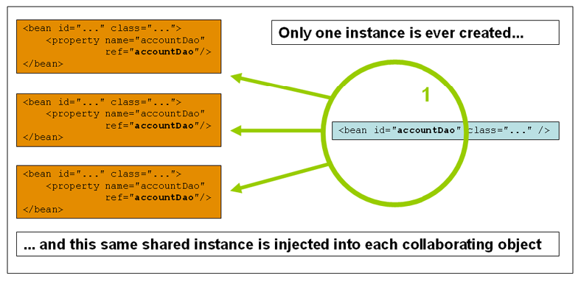
Singleton

Slide 56
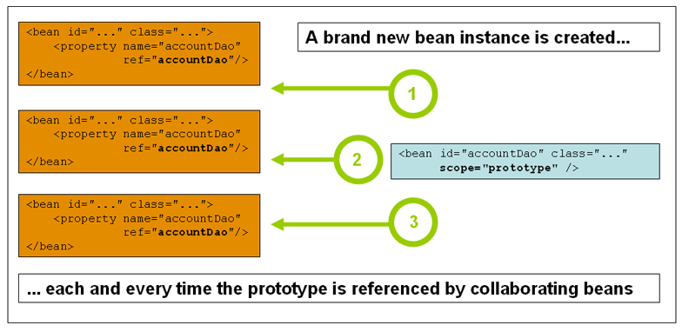
Prototype Scope

Slide 57
Wiring Collections
<list>
  Wiring a list of values, allowing duplicates
<set>
  Wiring a set of values, ensuring no duplicates
<map>
  Wiring a collection of name-value pairs where name and value can be of any type
<props>
  Wiring a collection of name-value pairs where the name and value are both Strings

Slide 58
Wiring Collections
  @Data
  @NoArgsConstructor
  @AllArgsConstructor
  @ToString
  @Component(value="first")
  public class FoodItem {
  private long itemCode;
  private String itemName;
  private String itemType;
  private String category;
  private double unitPrice;
  }

Slide 59
Wiring Collections
  @Data
  @NoArgsConstructor
  @AllArgsConstructor
  @ToString
  public class Catalog {
  private long code;
  private String catalogName;
  private Address address;
  @Autowired(required=false)
  private List<FoodItem> itemList;
  }

Slide 60
Wiring Collection
  public class Catalog {
  private long code;
  private String catalogName;
  private Address address;
  @Autowired(required=false)
  private List<FoodItem> itemList;
  public Catalog(long code, String catalogName, Address address) {
    super();
    this.code = code;
    this.catalogName = catalogName;
    this.address = address;
  }
  }

Slide 61
Configuration File
  @Configuration
  public class CustomConfig {
  @Bean()
  public Catalog catalog() {
  return new Catalog(101,"Classical Menu",address());
  }
  @Bean
  public Address address() {
  return new Address("Gandhi Street","behru Nagar","chennai",600040);
  }

Slide 62
Configuration File
  @Bean
  @Order(2)
  public FoodItem italian() {
  return new FoodItem(103,"Pasta","lunch","italian",150.00);
  }
  @Bean
  @Order(1)
  public FoodItem mexican() {
  return new FoodItem(105,"panCake","breakfast","mexican",140);
  }
  }

Slide 63
Composing Java Based Configuration
Spring’s Java-based configuration feature lets you compose annotations, which can reduce the complexity of your configuration.
Useful in case scanning, a configuration classes as entry points
@Import
  Loading @Bean definitions from another configuration class
  @Configuration
  public class ConfigA {
  @Bean public A a() {
  return new A();
  } }

Slide 64
Configurations
  @Configuration
  @Import(ConfigA.class)
  public class ConfigB {
  @Bean public B b() {
  return new B();
  }
  }

Slide 65
Method Injection
Solution to the problem of injecting different scoped beans.
It is a kind of injection used for dynamically overriding a class and its abstract methods to create instances every time the bean is injected.
An advanced form of dependency injection and should be used in very special cases as it involves byte-code manipulation by Spring.
Singletons are instantiated at context creation, it changes the way Spring uses the CGILIB to change the Bytecode.

Slide 66
Method Injection
A Singleton Bean “A” which has a dependency of non singleton (prototype) bean “B” .
Container will create only one instance of bean “A” thus will have only one opportunity to inject the prototype bean “B” in it and every time you makes a call to get bean B from bean A , always the same bean will be returned.

Slide 67
Using Method Injection
We need to create an abstract method in Singleton class with return type as Prototype Bean .and Prototype bean class will declare one method which returns the current instance (this).
Method Injection is the approach in which method name is configured which will be used to resolve the dependency.

Slide 68
Method Injection
DiscountService
getDiscount()
Discount Notification
Performs Method Injection
on getDiscount()
SPRING FRAMEWORK
Main Method
Loads bean Using

Slide 69
Method Injection Example
  @Scope("singleton")
  public abstract class DiscountService {
  @Lookup
  protected abstract DiscountNotification getDiscount(String month);
  public void print() {
  System.out.println("Hello");
  }
  }

Slide 70
Method Injection Example
  @Scope("prototype" )
  public class DiscountNotification {
  private String month;
  public DiscountNotification(String month) {
  super();
  this.month = month;
  }
  public double showDiscount() {
  if(month.equals("april")) {
  return 0.50;
  } else {
  return 0.10;
  }
  }
  }

Slide 71
Method Injection Example
  @Bean
  public DiscountService discountService() {
  return new DiscountService() {
  @Override
  protected DiscountNotification getDiscount(String month) {
  return new DiscountNotification(month);
  }
  };
  }

Slide 72
Test the Scopes
  DiscountService service = ctx.getBean(DiscountService.class);
  DiscountNotification protoBean;
  protoBean = service.getDiscount("april");
  log.info("Hash Code :="+protoBean.hashCode());
  log.info("Discount :="+protoBean.showDiscount());
  protoBean = service.getDiscount("may");
  log.info("Hash Code :="+protoBean.hashCode());
  log.info("Discount :="+protoBean.showDiscount());

Slide 73
Life Cycle Methods Annotation Driven
  @Component
  public class Annot_Invoice {
  @PostConstruct
  public void myInit()
  {
  System.out.println("Inside init Method");
  }
  @PreDestroy
  public void myDestroy()
  {
  System.out.println("Inside Destroy Method");
  }
  }

Slide 74
Life Cycle Java Based Configuration
  public class Employee {
  public void start() { // Initialization Work }
  public void close() {
  // Destruction Work
  }
  }
  @Bean(initMethod="start",destroyMethod="close")
  public Employee myBean() {
  return new Employee(employee_Id,employee_Name);
  }

Slide 75
Life Cycle Methods
  ublic class DeliveryExecutive {
  @Autowired
  private Environment env;
  public DeliveryExecutive{
  env.getActiveProfiles() -> Will throw Null Pointer Exception
  }
  public void init() {
  log.info("Init Method called");
  log.info(env.getActiveProfiles().toString());
  System.out.println(Arrays.asList(env.getDefaultProfiles().toString()));
  }
  }

Slide 76
PROFILES

Slide 77
Profiles
A way to segregate parts of application configuration and make it only available in certain environments.
Used to load different types or sets of classes
Spring profiles are Created with @Profile annotation.
  attach a profile name to an @Configuration annotation.
Profile-specific variants of can be set in the application.properties
By Setting a property value
  spring.profiles.active=test1

Slide 78
Profiles -Example
  public class MyDataSource {
  private String driverClass;
  private String jdbcURL;
  return jdbcURL;
  }

Slide 79
Profiles-Cont
  @Configuration
  @Profile("deve")
  public class DevelopmentDataBase {
  @Bean
  public MyDataSource dataBase() {
  return new MyDataSource("OracleDriver", "localHost");
  }
  }

Slide 80
Profiles- Contd
  @Configuration
  @Profile("prod")
  public class ProductionDataBase {
  @Bean
  public MyDataSource dataBase() {
  return new MyDataSource("SqlDriver", "192.100.10");
  }
  }
Application.properties
  spring.profiles.active=prod
  server.port=4040

Slide 81
Profiles Application
  public static void main(String[] args) {
  ApplicationContext ctx=SpringApplication.run(ProfilesExampleApplication.class, args);
  MyDataSource ds = ctx.getBean(MyDataSource.class);
  System.out.println(ds);
  }

Slide 82
Color-coded output
ANSI supported terminal can have color output
spring.output.ansi.enabled to override the auto detection.

Slide 83
SPRING AOP

Slide 84
Aspect Oriented Programming
It’s a Programming technique that promotes separation of concerns within a software system
It is not a replacement for Object Oriented Programming.
AOP is another way of organizing Program Structure
An aspect of a program which affect (crosscut) other concerns.
Cross Cutting Concerns
  Transaction management
  Security
  Auditing
  Event handling

Slide 85
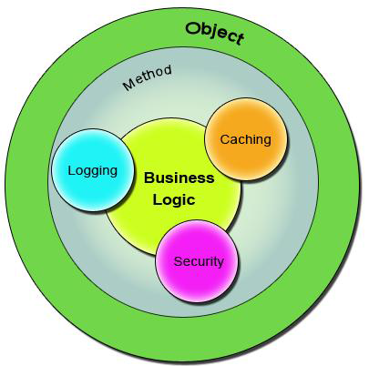
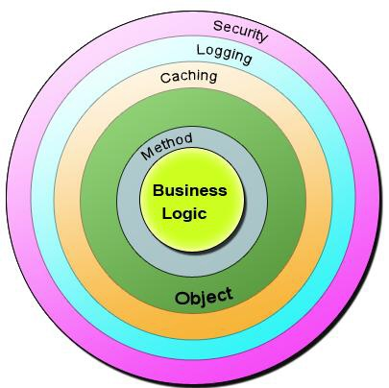
Bean in Spring container

Slide 86
Sample Code
  public class Account {
  public long deposit(long depositAmount){
  newAmount = existingAccount + depositAccount;
  currentAmount = newAmount;
  return currentAmount;
  }
  public long withdraw(long withdrawalAmount){
  if (withdrawalAmount <= currentAmount){
  currentAmount = currentAmount – withdrawalAmount;
  }
  return currentAmount;
  }
  }

Slide 87
The Challenge ?
Requirment -1
  Add security to the Account class - only users with BankAdmin privilege is allowed to do the operations.
Requirement-2
  Account class is to provide some kind of Logging
Requirement-3
Account class need to provide Transaction Management Facility.
New requirements forces the methods and the logic to change a lot which is against the Software Design.
The code has to undergo the Software Development Lifecycle of Development, Testing, Bug Fixing, Development, Testing,

Slide 88
The Solution !
public void deposit(){
// Transaction Management
// Logging
// Checking for the Privileged User
// Actual Deposit Logic comes here
}
public void withdraw(){
// Transaction Management
// Logging
// Checking for the Privileged User
// Actual Withdraw Logic comes here
}
The above logic that cross-cuts or overlaps the existing business logic as Concerns or Cross-Cutting Concerns.
These cross-cutting concerns from the application code can be modularized as different entities.

Slide 89
AOP Terminologies-Aspect
An Aspect is a functionality or a feature that cross-cuts over objects.
Logging and Transaction Management are the aspects.
public void businessOperation(BusinessData data)
{
// Logging logger.info("Business Method Called");
// Transaction Management Begin transaction.begin();
// Do the original business operation here transaction.end();
}

Slide 90
AOP Terminologies-Joint Point
Join Points defines the various Execution Points where an Aspect can be applied.
In Spring AOP, a join point always represents a method execution.
  public void someBusinessOperation(BusinessData data){
  //Method Start - > Possible aspect code here like logging.
  try{
  // Original Business Logic here.
  } catch(Exception exception) {
  // Exception -> Aspect code here when some exception is raised. }
  finally{
  // Finally -> Even possible to have aspect code at this point too.
  }
  // Method End -> Aspect code here in the end of a method.
  }

Slide 91
AOP Terminologies-JoinPoints
Points in the execution of the program
  Start of the Method,
  End of the Method,
  Exception Block,
  Finally Block
In these points an Aspect can be made to execute.
These Execution Points embedding Aspects are called Join Points.
An Aspect need not be applied to all the possible Join Points.

Slide 92
AOP Terminologies-Pointcut
Join Points refer to the Logical Points wherein a particular Aspect or a Set of Aspects can be applied.
A Pointcut or a Pointcut Definition will exactly tell on which Join Points the Aspects will be applied.
pointcut method_start_end_pointcut(){
// This point cut applies the aspects, logging and transaction, before the beginning and the end of the method.
}
pointcut catch_and_finally_pointcut(){
// This point cut applies the aspects, logging and transaction, in the catch block (whenever an exception raises) and the finally block.
}

Slide 93
Advice
Advice is the code that implements the Aspect.
Aspect defines the functionality in a more abstract manner.
Advice provides a Concrete code Implementation for the Aspect.
Creating Advices in Spring
Spring provides support only for Method Aspect and not for Field Aspect

Slide 94
Advices
  Before advice :@Before
  Executes before a join point,
  Does not have the ability to prevent execution flow proceeding to the join point (unless it throws an exception).
After returning advice : @AfterReturning
  Executed after a join point completes normally:
After throwing advice : @AfterThrowing
  Executed if a method exits by throwing an exception.
  After advice :@After
  Executed when normal or exceptional return by which a join point exits
  Around advice : @Around
  Advice that surrounds a join point

Slide 95

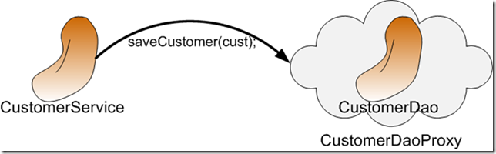
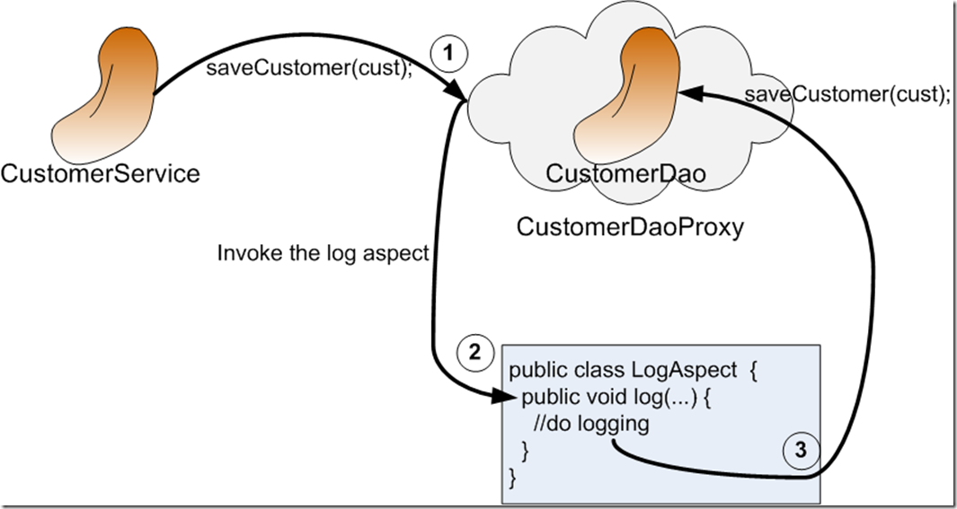
AOP Proxy Mechanism

Slide 96
Using Auto Proxy
Can create proxies automatically for selected bean definitions.
Built on Spring "bean post processor" infrastructure,
Need for ProxyFactoryBean is eliminated
  @Configuration
  @EnableAspectJAutoProxy
  public class AppConfig { }

Slide 97
Proxy Creating
Can control the type of proxy that gets created
proxyTargetClass()
  Enables CGLIB-style 'subclass' proxies as opposed to the default interface-based JDK proxy approach.
@Configuration @EnableAspectJAutoProxy(proxyTargetClass=true)
public class AppConfig { // ... }
@EnableAspectJAutoProxy(proxyTargetClass=false)
  Indicates that JDK dynamic proxy will be created to support aspect execution on the object.
  And therefore as this type of proxy requires a class to implement an interface your MessagePrinter must implement some interface which declares method getMessage.
@EnableAspectJAutoProxy(proxyTargetClass=true)
  On the opposite instruct to use CGLIB proxy which is able to create proxy for a class without an interface.

Slide 98
Format of an execution expression
execution(
  modifiers-pattern
  returning-type-pattern
  declaring-type-pattern
  name-pattern(param-pattern)
  throws-pattern
)
execution(public * *(..)) or within(com.xyz.service.*)
execution – for matching method execution join points
within – execution of a method declared within a matching type

Slide 99
Declaring a pointcut
execution(public * *(..))
the execution of any public method:
execution(* set*(..)) -
the execution of any methods beginning with "set":
execution(* com.xyz.service.AccountService.*(..))
the execution of any method defined by the named interface:
execution(* com.xyz.service.*.*(..))
the execution of any method defined in the service package:
within(com.xyz.service.*)
any join point within the service package:

Slide 100
Currency Converter
  public class CurrencyConverter implements MyInterface {
  public double dollorToRupess(double dlrAmt) {
  return dlrAmt * 49.0d;
  }
  public double dollorToEuro(String dlrAmt)
  {
  double val =Double.parseDouble(dlrAmt);
  return val * 70.00d;
  }

Slide 101
@Around Advice
@Aspect
public class MyAroundAdvice {
@Around("execution(* com.training.CurrencyConverter.*(..))")
public Object aroundLog(ProceedingJoinPoint pjp) throws Throwable {
System.out.println("Called Before Method Invocation");
Object ret =pjp.proceed();
System.out.println("I am Around ");
return ret;
}
}

Slide 102
After returning advice
  @Aspect
  public class BankAspect {
  @AfterReturning( pointcut="execution(* get*(..))",
  returning="retVal")
  public void logAfter(JoinPoint joinPoint, Object retVal) {
  //to do something
  }
  }

Slide 103
Before advice
  @Aspect
  public class BankAspect {
  @Pointcut("execution(public * * (..))")
  public void anyPublicMethod() {}
  @Before("anyPublicMethod()")
  public void logBefore(JoinPoint joinPoint) {
  //to do something
  }
  }

Slide 104
After throwing advice
  @Aspect
  public class BankAspect {
  @AfterThrowing(
  pointcut = "execution(* bank..*ServiceImpl.add*(..))",
  throwing = "exception")
  public void afterThrowing(Exception exception) {
  //to do something
  }
  }

Slide 105
Aspect and advice ordering
order of advice in the same aspect
  before
  around
  after finally
  after returning or after throwing
Spring interface for ordering aspects
  org.springframework.core.Ordered
  Spring annotation
    org.springframework.core.annotation.Order

Slide 106
Java Based Configuration
  @Configuration
  @EnableAspectJAutoProxy
  public class AOPJavaConfig {
  @Bean
  public CurrencyConverter convService() {
  return new CurrencyConverter();
  }
  @Bean
  public MyAroundAdvice myAspect() {
  return new MyAroundAdvice();
  }
  }

Slide 107
Application
  public static void main(String[] args) {
  AnnotationConfigApplicationContext ctx3=new AnnotationConfigApplicationContext(AOPJavaConfig.class);
  Converter res=(Converter)ctx3.getBean("convService");
  System.out.println(res.dollorToEuro(100));
  }
  }

Slide 108
Creating Custom Advice
  package com.example.demo.utils;
  import static java.lang.annotation.ElementType.METHOD;
  import static java.lang.annotation.RetentionPolicy.RUNTIME;
  import java.lang.annotation.Retention;
  import java.lang.annotation.Target;
  @Retention(RUNTIME)
  @Target(METHOD)
  public @interface LogExecutionTime {
  }

Slide 109
Creating Aspect
  A class, annotated with @Aspect:
  @Aspect
  @Component
  public class ExampleAspect {
  }
  @Component needs to be a Spring bean to be detected.
  A class where the logic of custom annotation to inject.

Slide 110
Creating a Aspect
  @Aspect
  @Component
  public class CustomAdvice {
  @Around("@annotation(LogExecutionTime)")
  public Object logExecutionTime(ProceedingJoinPoint joinPoint) throws Throwable {
  long start = System.currentTimeMillis();
  Object proceed = joinPoint.proceed();
  long executionTime = System.currentTimeMillis() - start;
  System.out.println(joinPoint.getSignature() + " executed in " + executionTime + "ms");
  return proceed;
  }
  }

Slide 111
Adding Custom Advices
  public class ConverterService {
  @LogExecutionTime
  public double dollorToRupees(double dlrAmount) throws InterruptedException {
  Thread.sleep(200);
  return dlrAmount * 0.65;
  }
  }

Slide 112
Configuration Class
  package com.example.demo.config;
  import org.springframework.context.annotation.Bean;
  import org.springframework.context.annotation.Configuration;
  import com.example.demo.service.ConverterService;
  @Configuration
  public class AppConfiguration {
  @Bean
  public ConverterService converterService() {
  return new ConverterService();
  }
  }

