Slide 1


HACKOVERFLOW-2022
Team Description
Team Name: Ideal Bits
Team leader: Ujjwal Raj
Team members:
Shivam Upadhyay
Sushil Kumar
Atul Kumar

Slide 2
Problem statement During the pandemic time of corona. People who were corona positive suffered a lot in finding hospitals. People wasted their time in visiting different hospitals in hope of getting vacant beds or waited in same hospital till they get their turn. There were some hospitals where beds were available but due to lack of information people were not able to reach out there. The problem is not only faced during pandemic but also in normal days. We can see that when we visit some hospitals or doctors. People waits from morning till evening for their turn to come for appointment.
Solution
We are developing a website HOPEFINDER where people can find nearby hospitals by sharing their location and we are using an GOOGLE MAP API through which user can find location of nearby hospital and can go to hospital by map navigation.
User can know availability of doctors and beds, status of hospital whether closed or open. We will use hospital database through which user can get current status of availability of beds and doctors. User can register for booking an appointment online using website so that they don’t have to wait longer in queue. Registered user data are stored in database using mysql. We will developed chat bot using javascript library which can be used by user for quick assistance.

Slide 3
Workflow
HOME PAGE
HOSPITALS
CHAT BOT
DOCTORS
JAVASCRIPT LIBRARY
CHAT WITH DOCTOR
HOSPITAL DETAILS
CHECK AVAILABILITY
BOOK APPOINTMENT
MYSQL
DATABASE
ICU BEDS
BLOOD BANK
DOCTORS

Slide 4
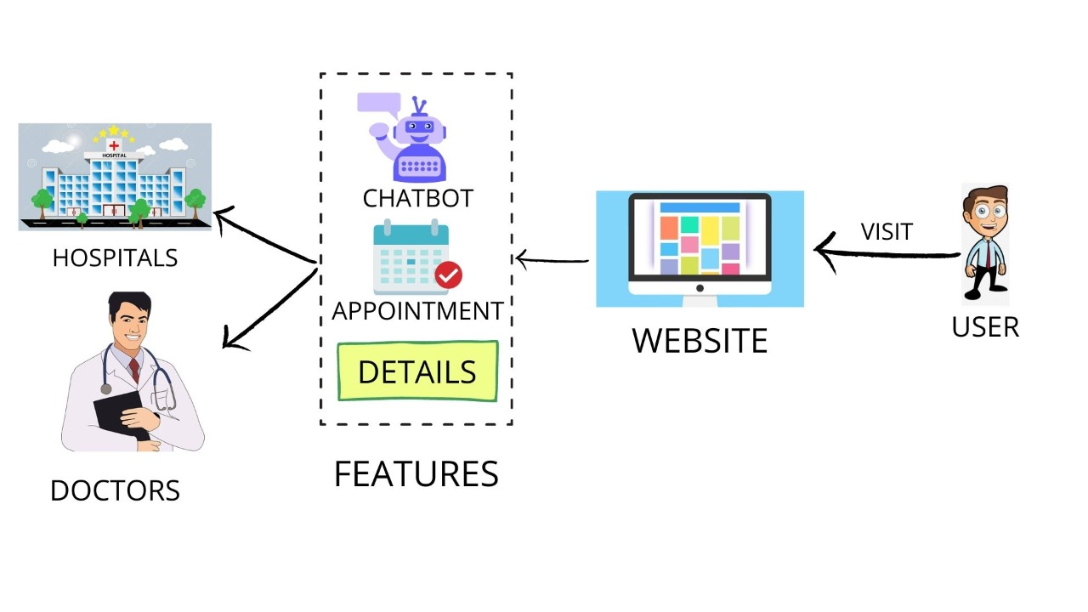

Slide 5
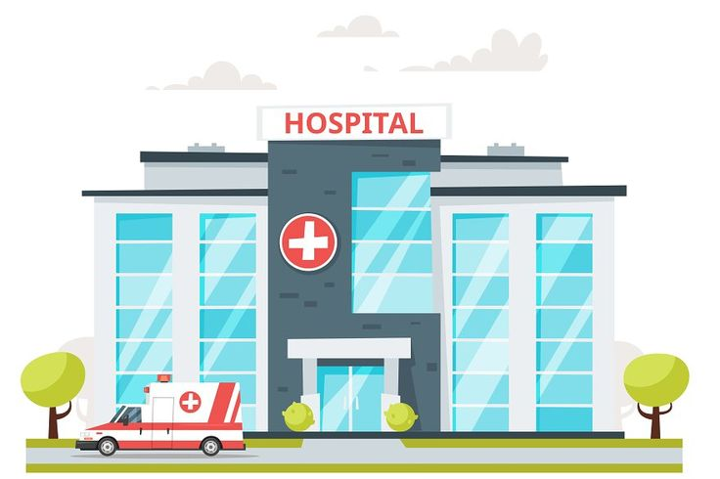
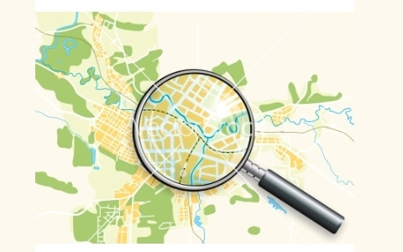
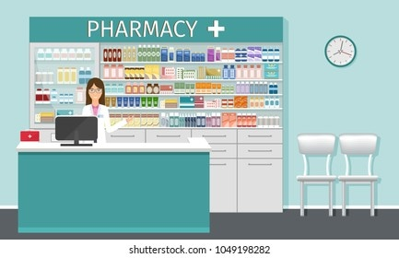
FINDS HOSPITALS AND PHARMACY
AND NAVIGATE YOU TO REACH THERE

Slide 6

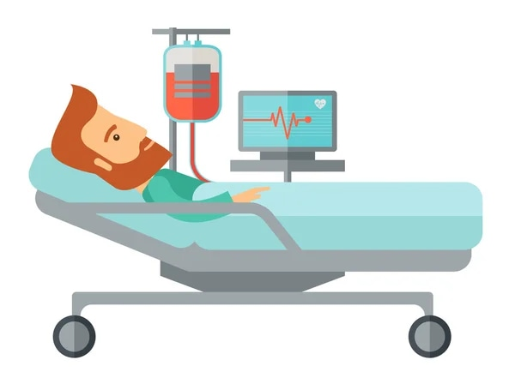
SHOWS YOU THE AVAILABILITY OF DOCTORS AND BEDS

Slide 7
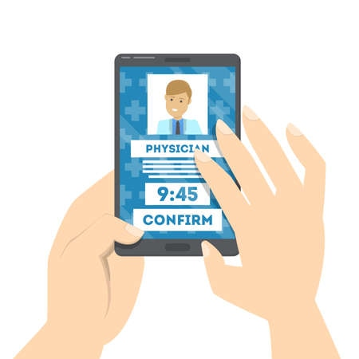
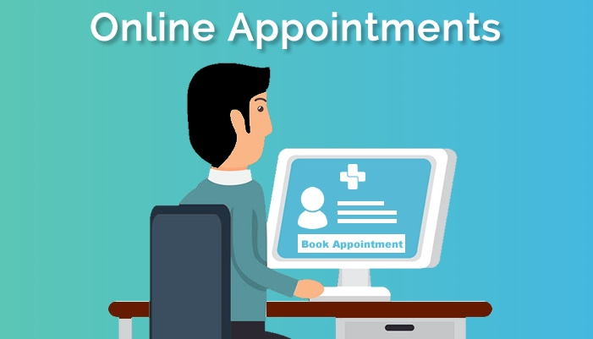
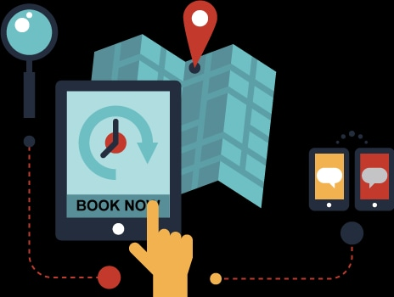
USER CAN BOOK AN APPOINTMENT ONLINE OR CAN CHAT WITH DOCTORS

Slide 8

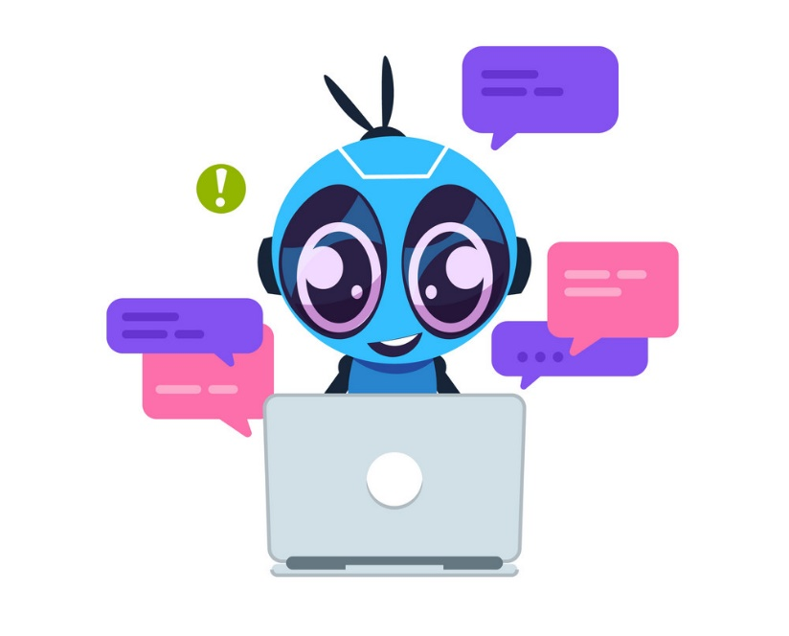

CHAT BOT FOR QUICK ASSISTANCE

Slide 9
Conclusion and Future scope
TAKE LESS TIME FOR PERSON TO SEARCH FOR CORRECT DOCTORS OR HOSPITALS WHICH WILL BE HELPFUL IN CASE OF EMERGENCY.
WILL BE ABLE TO COPE UP WITH THE FUTURE PANDEMIC SITUATION.
ONE TO ONE ONLINE INTERACTION WITH DOCTORS MAY REDUCE PHYSICAL MEETINGS IN CASE OF LOW LEVEL PROBLEMS.
BOOK AN APPOINTMENT ONLINE WHICH WILL SAVE A LOT OF TIME.

Slide 10
References
GitHub
StackOverflow
Youtube
Bootstrap

Slide 11
THANK YOU

