Slide 1
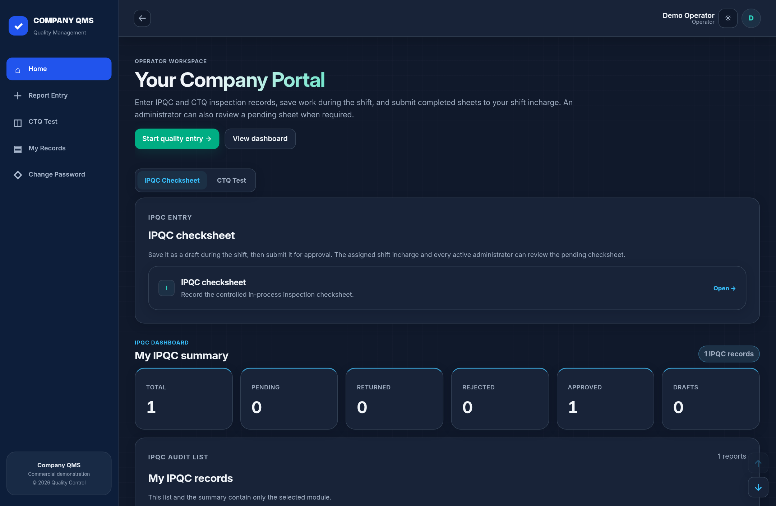
COMPANY QMS / DIGITAL CHECKSHEETS
Your checksheet. Upgraded.
From paper entries
to quality records
you can trace.
Enter clearly.
Review confidently.
IPQC + CTQ • Guided entry • Approvals • PDF reports
Full original forms. Generic branding. Actual demo app screenshots.
01

Slide 2
COMPANY QMS / DIGITAL CHECKSHEETS
Same checksheet. Less manual work.
ENTRY
Handwritten entries
Structured fields + required checks
CALCULATIONS
Manual working
Automatic CTQ averages and results
REVIEW
Physical handover
Assigned reviewer + visible status
RECORDS
Search through files
Filter reports + download PDFs
Full original forms. Generic branding. Actual demo app screenshots.
02

Slide 3
COMPANY QMS / DIGITAL CHECKSHEETS
Simple flow. Clear accountability.
OPERATOR
SHIFT INCHARGE
SAVED RECORD
Fill checksheet
Save draft > Submit
→
Verify readings
Approve or return
→
Approved checksheet
PDF + review history
RETURNED? Operator corrects the entry and resubmits.
ADMIN: Monitors all records and can also review pending reports.
Full original forms. Generic branding. Actual demo app screenshots.
03
Notes:
Shift incharge is the assigned primary reviewer. Admin can approve, approve with remarks, return or reject any pending report. Approved and rejected records are locked. Account management is a separate Super User responsibility.

Slide 4
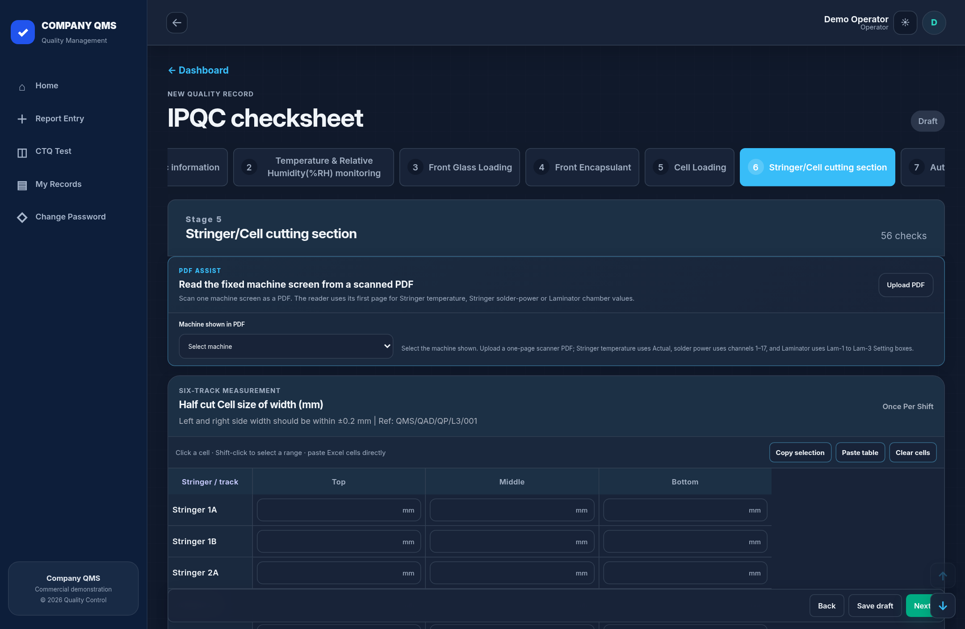
COMPANY QMS / DIGITAL CHECKSHEETS
Guided entry. Full original IPQC fields.
Familiar coverage
36 stages
166 parameters
Complete records
860 observation fields
Required before submission
Work at your pace
Save drafts
Continue during the shift
Full original forms. Generic branding. Actual demo app screenshots.
04
Notes:
IPQC definitions match original QMS except generic company identifiers. Screenshot shows the original Stringer parameter matrices. Screenshot uses sample data, not production records.

Slide 5
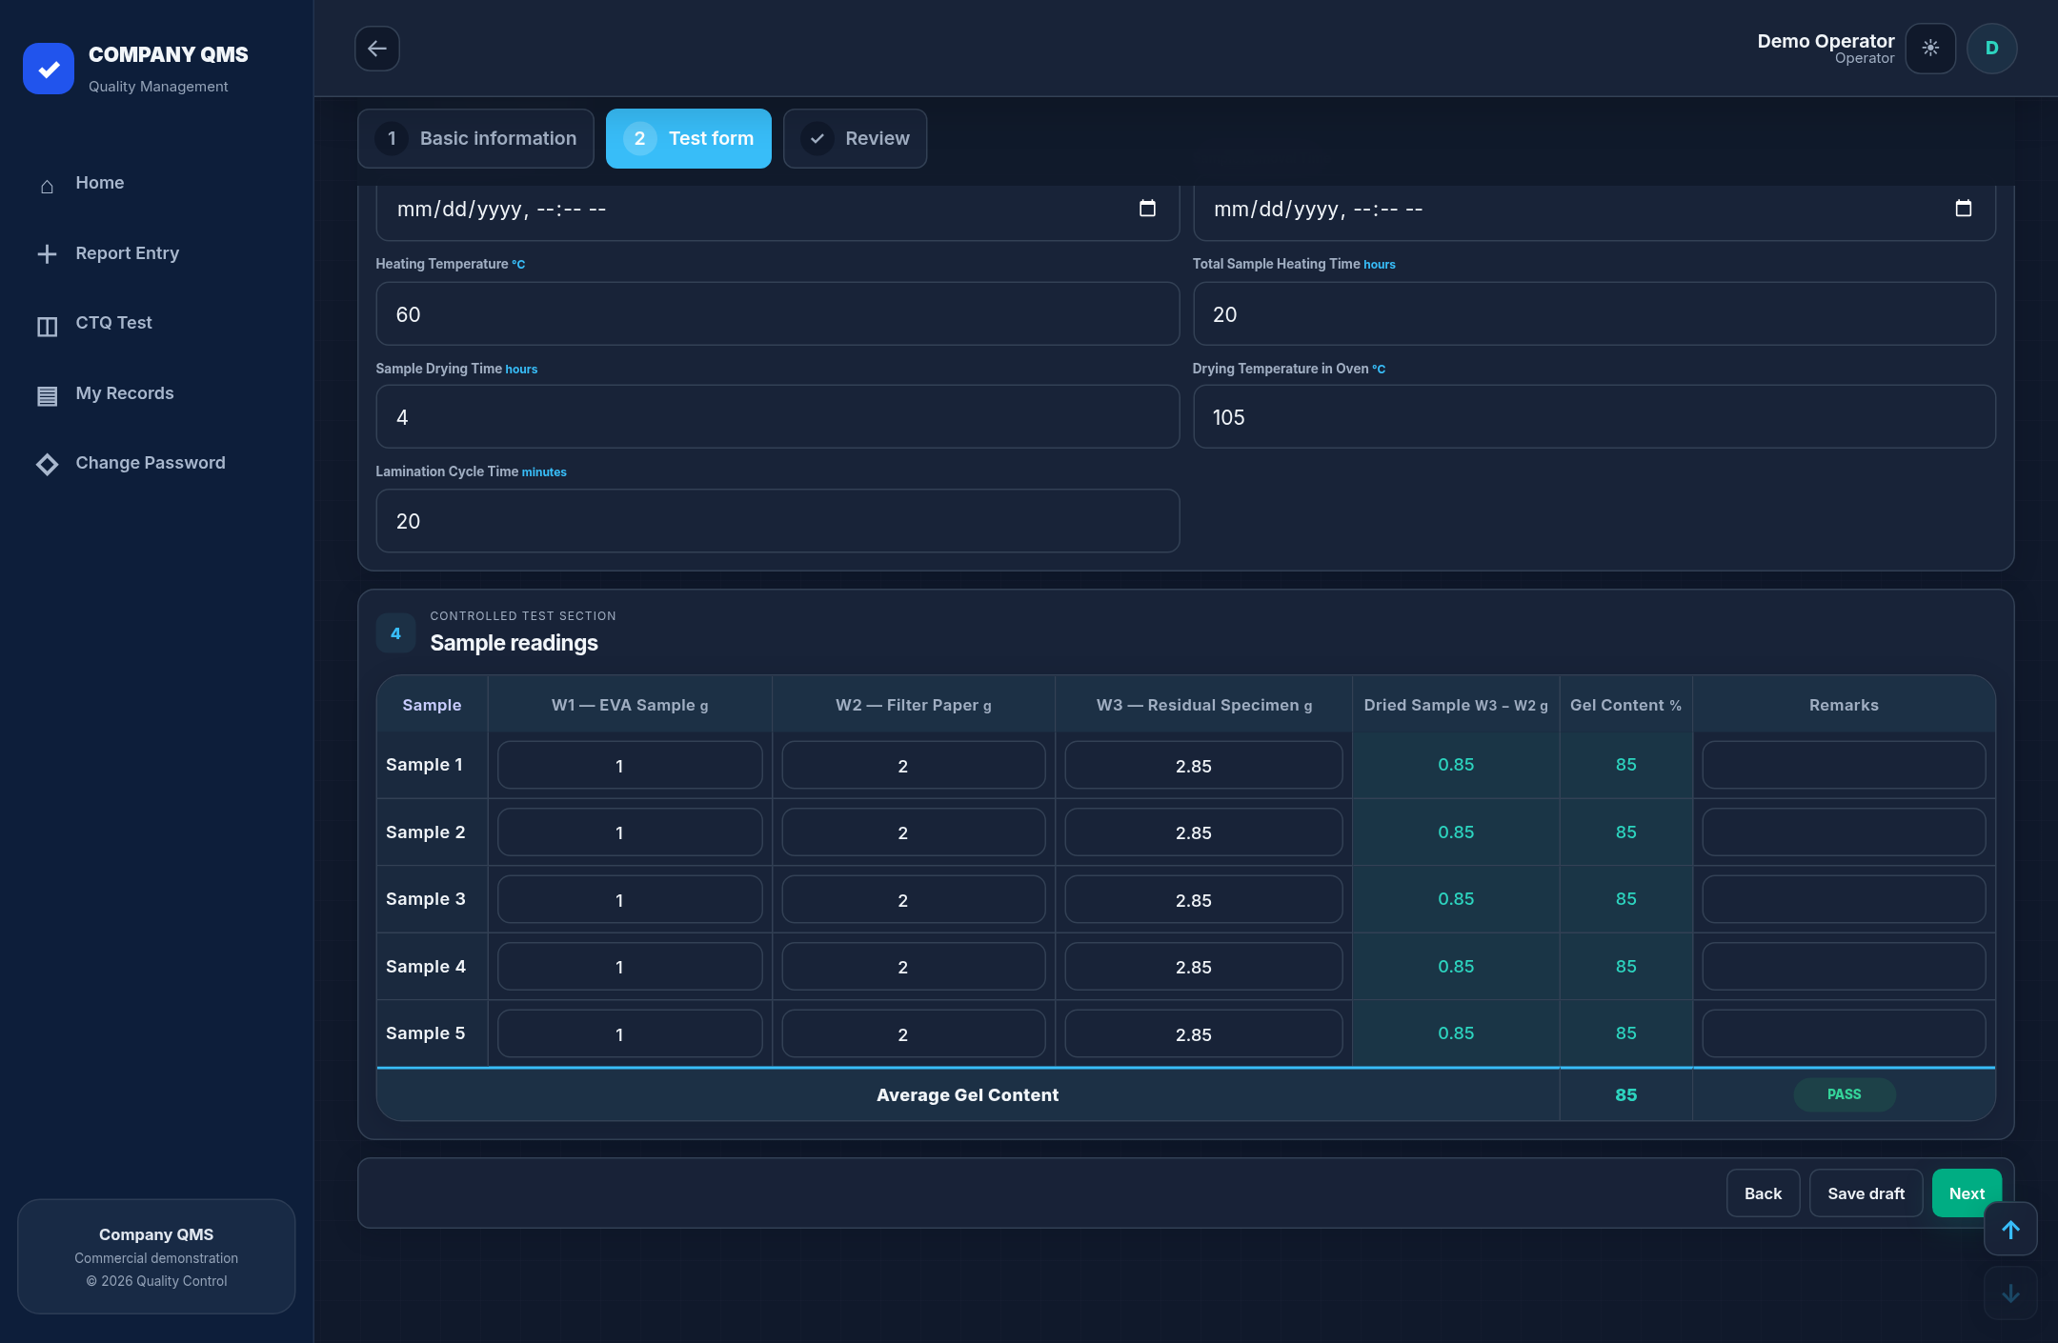
COMPANY QMS / DIGITAL CHECKSHEETS
Readings in. Calculations done.
Automatic results
Sample values become
calculated CTQ results.
Full test coverage
Gel, Ribbon, Adhesion
and Busbar Peel.
Visible assessment
Review averages and
calculated PASS / FAIL.
Full original forms. Generic branding. Actual demo app screenshots.
05
Notes:
Screenshot: five Gel sample readings. W1=1 g, W2=2 g, W3=2.85 g, calculated gel=85% and average=85%. This screenshot demonstrates calculations; it is not a submitted complete Gel record. Screenshot uses sample data, not production records.

Slide 6
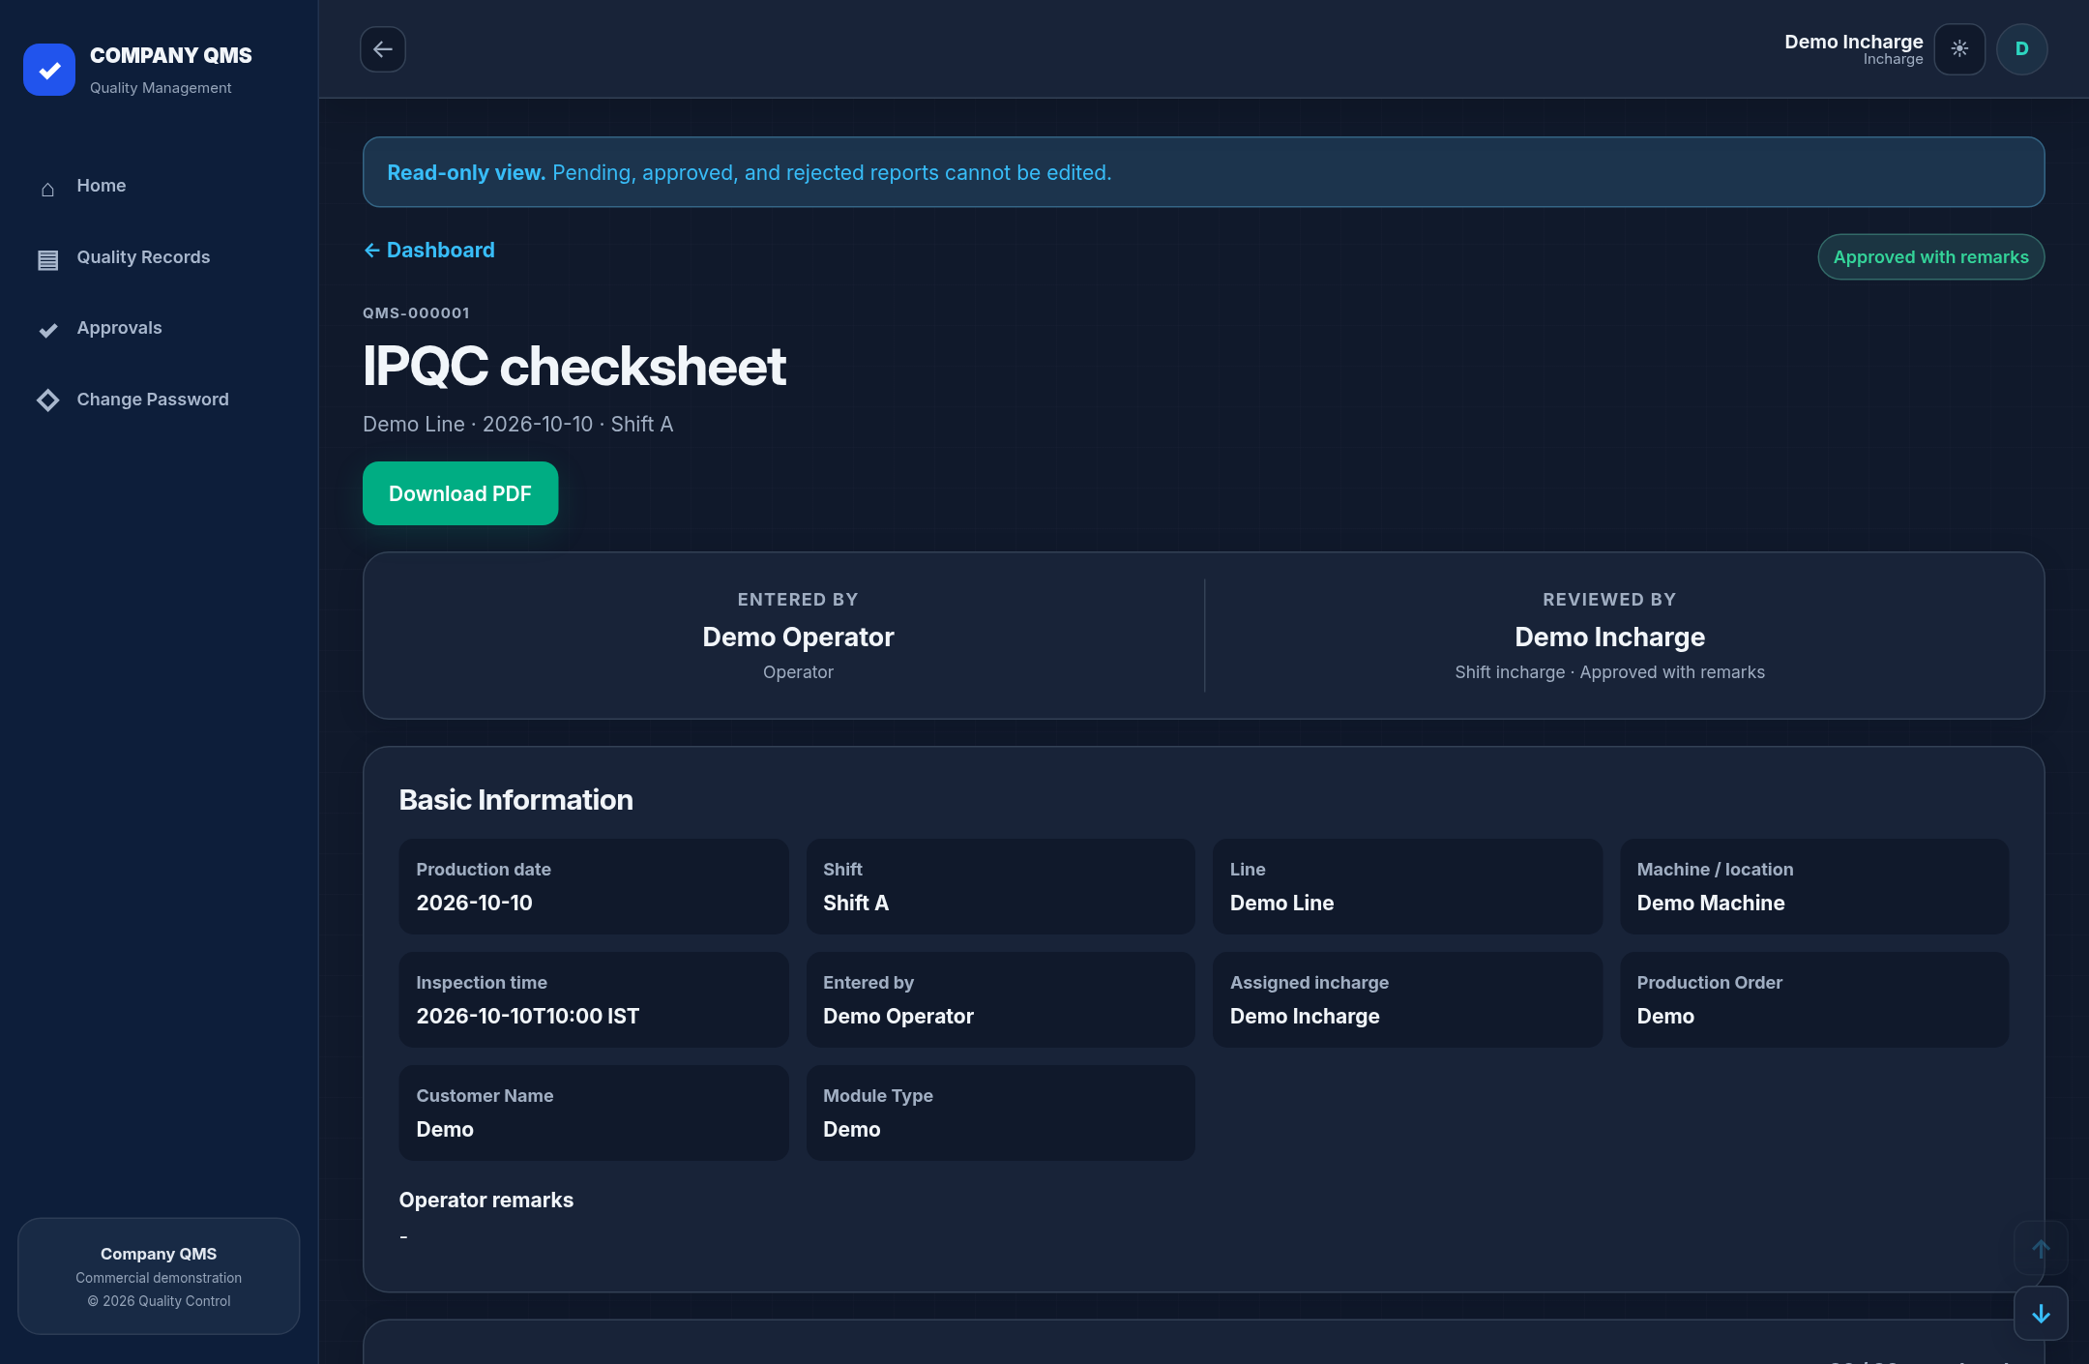
COMPANY QMS / DIGITAL CHECKSHEETS
Review once. Keep the history.
Clear responsibility
Assigned incharge
verifies the report.
Controlled correction
Return incomplete work
for operator correction.
Traceable output
Review history and
downloadable PDF.
Full original forms. Generic branding. Actual demo app screenshots.
06
Notes:
Screenshot shows a submitted IPQC record approved with remarks through the current application workflow. Approved/rejected records are locked. Screenshot uses sample data, not production records.

Slide 7
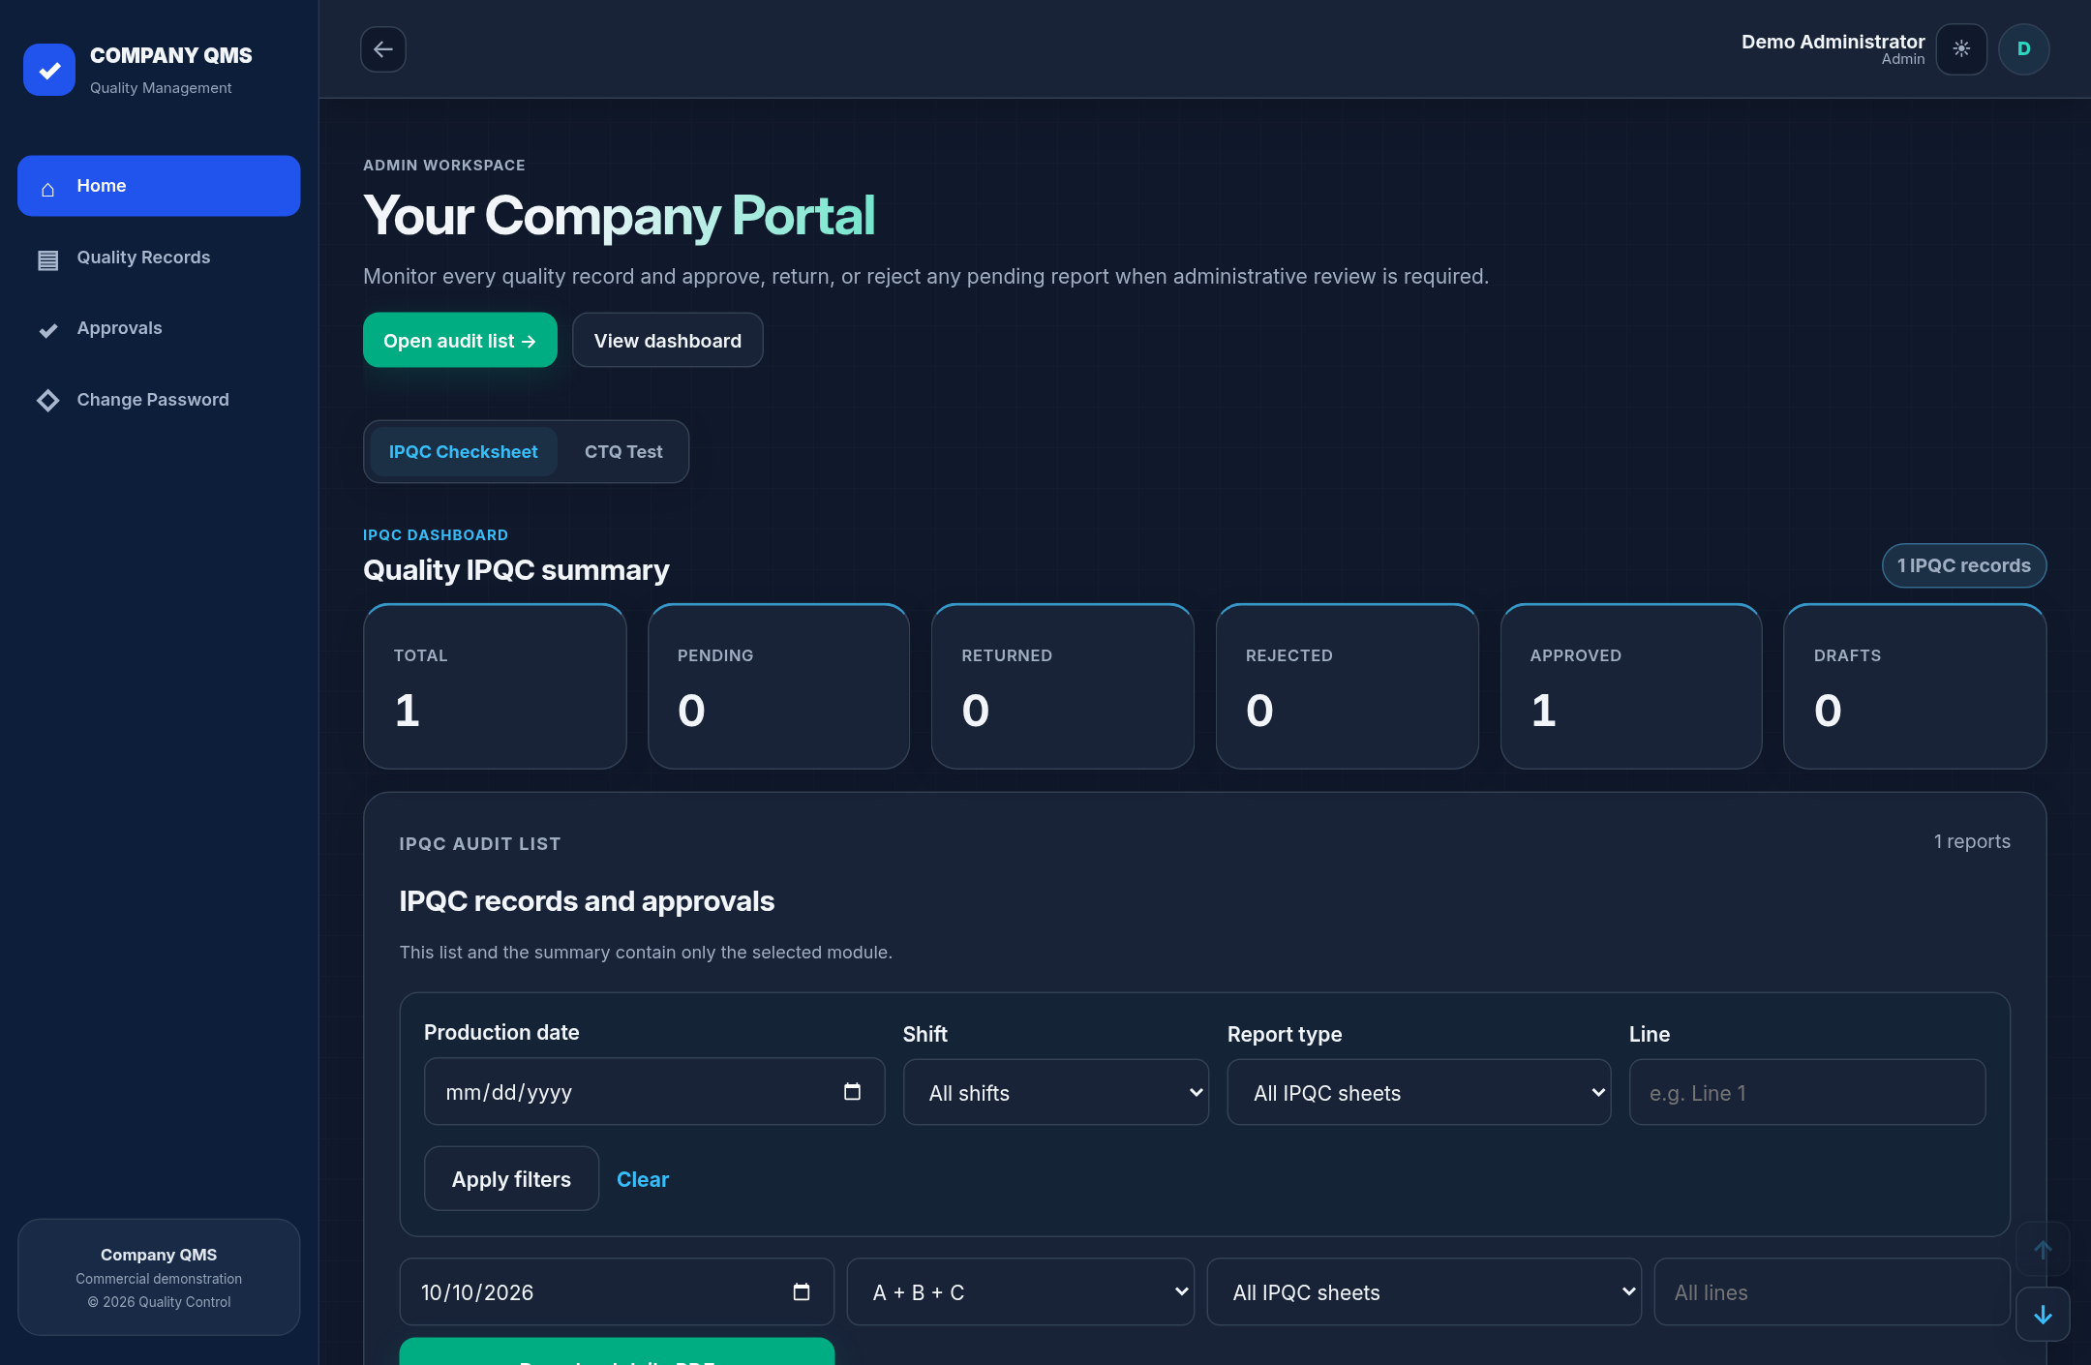
COMPANY QMS / DIGITAL CHECKSHEETS
Visibility beyond the checksheet.
See report status
Pending, returned,
approved and drafts.
Find records
Filter by date, shift,
line and report type.
Admin oversight
Monitor all reports;
review pending records.
Full original forms. Generic branding. Actual demo app screenshots.
07
Notes:
Screenshot uses the administrator account and an approved sample IPQC record. Admin has report oversight; separate Super User handles account management. Screenshot uses sample data, not production records.

Slide 8
COMPANY QMS / DIGITAL CHECKSHEETS
See the difference on your own line.
One line. One shift. One focused pilot.
TRY
MEASURE
DECIDE
Entry > Review > PDF
Use your familiar checksheet.
Completeness, approval time
and record retrieval time.
Collect team feedback.
Expand after pilot review.
Make quality records easier to enter, review and retrieve.
Full original forms. Generic branding. Actual demo app screenshots.
08
Notes:
Benefits are based on app capabilities. Measure actual time savings, error rates and ROI in a company pilot. No unsupported best-in-market or guaranteed savings claims.

