Slide 1
Polymers – Bouncy Balls and Spherification
Nathan Ellebracht
Week of April 22, 2013
(adapted from Michael Song)

Slide 2
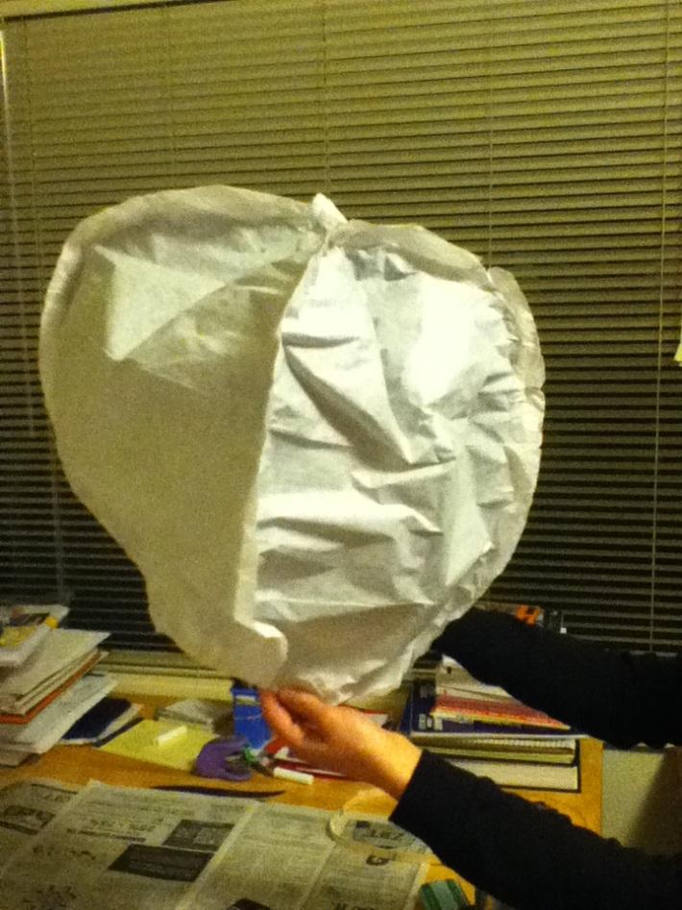
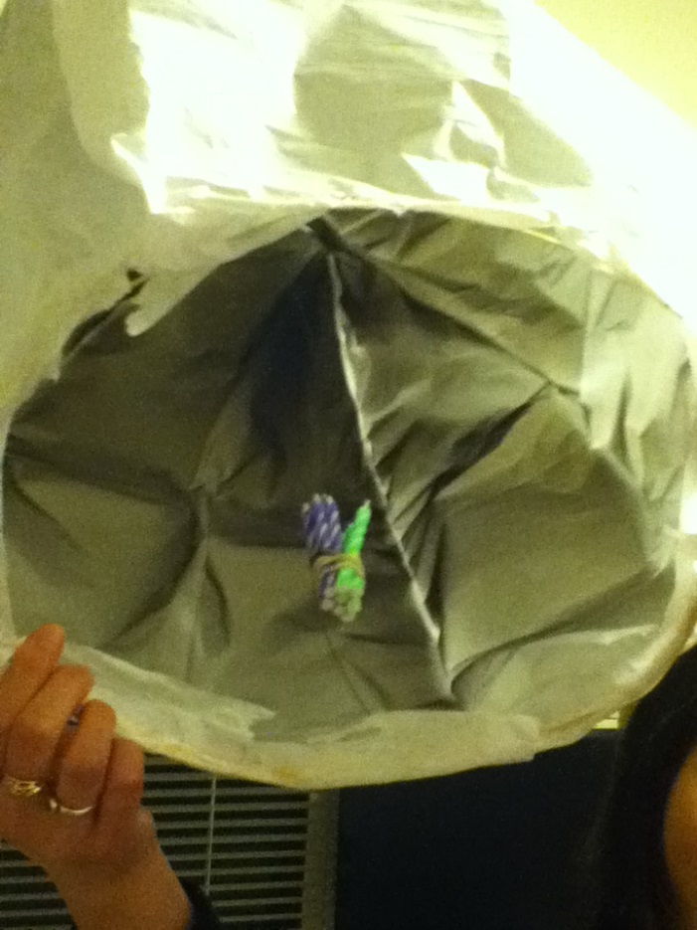
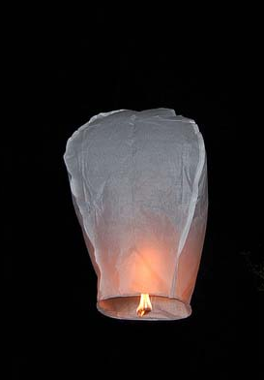
Sky Lanterns – not quite
“theory”
Lovingly constructed!
… no takeoff ☹

Slide 3
Brief Agenda/Outline
Introduction to polymers (~10 min)
Group discussion with examples
Spherification (30+ minutes)
Explanation, module, discussion
Borax bouncy balls (20-30 minutes)
Module, discussion, “experimentation”
Discussion (10+ minutes)
Recap, go over examples again

Slide 4
Teaching Goals
In reality, polymers are rather complicated…
Goals:
Basic idea of what polymers are
Repeating subunits: “monomers”, analogy with paper clip chain
Examples of polymers in everyday life
Plastic bags, rubber, nylon, teflon, styrofoam, tupperware

Slide 5
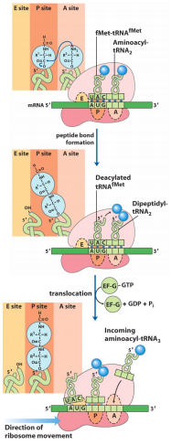
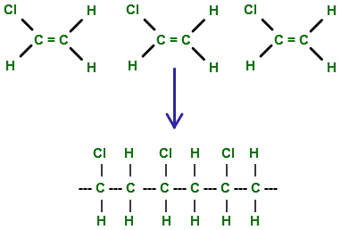
Polymer Overview
Macromolecules consisting of repeating subunits or monomers
Natural, biological, and synthetic examples
Polyvinyl chloride
Polypeptide synthesis

Slide 6
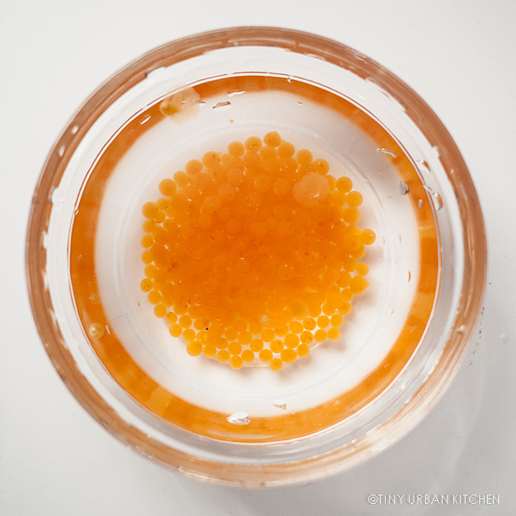
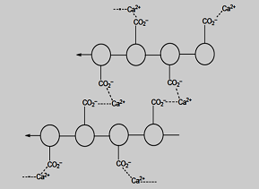
Module 1: Synthetic Caviar
Calcium ions help crosslink individual alginate polymer
Results in an insoluble layer of gel on the outside of the juice beads
Traps the fruit juice inside and creates a relatively stable “caviar” sphere

Slide 7
Module 1: Procedure
Solution 1: 2g of calcium lactate in a cup, fill ½ – ¾ full of water
Solution 2: ~1.5g of sodium alginate, fill cup ½ full of fruit juice. Stir 5-10 minutes. Food coloring if desired
Put solution 1 in a bowl. Use dropper to add small drops of solution 2 to solution 1
Collect, dry, examine, and eat the “caviar”!

Slide 8
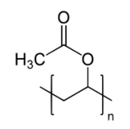
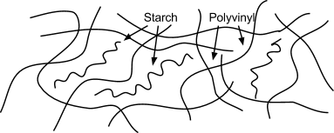
Module 2: Borax Bouncy Balls
White glue: polyvinyl acetate (PVA)
With borax + alkalinity, PVA chains crosslink and form networks of branched chains
Corn starch (also a polymer) gets trapped between the crosslinked chains -> bouncy, stretchy
Polyvinyl acetate unit

Slide 9
Module 2: Procedure
Solution 1: combine 1/2 tsp borax powder + 3 tsp of warm water (ratio is important)
Solution 2: 4 tsp white glue in a 2nd cup
Add 2 tsp corn starch to solution 1
Add solution 1 to solution 2
Wait 10-15 for reaction!
Stir until thick and viscous
Remove and knead/shape with hands
Add some glue to the outside: smooth shell
Bounce away! Take home in a baggy

Slide 10
Summary/Discussion
Emphasize the general idea of what a polymer is – many bonded monomers
Recall examples of polymers in everyday life, compare with what we made
Enjoy the “caviar” and bouncy balls!

