Slide 1

Spring 2012 Infosession
beam.berkeley.edu
Notes:
You can change the subtitle to whatever is appropriate.

Slide 2
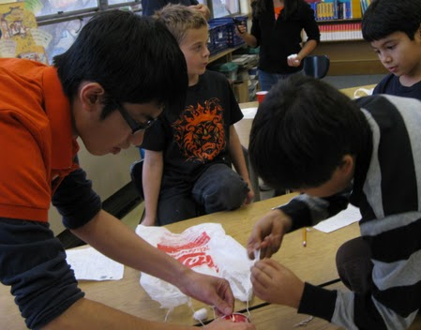

Mission Statement
We want to impact the future of students in our community through hands-on learning.
Notes:
Mission Statement (aka tribute to all other presentations)

Slide 3
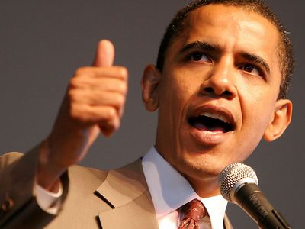
“Leadership tomorrow depends on how we educate our students today, especially in those fields that hold the promise of producing future innovations and innovators.”
Barack Obama
Notes:
Motivation

Slide 4
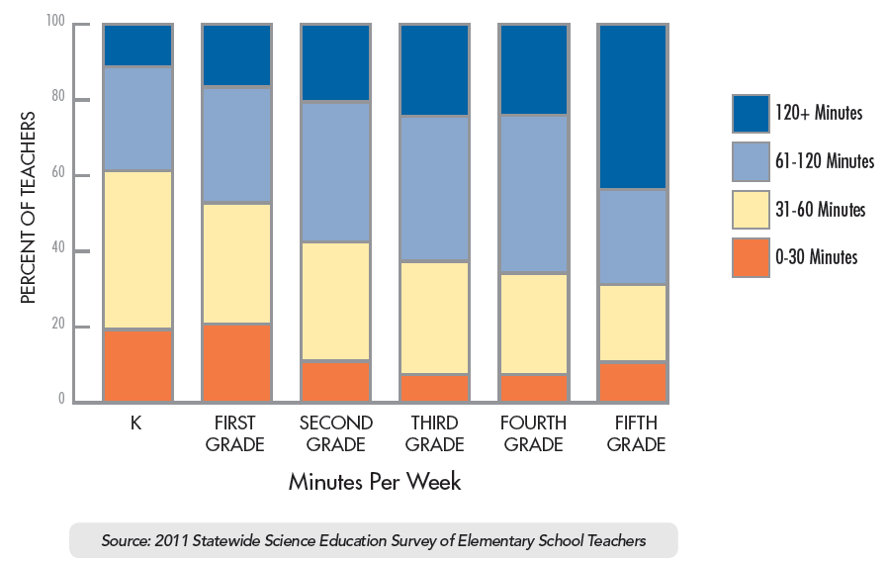
Time spent on science
http://www.lawrencehallofscience.org/story/statewide_study

Slide 5
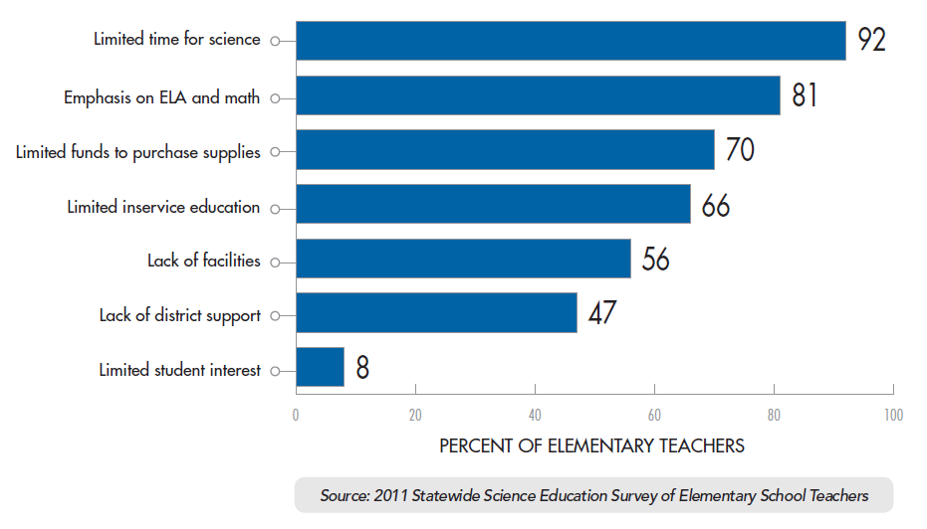
Why is science suffering?

Slide 6
What do you bring?
Time
Passion
Expertise

Slide 7
Who inspired you?
Notes:
Motivation

Slide 8
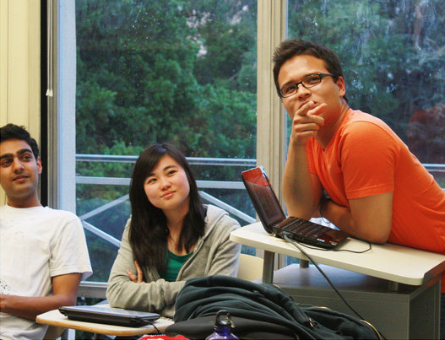
What we do
Create
Plan
Teach
Apply
Notes:
CREATE: a lesson, an activity. PLAN: and assess the quality of the lesson as well as how well it gets the theory across. TEACH: the lesson to the students. APPLY: the lesson with the activity as well as pointing out other applications of that lesson in the student’s lives.

Slide 9
Each week, you will:
Volunteer at a school
Blog about your experience
Attend weekly Decal
4 hrs

Slide 10
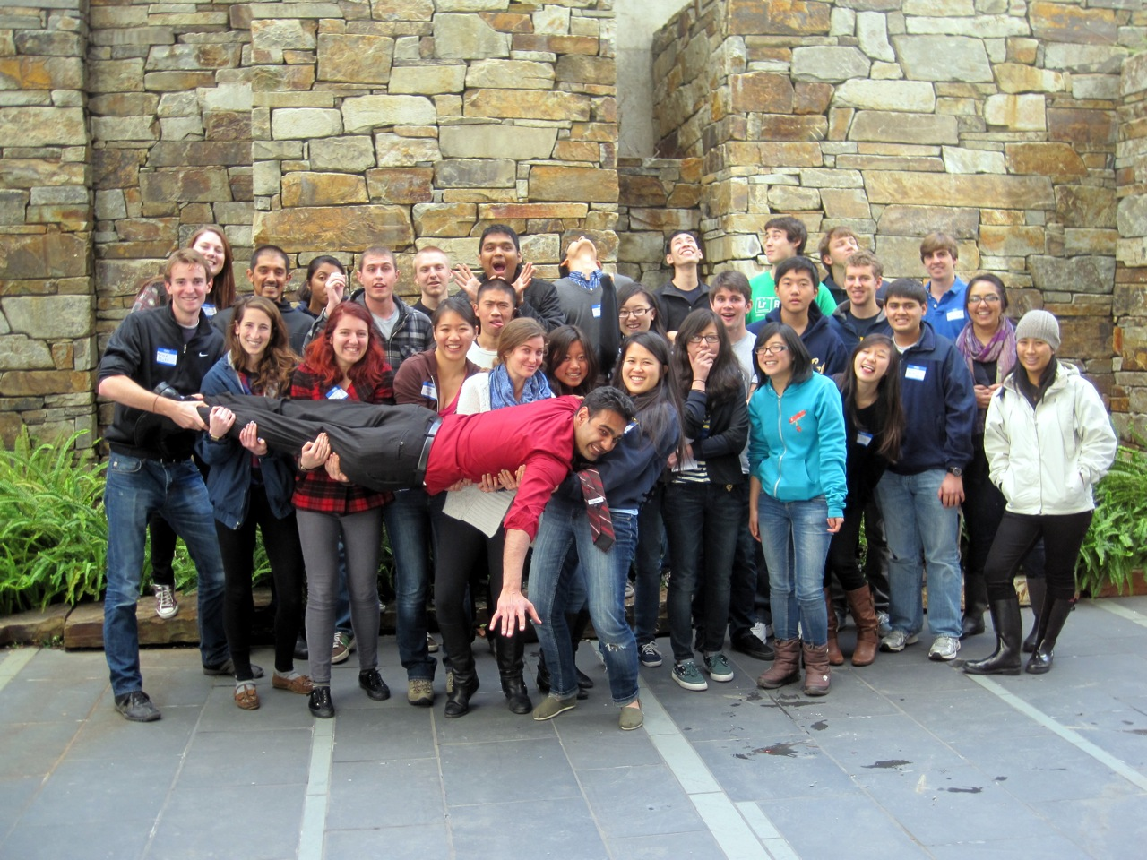
Why should I join?
Make friends
Do hands-on activities
Serve your community

Slide 11
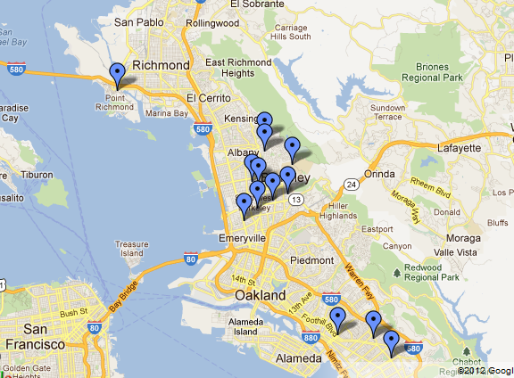
Schools
Elementary Schools
Berkeley Maynard
Cragmont
Emerson
Eres Academy
Leconte
Malcolm X
Oxford
Washington (Berkeley)
Washington (Richmond)
High Schools
Cal Prep
Unity High
Lawrence Hall of Science
Saturday / Sunday

Slide 12
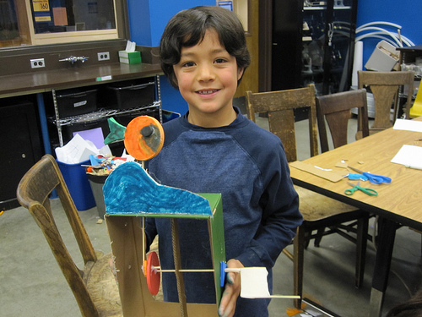
Ingenuity Lab
Volunteer at Lawrence Hall of Science
Less structured
All ages
Saturday/Sunday
Separate weekly meeting

Slide 13
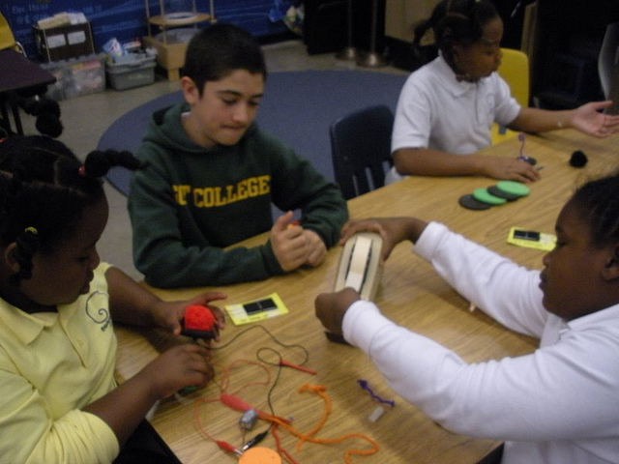
Curriculum
Activities
Water bottle rockets
Polymer “caviar”
Flame-wave tube
Projects
Mag-Lev trains
Pin-hole camera
Telegraph machine
… and More!

Slide 14
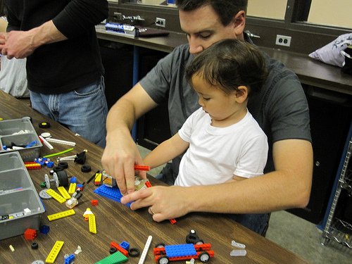
Decal Requirements
Miss no more than 2 Decal meetings
Miss no more than 1 volunteer session
Create a lesson plan with your BEAM team

Slide 15



First Decal Meeting:
Monday, Feb 6th 7pm
CCN’s
98: 10312
198: 10645
beam.berkeley.edu
facebook.com/beam.teach
beam.teach@gmail.com
Spring 2012 Infosession
beam.berkeley.edu
Notes:
If you have any questions or suggestions, just e-mail me back!

Slide 16
Get Involved!
First DeCal Meeting:
Monday, Feb 6th 7pm
CCN’s
98: 10312
198: 10645
beam.berkeley.edu
facebook.com/beam.teach
beam.teach@gmail.com
Notes:
Now it’s your turn! To learn more about BEAM, come to our first info session on () or out first DeCal on () or visit our website at (). Just look for our signature water bottle rocket launches! Hope to see you there!

Slide 17
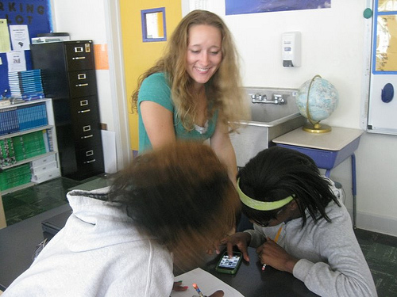
Course Control Numbers
“There is growing potential for improving elementary school science education in the Bay Area.”
“Research indicates that external organizations currently play a key role in supporting Bay Area elementary school science education”
LHS/REA Study
Lower Division (98): 10312
Upper Division (198): 10645

Slide 18
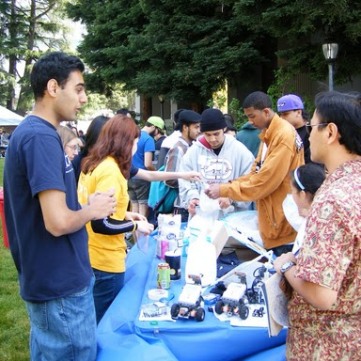
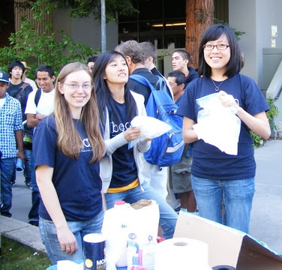
Make friends and learn more
Joining BEAM compliments and strengthens your education at CAL
Notes:
Talk about the hands on, non theoretical part for undergrads here

Slide 19
We are growing!
Notes:
Definitely a selling point for me at least. Because its small and growing, it gives everybody the opportunity to feel important within the club. (Unlike some other clubs with many, many half members).

