Slide 1
Exploring Hallucination Detection in
Large Language Models
Team - 111
Ajay Rajendra Kumar | Vicky Daniel | Vaibhav Sankaran
CS6120 Natural Language Processing

Slide 2
Problem Statement and Motivation
What is hallucination in LLMs?
LLMs generate fluent but factually incorrect or unsupported text
Particularly harmful in open-domain QA where accuracy is critical
Why is it hard to detect?
Existing methods rely on repeated sampling which is expensive and slow
Post-processing approaches add latency at inference time
Supervised methods require costly human-annotated hallucination labels
Our motivation
Detect hallucinations in real-time during inference with no annotation cost
LLMs may already encode uncertainty in their internal representations
Build a lightweight, model-agnostic detection and mitigation framework
2

Slide 3
Prior Work Review
Sampling-based methods (SelfCheckGPT)
Generate multiple outputs and compare consistency across samples
High compute cost - requires N forward passes per query
Retrieval-Augmented Generation (RAG)
Grounds answers in external documents to reduce fabrication
Prevents hallucination but does not detect it post-generation
Probing internal states (ITI - Inference-Time Intervention)
Uses hidden states to predict truthfulness
Supervised - depends on labeled training data per model
How about we use internal states of LLMs to guide hallucination detection?
3

Slide 4
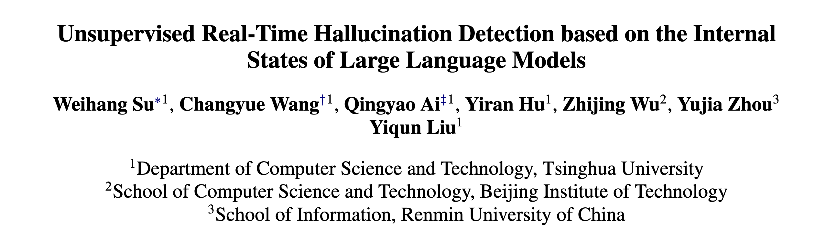
Base Paper: The MIND Framework
Uses internal states of the model to detect hallucinations
Key insight: Aggregate last token embedding of every layer
Self-supervised data generation
Train a light-weight MLP to perform classification
Predicts hallucination at sentence level during generation
4

Slide 5
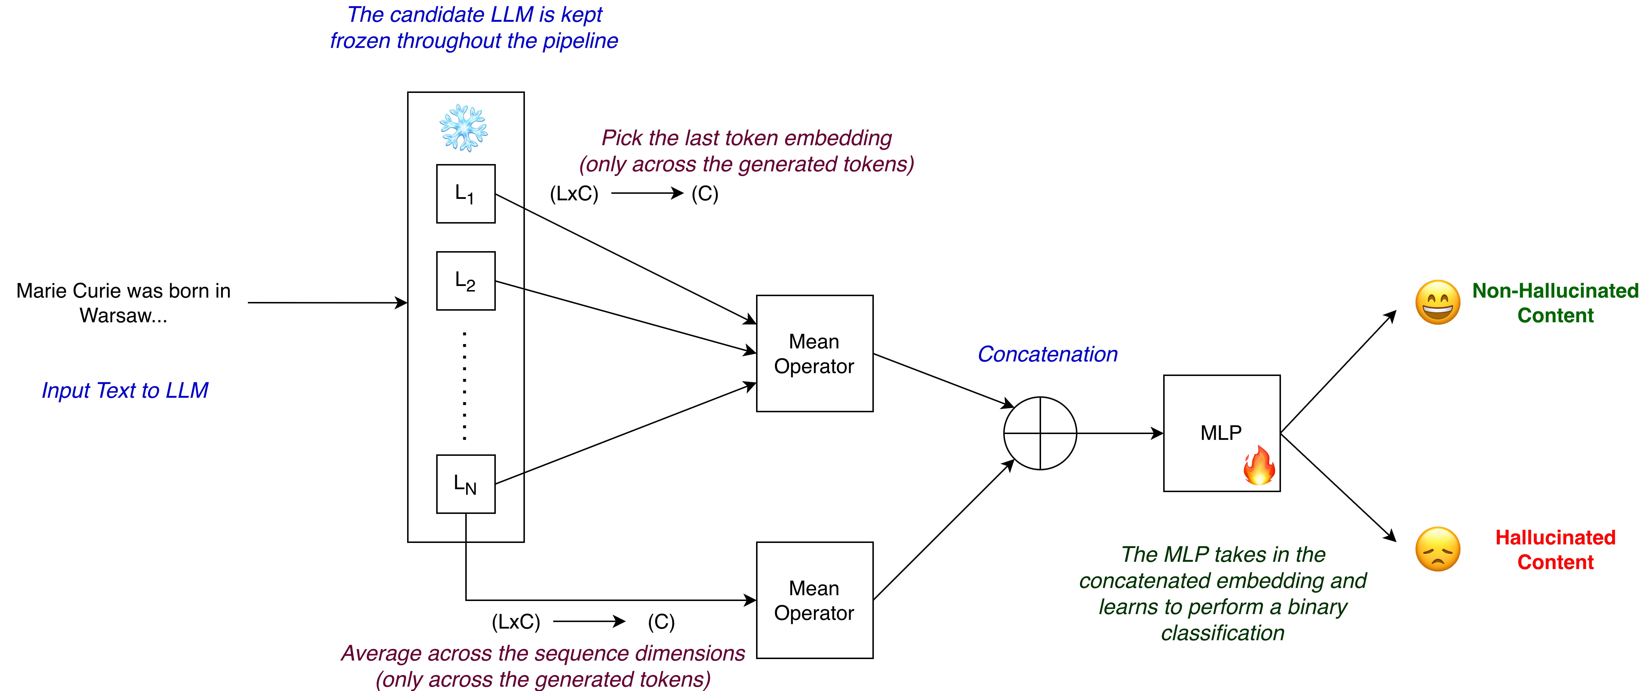
MIND: System Architecture
5

Slide 6
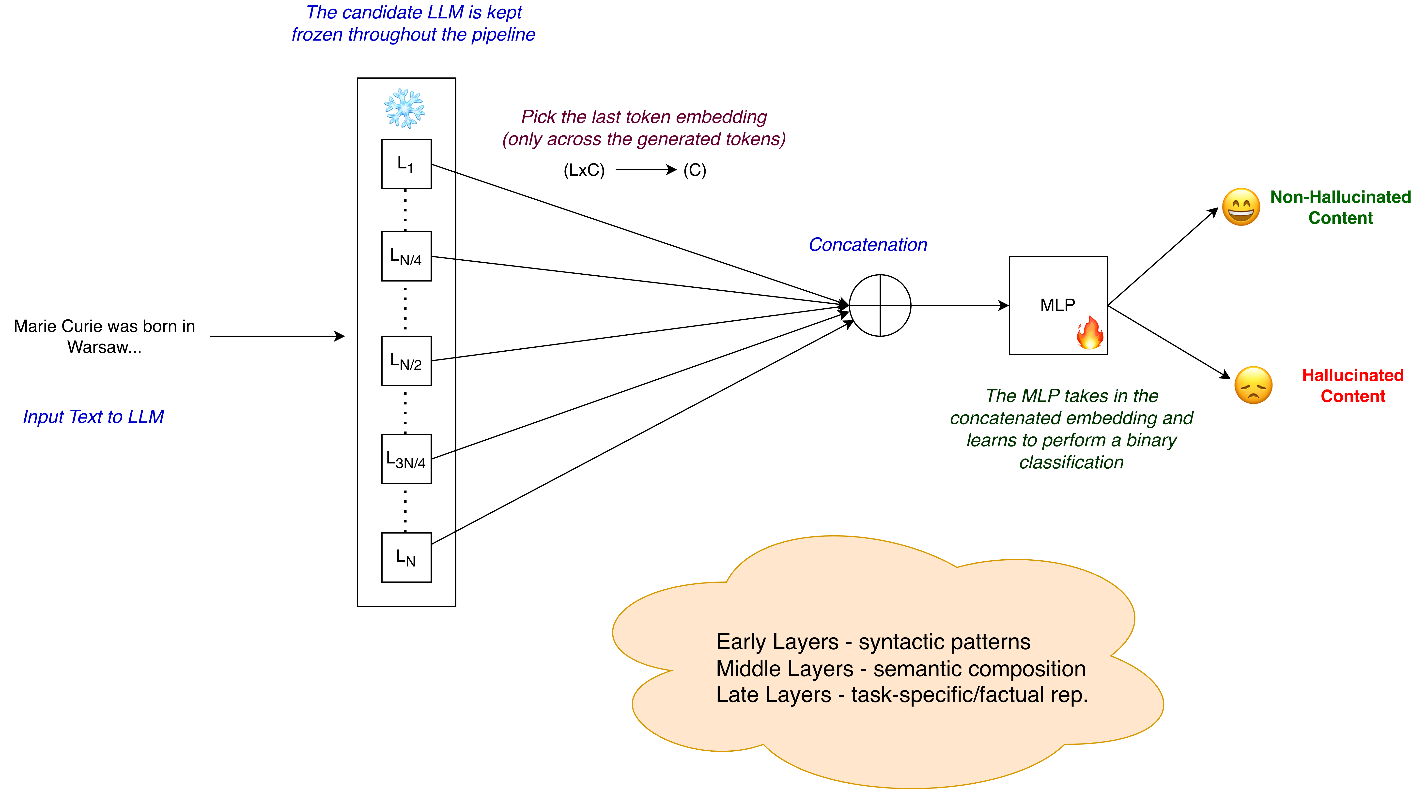
Method-1
6
Notes:
I'll now walk you through the four methods we explored. In our first method, we extract the last token's hidden state from 5 transformer layers, concatenate them, and feed this into the MLP classifier. Our intuition behind this approach was that the model learns syntactic patterns in the early layers, semantic compositions in the middle layers and task-specific/factual representations in the late layers. We wanted to probe if averaging token embeddings might lead to loss in training signals for the MLP and hence we perform concatenation.

Slide 7
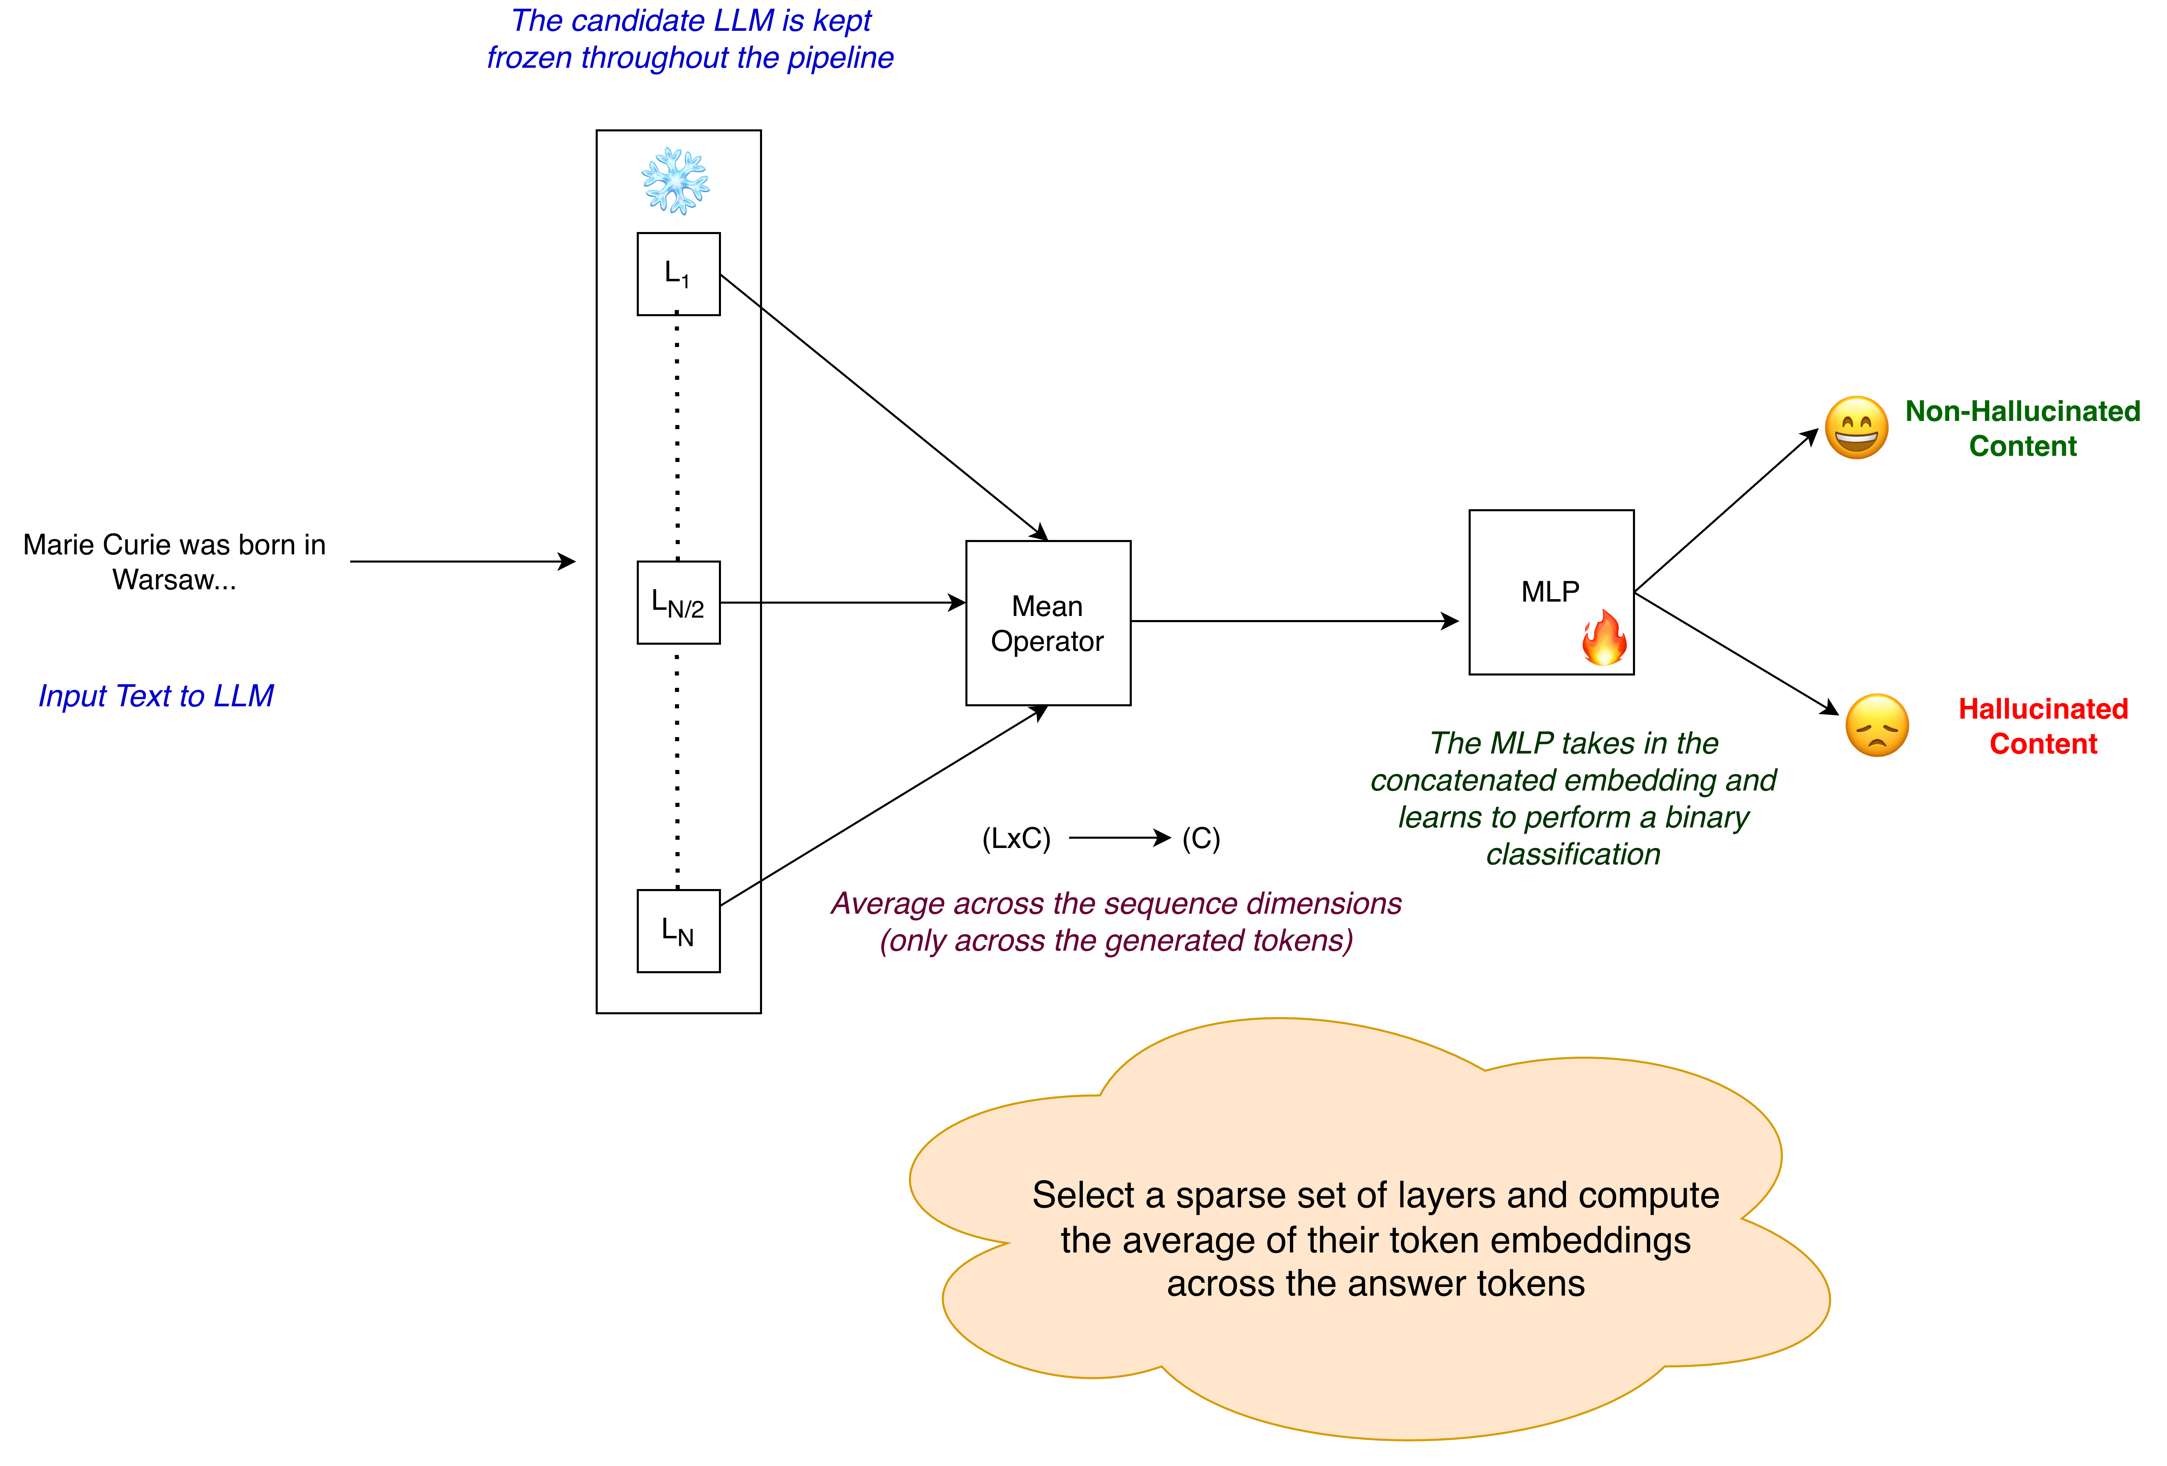
Method-2
7
Notes:
Method 2 is an extension where instead of just taking the last token, we take the mean pooling across all tokens in the sentence for each layer. The intuition is that a single token may not capture the full meaning of the sentence, so averaging across all tokens gives a richer representation before feeding it to the classifier.

Slide 8
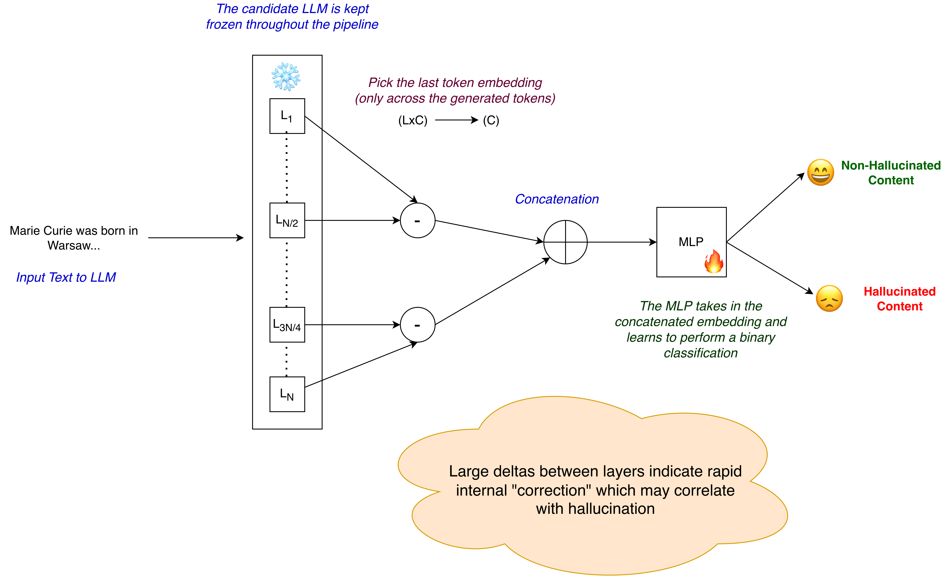
Method-3
7
Notes:
Method 3 looks at delta features — that is, the difference between hidden states of consecutive layers. The idea here is that changes across layers might signal where the model is uncertain or inconsistent, which could be a marker for hallucination. We compute these differences and use them as features for the classifier.

Slide 9
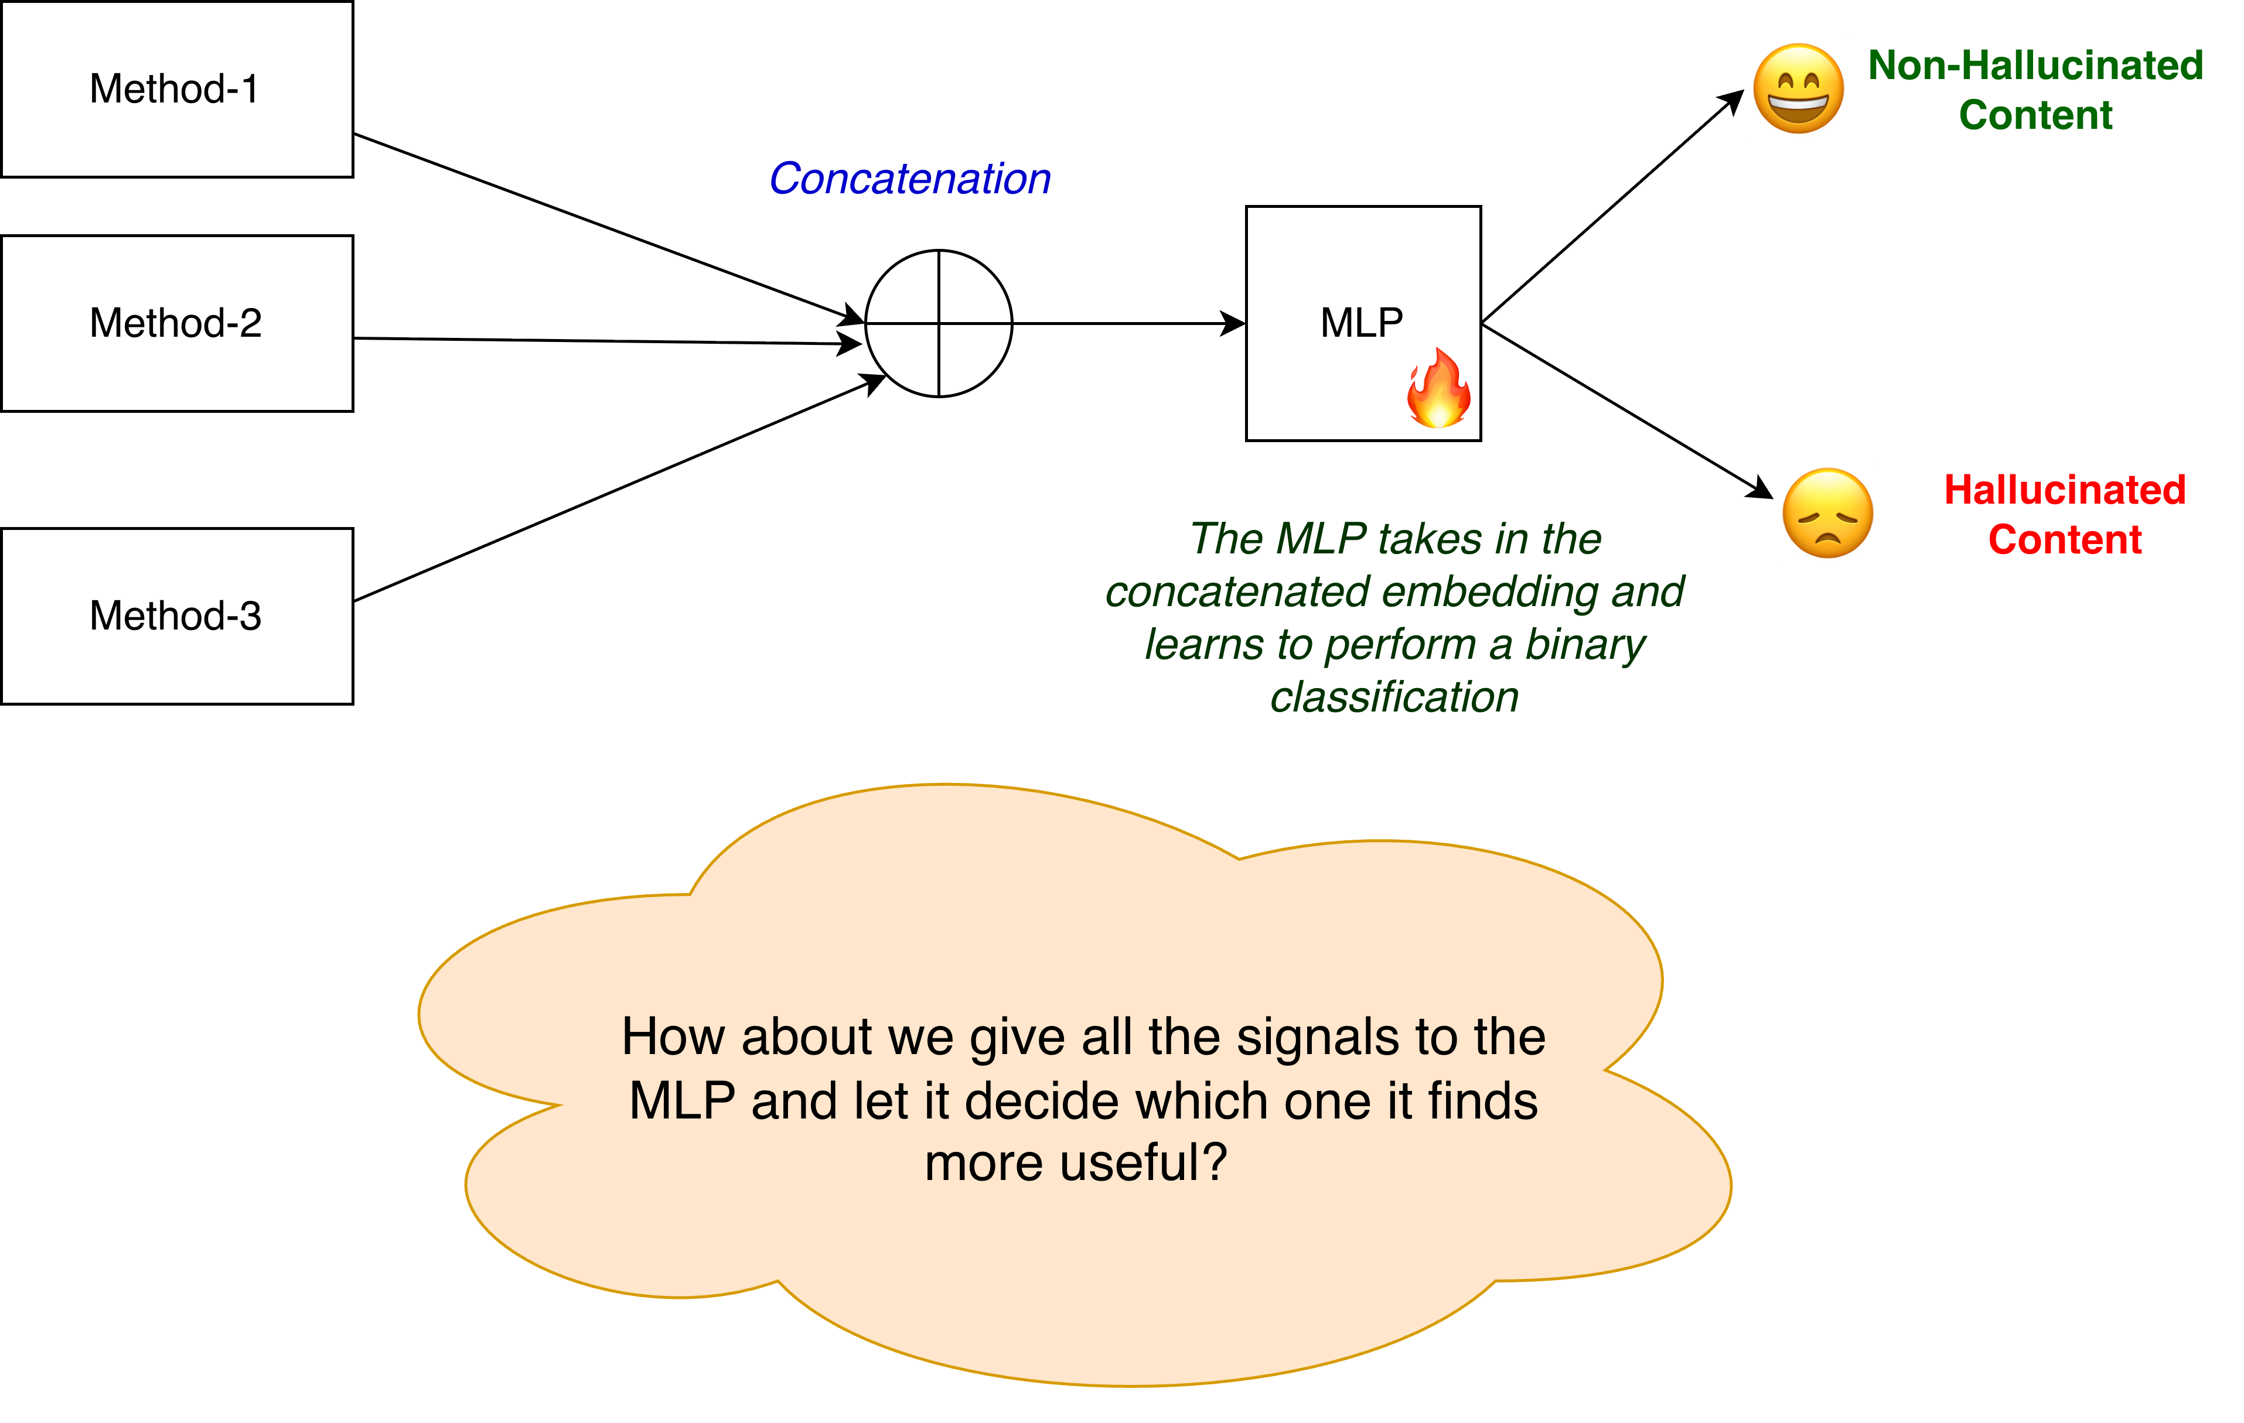
Method-4
8
Notes:
Method 4 uses multi-layer mean aggregation — we take the mean of all layer embeddings rather than concatenating them. This keeps the feature dimension fixed regardless of model depth, making it more generalizable.

Slide 10
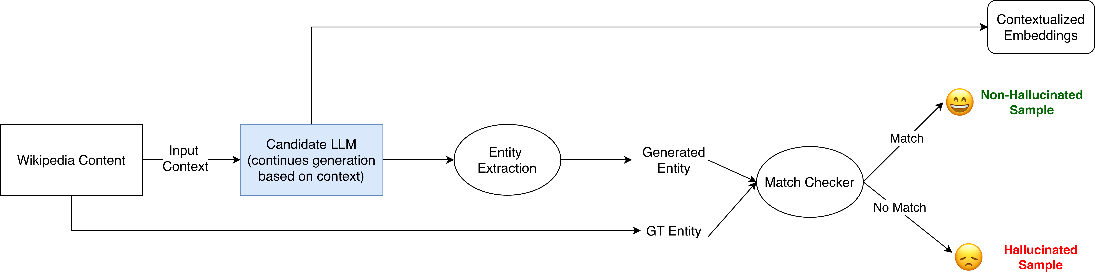
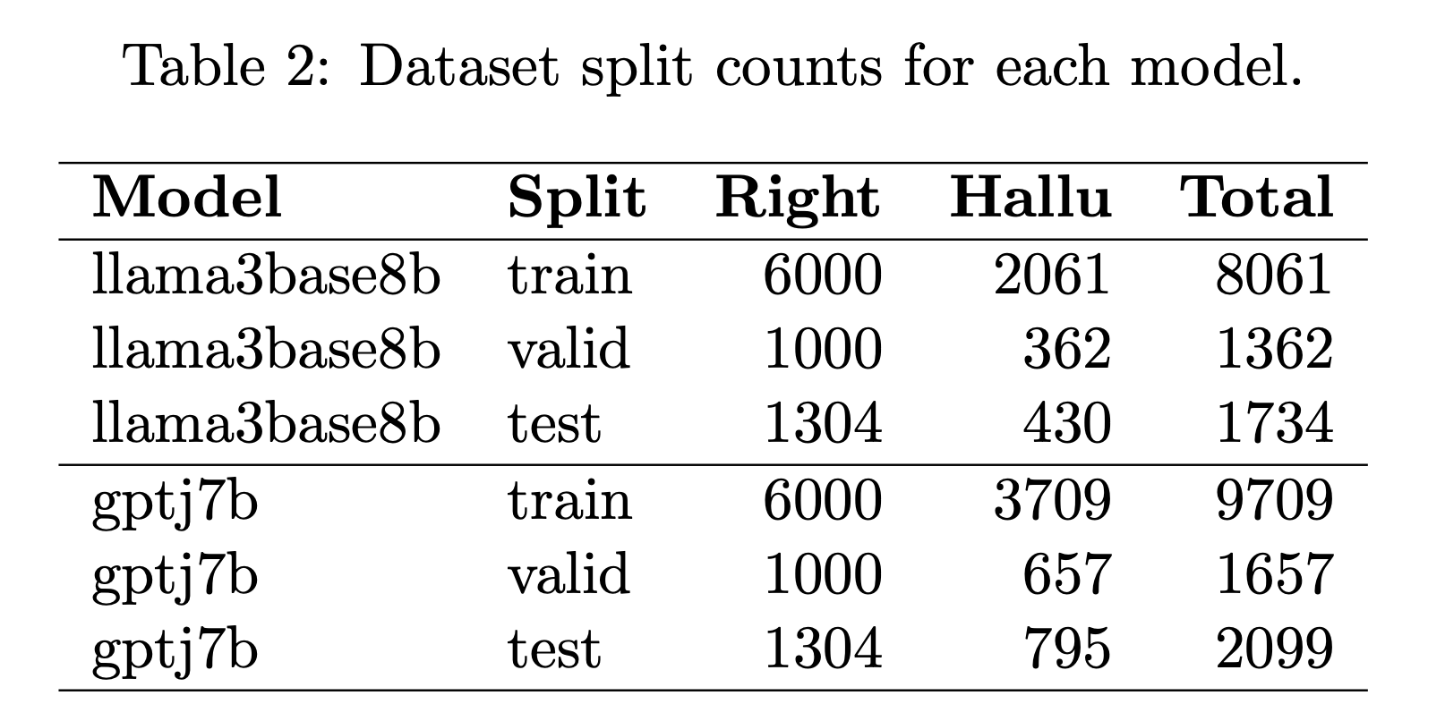
Training Data Methodology: Self-Supervised Pipeline
Framework: Adapted from the MIND architecture
Dynamic Generation: Creates model-dependent training data on the fly
Pipeline Components:
Extraction: Powered by spaCy for robust entity recognition
Validation: Match-checker verifies generated entities against Ground Truth (GT)
9
Notes:
To train our classifiers, we built a self-supervised data generation pipeline adapted from MIND. It dynamically creates training data specific to each model — no human labels needed. We use spaCy for entity extraction from generated text, and then a match-checker verifies whether the extracted entities align with the ground truth. This automatically labels sentences as hallucinated or not. [Handoff to Vicky for HELM Benchmark and Results]

Slide 11
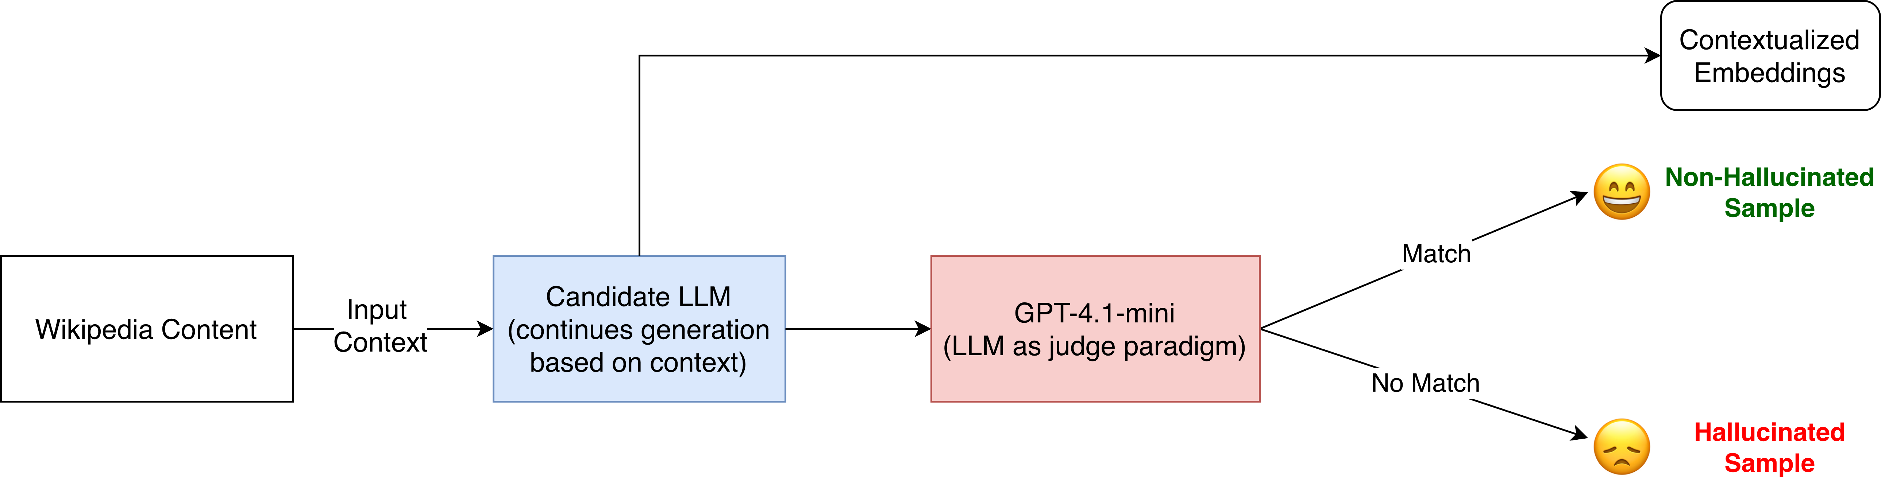
HELM Benchmark Generation
Input Source: Uses Wikipedia Content (WikiText-103) to establish baseline context
Candidate Generation: The target LLM continues generation while extracting contextualized embeddings
Evaluation: Employs GPT-4.1-mini under an LLM-as-judge paradigm
Sample Classification:
Match: Categorized as a Non-Hallucinated Sample
No Match: Categorized as a Hallucinated Sample
10

Slide 12
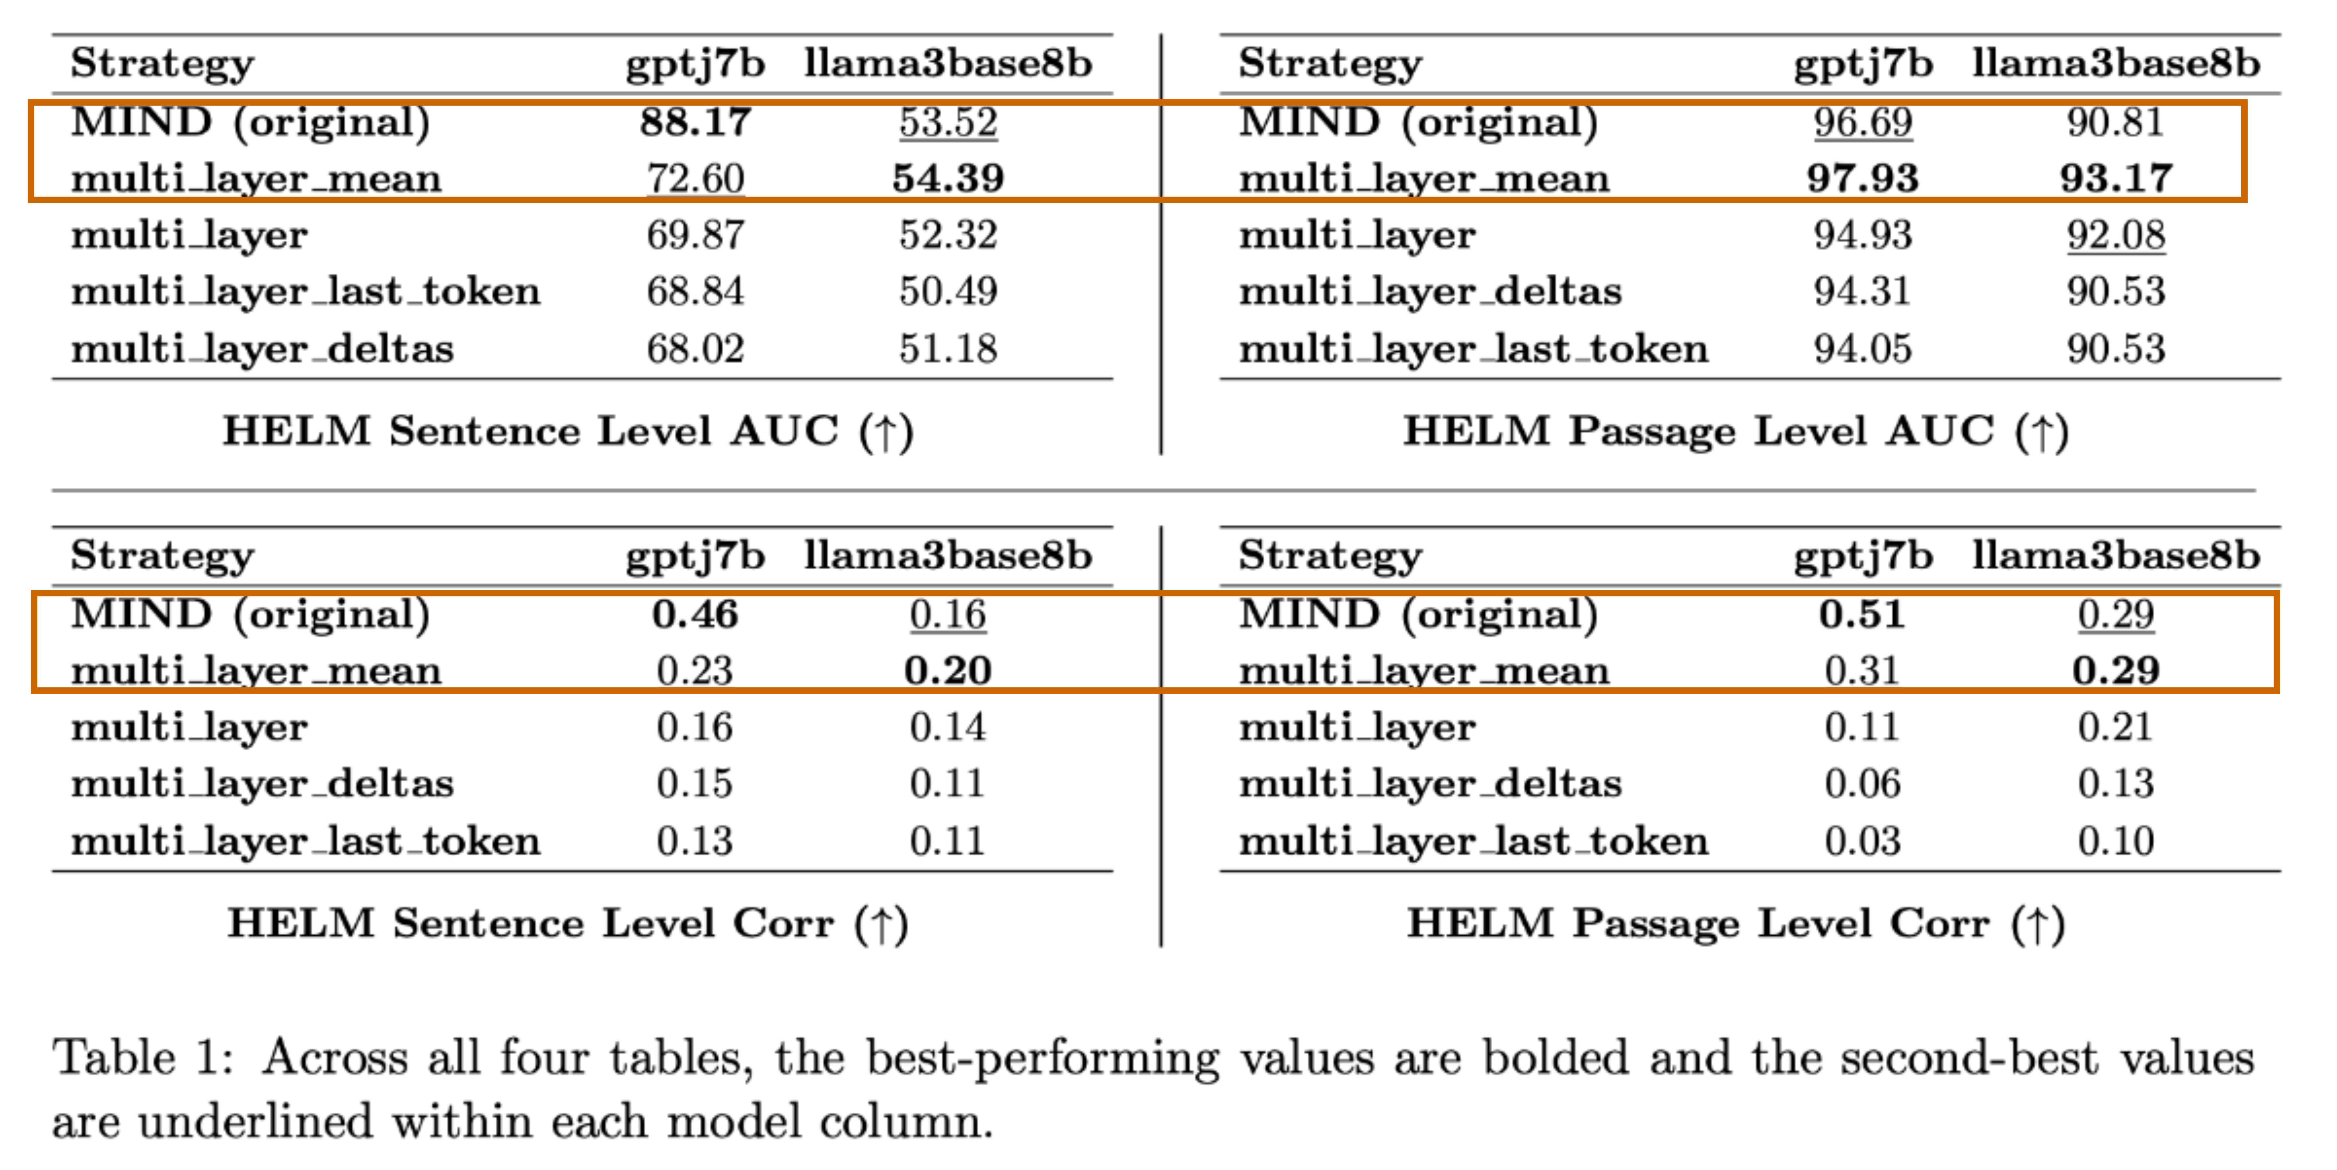
Results & Findings: Model-Dependent Performance
Evaluation Metrics
AUC (Area Under Curve) - Threshold-independent measure of classification performance
Correlation - Measures alignment between classifier confidence and ground truth
Key Findings
Model-dependent behavior is dominant: No single strategy wins across the board
MIND is strong but fragile: Dominates on GPT-J but fails to generalize to Llama-3
multi_layer_mean is the most robust: The only method that consistently performs best on Llama-3 across all metrics
11

Slide 13
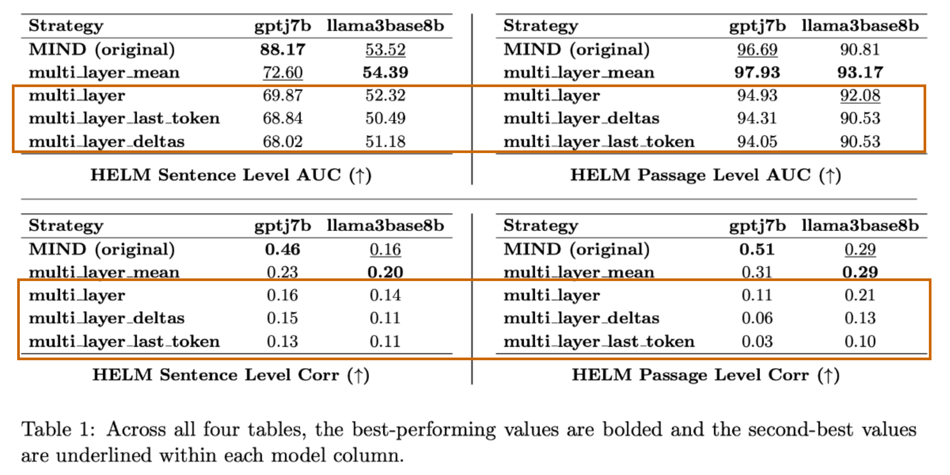
Results & Findings: Analyzing Feature Strategies
Aggregation function is critical
Mean pooling (multi_layer_mean) significantly outperforms naive concatenation (multi_layer)
Takeaway: How representations are combined matters much more than simply increasing the number of representations used
Consistently weak strategies
Delta-based features (multi_layer_deltas)
Last-token representations (multi_layer_last_token)
12

Slide 14
Discussion: Challenges Faced
Primary Challenges
Data Scarcity: Lack of existing HELM benchmark data for our target models
Resource Constraints: Compute bottlenecks when running large-scale models, coupled with budget limitations for OpenAI API annotations
Engineering Overhead: Extensive codebase refactoring required to integrate custom pipeline implementations
Future Scope
Architectural Expansion: Experiment with more complex classifier designs
Model Diversity: Broaden evaluation across a wider range of foundation models
13

Slide 15
Individual Contributions
Ajay Rajendra Kumar
Vicky Daniel
Vaibhav Sankaran
Method 1
Method 4
Method 2
Self-Supervised Data Generation Pipeline
Method 3
HELM Benchmark Generation
Literature review and prior work analysis
Experiment design and evaluation methodology
Results analysis and interpretation
Report and Presentation preparation
Codebase development and debugging
14

Slide 16
Thank You!

