Slide 1
Stakeholder Presentation
Group 24
Bryn Lom, Craig Tiu, Kye Felton, Regina Wang, Ruoyao Tan, Vicky Lin

Slide 2

Introduction
It is quite difficult to interact with people with the current pandemic.

Slide 3

The solution: Quarantinder

Slide 4
Quarantinder components
Personal profile
Account creation and maintenance
Personal blog
Matching and blocking
Messaging
Zoom API

Slide 5
Personal Profile

Slide 6

Personal Profile
Motivation:
Need a way for users to express themselves.
Display preferences to find people who match.
Show details so they can be found through other user’s preferences.

Slide 7
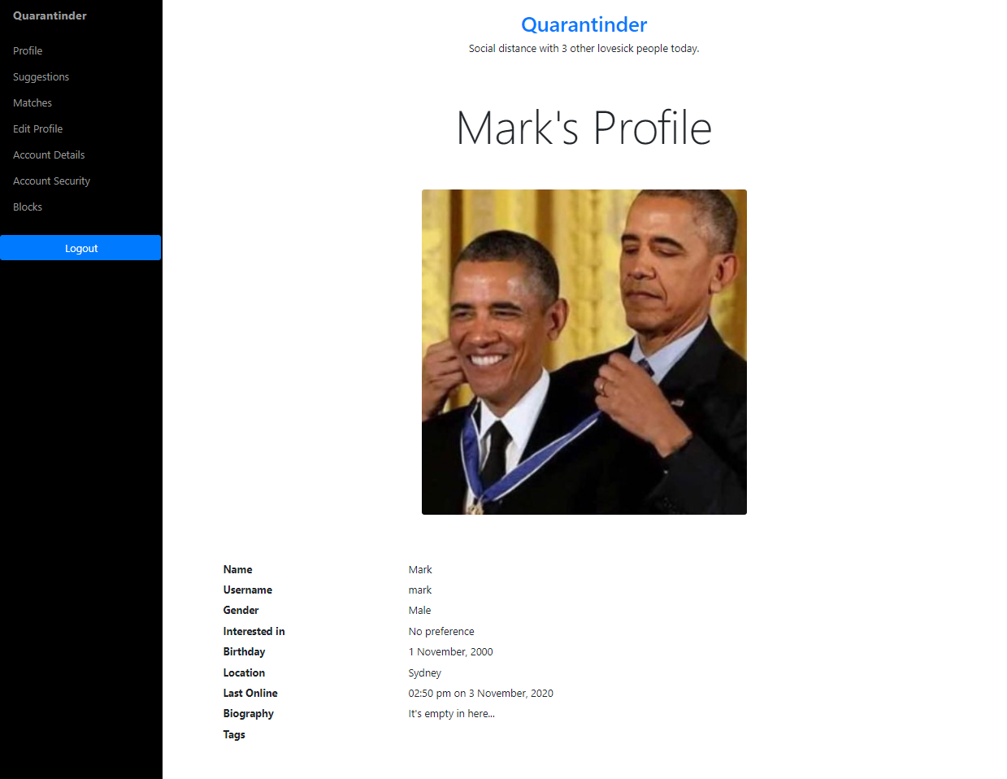
Personal Profile
Solution:
User profile for users:
Shows information such as birthday, location, last online, biography and interests
Edit user profile
Upload custom images

Slide 8
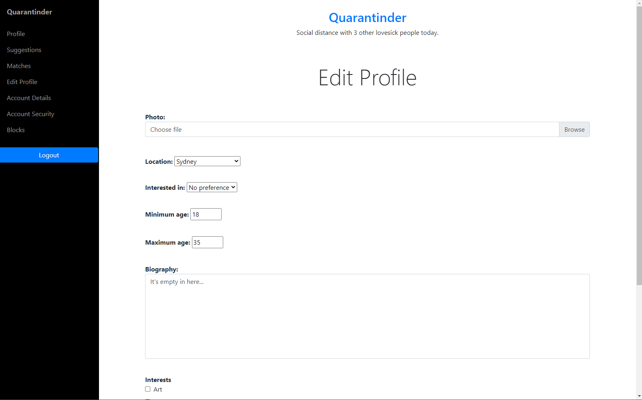
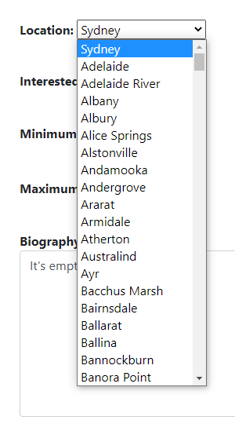

Personal Profile
Edit Profile
Choose Location
Upload Photo

Slide 9
Personal Profile
Benefits:
Users are able to express themselves through their profile, i.e. biography and profile picture
Users can see other user’s interests to determine if they are a good match
Users can change their profile details at any time through a simple, easy-to-use interface

Slide 10
Account creation management and security

Slide 11
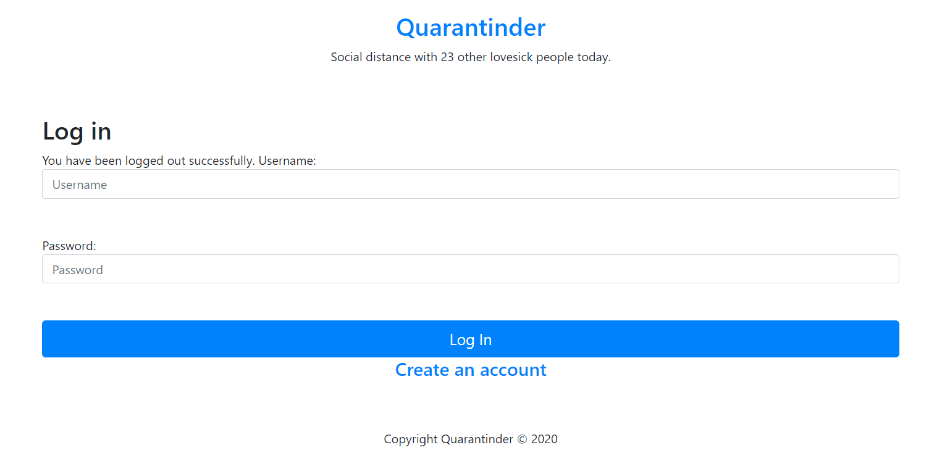
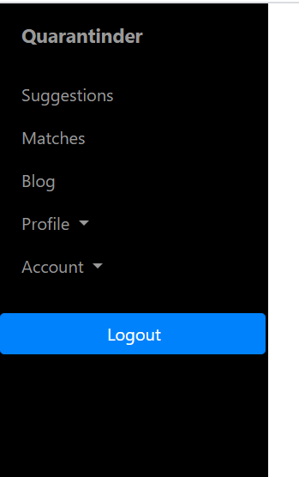
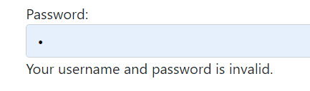
Account creation and security
Motivation:
Ability to login using own unique username and secured password
Inform users about errors using validations
Security of the users within
Log out will also provide confirmation
Notes:
Problem: users access page without login

Slide 12
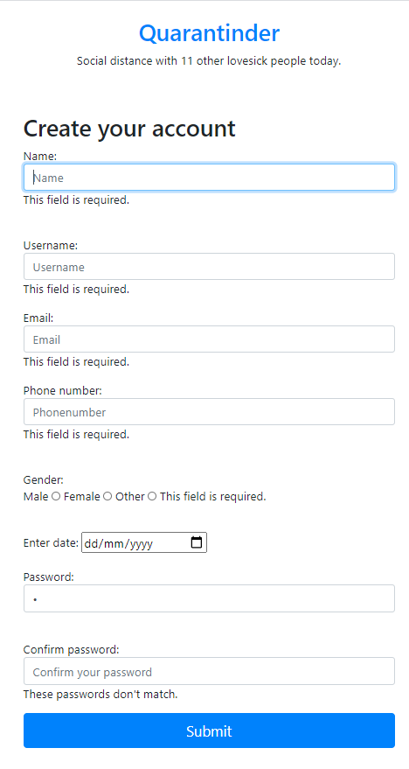
Account creation
Unique username, email and phone number to prevent duplicate identities
Field validation “Passwords don’t match” “Field required” “Someone already has that username” “Email already registered” “Phone already registered”
Benefits: Informed user to fix errors Users encouraged to have one account

Slide 13
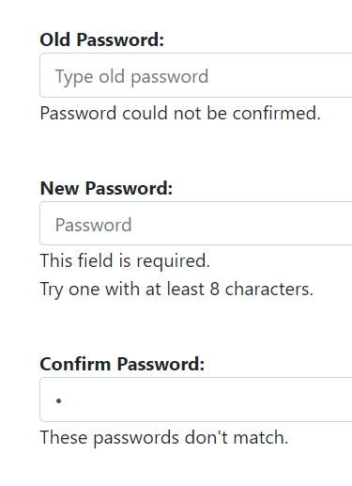
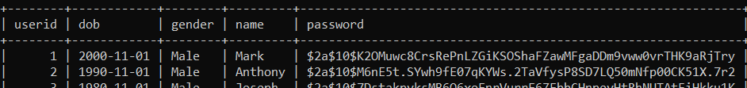
Password security
Change password
Must use old password, adds security
Field validation
<Backend> Hashed password for all accounts
Redirect to profile page on success

Slide 14
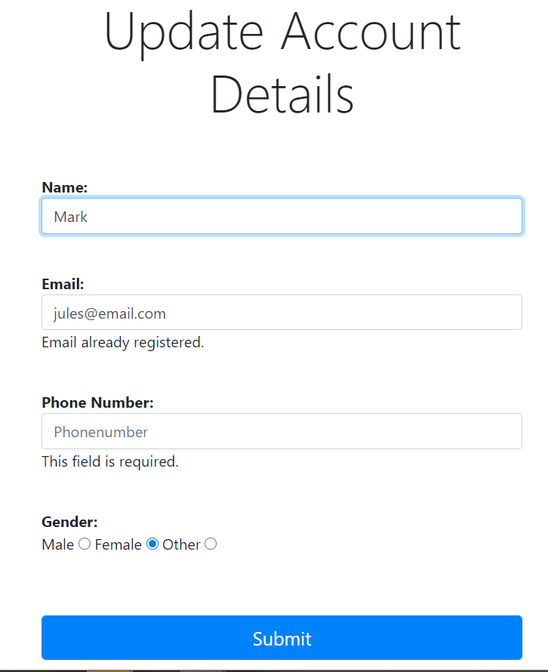
Update details
Allow users to change their account details after registration
Validators also present
Consistent style of forms overall to reduce confusion

Slide 15
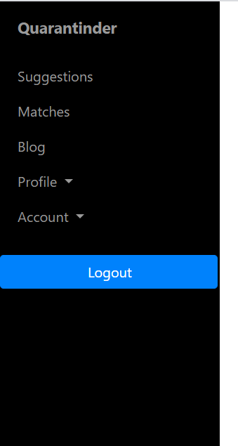
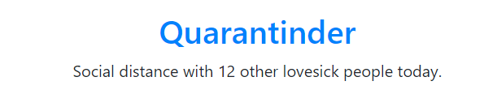
Common UI elements
Sidebar:
Header
Fun header to give a sense of community
Easier navigation to across the site from any logged in page

Slide 16
Personal Blog

Slide 17
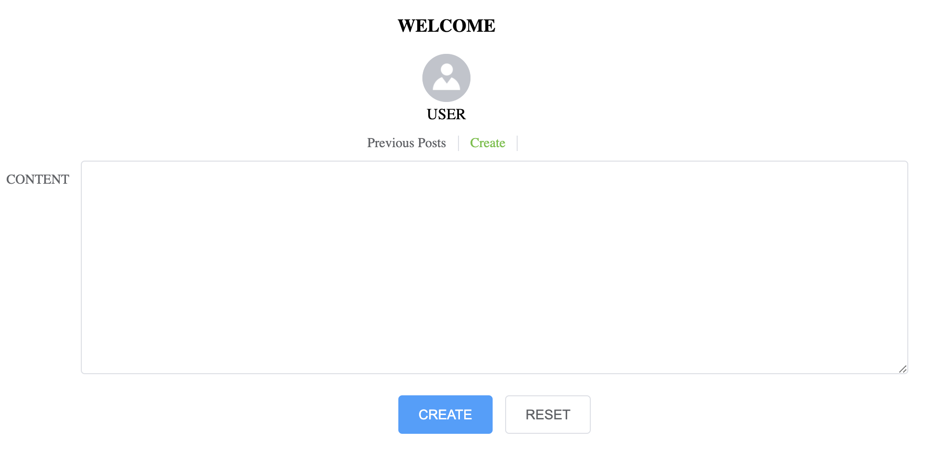
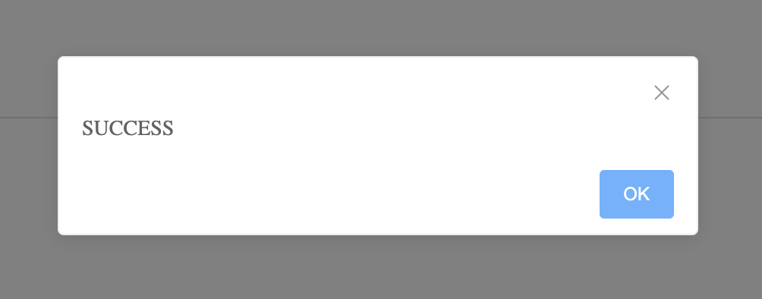
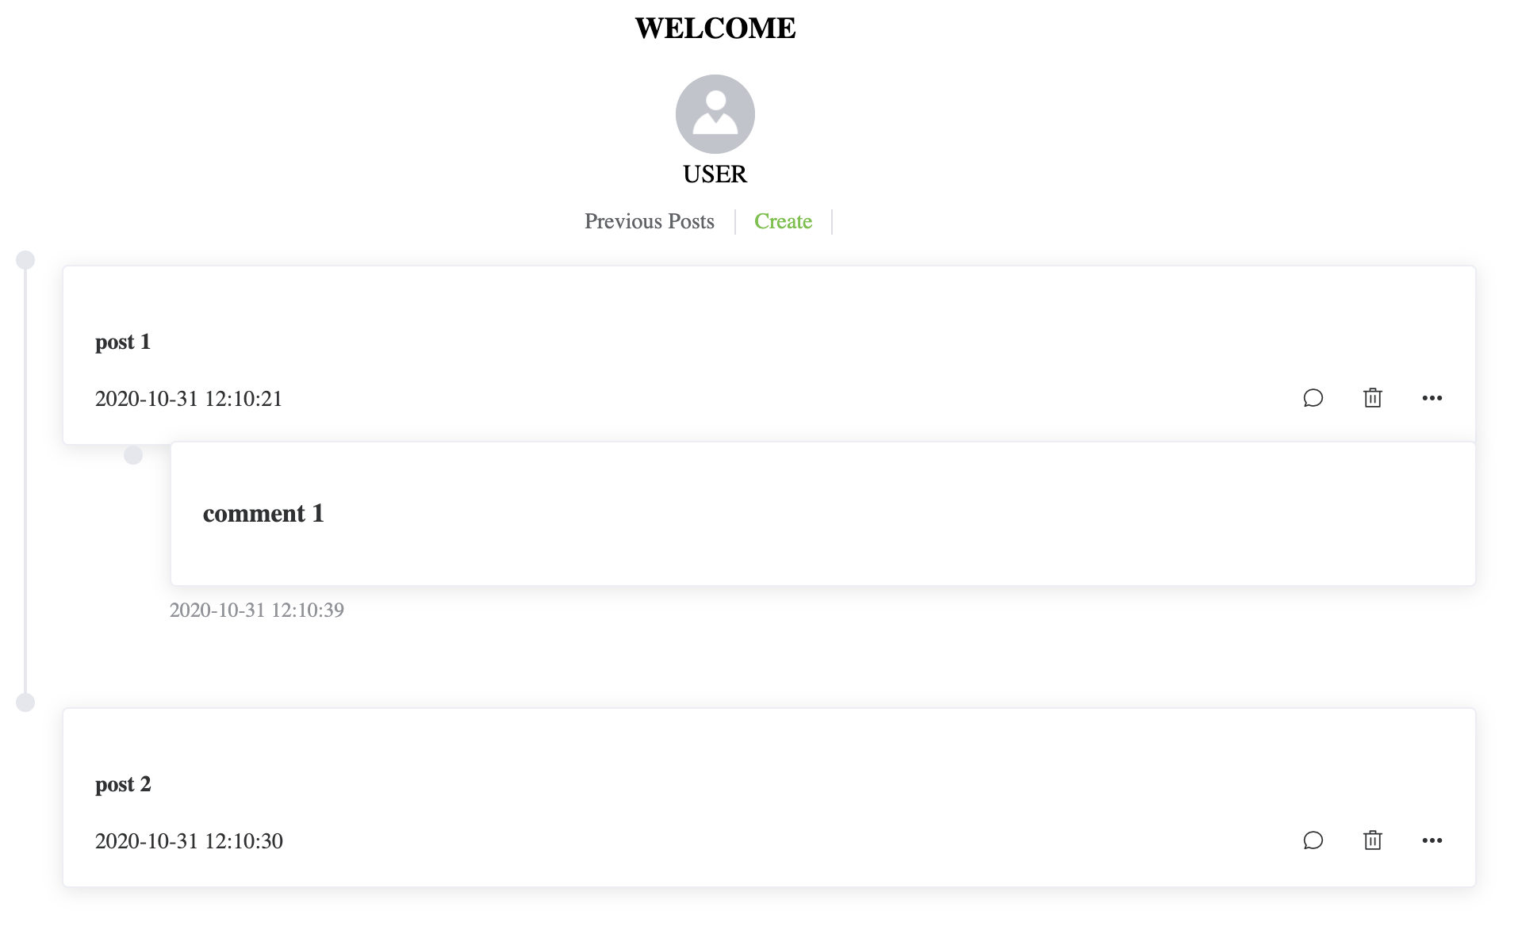
Blog
Motivation: Be able to find a suitable person on the platform to meet, date and interact.
Solution:
User can create a new blog.
Users can view, comment or delete their own previous blogs.
Observers can only view blogs and comment blogs of other users.

Slide 18





Blog
Benefit:
Real-time sharing.
Allows other users to understand the owner of the blog better.
Writes down what they wants to say freely.
Releases negative emotions.

Slide 19
Matching & Blocking

Slide 20
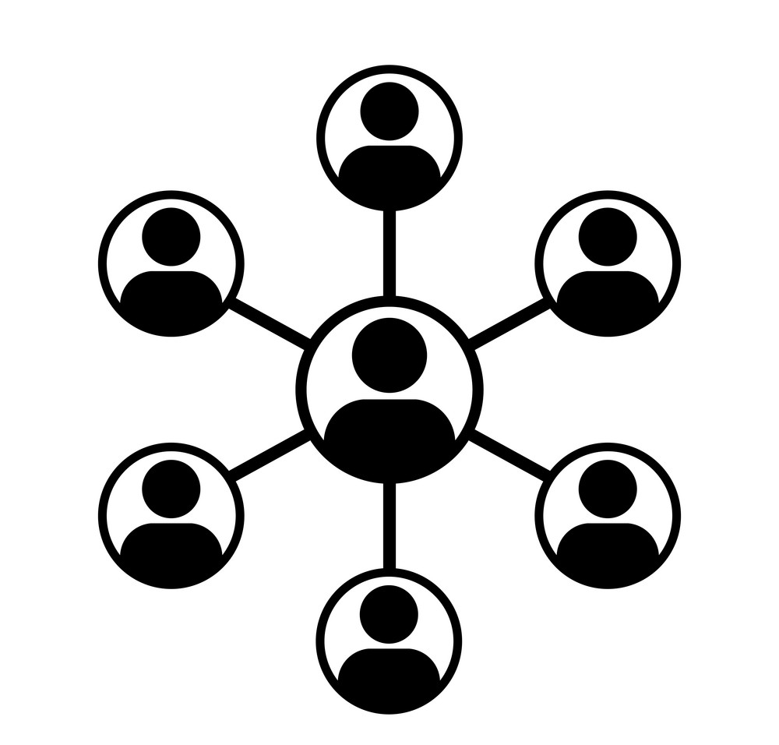
Motivation
Matching & Blocking
Find and meet like-minded people.
Share content within your network.
Feel protected from other unfriendly users.

Slide 21
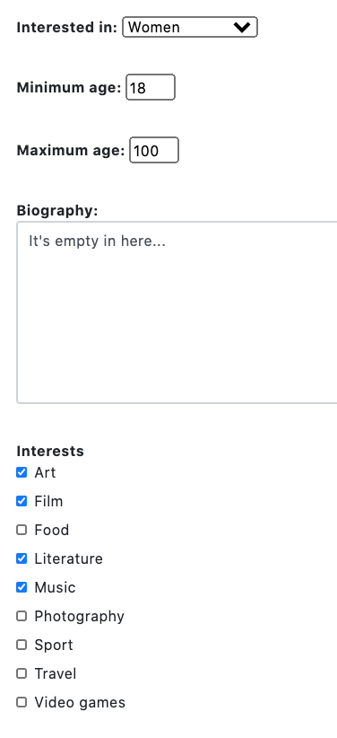
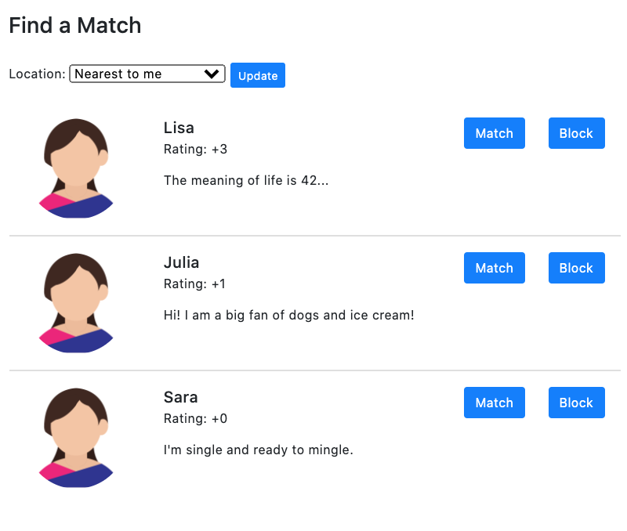
Solution
Matching & Blocking

Slide 22
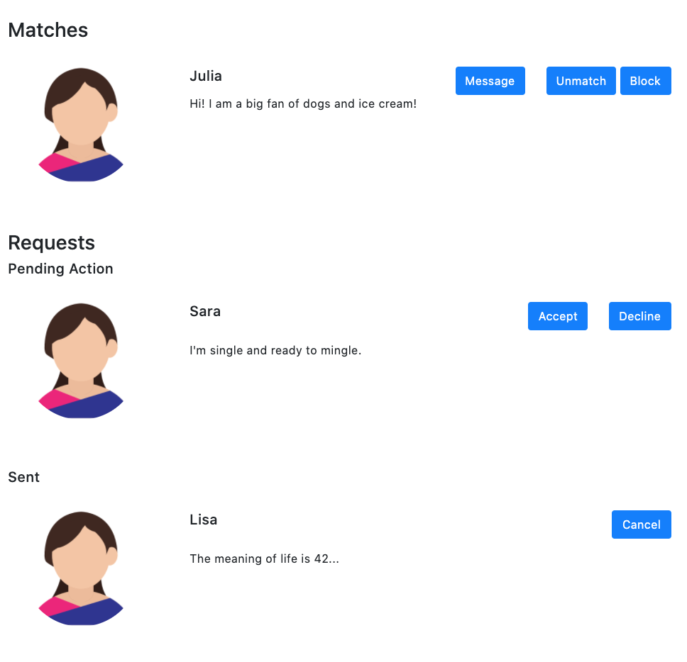
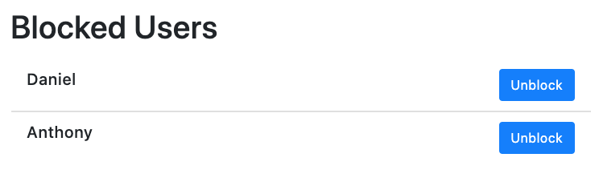
Solution
Matching & Blocking

Slide 23
Benefits
Matching & Blocking
Personalised: Users can find and meet others based on their preferences (gender, age and location) and similar interests through the suggestions page.
Ease of use: User’s easily view other user’s content and message them through the matches page.
Safety: User’s can manage who can view their content and message them through the blocked users page.
“The ultimate outcome is a more personalised, enjoyable and safe experience.”

Slide 24
Messaging

Slide 25

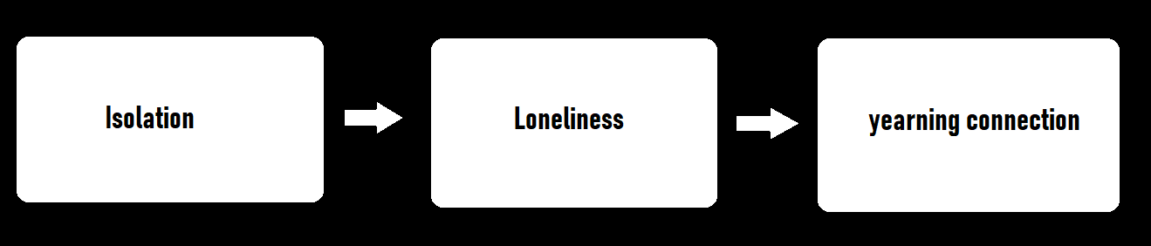
Messaging
Motivation

Slide 26
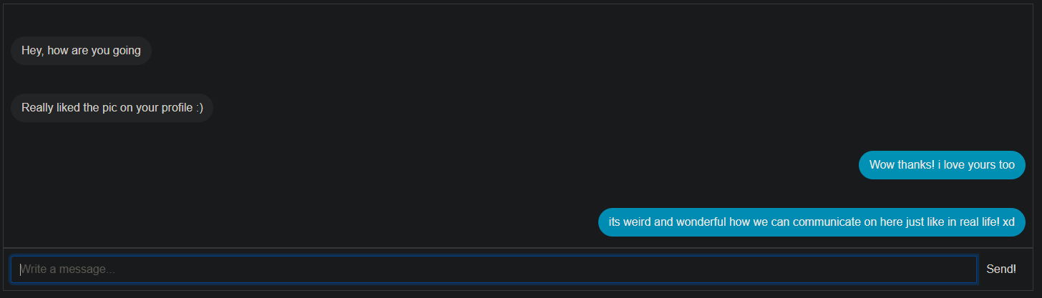
Messaging
Websocket based solution

Slide 27
Messaging
Benefit:
Talking to new people
Setting a new identity for yourself and discussing hobbies
Talking to multiple people!
Saved previous messages
LIVE!
Private
Is a stepping stone to more deep connections/communication

Slide 28
Video Chatting

Slide 29
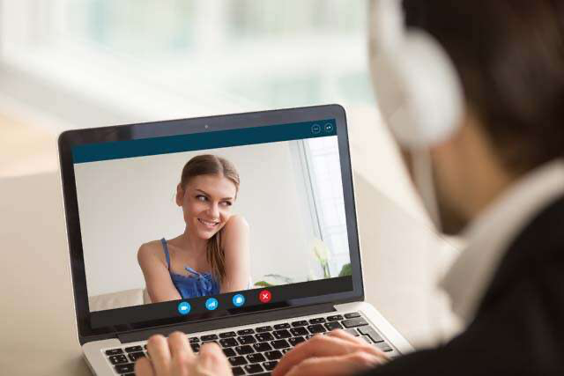
Video Chatting
Motivation:
Messaging for some times
Video chatting
Keen to know more about the other person
Seek more interactive communication means

Slide 30
Video Chatting
Usability
USyd Librarians
Solution and Benefit:
Easy scheduling, management and invitation
External API
Utilising zoom and zoom API to provide video chats
Security
Oauth authentication used to ensure security of user accounts
Solution and Benefits
Integration
Integrating video chat scheduling to the web app
Functionality
Contributing to the overall goal of the web app

Slide 31
Video Chatting
Delete Meeting
Users would be able to delete a scheduled meeting
Expected Outcome:
Delete Meeting
Send Invitation
Schedule Meeting
Schedule Meeting
Send Invitation
Users would be able to get an invitation of the meeting and send it to the other person
Users would be able to schedule a video chat on the web app
View Meetings
View Meetings
Users would be able to view a list of their existing meetings

Slide 32
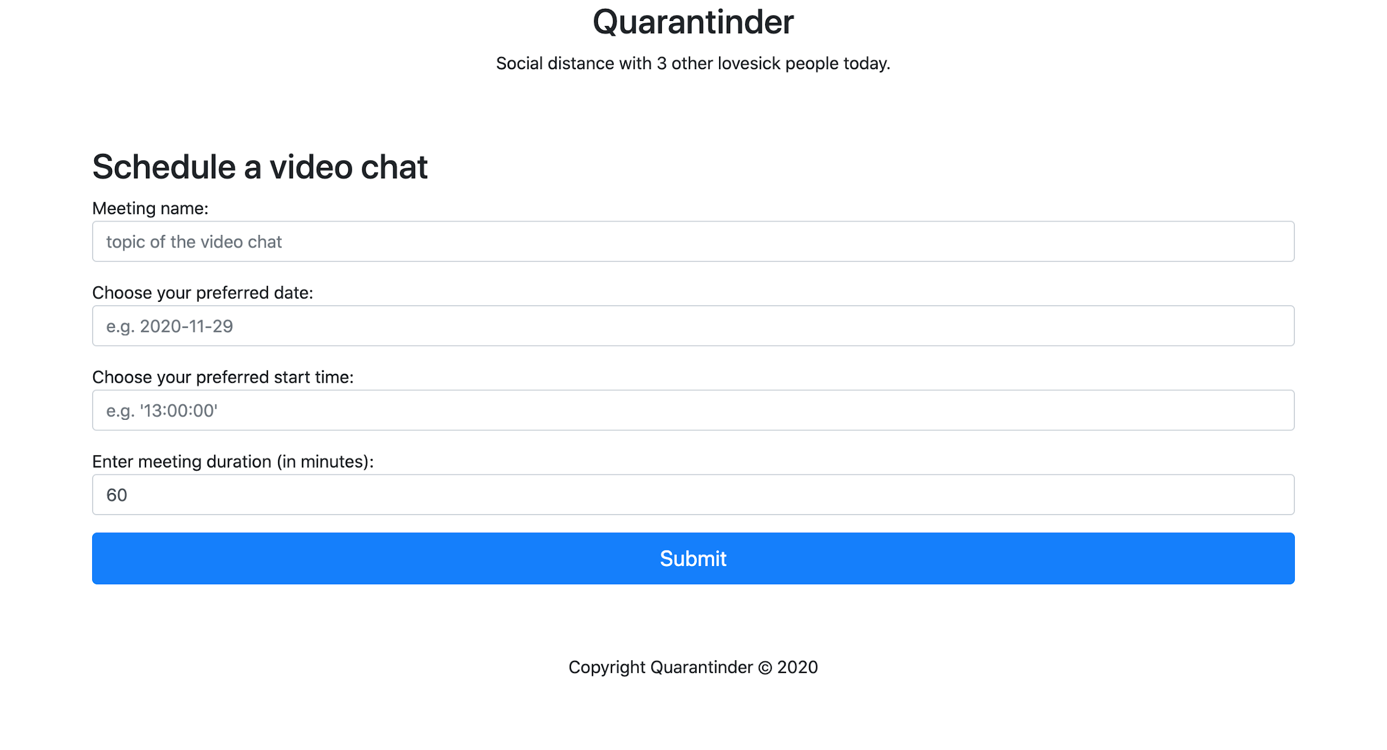
Video Chatting
Expected Outcome:

Slide 33
THANK YOU
Any questions?

