Slide 1

AvTriX
BRAND BOOK | MASTER DIRECTION
Born from the Aviatrix.
Built on engineering.
Powered by intelligence.
Engineering Insight. Smarter Sourcing. Stronger Fleets.
VERSION 1.0 | OCTOBER 2026
Notes:
Supporting photography is AI-generated for editorial direction. It is not the AvTrix logo artwork.

Slide 2
Using this book
The source of truth for the current AvTrix direction
This guide protects the selected identity while turning it into a practical system for documents, digital products and commercial communication.
IDENTITY STATUS
Direction locked
The name, narrative, palette, three wings, flight path, X device and selected Aviatrix reference remain unchanged.
01
Apply consistently
Use the rules as a connected system, not as isolated styling choices.
02
Keep copper selective
Production pending
Copper signals insight, value and decision points. Navy carries the brand.
Final vector master artwork is still required before manufacture, signage or trademark filing.
03
Escalate exceptions
When a use case falls outside this guide, return to the core narrative and production master.
AVTRIX BRAND BOOK
02

Slide 3
03
Brand foundation
A clear story gives every visual and verbal choice a reason.
Born from the Aviatrix. Built on engineering. Powered by intelligence.
AVTRIX BRAND BOOK
03

Slide 4
The brand idea
One narrative, one commercial promise
Born from the Aviatrix.
Built on engineering.
Powered by intelligence.
COMMERCIAL PROMISE
Engineering Insight. Smarter Sourcing. Stronger Fleets.
EDITORIAL LINE
Insight informed by experience.
AVTRIX BRAND BOOK
04

Slide 5
The AvTrix name
Derived from Aviatrix: a woman who flies
AVIATRIX
NAME PRINCIPLES
01
Say it with confidence
AVTRIX
Pronounce AvTrix as a single name. The Aviatrix origin can be introduced in brand storytelling.
02
Protect the capital T and X
Use AvTrix in prose and lockups. The X may carry copper emphasis in display settings.
The shortened name keeps the spirit of the original word while creating a sharper, contemporary form suited to engineering, procurement and intelligence.
03
Avoid invented acronyms
The meaning is authentic and human. Do not retrofit the letters into a technical acronym.
AVTRIX BRAND BOOK
05

Slide 6
Brand story
Experience in flight becomes intelligence on the ground
01
The Aviatrix
The name begins with capability, resolve and a direct relationship with flight.
02
Engineering judgement
X
Technical understanding turns part numbers, records and constraints into dependable decisions.
03
Commercial intelligence
Market knowledge and evidence improve sourcing choices and support stronger fleet outcomes.
AVTRIX BRAND BOOK
06

Slide 7
Positioning
Engineering-led aviation procurement and fleet intelligence
AvTrix brings engineering judgement into aviation sourcing and fleet decisions, helping operators, asset owners and supply partners act with better context and greater confidence.
Where we play
How we win
What we avoid
Components, technical records, supplier intelligence, procurement analysis and fleet-level decision support.
Evidence, engineering literacy, disciplined sourcing and clear communication that connects technical detail to commercial action.
Commodity-broker language, vague innovation claims, decorative aviation clichés and intelligence without traceable judgement.
AVTRIX BRAND BOOK
07

Slide 8
Purpose and promise
Why AvTrix exists and what clients should expect
PURPOSE
PROMISE
To make aviation decisions stronger by connecting technical understanding with commercial intelligence.
Engineering Insight.
Smarter Sourcing.
Stronger Fleets.
Every engagement should make the decision clearer, the sourcing route better informed or the fleet position more resilient.
AVTRIX BRAND BOOK
08

Slide 9
Values
Standards that shape the work
01
Technical integrity
We respect the engineering facts and make uncertainty visible.
02
Informed judgement
Experience gives context to data and discipline to recommendations.
03
Commercial clarity
We make sourcing choices understandable, comparable and actionable.
04
Responsible pace
Urgency never replaces verification, traceability or sound judgement.
05
Independent thinking
We challenge assumptions and follow the evidence to the right answer.
AVTRIX BRAND BOOK
09

Slide 10
Core audiences
Technical and commercial decision-makers across aviation
Operators and airlines
Lessors and asset owners
Need dependable component, supplier and fleet insight under operational pressure.
Need technical context that protects asset value and improves portfolio decisions.
MRO and engineering teams
Suppliers and manufacturers
Need sourcing partners who understand configuration, records and airworthiness constraints.
Need credible routes to market, clearer demand signals and informed commercial positioning.
AVTRIX BRAND BOOK
10

Slide 11
Capability architecture
The commercial story moves from insight to action to fleet outcome
01
02
03
Engineering intelligence
Procurement
Fleet intelligence
Interpret part, configuration, records and technical risk with engineering context.
Source more intelligently through supplier knowledge, market evidence and structured comparison.
Connect component decisions to availability, reliability, lifecycle and asset performance.
ENGINEERING INSIGHT
SMARTER SOURCING
STRONGER FLEETS
AVTRIX BRAND BOOK
11

Slide 12
Messaging hierarchy
Use each line for a distinct job
MASTER NARRATIVE
Born from the Aviatrix. Built on engineering. Powered by intelligence.
Brand introductions, About pages, launch material
COMMERCIAL PROMISE
Engineering Insight. Smarter Sourcing. Stronger Fleets.
Proposals, capability statements, sales decks
EDITORIAL LINE
Insight informed by experience.
Reports, articles, research and thought leadership
POSITIONING
Engineering-led aviation procurement and fleet intelligence.
Profile copy, metadata, company descriptions
AVTRIX BRAND BOOK
12

Slide 13
Tone of voice
Calm authority with engineering clarity
Informed
Show the reasoning and the evidence behind the view.
Direct
Use precise language and clear recommendations.
AV
Measured
State uncertainty, limits and trade-offs without drama.
VOICE
Human
Let experience and judgement be present without becoming personal theatre.
AVTRIX BRAND BOOK
13

Slide 14
Writing examples
What AvTrix sounds like in practice
USE
AVOID
We found three viable sourcing routes. One carries a documentation risk that needs engineering review.
We deliver next-generation, end-to-end aviation solutions.
Availability has improved, but lead-time confidence remains uneven across approved suppliers.
Our unique ecosystem unlocks game-changing procurement value.
Our recommendation reflects configuration fit, records quality and total acquisition risk.
AvTrix leverages cutting-edge data to transform everything.
AVTRIX BRAND BOOK
14

Slide 15
15
Identity system
The identity balances human origin, technical precision and confident restraint.
Born from the Aviatrix. Built on engineering. Powered by intelligence.
AVTRIX BRAND BOOK
15

Slide 16
Logo system
One identity with a controlled set of expressions
01
Primary
Aviatrix symbol + AvTrix wordmark
AvTriX
02
Secondary
Horizontal lockup for documents and web
WORDMARK
03
Wordmark
AvTrix with the copper X
SELECTED AVIATRIX
MASTER SYMBOL
04
Symbol
Aviatrix + three wings + flight path
05
Micro
Simplified production master for small use
Use the approved elegant profile, three wings and flight path from the selected reference board. Do not substitute or redraw from memory.
06
X device
Standalone graphic device, never a substitute signature
AVTRIX BRAND BOOK
16

Slide 17
Logo lockups
Choose the simplest version that preserves recognition
AvTriX
AvTriX
PRIMARY HORIZONTAL
REVERSED WORDMARK
X
Preferred order
AVIATRIX
SYMBOL
1. Full signature
2. Horizontal lockup
3. Wordmark
4. Symbol or micro mark
5. X device as supporting graphic
SYMBOL-ONLY
X DEVICE
AVTRIX BRAND BOOK
17

Slide 18
Clear space and minimum size
Give the mark room to carry authority
X
MINIMUM SIZES
PRINT
Full signature 35 mm
Wordmark 24 mm
Micro mark 8 mm
AvTriX
X
X
DIGITAL
Full signature 180 px
Wordmark 120 px
Micro mark 24 px
X
Use the cap height of the wordmark X as the minimum clear space on every side.
Final thresholds must be confirmed against the vector masters and small-size optical tests.
AVTRIX BRAND BOOK
18

Slide 19
Core colour palette
Navy carries authority. Copper reveals value. Cream gives space.
AvTrix Navy
Heritage Copper
Aviatrix Copper
Signal Cream
Engineering Sand
#1A1F25
#B8864F
#CBA36A
#FCFAF6
#F5EDDF
Recommended balance
60% navy / 25% cream and sand / 10% white space / 5% copper emphasis
AVTRIX BRAND BOOK
19

Slide 20
Approved gradients
Use gradients as light and depth, never as decoration
Copper beam
0% #B8864F 55% #CBA36A 100% #F5EDDF
Navy depth
0% #101318 55% #1A1F25 100% #2B333C
Cream horizon
0% #F5EDDF 70% #FCFAF6 100% #FFFFFF
Allowed: covers, section dividers, photography overlays and selective data emphasis. Avoid rainbow blends, high-saturation effects and gradients inside small body text.
AVTRIX BRAND BOOK
20

Slide 21
Typography
A technical sans serif supported by an editorial voice
BAHNSCHRIFT
Georgia
PRIMARY | HEADINGS, DATA, NAVIGATION
EDITORIAL | NARRATIVE AND QUOTATIONS
ABCDEFGHIJKLMNOPQRSTUVWXYZ
abcdefghijklmnopqrstuvwxyz 0123456789
Insight informed by experience.
Engineering context turns information into judgement.
RECOMMENDED HIERARCHY
Use sentence case. Keep line lengths measured. Use bold weight for decisions, not for entire paragraphs. Never outline, stretch or artificially condense type.
Display 38-56 pt
Section title 28-36 pt
Body 16-20 pt
Caption 10-12 pt
AVTRIX BRAND BOOK
21

Slide 22
Graphic language
Motion and precision without visual noise
01
Three wings
02
Flight path
A repeated three-part rhythm representing engineering insight, sourcing and fleet strength.
A fine directional line used to connect evidence, decisions and outcomes.
03
X device
04
Copper signal
A point of convergence and decision. Use as a crop, aperture or emphasis field.
A small, deliberate highlight for insight, selection, risk or recommended action.
AVTRIX BRAND BOOK
22

Slide 23
Three wings, flight path and X
The devices form a single visual grammar
X
THREE WINGS
FLIGHT PATH
X DEVICE
Keep the three elements aligned and directional. Do not add a fourth wing or turn the device into generic speed lines.
Use a single fine route with one clear destination. Avoid loops, map clichés and decorative dotted paths.
Use for convergence, framing or emphasis. The X must support the signature, not compete with it.
AVTRIX BRAND BOOK
23

Slide 24
Aviatrix imagery
Human authority grounded in real aviation environments
Show capability before glamour.
People
Confident, observant and technically credible. Natural expressions, working environments, restrained styling.
AVIATRIX
Aircraft
Structural detail, wing geometry, maintenance environments and fleet scale. Avoid tourism imagery.
CALM AUTHORITY
Light
Navy shadows, cream daylight and selective copper warmth. Keep skin tones and metal surfaces natural.
Composition
Strong negative space, precise crops and quiet horizons that support editorial typography.
AVTRIX BRAND BOOK
24

Slide 25
Iconography
Functional, precise and visually quiet
E
P
F
!
Engineering
Procurement
Fleet
Status
component, records, configuration, inspection
supplier, quote, lead time, availability
aircraft, utilisation, reliability, lifecycle
verified, caution, action, restricted
CONSTRUCTION
Use a consistent 24 px grid, 1.5-2 px stroke, rounded line joins and simple silhouettes. Fill only selected or critical states.
COLOUR
Navy by default. Copper for active insight and decision points. Green and red remain functional status colours, not brand accents.
AVTRIX BRAND BOOK
25

Slide 26
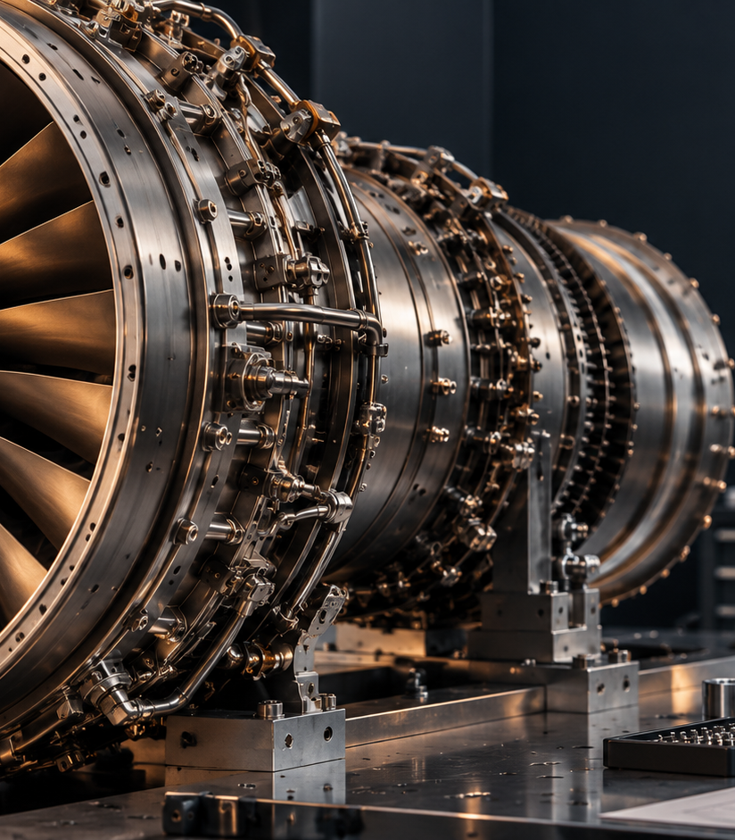
Engineering and data visualisation
Data should help a decision, show confidence and keep technical context visible.
01
Start with the question
Title charts with the decision or comparison they support.
02
Use copper for the answer
Highlight the selected route, risk or insight. Keep context in muted navy and grey.
03
Show confidence
Include source, date, units, assumptions and status where they affect interpretation.
04
Prefer clarity
Use direct labels and simple scales. Avoid 3D charts, decorative gauges and unexplained scores.
AVTRIX BRAND BOOK
26
Notes:
Supporting image is AI-generated editorial photography. Any technical claim must use verified source data in final client material.

Slide 27
Corporate document system
Reports should feel engineered, not decorated
Signature document
Component Intelligence Report
DOCUMENT RHYTHM
01 Decision first
A decision-ready report connecting part identity, configuration, records, supplier landscape, market position, sourcing options and recommended action.
Open with the recommendation, status or question.
02 Evidence next
Show technical and commercial evidence with traceable sources.
CORE TEMPLATES
03 Action clear
Letterhead and correspondence
Quotation and RFQ
Capability statement
Proposal and pitch deck
Supplier communication
Procurement analysis
Fleet intelligence report
Engineering brief
Close with ownership, timing and unresolved conditions.
AVTRIX BRAND BOOK
27

Slide 28

Website and digital product
Structure the experience around Engineering Intelligence, Procurement and Fleet Intelligence.
Navigation
Keep the main routes few and explicit. Surface capabilities, insights, the Aviatrix story and platform access.
Product UI
Navy dominates. Copper identifies decisions, selected states and high-value insight. Cream supports long-form reading.
Data
Tables, filters and charts must remain legible under pressure. Status and confidence should never rely on colour alone.
AVTRIX BRAND BOOK
28
Notes:
Supporting image is AI-generated editorial photography and carries no airline livery.

Slide 29
Applications
Consistency comes from restraint across every touchpoint
01
02
03
Report covers
Proposals
Presentations
Large title, strong negative space, one copper signal.
Clear decision structure and disciplined evidence.
Editorial pacing with data-led conclusions.
04
05
06
LinkedIn
Email
Business cards
One idea per post, strong crop, minimal copy.
Wordmark, contact details and no decorative banners.
Navy field, cream type, copper X or edge detail.
The logo should sign the work. It should not become the work.
AVTRIX BRAND BOOK
29

Slide 30
Guardrails and production handoff
Protect the selected identity at every scale
DO
DON'T
Use the approved Aviatrix master
Keep proportions and clear space
Lead with navy and cream
Use copper for insight and emphasis
Write with calm technical authority
Verify technical and commercial claims
Trace or reinterpret the concept mark
Stretch, rotate or add effects
Turn copper into a dominant background
Use generic flight or speed clichés
Make unsupported superlative claims
Present concept files as production vectors
Production requirement
The selected AI-generated logo board is concept artwork. Before production, commission precise vector master artwork, standardise the Aviatrix geometry, confirm typefaces and gradient stops, test small sizes, and export controlled SVG, EPS, PDF and PNG masters.
END OF MASTER GUIDE | AVTRIX BRAND BOOK V1.0
AVTRIX BRAND BOOK
30

