Slide 1
TO – DO LIST MANAGER
BY
VIGNESH S

Slide 2
Problem Statement
Design and develop a Command-Line Interface (CLI) based To-Do List Manager that enables users to efficiently manage daily tasks by adding, removing, updating and viewing task status. The system should maintain task data during runtime, ensure proper input validation and handle edge cases to provide a reliable and user-friendly experience.

Slide 3
Logic
Initialization
Create a ToDoList object containing a list of tasks
Each task is represented as an object of the Task class
Each task stores name, status, and timestamp
Continuous Execution
Use an infinite loop (while True)
Display menu repeatedly until user exits
Keeps program interactive

Slide 4
User Input Handling
Accept menu choice from user
Validate input using try-except
Ensure input is numeric
Prevent program crashes due to invalid input
Add Task Operation
Accept task name from user
Validate empty input
Create a Task object with:
Task name
Default status → “Not yet completed”
Current date and time
Add task to the list

Slide 5
Remove Task Operation
Check if task list is not empty
Display tasks with index
Accept index from user
Validate index range
Remove selected task
Update Task Status Operation
Ensure tasks exist
Display tasks
Select task using index
Toggle status:
Not yet completed → Completed
Completed → Not yet completed

Slide 6
Display User Operation
Check if tasks exist
Display tasks in tabular format:
Task ID
Task Name
Status
Timestamp
Exit Operation
Exit program using sys.exit()
Display exit message

Slide 7
Edge Cases Handled
Invalid input (non-numeric values)
Removing task when list is empty
Updating task when no tasks exist
Index out of range
Empty task input
Wrong menu selection

Slide 8
Python Concepts Used
Classes & Objects (OOP) → Task and ToDoList
Lists → Store task objects
Functions → Modular design
Loops → Continuous execution
Exception Handling → Error handling
Datetime Module → Timestamp
Match-Case → Menu handling
State Handling → Data persists during runtime

Slide 9
Code Walkthrough
add_task() Takes input, validates it, creates a task object, and adds it
remove_task() Displays tasks, removes selected task, handles invalid input
update_status() Toggles task status using index
display_task() Displays tasks in structured format
check_available() Checks whether task list is empty

Slide 10
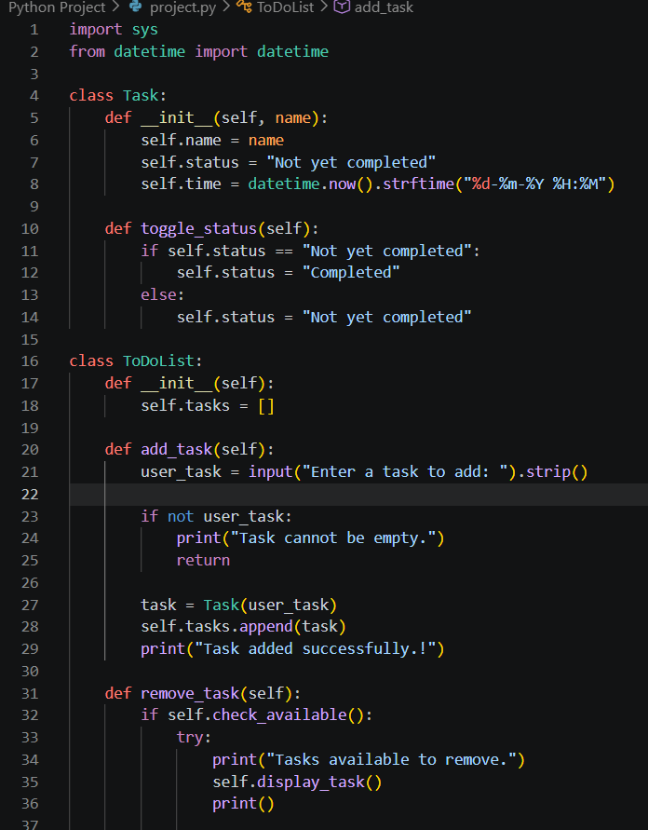
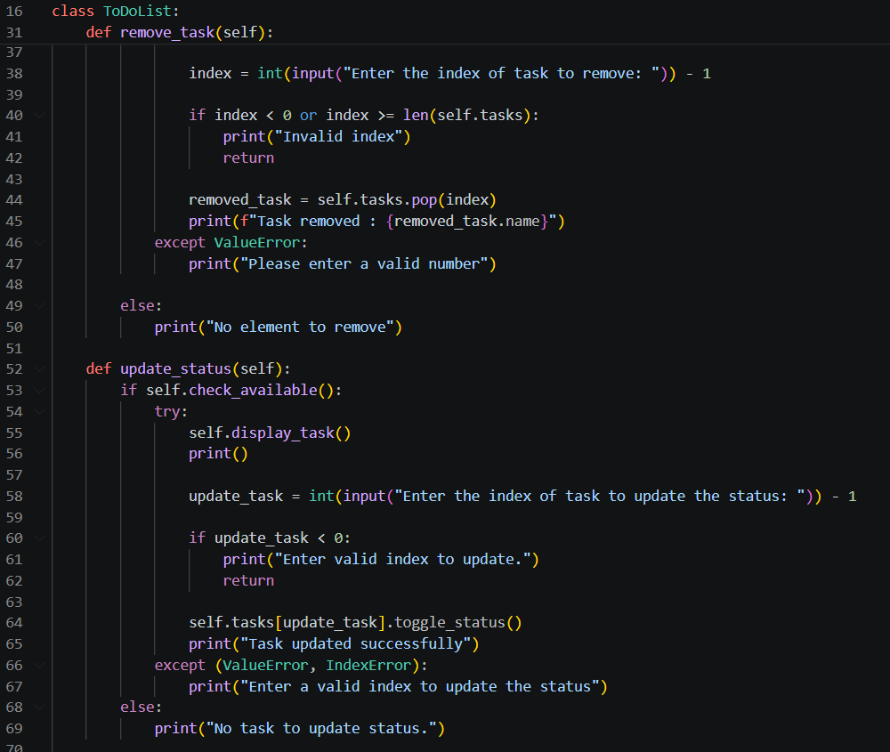
Code

Slide 11
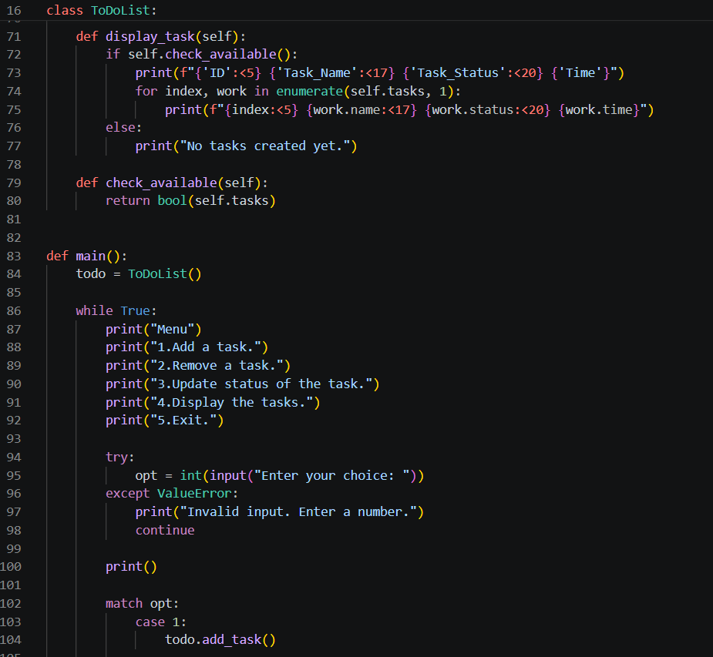
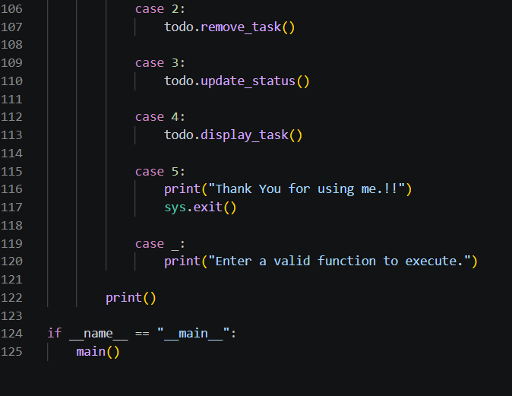

Slide 12
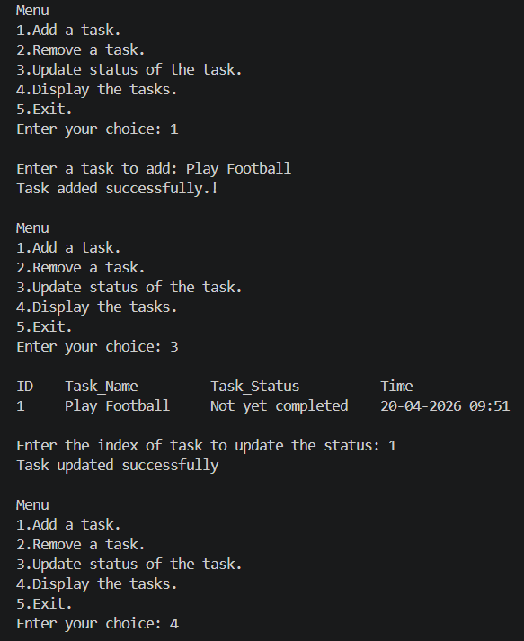
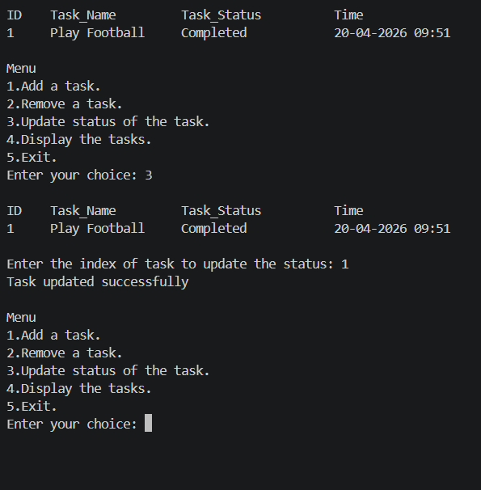
Output

Slide 13
OOP Concept in Python
The program is implemented using Object-Oriented Programming (OOP).
Task Class
Attributes:
Task name
Status
Timestamp
Method:
Toggle task status
ToDoList Class
Attributes:
List of task objects
Methods:
Add task
Remove task
Update status
Display tasks

Slide 14
Limitations
No Data Persistence Tasks are stored only in memory and are lost when the program exits.
CLI-Based Interface Only The system uses a command-line interface, which is less user-friendly compared to graphical applications.
No Deadline or Due Date Feature Tasks do not include deadlines, making it harder to manage time-sensitive activities.
No Multi-User Support The application is designed for a single user and does not support multiple profiles.

Slide 15
Conclusion
Successfully developed a CLI-based To-Do List Manager using OOP
Demonstrates effective use of Python concepts
Provides a simple and efficient task management solution

