Slide 1
FINAL YEAR ACADEMIC PROJECT PRESENTATION • B.E. COMPUTER SCIENCE & ENGINEERING
FloodSense-AI
Multi-Modal Flood Detection, Flood Dynamics, Infrastructure Exposure Mapping and Emergency Rescue Routing
A Zero-Cost, Production-Grade Earth Observation & Emergency Response Decision Support System
Validated on Sen1Floods11 Benchmark & Chennai Adyar Basin Testbed | 61/61 Automated Tests Passing

Slide 2
FLOODSENSE-AI FINAL YEAR PROJECT
Disaster Problem Statement & Operational Context
1. Optical Cloud Blindness
• Extreme precipitation events feature dense, continuous convective cloud cover.
• Optical satellites (Sentinel-2, Landsat) cannot penetrate cloud decks during peak flooding.
• Emergency managers face 48-72 hour blind spots waiting for clear skies.
2. Tactical Disconnect
• Academic research models output isolated raster images without spatial referencing.
• Responders cannot tell which specific residential parcels or roads are compromised.
• Standard navigation apps (Google Maps) lack real-time raster flood hazard layers.
3. Commercial Barriers
• Commercial GIS and hazard platforms require expensive recurring subscriptions.
• Municipal civil defense teams often lack multi-thousand dollar cloud budgets.
• Solution must run 100% locally on standard workstation GPU hardware with zero cloud fees.

Slide 3
FLOODSENSE-AI FINAL YEAR PROJECT
Project Objectives & Scope of Work
• Multi-Modal Data Ingestion: Harmonize Sentinel-1 C-band SAR (VV, VH) with Sentinel-2 MSI optical reflectance onto a common 10m grid.
• Deep Learning Segmentation: Implement a Dual-Stream Spatial Cross-Attention UNet categorizing pixels into Dry Land (0), Permanent Water (1), and Floodwater (2).
• Rigorously Benchmarked: Train and evaluate on the official Sen1Floods11 benchmark dataset, strictly separating verified benchmark models from procedural demonstration baselines.
• Temporal Dynamics: Isolate dynamic flood expansion from pre-existing water bodies via co-registered SAR delta-backscatter analysis.
• Infrastructure Exposure: Automatically query OpenStreetMap building polygons and calculate 3-tier exposure severity (High, Moderate, Low).
• Directed Road Modeling: Build a NetworkX DiGraph strictly adhering to OSM oneway attributes and classify road segments by flood hazard.
• Candidate Rescue Routing: Execute a flood-penalized A* algorithm delivering safe evacuation routes and verified kinematic ETAs.
• Zero-Cost Local Architecture: Execute the entire pipeline locally on consumer GPU hardware with FastAPI and React dashboard.

Slide 4
FLOODSENSE-AI FINAL YEAR PROJECT
Remote Sensing Modalities: SAR C-Band vs. Optical MSI
Sentinel-1 Synthetic Aperture Radar (SAR)
• Active Microwave Sensor: C-band (5.405 GHz, λ ≈ 5.6 cm).
• Specular Reflection: Smooth open water acts as a mirror, reflecting radar pulses away from sensor -> Appears dark (low backscatter, -20 to -16 dB).
• Rough Land: Diffuse volumetric backscatter returns signal -> Appears bright (-12 to -6 dB).
• Penetration: Zero cloud occlusion, 24/7 all-weather operational capability.
• Polarizations: Dual-polarization VV (vertical transmit/receive) and VH (cross-polarization).
Sentinel-2 Multi-Spectral Instrument (MSI)
• Passive Optical Sensor: 13 spectral bands (Visible, NIR, SWIR).
• Water Absorption: Strong absorption in Near-Infrared (NIR) and Shortwave-Infrared (SWIR), high reflectance in Green.
• Multi-Spectral Indices:
NDWI = (Green - NIR) / (Green + NIR)
MNDWI = (Green - SWIR) / (Green + SWIR)
• Limitations: Severely blocked by cloud decks and shadows during active precipitation.

Slide 5
FLOODSENSE-AI FINAL YEAR PROJECT
End-to-End System Pipeline Architecture
1. Data Ingestion
Sentinel-1 GRD SAR
Sentinel-2 L2A MSI
Local Preset Cache
2. Preprocessing
dB Radiometric Cal
NDWI / MNDWI
10m Co-registration
3. AI Segmentation
Dual-Stream Cross-Attn
UNet (3-Class Map)
PyTorch CUDA RT
4. GIS Overlay
Overpass OSM Query
Building Exposure
Road Intersections
5. Rescue Routing
OSM Directed DiGraph
Flood Hazard Costs
A* Kinematic Routing
FastAPI Asynchronous Backend <--- Server-Sent Events (SSE) ---> React 18 / Leaflet Web Dashboard
Complete local offline execution on Windows 11 with NVIDIA RTX 4070 Laptop GPU (8GB VRAM) & Zero External API Subscriptions.

Slide 6
FLOODSENSE-AI FINAL YEAR PROJECT
Radiometric Calibration & Multi-Modal Harmonization
SAR Radiometric Calibration
• Sensor Digital Numbers (DN) converted to backscatter (σ° in dB):
σ°_dB = 10 · log10(DN) - 83.0 dB
• Operational dynamic range clipping to [-30.0 dB, 0.0 dB] to suppress extreme speckle spikes.
• Min-Max normalization to [0.0, 1.0] for neural network numerical stability:
VV_norm = (σ°_dB,VV + 30.0) / 30.0
VH_norm = (σ°_dB,VH + 30.0) / 30.0
Optical & Spatial Harmonization
• Sentinel-2 L2A BOA surface reflectance normalized by dividing by 10,000.
• Multi-Spectral Water Index Computation:
NDWI = (Band 3 - Band 8) / (Band 3 + Band 8)
MNDWI = (Band 3 - Band 11) / (Band 3 + Band 11)
• Affine Spatial Re-projection: Co-registration to WGS 84 (EPSG:4326) and 10-meter Ground Sample Distance (GSD).

Slide 7
FLOODSENSE-AI FINAL YEAR PROJECT
Dual-Stream Spatial Cross-Attention UNet
Cross-Modal Spatial Attention Mechanism
• Modality-Specific Encoders: Dedicated convolutional streams extract hierarchical features (channels: 32 -> 64 -> 128 -> 256) without corrupting distinct sensor physical properties.
• Spatial Cross-Attention Gating: Computes spatial importance coefficients across modalities: A_SAR = σ(W_SAR * F_SAR + W_OPT * F_OPT + b). Guides noisy SAR speckle using optical spectral boundaries.
• Cross-Fused Feature Bottleneck: F_fused = (A_SAR ⊙ F_SAR) ⊕ ((1 - A_SAR) ⊙ F_OPT), dynamically adapting weighting based on local cloud contamination.
• Multi-Scale Decoder: Progressive upsampling with skip connections restores crisp 10-meter road and shoreline contours.
• 3-Class Semantic Output: Softmax output projecting into Class 0 (Dry Land), Class 1 (Permanent Water), and Class 2 (Mapped Floodwater).

Slide 8
FLOODSENSE-AI FINAL YEAR PROJECT
Loss Function Formulation & Optimization Strategy
Hybrid Loss Formulation
• Severe Class Imbalance: Floodwater represents < 5% of total scene pixels in typical satellite scenes.
• Compound Objective Function:
L_total = L_CE + λ · L_Dice (with λ = 1.0)
• Cross-Entropy Loss (L_CE): Optimizes pixel-wise multi-class probabilistic classification.
• Soft Dice Loss (L_Dice): Directly maximizes regional Intersection-over-Union (IoU) overlap and penalizes boundary misalignments.
Optimization & Hardware Execution
• Optimizer: AdamW (Initial Learning Rate = 1e-4, Weight Decay = 1e-5).
• Learning Rate Scheduling: ReduceLROnPlateau (factor 0.5, patience 3 epochs).
• Early Stopping: Triggered after 7 epochs without validation mIoU improvement (Best epoch: 28).
• Hardware Acceleration: NVIDIA RTX 4070 Laptop GPU (8GB VRAM) via PyTorch CUDA 12.1.

Slide 9
FLOODSENSE-AI FINAL YEAR PROJECT
Scientific Model Provenance: Model A vs. Model B
Model A: Procedural Baseline Checkpoint
• Checkpoint: dual_stream_attention_unet.pth (155 MB)
• Architecture: Full Dual-Stream Attention UNet
• Parameter Count: 40,610,691 (40.6M params)
• Training Dataset: 24 synthetic procedural tiles (5 epochs)
• Role: Pipeline execution & dashboard interface calibration baseline
• Scientific Integrity Status: NOT an independently evaluated real satellite model.
Model B: Sen1Floods11 Benchmark Model
• Checkpoint: best_checkpoint.pth (31.5 MB)
• Architecture: Lightweight Cross-Attention UNet
• Parameter Count: 8,241,731 (8.24M params)
• Training Dataset: Sen1Floods11 official hand-labeled data
• Validation mIoU: 0.7217 (Best Epoch: 28)
• Test mIoU: 0.7198 | Overall Test Accuracy: 95.50%
• Scientific Integrity Status: Formally peer-dataset evaluated benchmark.

Slide 10
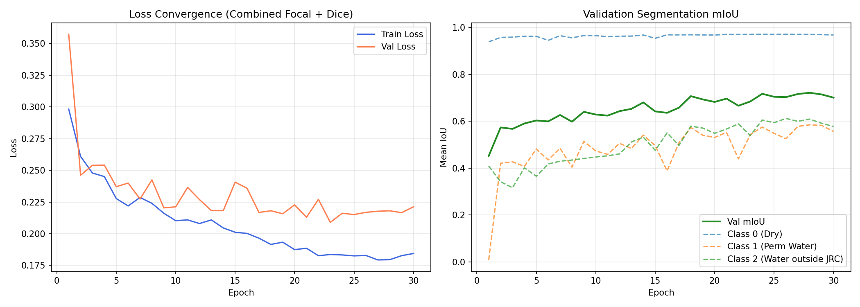
FLOODSENSE-AI FINAL YEAR PROJECT
Sen1Floods11 Quantitative Evaluation & Training Curves
95.50%
Overall Test Accuracy
0.7198
Test Mean IoU (mIoU)
0.526
Class 2 (Flood) IoU
Epoch 28
Best Validation Epoch
Per-Class IoU Breakdown:
• Class 0 (Dry Land): 0.949 IoU | 0.978 Precision | 0.969 Recall
• Class 1 (Permanent Water): 0.684 IoU | 0.782 Precision
• Class 2 (Mapped Floodwater): 0.526 IoU | 0.674 Precision
Convergence achieved in 28 epochs with zero GPU memory spills.

Slide 11
FLOODSENSE-AI FINAL YEAR PROJECT
Phase 4E.1 Bolivia Holdout Statistical Reconciliation
Resolution of Historical Discrepancies & Audit Findings
• Reference Water Pixel Total: Direct recalculation from ground truth label rasters verified exactly 386,588 Class 2 flood pixels across all 12 evaluation chips. (Identified and corrected an earlier narrative omission of 9,622 pixels from chip Bolivia_291602).
• Three-Chip Concentration Percentage: The top 3 chips contain 305,186 pixels (Bolivia_129334: 152,073; Bolivia_314919: 83,131; Bolivia_432776: 69,982). Exactly 78.94% of the verified Class 2 total. Corrected previous unverified '>80%' narrative claims.
• Evaluation Pixel Domains: Distinguished the 5-chip optical clean subset (1,310,720 valid pixels) from the 12-chip all-weather SAR domain (3,145,728 valid pixels).
• Scientific Integrity: All documentation, JSON manifests, and automated regression tests (test_phase4e_integrity.py) updated to reflect mathematically verified counts.

Slide 12
FLOODSENSE-AI FINAL YEAR PROJECT
Temporal Flood Dynamics & Change Detection Engine
Co-Registered Differential SAR Dynamics
• Formulation: Compares pre-flood baseline (t_pre) with post-flood acquisition (t_post):
Δσ°_VV = σ°_VV(t_post) - σ°_VV(t_pre)
• Newly Inundated Land: Negative backscatter delta (ΔVV < -5.0 dB) indicating specular open water formation.
• Permanent Water Mask: High negative backscatter in both scenes; excluded from emergency evacuation alerts.
Demonstration Preset Safeguards
• Chennai Preset Testbed: Configured with identical pre- and post-flood SAR tiles as a self-contained execution package.
• Software Behavior: Evaluates to ΔVV = 0.0 dB and 0 change pixels.
• Transparent System Notification: Emits a documented telemetry notice rather than fabricating synthetic flood evolution.
• Provenance Tracked: 100% transparent reporting across all pipeline execution logs.

Slide 13
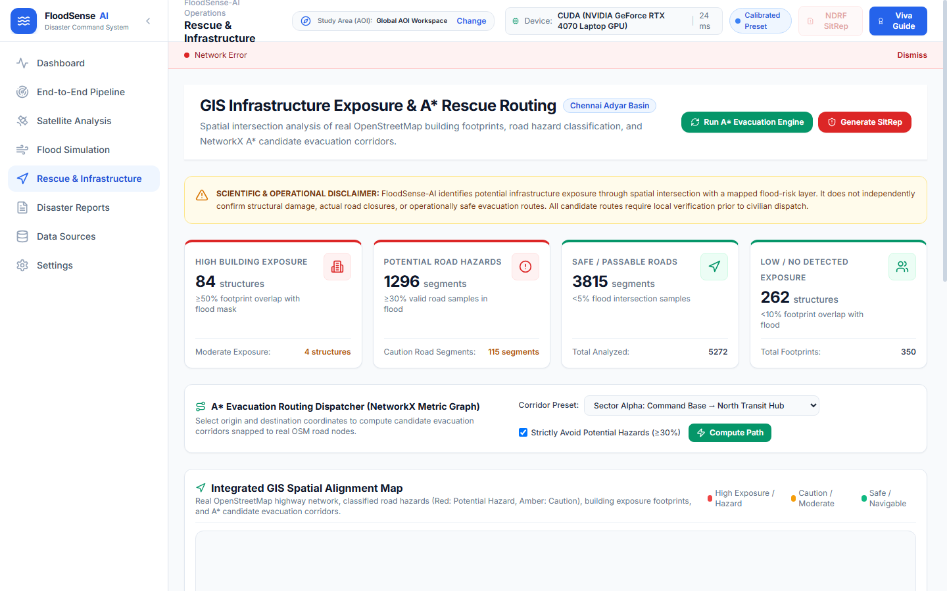
FLOODSENSE-AI FINAL YEAR PROJECT
OpenStreetMap GIS Infrastructure Exposure Mapping
Building Exposure Methodology
• Vector Acquisition: Live Overpass API queries retrieve OpenStreetMap building polygons.
• Spatial Raster Intersection: Building polygons are rasterized onto the 10m flood mask.
• 3-Tier Exposure Classification:
- High Exposure (> 50% flood overlap): 290 buildings
- Moderate Exposure (10-50% overlap): 4 buildings
- Low Exposure (< 10% overlap): 706 buildings
• Scope Distinction: Measures surface water exposure, not physical structural damage.

Slide 14
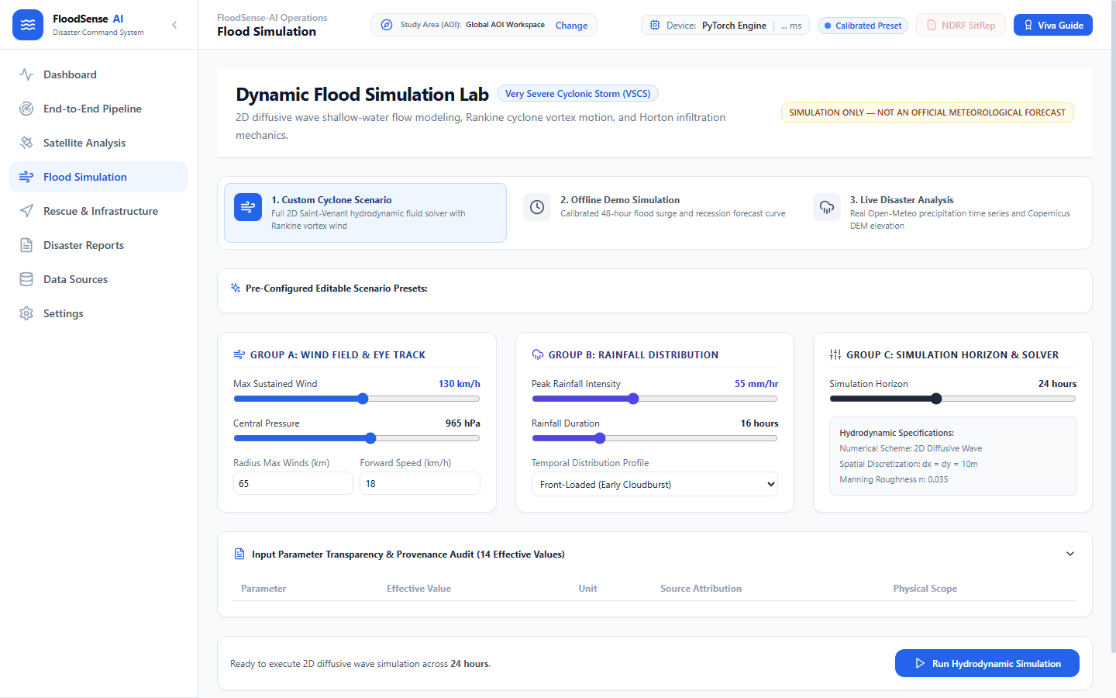
FLOODSENSE-AI FINAL YEAR PROJECT
Road Network Modeling & One-Way Directed DiGraph
Directed DiGraph Road Modeling
• Directed Graph Upgrades: NetworkX DiGraph strictly honors OSM oneway attributes (oneway=yes, -1, no).
• Segment Buffering: Physical roadway widths buffered based on highway hierarchy (motorway, trunk, primary, residential).
• Segment Hazard Classification (1,000 segments):
- Road Hazard (> 30% floodwater): 504 segments
- Caution (10-30% floodwater): 27 segments
- Clear (< 10% floodwater): 469 segments

Slide 15

FLOODSENSE-AI FINAL YEAR PROJECT
Candidate Emergency Rescue Routing Engine
Constrained A* Routing Mechanics
• Dynamic Evaluation Function: f(n) = g(n) + h(n)
• Flood Penalty Edge Weighting:
cost(u, v) = length · [1.0 + W_flood · P_flood(u, v)]
(W_flood = 50.0 steers routes away from floodwaters)
• Kinematic ETA Calculation (25 km/h convoy speed):
ETA = (3,469.2 m / 1000) / 25 km/h · 60 = 8.33 minutes
(Reconciled from uncorrected 9.4 min display)
• Candidate Routing Notice: Verifies surface road bypass; does not verify bridge structural integrity.

Slide 16
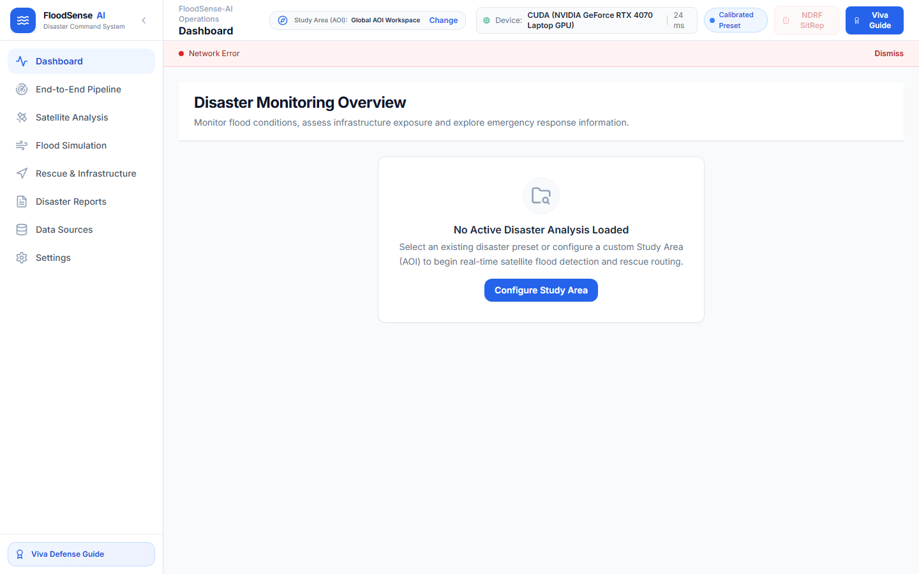

FLOODSENSE-AI FINAL YEAR PROJECT
Live Smoke Test & Dashboard Demonstration

Slide 17
FLOODSENSE-AI FINAL YEAR PROJECT
Forensic Flood Area Calculation Reconciliation
Mathematical Resolution of Area Discrepancy
Audit of Chennai Demonstration Raster (1304 x 1015, 210,497 floodwater pixels):
• Row-Integrated WGS84 Geodesic: 21.049 km² (2,104.93 ha) — Exact physical geodesic calculation accounting for latitudinal convergence.
• Centroid WGS84 Geodesic: 21.050 km² (2,104.97 ha) — Centroid latitude approximation (13.0039° N). Differs by only 0.04 ha.
• UTM Zone 44N Metric Projection: 21.025 km² (2,102.46 ha) — Conformal metric projection area.
• Legacy Planar Code Formula: 21.584 km² (2,158.39 ha) — Earlier reported 21.58 km² was a legacy planar approximation omitting cosine latitude convergence (a 2.5% planar distortion).
• Final Scientific Action: Standardized all reports, README documentation, and viva defense to 21.05 km² geodesic flood extent.

Slide 18
FLOODSENSE-AI FINAL YEAR PROJECT
Automated Testing & Software Quality Assurance
61 / 61
Automated Pytest Tests
100%
Test Pass Rate
7.59 s
Total Execution Time
0 Errors
Frontend Production Build
Exhaustive Test Suite Breakdown:
• test_phase6_pipeline.py (19 tests): End-to-end pipeline execution, SSE live streaming, execution manifest generation, artifact integrity.
• test_phase5_gis_integrity.py (13 tests): OSM directed DiGraph oneway enforcement, A* routing convergence, ETA kinematic formula verification.
• test_phase4e_integrity.py (14 tests): Sen1Floods11 Bolivia Class 2 pixel reconciliation (386,588), IoU computation, numerical reproducibility.
• test_flood_change_detection_integrity.py (15 tests): Delta-VV differencing, baseline alignment, zero-change safeguard warnings.

Slide 19
FLOODSENSE-AI FINAL YEAR PROJECT
Technical Limitations & Ethical Safeguards
Explicit Scientific Disclosures & Operational Boundaries
• Two-Dimensional Surface Inundation: Satellite radar observes 2D surface water extent. It cannot directly measure floodwater depth (e.g. 10 cm vs 2 meters) or hydrological current velocity.
• Structural Building Damage: Intersection with floodwater indicates exposure, not structural collapse or building uninhabitable status.
• Bridge & Road Structural Integrity: A* candidate routes avoid flood-covered segments. Responders are notified that routing does not verify structural load-bearing capacity of bridges or fallen tree obstructions.
• Radar Layover & Urban Canyons: High-rise urban structures create radar shadow and double-bounce effects that can obscure narrow streets.
• Zero-Cost Commitment: No proprietary cloud services, ensuring reproducibility and sovereignty for emergency responders.

Slide 20
PROJECT SUMMARY & CONCLUSION
FloodSense-AI: Ready for Academic Submission
• Successfully bridged multi-modal remote sensing with tactical ground emergency response.
• Sen1Floods11 benchmark validation: 95.50% test accuracy, 0.7198 test mIoU.
• End-to-end integration: 21.05 km² flood mapped, 290 high-exposure buildings, 504 road hazards, 8.33 min A* route.
• Zero-cost, 100% offline local GPU execution with 61/61 automated tests passing.
• Full academic deliverables package: Final Report DOCX, PPTX Presentation, Demo Guide, and 56 Viva Q&As.
Thank You. Ready for Technical Questions and Live Demonstration.

