Slide 1
Mobile Platforms and Application Development 7052CEM
Waqas Iftikhar
COVENTRY University UK.

Slide 2
Agenda
Learning Outcomes
Critically evaluate different technology design and implementation options for developing mobile apps with rationale and recommendations.
Evaluate mobile app development resources and apply appropriate tools, apps editors or the Integrated Development Environments (IDEs) for developing cross platform apps.
1. Why it is suitable for developing your chosen topic.
2. Any limitations that might cause issues.
3. The Steps to Configure the appropriate IDE.
4. A demonstration of feature 1 for the chosen platforms.

Slide 3
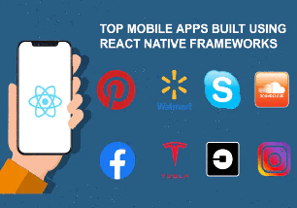







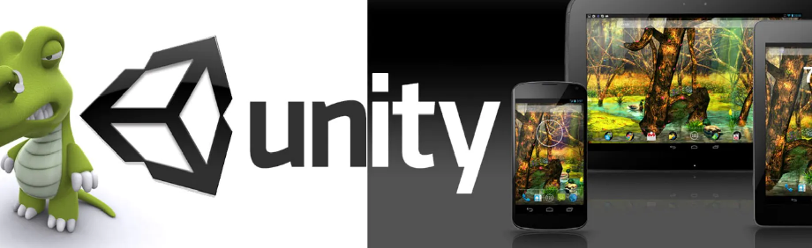
Mobile Cross Application Development tools
React Native
Xamarin
Ionic
Flutter
Appcelerator
Adobe PhoneGap
Corona
QT
Unity3D

Slide 4

Why Flutter?
Opensource
Support high-performance cross platform applications from a single codebase
Utilizes Dart programming language.
it supports a widget that helps in enhancing the look of an app.

Slide 5
Flutter Limitations
Flutter Is a Young Technology and under development
Few third-party packages
Limited computational complexity
Lack of vector graphics and animations support

Slide 6
Configuration Step
Start Android Studio.
Open plugin preferences (File > Settings > Plugins).
Select the Flutter plugin and click Install.
Click Yes when prompted to install the Dart plugin.
Click Restart when prompted.

Slide 7
Creating a new flutter project
In the IDE, click Create New Project from the Welcome window or File > New > Project from the main IDE window.
Select Flutter in the menu and click Next.
Enter Project name and Project location.
If want to publish the app, set the company domain and Click Finish.

Slide 8
My Cross Platform Application
Name: Quiz Way app
Scope: In E-learning and Job Interview
Tools & Techniques: Android Studio, Flutter, Postman etc.
Features:
1- Different quiz categories
2- Chose length of the quiz (i.e., 10, 20, 30 etc.)
3- Can chose difficulty level (i.e., Easy, Medium, Hard, Random)
4- Attempt Multiple Type Questions
5- View Results
6- View Correct Answers

Slide 9
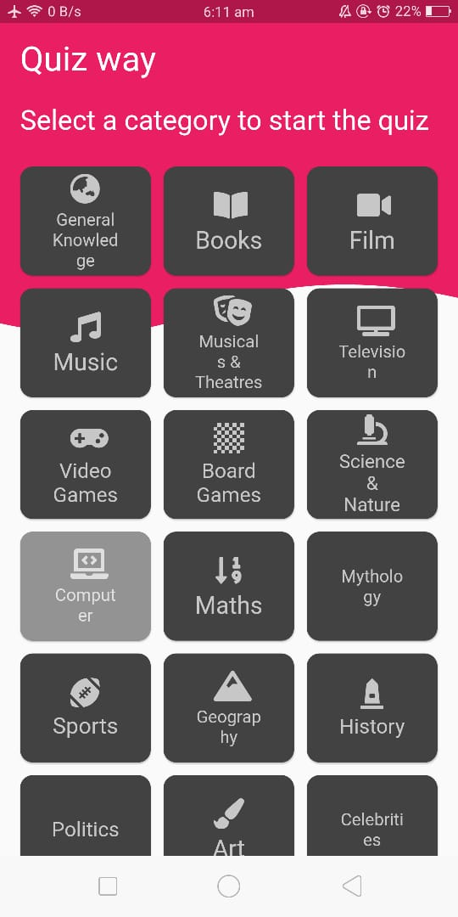
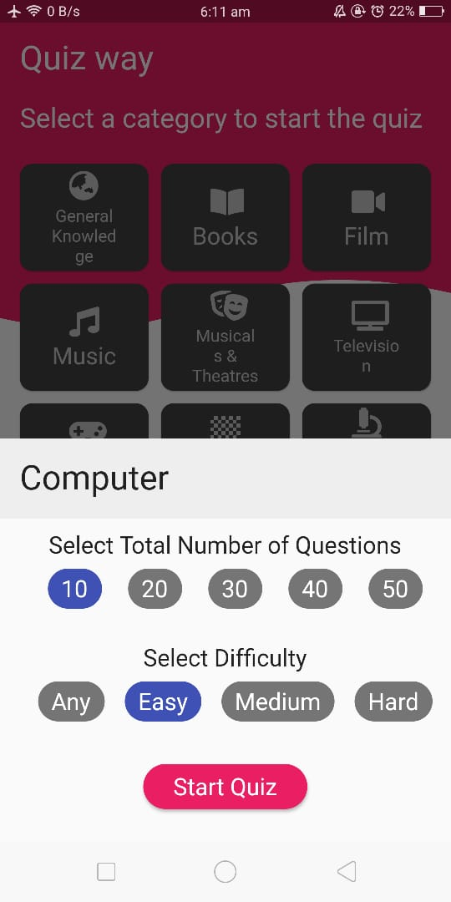
My Cross Platform Application Features
Different quiz categories
Length of the quiz

Slide 10
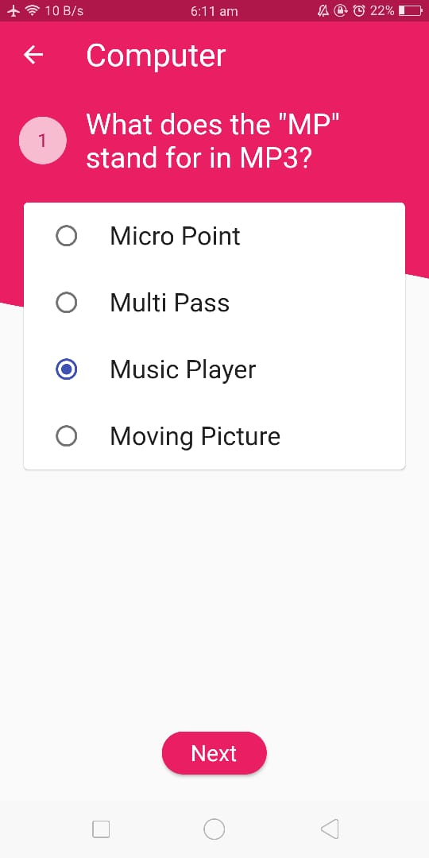
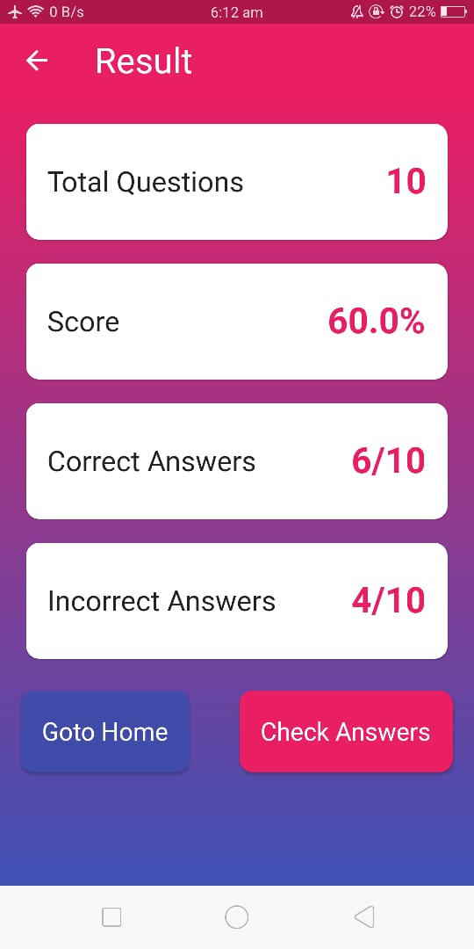
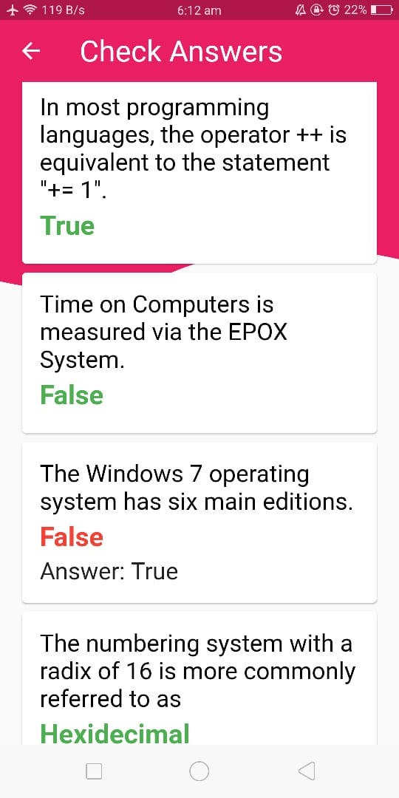
My Cross Platform Application Features
Attempt MCQ Quiz
View Result
Check Correct Solution

